Slide 1


CSE309 Computer Architecture and Organization
Lecture #2
Computers Arithmetic & Logic Design
Prepared & Presented by Asst. Prof. Dr. Samsun M. BAŞARICI

Slide 2
Part 1
Computer Arithmetics

Slide 3
Learning Objectives
Recapitulate number systems
Convert between number systems
Perform arithmetic in different number systems

Slide 4
Outline
Number Systems and Computer Arithmetic
The decimal system
Positional number systems
The binary system
Converting between binary and decimal
  Integers
  Fractions
Hexadecimal notation
Notes:
Chapter 1 summary.

Slide 5
The Decimal System
System based on decimal digits (0, 1, 2, 3, 4, 5, 6, 7, 8, 9) to represent numbers
For example the number 83 means eight tens plus three:
83 = (8 * 10) + 3
The number 4728 means four thousands, seven hundreds, two tens, plus eight:
4728 = (4 * 1000) + (7 * 100) + (2 * 10) + 8
The decimal system is said to have a base, or radix, of 10. This means that each digit in the number is multiplied by 10 raised to a power corresponding to that digit’s position:
83 = (8 * 10¹) + (3 * 10⁰)
4728 = (4 * 10³) + (7 * 10²) + (2 * 10¹) + (8 * 10⁰)
Notes:
In everyday life we use a system based on decimal digits (0, 1, 2, 3, 4, 5, 6, 7, 8, 9) to
represent numbers, and refer to the system as the decimal system. Consider what
the number 83 means. It means eight tens plus three:
83 = (8 * 10) + 3
The number 4728 means four thousands, seven hundreds, two tens, plus eight:
4728 = (4 * 1000) + (7 * 100) + (2 * 10) + 8
The decimal system is said to have a base, or radix, of 10. This means that each digit
in the number is multiplied by 10 raised to a power corresponding to that digit’s
position:
83 = (8 * 10¹) + (3 * 10⁰)
4728 = (4 * 10³) + (7 * 10²) + (2 * 10¹) + (8 * 10⁰)

Slide 6
Decimal Fractions
The same principle holds for decimal fractions, but negative powers of 10 are used. Thus, the decimal fraction 0.256 stands for 2 tenths plus 5 hundredths plus 6 thousandths:
0.256 = (2 * 10⁻¹) + (5 * 10⁻²) + (6 * 10⁻³)
A number with both an integer and fractional part has digits raised to both positive and negative powers of 10:
442.256 = (4 * 10²) + (4 + 10¹) + (2 * 10⁰) + (2 * 10⁻¹) + (5 * 10⁻²)
+ (6 * 10⁻³)
Most significant digit
  The leftmost digit (carries the highest value)
Least significant digit
  The rightmost digit
Notes:
The same principle holds for decimal fractions, but negative powers of 10 are
used. Thus, the decimal fraction 0.256 stands for 2 tenths plus 5 hundredths plus
6 thousandths:
0.256 = (2 * 10⁻¹) + (5 * 10-²) + (6 * 10-³)
A number with both an integer and fractional part has digits raised to both
positive and negative powers of 10:
442.256 = (4 * 10²) + (4 + 10¹) + (2 * 10⁰) + (2 * 10⁻¹) + (5 * 10⁻²)
+ (6 * 10⁻³)
In any number, the leftmost digit is referred to as the most significant digit,
because it carries the highest value. The rightmost digit is called the least significant
digit. In the preceding decimal number, the 4 on the left is the most significant digit
and the 6 on the right is the least significant digit.

Slide 7
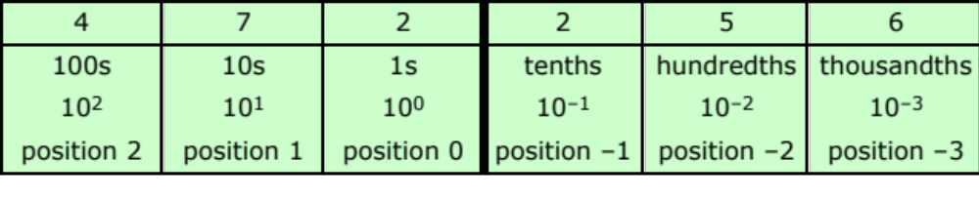
Positional Interpretation of a Decimal Number
Notes:
Table 9.1 shows the relationship between each digit position and the value
assigned to that position. Each position is weighted 10 times the value of the position
to the right and one-tenth the value of the position to the left. Thus, positions represent
successive powers of 10. If we number the positions as indicated in Table 9.1,
then position i is weighted by the value 10^{i}.
One other observation is worth making. Consider the number 509 and ask
how many tens are in the number. Because there is a 0 in the tens position, you
might be tempted to say there are no tens. But there are in fact 50 tens. What the 0
in the tens position means is that there are no tens left over that cannot be lumped
into the hundreds, or thousands, and so on. Therefore, because each position holds
only the leftover numbers that cannot be lumped into higher positions, each digit
position needs to have a value of no greater than 9. Nine is the maximum value that
a position can hold before it flips over into the next higher position.

Slide 8
Positional Number Systems
Each number is represented by a string of digits in which each digit position i has an associated weight r^{i}, where r is the radix, or base, of the number system.
The general form of a number in such a system with radix r is
( . . . a₃a₂a₁a₀.a₋₁a₋₂a₋₃ . . . )_{r}
where the value of any digit a_{i} is an integer in the range 0 < a_{i} < r. The dot between a₀ and a₋₁ is called the radix point.
Notes:
In a positional number system, each number is represented by a string of digits in
which each digit position i has an associated weight r^{i}, where r is the radix, or base,
of the number system. The general form of a number in such a system with radix r is
(. . . a₃a₂a₁a₀.a₋₁a₋₂a₋₃ . . .)_{r}
where the value of any digit a_{i} is an integer in the range 0 < a_{i} < r. The dot between
a₀ and a₋₁ is called the radix point.
The decimal system, then, is a special case of a positional number system with
radix 10 and with digits in the range 0 through 9.

Slide 9
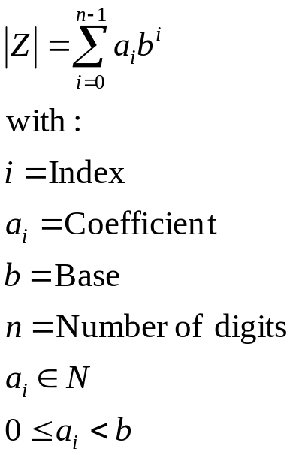
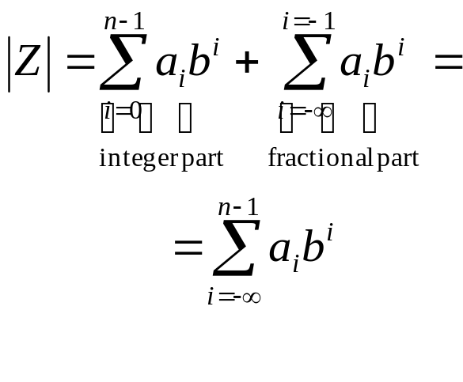
Positional Number Systems (formal)
or

Slide 10
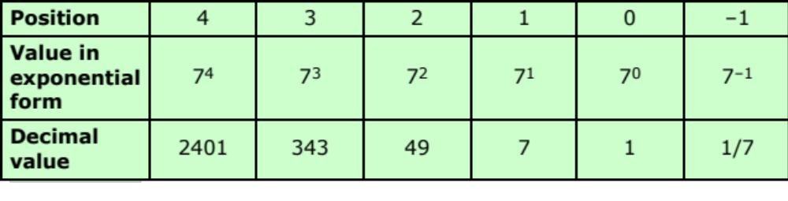
Positional Interpretation of a Number in Base 7
Notes:
As an example of another positional system, consider the system with base 7.
Table 9.2 shows the weighting value for positions –1 through 4. In each position, the
digit value ranges from 0 through 6.

Slide 11
The Binary System
Only two digits, 1 and 0
Represented to the base 2
The digits 1 and 0 in binary notation have the same meaning as in decimal notation:
0₂ = 0₁₀
1₂ = 1₁₀
To represent larger numbers each digit in a binary number has a value depending on its position:
10₂ = (1 * 2¹) + (0 * 2⁰) = 2₁₀
11₂ = (1 * 2¹) + (1 * 2⁰) = 3₁₀
100₂ = (1 * 2²) + (0 * 2¹) + (0 * 2⁰) = 4₁₀
and so on. Again, fractional values are represented with negative powers of the radix:
1001.101 = 2³ + 2⁰ + 2⁻¹ + 2⁻³ = 9.625₁₀
Notes:
In the decimal system, 10 different digits are used to represent numbers with a base
of 10. In the binary system, we have only two digits, 1 and 0. Thus, numbers in the
binary system are represented to the base 2.
To avoid confusion, we will sometimes put a subscript on a number to indicate
its base. For example, 83₁₀ and 4728₁₀ are numbers represented in decimal notation
or, more briefly, decimal numbers. The digits 1 and 0 in binary notation have the
same meaning as in decimal notation:
0₂ = 0₁₀
1₂ = 1₁₀
To represent larger numbers, as with decimal notation, each digit in a binary number
has a value depending on its position:
10₂ = (1 * 2¹) + (0 * 2⁰) = 2₁₀
11₂ = (1 * 2¹) + (1 * 2⁰) = 3₁₀
100₂ = (1 * 2²) + (0 * 2¹) + (0 * 2⁰) = 4₁₀
and so on. Again, fractional values are represented with negative powers of the
radix:
1001.101 = 2³ + 2⁰ + 2⁻¹ + 2⁻³ = 9.625₁₀

Slide 12
Binary System (Cont.)
The traditional decimal system is based on powers of ten.
The Binary system is based on powers of two.

Slide 13
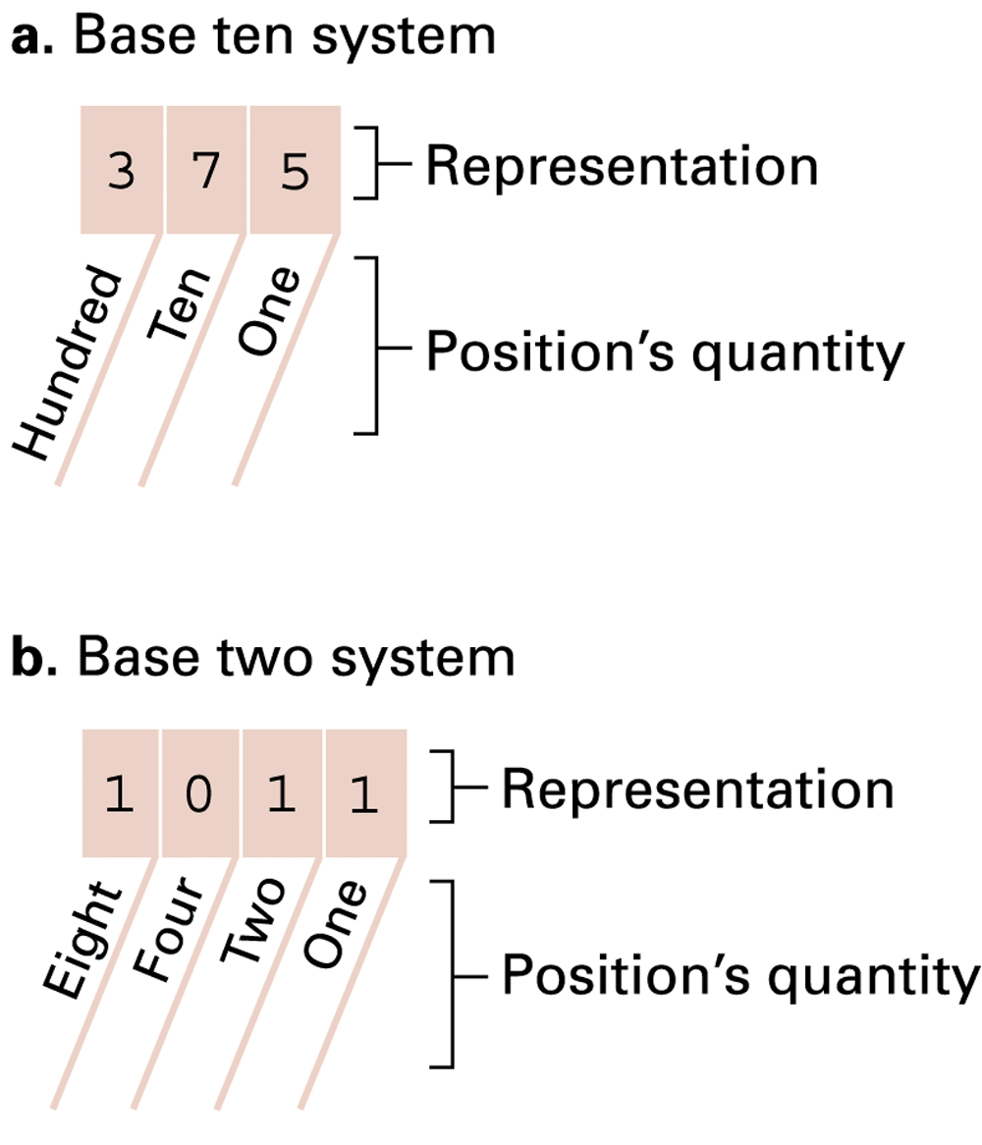
Base Ten vs. Binary Systems

Slide 14
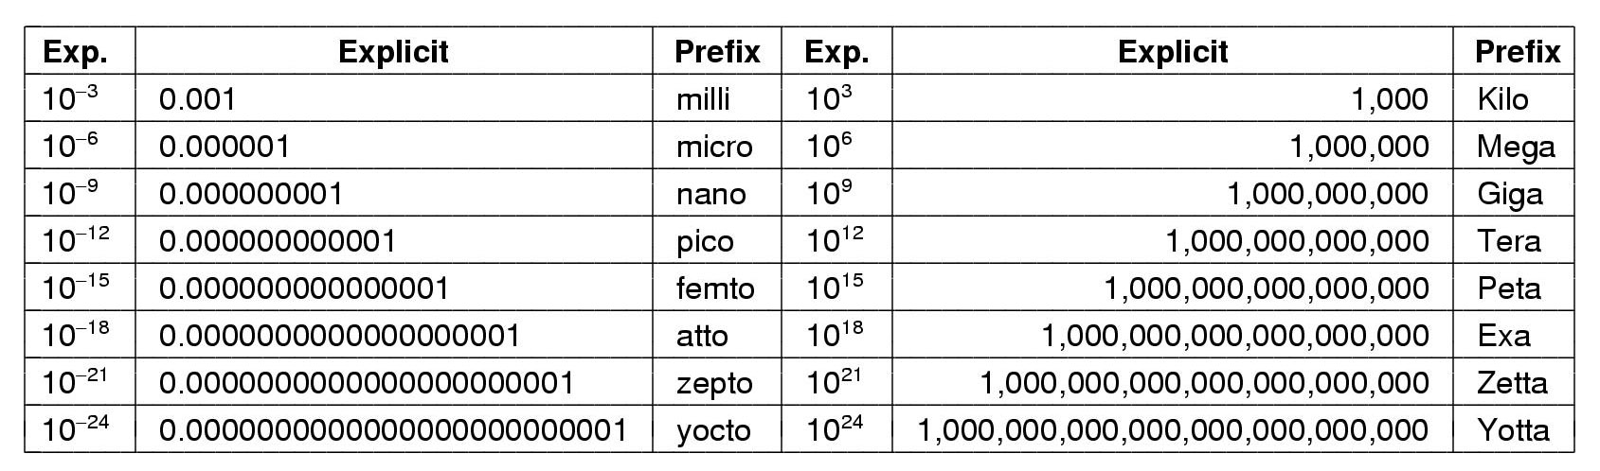
Metric Units
The metric prefixes

Slide 15

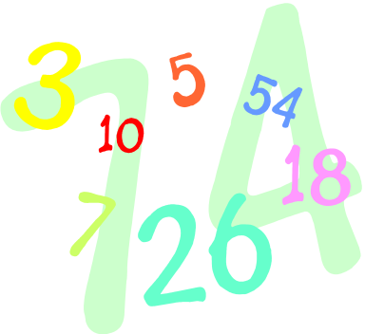
Converting Between Binary and Decimal
Binary notation to decimal notation:
  Multiply each binary digit by the appropriate power of 2 and add the results
Decimal notation to binary notation:
  Integer and fractional parts are handled separately
Notes:
It is a simple matter to convert a number from binary notation to decimal notation.
In fact, we showed several examples in the previous subsection. All that is required
is to multiply each binary digit by the appropriate power of 2 and add the results.
To convert from decimal to binary, the integer and fractional parts are handled
separately.

Slide 16
Number base conversions
Remember:
  Addition:
    augend
    +addend
    sum
  Subtraction:
    minuend
    -subtrahend
    difference
    (In binary Bit change 1 – 0 = 1 and 1 – 1 = 0)
  Multiplication:
    multiplicant
    x multiplier
    product

Slide 17
Number base conversions (Cont.)
General:
  Integer numbers:
    Divide with target base, remember the remainder
  Fractional numbers:
    Multiply with target base, remember the integer part

Slide 18
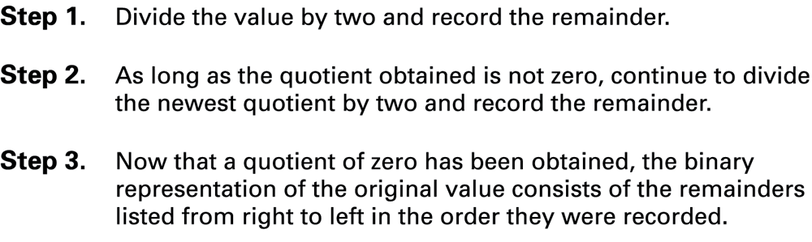
Algorithm for finding the binary representation of a positive integer

Slide 19
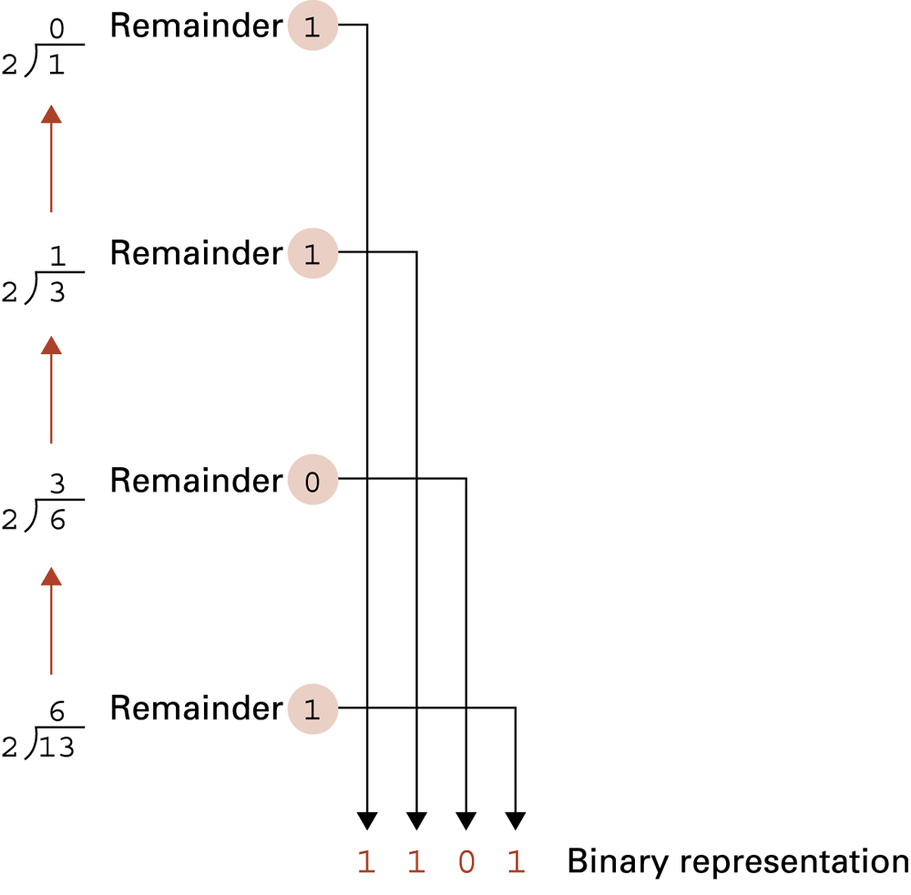
Applying the algorithm

Slide 20
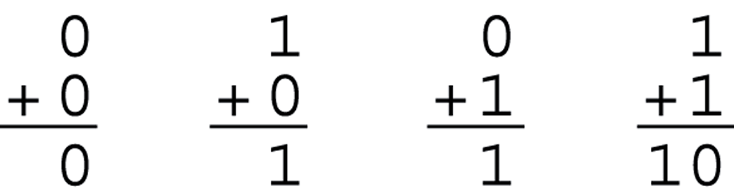
The binary addition facts

Slide 21
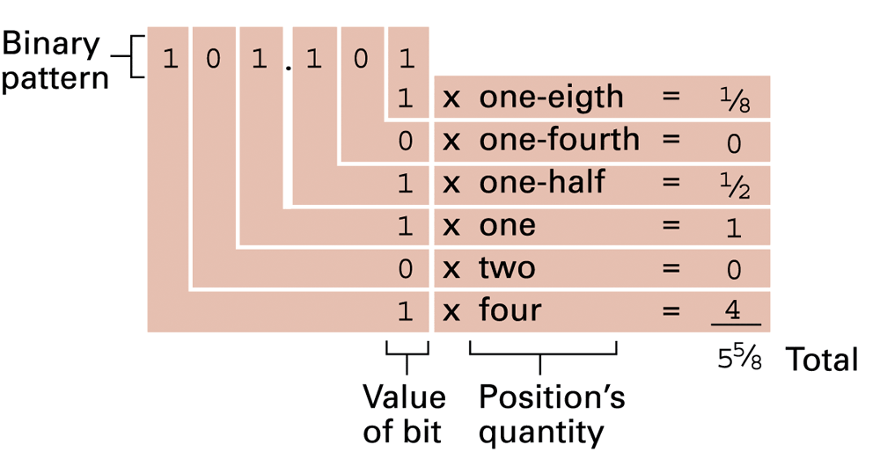
Decoding the binary representation 101.101

Slide 22
Number base conversions (Cont.)
Some examples:
Decimal (base 10) | Binary (base 2) | Octal (base 8) | Hexadecimal (Base 16)
00 | 0000 | 01 | 0
01 | 0001 | 02 | 1
02 | 0010 | 03 | 2
03 | 0011 | 04 | 3
04 | 0100 | 05 | 4
05 | 0101 | 06 | 5
06 | 0110 | 07 | 6
07 | 0111 | 10 | 7
08 | 1000 | 11 | 8
09 | 1001 | 12 | 9
10 | 1010 | 13 | A
11 | 1011 | 14 | B
12 | 1100 | 15 | C
13 | 1101 | 16 | D
14 | 1110 | 17 | E
15 | 1111 | 18 | F

Slide 23
For the integer part, recall that in binary notation, an integer represented by
b_{m-1}b_{m-2} . . . b₂b₁b₀ b_{i} = 0 or 1
has the value
(b_{m-1} * 2^{m-1}) + (b_{m-2} * 2 ^{m-2}) + . . . + (b₁ * 2¹) + b₀
Suppose it is required to convert a decimal integer N into binary form. If we divide N by 2, in the decimal system, and obtain a quotient N₁ and a remainder R₀, we may write
N = 2 * N₁ + R₀ R₀ = 0 or 1
Next, we divide the quotient N₁ by 2. Assume that the new quotient is N₂ and the new remainder R₁. Then
N₁ = 2 * N₂ + R₁ R₁ = 0 or 1
so that
N = 2(2N₂ + R₁) + R₀ = (N₂ * 2²) + (R₁ * 2¹) + R₀
If next
N₂ = 2N₃ + R₂
we have
N = (N₃ * 2³) + (R₂ * 2²) + (R₁ * 2¹) + R₀
Integers
Continued . . .
Notes:
For the integer part, recall that in binary notation, an integer represented by
b_{m-1}b_{m-2} . . . b₂b₁b₀
b_{i} = 0 or 1
has the value
(b_{m-1} * 2^{m-1}) + (b_{m-2} * 2^{m-2}) + . . . + (b₁ * 2¹) + b₀
Suppose it is required to convert a decimal integer N into binary form. If we
divide N by 2, in the decimal system, and obtain a quotient N1 and a remainder R0,
we may write
N = 2 * N₁ + R₀ R₀ = 0 or 1
Next, we divide the quotient N₁ by 2. Assume that the new quotient is N₂ and the
new remainder R₁. Then
N₁ = 2 * N₂ + R₁ R₁ = 0 or 1
so that
N = 2(2N₂ + R₁) + R₀ = (N₂ * 2²) + (R₁ * 2¹) + R₀
If next
N₂ = 2N₃ + R₂
we have
N = (N₃ * 2³) + (R₂ * 2²) + (R₁ * 2¹) + R₀

Slide 24
Integers
Because N >N₁ > N_{2 . . .} , continuing this sequence will eventually produce a quotient N_{m-1} = 1 (except for the decimal integers 0 and 1, whose binary equivalents are 0 and 1, respectively) and a remainder R_{m-2}, which is 0 or 1. Then
N = (1 * 2^{m-1}) + (R_{m-2} * 2^{m-2}) + . . . + (R₂ * 2²) + (R₁ * 2¹) + R₀
which is the binary form of N. Hence, we convert from base 10 to base 2 by repeated divisions by 2. The remainders and the final quotient, 1, give us, in order of increasing significance, the binary digits of N.
Notes:
Because N > N₁ > N₂ . . . , continuing this sequence will eventually produce a quotient
N_{m-1} = 1 (except for the decimal integers 0 and 1, whose binary equivalents
are 0 and 1, respectively) and a remainder R_{m-2}, which is 0 or 1. Then
N = (1 * 2^{m-1}) + (R_{m-2} * 2^{m-2}) + . . . + (R₂ * 2²) + (R₁ * 2¹) + R₀
which is the binary form of N. Hence, we convert from base 10 to base 2 by repeated
divisions by 2. The remainders and the final quotient, 1, give us, in order of increasing
significance, the binary digits of N. Figure 9.1 shows two examples.

Slide 25
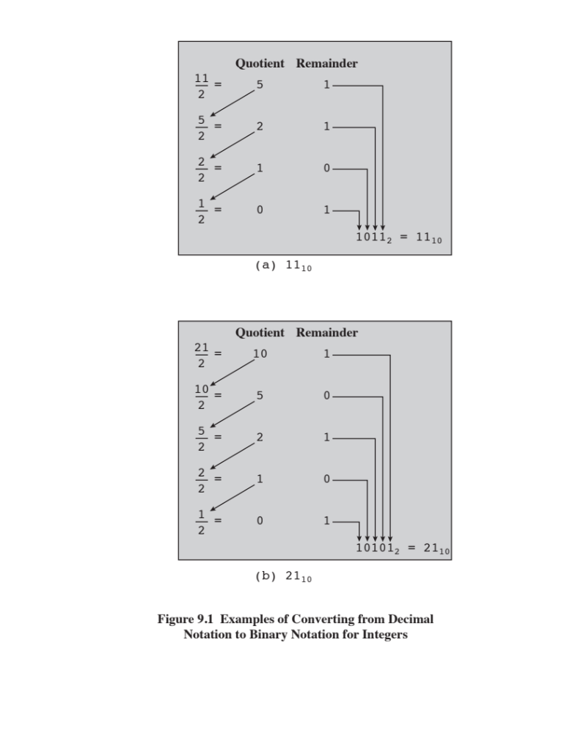
Notes:
Figure 9.1. Examples of converting from decimal notation to binary notation for integers.

Slide 26

For the fractional part, recall that in binary notation, a number with a value between 0 and 1 is represented by
0.b₋₁b₋₂b₋₃ . . . b_{i} = 0 or 1 and has the value
(b₋₁ * 2⁻¹) + (b₋₂ * 2⁻²) + (b₋₃ * 2⁻³) . . .
This can be rewritten as
2⁻¹ * (b₋₁ + 2⁻¹ * (b₋₂ + 2⁻¹ * (b₋₃ + . . . ) . . . ))
Suppose we want to convert the number F (0 < F < 1) from decimal to binary notation. We know that F can be expressed in the form
F = 2⁻¹ * (b₋₁ + 2⁻¹ * (b₋₂ + 2⁻¹ * (b₋₃ + . . . ) . . . ))
If we multiply F by 2, we obtain,
2 * F = b₋₁ + 2⁻¹ * (b₋₂ + 2⁻¹ * (b₋₃ + . . . ) . . . )
Fractions
Continued . . .
Notes:
For the fractional part, recall that in binary notation, a number with a value between
0 and 1 is represented by
0.b₋₁b₋₂b₋₃ . . . b_{i} = 0 or 1
and has the value
(b₋₁ * 2⁻¹) + (b₋₂ * 2⁻²) + (b₋₃ * 2⁻³)c
This can be rewritten as
2⁻¹ * (b₋₁ + 2⁻¹ * (b₋₂ + 2⁻¹ * (b₋₃ + . . . ) . . . ))
This expression suggests a technique for conversion. Suppose we want to convert
the number F (0 < F < 1) from decimal to binary notation. We know that F
can be expressed in the form
F = 2⁻¹ * (b₋₁ + 2⁻¹ * (b₋₂ + 2⁻¹ * (b₋₃ + . . . ) . . . ))
If we multiply F by 2, we obtain,
2 * F = b₋₁ + 2⁻¹ * (b₋₂ + 2⁻¹ * (b₋₃ + . . . ) . . . )

Slide 27
From this equation, we see that the integer part of (2 * F), which must be either 0 or 1 because 0 < F < 1, is simply b₋₁. So we can say (2 * F) = b₋₁ + F₁, where 0 < F₁ < 1 and where
F₁ = 2-1 * (b₋₂ + 2⁻¹ * (b₋₃ + 2⁻¹ * (b₋₄ + . . . ) . . . ))
To find b₋₂, we repeat the process.
At each step, the fractional part of the number from the previous step is multiplied by 2. The digit to the left of the decimal point in the product will be 0 or 1 and contributes to the binary representation, starting with the most significant digit. The fractional part of the product is used as the multiplicand in the next step.
Fractions
Notes:
From this equation, we see that the integer part of (2 * F), which must be
either 0 or 1 because 0 < F < 1, is simply b₋₁. So we can say (2 * F) = b₋₁ + F₁,
where 0 < F₁ < 1 and where
F₁ = 2⁻¹ * (b-₂ + 2⁻¹ * (b₋₃ + 2⁻¹ * (b₋₄ + . . .) . . .))
To find b₋₂, we repeat the process. Therefore, the conversion algorithm involves
repeated multiplication by 2. At each step, the fractional part of the number from
the previous step is multiplied by 2. The digit to the left of the decimal point in the
product will be 0 or 1 and contributes to the binary representation, starting with the
most significant digit. The fractional part of the product is used as the multiplicand
in the next step. Figure 9.2 shows two examples.

Slide 28
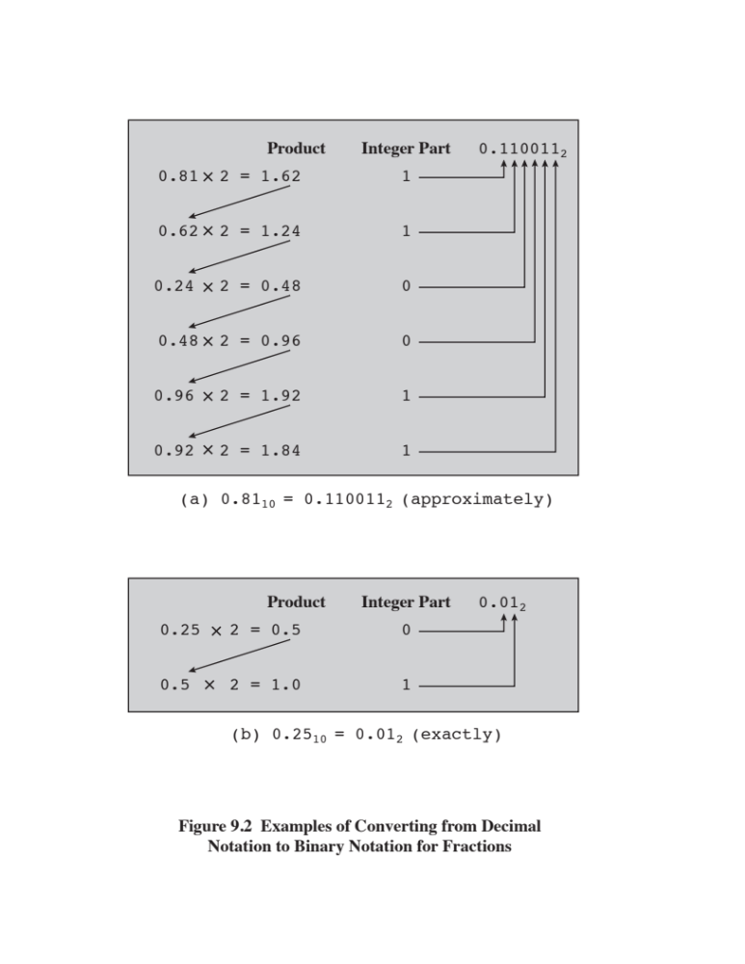
Figure 9.2
Examples of
Converting
from
Decimal Notation
To
Binary Notation
For Fractions
Notes:
This process is not necessarily exact; that is, a decimal fraction with a finite
number of digits may require a binary fraction with an infinite number of digits. In
such cases, the conversion algorithm is usually halted after a prespecified number of
steps, depending on the desired accuracy.

Slide 29
Hexadecimal Notation
Binary digits are grouped into sets of four bits, called a nibble
Each possible combination of four binary digits is given a symbol, as follows:
0000 = 0 0100 = 4 1000 = 8 1100 = C
0001 = 1 0101 = 5 1001 = 9 1101 = D
0010 = 2 0110 = 6 1010 = A 1110 = E
0011 = 3 0111 = 7 1011 = B 1111 = F
Because 16 symbols are used, the notation is called hexadecimal and the 16 symbols are the hexadecimal digits
Thus
2C₁₆ = (2₁₆ * 16¹) + (C₁₆ * 16⁰)
= (2₁₀ * 16¹) + (12₁₀ * 16⁰) = 44
Notes:
Because of the inherent binary nature of digital computer components, all forms of
data within computers are represented by various binary codes. However, no matter
how convenient the binary system is for computers, it is exceedingly cumbersome
for human beings. Consequently, most computer professionals who must spend time
working with the actual raw data in the computer prefer a more compact notation.
What notation to use? One possibility is the decimal notation. This is certainly
more compact than binary notation, but it is awkward because of the tediousness of
converting between base 2 and base 10.
Instead, a notation known as hexadecimal has been adopted. Binary digits are
grouped into sets of four bits, called a nibble. Each possible combination of four
binary digits is given a symbol.
Because 16 symbols are used, the notation is called hexadecimal, and the 16 symbols
are the hexadecimal digits.

Slide 30
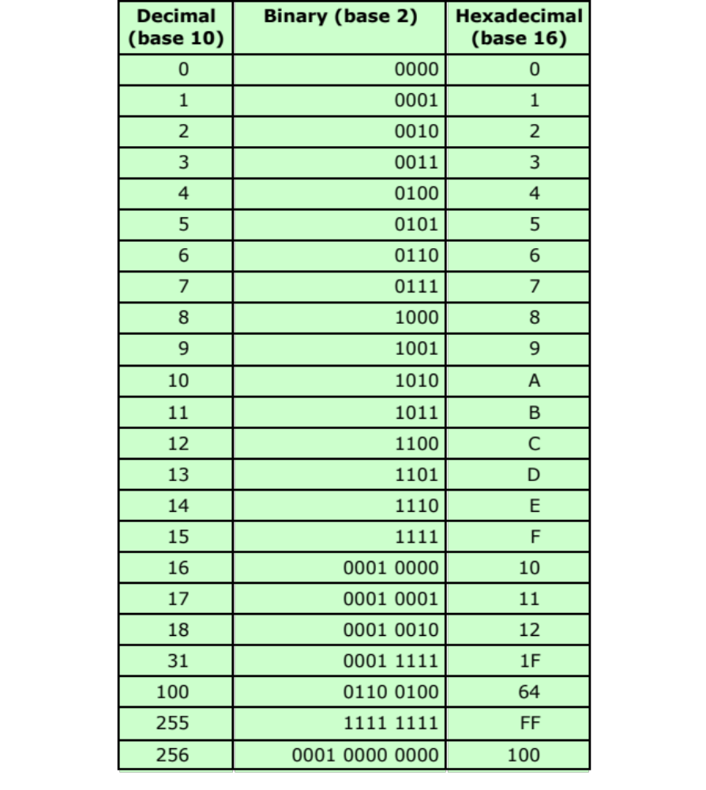
Table 9.3
Decimal, Binary, and Hexadecimal
Notes:
A sequence of hexadecimal digits can be thought of as representing an integer
in base 16 (Table 9.3).

Slide 31
Hexadecimal Notation
Not only used for representing integers but also as a concise notation for representing any sequence of binary digits
Reasons for using hexadecimal notation are:
It is more compact than binary notation
In most computers, binary data occupy some multiple of 4 bits, and hence some multiple of a single hexadecimal digit
It is extremely easy to convert between binary and hexadecimal notation
Notes:
Hexadecimal notation is not only used for representing integers but also used
as a concise notation for representing any sequence of binary digits, whether they
represent text, numbers, or some other type of data. The reasons for using hexadecimal
notation are as follows:
1. It is more compact than binary notation.
2. In most computers, binary data occupy some multiple of 4 bits, and hence
some multiple of a single hexadecimal digit.
3. It is extremely easy to convert between binary and hexadecimal notation.

Slide 32
Complements
Diminished Radix Complement:
  Given number N in base b with n digits
  (b-1)-Complement: (b^{n} - 1) – N
Radix Complement:
  Given number N in base b with n digits
  b-Complement: b^{n} – N for N ≠ 0 and 0 for N = 0
  b-complement = (b – 1)-complement + 1

Slide 33
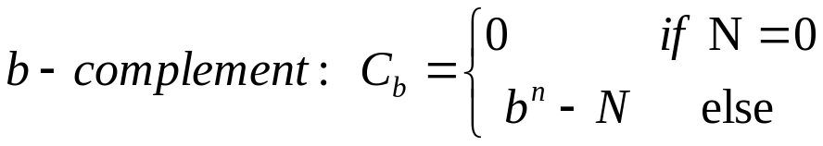
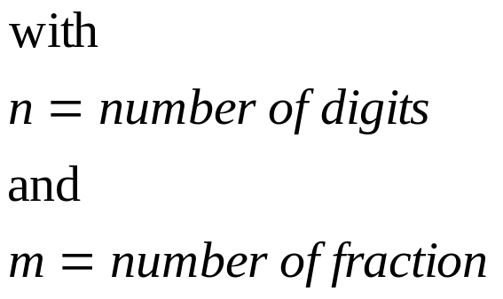
Complements (Cont.)
General:

Slide 34
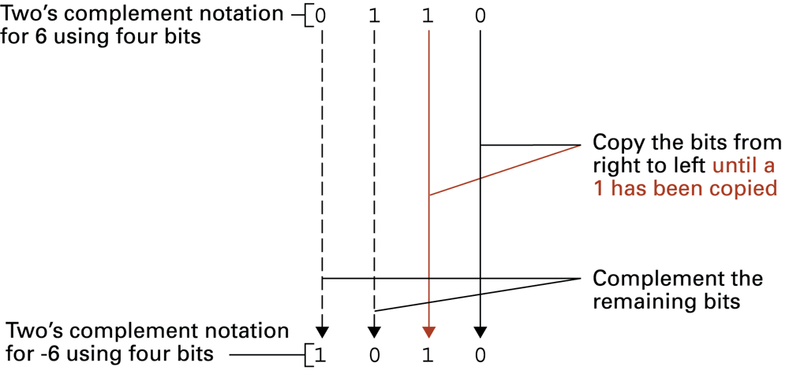
Example: Coding -6 in 2’s complement

Slide 35
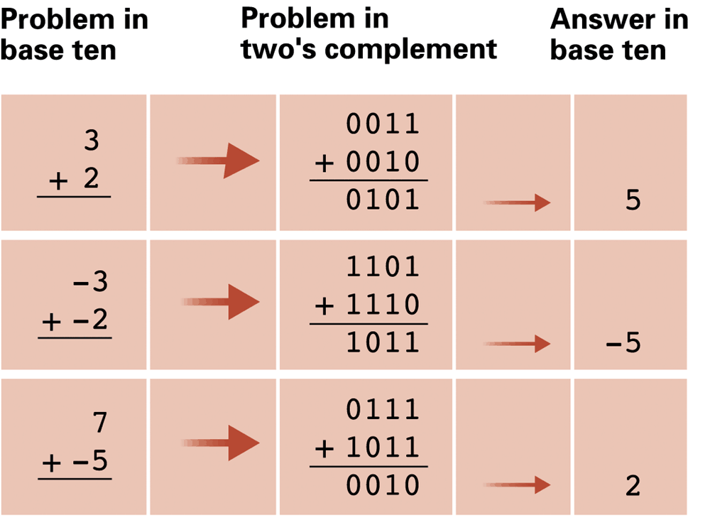
Example:
Addition in 2’s Complement

Slide 36
Example: Subtraction with Complements
General steps:
  Add the minuend, M, to b‘s complement of the subtrahend, N. This performs M + ( b^{n} – N ) = M – N + b^{n}
  If M ≥ N, the sum will produce an end carry, b^{n}, which can be discarded. What is left is the result M – N
  If M < N, the sum does produce an end carry and is equal to b^{n} – ( N – M ), which is the b‘s complement of (N – M).

Slide 37
Signed binary numbers
Signed-magnitude convention:
  Symbol used for sign, i.e. + or – or 0 or 1
  Example:
    (0111)₂ = (+7)₁₀
    (1111)₂ = (-7)₁₀
    (1111): 1 (Sign) and 111 (Magnitude)

Slide 38
Signed binary numbers (Cont.)
Decimal | Signed 2‘s complement | Signed 1‘s complement | Signed magnitude
+7 | 0111 | 0111 | 0111
+6 | 0110 | 0110 | 0110
+5 | 0101 | 0101 | 0101
+4 | 0100 | 0100 | 0100
+3 | 0011 | 0011 | 0011
+2 | 0010 | 0010 | 0010
+1 | 0001 | 0001 | 0001
+0 | 0000 | 0000 | 0000
-0 | - | 1111 | 1000
-1 | 1111 | 1110 | 1001
-2 | 1110 | 1101 | 1010
-3 | 1101 | 1100 | 1011
-4 | 1100 | 1011 | 1100
-5 | 1011 | 1010 | 1101
-6 | 1010 | 1001 | 1110
-7 | 1001 | 1000 | 1111
-8 | 1000 | - | -
Signed-complement convention

Slide 39
Summary
Number Systems
Converting between binary and decimal
  Integers
  Fractions
Hexadecimal notation
The decimal system
Positional number systems
The binary system
Notes:
Chapter 9 summary.

Slide 40
Part 2
Computer Arithmetics

Slide 41
Learning Objectives
Understand the working principles of ALU
Differentiate between various integer representations
Understand floating-point representation
Perform both integer and floating-point arithmetic

Slide 42
Outline
Computer Arithmetic
ALU
Integer representation
  Sign-magnitude representation
  Twos complement representation
  Range extension
  Fixed-point representation
  Floating-point representation
  Principles
  IEEE standard for binary floating-point representation
  Integer arithmetic
  Negation
  Addition and subtraction
  Multiplication
  Division
  Floating-point arithmetic
  Addition and subtraction
  Multiplication and division
  Precision consideration
  IEEE standard for binary floating-point arithmetic
Notes:
Chapter 2 summary.

Slide 43

Arithmetic & Logic Unit (ALU)
Part of the computer that actually performs arithmetic and logical operations on data
All of the other elements of the computer system are there mainly to bring data into the ALU for it to process and then to take the results back out
Based on the use of simple digital logic devices that can store binary digits and perform simple Boolean logic operations
Notes:
The ALU is that part of the computer that actually performs arithmetic and logical
operations on data. All of the other elements of the computer system—control unit,
registers, memory, I/O—are there mainly to bring data into the ALU for it to process
and then to take the results back out. We have, in a sense, reached the core or
essence of a computer when we consider the ALU.
An ALU and, indeed, all electronic components in the computer are based on
the use of simple digital logic devices that can store binary digits and perform simple
Boolean logic operations.

Slide 44
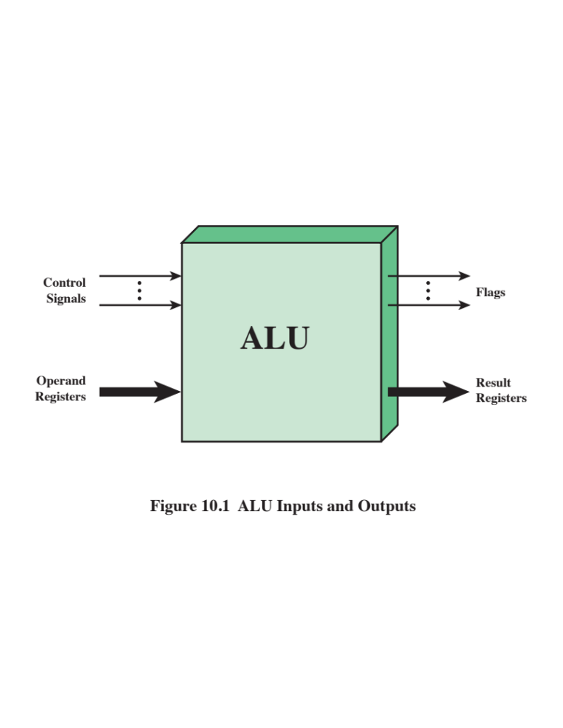
Notes:
Figure 10.1 indicates, in general terms, how the ALU is interconnected with
the rest of the processor. Operands for arithmetic and logic operations are presented
to the ALU in registers, and the results of an operation are stored in registers.
These registers are temporary storage locations within the processor that are
connected by signal paths to the ALU (e.g., see Figure 2.3). The ALU may also set
flags as the result of an operation. For example, an overflow flag is set to 1 if the
result of a computation exceeds the length of the register into which it is to be stored.
The flag values are also stored in registers within the processor. The processor
provides signals that control the operation of the ALU and the movement of the
data into and out of the ALU.
The flag values are also stored in registers within the processor. The processor provides
signals that control the operation of the ALU and the movement of the data
into and out of the ALU.

Slide 45

Integer Representation
In the binary number system arbitrary numbers can be represented with:
  The digits zero and one
  The minus sign (for negative numbers)
  The period, or radix point (for numbers with a fractional component)
  For purposes of computer storage and processing we do not have the benefit of special symbols for the minus sign and radix point
  Only binary digits (0,1) may be used to represent numbers
Notes:
In the binary number system, arbitrary numbers can be represented with just the
digits zero and one, the minus sign (for negative numbers), and the period, or radix
point (for numbers with a fractional component).
For purposes of computer storage and processing, however, we do not have the benefit
of special symbols for the minus sign and radix point. Only binary digits (0 and 1)
may be used to represent numbers. If we are limited to nonnegative integers, the
representation is straightforward.

Slide 46
Sign-Magnitude Representation
There are several alternative conventions used to represent negative as well as positive integers
All of these alternatives involve treating the most significant (leftmost) bit in the word as a sign bit
If the sign bit is 0 the number is positive
If the sign bit is 1 the number is negative
Sign-magnitude representation is the simplest form that employs a sign bit
Drawbacks:
Addition and subtraction require a consideration of both the signs of the numbers and their relative magnitudes to carry out the required operation
There are two representations of 0
Because of these drawbacks, sign-magnitude representation is rarely used in implementing the integer portion of the ALU
Notes:
There are several alternative conventions used to represent negative as well as positive
integers, all of which involve treating the most significant (leftmost) bit in the
word as a sign bit. If the sign bit is 0, the number is positive; if the sign bit is 1, the
number is negative.
The simplest form of representation that employs a sign bit is the sign-magnitude
representation. In an n-bit word, the rightmost n - 1 bits hold the
magnitude of the integer.
There are several drawbacks to sign-magnitude representation. One is that addition
and subtraction require a consideration of both the signs of the numbers and their
relative magnitudes to carry out the required operation. This should become clear in the
discussion in Section 10.3. Another drawback is that there are two representations of 0:
This is inconvenient because it is slightly more difficult to test for 0 (an operation
performed frequently on computers) than if there were a single representation.
Because of these drawbacks, sign-magnitude representation is rarely used in
implementing the integer portion of the ALU. Instead, the most common scheme is
twos complement representation.

Slide 47
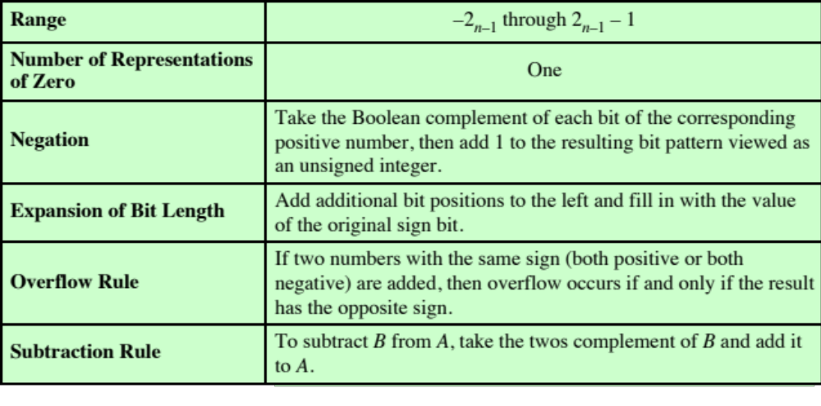
Table 10.1
Characteristics of Twos Complement Representation and Arithmetic
Notes:
Like sign magnitude, twos complement representation uses the most significant bit
as a sign bit, making it easy to test whether an integer is positive or negative. It
differs from the use of the sign-magnitude representation in the way that the other
bits are interpreted. Table 10.1 highlights key characteristics of twos complement
representation and arithmetic, which are elaborated in this section and the next.
Most treatments of twos complement representation focus on the rules for
producing negative numbers, with no formal proof that the scheme is valid. Instead,
our presentation of twos complement integers in this section and in Section 10.3 is
based on [DATT93], which suggests that twos complement representation is best
understood by defining it in terms of a weighted sum of bits, as we did previously
for unsigned and sign-magnitude representations. The advantage of this treatment
is that it does not leave any lingering doubt that the rules for arithmetic operations
in twos complement notation may not work for some special cases.

Slide 48
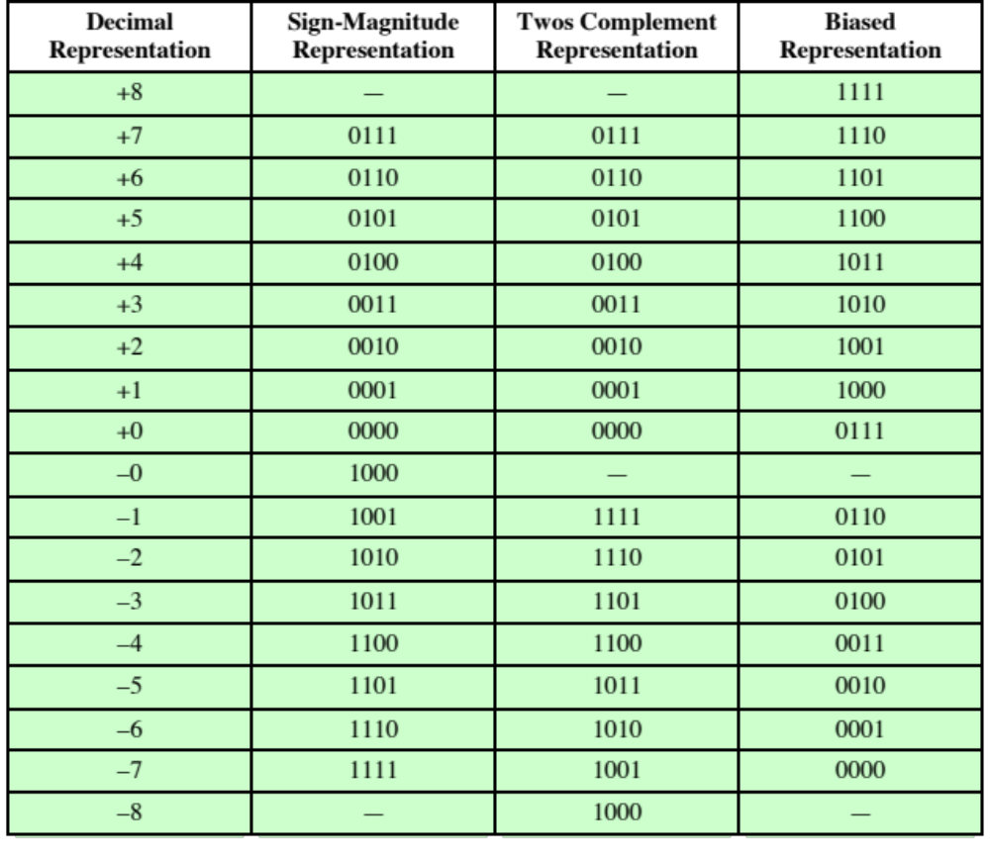
Table 10.2
Alternative Representations for 4-Bit Integers
Notes:
Table 10.2 compares the sign-magnitude and twos complement representations
for 4-bit integers. Although twos complement is an awkward representation
from the human point of view, we will see that it facilitates the most important arithmetic
operations, addition and subtraction. For this reason, it is almost universally
used as the processor representation for integers.

Slide 49
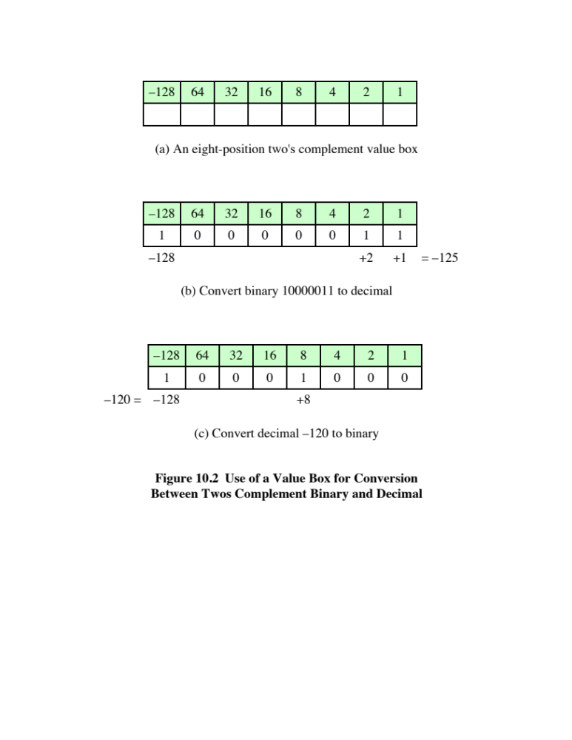
Notes:
A useful illustration of the nature of twos complement representation is a
value box, in which the value on the far right in the box is 1 (2⁰ ) and each succeeding
position to the left is double in value, until the leftmost position, which is negated.
As you can see in Figure 10.2a, the most negative twos complement number that
can be represented is - 2^{n-1} ; if any of the bits other than the sign bit is one, it adds a
positive amount to the number. Also, it is clear that a negative number must have a
1 at its leftmost position and a positive number must have a 0 in that position. Thus,
the largest positive number is a 0 followed by all 1s, which equals 2^{n-1} - 1.
The rest of Figure 10.2 illustrates the use of the value box to convert from twos
complement to decimal and from decimal to twos complement.

Slide 50
Range Extension
  Range of numbers that can be expressed is extended by increasing the bit length
  In sign-magnitude notation this is accomplished by moving the sign bit to the new leftmost position and fill in with zeros
  This procedure will not work for twos complement negative integers
  Rule is to move the sign bit to the new leftmost position and fill in with copies of the sign bit
  For positive numbers, fill in with zeros, and for negative numbers, fill in with ones
  This is called sign extension
Notes:
It is sometimes desirable to take an n-bit integer and store it in m bits, where m > n.
This expansion of bit length is referred to as range extension, because the range
of numbers that can be expressed is extended by increasing the bit length.
In sign-magnitude notation, this is easily accomplished: simply move the sign bit
to the new leftmost position and fill in with zeros.
This procedure will not work for twos complement negative integers.
Instead, the rule for twos complement integers is to move the sign bit to the
new leftmost position and fill in with copies of the sign bit. For positive numbers, fill
in with zeros, and for negative numbers, fill in with ones. This is called sign extension.

Slide 51
Fixed-Point Representation
The radix point (binary point) is fixed and assumed to be to the right of the rightmost digit
Programmer can use the same representation for binary fractions by scaling the numbers so that the binary point is implicitly positioned at some other location
Notes:
Finally, we mention that the representations discussed in this section are sometimes
referred to as fixed point. This is because the radix point (binary point) is fixed and
assumed to be to the right of the rightmost digit. The programmer can use the same
representation for binary fractions by scaling the numbers so that the binary point is
implicitly positioned at some other location.

Slide 52
Negation
Twos complement operation
  Take the Boolean complement of each bit of the integer (including the sign bit)
  Treating the result as an unsigned binary integer, add 1
  The negative of the negative of that number is itself:
+18 = 00010010 (twos complement)
bitwise complement = 11101101
+ 1
11101110 = -18
-18 = 11101110 (twos complement)
bitwise complement = 00010001
+ 1
00010010 = +18
Notes:
In sign-magnitude representation, the rule for forming the negation of an integer is
simple: invert the sign bit. In twos complement notation, the negation of an integer
can be formed with the following rules:
1. Take the Boolean complement of each bit of the integer (including the sign
bit). That is, set each 1 to 0 and each 0 to 1.
2. Treating the result as an unsigned binary integer, add 1.
This two-step process is referred to as the twos complement operation, or the taking
of the twos complement of an integer.
As expected, the negative of the negative of that number is itself:

Slide 53
Negation Special Case 1
0 = 00000000 (twos complement)
Bitwise complement = 11111111
Add 1 to LSB + 1
Result 100000000
Overflow is ignored, so:
- 0 = 0
Notes:
There is a carry out of the most significant bit position, which is ignored. The result
is that the negation of 0 is 0, as it should be.

Slide 54
Negation Special Case 2
-128 = 10000000 (twos complement)
Bitwise complement = 01111111
Add 1 to LSB + 1
Result 10000000
So:
-(-128) = -128 X
Monitor MSB (sign bit)
It should change during negation
Notes:
The second special case is more of a problem. If we take the negation of the bit
pattern of 1 followed by n - 1 zeros, we get back the same number.

Slide 55
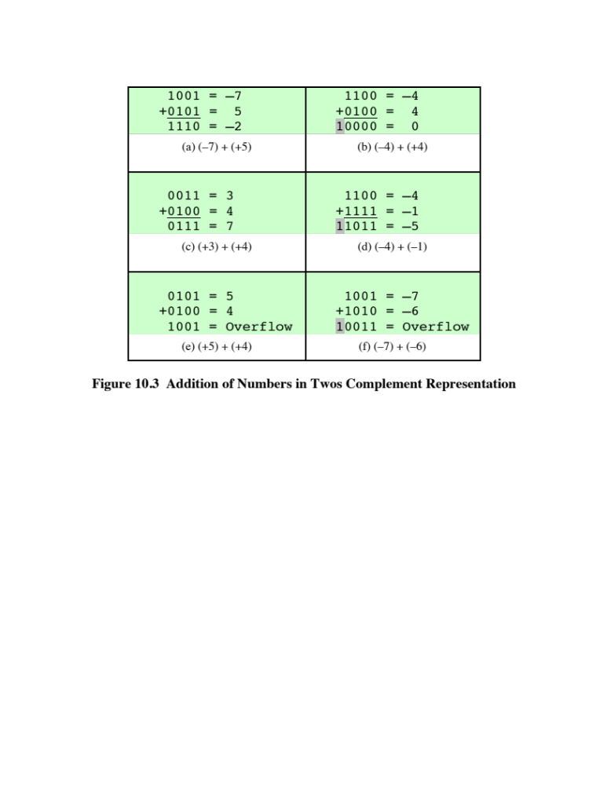
Notes:
Addition in twos complement is illustrated in Figure 10.3. Addition proceeds as if
the two numbers were unsigned integers. The first four examples illustrate successful
operations. If the result of the operation is positive, we get a positive number
in twos complement form, which is the same as in unsigned-integer form. If the
result of the operation is negative, we get a negative number in twos complement
form. Note that, in some instances, there is a carry bit beyond the end of the word
(indicated by shading), which is ignored.

Slide 56
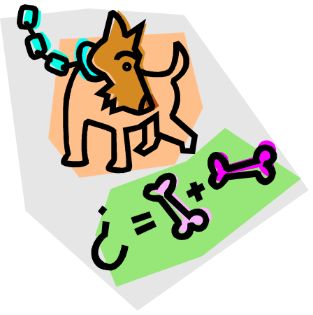
Overflow
OVERFLOW RULE:
If two numbers are added, and they are both positive or both negative, then overflow occurs if and only if the result has the opposite sign.
Rule
Notes:
On any addition, the result may be larger than can be held in the word size
being used. This condition is called overflow. When overflow occurs, the ALU must
signal this fact so that no attempt is made to use the result.
Figures 10.3e and f show examples of overflow. Note that overflow can occur
whether or not there is a carry.

Slide 57
Subtraction
SUBTRACTION RULE:
To subtract one number (subtrahend) from another (minuend), take the twos complement (negation) of the subtrahend and add it
to the minuend.
Rule
Notes:
Subtraction rule.

Slide 58
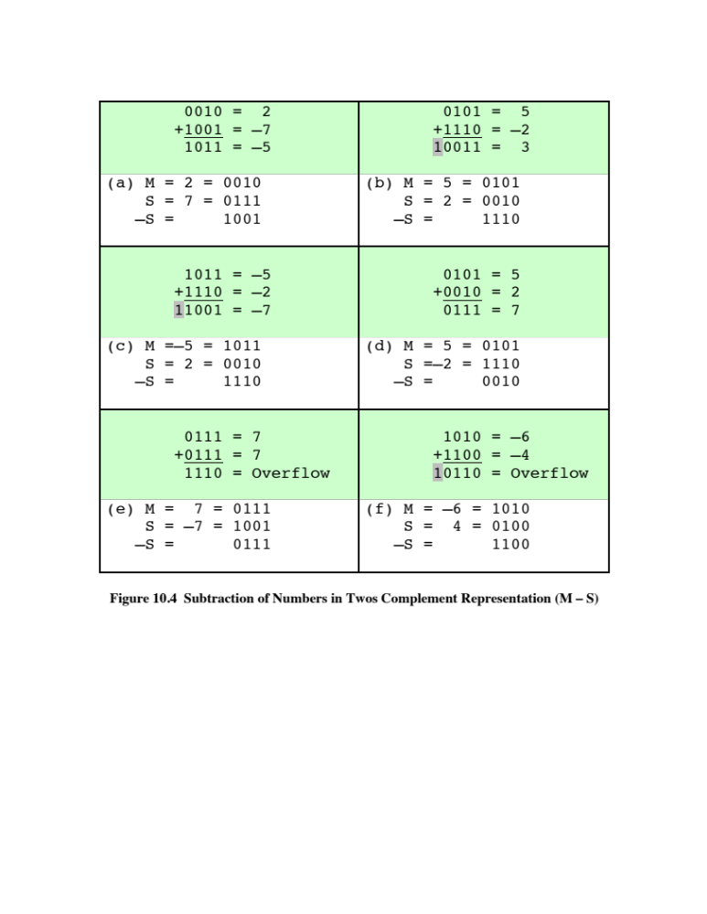
Notes:
Thus, subtraction is achieved using addition, as illustrated in Figure 10.4. The
last two examples demonstrate that the overflow rule still applies.

Slide 59
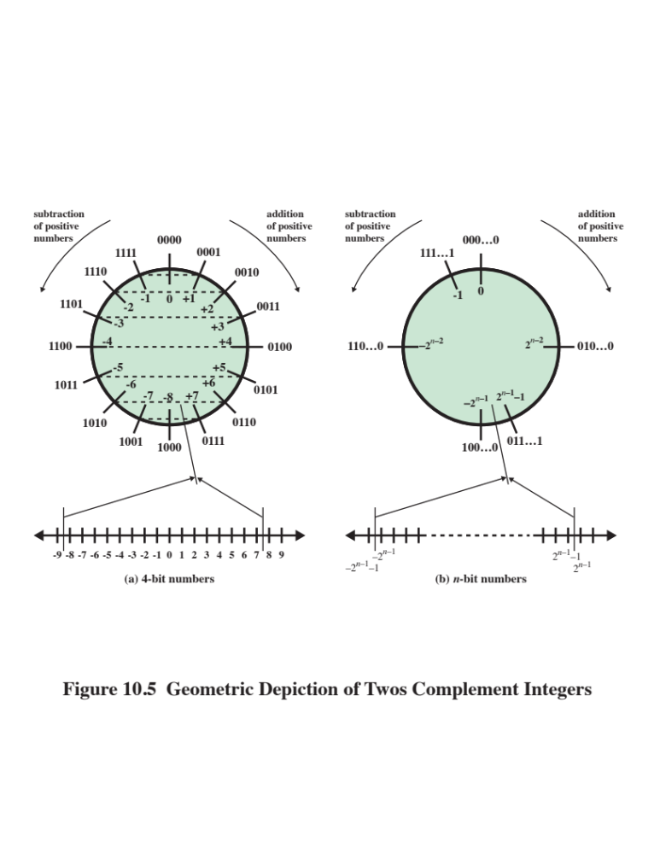
Notes:
Some insight into twos complement addition and subtraction can be gained by
looking at a geometric depiction [BENH92], as shown in Figure 10.5. The circle in
the upper half of each part of the figure is formed by selecting the appropriate segment
of the number line and joining the endpoints. Note that when the numbers are
laid out on a circle, the twos complement of any number is horizontally opposite that
number (indicated by dashed horizontal lines). Starting at any number on the circle,
we can add positive k (or subtract negative k) to that number by moving k positions
clockwise, and we can subtract positive k (or add negative k) from that number by
moving k positions counterclockwise. If an arithmetic operation results in traversal
of the point where the endpoints are joined, an incorrect answer is given (overflow).

Slide 60
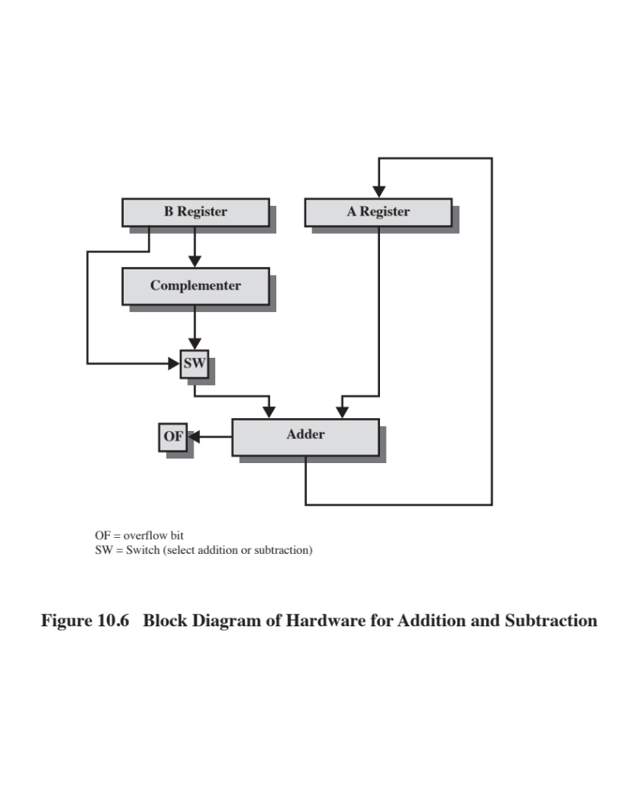
Notes:
Figure 10.6 suggests the data paths and hardware elements needed to accomplish
addition and subtraction. The central element is a binary adder, which is presented
two numbers for addition and produces a sum and an overflow indication.
The binary adder treats the two numbers as unsigned integers. (A logic implementation
of an adder is given in Chapter 11.) For addition, the two numbers are
presented to the adder from two registers, designated in this case as A and B registers.
The result may be stored in one of these registers or in a third. The overflow
indication is stored in a 1-bit overflow flag (0 = no overflow; 1 = overflow). For
subtraction, the subtrahend (B register) is passed through a twos complementer
so that its twos complement is presented to the adder. Note that Figure 10.6 only
shows the data paths. Control signals are needed to control whether or not the complementer
is used, depending on whether the operation is addition or subtraction.

Slide 61
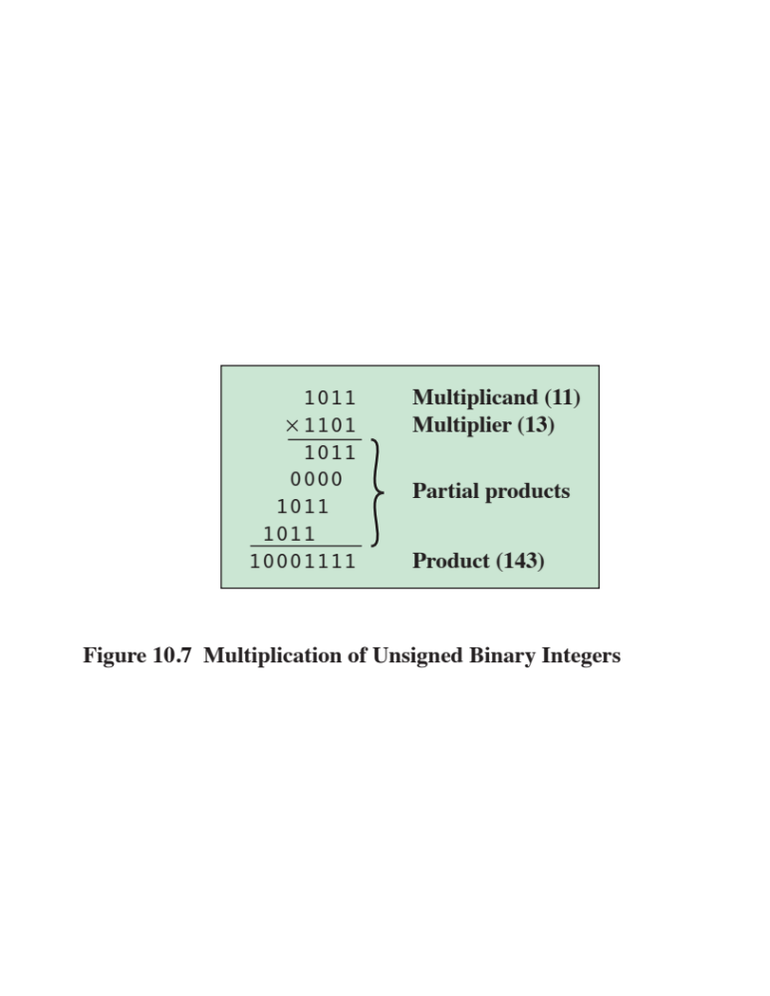
Notes:
Compared with addition and subtraction, multiplication is a complex operation,
whether performed in hardware or software. A wide variety of algorithms have been
used in various computers. The purpose of this subsection is to give the reader some
feel for the type of approach typically taken. We begin with the simpler problem of
multiplying two unsigned (nonnegative) integers, and then we look at one of the most
common techniques for multiplication of numbers in twos complement representation.
Figure 10.7 illustrates the multiplication of unsigned
binary integers, as might be carried out using paper and pencil. Several important
observations can be made:
1. Multiplication involves the generation of partial products, one for each digit in the
multiplier. These partial products are then summed to produce the final product.
2. The partial products are easily defined. When the multiplier bit is 0, the partial
product is 0. When the multiplier is 1, the partial product is the multiplicand.
3. The total product is produced by summing the partial products. For this operation,
each successive partial product is shifted one position to the left relative
to the preceding partial product.
4. The multiplication of two n-bit binary integers results in a product of up to 2n
bits in length (e.g., 11 * 11 = 1001).
Compared with the pencil-and-paper approach, there are several things we can
do to make computerized multiplication more efficient. First, we can perform a running
addition on the partial products rather than waiting until the end. This eliminates
the need for storage of all the partial products; fewer registers are needed. Second,
we can save some time on the generation of partial products. For each 1 on the multiplier,
an add and a shift operation are required; but for each 0, only a shift is required.

Slide 62
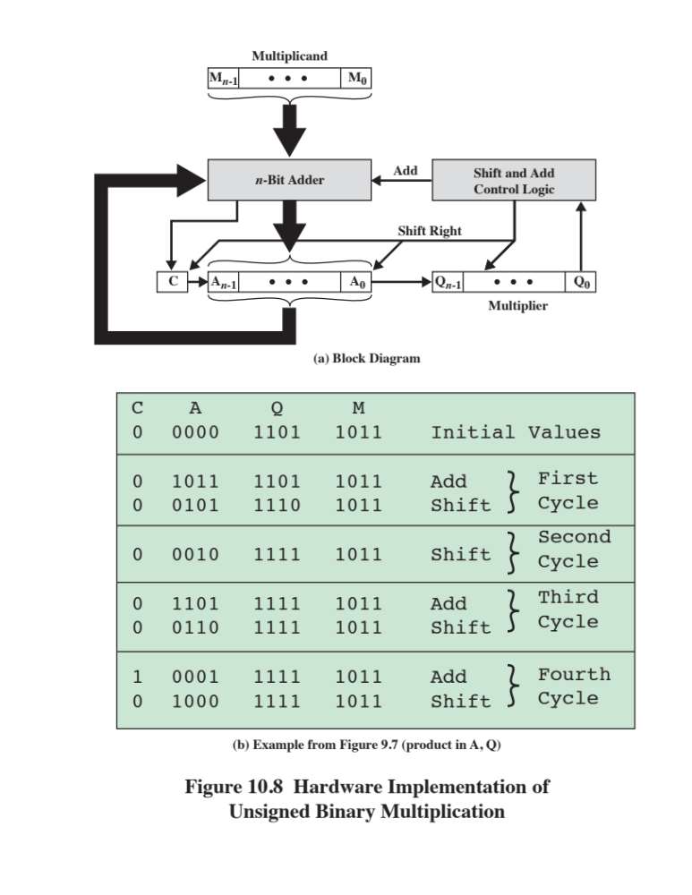
Notes:
Figure 10.8a shows a possible implementation employing these measures. The
multiplier and multiplicand are loaded into two registers (Q and M). A third register,
the A register, is also needed and is initially set to 0. There is also a 1-bit C register,
initialized to 0, which holds a potential carry bit resulting from addition.

Slide 63
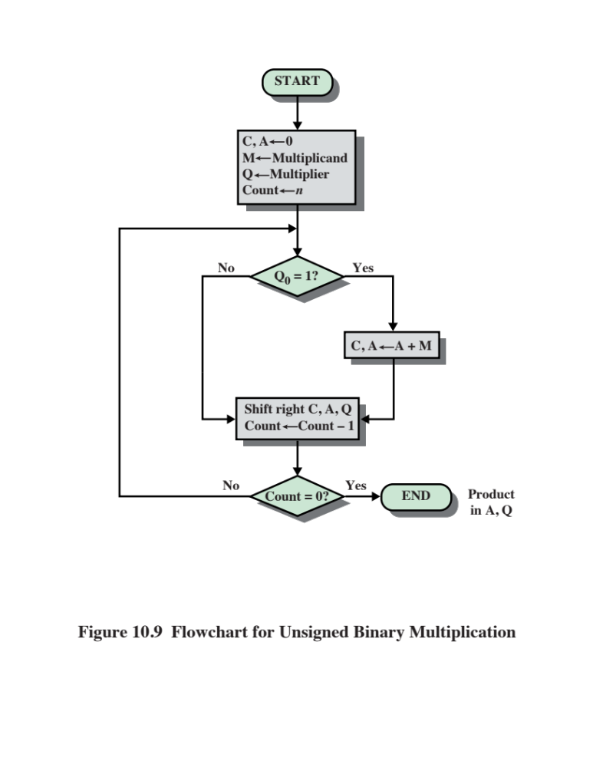
Notes:
The operation of the multiplier is as follows. Control logic reads the bits of the
multiplier one at a time. If Q₀ is 1, then the multiplicand is added to the A register
and the result is stored in the A register, with the C bit used for overflow. Then all
of the bits of the C, A, and Q registers are shifted to the right one bit, so that the C
bit goes into A_{n-1}, A₀ goes into Q_{n-1} and Q₀ is lost. If Q₀ is 0, then no addition is
performed, just the shift. This process is repeated for each bit of the original multiplier.
The resulting 2n-bit product is contained in the A and Q registers. A flowchart
of the operation is shown in Figure 10.9, and an example is given in Figure 10.8b.
Note that on the second cycle, when the multiplier bit is 0, there is no add operation.

Slide 64
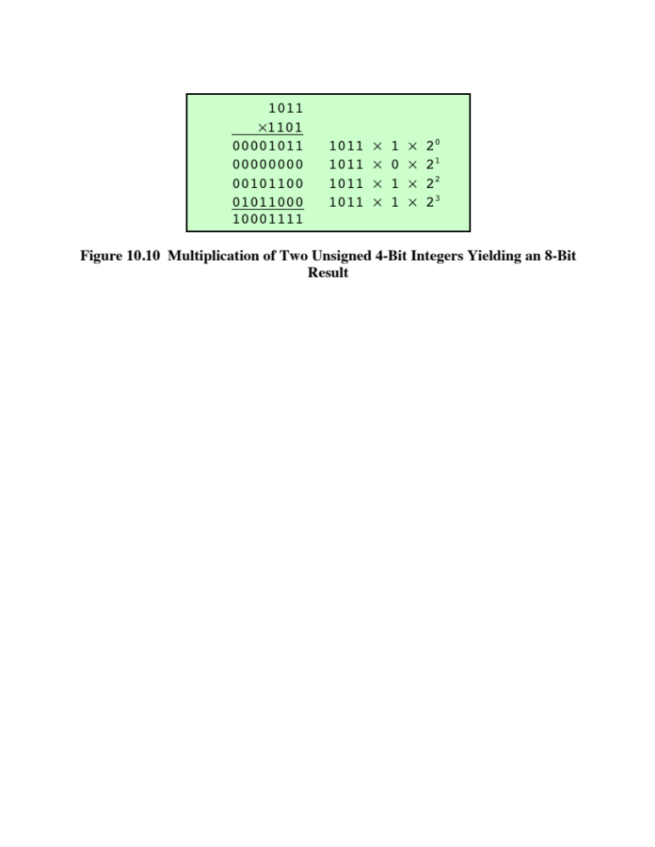
Notes:
Figure 10.10 recasts Figure 10.7 to make the generation of partial products by multiplication explicit.
The only difference in Figure 10.10 is that it recognizes that the partial products
should be viewed as 2n-bit numbers generated from the n-bit multiplicand.
Thus, as an unsigned integer, the 4-bit multiplicand 1011 is stored in an 8-bit
word as 00001011. Each partial product (other than that for 2⁰ ) consists of this number
shifted to the left, with the unoccupied positions on the right filled with zeros
(e.g., a shift to the left of two places yields 00101100).

Slide 65
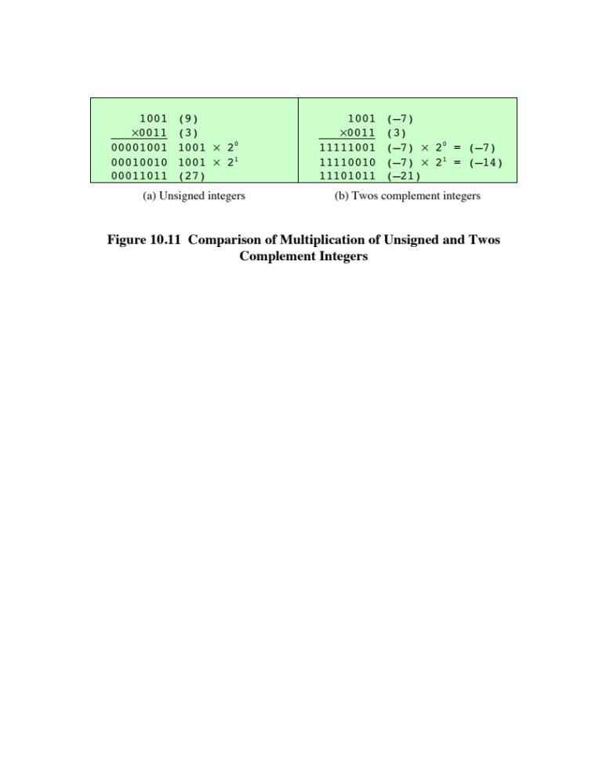
Notes:
Now we can demonstrate that straightforward multiplication will not work if
the multiplicand is negative. The problem is that each contribution of the negative
multiplicand as a partial product must be a negative number on a 2n-bit field; the sign
bits of the partial products must line up. This is demonstrated in Figure 10.11, which
shows that multiplication of 1001 by 0011. If these are treated as unsigned integers,
the multiplication of 9 * 3 = 27 proceeds simply. However, if 1001 is interpreted
as the twos complement value -7, then each partial product must be a negative
twos complement number of 2n (8) bits, as shown in Figure 10.11b. Note that this is
accomplished by padding out each partial product to the left with binary 1s.

Slide 66
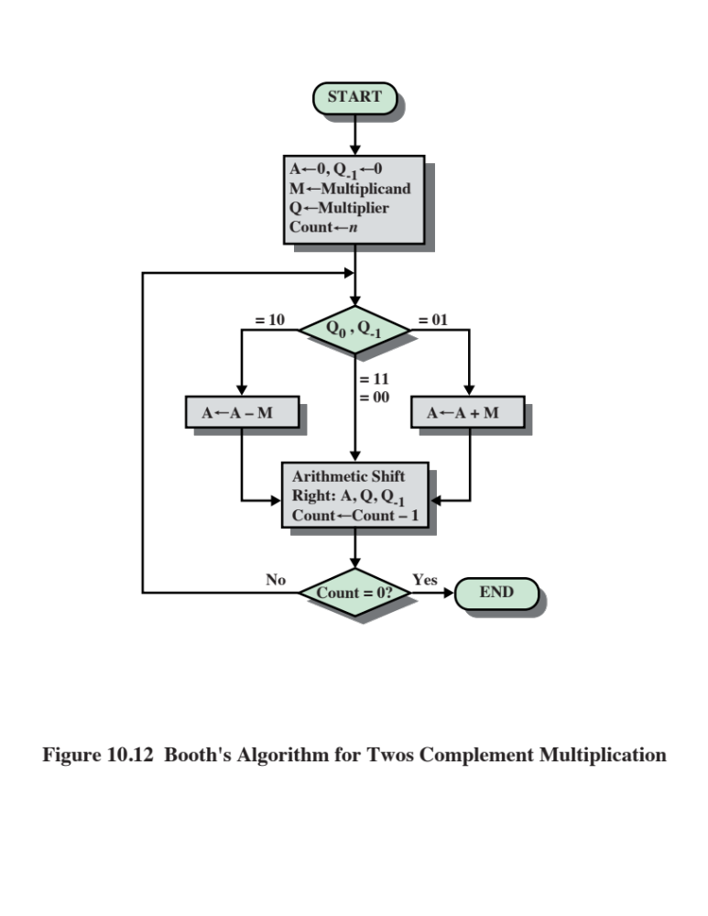
Notes:
There are a number of ways out of this dilemma. One would be to convert
both multiplier and multiplicand to positive numbers, perform the multiplication,
and then take the twos complement of the result if and only if the sign of the two
original numbers differed. Implementers have preferred to use techniques that
do not require this final transformation step. One of the most common of these is
Booth’s algorithm [BOOT51]. This algorithm also has the benefit of speeding up
the multiplication process, relative to a more straightforward approach.
Booth’s algorithm is depicted in Figure 10.12 and can be described as follows.
As before, the multiplier and multiplicand are placed in the Q and M registers,
respectively. There is also a 1-bit register placed logically to the right of the least
significant bit (Q₀) of the Q register and designated Q₋₁ its use is explained shortly.
The results of the multiplication will appear in the A and Q registers. A and Q₋₁
are initialized to 0. As before, control logic scans the bits of the multiplier one at a
time. Now, as each bit is examined, the bit to its right is also examined. If the two
bits are the same (1–1 or 0–0), then all of the bits of the A, Q, and Q₋₁ registers are
shifted to the right 1 bit. If the two bits differ, then the multiplicand is added to or
subtracted from the A register, depending on whether the two bits are 0–1 or 1–0.
Following the addition or subtraction, the right shift occurs. In either case, the right
shift is such that the leftmost bit of A, namely, A_{n-1} not only is shifted into A_{n-2},
but also remains in A_{n-1}. This is required to preserve the sign of the number in A
and Q. It is known as an arithmetic shift, because it preserves the sign bit.

Slide 67
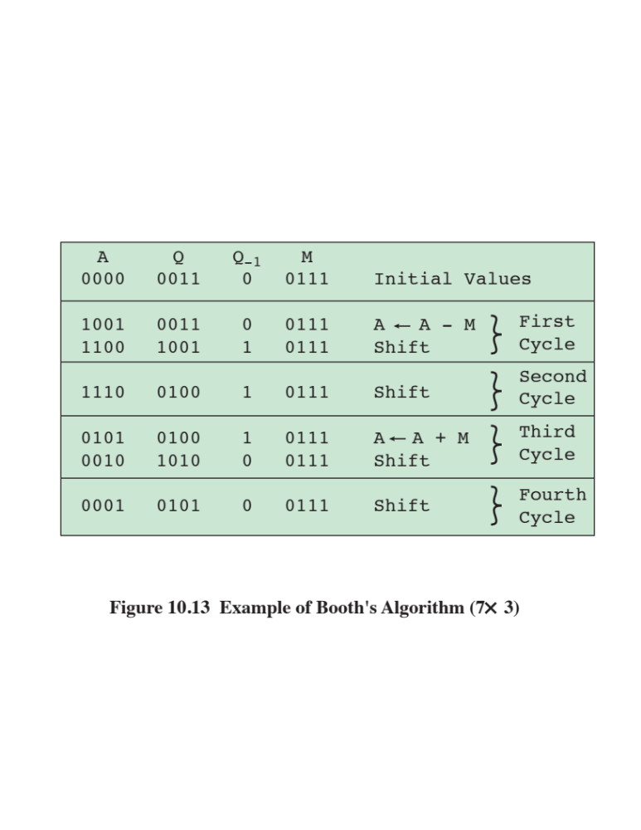
Notes:
Figure 10.13 shows the sequence of events in Booth’s algorithm for the multiplication
of 7 by 3.

Slide 68
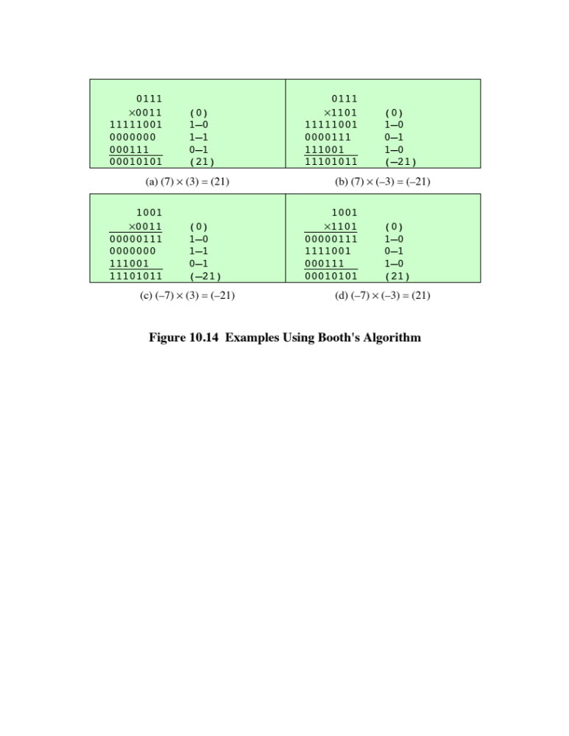
Notes:
More compactly, the same operation is depicted in Figure 10.14a.
The rest of Figure 10.14 gives other examples of the algorithm. As can be seen, it
works with any combination of positive and negative numbers. Note also the efficiency
of the algorithm. Blocks of 1s or 0s are skipped over, with an average of only
one addition or subtraction per block.

Slide 69
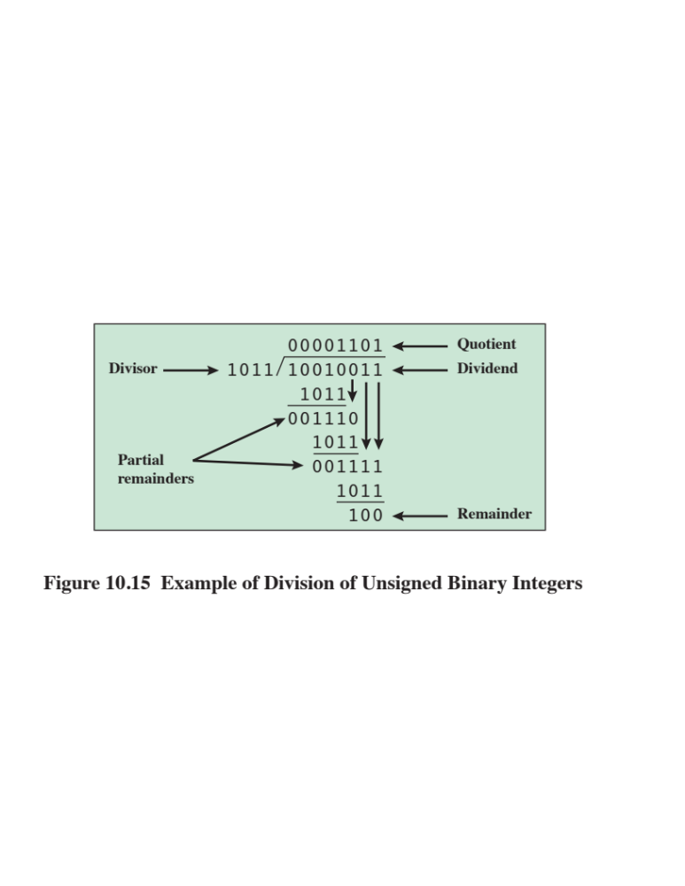
Notes:
Division is somewhat more complex than multiplication but is based on the same
general principles. As before, the basis for the algorithm is the paper-and-pencil
approach, and the operation involves repetitive shifting and addition or subtraction.
Figure 10.15 shows an example of the long division of unsigned binary integers.
It is instructive to describe the process in detail. First, the bits of the dividend
are examined from left to right, until the set of bits examined represents a number
greater than or equal to the divisor; this is referred to as the divisor being able to
divide the number. Until this event occurs, 0s are placed in the quotient from left
to right. When the event occurs, a 1 is placed in the quotient and the divisor is subtracted
from the partial dividend. The result is referred to as a partial remainder.
From this point on, the division follows a cyclic pattern. At each cycle, additional
bits from the dividend are appended to the partial remainder until the result is
greater than or equal to the divisor. As before, the divisor is subtracted from this
number to produce a new partial remainder. The process continues until all the bits
of the dividend are exhausted.

Slide 70
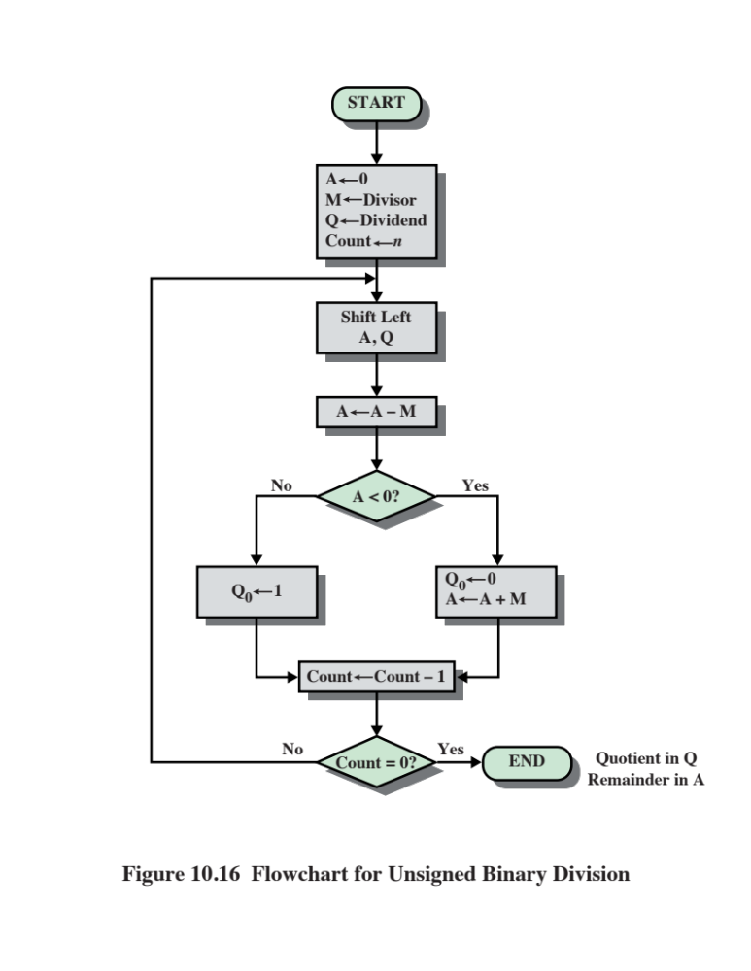
Notes:
Figure 10.16 shows a machine algorithm that corresponds to the long division
process. The divisor is placed in the M register, the dividend in the Q register. At
each step, the A and Q registers together are shifted to the left 1 bit. M is subtracted
from A to determine whether A divides the partial remainder.3 If it does, then Q0
gets a 1bit. Otherwise, Q0 gets a 0 bit and M must be added back to A to restore the
previous value. The count is then decremented, and the process continues for n steps.
At the end, the quotient is in the Q register and the remainder is in the A register.

Slide 71
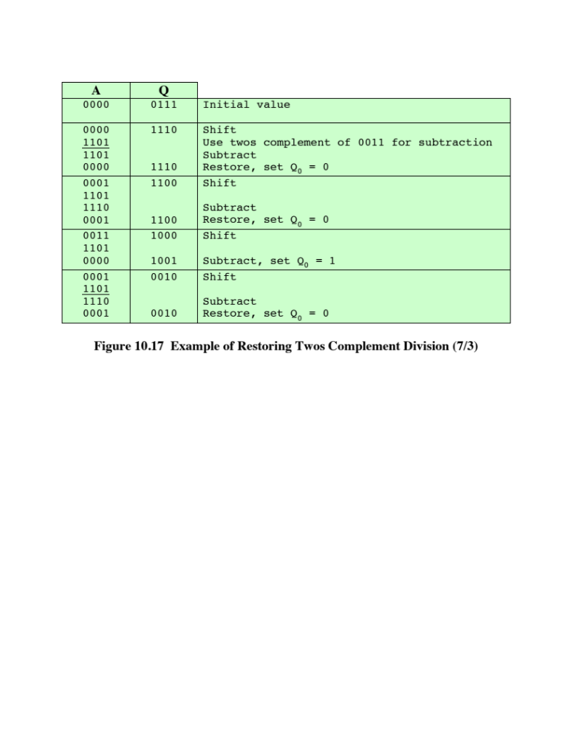
Notes:
This process can, with some difficulty, be extended to negative numbers. We
give here one approach for twos complement numbers. An example of this approach
is shown in Figure 10.17.
The reader will note from Figure 10.17 that ( - 7)/(3) and (7)/( - 3) produce
different remainders. We see that the magnitudes of Q and R are unaffected by the
input signs and that the signs of Q and R are easily derivable from the signs of D and
V. Specifically, sign(R ) = sign(D ) and sign(Q ) = sign(D ) * sign(V ). Hence, one
way to do twos complement division is to convert the operands into unsigned values
and, at the end, to account for the signs by complementation where needed. This is
the method of choice for the restoring division algorithm [PARH10].

Slide 72
Floating-Point Representation
Principles
With a fixed-point notation it is possible to represent a range of positive and negative integers centered on or near 0
By assuming a fixed binary or radix point, this format allows the representation of numbers with a fractional component as well
Limitations:
  Very large numbers cannot be represented nor can very small fractions
  The fractional part of the quotient in a division of two large numbers could be lost
Notes:
With a fixed-point notation (e.g., twos complement) it is possible to represent a
range of positive and negative integers centered on or near 0. By assuming a fixed
binary or radix point, this format allows the representation of numbers with a fractional
component as well.
This approach has limitations. Very large numbers cannot be represented, nor
can very small fractions. Furthermore, the fractional part of the quotient in a division
of two large numbers could be lost.
For decimal numbers, we get around this limitation by using scientific
notation. Thus, 976,000,000,000,000 can be represented as 9.76 * 10¹⁴ , and
0.0000000000000976 can be represented as 9.76 * 10-¹⁴ , What we have done, in
effect, is dynamically to slide the decimal point to a convenient location and use the
exponent of 10 to keep track of that decimal point. This allows a range of very large
and very small numbers to be represented with only a few digits.
This same approach can be taken with binary numbers.

Slide 73
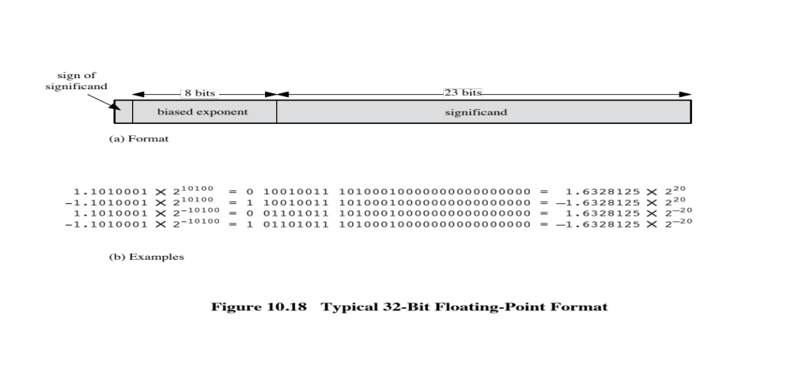
Notes:
The principles used in representing binary floating-point numbers are best
explained with an example. Figure 10.18a shows a typical 32-bit floating-point format.
The leftmost bit stores the sign of the number (0 = positive, 1 = negative).
The exponent value is stored in the next 8 bits. The representation used is known as
a biased representation. A fixed value, called the bias, is subtracted from the field
to get the true exponent value. Typically, the bias equals (2^{k-1} - 1), where k is the
number of bits in the binary exponent. In this case, the 8-bit field yields the numbers
0 through 255. With a bias of 127 (2⁷ - 1), the true exponent values are in the range
-127 to +128. In this example, the base is assumed to be 2.

Slide 74
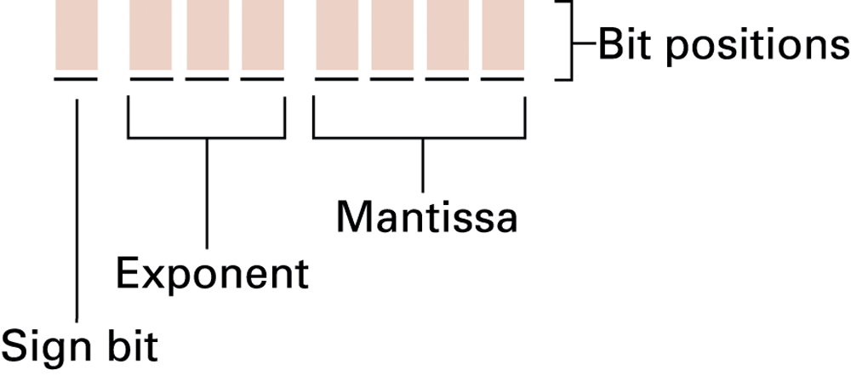
Floating-point notation

Slide 75
Floating-Point
Significand
The final portion of the word
Any floating-point number can be expressed in many ways
Normal number
  The most significant digit of the significand is nonzero
The following are equivalent, where the significand is expressed in binary form:
0.110 * 2⁵
110 * 2²
0.0110 * 2⁶
Notes:
Table 10.2 shows the biased representation for 4-bit integers. Note that when
the bits of a biased representation are treated as unsigned integers, the relative magnitudes
of the numbers do not change. For example, in both biased and unsigned
representations, the largest number is 1111 and the smallest number is 0000. This is
not true of sign-magnitude or twos complement representation. An advantage of
biased representation is that nonnegative floating-point numbers can be treated as
integers for comparison purposes.
The final portion of the word (23 bits in this case) is the significand.
Any floating-point number can be expressed in many ways.
To simplify operations on floating-point numbers, it is typically required that they
be normalized. A normal number is one in which the most significant digit of the
significand is nonzero. For base 2 representation, a normal number is therefore one
in which the most significant bit of the significand is one.

Slide 76
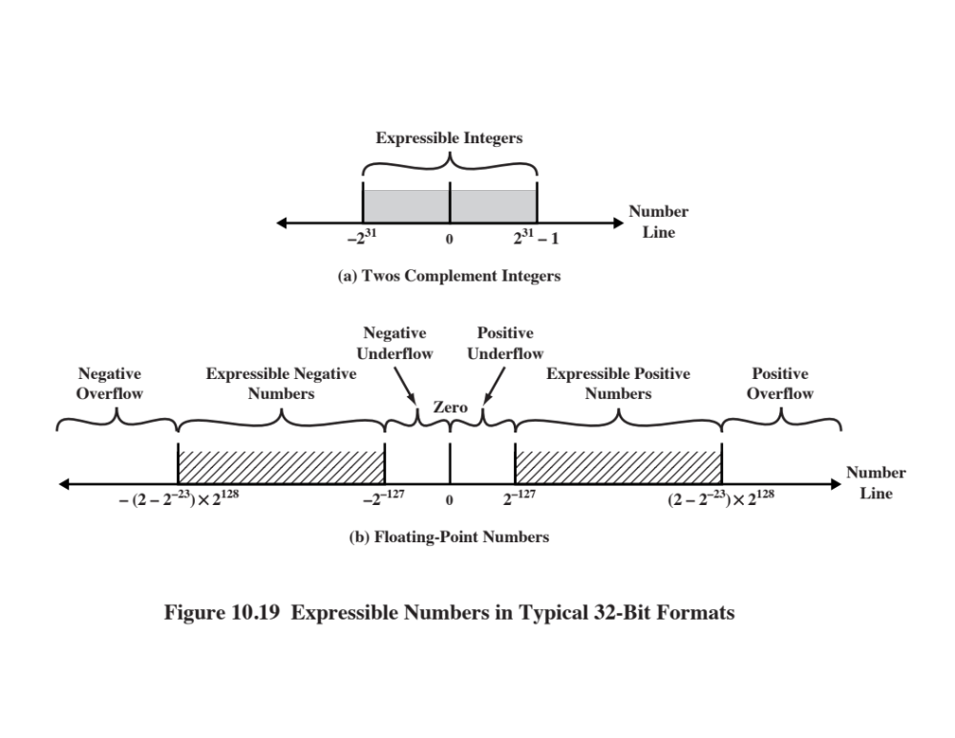
Notes:
Figure 10.19 indicates the range of numbers that can be represented
in a 32-bit word. Using twos complement integer representation, all of the
integers from -2³¹ to 2³¹ - 1 can be represented, for a total of 2³² different numbers.
With the example floating-point format of Figure 10.18, the following ranges
of numbers are possible:
• Negative numbers between -(2 - 2⁻²³) * 2¹²⁸ and -2⁻¹²⁷
• Positive numbers between 2⁻¹²⁷ and (2 - 2⁻²³) * 2¹²⁸
Five regions on the number line are not included in these ranges:
• Negative numbers less than -(2 - 2⁻²³) * 2¹²⁸, called negative overflow
• Negative numbers greater than 2⁻¹²⁷, called negative underflow
• Zero
• Positive numbers less than 2⁻¹²⁷, called positive underflow
• Positive numbers greater than (2 - 2⁻²³) * 2¹²⁸, called positive overflow
The representation as presented will not accommodate a value of 0.
However, as we shall see, actual floating-point representations include a special
bit pattern to designate zero. Overflow occurs when an arithmetic operation
results in an absolute value greater than can be expressed with an exponent of 128
(e.g., 2¹²⁰ * 2¹⁰⁰ = 2²²⁰). Underflow occurs when the fractional magnitude is too
small (e.g., 2⁻¹²⁰ * 2⁻¹⁰⁰ = 2⁻²²⁰). Underflow is a less serious problem because
the result can generally be satisfactorily approximated by 0.
It is important to note that we are not representing more individual values
with floating-point notation. The maximum number of different values that can be
represented with 32 bits is still 2³². What we have done is to spread those numbers
out in two ranges, one positive and one negative. In practice, most floating-point
numbers that one would wish to represent are represented only approximately.
However, for moderate sized integers, the representation is exact.

Slide 77
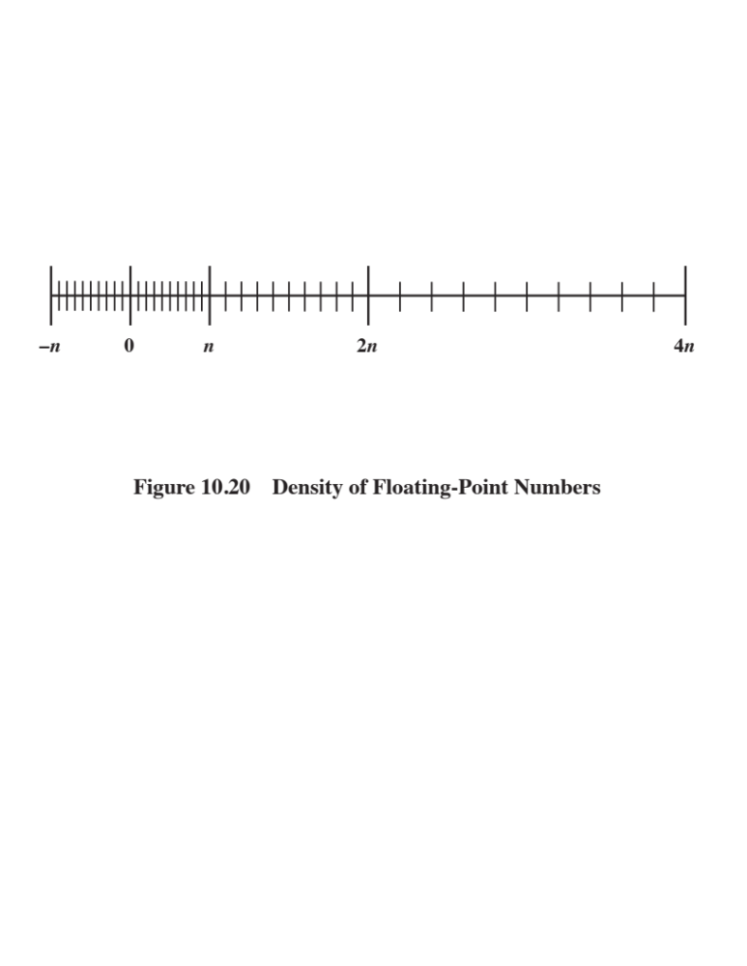
Notes:
Also, note that the numbers represented in floating-point notation are not
spaced evenly along the number line, as are fixed-point numbers. The possible values
get closer together near the origin and farther apart as you move away, as shown
in Figure 10.20. This is one of the trade-offs of floating-point math: Many calculations
produce results that are not exact and have to be rounded to the nearest value
that the notation can represent.
In the type of format depicted in Figure 10.18, there is a trade-off between
range and precision. The example shows 8 bits devoted to the exponent and 23 to
the significand. If we increase the number of bits in the exponent, we expand the
range of expressible numbers. But because only a fixed number of different values
can be expressed, we have reduced the density of those numbers and therefore the
precision. The only way to increase both range and precision is to use more bits.
Thus, most computers offer, at least, single-precision numbers and doubleprecision
numbers. For example, a processor could support a single-precision format of
64 bits, and a double-precision format of 128 bits.
So there is a trade-off between the number of bits in the exponent and the
number of bits in the significand. But it is even more complicated than that. The
implied base of the exponent need not be 2. The IBM S/390 architecture, for
example, uses a base of 16 [ANDE67b]. The format consists of a 7-bit exponent and
a 24-bit significand.
The advantage of using a larger exponent is that a greater range can be
achieved for the same number of exponent bits. But remember, we have not
increased the number of different values that can be represented. Thus, for a fixed
format, a larger exponent base gives a greater range at the expense of less precision.

Slide 78
IEEE Standard 754
Most important floating-point representation is defined
Standard was developed to facilitate the portability of programs from one processor to another and to encourage the development of sophisticated, numerically oriented programs
Standard has been widely adopted and is used on virtually all contemporary processors and arithmetic coprocessors
IEEE 754-2008 covers both binary and decimal floating-point representations
Notes:
The most important floating-point representation is defined in IEEE Standard 754,
adopted in 1985 and revised in 2008. This standard was developed to facilitate the
portability of programs from one processor to another and to encourage the development
of sophisticated, numerically oriented programs. The standard has been
widely adopted and is used on virtually all contemporary processors and arithmetic
coprocessors. IEEE 754-2008 covers both binary and decimal floating-point representations.
In this chapter, we deal only with binary representations.

Slide 79
IEEE 754-2008
Defines the following different types of floating-point formats:
Arithmetic format
  All the mandatory operations defined by the standard are supported by the format. The format may be used to represent floating-point operands or results for the operations described in the standard.
Basic format
  This format covers five floating-point representations, three binary and two decimal, whose encodings are specified by the standard, and which can be used for arithmetic. At least one of the basic formats is implemented in any conforming implementation.
Interchange format
  A fully specified, fixed-length binary encoding that allows data interchange between different platforms and that can be used for storage.
Notes:
IEEE 754-2008 defines the following different types of floating-point formats:
• Arithmetic format: All the mandatory operations defined by the standard are
supported by the format. The format may be used to represent floating-point
operands or results for the operations described in the standard.
• Basic format: This format covers five floating-point representations, three
binary and two decimal, whose encodings are specified by the standard, and
which can be used for arithmetic. At least one of the basic formats is implemented
in any conforming implementation.
• Interchange format: A fully specified, fixed-length binary encoding that allows
data interchange between different platforms and that can be used for storage.

Slide 80
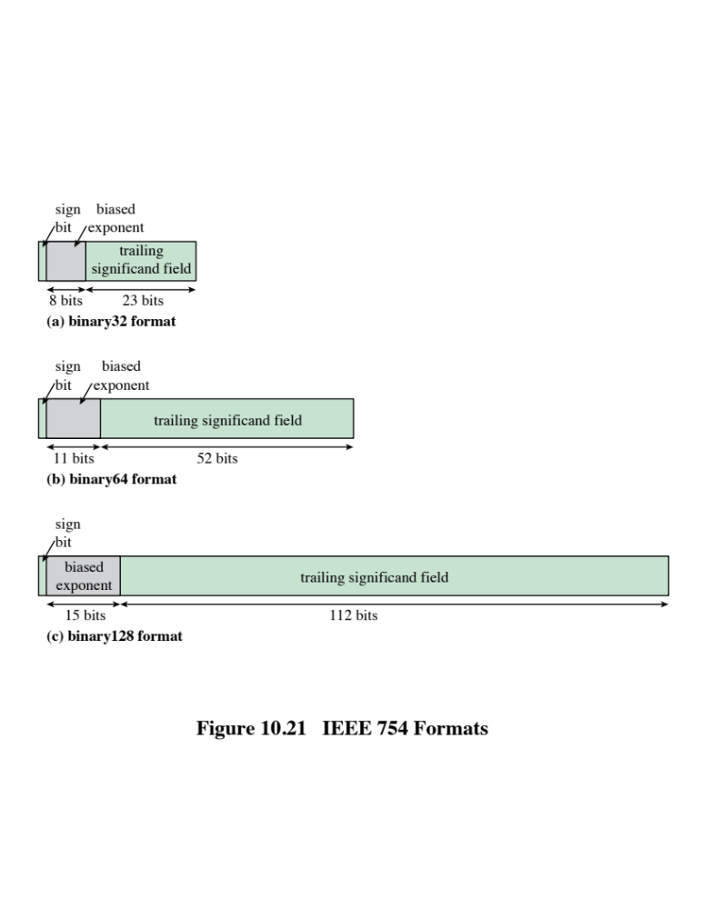
Notes:
The three basic binary formats have bit lengths of 32, 64, and 128 bits, with
exponents of 8, 11, and 15 bits, respectively (Figure 10.21).

Slide 81
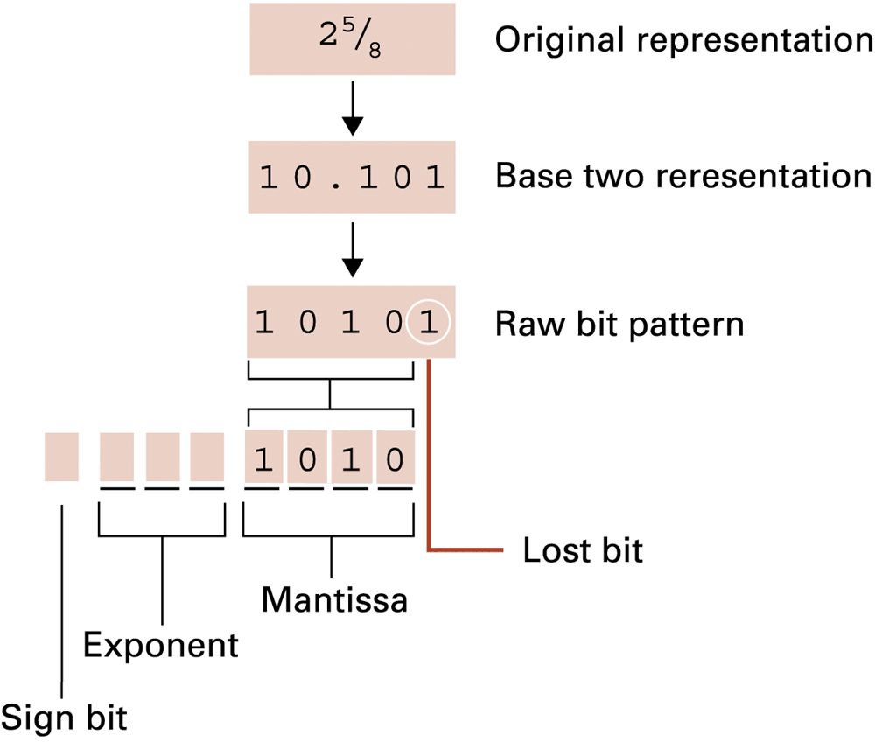
Example:
Encoding the value 2 5⁄8

Slide 82
Range of values in ieee floating point
Single precision range:
  2⁻¹²⁶ to 2¹²⁷ ≈ 10⁻³⁸ to 10³⁸
Double precision range:
  2⁻¹⁰²² to 2¹⁰²⁴ ≈ 10⁻³⁰⁸ to 10³⁰⁸

Slide 83
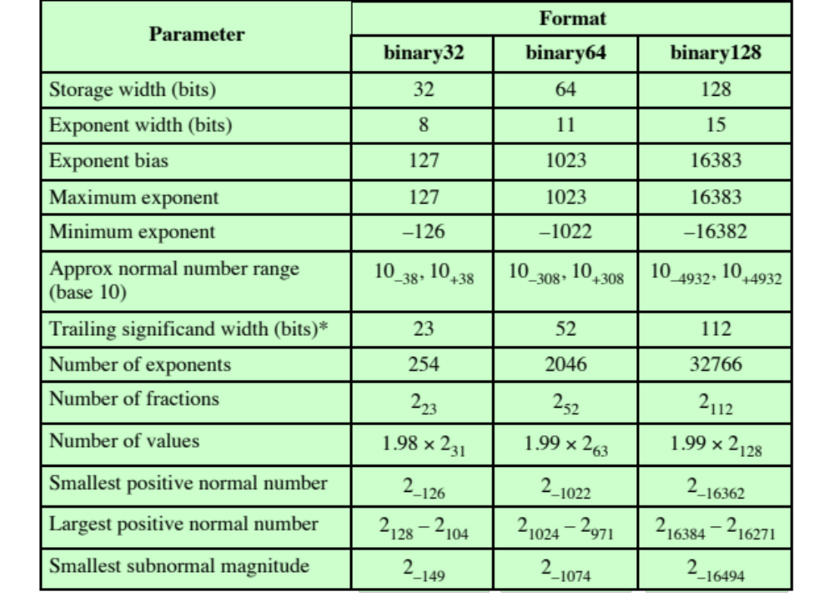
Table 10.3 IEEE 754 Format Parameters
* not including implied bit and not including sign bit
Notes:
Table 10.3 summarizes
the characteristics of the three formats. The two basic decimal formats have bit
lengths of 64 and 128 bits. All of the basic formats are also arithmetic format types
(can be used for arithmetic operations) and interchange format types (platform
independent).
Several other formats are specified in the standard. The binary16 format is
only an interchange format and is intended for storage of values when higher precision
is not required. The binary{k } format and the decimal{k } format are interchange
formats with total length k bits and with defined lengths for the significand
and exponent. The format must be a multiple of 32 bits; thus formats are defined for
k = 160, 192, and so on. These two families of formats are also arithmetic formats.

Slide 84

Additional Formats
Extended Precision Formats
Extendable Precision Format
Provide additional bits in the exponent (extended range) and in the significand (extended precision)
Lessens the chance of a final result that has been contaminated by excessive roundoff error
Lessens the chance of an intermediate overflow aborting a computation whose final result would have been representable in a basic format
Affords some of the benefits of a larger basic format without incurring the time penalty usually associated with higher precision
Precision and range are defined under user control
May be used for intermediate calculations but the standard places no constraint or format or length
Notes:
In addition, the standard defines extended precision formats, which
extend a supported basic format by providing additional bits in the exponent
(extended range) and in the significand (extended precision). The exact format
is implementation dependent, but the standard places certain constraints on the
length of the exponent and significand. These formats are arithmetic format types
but not interchange format types. The extended formats are to be used for intermediate
calculations. With their greater precision, the extended formats lessen the
chance of a final result that has been contaminated by excessive round-off error;
with their greater range, they also lessen the chance of an intermediate overflow
aborting a computation whose final result would have been representable in a basic
format. An additional motivation for the extended format is that it affords some
of the benefits of a larger basic format without incurring the time penalty usually
associated with higher precision.
Finally, IEEE 754-2008 defines an extendable precision format as a format
with a precision and range that are defined under user control. Again, these formats
may be used for intermediate calculations, but the standard places no constraint or
format or length.

Slide 85
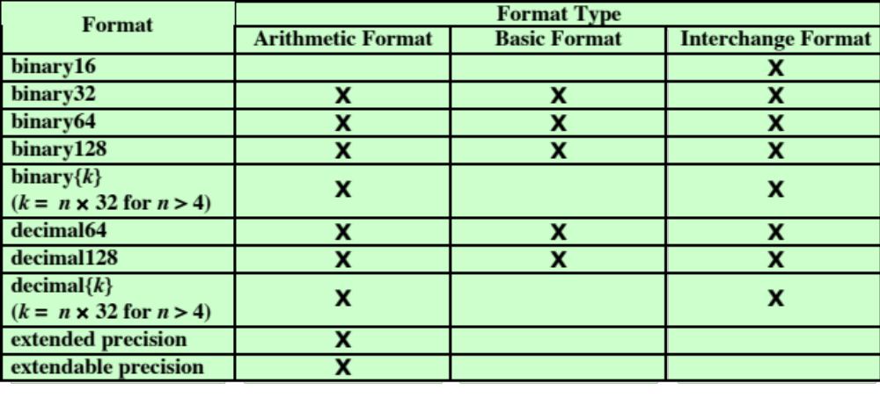
Table 10.4
IEEE Formats
Notes:
Table 10.4 shows the relationship between defined formats and format types.

Slide 86
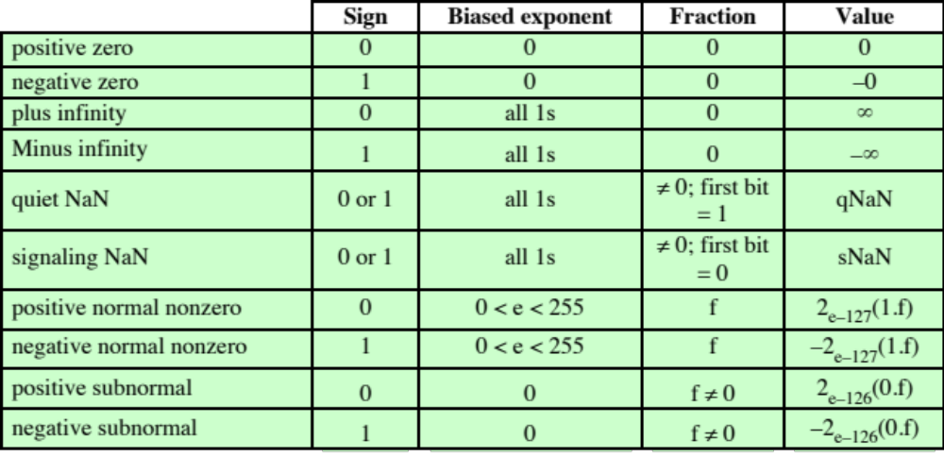
Table 10.5
Interpretation of IEEE 754 Floating-Point Numbers (page 1 of 3)
(a) binary32 format
Notes:
Not all bit patterns in the IEEE formats are interpreted in the usual way;
instead, some bit patterns are used to represent special values. Table 10.5 indicates
the values assigned to various bit patterns. The exponent values of all zeros (0 bits)
and all ones (1 bits) define special values.
The following classes of numbers are represented:
• For exponent values in the range of 1 through 254 for 32-bit format, 1 through
2046 for 64-bit format, and 1 through 16382, normal nonzero floating-point
numbers are represented. The exponent is biased, so that the range of exponents
is -126 through +127 for 32-bit format, and so on. A normal number
requires a 1 bit to the left of the binary point; this bit is implied, giving an
effective 24-bit, 53-bit, or 113-bit significand. Because one of the bits is implied,
the corresponding field in the binary format is referred to as the trailing
significand field.
• An exponent of zero together with a fraction of zero represents positive or
negative zero, depending on the sign bit. As was mentioned, it is useful to have
an exact value of 0 represented.
• An exponent of all ones together with a fraction of zero represents positive
or negative infinity, depending on the sign bit. It is also useful to have a representation
of infinity. This leaves it up to the user to decide whether to treat
overflow as an error condition or to carry the value and proceed with whatever
program is being executed.
• An exponent of zero together with a nonzero fraction represents a subnormal
number. In this case, the bit to the left of the binary point is zero and the true
exponent is -126 or -1022. The number is positive or negative depending on
the sign bit.
• An exponent of all ones together with a nonzero fraction is given the value
NaN, which means Not a Number, and is used to signal various exception
conditions.
The significance of subnormal numbers and NaNs is discussed in Section 10.5.

Slide 87
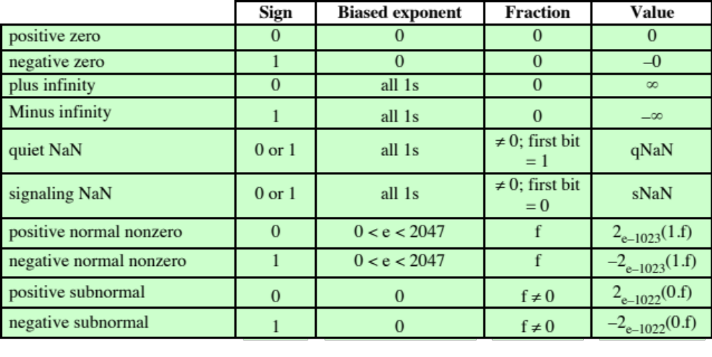
Table 10.5
Interpretation of IEEE 754 Floating-Point Numbers (page 2 of 3)
(a) binary64 format
Notes:
Table 10.5 continued.

Slide 88
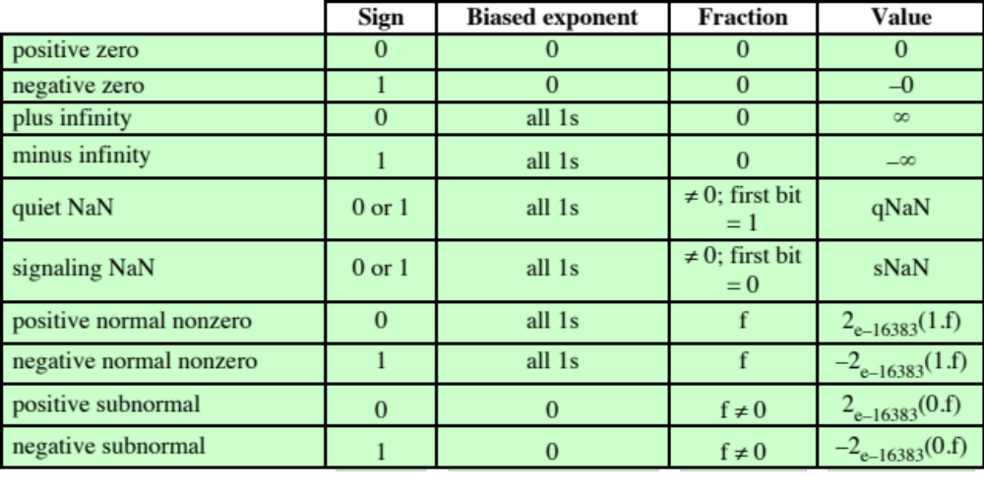
Table 10.5
Interpretation of IEEE 754 Floating-Point Numbers (page 3 of 3)
(a) binary128 format
Notes:
Table 10.5 continued.

Slide 89
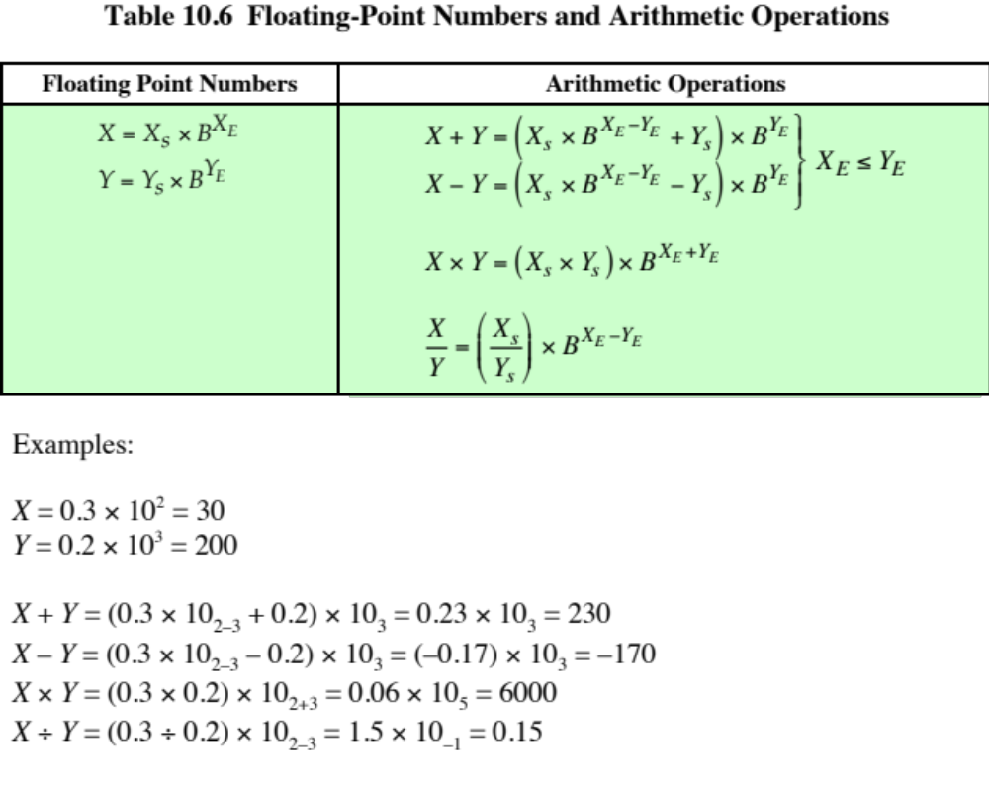
Notes:
Table 10.6 summarizes the basic operations for floating-point arithmetic. For addition
and subtraction, it is necessary to ensure that both operands have the same
exponent value. This may require shifting the radix point on one of the operands to
achieve alignment. Multiplication and division are more straightforward.
A floating-point operation may produce one of these conditions:
• Exponent overflow: A positive exponent exceeds the maximum possible exponent
value. In some systems, this may be designated as + ∞ or - ∞.
• Exponent underflow: A negative exponent is less than the minimum possible
exponent value (e.g., -200 is less than -127). This means that the number is
too small to be represented, and it may be reported as 0.
• Significand underflow: In the process of aligning significands, digits may flow
off the right end of the significand. As we shall discuss, some form of rounding
is required.
• Significand overflow: The addition of two significands of the same sign may
result in a carry out of the most significant bit. This can be fixed by realignment,
as we shall explain.

Slide 90

Notes:
In floating-point arithmetic, addition and subtraction are more complex than multiplication
and division. This is because of the need for alignment. There are four
basic phases of the algorithm for addition and subtraction:
1. Check for zeros.
2. Align the significands.
3. Add or subtract the significands.
4. Normalize the result.
A typical flowchart is shown in Figure 10.22. A step-by-step narrative highlights
the main functions required for floating-point addition and subtraction. We
assume a format similar to those of Figure 10.21. For the addition or subtraction
operation, the two operands must be transferred to registers that will be used by the
ALU. If the floating-point format includes an implicit significand bit, that bit must
be made explicit for the operation.
Phase 1: Zero check. Because addition and subtraction are identical except
for a sign change, the process begins by changing the sign of the subtrahend if
it is a subtract operation. Next, if either operand is 0, the other is reported as
the result.
Phase 2: Significand alignment. The next phase is to manipulate the numbers
so that the two exponents are equal.
Alignment may be achieved by shifting either the smaller number to the
right (increasing its exponent) or shifting the larger number to the left. Because
either operation may result in the loss of digits, it is the smaller number that is
shifted; any digits that are lost are therefore of relatively small significance. The
alignment is achieved by repeatedly shifting the magnitude portion of the significand
right 1 digit and incrementing the exponent until the two exponents are
equal. (Note that if the implied base is 16, a shift of 1 digit is a shift of 4 bits.) If this
process results in a 0 value for the significand, then the other number is reported
as the result. Thus, if two numbers have exponents that differ significantly, the
lesser number is lost.
Phase 3: Addition. Next, the two significands are added together, taking into
account their signs. Because the signs may differ, the result may be 0. There
is also the possibility of significand overflow by 1 digit. If so, the significand
of the result is shifted right and the exponent is incremented. An exponent
overflow could occur as a result; this would be reported and the operation
halted.
Phase 4: Normalization. The final phase normalizes the result. Normalization
consists of shifting significand digits left until the most significant digit (bit, or
4 bits for base-16 exponent) is nonzero. Each shift causes a decrement of the
exponent and thus could cause an exponent underflow. Finally, the result must
be rounded off and then reported. We defer a discussion of rounding until after
a discussion of multiplication and division.

Slide 91

Notes:
Floating-point multiplication and division are much simpler processes than addition
and subtraction, as the following discussion indicates.
We first consider multiplication, illustrated in Figure 10.23. First, if either
operand is 0, 0 is reported as the result. The next step is to add the exponents. If
the exponents are stored in biased form, the exponent sum would have doubled
the bias. Thus, the bias value must be subtracted from the sum. The result could
be either an exponent overflow or underflow, which would be reported, ending the
algorithm.
If the exponent of the product is within the proper range, the next step is to
multiply the significands, taking into account their signs. The multiplication is performed
in the same way as for integers. In this case, we are dealing with a sign-magnitude
representation, but the details are similar to those for twos complement
representation. The product will be double the length of the multiplier and multiplicand.
The extra bits will be lost during rounding.
After the product is calculated, the result is then normalized and rounded,
as was done for addition and subtraction. Note that normalization could result in
exponent underflow.

Slide 92

Notes:
Finally, let us consider the flowchart for division depicted in Figure 10.24.
Again, the first step is testing for 0. If the divisor is 0, an error report is issued,
or the result is set to infinity, depending on the implementation. A dividend of 0
results in 0. Next, the divisor exponent is subtracted from the dividend exponent.
This removes the bias, which must be added back in. Tests are then made for exponent
underflow or overflow.
The next step is to divide the significands. This is followed with the usual normalization
and rounding.

Slide 93

Notes:
We mentioned that, prior to a floating-point operation, the exponent
and significand of each operand are loaded into ALU registers. In the case of the
significand, the length of the register is almost always greater than the length of the
significand plus an implied bit. The register contains additional bits, called guard
bits, which are used to pad out the right end of the significand with 0s.
The reason for the use of guard bits is illustrated in Figure 10.25. Consider numbers in
the IEEE format, which has a 24-bit significand, including an implied 1 bit to the left of
the binary point. Two numbers that are very close in value are x = 1.00 . . . 00 * 2¹
and y = 1.11 . . . 11 * 2⁰. If the smaller number is to be subtracted from the larger,
it must be shifted right 1 bit to align the exponents. This is shown in Figure 10.25a. In the
process, y loses 1 bit of significance; the result is 2⁻²². The same operation is repeated in
part (b) with the addition of guard bits. Now the least significant bit is not lost due to alignment,
and the result is 2⁻²³, a difference of a factor of 2 from the previous answer. When
the radix is 16, the loss of precision can be greater. As Figures 10.25c and d show, the difference
can be a factor of 16.

Slide 94
Precision Considerations
Rounding
IEEE standard approaches:
  Round to nearest:
    The result is rounded to the nearest representable number.
  Round toward +∞ :
    The result is rounded up toward plus infinity.
  Round toward -∞:
    The result is rounded down toward negative infinity.
  Round toward 0:
    The result is rounded toward zero.
Notes:
Another detail that affects the precision of the result is the rounding
policy. The result of any operation on the significands is generally stored in a longer
register. When the result is put back into the floating-point format, the extra bits
must be eliminated in such a way as to produce a result that is close to the exact
result. This process is called rounding.
A number of techniques have been explored for performing rounding. In fact,
the IEEE standard lists four alternative approaches:
• Round to nearest: The result is rounded to the nearest representable number.
• Round toward +∞ : The result is rounded up toward plus infinity.
• Round toward -∞: The result is rounded down toward negative infinity.
• Round toward 0: The result is rounded toward zero.
Let us consider each of these policies in turn. Round to nearest is the default
rounding mode listed in the standard and is defined as follows: The representable
value nearest to the infinitely precise result shall be delivered.
The standard also addresses the special case of extra bits of the form 10000.…
Here the result is exactly halfway between the two possible representable values.
One possible technique here would be to always truncate, as this would be the simplest
operation. However, the difficulty with this simple approach is that it introduces
a small but cumulative bias into a sequence of computations. What is required
is an unbiased method of rounding. One possible approach would be to round up or
down on the basis of a random number so that, on average, the result would be unbiased.
The argument against this approach is that it does not produce predictable,
deterministic results. The approach taken by the IEEE standard is to force the result
to be even: If the result of a computation is exactly midway between two representable
numbers, the value is rounded up if the last representable bit is currently 1 and
not rounded up if it is currently 0.

Slide 95
Interval Arithmetic
Provides an efficient method for monitoring and controlling errors in floating-point computations by producing two values for each result
The two values correspond to the lower and upper endpoints of an interval that contains the true result
The width of the interval indicates the accuracy of the result
If the endpoints are not representable then the interval endpoints are rounded down and up respectively
If the range between the upper and lower bounds is sufficiently narrow then a sufficiently accurate result has been obtained
Minus infinity and rounding to plus are useful in implementing interval arithmetic
Truncation
Round toward zero
Extra bits are ignored
Simplest technique
A consistent bias toward zero in the operation
  Serious bias because it affects every operation for which there are nonzero extra bits
Notes:
The next two options, rounding to plus and minus infinity, are useful in implementing
a technique known as interval arithmetic. Interval arithmetic provides an
efficient method for monitoring and controlling errors in floating-point computations
by producing two values for each result. The two values correspond to the
lower and upper endpoints of an interval that contains the true result. The width of
the interval, which is the difference between the upper and lower endpoints, indicates
the accuracy of the result. If the endpoints of an interval are not representable,
then the interval endpoints are rounded down and up, respectively. Although
the width of the interval may vary according to implementation, many algorithms
have been designed to produce narrow intervals. If the range between the upper
and lower bounds is sufficiently narrow, then a sufficiently accurate result has been
obtained. If not, at least we know this and can perform additional analysis.
The final technique specified in the standard is round toward zero. This is,
in fact, simple truncation: The extra bits are ignored. This is certainly the simplest
technique. However, the result is that the magnitude of the truncated value is always
less than or equal to the more precise original value, introducing a consistent bias
toward zero in the operation. This is a serious bias because it affects every operation
for which there are nonzero extra bits.

Slide 96
IEEE Standard for Binary Floating-Point Arithmetic
Infinity
Is treated as the limiting case of real arithmetic, with the infinity values given the following interpretation:
  - ∞ < (every finite number) < + ∞
For example:
5 + (+ ∞ ) = + ∞ 5÷ (+ ∞ ) = +0
5 - (+ ∞ ) = - ∞ (+ ∞ ) + (+ ∞ ) = + ∞
5 + (- ∞ ) = - ∞ (- ∞ ) + (- ∞) = - ∞
5 - (- ∞ ) = + ∞ (- ∞ ) - (+ ∞ ) = - ∞
5 * (+ ∞ ) = + ∞ (+ ∞ ) - (- ∞ ) = + ∞
Notes:
IEEE 754 goes beyond the simple definition of a format to lay down specific practices
and procedures so that floating-point arithmetic produces uniform, predictable
results independent of the hardware platform. One aspect of this has already been
discussed, namely rounding. This subsection looks at three other topics: infinity,
NaNs, and subnormal numbers.
Infinity arithmetic is treated as the limiting case of real arithmetic, with
the infinity values given the following interpretation:
- ∞ < (every finite number) < + ∞
With the exception of the special cases discussed subsequently, any arithmetic
operation involving infinity yields the obvious result.

Slide 97

Table 10.7
Operations that Produce a Quiet NaN
Notes:
A NaN is a symbolic entity encoded in floating-point
format, of which there are two types: signaling and quiet. A signaling NaN
signals an invalid operation exception whenever it appears as an operand. Signaling
NaNs afford values for uninitialized variables and arithmetic-like enhancements
that are not the subject of the standard. A quiet NaN propagates through almost
every arithmetic operation without signaling an exception. Table 10.7 indicates
operations that will produce a quiet NaN.
Note that both types of NaNs have the same general format (Table 10.4): an
exponent of all ones and a nonzero fraction. The actual bit pattern of the nonzero
fraction is implementation dependent; the fraction values can be used to distinguish
quiet NaNs from signaling NaNs and to specify particular exception conditions.

Slide 98

Notes:
Subnormal numbers are included in IEEE 754 to handle
cases of exponent underflow. When the exponent of the result becomes too small
(a negative exponent with too large a magnitude), the result is subnormalized by
right shifting the fraction and incrementing the exponent for each shift until the
exponent is within a representable range.
Figure 10.26 illustrates the effect of including subnormal numbers. The representable
numbers can be grouped into intervals of the form [2^{n}, 2^{n+1}]. Within each
such interval, the exponent portion of the number remains constant while the fraction
varies, producing a uniform spacing of representable numbers within the interval. As
we get closer to zero, each successive interval is half the width of the preceding interval
but contains the same number of representable numbers. Hence the density of
representable numbers increases as we approach zero. However, if only normal numbers
are used, there is a gap between the smallest normal number and 0. In the case of
the 32-bit IEEE 754 format, there are 2²³ representable numbers in each interval, and
the smallest representable positive number is 2⁻¹²⁶. With the addition of subnormal
numbers, an additional 2²³ - 1 numbers are uniformly added between 0 and 2⁻¹²⁶.
The use of subnormal numbers is referred to as gradual underflow [COON81].
Without subnormal numbers, the gap between the smallest representable nonzero
number and zero is much wider than the gap between the smallest representable
nonzero number and the next larger number. Gradual underflow fills in that gap
and reduces the impact of exponent underflow to a level comparable with roundoff
among the normal numbers.

Slide 99
Summary
Computer
Arithmetic
  Integer arithmetic
  Negation
  Addition and subtraction
  Multiplication
  Division
  Floating-point arithmetic
  Addition and subtraction
  Multiplication and division
  Precision consideration
  IEEE standard for binary floating-point arithmetic
ALU
Integer representation
  Sign-magnitude representation
  Twos complement representation
  Range extension
  Fixed-point representation
  Floating-point representation
  Principles
  IEEE standard for binary floating-point representation
Notes:
Chapter 10 summary.

Slide 100
Part 3
Digital Logic

Slide 101
Learning Objectives
Reprise Boolean algebra
Remember the working principles of logic gates
Use combinational logic to implement Boolean functions
Use combinational logic to design multiplexers, decoders, RAMs, adders etc.
Design sequential circuits
Devise programmable logic devices like PLAs, FPGAs

Slide 102
Outline
Digital Logic
Boolean Algebra
Gates
Combinational Circuits
  Implementation of Boolean Functions
  Multiplexers
  Decoders
  Read-Only-Memory
  Adders
  Sequential Circuits
  Flip-Flops
  Registers
  Counters
  Programmable Logic Devices
  Programmable Logic Array
  Field-Programmable Gate Array
Notes:
Chapter 2 summary.

Slide 103
Boolean Algebra
Mathematical discipline used to design and analyze the behavior of the digital circuitry in digital computers and other digital systems
Named after George Boole
  English mathematician
  Proposed basic principles of the algebra in 1854
  Claude Shannon suggested Boolean algebra could be used to solve problems in relay-switching circuit design
  Is a convenient tool:
  Analysis
    It is an economical way of describing the function of digital circuitry
  Design
    Given a desired function, Boolean algebra can be applied to develop a simplified implementation of that function
Notes:
2
The digital circuitry in digital computers and other digital systems is designed, and its behavior is analyzed, with the use of a mathematical discipline known as Boolean algebra. The name is in honor of an English mathematician George Boole, who proposed the basic principles of this algebra in 1854 in his treatise, An Investigation of the Laws of Thought on Which to Found the Mathematical Theories of Logic and Probabilities. In 1938, Claude Shannon, a research assistant in the Electrical Engineering Department at M.I.T., suggested that Boolean algebra could be used to solve problems in relay-switching circuit design [SHAN38]. Shannon’s techniques were subsequently used in the analysis and design of electronic digital circuits. Boolean algebra turns out to be a convenient tool in two areas:
• Analysis: It is an economical way of describing the function of digital circuitry.
• Design: Given a desired function, Boolean algebra can be applied to develop a simplified implementation of that function.

Slide 104
Boolean Variables and Operations
Makes use of variables and operations
  Are logical
  A variable may take on the value 1 (TRUE) or 0 (FALSE)
  Basic logical operations are AND, OR, and NOT
  AND
  Yields true (binary value 1) if and only if both of its operands are true
  In the absence of parentheses the AND operation takes precedence over the OR operation
  When no ambiguity will occur the AND operation is represented by simple concatenation instead of the dot operator
  OR
  Yields true if either or both of its operands are true
  NOT
  Inverts the value of its operand
Notes:
3
As with any algebra, Boolean algebra makes use of variables and operations. In this case, the variables and operations are logical variables and operations. Thus, a variable may take on the value 1 (TRUE) or 0 (FALSE). The basic logical operations
are AND, OR, and NOT, which are symbolically represented by dot, plus sign, and overbar:
A AND B = A * B
A OR B = A + B
NOT A = Ā
The operation AND yields true (binary value 1) if and only if both of its operands are true. The operation OR yields true if either or both of its operands are true. The unary operation NOT inverts the value of its operand.
In the absence of parentheses, the AND operation takes precedence over the OR operation. Also, when no ambiguity will occur, the AND operation is represented by simple concatenation instead of the dot operator.

Slide 105
Bits and Bit Patterns
Bit: Binary Digit (0 or 1)
Bit Patterns are used to represent information.
  Numbers
  Text characters
  Images
  Sound
  And others

Slide 106
Boolean Operations
Boolean Operation: An operation that manipulates one or more true/false values
Specific operations
  AND
  OR
  XOR (exclusive or)
  NOT

Slide 107

Boolean operations:
AND, OR, XOR (exclusive or)

Slide 108


Table 11.1 Boolean Operators
(a) Boolean Operators of Two Input Variables
Notes:
4
Table 11.1a defines the basic logical operations in a form known as a truth table, which lists the value of an operation for every possible combination of values of operands. The table also lists three other useful operators: XOR, NAND, and NOR. The exclusive-or (XOR) of two logical operands is 1 if and only if exactly one of the operands has the value 1. The NAND function is the complement (NOT) of
the AND function, and the NOR is the complement of OR.
As we shall see, these three new operations can be useful in implementing certain digital circuits.
The logical operations, with the exception of NOT, can be generalized to more than two variables, as shown in Table 11.1b.

Slide 109

Table 11.2
Basic Identities of Boolean Algebra
Notes:
4
Table 11.2 summarizes key identities of Boolean algebra. The equations have been arranged in two columns to show the complementary, or dual, nature of the AND and OR operations. There are two classes of identities: basic rules (or postulates), which are stated without proof, and other identities that can be derived from the basic postulates. The postulates define the way in which Boolean expressions are interpreted.

Slide 110
Gates
Gate: A device that computes a Boolean operation
  Often implemented as (small) electronic circuits
  Provide the building blocks from which computers are constructed

Slide 111

Notes:
The fundamental building block of all digital logic circuits is the gate. Logical functions are implemented by the interconnection of gates.
A gate is an electronic circuit that produces an output signal that is a simple Boolean operation on its input signals. The basic gates used in digital logic are AND, OR, NOT, NAND, NOR, and XOR. Figure 11.1 depicts these six gates. Each gate is defined in three ways: graphic symbol, algebraic notation, and truth table. The symbology used in this chapter is from the IEEE standard, IEEE Std 91. Note that the inversion (NOT) operation is indicated by a circle.
Each gate shown in Figure 11.1 has one or two inputs and one output. However, as indicated in Table 11.1b, all of the gates except NOT can have more than two inputs. Thus, (X + Y + Z) can be implemented with a single OR gate with three inputs. When one or more of the values at the input are changed, the correct output signal appears almost instantaneously, delayed only by the propagation time of signals through the gate (known as the gate delay). The significance of this delay is discussed in Section 11.3. In some cases, a gate is implemented with two outputs, one output being the negation of the other output.
Here we introduce a common term: we say that to assert a signal is to cause a signal line to make a transition from its logically false (0) state to its logically true (1) state. The true (1) state is either a high or low voltage state, depending on the type of electronic circuitry.
Typically, not all gate types are used in implementation. Design and fabrication are simpler if only one or two types of gates are used. Thus, it is important to identify functionally complete sets of gates. This means that any Boolean function can be implemented using only the gates in the set. The following are functionally complete sets:
AND, OR, NOT
AND, NOT
OR, NOT
NAND
NOR
It should be clear that AND, OR, and NOT gates constitute a functionally complete set, because they represent the three operations of Boolean algebra. For the AND and NOT gates to form a functionally complete set, there must be a way to synthesize the OR operation from the AND and NOT operations. This can be done by applying DeMorgan’s theorem.
Similarly, the OR and NOT operations are functionally complete because they can be used to synthesize the AND operation.

Slide 112

AND, OR, XOR, and NOT gates And their input and output values

Slide 113

Notes:
Figure 11.2 shows how the AND, OR, and NOT functions can be implemented solely with NAND gates.

Slide 114

Notes:
Figure 11.3 shows the same thing for NOR gates. For this reason, digital circuits can be, and frequently are, implemented solely with NAND gates or solely with NOR gates.
With gates, we have reached the most primitive circuit level of computer hardware. An examination of the transistor combinations used to construct gates departs from that realm and enters the realm of electrical engineering. For our purposes, however, we are content to describe how gates can be used as building blocks to implement the essential logical circuits of a digital computer.

Slide 115
Combinational Circuit
An interconnected set of gates whose output at any time is a function only of the input at that time
The appearance of the input is followed almost immediately by the appearance of the output, with only gate delays
Consists of n binary inputs and m binary outputs
Can be defined in three ways:
Truth table
For each of the 2^{n} possible combinations of input signals, the binary value of each of the m output signals is listed
Graphical symbols
The interconnected layout of gates is depicted
Boolean equations
Each output signal is expressed as a Boolean function of its input signals
Notes:
A combinational circuit is an interconnected set of gates whose output at any time is a function only of the input at that time. As with a single gate, the appearance of the input is followed almost immediately by the appearance of the output, with only gate delays.
In general terms, a combinational circuit consists of n binary inputs and m binary outputs. As with a gate, a combinational circuit can be defined in three ways:
Truth table: For each of the 2^{n} possible combinations of input signals, the binary value of each of the m output signals is listed.
Graphical symbols: The interconnected layout of gates is depicted.
Boolean equations: Each output signal is expressed as a Boolean function of
its input signals.

Slide 116

Table 11.3
A Boolean Function of Three Variables
Notes:
Any Boolean function can be implemented in electronic form as a network of gates. For any given function, there are a number of alternative realizations. Consider the Boolean function represented by the truth table in Table 11.3.
There are three combinations of input values that cause F to be 1, and if any one of these combinations occurs, the result is 1. This form of expression, for self- evident reasons, is known as the sum of products (SOP) form.

Slide 117

Notes:
Figure 11.4 shows a straightforward implementation with AND, OR, and NOT gates.

Slide 118

Notes:
Product of sums (POS) form, which is illustrated in Figure 11.5. For clarity, NOT gates are not shown. Rather, it is assumed that each input signal and its complement are available. This simplifies the logic diagram and makes the inputs to the gates more readily apparent.
Thus, a Boolean function can be realized in either SOP or POS form. At this point, it would seem that the choice would depend on whether the truth table contains more 1s or 0s for the output function: The SOP has one term for each 1, and the POS has one term for each 0. However, there are other considerations:
It is often possible to derive a simpler Boolean expression from the truth table than either SOP or POS
It may be preferable to implement the function with a single gate type (NAND or NOR)
The significance of the first point is that, with a simpler Boolean expression, fewer gates will be needed to implement the function. Three methods that can be used to achieve simplification are
• Algebraic simplification
• Karnaugh maps
• Quine–McCluskey tables

Slide 119

Notes:
Algebraic simplification involves the application of the identities of Table 11.2 to reduce the Boolean expression to one with fewer elements.
For example, consider again Equation (11.1).
This expression can be implemented as shown in Figure 11.6. The simplification of Equation (11.1) was done essentially by observation. For more complex expressions, some more systematic approach is needed.

Slide 120

Notes:
For purposes of simplification, the Karnaugh map is a convenient way of representing a Boolean function of a small number (up to four) of variables. The map is an array of 2^{n} squares, representing all possible combinations of values of n binary variables. Figure 11.7a shows the map of four squares for a function of two variables. It is essential for later purposes to list the combinations in the order 00, 01, 11, 10. Because the squares corresponding to the combinations are to be used for recording information, the combinations are customarily written above the squares. In the case of three variables, the representation is an arrangement of eight squares (Figure 11.7b), with the values for one of the variables to the left and for the other two variables above the squares. For four variables, 16 squares are needed, with the arrangement indicated in Figure 11.7c.
The map can be used to represent any Boolean function in the following way. Each square corresponds to a unique product in the sum-of-products form, with a 1 value corresponding to the variable and a 0 value corresponding to the NOT of that variable. For each such product in the function, 1 is placed in the corresponding square. Given the truth table of a Boolean function, it is an easy matter to construct the map: for each combination of values of variables that produce a result of 1 in the truth table, fill in the corresponding square of the map with 1. Figure 11.7b shows the result for the truth table of Table 11.3. To convert from a Boolean expression to a map, it is first necessary to put the expression into what is referred to as canonical form: each term in the expression must contain each variable. So, for example, if we have Equation (11.3), we must first expand it into the full form of Equation (11.1) and then convert this to a map.
The labeling used in Figure 11.7d emphasizes the relationship between variables and the rows and columns of the map. Here the two rows embraced by the symbol A are those in which the variable A has the value 1; the rows not embraced by the symbol A are those in which A is 0; similarly for B, C, and D.

Slide 121

Notes:
Once the map of a function is created, we can often write a simple algebraic expression for it by noting the arrangement of the 1s on the map. The principle is as follows. Any two squares that are adjacent differ in only one of the variables. If two adjacent squares both have an entry of one, then the corresponding product terms differ in only one variable. In such a case, the two terms can be merged by eliminating that variable.
This process can be extended in several ways. First, the concept of adjacency can be extended to include wrapping around the edge of the map. Thus, the top square of a column is adjacent to the bottom square, and the leftmost square of a row is adjacent to the rightmost square. These conditions are illustrated in Figures 11.8b and c. Second, we can group not just 2 squares but 2^{n} adjacent squares (i.e., 2, 4, 8, etc.). The next three examples in Figure 11.8 show groupings of 4 squares. Note that in this case, two of the variables can be eliminated. The last three examples show groupings of 8 squares, which allow three variables to be eliminated.
We can summarize the rules for simplification as follows:
1. Among the marked squares (squares with a 1), find those that belong to a unique largest block of 1, 2, 4, or 8 and circle those blocks.
2. Select additional blocks of marked squares that are as large as possible and as few in number as possible, but include every marked square at least once. The results may not be unique in some cases. For example, if a marked square combines with exactly two other squares, and there is no fourth marked square to complete a larger group, then there is a choice to be made as two which of the two groupings to choose. When you are circling groups, you are allowed to use the same 1 value more than once.
3. Continue to draw loops around single marked squares, or pairs of adjacent marked squares, or groups of four, eight, and so on in such a way that every marked square belongs to at least one loop; then use as few of these blocks as possible to include all marked squares.

Slide 122

Notes:
Figure 11.9a, based on Table 11.3, illustrates the simplification process. If any
isolated 1s remain after the groupings, then each of these is circled as a group of 1s.
Finally, before going from the map to a simplified Boolean expression, any group of 1s that is completely overlapped by other groups can be eliminated. This is shown in Figure 11.9b. In this case, the horizontal group is redundant and may be ignored in creating the Boolean expression.
One additional feature of Karnaugh maps needs to be mentioned. In some cases, certain combinations of values of variables never occur, and therefore the corresponding output never occurs. These are referred to as “don’t care” conditions. For each such condition, the letter “d” is entered into the corresponding square of the map. In doing the grouping and simplification, each “d” can be treated as a 1 or 0, whichever leads to the simplest expression.

Slide 123

Table 11.4
Truth Table for the One-Digit Packed
Decimal Incrementer
Table 11.4 Truth Table for the One-Digit Packed Decimal Incrementer
Notes:
Table 11.4 shows the truth table for producing a 4-bit result that is one more than a 4-bit BCD input. The addition is modulo 10. Thus, 9 + 1 = 0. Also, note that six of the input codes produce “don’t care” results, because those are not valid BCD inputs.

Slide 124

Notes:
Figure 11.10 shows the resulting Karnaugh maps for each of the output variables. The d squares are used to achieve the best possible groupings.

Slide 125

Table 11.5
First Stage of Quine-McCluskey Method
(for F = ABCD + AB D + AB + A CD + BCD + BC + B D + D)
Notes:
For more than four variables, the Karnaugh map method becomes increasingly cumbersome. With five variables, two 16 * 16 maps are needed, with one map considered to be on top of the other in three dimensions to achieve adjacency. Six variables require the use of four 16 * 16 tables in four dimensions! An alternative approach is a tabular technique, referred to as the Quine–McCluskey method. The method is suitable for programming on a computer to give an automatic tool for producing minimized Boolean expressions.
The first step is to construct a table in which each row corresponds to one of the product terms of the expression. The terms are grouped according to the number of complemented variables. That is, we start with the term with no complements, if it exists, then all terms with one complement, and so on. Table 11.5 shows the list for our example expression, with horizontal lines used to indicate the grouping. For clarity, each term is represented by a 1 for each uncomplemented variable and a 0 for each complemented variable. Thus, we group terms according to the number of 1s they contain. The index column is simply the decimal equivalent and is useful in what follows.
The next step is to find all pairs of terms that differ in only one variable, that is, all pairs of terms that are the same except that one variable is 0 in one of the terms and 1 in the other. Because of the way in which we have grouped the terms, we can do this by starting with the first group and comparing each term of the first group with every term of the second group. Then compare each term of the second group with all of the terms of the third group, and so on. Whenever a match is found, place a check next to each term, combine the pair by eliminating the variable that differs in the two terms, and add that to a new list. This process continues until the entire original table has been examined.
The new table is organized into groups, as indicated, in the same fashion as the first table. The second table is then processed in the same manner as the first. That is, terms that differ in only one variable are checked and a new term produced for a third table. In this example, the third table that is produced contains only one term: BD.
In general, the process would proceed through successive tables until a table with no matches was produced. In this case, this has involved three tables.

Slide 126

Table 11.6
Last Stage of Quine-McCluskey Method
(for F = ABCD + AB D + AB + A CD + BCD + BC + B D + D)
Notes:
Once the process just described is completed, we have eliminated many of the possible terms of the expression. Those terms that have not been eliminated are used to construct a matrix, as illustrated in Table 11.6. Each row of the matrix corresponds to one of the terms that have not been eliminated (has no check) in any of the tables used so far. Each column corresponds to one of the terms in the original expression. An X is placed at each intersection of a row and a column such that the row element is “compatible” with the column element. That is, the variables present in the row element have the same value as the variables present in the column element. Next, circle each X that is alone in a column. Then place a square around each X in any row in which there is a circled X. If every column now has either a squared or a circled X, then we are done, and those row elements whose Xs have been marked constitute the minimal expression.
In cases in which some columns have neither a circle nor a square, additional processing is required. Essentially, we keep adding row elements until all columns are covered.

Slide 127

Notes:
Another consideration in the implementation of Boolean functions concerns the types of gates used. It is sometimes desirable to implement a Boolean function solely with NAND gates or solely with NOR gates. Although this may not be the minimum-gate implementation, it has the advantage of regularity, which can simplify the manufacturing process.

Slide 128

Notes:
The multiplexer connects multiple inputs to a single output. At any time, one of the inputs is selected to be passed to the output. A general block diagram representation is shown in Figure 11.12. This represents a 4-to-1 multiplexer. There are four input lines, labeled D0, D1, D2, and D3. One of these lines is selected to provide the output signal F. To select one of the four possible inputs, a 2-bit selection code is needed, and this is implemented as two select lines labeled S1 and S2.

Slide 129

Table 11.7
4-to-1 Multiplexer Truth Table
Notes:
An example 4-to-1 multiplexer is defined by the truth table in Table 11.7. This is a simplified form of a truth table. Instead of showing all possible combinations of input variables, it shows the output as data from line D0, D1, D2, or D3.

Slide 130

Notes:
Figure 11.13 shows an implementation using AND, OR, and NOT gates. S1 and S2 are connected to the AND gates in such a way that, for any combination of S1 and S2, three of the AND gates will output 0. The fourth AND gate will output the value of the selected line, which is either 0 or 1. Thus, three of the inputs to the OR gate are always 0, and the output of the OR gate will equal the value of the selected input gate. Using this regular organization, it is easy to construct multiplexers of size 8-to-1, 16-to-1, and so on.

Slide 131

Notes:
Multiplexers are used in digital circuits to control signal and data routing. An example is the loading of the program counter (PC). The value to be loaded into the program counter may come from one of several different sources:
* A binary counter, if the PC is to be incremented for the next instruction
*The instruction register, if a branch instruction using a direct address has just been executed
*The output of the ALU, if the branch instruction specifies the address using a displacement mode
These various inputs could be connected to the input lines of a multiplexer, with the PC connected to the output line. The select lines determine which value is loaded into the PC. Because the PC contains multiple bits, multiple multiplexers are used, one per bit. Figure 11.14 illustrates this for 16-bit addresses.

Slide 132

Notes:
A decoder is a combinational circuit with a number of output lines, only one of which is asserted at any time. Which output line is asserted depends on the pattern of input lines. In general, a decoder has n inputs and 2n outputs. Figure 11.15 shows a decoder with three inputs and eight outputs.

Slide 133

Notes:
Decoders find many uses in digital computers. One example is address decoding. Suppose we wish to construct a 1K-byte memory using four 256 * 8-bit RAM chips. We want a single unified address space, which can be broken down as follows:
Address Chip
0000-00FF 0
0100-01FF 1
0200-02FF 2
0300-03FF 3
Each chip requires 8 address lines, and these are supplied by the lower-order 8 bits of the address. The higher-order 2 bits of the 10-bit address are used to select one of the four RAM chips. For this purpose, a 2-to-4 decoder is used whose output enables one of the four chips, as shown in Figure 11.16.

Slide 134

Notes:
With an additional input line, a decoder can be used as a demultiplexer. The demultiplexer performs the inverse function of a multiplexer; it connects a single input to one of several outputs. This is shown in Figure 11.17. As before, n inputs are decoded to produce a single one of 2^{n} outputs. All of the 2^{n} output lines are ANDed with a data input line. Thus, the n inputs act as an address to select a particular out- put line, and the value on the data input line (0 or 1) is routed to that output line.
The configuration in Figure 11.17 can be viewed in another way. Change the label on the new line from Data Input to Enable. This allows for the control of the timing of the decoder. The decoded output appears only when the encoded input is present and the enable line has a value of 1.

Slide 135
Read-Only Memory (ROM)
Memory that is implemented with combinational circuits
  Combinational circuits are often referred to as “memoryless” circuits because their output depends only on their current input and no history of prior inputs is retained
Memory unit that performs only the read operation
  Binary information stored in a ROM is permanent and is created during the fabrication process
  A given input to the ROM (address lines) always produces the same output (data lines)
  Because the outputs are a function only of the present inputs, ROM is a combinational circuit
Notes:
Combinational circuits are often referred to as “memoryless” circuits, because their output depends only on their current input and no history of prior inputs is retained. However, there is one sort of memory that is implemented with combinational circuits, namely read-only memory (ROM).
Recall that a ROM is a memory unit that performs only the read operation. This implies that the binary information stored in a ROM is permanent and was created during the fabrication process. Thus, a given input to the ROM (address lines) always produces the same output (data lines). Because the outputs are a function only of the present inputs, the ROM is in fact a combinational circuit.

Slide 136

Table 11.8
Truth Table for a ROM
Notes:
A ROM can be implemented with a decoder and a set of OR gates. As an example, consider Table 11.8. This can be viewed as a truth table with four inputs and four outputs. For each of the 16 possible input values, the corresponding set of values of the outputs is shown. It can also be viewed as defining the contents of a 64-bit ROM consisting of 16 words of 4 bits each. The four inputs specify an address, and the four outputs specify the contents of the location specified by the address. Figure 11.18 shows how this memory could be implemented using a 4-to-16 decoder and four OR gates. As with the PLA, a regular organization is used, and the interconnections are made to reflect the desired result.

Slide 137

Notes:
Figure 11.18 shows how this memory could be implemented using a 4-to-16
decoder and four OR gates. As with the PLA, a regular organization is used, and
the interconnections are made to reflect the desired result.

Slide 138

Table 11.9
Binary Addition Truth Tables
Notes:
Binary addition differs from Boolean algebra in that the result includes a carry term.
However, addition can still be dealt with in Boolean terms. In Table 11.9a, we show the logic for adding two input bits to produce a 1-bit sum and a carry bit. This truth table could easily be implemented in digital logic. However, we are not interested in performing addition on just a single pair of bits. Rather, we wish to add two n-bit numbers. This can be done by putting together a set of adders so that the carry from one adder is provided as input to the next.
For a multiple-bit adder to work, each of the single-bit adders must have three inputs, including the carry from the next-lower-order adder. The revised truth table appears in Table 11.9b.

Slide 139

Notes:
A 4-bit adder is depicted in Figure 11.19.

Slide 140

Notes:
Figure 11.20 is an implementation using AND, OR, and NOT gates.

Slide 141

Notes:
Thus we have the necessary logic to implement a multiple-bit adder such as shown in Figure 11.21. Note that because the output from each adder depends on the carry from the previous adder, there is an increasing delay from the least significant to the most significant bit. Each single-bit adder experiences a certain amount of gate delay, and this gate delay accumulates. For larger adders, the accumulated delay can become unacceptably high.
If the carry values could be determined without having to ripple through all the previous stages, then each single-bit adder could function independently, and delay would not accumulate. This can be achieved with an approach known as carry lookahead.
Figure 11.21 shows how a 32-bit adder can be constructed out of four 8-bit adders. In this case, the carry must ripple through the four 8-bit adders, but this will be substantially quicker than a ripple through thirty-two 1-bit adders.

Slide 142
Sequential Circuit
Current output depends not only on the current input, but also on the past history of inputs
Makes use of combinational circuits
Sequential
Circuit
Notes:
Combinational circuits implement the essential functions of a digital computer. However, except for the special case of ROM, they provide no memory or state information, elements also essential to the operation of a digital computer. For the latter purposes, a more complex form of digital logic circuit is used: the sequential circuit. The current output of a sequential circuit depends not only on the current input, but also on the past history of inputs. Another and generally more useful way to view it is that the current output of a sequential circuit depends on the current input and the current state of that circuit.
In this section, we examine some simple but useful examples of sequential circuits. As will be seen, the sequential circuit makes use of combinational circuits.

Slide 143
Flip-Flops
Simplest form of sequential circuit
There are a variety of flip-flops, all of which share two properties:
        The flip-flop is a bistable device. It exists in one of two states and, in the absence of input, remains in that state. Thus, the flip-flop can function as a 1-bit memory.
        The flip-flop has two outputs, which are always the complements of each other.
Notes:
The simplest form of sequential circuit is the flip-flop. There are a variety of flip- flops, all of which share two properties:
The flip-flop is a bistable device. It exists in one of two states and, in the absence of input, remains in that state. Thus, the flip-flop can function as a 1-bit memory.
The flip-flop has two outputs, which are always the complements of each other.

Slide 144
Flip-flops (Cont.)
Flip-flop: A circuit built from gates that can store one bit.
  Has an input line which sets its stored value to 1
  Has an input line which sets its stored value to 0
  While both input lines are 0, the most recently stored value is preserved

Slide 145

A simple flip-flop circuit

Slide 146

Setting the output of a flip-flop to 1

Slide 147
Setting the output of a flip-flop to 1 (Cont.)

Slide 148
Setting the output of a flip-flop to 1 (Cont.)

Slide 149

Another way of constructing a flip-flop

Slide 150

Notes:
Figure 11.22 shows a common configuration known as the S–R flip-flop or S–R latch.
The circuit has two inputs, S (Set) and R (Reset), and two outputs, and consists of two NOR gates connected in a feedback arrangement.

Slide 151

Notes:
Figure 11.23 NOR S-R Latch Timing Diagram.

Slide 152

Notes:
The S–R latch can be defined with a table similar to a truth table, called a characteristic table, which shows the next state or states of a sequential circuit as a function of current states and inputs. In the case of the S–R latch, the state can be defined by the value of Q. Table 11.10a shows the resulting characteristic table. Observe that the inputs S = 1,R = 1 are not allowed, because these would pro- duce an inconsistent output. The table can be expressed more compactly, as in Table 11.10b. An illustration of the behavior of the S–R latch is shown in Table 11.10c.

Slide 153

Notes:
The output of the S–R latch changes, after a brief time delay, in response to a change in the input. This is referred to as asynchronous operation. More typically, events in the digital computer are synchronized to a clock pulse, so that changes occur only when a clock pulse occurs. Figure 11.24 shows this arrangement. This device is referred to as a clocked S–R flip-flop. Note that the R and S inputs are passed to the NOR gates only during the clock pulse.

Slide 154

Notes:
One problem with S–R flip-flop is that the condition R = 1,S = 1 must be avoided. One way to do this is to allow just a single input. The D flip-flop accomplishes this. Figure 11.25 shows a gate implementation of the D flip-flop. By using an inverter, the non-clock inputs to the two AND gates are guaranteed to be the opposite of each other.
The D flip-flop is sometimes referred to as the data flip-flop because it is, in effect, storage for one bit of data. The output of the D flip-flop is always equal to the most recent value applied to the input. Hence, it remembers and produces the last input. It is also referred to as the delay flip-flop, because it delays a 0 or 1 applied to its input for a single clock pulse.

Slide 155

Notes:
Another useful flip-flop is the J–K flip-flop. Like the S–R flip-flop, it has two inputs. However, in this case all possible combinations of input values are valid. Figure 11.26 shows a gate implementation of the J–K flip-flop.

Slide 156

Notes:
Figure 11.27 shows its characteristic table (along with those for the S–R and D flip-flops). Note that the first three combinations are the same as for the S–R flip-flop. With no input asserted, the output is stable. If only the J input is asserted, the result is a set function, causing the output to be 1; if only the K input is asserted, the result is a reset function, causing the output to be 0. When both J and K are 1, the function performed is referred to as the toggle function: the output is reversed. Thus, if Q is 1 and 1 is applied to J and K, then Q becomes 0. The reader should verify that the implementation of Figure 11.26 produces this characteristic function.

Slide 157

Notes:
A parallel register consists of a set of 1-bit memories that can be read or written simultaneously. It is used to store data. The registers that we have discussed throughout this book are parallel registers.
The 8-bit register of Figure 11.28 illustrates the operation of a parallel register using D flip-flops. A control signal, labeled load, controls writing into the register from signal lines, D11 through D18. These lines might be the output of multiplexers, so that data from a variety of sources can be loaded into the register.

Slide 158

Notes:
A shift register accepts and/or transfers information serially. Consider, for example, Figure 11.29, which shows a 5-bit shift register constructed from clocked D flip-flops. Data are input only to the leftmost flip-flop. With each clock pulse, data are shifted to the right one position, and the rightmost bit is transferred out.
Shift registers can be used to interface to serial I/O devices. In addition, they can be used within the ALU to perform logical shift and rotate functions. In this
latter capacity, they need to be equipped with parallel read/write circuitry as well as serial.

Slide 159
Counter
A register whose value is easily incremented by 1 modulo the capacity of the register
After the maximum value is achieved the next increment sets the counter value to 0
An example of a counter in the CPU is the program counter
Can be designated as:
  Asynchronous
    Relatively slow because the output of one flip-flop triggers a change in the status of the next flip-flop
  Synchronous
    All of the flip-flops change state at the same time
    Because it is faster it is the kind used in CPUs
Notes:
Another useful category of sequential circuit is the counter. A counter is a register whose value is easily incremented by 1 modulo the capacity of the register; that is, after the maximum value is achieved the next increment sets the counter value to 0. Thus, a register made up of n flip-flops can count up to 2^{n} - 1. An example of a counter in the CPU is the program counter.
Counters can be designated as asynchronous or synchronous, depending on the way in which they operate. Asynchronous counters are relatively slow because the output of one flip-flop triggers a change in the status of the next flip-flop. In a synchronous counter, all of the flip-flops change state at the same time. Because the latter type is much faster, it is the kind used in CPUs. However, it is useful to begin the discussion with a description of an asynchronous counter.

Slide 160

Notes:
An asynchronous counter is also referred to as a ripple counter, because the change that occurs to increment the counter starts at one end and “ripples” through to the other end. Figure 11.30 shows an implementation of a 4-bit counter using J–K flip-flops, together with a timing diagram that illustrates its behavior. The timing diagram is idealized in that it does not show the propagation delay that occurs as the signals move down the series of flip-flops. The output of the leftmost flip-flop (Q₀) is the least significant bit. The design could clearly be extended to an arbitrary number of bits by cascading more flip-flops.
In the illustrated implementation, the counter is incremented with each clock pulse. The J and K inputs to each flip-flop are held at a constant 1. This means that, when there is a clock pulse, the output at Q will be inverted (1 to 0; 0 to 1). Note that the change in state is shown as occurring with the falling edge of the clock pulse; this is known as an edge-triggered flip-flop. Using flip-flops that respond to the transition in a clock pulse rather than the pulse itself provides better timing control in complex circuits. If one looks at patterns of output for this counter, it can be seen that it cycles through 0000, 0001, ..., 1110, 1111, 0000, and so on.

Slide 161

Notes:
The ripple counter has the disadvantage of the delay involved in changing value, which is proportional to the length of the counter. To overcome this disadvantage, CPUs make use of synchronous counters, in which all of the flip-flops of the counter change at the same time. In this subsection, we present a design for a 3-bit synchronous counter. In doing so, we illustrate some basic concepts in the design of a synchronous circuit.
For a 3-bit counter, three flip-flops will be needed. Let us use J–K flip-flops. Label the uncomplemented output of the three flip-flops A, B, and C, respectively, with C representing the least significant bit. The first step is to construct a truth table that relates the J–K inputs and outputs, to allow us to design the overall circuit. Such a truth table is shown in Figure 11.31a. The first three columns show the possible combinations of outputs A, B, and C. They are listed in the order that they will appear as the counter is incremented. Each row lists the current value of A, B, C and the inputs to the three flip-flops that will be required to reach the next value of A, B, C.
Let us return to Figure 11.31a. Consider the first row. We want the value of A to remain 0, the value of B to remain 0, and the value of C to go from 0 to 1 with the next application of a clock pulse. The excitation table shows that to maintain an output of 0, we must have inputs of J = 0 and don’t care for K. To effect a transition from0to1,theinputsmustbeJ = 1andK = d. These values are shown in the first row of the table. By similar reasoning, the remainder of the table can be filled in.
Having constructed the truth table of Figure 11.31a, we see that the table shows the required values of all of the J and K inputs as functions of the current values of A, B, and C. With the aid of Karnaugh maps, we can develop Boolean expressions for these six functions. This is shown in part b of the figure. For example, the Karnaugh map for the variable Ja (the J input to the flip-flop that produces the A output) yields the expression Ja = BC. When all six expressions are derived, it is a straightforward matter to design the actual circuit, as shown in part c of the figure.

Slide 162

Table
11.11
PLD
Terminology
Notes:
As the level of integration provided by integrated circuits increases, other considerations apply. Early integrated circuits, using small-scale integration (SSI), provided from one to ten gates on a chip. Each gate is treated independently, in the building-block approach described so far. To construct a logic function, a number of these chips are laid out on a printed circuit board and the appropriate pin interconnections are made.
Increasing levels of integration made it possible to put more gates on a chip and to make gate interconnections on the chip as well. This yields the advantages of decreased cost, decreased size, and increased speed (because on-chip delays are of shorter duration than off-chip delays). A design problem arises, however. For each particular logic function or set of functions, the layout of gates and interconnections on the chip must be designed. The cost and time involved in such custom chip design is high. Thus, it becomes attractive to develop a general-purpose chip that can be readily adapted to specific purposes. This is the intent of the programmable logic device (PLD).
There are a number of different types of PLDs in commercial use. Table 11.11 lists some of the key terms and defines some of the most important types. In this section, we first look at one of the simplest such devices, the programmable logic array (PLA) and then introduce perhaps the most important and widely used type of PLD, the field-programmable gate array (FPGA).

Slide 163

Notes:
The PLA is based on the fact that any Boolean function (truth table) can be expressed in a sum-of-products (SOP) form, as we have seen. The PLA consists of a regular arrangement of NOT, AND, and OR gates on a chip. Each chip input is passed through a NOT gate so that each input and its complement are available to each AND gate. The output of each AND gate is available to each OR gate, and the output of each OR gate is a chip output. By making the appropriate connections, arbitrary SOP expressions can be implemented.
Figure 11.32a shows a PLA with three inputs, eight gates, and two outputs. On the left is a programmable AND array. The AND array is programmed by establishing a connection between any PLA input or its negation and any AND gate input by connecting the corresponding lines at their point of intersection. On the
right is a programmable OR array, which involves connecting AND gate outputs to OR gate inputs. Most larger PLAs contain several hundred gates, 15 to 25 inputs, and 5 to 15 outputs. The connections from the inputs to the AND gates, and from the AND gates to the OR gates, are not specified until programming time.
PLAs are manufactured in two different ways to allow easy programming (making of connections). In the first, every possible connection is made through a fuse at every intersection point. The undesired connections can then be later removed by blowing the fuses. This type of PLA is referred to as a field-programmable logic array. Alternatively, the proper connections can be made during chip fabrication by using an appropriate mask supplied for a particular interconnection pattern. In either case, the PLA provides a flexible, inexpensive way of implementing digital logic functions.
Figure 11.32b shows a programmed PLA that realizes two Boolean expressions.

Slide 164

Notes:
The PLA is an example of a simple PLD (SPLD). The difficulty with increasing capacity of a strict SPLD architecture is that the structure of the programmable logic-planes grows too quickly in size as the number of inputs is increased. The only feasible way to provide large capacity devices based on SPLD architectures is then to integrate multiple SPLDs onto a single chip and provide interconnect to programmably connect the SPLD blocks together. Many commercial PLD products
exist on the market today with this basic structure, and are collectively referred to as Complex PLDs (CPLDs). The most important type of CPLD is the FPGA.
An FPGA consists of an array of uncommitted circuit elements, called logic blocks, and interconnect resources. An illustration of a typical FPGA architecture is shown in Figure 11.33. The key components of an FPGA are;
• Logic block: The configurable logic blocks are where the computation of the user’s circuit takes place.
• I/O block: The I/O blocks connect I/O pins to the circuitry on the chip.
• Interconnect: These are signal paths available for establishing connections
among I/O blocks and logic blocks.

Slide 165

Notes:
Figure 11.34 shows an example of a simple logic block consisting of a D flip-flop, a 2-to-1 multiplexer, and a 16-bit lookup table. The lookup table is a memory consisting of 16 1-bit elements, so that 4 input lines are required to select one of the 16 bits. Larger logic blocks have larger lookup tables and multiple interconnected lookup tables. The combinational logic realized by the lookup table can be output directly or stored in the D flip-flop and output synchronously. A separate one-bit memory controls the multiplexer to determine whether the output comes directly from the lookup table or from the flip-flop.
By interconnecting numerous logic blocks, very complex logic functions can be easily implemented.

Slide 166
Summary
Digital
Logic
Boolean Algebra
Gates
Combinational Circuits
  Implementation of Boolean Functions
  Multiplexers
  Decoders
  Read-Only-Memory
  Adders
  Sequential Circuits
  Flip-Flops
  Registers
  Counters
  Programmable Logic Devices
  Programmable Logic Array
  Field-Programmable Gate Array
Notes:
Chapter 11 summary.

Slide 167
Next Lecture
Computer Systems: Top-Level View

Slide 168
References
William Stallings; “Computer Organization and Architecture, Designing for Performance”, 10th Global Ed., Pearson, 2016.
Douglas E. Comer; “Essentials of Computer Architecture”, 2nd Ed., Taylor & Francis, 2017.

