Slide 1



L
L Line
CSE 420
Computer Games
Lecture #12 Game Engine

Slide 2
Objectives
Exploring the features of a higher-level game engine
Building a more powerful Sprite class
Building a class to simplify the main loop
Creating custom graphic interface widgets
Building games with the game engine

Slide 3
Why Build a High-Level Engine?
You understand the concepts now.
It's time to use them in interesting new ways.
The game engine encapsulates what you already know.
It frees you to think about solving harder problems.
You can modify it to make an engine that makes your own programming more efficient.

Slide 4
Examining the gameEngine Code
The gameEngine is just a Python module.
There's very little new in the code. It's mainly a series of class definitions.
There's a main function used only for testing.
Normally, gameEngine is imported.
See gameEngine.py for code details.

Slide 5
Classes in gameEngine
Scene
SuperSprite
Label
Button
Scroller
MultiScroller

Slide 6
gameEngine Initialization
When gameEngine is started, it does some basic initialization:
  Imports pygame
  Imports math
  Initializes pygame

Slide 7
Making a Scene
gameEngine vastly simplifies building a simple game.
""" simpleGe.py
example of simplest possible
game engine program
"""
import pygame, gameEngine
game = gameEngine.Scene()
game.start()

Slide 8
How gameEngine
Creates a Scene
The simpleGe.py program imports pygame and gameEngine.
simpleGe.py creates an instance of gameEngine.Scene, which encap-sulates the main loop.
Starting the scene starts the program, and everything else is automatic.

Slide 9
Introducing the SuperSprite
The gameEngine module has an improved Sprite class.
This sprite adds various capabilities to the standard Sprite class.
It can be easily added to a scene.
See superSprite.py.

Slide 10
Building a SuperSprite
""" superSprite.py
show a very basic form of supersprite
"""
import pygame, gameEngine
def main():
game = gameEngine.Scene()
ship = gameEngine.SuperSprite(game)
#customize the ship sprite
ship.setImage("ship.gif")
ship.setAngle(135)
ship.setSpeed(5)
ship.setBoundAction(ship.BOUNCE)

Slide 11
Notes about the SuperSprite
The SuperSprite takes a scene as its parameter.
It has a setImage() method for easy image loading.
You can set its speed and angle.
You can set a boundary action, and the sprite will know how to wrap, bounce, or stop automatically.
You can make a subclass of the SuperSprite to add your own enhancements.

Slide 12
Modifying the Scene
#customize the scene
game.setCaption("Introducing Super Sprite!")
game.background.fill((0x33, 0x33, 0x99))
game.sprites = [ship]
#let 'er rip!
game.start()
if __name__ == "__main__":
main()
After you create a scene instance, you can make basic changes by modifying its public attributes.
Later, I show how to make more dramatic changes by extending the Scene class.

Slide 13
Notes on the Scene
The scene object can be modified.
Its caption can be changed.
You can assign any number of sprites.
It has a number of other useful characteristics that will be detailed shortly.

Slide 14
Extending the SuperSprite
Things get more interesting when you make your own extensions of the base classes.
carGE.py demonstrates building a car by using a custom variant of the SuperSprite class.

Slide 15
Making a Custom Car Class
The Car class is an extension of SuperSprite.
Begin by initializing the parent class.
Set its image to an appropriate figure.
""" carGE.py
extend SuperSprite to add keyboard input
"""
import pygame, gameEngine
class Car(gameEngine.SuperSprite):
def __init__(self, scene):
gameEngine.SuperSprite.__init__(self, scene)
self.setImage("car.gif")

Slide 16
Checking Events SuperSprite-Style
The checkEvents() method is called by update() automatically.
It can be used to handle input from the keyboard or mouse, collisions.
Code placed here will be activated early in the update() process, before moving the object.

Slide 17
The car.checkEvents() Method
def checkEvents(self):
keys = pygame.key.get_pressed()
if keys[pygame.K_LEFT]:
self.turnBy(5)
if keys[pygame.K_RIGHT]:
self.turnBy(-5)
if keys[pygame.K_UP]:
self.speedUp(.2)
if keys[pygame.K_DOWN]:
self.speedUp(-.2)
self.drawTrace()

Slide 18
What Happens in checkEvents()
Get input from the keyboard.
If the user presses left or right, use the turnBy() method to turn the sprite.
Up and down key presses call the speedUp() method to change speed.
Draw the car's path on the background. (I did this in Figure 10-3, so you can tell the car is moving.)

Slide 19
Starting the Game
carGE.py uses a stock Scene class.
Create an instance of the car.
Add it to the game's sprite list.
Start the gameEngine.
def main():
game = gameEngine.Scene()
game.background.fill((0xCC, 0xCC, 0xCC))
car = Car(game)
game.sprites = [car]
game.start()

Slide 20
Extending the Scene Class
You can also make a custom extension of the Scene class.
Most real gameEngine games have one Scene class per state (intro, help, play, and game over).
Extending the Scene class allows you to add event handling at the scene level.
See spaceGE.py.

Slide 21
Scene Attributes
You can directly modify these attributes of the Scene class:
This can be done on a standard scene or a custom (extended) scene.
Name | Type | Description
background | Surface | The background drawing surface of the scene.
screen | Surface | The primary drawing surface of the scene.
sprites | List of sprite objects | The primary sprite group. You can create other sprite groups with the Scene class's makeSpriteGroup() and addGroup() methods.

Slide 22
Scene Attribute Notes
Use the background attribute if you want to draw directly on the screen's background.
Use screen to determine the size of the screen, or to draw or blit directly to the screen.
sprites is the standard list of sprites. Any sprites in this list are automatically drawn and updated every frame.

Slide 23
Scene Methods
Name | Parameters | Description
__init__() | None | Initiator. If you're writing an extension of the Scene class, be sure to call Scene.__init__(self) at the beginning of the method.
start() | None | Starts the __mainLoop() method.
stop() | None | Ends the Scene object's main loop and sends control back to the calling program.
makeSpriteGroup(sprites) | sprites: a list of sprites to add to the new sprite group | Returns a sprite group.
addSpriteGroup(group) | group: a sprite group created through the Scene class's makeSpriteGroup() method or the pygame.sprite.Group() | Adds the group to the Scene's list of groups. Group is automatically cleared, updated, and redrawn inside main loop.
setCaption(title) | title: a string containing new caption | Sets the window caption to the text specified by title.

Slide 24
Scene Control Methods
start() is used to start the scene's main loop.
stop() exits the scene's main loop and returns control to the calling module.
These features allow you to write a program with multiple scenes.
Each scene can be thought of as a program state (intro, instructions, game, and end).

Slide 25
Scene Sprite Group Management Tools
All scenes have the built-in sprites list.
A scene can have more than one sprite group.
Use scene.createSpriteGroup() and scene.addSpriteGroup() to add additional sprite groups.
All will be automatically updated and drawn.
asteroids.py (described later) demonstrates this technique.

Slide 26
Scene Event Methods
These methods are intended to be overwritten in a subclass of Scene.
Use doEvents() when you want access to the pygame event object.
Name | Parameters | Description
doEvents(event) | event: the event object passed to the doEvents() method | Override this method to write code that has access to the event object and runs every frame.
update() | None | Override this method to write code that runs every frame. Note that doEvents() is called before update().

Slide 27
How spaceGE.py Works
spaceGE.py uses an ordinary SuperSprite.
It extends the scene for event handling.
All event handling happens in the scene.
class Game(gameEngine.Scene):
def __init__(self):
gameEngine.Scene.__init__(self)
self.setCaption("Space-style Motion in GameEngine")
self.ship = gameEngine.SuperSprite(self)
self.ship.setImage("ship.gif")
self.sprites = [self.ship]

Slide 28
Initializing the Scene
Initialize the parent class (Scene).
Add a SuperSprite as an attribute.
Assign ship to the sprites list.
class Game(gameEngine.Scene):
def __init__(self):
gameEngine.Scene.__init__(self)
self.setCaption("Space-style Motion in GameEngine")
self.ship = gameEngine.SuperSprite(self)
self.ship.setImage("ship.gif")
self.sprites = [self.ship]

Slide 29
Checking Events in the Scene
The scene object has techniques for event handling.
The update() method handles keystrokes.
update() is automatically called every frame (as it is in sprites).
I used ship.addForce() to change the ship's force vector.

Slide 30
The spaceGE.update() Code
def update(self):
#change rotation to change orientation of ship
#but not direction of motion
keys = pygame.key.get_pressed()
if keys[pygame.K_RIGHT]:
self.ship.rotateBy(-5)
if keys[pygame.K_LEFT]:
self.ship.rotateBy(5)
if keys[pygame.K_UP]:
#add a force vector to the ship in the
#direction it's currently pointing
self.ship.addForce(.2, self.ship.rotation)

Slide 31
Exploring Graphical Widgets
You've already seen how useful elements such as labels and buttons can be.
gameEngine has a simple set of GUI elements built in.
These elements are sprites, so they’re manipulated along with all other sprites.
They have special features for position and display of information.

Slide 32
Graphical Widgets in gameEngine
Label: Displays information; has color, position, size, text, and font attributes.
Button: All label features, plus active (true when being clicked) and clicked (true when clicked and released).
Scroller: A simple scrollbar substitute, used to input numeric information.
Multiline text: A special label for handling multiple lines of text.
See GUIDemoGE.py.

Slide 33
Label Attributes
Manipulate the label by modifying these public attributes:
Name | Type | Description
font | pygame.font.Font instance | The font and size that will be used in this label.
text | string | Text to display.
fgColor | color tuple (R,G,B) | Foreground color of text.
bgColor | color tuple (R,G,B) | Background color behind text.
center | position tuple (x, y) | Position of label center, used to position entire label.
size | size tuple (width, height) | Used to set label's size.

Slide 34
Building a Label
Create the label.
Set the label’s properties.
self.label = gameEngine.Label()
self.label.font = pygame.font.Font("goodfoot.ttf", 40)
self.label.text = "Label"
self.label.fgColor = (0xCC, 0x00, 0x00)
self.label.bgColor = (0xCC, 0xCC, 0x00)
self.label.center = (320, 100)
self.label.size = (100, 50)

Slide 35
Button Attributes
Most button attributes are inherited from the label.
Name* | Type | Description
font | pygame Font class | The font that will be used in this label.
text | string | Text to display.
fgColor | color tuple (R, G, B) | Foreground color of text.
bgColor | color tuple (R, G, B) | Background color behind text.
center | position tuple (x, y) | Position of label center, used to position entire label.
size | size tuple (width, height) | Used to set label's size.
* These attributes are inherited from the Label class.

Slide 36
Read-Only Button Attributes
The Button class has two special Boolean attributes.
Both attributes are used to detect mouse clicks on the button.
These are read-only attributes; there's no point in setting them through code.
Name | Type | Description
Active | Boolean | True if mouse button is down and mouse is over button rect.
Clicked | Boolean | True if mouse was pressed and released over button rect.

Slide 37
Creating a Button
Buttons have all the same properties as labels (because they’re extended from the Label class).
All properties have default values, so they can be left blank.
self.button = gameEngine.Button()
self.button.center = (450, 180)
self.button.text = "don't click me"

Slide 38
Scroller Attributes
Name | Type | Description
font* | pygame.font.Font.object | The font that will be used in this label.
text* | string | Text to display.
fgColor* | color tuple (R, G, B) | Foreground color of text.
bgColor* | color tuple (R, G, B) | Background color behind text
center* | position tuple (x, y) | Position of label center. Used to position entire label.
size* | size tuple (width, height) | Used to set label's size.
Value | integer or float | The numeric value that the scroller displays.
min Value | integer or float | Minimum value attainable by scroller. Can be negative.
max Value | integer or float | Maximum value attainable by scroller.
Increment | integer or float | If mouse is currently clicked, change amount by this amount.
* These attributes are inherited from the Label class.

Slide 39
Making a Scroller
The Scroller is derived from Button (which in turn comes from Label).
Its most important attribute is value (a numeric value).
self.scroller = gameEngine.Scroller()
self.scroller.center = (450, 250)
self.scroller.minValue= 0
self.scroller.maxValue = 250
self.scroller.value = 200
self.scroller.increment = 5

Slide 40
Scroller Attribute Notes
value: The numeric value of the scroller; can be an integer or a float.
minValue, maxValue: Indicate range of possible values.
increment: Indicates how much the scroller will move on each click.
Click on the left half of the scroller to decrement, on the right half to increment.

Slide 41
Building a MultiLabel
The multi-line label is also derived from the Label.
It takes a list of strings called textLines.
All other attributes are just like the Label.
def addMultiLabel(self):
self.multi = gameEngine.MultiLabel()
self.multi.textLines = [
"This is a multiline text box.",
"It's useful when you want to",
"put larger amounts of text",
"on the screen. Of course, you",
"can change the colors and font."
]
self.multi.size = (400, 120)
self.multi.center = (320, 400)

Slide 42
SuperSprite Overview
SuperSprite is controlled with public methods broken into the following categories:
  Primary methods: Basic setup and movement
  Vector manipulation: More advanced vector-based motion methods
  Utility methods: Set behavior, check collisions, compare with other objects

Slide 43
SuperSprite Primary Methods
Name | Parameters | Description
__init_(scene) | scene: a gameEngine Scene object. The scene to which this instance is associated. | Initializes the SuperSprite instance. If you are extending the class, be sure to call SuperSprite.__init_(self) at the beginning of the method.
setImage(image) | image: the filename of an image. (If the image has a front, the front of the image should face East.) | Used to set the image attribute. Creates an image master that can be automatically rotated as needed.
setPosition(position) | position: (x, y) coordinates of the desired position on-screen | Moves the sprite immediately to the given coordinates.
setSpeed(speed) | speed: The number of pixels that the sprite will travel per frame | Sets the speed to any arbitrary value, including negative values. No speed limits imposed.
speedUp(amount) | amount: the pixel-per-frame increase in speed. Can be floating-point and/or negative value. (Negative will slow the sprite down and eventually cause the sprite to move backward.) | Changes the speed by amount pixels per frame. Respects speed limits. (@@nd3 to +10 by default, or changed by setSpeedLimits().)
setAngle(dir) | dir: an angle in degrees (East is 0, increases counterclockwise) | Arbitrarily sets both the visual rotation and the direction of travel to dir.
turnBy(amount) | amount: an angle in degrees (negative values turn clockwise, positive values turn counterclockwise) | Changes both visual rotation and direction of travel by amount degrees.

Slide 44
SuperSprite Primary Method Notes
These are the methods you’ll most frequently use to manipulate the SuperSprite and its derivatives.
Use these methods rather than relying on attributes.
dx and dy are automatically calculated.
The sprite automatically moves itself based on speed and direction.

Slide 45
SuperSprite Vector Methods
Name | Parameters | Description
setDX(dx) | dx: new dx value | Changes the dx attribute of the sprite. Use this method instead of directly assigning a dx value.
setDY(dy) | dy: new dy value | Changes the dy attribute of the sprite. Use this method instead of directly assigning a dy vaule.
addDX(ddx) | ddx: change in dx | Changes the dx attribute of the sprite by the indicated amount.
setDY(ddy) | ddy: change in dy | Changes the dy attribute of the sprite by the indicated amount.
setComponents(dx, dy) | dx, dy: new motion-vector components | Assigns dx and dy in one step.
updateVector() | None | If you must set dx and dy attributes directly, this method makes the change permanent when invoked.
moveBy(vector) | vector: motion vector in component form (dx, dy) | Moves the sprite according to the vector without affecting rotation, direction, or speed.
addForce(amt, angle) | amt: length of force vector angle: angle of force vector | Adds force vector to current speed and direction of travel. Used for simulating skidding, gravity, and so on.
forward(amt) | amt: number of pixels to move | Moves in the current facing direction. Does not change speed.
rotateBy(amt) | amt: degrees of rotation to add to visual rotation | Changes visual rotation without affecting direction of travel.

Slide 46
SuperSprite Vector
Method Notes
Sometimes, you need more sophisticated control.
Use these methods to directly control various sprite characteristics, especially dx and dy.
You can also move by a certain vector or add a force vector to the current motion vector.
You can move forward in the current motion of travel with forward().
You can rotate the visual orientation, without changing dx and dy, by using the rotate() method.

Slide 47
SuperSprite Utility Methods
Name | Parameters | Description
setBoundAction(action) | action: one of the following: WRAP around screen BOUNCE off boundary STOP at edge of screen HIDE offstage and stop CONTINUE indefinitely | Sets the boundary action to the specified value. If none is specified, then WRAP is the default behavior.
setSpeedLimits(max, min) | max: maximum speed (pixels per frame) min: minimum speed (pixels per frame) | Sets the upper and lower speed limits. Respected by the speedUp() method.
mouseDown() | None | Returns True if mouse button is currently pressed over a sprite. Can be used for drag-and-drop.
clicked() | None | Returns True if mouse button is pressed and released over a sprite. Makes sprite act like a button.
collidesWith(target) | target: any sprite (ordinary or SuperSprite) | Returns True if colliding with target.
collidesGroup(group) | group: a sprite group | Returns True if a sprite in the group was hit in this frame, or None if there are no collisions between the sprite and group.
distanceTo(point) | point: a specific set of (x, y) coordinates on-screen | Determines the distance from the center of the sprite to point.
dirTo(point) | point: a specific set of (x, y) coordinates on-screen | Determines direction from center of sprite to point.
dataTrace() | None | Prints x, y, speed, dir, dx, and dy. Used for debugging.

Slide 48
SuperSprite Utility
Method Notes
setBoundAction() and setSpeedLimits() are used to alter the behavior of the sprite.
mouseDown and clicked check for mouse events.
Two collision methods simplify collision detection.
distanceTo() and dirTo() help compare the sprite with other elements.
dataTrace() prints helpful debugging information to the console.

Slide 49
SuperSprite Event Methods
The event methods aren’t meant to be called directly.
Overwrite them in a subclass of SuperSprite to add event handling.
Overwrite checkBounds() if you need a specialized type of boundary checking.
Name | Type | Description
checkEvents() | None | Overwrite this method to add code that will run on each frame (usually event- or collision-handling code).
checkBounds() | None | Overwrite this method if you need a boundary-checking technique that isn't covered in the built-in techniques.

Slide 50
Example: The Adventure Game
This game uses a special Node class to store data about each node.
The node information is copied to the screen by using GUI elements.
One screen is reused for the entire game.
See adventure.py.

Slide 51
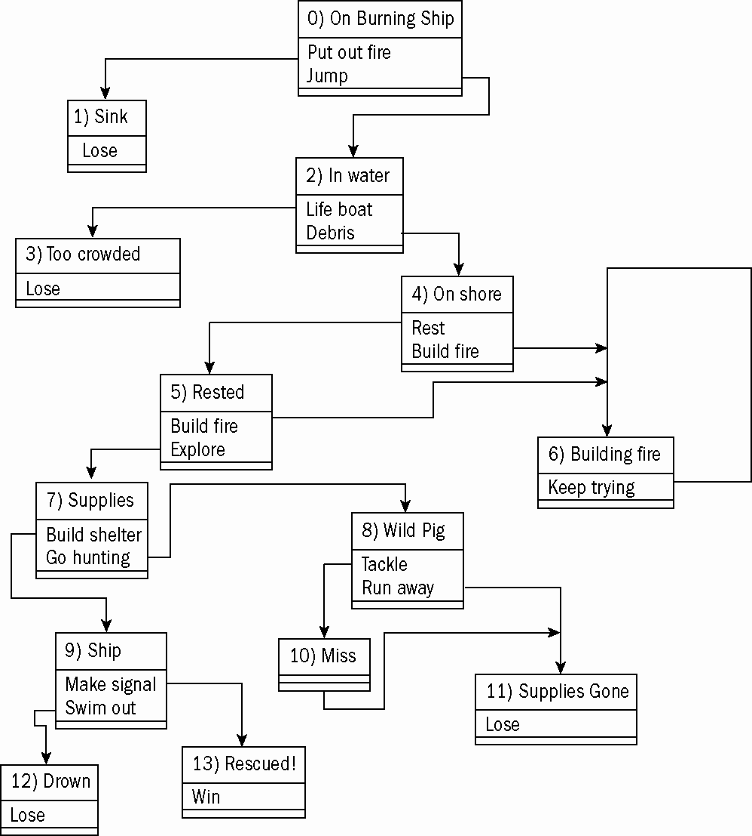
Adventure Game Overview

Slide 52
Adventure Game Node Information
The adventure game is based on nodes.
Node is a class with attributes but no methods.
The entire game is stored as a list of nodes.
The custom scene has methods to read the nodes and populate GUI widgets.

Slide 53
Sample Adventure Node
#0
nodeList.append( Node(
"On Burning Ship",
[ "Your vacation is going fine",
"except you wake up to find",
"your cruise ship is on fire.",
"",
"Do you attempt to fight the",
"fire or jump overboard?"
],
"Put out Fire", 1,
"Jump", 2
))

Slide 54
Example: Lunar Lander
gameEngine makes it easy to build this type of game.
Make a lander and platform based on SuperSprite.
Add gravity.
User input controls motion.
Check for a proper landing.
See lander.py.

Slide 55
Example: Asteroids
Build three custom SuperSprites:
  Ship: The user avatar.
  Bullet: Fired from the ship.
  Rock: A list of these will be the enemies.
Custom scene:
  Builds the objects
  Manages collisions
See asteroids.py.

Slide 56
There's More!
The Web site (of the textbook) includes several appendixes:
  Appendix B: The documentation for gameEngine, with some additional examples.
  Appendix C: Explains how to create installable modules, Windows executables, and installation programs.
  Appendix D: Demonstrates basic graphic and audio skills by using open source tools.

Slide 57
Discussion Questions
What are some advantages of a game engine?
Why might you make subclasses of the SuperSprite and Scene classes?
Why might you want multiple scenes in a game?
What additions would you add to the game engine?

Slide 58
Summary
You should now understand
  The features of a higher-level game engine
  Building a more powerful Sprite class
  Building a class to simplify the main loop
  Creating custom graphic interface widgets
  Building games with the game engine

Slide 59
References
Andy Harris, “Game Programming, The L Line, The Express Line to Learning”; Wiley, 2007

