Slide 1


CSE 414 Systems Analysis and Design
Lecture #11
Designing Distributed and Internet Systems
Prepared & Presented by Asst. Prof. Dr. Samsun M. BAŞARICI

Slide 2
Learning Objectives
Distinguish between file server and client/server environments and contrast how each is used in a LAN.
Describe cloud computing and other current trends that help organizations address ID infrastructure-related challenges.
Describe standards shaping the design of Internet-based systems, options for ensuring Internet design consistency, site management issues influencing customer loyalty, trustworthiness, and security.

Slide 3
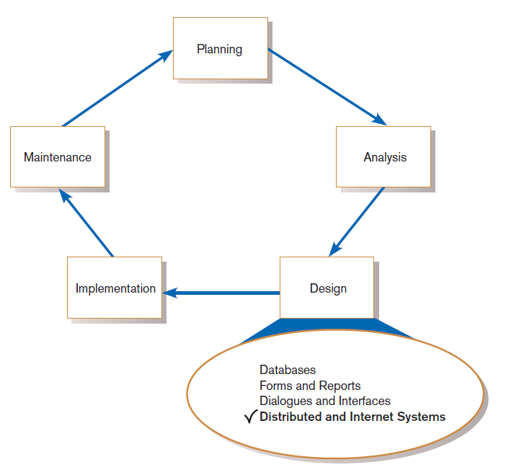
Designing Distributed and Internet Systems
FIGURE 12-1
Systems development life cycle (SDLC)
Notes:
This is the fourth chapter emphasizing the Design phase of the SDLC. Previously, we discussed database design, design of individual forms and reports, and the design of the overall interplay of forms and reports (often called dialogues) that take place as the user interacts with the system. In this chapter, we concentrate on Web-based applications. Of course, there are still many desktop programs and even legacy mainframe systems. But the most common platform for large scale multi-user applications are based on the Internet. We’ll discuss issues and techniques here.

Slide 4
The Process of Designing Distributed and Internet Systems
This process is similar to designing single-location systems.
Due to multi-location deployment, numerous design issues must be considered.
There is more opportunity for failure due to number of components.
Main issues involve ensuring reliability, availability, survivability, performance.
Notes:
When we use the word “distributed”, what we mean is that aspects of the system (including user interface, application logic, and data storage) are distributed among many computers connected together via networks (typically the Internet).

Slide 5
Deliverables and Outcome
Document that consolidates system design information:
  Description of each site
  Description of data usage for each site
  Description of business process for each site
  Contrasts of alternative IS architectures for site, data and processing needs of each site
Notes:
As with all design efforts, this one produced a set of deliverables that inform the implementation phase of the SDLC.

Slide 6
Designing Systems for Local Area Networks (LANs)
LAN: the cabling, hardware, and software used to connect workstations, computers, and file servers located in a confined geographical area
  Typically within one building or campus

Slide 7
Designing LAN and Client/Server Systems
LAN systems are either of these:
  LAN-based file server architecture.
  Client/server architecture.
Notes:
Systems that operate in a networked environment are generally called client/server systems. Some computers in the network are servers, providing some kind of service (such as data) to the clients. The system’s human users are typically sitting at client computers, and share the common serviced provided by server computers.
The simplest configuration is the file server architecture, which we’ll look at next.

Slide 8
File Servers
File server: a device that manages file operations and is shared by each client PC attached to a LAN

Slide 9
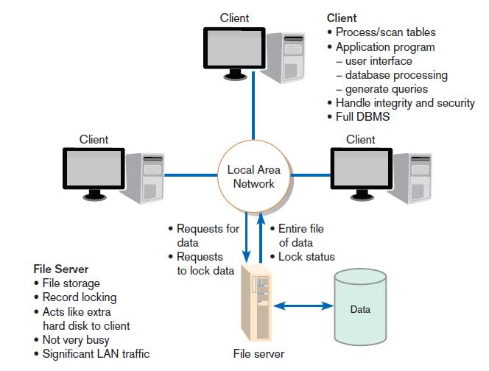
FIGURE 12-3
File server model
Notes:
Note that we’re not talking about the Web here. We’re talking about a local area network (LAN), like one in a company’s department. The computer lab in your college is likely configured as a LAN. In an environment like this, there will often be a computer that provides file and print resources for the other computers in the network.

Slide 10
Limitations of File Servers
Excessive data movement
  Entire data table must be transferred, instead of individual records.
Need for powerful client workstations
  Each client workstation must devote memory to a full DBMS.
Decentralized data control
  Record concurrency control, recovery, and security are complicated.
Notes:
With simple file servers, the applications and data control take place on the client computers. The file server simply holds shared data.
Since the client’s have to be powerful, we sometimes call these “fat clients” as opposed to “thin clients” that you see in Web applications. We’ll see more about this distinction later.

Slide 11
Designing Systems for a Client/Server Architecture
Client/server architecture: a LAN-based computing environment in which central database server or engine performs all database commands sent to it from client workstations, and application programs on each client concentrate on user interface functions
Notes:
When you migrate from the file server architecture to a C/S architecture, you are taking some of the computing tasks away from the clients and putting them to the server. A typical manifestation of this is to take all database management system (DBMS) operations and house them at the server. Now, clients just make data access requests to the server, which processes these and sends back the desired data.

Slide 12
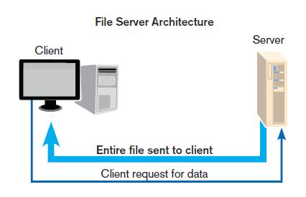
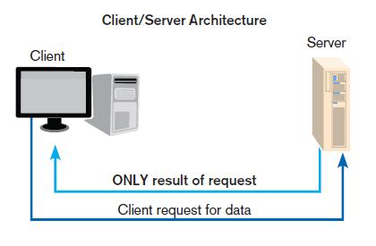
File Server vs. Client/Server
Notes:
You can see the increased efficiency and control. For one thing, the server only sends specific data, not entire files, which saves on network bandwidth. Second, the control a computing load is taken by the server, increasing security and decreasing computing demand on the clients.

Slide 13
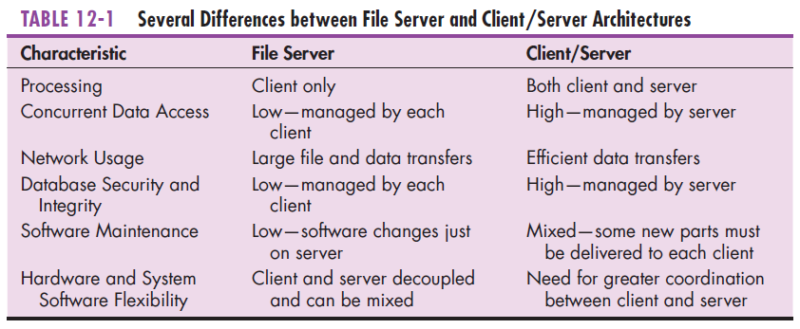
File Server vs. Client/Server (cont.)
Notes:
C/S architecture has several advantages over file servers, but they are a bit more complicated to configure and maintain.

Slide 14
Designing Systems for a Client/Server Architecture
Application processing is divided between client and server.
Client manages the user interface.
Database server is responsible for data storage and query processing.
Notes:
The degree to which application processing takes place at the client vs. the server is the degree of “thinness” or “fatness” of a client. We typically think of Web based systems as having thin clients, because the only processing is what the browser does. That’s mostly just presentation and user interface, with business logic and data processing taking place at the server. But in a LAN-based C/S architecture, you might have application programs running on the client, which make data requests to the server. Here, the client’s are a bit “fatter”. It’s all a matter of degree.

Slide 15
Designing Systems for a Client/Server Architecture (Cont.)
Database engine: the (back-end) portion of the client/server database system running on the server that provides database processing and shared access functions

Slide 16
Designing Systems for a Client/Server Architecture (Cont.)
Client: the (front-end) portion of the client/server database system that provides the user interface and data manipulation functions

Slide 17
Designing Systems for a Client/Server Architecture (Cont.)
Application program interface (API): software building blocks that are used to ensure that common system capabilities, such as user interfaces and printing, as well as modules are standardized to facilitate data exchange between clients and servers
  Common API interface can be used by any kind of DBMS (MySQL, Sybase, or Oracle)
Notes:
Any time you use some pre-existing software library, you are working with an API. They are not only for DBMS connections. APIs are used for visualizations, for object-oriented services, for working with ERP systems, or for Web services.
Also note that although we’re still talking about local C/S systems, APIs are not limited to this. There are plenty of APIs that exist in Web environments. And there are also APIs for standalone desktop (single user) environments.

Slide 18
Client/Server Advantages
Leverages benefits of microcomputer technology
Processing performed close to data source
  Improves response time
  Reduces network traffic
Facilitates use of GUIs
Encourages acceptance of open systems

Slide 19
Advanced Forms of Client/Server Architectures
Applications are distributed between client and server in a variety of ways.
Components of an IS:
  Data management: functions that manage all interaction between software and files and databases (data retrieval/querying, updating, security, concurrency control, and recovery)
  Data presentation: functions the manage the interface between system users and the software (display and printing of forms and reports, validating system inputs)
  Data analysis: functions transform inputs into outputs, including simple summarization to complex mathematical modeling such as regression analysis
Notes:
Data management always happens at the server, and presentation happens at the client. Depending on how “thin” the client is, analysis could happen at server, client, or distributed between the two.

Slide 20
Advanced Forms of Client/Server Architectures (Cont.)
Application server: a computing server where data analysis functions primarily reside.
Virtual machine: a software emulation of a physical computer system, both hardware and operating system, that allows more efficient sharing of physical hardware resources.
Virtualization: the act of creating virtual (rather than physical) versions of a variety of computing capabilities including hardware platforms, operating systems, storage devices, and networks.
Notes:
Here are some definitions that apply to modern client/server architectures. Let’s discuss these.

Slide 21
Advanced Forms of Client/Server Architectures (Cont.)
Three-tiered client/server: advanced client/server architectures in which there are three logical and distinct applications—data management, presentation, and analysis—that are combined to create a single information system.
Middleware: a combination of hardware, software, and communication technologies that bring data management, presentation, and analysis together into a three-tiered client/server environment.
Thin client: a client device designed so that most processing and data storage occur on the server.

Slide 22
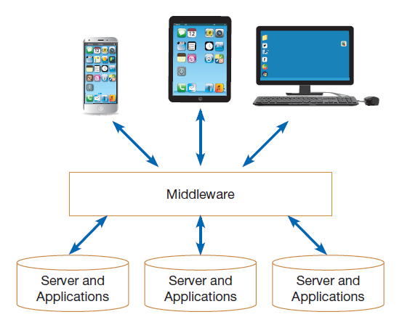
Middleware Environments
Figure 12-6
Middleware ties together diverse applications and devices
Notes:
If you are an application developer, you will frequently work with middleware. The way you interact with the middleware is to use the functions and objects of its API.

Slide 23
Advanced Forms of Client/Server Architectures (Cont.)
Applications can be partitioned in a way that best fits the organizational computing need
Easier customization: application code resides on application server, so change done only in one place
Easier maintenance: data analysis is separate from user interface, so changing one can be done independently of the other

Slide 24
Cloud Computing
Cloud computing: provision of applications over the Internet where customers do not have to invest in the hardware and software resources needed to run and maintain the applications, but are charged on a per-use basis.
Amazon Example: Amazon Web Services (AWS), Simple Storage Service (S3), Elastic Compute Cloud (EC2)

Slide 25
Cloud Computing (Cont.)
Information systems infrastructure: The hardware, software, data, facilities, human resources, and services used by organizations to support their decision making, business processes, and competitive strategy.
Notes:
A company’s IS infrastructure might be fragmented and difficult to consolidate. Organizations increasingly buy or rent IS infrastructure services instead of trying to manage and maintain their own infrastructure.

Slide 26
Cloud Computing (Cont.)
Utility computing: A form of on-demand computing where resources in terms of processing, data storage, or networking are rented on an as needed basis. The organization only pays for the services used.
Notes:
Cloud computing follows the utility model, providing services to companies. These are often termed [blank]-as-a-service. For example, SaaS is Software as a Service. IaaS is Infrastructure as a Service. PaaS is Platform as a Service.

Slide 27
Cloud Characteristics
On-Demand Self Service
Rapid Elasticity
Broad Network Access
Resource Pooling
Measured Service

Slide 28
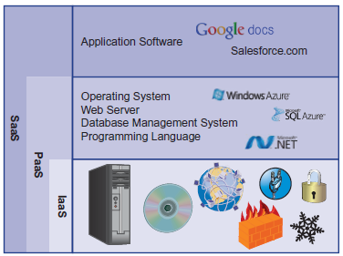
Service Models
Infrastructure as a Service (IaaS): provides basic processing, storage, and network capabilities
Platform as a Service (PaaS): customers run their own applications, using tools provided by the service provider.
Software as a Service (SaaS): applications are provided by the service provider
Figure 12-10
Services by SaaS, PaaS, and IaaS providers.
Notes:
IaaS is most basic service model. PaaS will include infrastructure along with platform. SaaS will typically include both the platform and infrastructure on which the application runs.
Amazon’s EC2 and S3 can be considered to be IaaS. Microsoft’s Windows Azure is a PaaS provider. Salesforce.com is an example of SaaS.

Slide 29
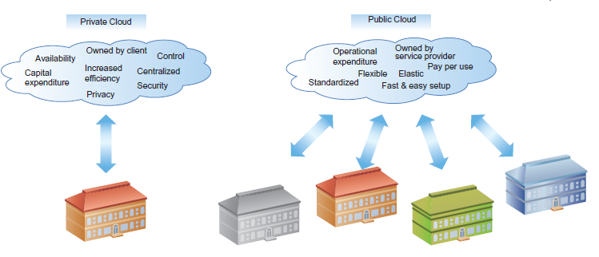
Figure 12-11
Public clouds versus private clouds.
Notes:
Clouds can be public or private. A company has more control over a private cloud than if it purchases services from a public cloud. But this comes along with maintenance and infrastructure costs.

Slide 30
Managing the Cloud
Issues to consider when choosing service providers:
  Availability/Reliability – no cloud service is completely immune to errors, network outages, or hardware failures
  Scalability – this is the promise of the cloud, but there may be limits
  Viability – you want to make sure the service provider will last over time
  Security, Privacy, and Compliance – these are critical (e.g. Sarbanes-Oxley, HIPAA)
  Diversity of Offerings – which provider can offer services needed now and in the future?
  Openness – how interoperable is the service?
  Cost – how will cloud cost compare to internal, public vs. private?

Slide 31
Service-Oriented Architecture
A software architecture
Business processes broken down into individual components (services)
Designed to achieve desired results for the service consumer
  Application
  Another service
  Person (user)
Principles:
  Reusability
  Interoperability
  Componentization
Notes:
Reusability means that the service should be usable in many different applications. Interoperability means that the service should work with any other service.

Slide 32
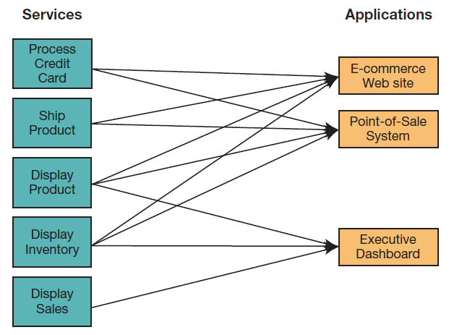
Figure 12-13
Using SOA, multiple applications can
invoke multiple services.
Notes:
An SOA is composed of services, not full applications. An application combines services together as components of the application.

Slide 33
Web Services
Web service: A method of communication between two electronic devices over a network.
eXtensible Markup Language (XML): An Internet authoring language that allows designers to create customized tags, enabling the definition, transmission, validation, and interpretation of data between applications.
JavaScript Object Notation (JSON): A lightweight data interchange approach that is relatively easy for humans to understand and for computers to generate or interpret.
Notes:
Web services typically provide output in the form of XML or JSON.

Slide 34
Web Services (Cont.)
Simple Object Access Protocol (SOAP): A protocol for communicating XML data between web service applications and the operating system.
Representational State Transfer (REST): A relatively simple and fast protocol for communicating JSON data between web service applications and the operating system.
Notes:
Web services typically take requests in the form of SOAP or REST. SOAP is more complex and provides a rich framework for representing the request. REST is simpler, but less expressive.

Slide 35
Designing Internet Systems
Most new system development focuses on Internet-based applications (for internal processing, business-to-business, and business-to-consumer).
Main design issues: standards, separating content from display, future evolution, site consistency, site management and online data management

Slide 36
Standards Drive the Internet
Internet design is simpler than client/server due to proliferation of standards.

Slide 37
Standards Drive the Internet (Cont.)
Types of Standards:
  Domain naming (BIND): a method for translating domain names into Internet Protocol (IP) addresses
    “B” refers to Berkeley, Ca. where first developed.
  Hypertext Transfer Protocol (HTTP): a communication protocol for exchanging information on the Internet
  Hypertext Markup Language (HTML): the standard language for representing content on the Web via command tags

Slide 38
Site Consistency
Professionalism requires a consistent look-and-feel across all pages of a Web site.
Cascading Style Sheets (CSSs): a set of style rules that tells a Web browser how to present a document
Notes:
It’s important for the pages of a Web site to look like they belong together, so site consistency is key to this. CSS helps to standardize the look of different types of HTML elements.

Slide 39
Site Consistency (Cont.)
eXtensible Style Language (XSL): a specification for separating style from content when generating HTML documents
  Methods for transforming XML documents into a generic comprehensive form
  Methods for formatting the generic comprehensive form into a device-specific form
Notes:
XSL is also used for site consistency. The difference between CSS and XSL is that CSS formats HTML tags whereas XSL transforms XML data into presentable form in HTML (for browsers) or WAP (for mobile devices).

Slide 40
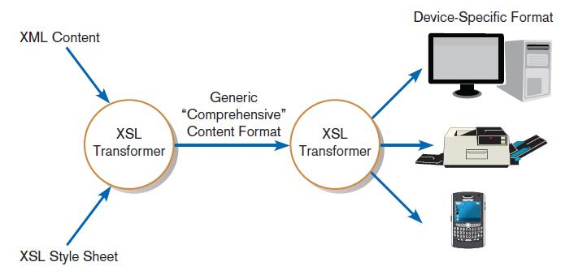
FIGURE 12-16
Combining XML data with XSL style sheet
to format content
Notes:
An XML document will contain data. An XSL style sheet will contain rules for transforming the data into and HTML document, and later into a display format consistent with the type of device that the user is interacting with.
In other words, XML content, queried from a remote data source, is formatted based on rules within an associated XSL style sheet. This content is then translated to a device-specific format and displayed to the user. For example, if the user has made the request from a Web browser, the presentation layer will produce an HTML document. If the request has been made from a wireless mobile phone, the content will be delivered as a Wireless Markup Language (WML) document.

Slide 41
Other Site Consistency Issues
Two key issues should be considered:
  Use unique titles.
  Choose words carefully.
Major problem is users do not know where they are going when they follow a hyperlink.
  You should have link titles to explain hyperlinks.

Slide 42
Design Issues Related to Site Management
Customer Loyalty and Trustworthiness
  Design quality
  Up-front disclosure
  Comprehensive, correct, and current content
  Connected to the rest of the Web

Slide 43
Customer Loyalty and Trustworthiness
Personalization: providing Internet content to a user based upon knowledge of that customer
Customization: Internet sites that allow users to customize the content and look of the site based on their personal preferences

Slide 44
Web Pages Must Live Forever
Customer Bookmarks
Links from Other Sites
Search Engine Referrals
Old Content Adds Value
System Security vs. Ease of Use
  “Remember my password”
  Use of cookies
Notes:
For commercial Internet sites, your links must live forever. This doesn’t mean that Web content cannot change and evolve. However, the links themselves cannot die. In other words, when users bookmark a page and return to your site, this link should return something useful to the user; otherwise, you run the risk of losing the customer. This requires some maintenance on your site’s old content.

Slide 45
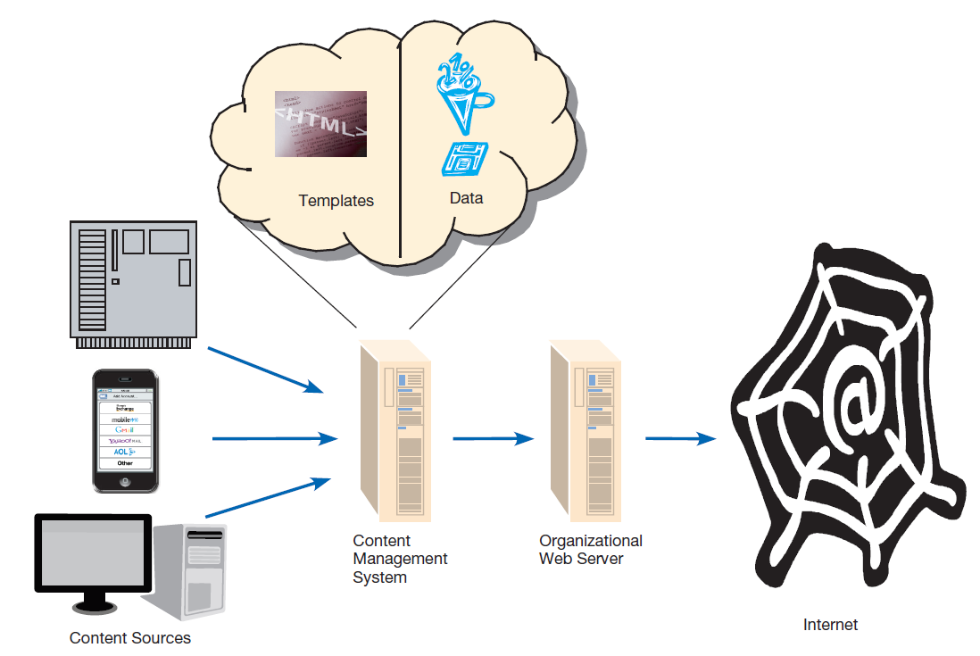
Website Content Management
Content management system (CMS): a special type of software application for collecting, organizing, and publishing Web site content
Figure 12-18
A content management system allows content from multiple sources to be stored separately from its formatting to ease Website management
Notes:
Content management systems make it easier for non-technical people to design and maintain Web content. You don’t need to know HTML, XML, CSS, XSL, etc. when using a CMS. But if you do know these things, you can still benefit from CMS to make your job easier.

Slide 46
Electronic Commerce Application: Designing a Distributed Advertisement Server for PVF’s WebStore
Benefits for including advertising:
  Potential to increase revenue generated from the WebStore
  Potential to create cross-promotions and alliances with other online commerce systems
  Potential to provide customers with improved service when looking for additional products that accessorize PVF’s product line
Notes:
These last few slides discuss the ideas of this chapter in the context of Pine Valley Furniture’s WebStore. The PVF people are trying to figure out how to effectively incorporate advertisement into their WebStore without detracting from its other functions.
Here we see reasons for including advertising on the WebStore.

Slide 47
Advertising on PVF’s WebStore
List of advertisement system concerns:
  Advertisement must be served quickly so that site performance is not affected.
  Advertisement must be uniform in size and resolution, so as not to disrupt the site layout.
  Advertisement links must not redirect the user’s browser away from the WebStore.
Notes:
PVF does not want the advertisement to harm the aesthetics and usability of the WebStore. Here are some concerns.

Slide 48
Designing the Advertising Component
Transactional requirements are to
  Determine which advertisements apply, based on where the user is in the WebStore.
  Personalize the advertisement if the identity of user and preferences are known.
  Check for any seasonal or promotional advertisements.
  Log the transaction.
Notes:
Here are some design considerations.

Slide 49
Designing the Management Reporting Component
Queries for top-management:
  “How many women, when shopping for desks, clicked on an advertisement for lamps?”
  “How many advertisements were served to shoppers looking at filing cabinets?”
  “How many people clicked on the first advertisement they saw?”
  “How many people clicked on an advertisement and then purchased something from the WebStore?”
Notes:
The answers to these queries will help guide future advertising decisions.

Slide 50
Summary
Now you learned how to:
  Distinguish between file server and client/server environments and contrast how each is used in a LAN.
  Describe cloud computing and other current trends that help organizations address ID infrastructure-related challenges.
  Describe standards shaping the design of Internet-based systems, options for ensuring Internet design consistency, site management issues influencing customer loyalty, trustworthiness, and security.

Slide 51
References
Joseph S. Valacich, Joey F. George, Modern Systems Analysis and Design, 8th Global Edition, Pearson, 2016

