Slide 1


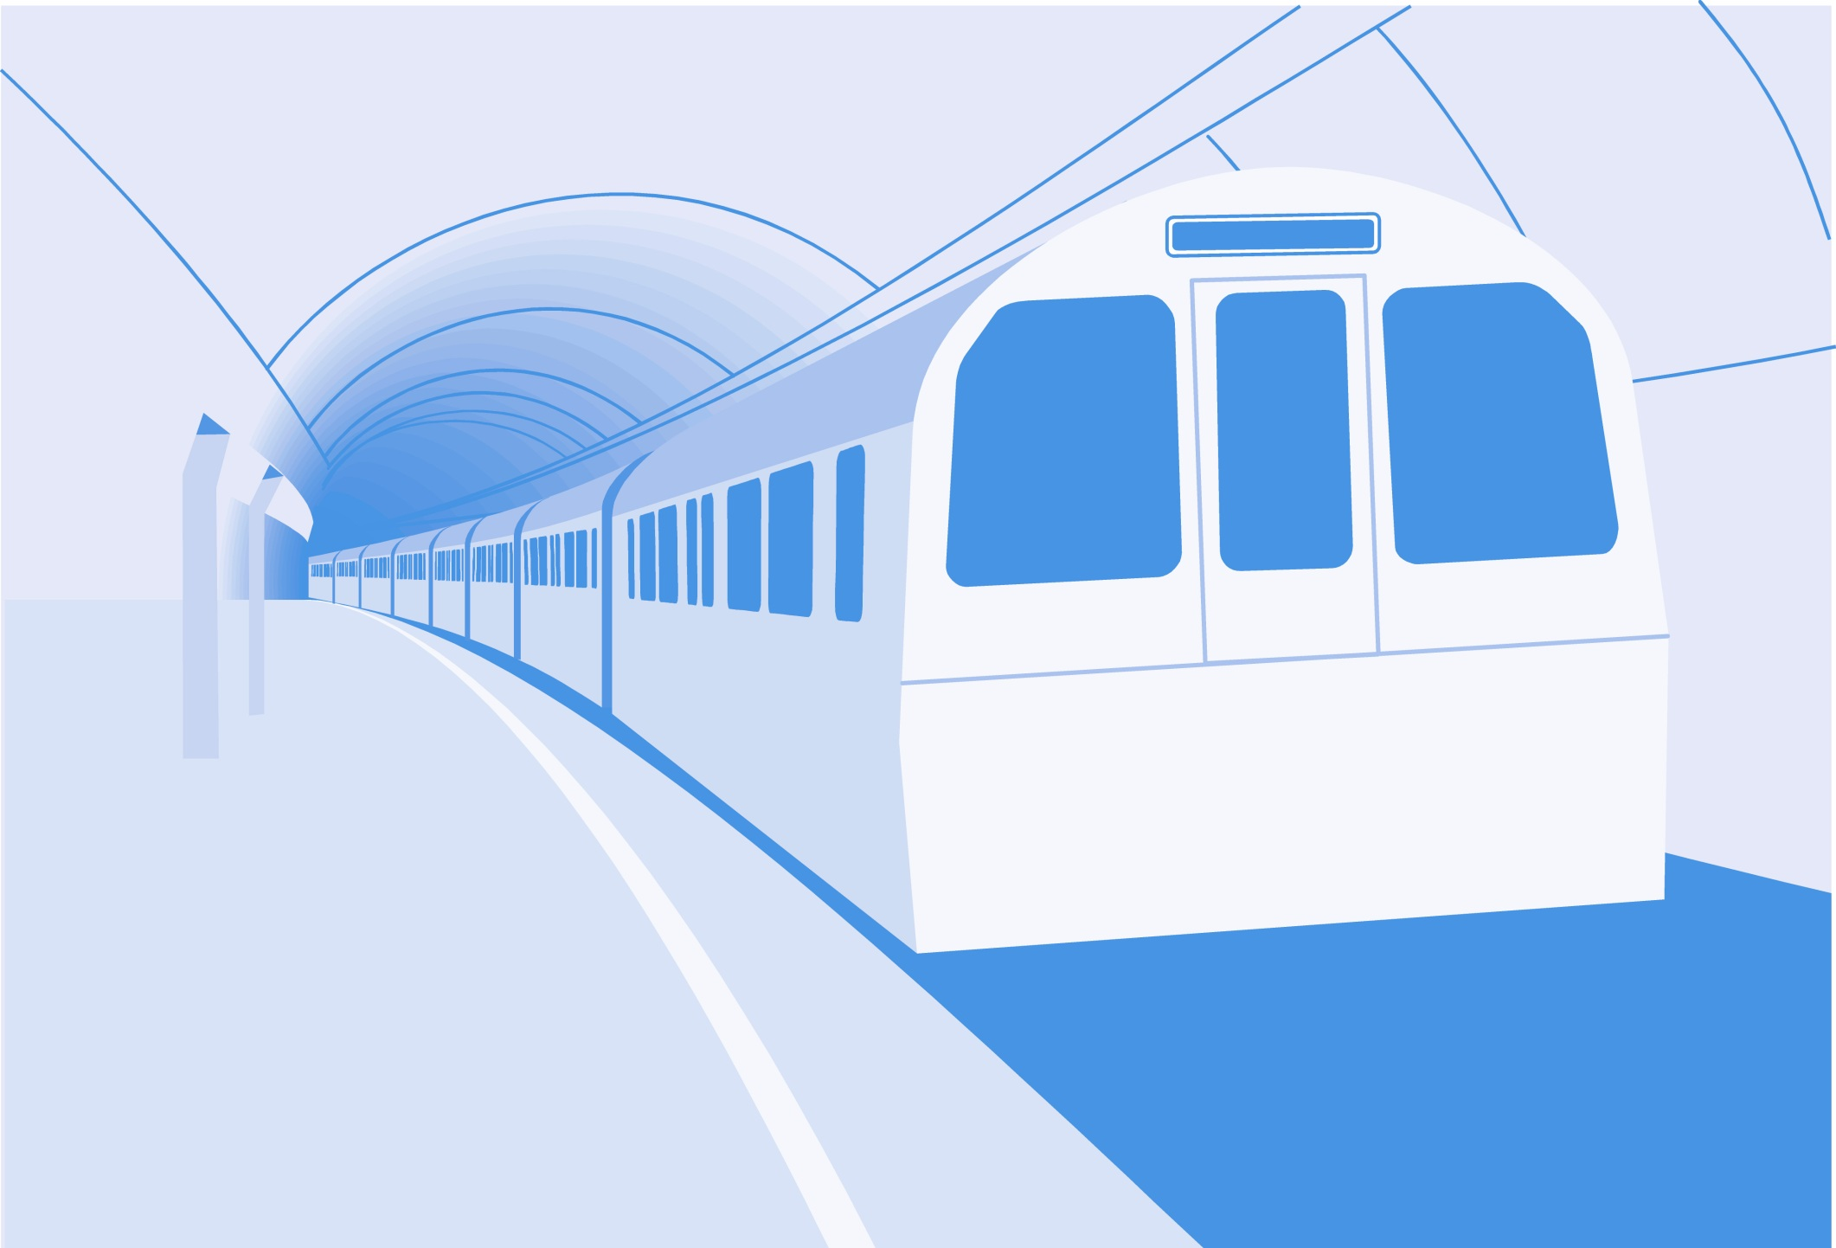
L
L Line
CSE 420
Computer Games
Lecture #11 Movement

Slide 2
Objectives
Understanding basic rules of motion
Getting continuous input from the
keyboard
Firing missiles from sprites
Using vector projection
Calculating the distance and angle
between points

Slide 3
Objectives (cont.)
Following the mouse
Handling basic gravity
Building a vehicle model with power,
turning rate, and drag
Modeling spacecraft motion
Handling orbital physics

Slide 4
Gaming and Physics
Games are about things moving around.
To get motion right, you must understand how motion works in the real world.
Basic physics describes these phenomena.
You should take a more formal physics course.

Slide 5
Newton's Laws
These Laws describe how things move.
The three primary Laws:
  An object at rest stays at rest.
  Force = mass * acceleration.
  Every action has an equal and opposite reaction.
Understanding these principles gives you the ability to model motion.

Slide 6
Vectors
Vector: Has direction and magnitude. Object motion is a vector because the magnitude is the speed and the direction is an angle.
Vector components: A vector can also be described in dx/dy terms. Converting from speed/direction to dx/dy is called vector projection.

Slide 7
Motion Terms
Position: The current position of an object, usually an (x, y) coordinate pair.
Velocity: A change in position during a time frame. Often determined as a vector and converted to dx/dy components for convenience. Measured in pixels per frame (ppf).
Acceleration: A change in velocity. A vector often changed to ddx/ddy. Sometimes called a force vector.

Slide 8
Multiple Force Vectors
Motion is a combination of various forces.
A balloon has weight pulling it down.
Helium adds a buoyant force pulling it up.
Wind adds a sideways force.
How will the balloon move?

Slide 9
Adding Force Vectors
It's easy to calculate multiple force vectors.
Convert each force into dx/dy components.
Add all dx values to get a total dx.
Add all dy values to get a total dy.

Slide 10
Force Vector Example
Force | X Component | Y Component
Gravity | 0 | 1
Buoyancy | 0 | -3
Wind | 4 | 0
Total | 4 | 2

Slide 11
Getting Continuous Keyboard Input
So far, keyboard input has been one event per key press.
Sometimes, you want continuous action as long as a key is pressed down.
This uses a technique called hardware polling.

Slide 12
Advantages of Hardware Polling
A sprite can handle its own key presses.
Keyboard input can be continuous.
Motion appears much smoother.
Hardware polling is pretty easy to implement.
See turret.py.
  Continuous keyboard input
  Very smooth rotation

Slide 13
Building a Rotating Turret
def __init__(self):
pygame.sprite.Sprite.__init__(self)
self.imageMaster = pygame.image.load("turret.gif")
self.imageMaster = self.imageMaster.convert()
self.rect = self.imageMaster.get_rect()
self.rect.center = (320, 240)
self.turnRate = 10
self.dir = 0
def update(self):
self.checkKeys()
self.rotate()

Slide 14
Notes on the Turret Class
To preserve quality when rotating, load the image into a master image.
Keep the turret in the center of the screen.
Set up the turnRate constant. Smaller is slower and smoother.
Set a dir constant.
Update involves
  Checking keyboard
  Rotating turret

Slide 15
Checking the Keyboard
Done in the turret's checkKeys() method
def checkKeys(self):
keys = pygame.key.get_pressed()
if keys[pygame.K_LEFT]:
self.dir += self.turnRate
if self.dir > 360:
self.dir = self.turnRate
if keys[pygame.K_RIGHT]:
self.dir -= self.turnRate
if self.dir < 0:
self.dir = 360 - self.turnRate

Slide 16
How Checking the
Keyboard Works
Store pygame.keyPressed() in a variable.
It’s a tuple of binary values, one for each key on the keyboard.
Use a keyboard constant to check a particular key.
Checking for left arrow:
keys = pygame.key.get_pressed()
if keys[pygame.K_LEFT]:

Slide 17
Rotating the Turret
The steps are just like Lecture #10 (Chapter 8):
  Save center.
  Transform the new image from imgMaster.
  Place back in center.
def rotate(self):
oldCenter = self.rect.center
self.image = pygame.transform.rotate(self.imageMaster,
self.dir)
self.rect = self.image.get_rect()
self.rect.center = oldCenter

Slide 18
Building the Main Loop
No keyboard handling!
Note: You still need the event.get() mechanism.
keepGoing = True
while keepGoing:
clock.tick(30)
for event in pygame.event.get():
if event.type == pygame.QUIT:
keepGoing = False
allSprites.clear(screen, background)
allSprites.update()
allSprites.draw(screen)
pygame.display.flip()

Slide 19
Vector Projection
Chapter 8 (Lecture #10) projects a vector in eight directions.
What if you want any direction, any speed?
You should be able to convert any vector into its dx/dy components.
This process is vector projection.

Slide 20
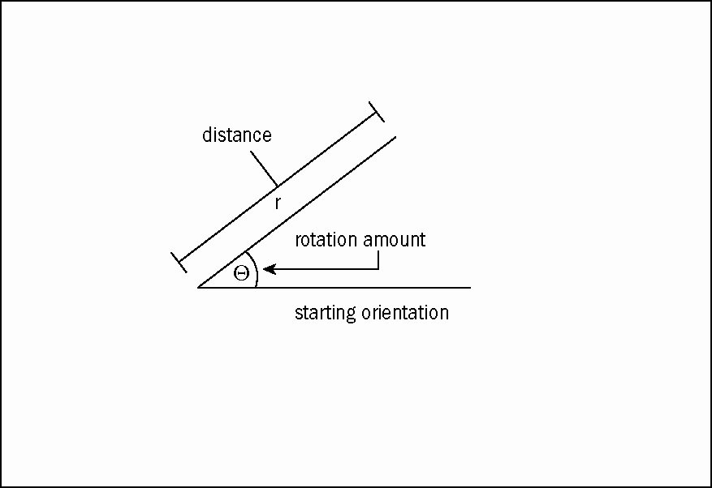
Looking at the Problem

Slide 21
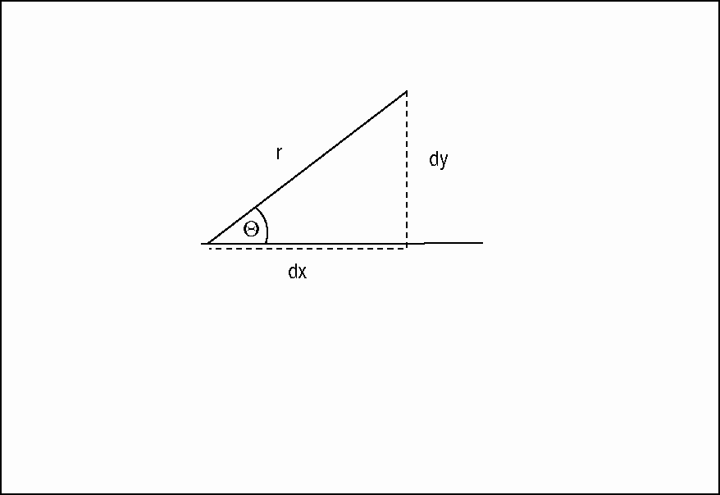
Building a Triangle

Slide 22
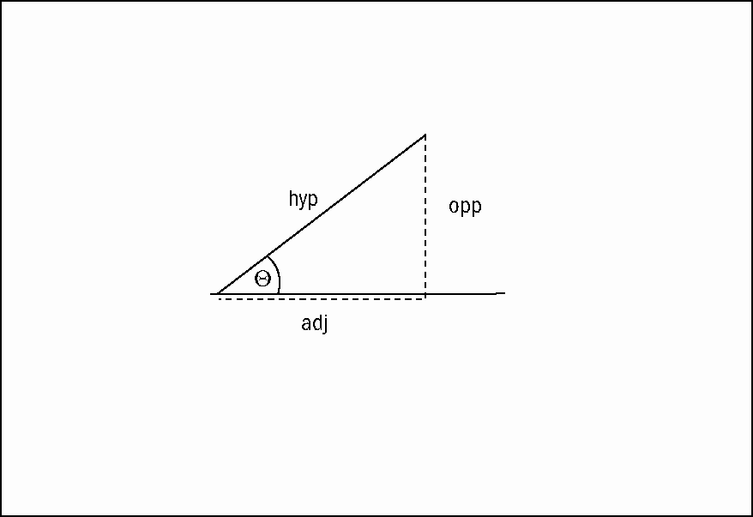
Using Trig Terms

Slide 23
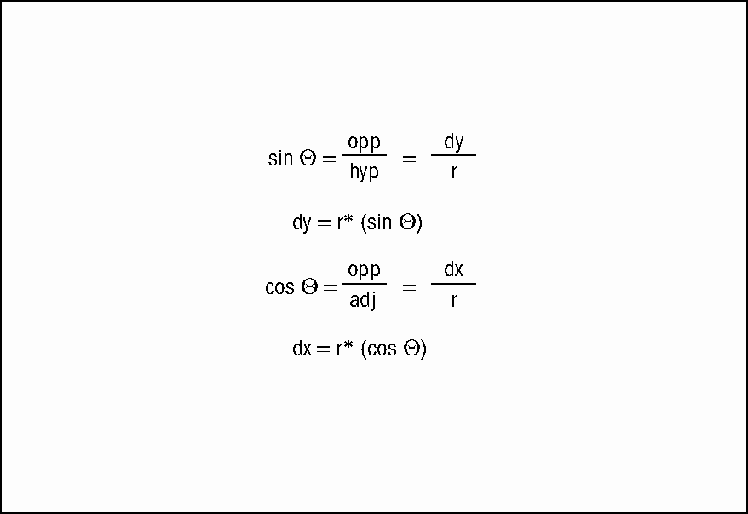
Solving for dy and dx

Slide 24
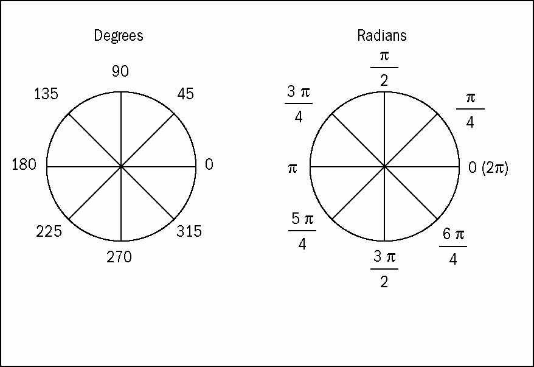
Dealing with Radians

Slide 25
How vecProj.py Works
Written in text mode for simplicity
Imports math module to get trig functions
Begins a loop
Inputs values for angle and distance
Converts angle to radians
Calculates dx and dy
Inverts dy (in math, y increases upward)
Outputs value
Asks user if he or she wants to repeat

Slide 26
The vecProj.py Program
""" vecProj
given any angle and distance,
converts to dx and dy
No GUI.
"""
import math
def main():
keepGoing = True
while keepGoing:
print
print "Give me an angle and distance,"
print "and I'll convert to dx and dy values"
print
r = float(raw_input("distance: "))
degrees = float(raw_input("angle (degrees): "))

Slide 27
The vecProj.py Program (Cont’d)
theta = degrees * math.pi / 180
dx = r * math.cos(theta)
dy = r * math.sin(theta)
# compensate for inverted y axis
dy *= -1
print "dx: %f, dy: %f" % (dx, dy)
response = raw_input("Again? (Y/N)")
if response.upper() != "Y":
keepGoing = False

Slide 28
Making the Turret Fire
With vector projection, you can make the turret fire a projectile.
The bullet gets dx and dy by projecting the turret's direction.
A label is added to output direction and charge.
See turretFire.py.

Slide 29
Adding a Label Class
class Label(pygame.sprite.Sprite):
""" Label Class (simplest version)
Properties:
font: any pygame font object
text: text to display
center: desired position of label center (x, y)
"""
def __init__(self):
pygame.sprite.Sprite.__init__(self)
self.font = pygame.font.SysFont("None", 30)
self.text = ""
self.center = (320, 240)
def update(self):
self.image = self.font.render(self.text, 1, (0, 0, 0))
self.rect = self.image.get_rect()
self.rect.center = self.center

Slide 30
Updating the Shell Class
The turret instance needs to know about the shell instance.
Pass the shell as a parameter to the turret constructor.
Store the shell as an attribute of the turret.
class Turret(pygame.sprite.Sprite):
def __init__(self, shell):
self.shell = shell
# … other init code here…

Slide 31
Add a charge Property to the Turret
The turret doesn't move, so it isn't correct to call it speed.
The charge indicates the speed of the shell when it’s fired.
Add a charge attribute in the turret constructor.
class Turret(pygame.sprite.Sprite):
def __init__(self, shell):
# … other init code here …
self.charge = 5

Slide 32
Modify the checkKeys() Method
The up and down keys change the charge.
The spacebar fires a shell.
if keys[pygame.K_UP]:
self.charge += 1
if self.charge > 20:
self.charge = 20
if keys[pygame.K_DOWN]:
self.charge -= 1
if self.charge < 0:
self.charge = 0
if keys[pygame.K_SPACE]:
self.shell.x = self.rect.centerx
self.shell.y = self.rect.centery
self.shell.speed = self.charge
self.shell.dir = self.dir

Slide 33
Firing the Shell
Set the shell's position equal to the turret's position so that the shell seems to be coming from the turret.
Set the shell's speed to the turret's charge.
Set the shell's direction to the turret's direction.

Slide 34
Creating the Shell Class
The shell itself is very ordinary.
I drew a circle instead of importing an image.
It hides offstage (-100, -100) when not needed.
It doesn't really get created by the turret – it's always around, just offstage.
This kind of illusion is very common.

Slide 35
Calculating the Shell's Vector
Use trig functions to determine dx
and dy.
Don't forget to invert dy to compensate for y increasing downward.
def calcVector(self):
radians = self.dir * math.pi / 180
self.dx = self.speed * math.cos(radians)
self.dy = self.speed * math.sin(radians)
self.dy *= -1

Slide 36
Resetting the Shell
Move the shell offstage.
Set the speed to 0 so the shell doesn't wander back.
def reset(self):
""" move off stage and stop"""
self.x = -100
self.y = -100
self.speed = 0

Slide 37
Modifying the Main Code
Create all three sprites.
Update the label in the main loop.
shell = Shell(screen)
turret = Turret(shell)
lblOutput = Label()
lblOutput.center = (100, 20)
allSprites = pygame.sprite.Group(shell, turret, lblOutput)
lblOutput.text = "dir: %d speed %d" % (turret.dir,
turret.charge)
allSprites.clear(screen, background)
allSprites.update()
allSprites.draw(screen)
pygame.display.flip()

Slide 38
Following the Mouse
Vector projection converts angle and distance to dx/dy.
Sometimes, you have dx/dy and want angle and distance.
More often, you have two points and want the angle and distance between them.
See followMouse.py.

Slide 39
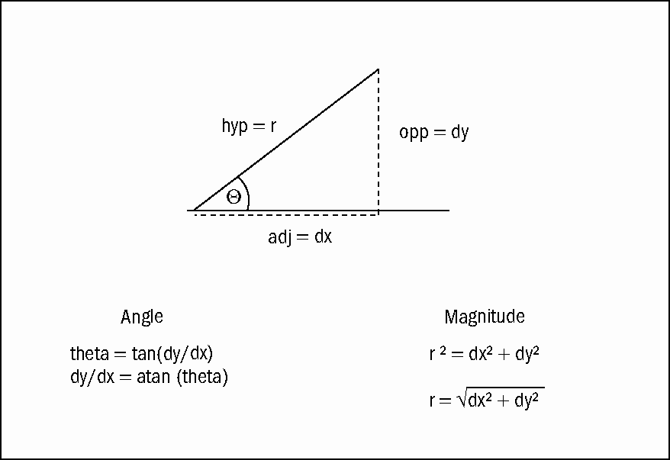
Converting Components Back to Vectors

Slide 40
Modifying the Turret Class
The turret class no longer reads the keyboard, so now its update calls a followMouse() method.
def update(self):
self.followMouse()
self.rotate()

Slide 41
Making a Turret Point towards the Mouse
Compare the turret position with the mouse position.
Subtract x values for dx.
Subtract y values for dy.
Use the atan() function to find the inverse tangent.
Convert to degrees.
Rotate the turret.

Slide 42
Following the Mouse
def followMouse(self):
(mouseX, mouseY) = pygame.mouse.get_pos()
dx = self.rect.centerx - mouseX
dy = self.rect.centery - mouseY
dy *= -1
radians = math.atan2(dy, dx)
self.dir = radians * 180 / math.pi
self.dir += 180
#calculate distance
self.distance = math.sqrt((dx * dx) + (dy * dy))

Slide 43
How followMouse() Works
Subtract positions to get dx, dy.
Compensate for the inverted y axis.
Calculate the angle between the turret and the mouse. (The atan2() function works even when dy is 0.)
Convert the radian result to degrees.
Offset by 180. (The result of atan2() is between -180 and 180.)
Calculate the distance by using the Pythagorean theorem.

Slide 44
Basic Gravity Concepts
Trajectories normally (near a planet) follow parabolic paths.
The horizontal speed of a projectile stays nearly constant (at least, in the game).
The vertical velocity decreases.
The object appears to pause at the top of the arc.
It hits the ground at the same speed it left the cannon.

Slide 45
Simulating Basic Gravity
See turretGrav.py.
The turret is now viewed from the side.
The shell follows a realistic arc.
The arc is drawn on the screen as the shell moves.

Slide 46
Adding Gravity to the Shell Class
Add a gravitational constant to the shell.
Set the initial dx and dy when the shell is fired.
Add a call to calcPos() in update().
self.gravity = .5
def update(self):
self.calcPos()
self.checkBounds()
self.rect.center = (self.x, self.y)

Slide 47
Adding the
Gravitational Force
Compensate for gravity in calcPos().
Draw the shell's path.
def calcPos(self):
#compensate for gravity
self.dy += self.gravity
#get old position for drawing
oldx = self.x
oldy = self.y
self.x += self.dx
self.y += self.dy
pygame.draw.line(self.background,
(0,0,0), (oldx, oldy), (self.x, self.y))

Slide 48
Drawing on the Background
Drawing on the screen is temporary.
To keep the drawings, draw on the background instead.
Pass the background to the shell as a parameter.
The shell draws its path on the background.
To erase the drawing, refill the background surface.

Slide 49
Building a Vector-Based Vehicle
Vector projection can add realism to vehicle models.
Write sprite code like in Lecture #10 (Chapter 8).
Change the calcVector() method to incorporate vector projection.
See carVec.py.

Slide 50
Creating a Vector-Based
Car Sprite
Add turnRate and accel properties to the car in its init() method.
Design an update() method to pass control around.
self.turnRate = 3
self.accel = .1
self.x = 320
self.y = 240
def update(self):
self.checkKeys()
self.rotate()
self.calcVector()
self.checkBounds()
self.rect.center = (self.x, self.y)

Slide 51
Checking the Keys
def checkKeys(self):
keys = pygame.key.get_pressed()
if keys[pygame.K_RIGHT]:
self.dir -= self.turnRate
if self.dir < 0:
self.dir = 360 - self.turnRate
if keys[pygame.K_LEFT]:
self.dir += self.turnRate
if self.dir > 360:
self.dir = self.turnRate
if keys[pygame.K_UP]:
self.speed += self.accel
if self.speed > 10:
self.speed = 10
if keys[pygame.K_DOWN]:
self.speed -= self.accel
if self.speed < -3:
self.speed = -3

Slide 52
Calculating the Vector
Use vector projection.
Check the code for other details – they’re just like Lecture # 10 (Chapter 8).
def calcVector(self):
radians = self.dir * math.pi / 180
self.dx = math.cos(radians)
self.dy = math.sin(radians)
self.dx *= self.speed
self.dy *= self.speed
self.dy *= -1
self.x += self.dx
self.y += self.dy

Slide 53
Making a More Versatile Vehicle Model
New parameters can make a better-behaved vehicle that's easier to tune:
  Power: Strength of the vehicle's engine in relationship to its mass.
  Drag: The sum of all the forces that cause a vehicle to slow down.
  Turn rate: The speed at which a vehicle turns.
  Speed: No longer set directly; a function of power and drag.
See carParam.py.

Slide 54
The miniGUI Module
carParam.py makes use of several Graphic User Interface (GUI) widgets.
I created them in a module called miniGUI.py.
They aren’t central to this discussion, so I won't dwell on them here.
They’re fully developed as part of a gaming library in Chapter 10.

Slide 55
Building the User Interface
The carParam.py program communicates with the user through labels and scrollers from miniGUI.py.
Copy miniGUI.py to the current directory.
Import miniGUI.py at the top of the program.
Each element is a sprite.
They're added to the sprite group like any other sprites.

Slide 56
Building the GUI Elements
Import miniGUI.py.
Create the label.
Create the scroller.
lblPower = miniGUI.Label()
lblPower.center = (80, 20)
lblPower.text = "Power"
scrPower = miniGUI.Scroller()
scrPower.center = (250, 20)
scrPower.bgColor = (0xFF, 0xFF, 0xFF)
scrPower.value = 5
scrPower.maxValue = 10
scrPower.increment = .5

Slide 57
Communicating with the User
In the main loop, get power, turnRate, and drag from the scrollers.
Copy the speed to the label for output.
car.power = scrPower.value
car.turnRate = scrTurn.value
car.drag = scrDrag.value
lblSpeed1.text = "%.2f" % car.speed

Slide 58
Checking the Keys in carParam
def checkKeys(self):
keys = pygame.key.get_pressed()
if keys[pygame.K_RIGHT]:
self.dir -= self.turnRate
if self.dir < 0:
self.dir = 360 - self.turnRate
if keys[pygame.K_LEFT]:
self.dir += self.turnRate
if self.dir > 360:
self.dir = self.turnRate
if keys[pygame.K_UP]:
self.speed += self.power
#no need to check for a max speed anymore
if keys[pygame.K_DOWN]:
self.speed -= self.power
if self.speed < -3:
self.speed = -3

Slide 59
Changes in checkKeys()
The up and down keys affect self.power rather than self.accel.
No need to check for maximum speed – that will be handled later.
power handles braking, as well as acceleration (but brakes are now much less important because the car will slow down on its own).

Slide 60
Compensating for Drag
The drag coefficient is a float between 0 and 1.
A smaller value means more efficient drag.
Subtract the drag from 1.
Multiply the speed by the resulting percentage.
Set slow speeds to 0.

Slide 61
Drag Code in calcVector()
def calcVector(self):
radians = self.dir * math.pi / 180
self.dx = math.cos(radians)
self.dy = math.sin(radians)
#compensate for drag
self.speed *= (1 - self.drag)
if self.speed < .5:
if self.speed > -.5:
self.speed = 0
self.dx *= self.speed
self.dy *= self.speed
self.dy *= -1

Slide 62
Building a Spacecraft Model
Cars tend to go in the direction they're pointing.
Spacecraft travel differently.
When you fire a thruster, it adds thrust in a particular direction.
You can easily fly perpendicular to the direction of travel in space.
See space.py.

Slide 63
Creating a Multi-State Ship
It's useful to see thrust.
The spaceship has four master sprites:
  imgCruise: No thrust
  imgThrust: Main thrusters
  imgLeft: Thrust rotating to left
  imgRight: Thrust rotating to right

Slide 64
Checking Keys in Space
Set the image to the default (imgCruise).
Change the image when turning or applying thrust.
Turn left or right the normal way. (Turning just changes the dir property).
Give thrust a small value when the up arrow is pressed.
Otherwise, set the thrust to 0.

Slide 65
space.py checkKeys()
def checkKeys(self):
keys = pygame.key.get_pressed()
self.imageMaster = self.imageCruise
if keys[pygame.K_RIGHT]:
self.dir -= self.turnRate
if self.dir < 0:
self.dir = 360 - self.turnRate
self.imageMaster = self.imageRight
if keys[pygame.K_LEFT]:
self.dir += self.turnRate
if self.dir > 360:
self.dir = self.turnRate
self.imageMaster = self.imageLeft
if keys[pygame.K_UP]:
self.thrust = .1
self.imageMaster = self.imageThrust
else:
self.thrust = 0

Slide 66
Creating a Motion Vector
Movement in space is reflective of Newton's First Law.
The ship's current motion is a vector.
If the user thrusts, add a small motion vector in the current direction.

Slide 67
The calcVector() Method
Calculate the thrust vector. (The vector will be 0 if the thrust is 0.)
Add thrustDX to self.dx and thrustDY to self.dy.
def calcVector(self):
radians = self.dir * math.pi / 180
thrustDx = self.thrust * math.cos(radians)
thrustDy = self.thrust * math.sin(radians)
thrustDy *= -1
self.dx += thrustDx
self.dy += thrustDy
self.speed = math.sqrt((self.dx * self.dx) + <cont'd>
(self.dy * self.dy))

Slide 68
Introducing Orbits
Orbits are a staple feature of space games.
Objects exert a force on each other.
Small stationary objects will be pulled towards larger objects.
With enough sideways velocity, an object will "skip past" instead of being drawn in.
An orbit happens when the small object's sideways speed is fast enough to avoid being pulled in but not fast enough to escape.

Slide 69
Characteristics of an Orbital Path
Lower orbits are faster than higher orbits.
Raise an orbit by thrusting in the orbital direction.
Lower an orbit by thrusting against the orbital direction.
Thrust affects the opposite side of the orbit.
See orbit.py.

Slide 70
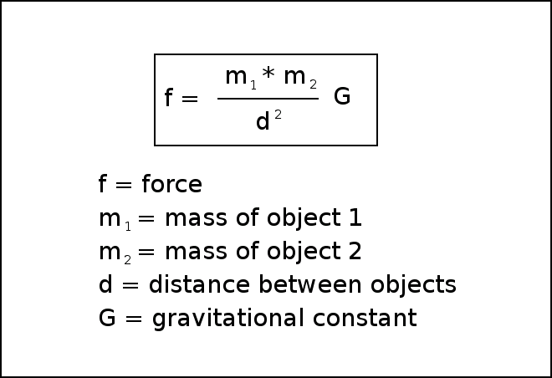
Newton's Law of Universal Gravitation

Slide 71
Working with
Planetary Gravity
The mass of the two objects is important.
The distance between the objects is also critical.
There's a gravitational constant, G.
Both objects exert a force on each other.

Slide 72
Simplifying Newton's Formula
For an arcade game, you can simplify things quite a bit.
One object is usually much smaller than the other, so I'll give the ship a mass of 1.
The force of the small object on the large one is so miniscule it will be ignored.
G can be left out for now.

Slide 73
Modifying the Ship to Orbit
Add a mass attribute. (Set the mass to 1 initially.)
The ship no longer needs a checkbounds() method because bouncing or wrapping would change the orbit.
The ship draws its own path, which makes it easier to visualize the orbits.

Slide 74
Building a Planet
The planet also needs a mass property.
It also has a gravitate() method that calculates the planet's pull on any object fed as a parameter.
The orbiting object's dx and dy attributes are adjusted to compensate for the gravitational pull.
This method is called once per frame.

Slide 75
The gravitate() Method
def gravitate(self, body):
""" calculates gravitational pull on
object """
(self.x, self.y) = self.rect.center
#get dx, dy, distance
dx = self.x - body.x
dy = self.y - body.y
distance = math.sqrt((dx * dx) + (dy * dy))
#normalize dx and dy
dx /= distance
dy /= distance
force = (body.mass * self.mass)/(math.pow(distance, 2))
dx *= force
dy *= force
body.dx += dx
body.dy += dy

Slide 76
How gravitate() Works
Accept a sprite as a parameter (the sprite must have a mass attribute).
Determine the planet's x and y values.
Calculate the dx and dy between the objects.
Calculate the distance between them.
Divide dx and dy by the distance. This creates a motion vector of length 1 drawing the ship and planet together.

Slide 77
More on gravitate()
Calculate the force of gravity.
Use a simplified form of the gravitation formula.
Multiply dx and dy by the gravitational force.
Add the new gravity vector to the ship's motion vector.
force = (body.mass * self.mass)/(math.pow(distance, 2))

Slide 78
Discussion Questions
How do Newton's Laws affect game development?
When is continuous keyboard motion preferred?
How does vector projection simplify motion code?
How might you make a system with a ship orbiting between a planet and the planet's moon?

Slide 79
Summary
You should now understand
  Basic rules of motion
  Getting continuous input from the keyboard
  Using vector projection
  Calculating the distance and angle between points
  Following the mouse
  Handling basic gravity and orbital physics
  Modeling spacecraft motion

Slide 80
Next Lecture
Game Engine

Slide 81
References
Andy Harris, “Game Programming, The L Line, The Express Line to Learning”; Wiley, 2007

