Slide 1


CSE 414 Systems Analysis and Design
Lecture #10
Designing Interfaces and Dialogues
Prepared & Presented by Asst. Prof. Dr. Samsun M. BAŞARICI

Slide 2
Learning Objectives
Explain the process of designing interfaces and dialogues and the deliverables for their creation.
Contrast and apply several methods for interacting with a system.
Describe and apply the general guidelines for designing interfaces and specific guidelines for layout design, structuring data entry fields, providing feedback, and system help.

Slide 3
Learning Objectives (Cont.)
Design human-computer dialogues and understand how dialogue diagramming can be used to design dialogues.
Design graphical user interfaces.
Discuss guidelines for the design of interfaces and dialogues for Internet-based electronic commerce systems.

Slide 4
Interface Design and Dialogues
Defining the manner in which humans and computers exchange inform
Interface design – focuses on how information is provided to and captured from users
Dialogues – analogous to a conversation between two people
Notes:
In the last chapter, we focused on the look-and-feel of each of the various screens that an application presents to the user. Here, we emphasize the back-and-forth that will take place between the user and the system.
Remember, we have CASE tools to help us do this. Therefore, it’s pretty simple to quickly make screen mockups. But we also want to look at the system as a whole, in other words the collection of screens, forms, reports. Part of this involves the navigation between screens, as we’ll see.

Slide 5
Designing Interfaces and Dialogues
User-focused activity
Prototyping methodology of iteratively:
  Collecting information
  Constructing a prototype
  Assessing usability
  Making refinements
Must answer the who, what, when, where, and how questions
Notes:
Prototyping is quite conducive for interface design. We’ll see more about this later.
Usability refers to how easy, informative, and enjoyable is the user’s experience with the system. Obviously, you want to maximize usability, and there are ways of measuring this. We’ll see more about this later.

Slide 6
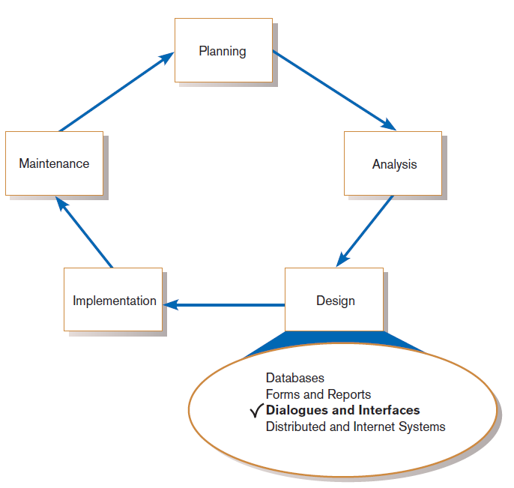
Designing Interfaces and Dialogues (Cont.)
FIGURE 11-1
Systems development life cycle (SDLC)
Notes:
Remember, we’re in the design phase here. By now, we’ve got a pretty good idea of the system requirements (the needs of the user). In a waterfall model, we’ve fallen from analysis to design, and may not return. But keep in mind that for agile methodologies, this cycle keeps going round and round, which means that what we do during design feeds our analysis and understanding of the requirements as well. Systems grow and evolve, and the development cycle evolves as well.
Note also that we are still talking about user interface design. Previously we talked about database design. Now, in our user interface design we’re looking at the overall interplay between user and system, as we’ll see.

Slide 7
Deliverables and Outcomes
Creation of a design specification
  A typical interface/dialogue design specification is similar to form design, but includes multiple forms and dialogue sequence specifications.
Notes:
In general, the output of the SDLC design phase is to produce a design specification. For database design, we produced a database design specification (both logical and physical). In terms of user interface design, we are producing specifications for user interface, not just in the context of an individual screen, but in the broader context of multiple screens and multiple interactions with the user.

Slide 8
Deliverables and Outcomes (Cont.)
The specification includes:
  Narrative overview
  Sample design
  Testing and usability assessment
  Dialogue sequence
Dialogue sequence—the ways a user can move from one display to another
Notes:
We’ll see some examples of dialogue sequences shortly.

Slide 9
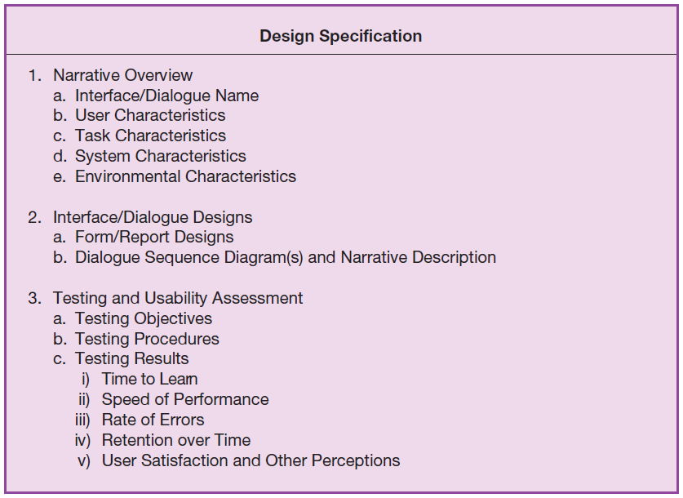
Figure 11-2
Specification outline for the design of interfaces and dialogues
Notes:
This is an outline of a possible user interface design spec. It includes descriptions of the users, task, system, and environment. Based on these factors, there are descriptions and diagrams of forms and reports, as well as diagrams of dialogue sequencing (more on this later). A lot of this can be done with the help of CASE tools.
Finally, you have description of how to test the effectiveness, usefulness, efficiency, etc. of the user interface design. We’ll talk more about this later as well.

Slide 10
Interaction Methods and Devices
Interface: a method by which users interact with an information system
All human-computer interfaces must:
  have an interaction style, and
  use some hardware device(s) for supporting this interaction.

Slide 11
Methods of Interacting
Command line
  Includes keyboard shortcuts and function keys
Menu
Form
Object-based
Natural language

Slide 12
Command Language Interaction
Command language interaction: a human-computer interaction method whereby users enter explicit statements into a system to invoke operations
Example from Linux command prompt:
  $ cp file.doc newfile.doc
  Makes a copy of file.doc and names it newfile.doc
  The dollar sign is the command prompt from Linux, not part of the command itself.
Notes:
Although most of our interaction with systems is done in a graphical user interface with windows and buttons and menus, etc., all operating systems include a command language and text-based command prompts. And applications that you develop can also support command line interaction if needed.

Slide 13
Menu Interaction
Menu interaction: a human-computer interaction method in which a list of system options is provided and a specific command is invoked by user selection of a menu option
Pop-up menu: a menu-positioning method that places a menu near the current cursor position
Notes:
You obviously encounter menus a lot as a typical user. Toolbars and banners are similar to menus.

Slide 14
Menu Interaction (Cont.)
Drop-down menu is a menu-positioning method that places the access point of the menu near the top line of the display.
  When accessed, menus open by dropping down onto the display.
  Visual editing tools help designers construct menus.

Slide 15
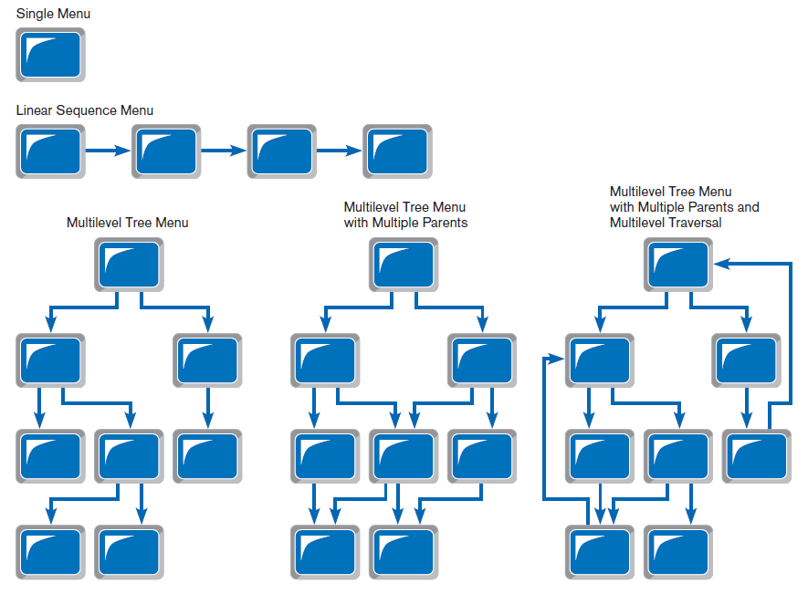
Figure 11-5
Various types of menu configurations
(Source: Based on Shneiderman et al., 2009.)
Notes:
As you can see, there are a lot of options in how to structure menus, and the decisions about menu structure are an important part of user interface design. You want your menus to be structured so as to make it as easy and intuitive as possible for users to navigate through the system.

Slide 16
Menu Interaction (Cont.)
Guidelines for Menu Design
  Wording — meaningful titles, clear command verbs, mixed upper/lower case
  Organization — consistent organizing principle
  Length — all choices fit within screen length
  Selection — consistent, clear and easy selection methods
  Highlighting — only for selected options or unavailable options
Notes:
These guidelines should be familiar to you. They are very similar to the guidelines for forms and reports that we discussed in chapter 10. You want your menus to be “user friendly”, just like your form and report layout and content.

Slide 17
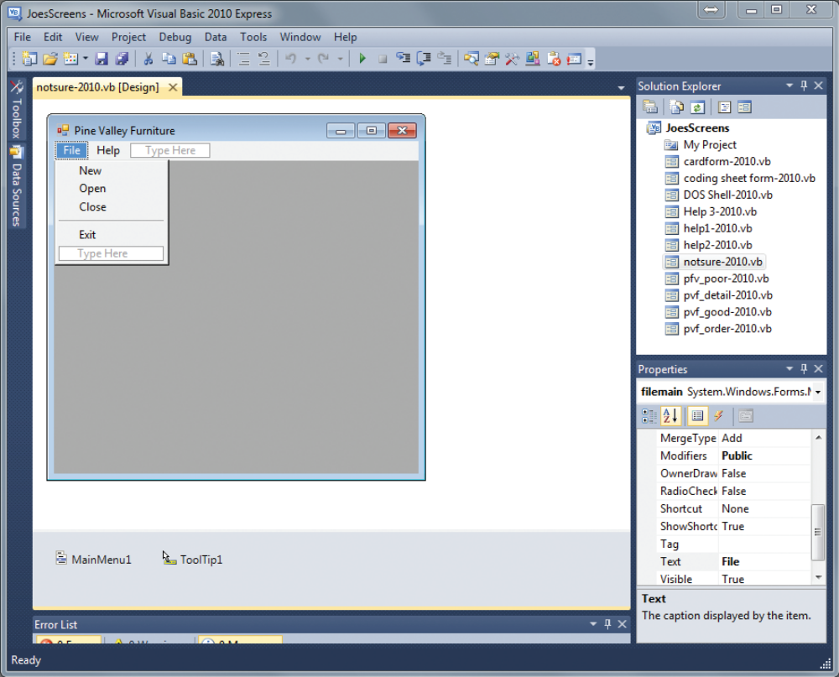
Menu Interaction (Cont.)
FIGURE 11-8
Menu building with Microsoft Visual Basic .NET
(Source: Microsoft Corporation.)
Notes:
GUI and CASE tools include menu building functions, making user interfaces easy to prototype.

Slide 18
Form Interaction
Form interaction: a highly intuitive human-computer interaction method whereby data fields are formatted in a manner similar to paper-based forms
  Allows users to fill in the blanks when working with a system.

Slide 19
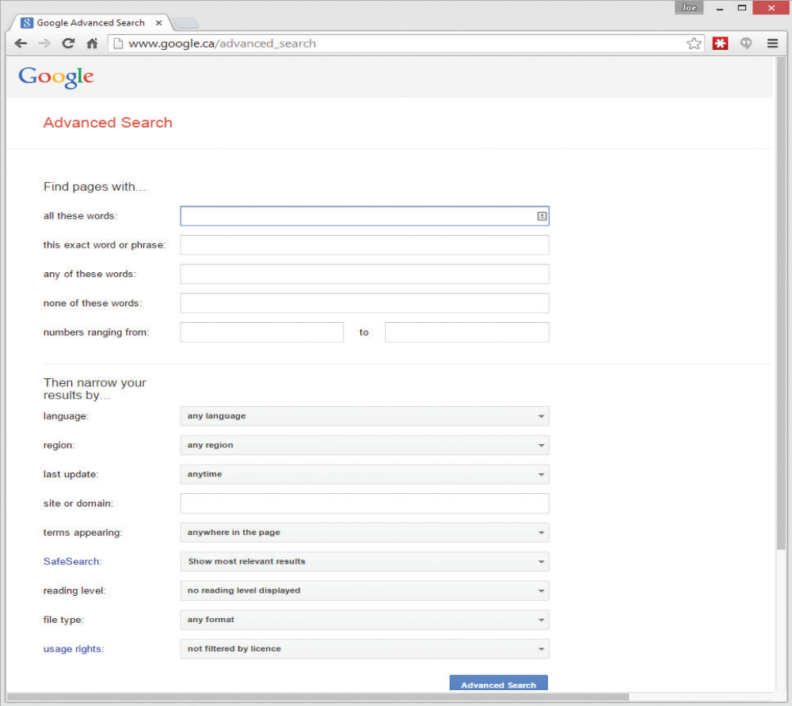
Form Interaction (Cont.)
FIGURE 11-9
Example of form interaction from the Google Advanced Search Engine
(Source: Google.)
Notes:
Obviously we talked about forms in the previous chapter. At that time we were focused on layout and presentation. But forms aren’t just for display, they are also for user interaction. So the kinds of widgets and icons should make it as easy as possible for users to enter information. This will be discussed in more detail later.

Slide 20
Object-Based Interaction
Object-based interaction: a human-computer interaction method in which symbols are used to represent commands or functions
Icons: graphical pictures that represent specific functions within a system
  Use little screen space and are easily understood by users

Slide 21
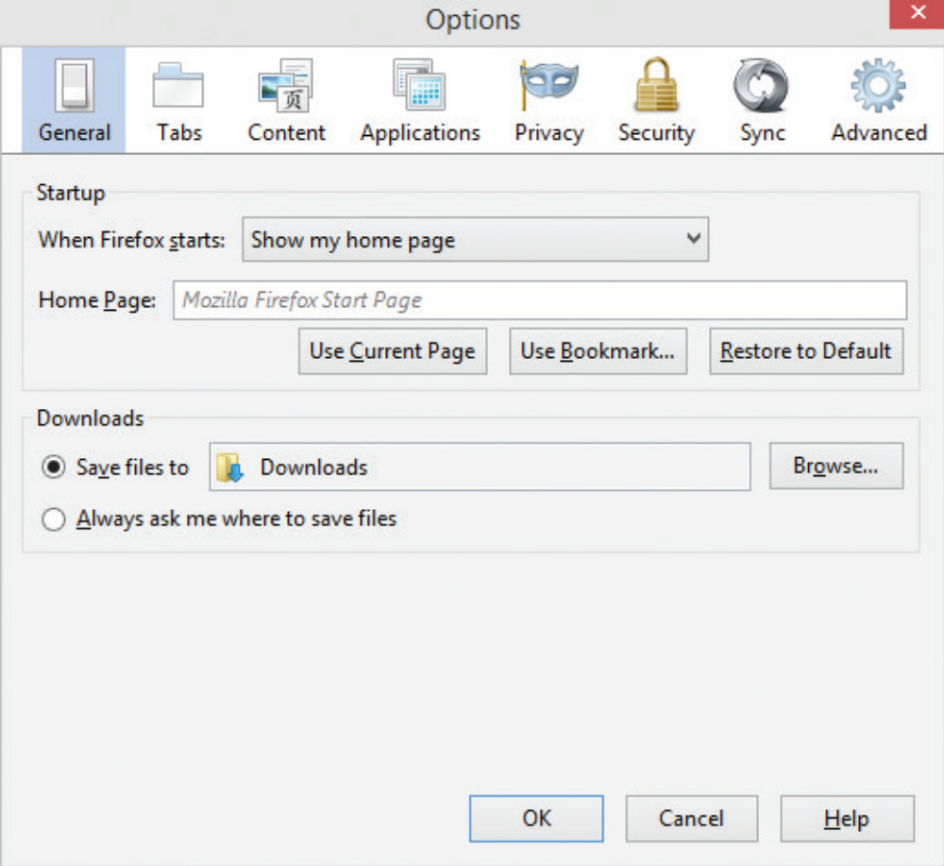
Object-Based Interaction (Cont.)
Figure 11-10
Object-based (icon) interface from the Option menu in the Firefox Web browser
(Source: Mozilla Firefox.)
Notes:
Each one of these icons are like buttons, and they trigger some function or service for the user.

Slide 22
Natural Language Interaction
Natural language interaction: a human-computer interaction method whereby inputs to and outputs from a computer-based application are in a conventional spoken language such as English
Based on research in artificial intelligence
Current implementations are tedious and difficult to work with, not as viable as other interaction methods.
Notes:
We’ve come a long way in this area. We especially see it with mobile apps like Google Now (for Androids) and Apple’s Siri for iPhones.

Slide 23
Hardware Options for System Interaction
Keyboard
Mouse
Joystick
Trackball
Touch screen
Light Pen
Graphics Tablet
Voice
Notes:
Obviously, some of these are used more than others. If you use a laptop computer you’re probably not using a joystick, and trackballs are much less common than they used to be. Touch screens are becoming standard on most displays. Keyboards and mice remain in wide use, but tablets continue to gain ground. Voice is still limited, but with natural language processing (NLP) advances we’ll see more of this in the future.

Slide 24
Usability Problems with Hardware Devices
Visual Blocking
  Extent to which device blocks display when using
User Fatigue
  Potential for fatigue over long use
Movement Scaling
  Extent to which device movement translates to equivalent screen movement
Durability
  Lack of durability or need for maintenance (e.g., cleaning) over extended use
Notes:
Each of the major approaches have their potential disadvantages. We can compare them along several dimensions. Here are a few.

Slide 25
Usability Problems with Hardware Devices (Cont.)
Adequate Feedback
  Extent to which device provides adequate feedback for each operation
Speed
  Cursor movement speed
Pointing Accuracy
  Ability to precisely direct cursor

Slide 26
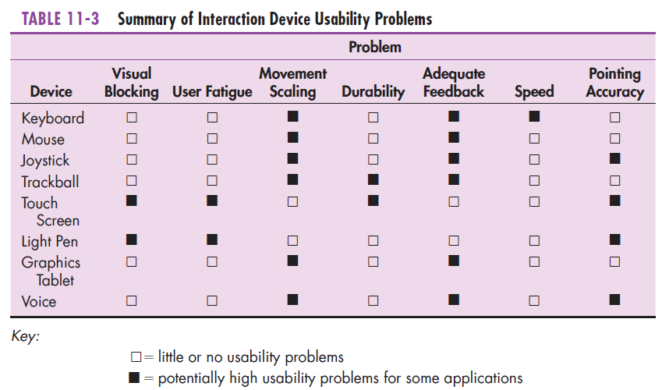
Usability Problems with Hardware Devices (Cont.)
Notes:
These two slides show the results of studies that were done in “usability assessment research”. This figure relates each device to the types of problems we just discussed.

Slide 27
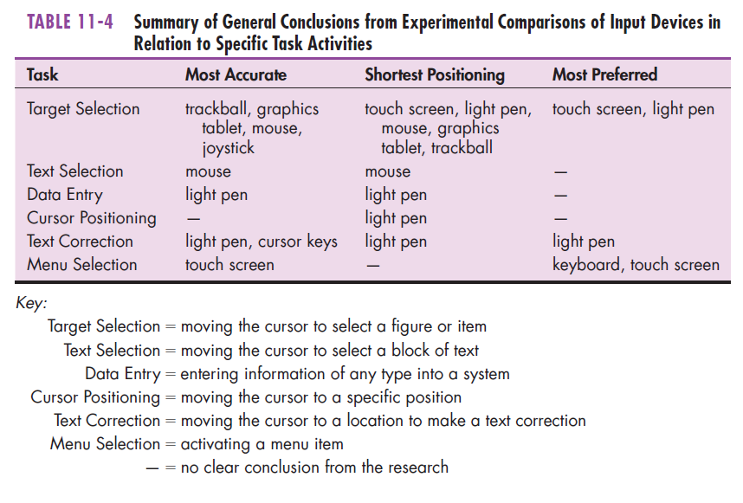
Usability Problems with Hardware Devices (Cont.)
Notes:
Here we see what the usability assessment research shows about the types of devices that are most useful for particular tasks. When selecting the hardware components for a user interface it’s good to know these things.

Slide 28
Designing Interfaces
Forms have several general areas in common:
  Header information
  Sequence and time-related information
  Instruction or formatting information
  Body or data details
  Totals or data summary
  Authorization or signatures
  Comments

Slide 29
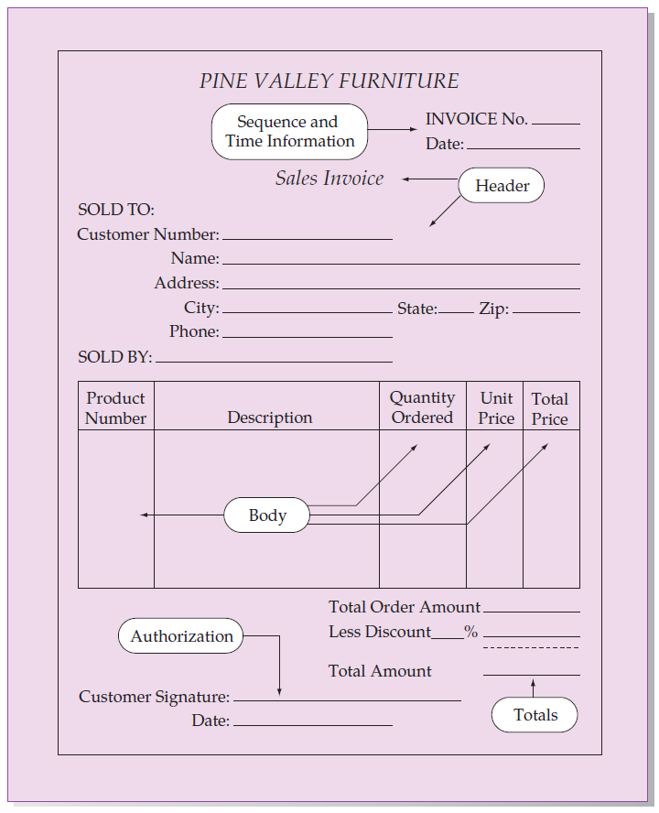
Figure 11-11
Paper-based form for reporting customer
sales activity (Pine Valley Furniture)
Notes:
Here’s a sample form. You can see all of the pieces that were listed in the previous slide.

Slide 30
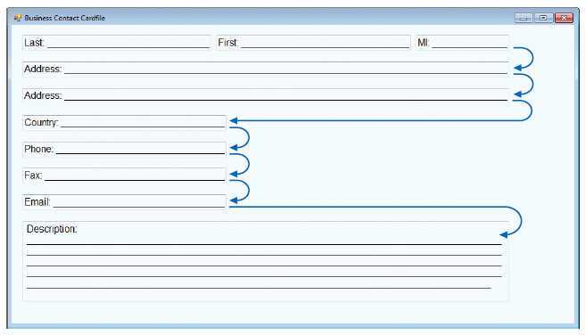
Designing Interfaces (Cont.)
Use standard formats similar to paper-based forms and reports.
Use left-to-right, top-to-bottom navigation.
Figure 11-13a
Proper flow between data entry field
(Source: Microsoft Corporation.)
Notes:
The tab key on the keyboard can take you from one field to another. When designing a form, the CASE tool allows you to control which field will be the one when that gets the focus when you tab in another one. A top-down, left-to right navigation is generally the most intuitive.

Slide 31
Structuring Data Entry
Entry | Never require data that are already online or that can be computed
Defaults | Always provide default values when appropriate
Units | Make clear the type of data units requested for entry
Replacement | Use character replacement when appropriate
Captioning | Always place a caption adjacent to fields
Format | Provide formatting examples
Justify | Automatically justify data entries
Help | Provide context-sensitive help when appropriate
Notes:
We want to make user-input as simple and as error-free as possible. So, we can design the user interface to automatically provide ways of ensuring this.

Slide 32
Controlling Data Input
Objective: Reduce data entry errors
Common sources of data entry errors in a field:
  Appending: adding additional characters
  Truncating: losing characters
  Transcripting: entering invalid data
  Transposing: reversing sequence of characters

Slide 33
Validation Tests and Techniques
Class or Composition
  Test to ensure that data are of proper type (e.g., all numeric, all alphabetic, all alphanumeric)
Combinations
  Test to see if the value combinations of two or more data fields are appropriate or make sense (e.g., Does the quantity sold make sense given the type of product?)
Notes:
Data input validation is very important. There are several things to validate, as we see in these next few slides. Let’s consider each of these in turn.

Slide 34
Validation Tests and Techniques (Cont.)
Expected Values
  Test to see if data are what is expected (e.g., match with existing customer names, payment amount, etc.)
Missing Data
  Test for existence of data items in all fields of a record (e.g., Is there a quantity field on each line item of a customer order?)
Notes:
GUI building CASE tools, like what we’ve seen with Microsoft Visual Studio, provide data input validation capabilities. You can, for example, set an input field to allow only numeric data to be entered, or you can set it so that a form’s data cannot be submitted with empty fields.

Slide 35
Validation Tests and Techniques (Cont.)
Pictures/Templates
  Test to ensure that data conform to a standard format (e.g., Are hyphens in the right places for a student ID number?)
Range
  Test to ensure data are within proper range of values (e.g., Is a student’s grade point average between 0 and 4.0?)

Slide 36
Validation Tests and Techniques (Cont.)
Reasonableness
  Test to ensure data are reasonable for situation (e.g., pay rate for a specific type of employee)
Self-Checking Digits
  Test where an extra digit is added to a numeric field in which its value is derived using a standard formula
Notes:
Some validation techniques may require behind-the-scenes coding to actually validate. Form-building tools can’t do all possible validation checks; after all, some of these validations depend on your company’s rules. In this case, the design phase wouldn’t implement the validation, but it would be included in the design specifications that are sent to the next SDLC phase, Implementation.

Slide 37
Validation Tests and Techniques (Cont.)
Size
  Test for too few or too many characters (e.g., Is social security number exactly nine digits?)
Values
  Test to make sure values come from set of standard values (e.g., two-letter state codes)

Slide 38
Providing Feedback
Three types of system feedback:
  Status information: keep user informed of what’s going on, helpful when user has to wait for response
  Prompting cues: tell user when input is needed, and how to provide the input
  Error or warning messages: inform user that something is wrong, either with data entry or system operation
Notes:
The dialogue between user and system is a two-way street. The system validates and takes input from users, as we saw in past few slides. The system also presents information to users, as we see here.

Slide 39
Providing Help
Place yourself in user’s place when designing help.
Guidelines for designing usable help:
  Simplicity — Help messages should be short and to the point.
  Organize — Information in help messages should be easily absorbed by users.
  Show — It is useful to explicitly show users how to perform an operation.
Notes:
Help information should be easy to read and understand, and it should be easy for the user to find what he or she is looking for,

Slide 40
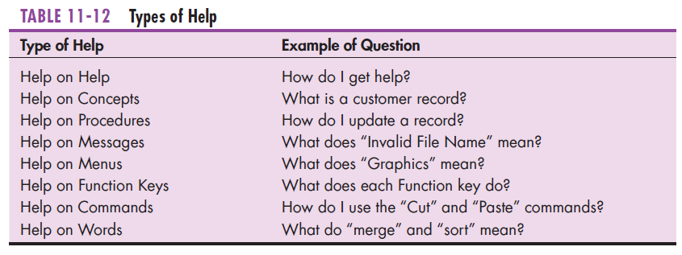
Types of Help

Slide 41
Designing Dialogues
Dialogue: the sequence of interaction between a user and a system
Dialogue design involves:
  Designing a dialogue sequence.
  Building a prototype.
  Assessing usability.
Notes:
Up to now, we’ve talked about individual forms and reports, menu structures of applications, validating user input and providing useful information. Now we start to talk about the dialogue between user and system. This is a sequence, often with branches and conditions, of forms and displays that are presented to user, depending on the particular tasks that need to be done. Designing this sequence in the most efficient and user-friendly manner is an important task at this phase of the SDLC.

Slide 42
Designing the Dialogue Sequence
Typical dialogue between user and Customer Information System:
  Request to view individual customer information.
  Specify the customer of interest.
  Select the year-to-date transaction summary display.
  Review the customer information.
  Leave system.

Slide 43
Guidelines for Designing Human-Computer Dialogues
Consistency
Shortcuts and Sequence
Feedback
Closure
Error Handling
Reversal
Control
Ease
Notes:
The book provides this list of guidelines, based a book called Designing the User Interface: Strategies for Effective Human-Computer Interaction
Shneiderman, Plaisant, Cohen, and Jacobs, published in 2009. Here’s what each of these items mean:
Dialogues should be consistent in sequence of actions, keystrokes, and terminology (e.g., the same labels should be used for the same operations on all screens, and the location of the same information should be the same on all displays).
Allow advanced users to take shortcuts using special keys (e.g., CTRL-C to copy highlighted text). A natural sequence of steps should be followed (e.g., enter first name before last name, if appropriate).
Feedback should be provided for every user action (e.g., confirm that a record has been added, rather than simply putting another blank form on the screen).
Dialogues should be logically grouped and have a beginning, middle, and end (e.g., the last in the sequence of screens should indicate that there are no more screens).
All errors should be detected and reported; suggestions on how to proceed should be made (e.g., suggest why such errors occur and what user can do to correct the error). Synonyms for certain responses should be accepted (e.g., accept either “t,” “T,” or “TRUE”).
Dialogues should, when possible, allow the user to reverse actions (e.g., undo a deletion); data should not be deleted without confirmation (e.g., display all the data for a record the user has indicated is to be deleted).
Dialogues should make the user (especially an experienced user) feel in control of the system (e.g., provide a consistent response time at a pace acceptable to the user).
It should be a simple process for users to enter information and navigate between screens (e.g., provide means to move forward, backward, and to specific screens, such as first and last).

Slide 44
Designing the Dialogue Sequence (Cont.)
Dialogue diagramming: a formal method for designing and representing human-computer dialogues using box and line diagrams
Notes:
We’ve talked about lots of diagramming models in this course, for process flow, database structures, and user interfaces. We’ve used diagrams in all SDLC phases so far, including planning, analysis, and design. Now, we’re going to talk about yet another diagramming technique, this time for representing the dialogue between user and system.

Slide 45
Designing the Dialogue Sequence (Cont.)
Three sections of the box:
  Top—contains a unique display reference number used by other displays for referencing it
  Middle—contains the name or description of the display
  Bottom—contains display reference numbers that can be accessed from the current display
Notes:
Each box in the diagram represents a particular user screen. The bottom part is important because it lists all the other screens that the user can get to from this screen.

Slide 46
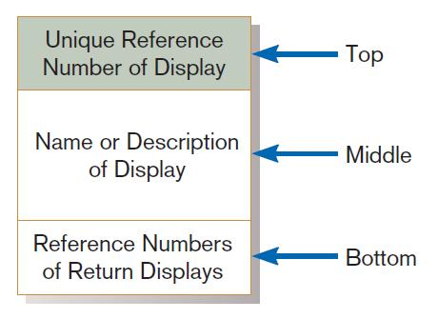
Designing the Dialogue Sequence (Cont.)
FIGURE 11-17
Sections of a dialogue diagramming box
Notes:
Here is the symbol of a single dialogue element,

Slide 47
Designing the Dialogue Sequence (Cont.)
Dialogue diagrams depict the sequence, conditional branching, and repetition of dialogues.

Slide 48
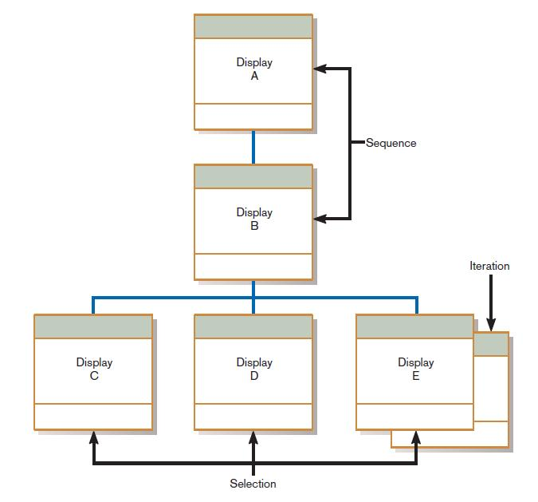
Designing the Dialogue Sequence (Cont.)
FIGURE 11-18
Dialogue diagram illustrating sequence, selection, and iteration
Notes:
This is like a flowchart. Remember, each box represents a screen display. We can sequence from one screen display to another. For example, a screen may ask a user to enter some information and then press the NEXT button, which brings up another screen. That would be a sequence. Or a user may select from a menu or a list of buttons to decide which screen to go to next; that would be a selection. Screens can even repeat themselves, which is an iteration. Each of these can be depicted in a dialogue diagram, as we see here.

Slide 49
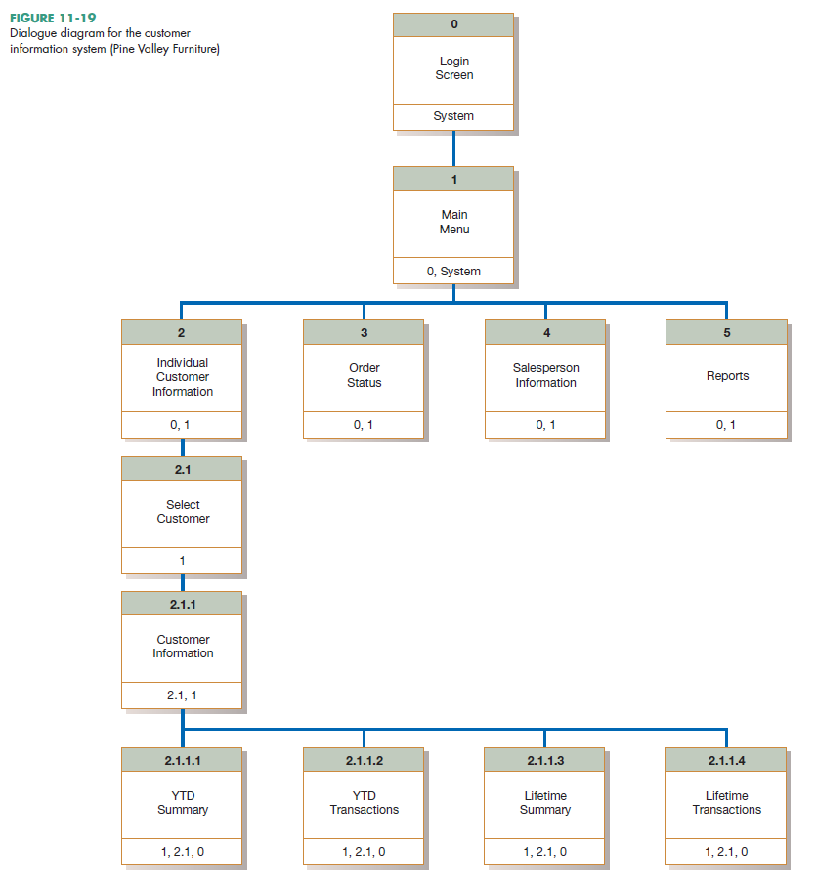
Designing the Dialogue Sequence (Cont.)
Notes:
Here is a practical example from Pine Valley Furniture.
Question: where to you see sequencing?
Answer: login to main menu, and also 2 to 2.1 to 2.1.1.
Question: where do you see selection?
Answer: menu choices branching out from 1. Also choices branching out from 2.1.1.
Question: where to you see iteration?
Answer: there is no iteration in this diagram. But you can think of examples of iterations. For example, consider an ATM. Within a dialogue, you may do several transactions, so the “transaction screen” would reappear multiple times. This is an example of iteration.

Slide 50
Building Prototypes and Assessing Usability
Optional activities
Building prototype displays using a graphical development environment
  Example: Microsoft’s Visual Studio .NET
  Easy-to-use input and output (form, report, or window) design utilities
Notes:
Yet again we see prototypes. That’s the great thing about CASE tools and other software development tools.

Slide 51
Graphical Interface Design Issues
Become an expert user of the GUI environment.
  Understand how other applications have been designed.
  Understand standards.
Understand the available resources and how they can be used.
  Become familiar with standards for menus and forms.
Notes:
User interface design is a skill that develops over time.

Slide 52
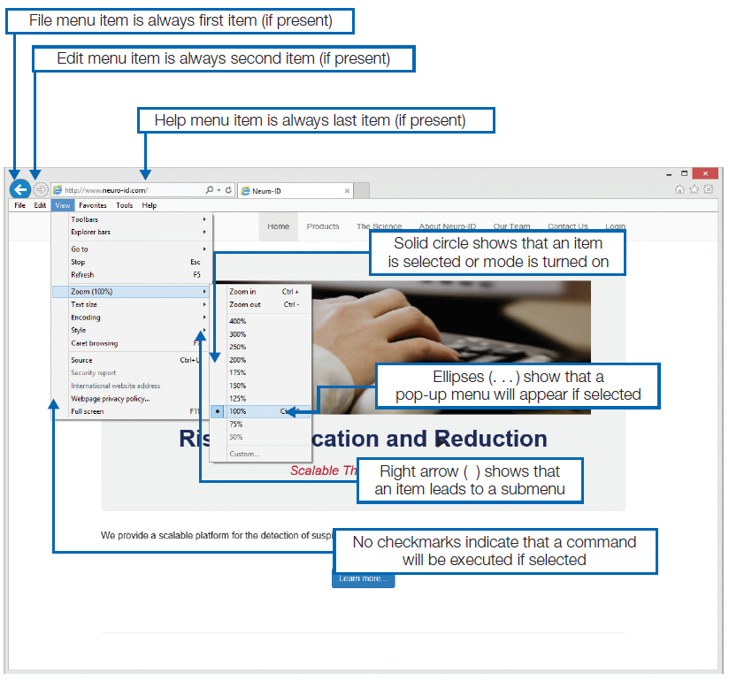
Graphical Interface Design Issues (Cont.)
Figure 11-21
Highlighting GUI design standards
(Source: University of Arizona.)
Notes:
There are lots of standards and guidelines available for doing good user interface design. This is an art as much as a science, and it’s a skill you’ll develop over time as a systems analyst.

Slide 53
Electronic Commerce Application: Designing Interfaces and Dialogues for Pine Valley Furniture WebStore
Central and critical design activity
Where customer interacts with the company
  Care must be put in design!
Prototyping design process is most appropriate to design the human interface.
Several general design guidelines have emerged.

Slide 54
General Guidelines
Web’s single “click-to-act” method of loading static hypertext documents (i.e. most buttons on the Web do not provide click feedback)
Limited capabilities of most Web browsers to support finely grained user interactivity

Slide 55
General Guidelines (Cont.)
Limited agreed-upon standards for encoding Web content and control mechanisms
Lack of maturity of Web scripting and programming languages as well as limitations in commonly used Web GUI component libraries

Slide 56
Designing Interfaces and Dialogues for Pine Valley Furniture
Key feature PVF wants for their WebStore:
  Incorporate “menu-driven navigation with cookie crumbs” into design of interface

Slide 57
Menu-Driven Navigation with Cookie Crumbs
Cookie crumbs: the technique of placing “tabs” on a Web page that show a user where he or she is on a site and where he or she has been
  Allow users to navigate to a point previously visited and will assure they are not lost
  Clearly show users where they have been and how far they have gone from home

Slide 58
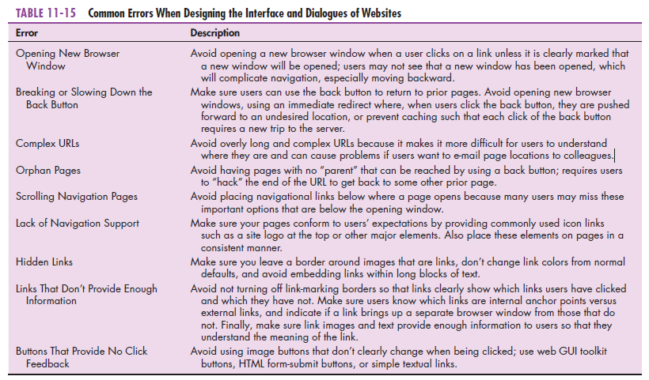
Notes:
This table shows a lot of good ideas of what to avoid in Web site design. Let’s look at each in turn…

Slide 59
Summary
Now you learned how to:
  Explain the process of designing interfaces and dialogues and the deliverables for their creation.
  Contrast and apply several methods for interacting with a system.
  Describe and apply the general guidelines for designing interfaces and specific guidelines for layout design, structuring data entry fields, providing feedback, and system help.

Slide 60
Summary (Cont.)
Now you learned how to:
  Design human-computer dialogues and understand how dialogue diagramming can be used to design dialogues.
  Design graphical user interfaces.
  Discuss guidelines for the design of interfaces and dialogues for Internet-based electronic commerce systems.

Slide 61
Next Lecture
Designing Distributed and Internet Systems

Slide 62
References
Joseph S. Valacich, Joey F. George, Modern Systems Analysis and Design, 8th Global Edition, Pearson, 2016

