Slide 1


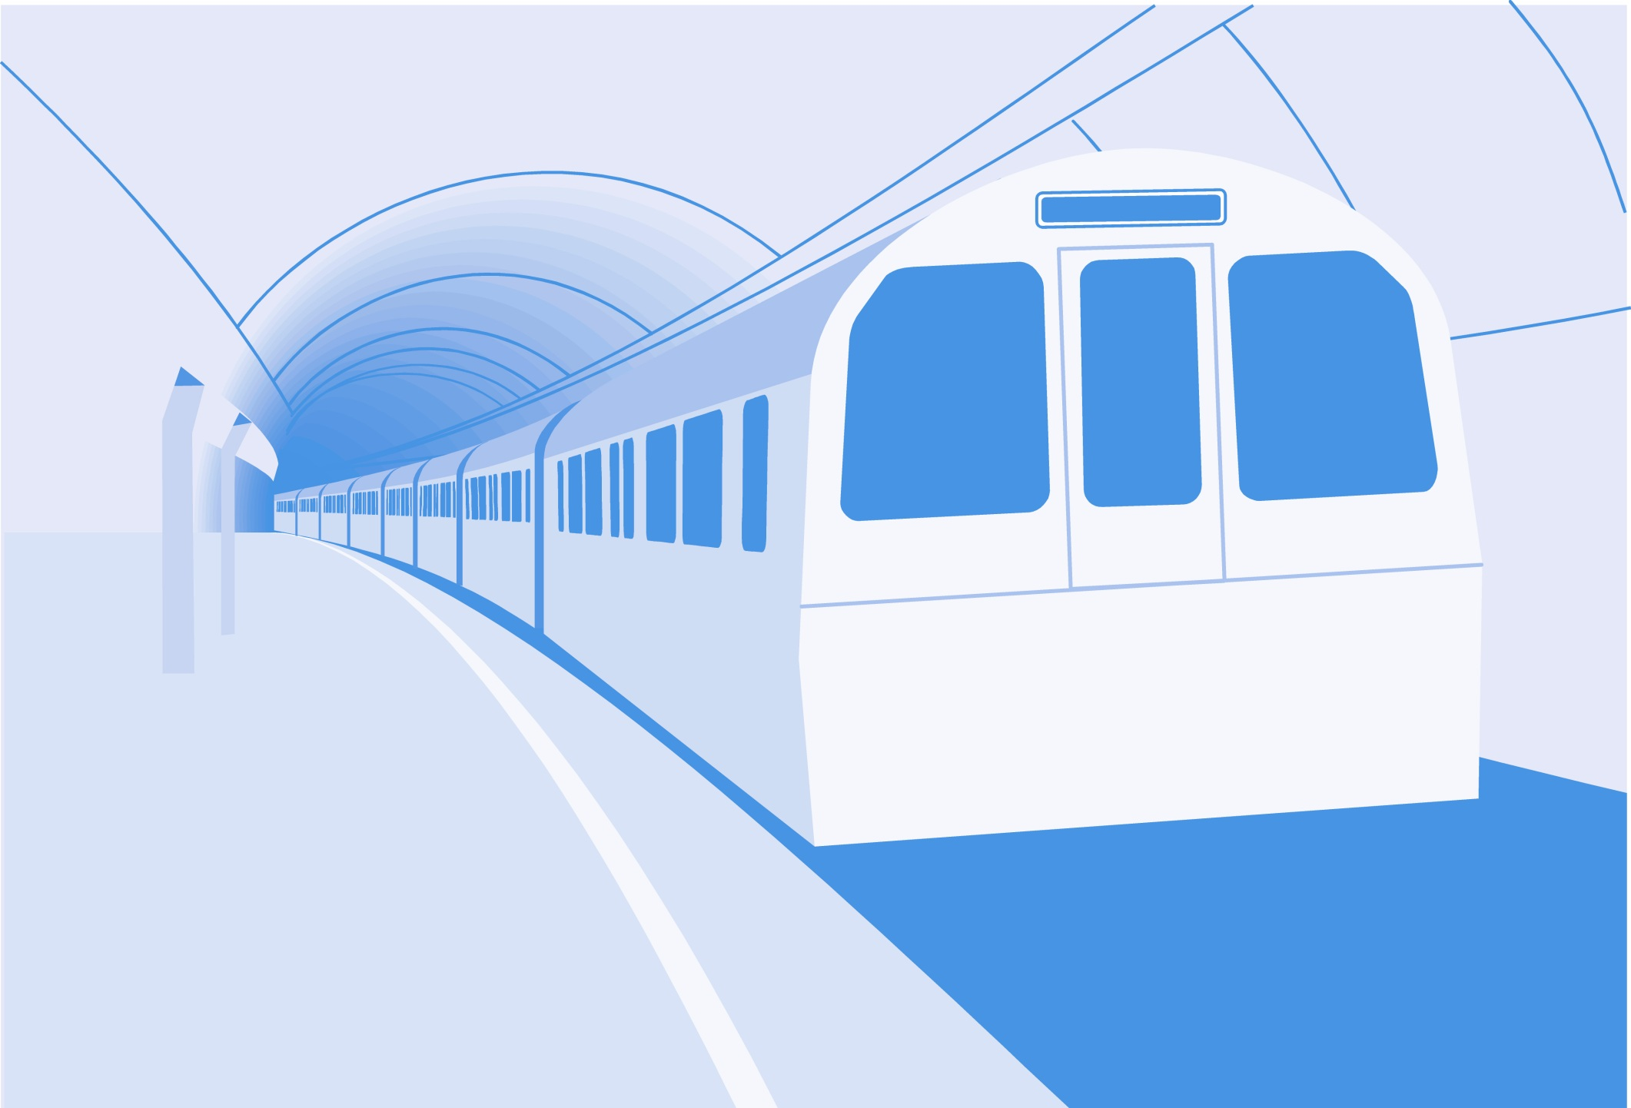
L
L Line
CSE 420
Computer Games
Lecture #10 Animated Sprites

Slide 2
Objectives
Examining different boundary-checking
procedures
Animating sprites with multiple images
Adding animation delays
Making a sprite respond to multiple
states

Slide 3
Objectives (cont.)
Rotating and resizing an image
Moving in multiple directions
Calculating basic motion vectors
Building a complex multi-state
animated sprite

Slide 4
Boundary Reactions
Scroll
Wrap
Bounce
Stop
Hide

Slide 5
Making a Reusable Sprite
The next few programs discussed use almost the same class.
The only difference is the way the boundary-checking occurs.
The ball can draw its path on the screen as it travels.
See wrap.py.

Slide 6
Initializing the Ball Class
class Ball(pygame.sprite.Sprite):
def __init__(self, screen, background):
pygame.sprite.Sprite.__init__(self)
self.screen = screen
self.background = background
self.image = pygame.Surface((30, 30))
self.image.fill((255, 255, 255))
pygame.draw.circle(self.image,
(0, 0, 255), (15, 15), 15)
self.rect = self.image.get_rect()
self.rect.center = (320, 240)
self.dx = 5
self.dy = 5

Slide 7
Notes on the Ball Class
It takes two parameters.
screen is needed so the ball will know where the boundaries are.
background is the background surface that will be drawn upon.
Both parameters are copied to attributes for use throughout the sprite.

Slide 8
Updating the Ball Class
Store oldCenter before moving.
Move the ball.
Draw a line on the background from oldCenter to current center.
Check boundaries.
def update(self):
oldCenter = self.rect.center
self.rect.centerx += self.dx
self.rect.centery += self.dy
pygame.draw.line(self.background, (0, 0, 0),
oldCenter, self.rect.center)
self.checkBounds()

Slide 9
Wrapping around the Screen
Move the sprite to the opposite wall if it goes too far.
def checkBounds(self):
""" wrap around screen """
if self.rect.centerx > self.screen.get_width():
self.rect.centerx = 0
if self.rect.centerx < 0:
self.rect.centerx = self.screen.get_width()
if self.rect.centery > self.screen.get_height():
self.rect.centery = 0
if self.rect.centery < 0:
self.rect.centery = self.screen.get_height()

Slide 10
Wrapping and the
Ball's Position
The sprite appears to travel halfway off the stage before moving.
This gives a less abrupt jump.
Compare the sprite's centerx and centery to screen coordinates for this effect.

Slide 11
Bouncing the Ball
See bounce.py.
The code is just like wrap.py except for the checkBounds() method.
If the ball hits top or bottom, it inverts its dy value.
If it hits either side, dx is inverted.

Slide 12
The bounce.py checkBounds()
def checkBounds(self):
""" bounce on encountering any screen boundary """
if self.rect.right >= self.screen.get_width():
self.dx *= -1
if self.rect.left <= 0:
self.dx *= -1
if self.rect.bottom >= self.screen.get_height():
self.dy *= -1
if self.rect.top <= 0:
self.dy *= -1

Slide 13
Notes on Bouncing
Check for the edge of the ball hitting the screen rather than the center.
Multiply dx by -1 to bounce off a vertical wall.
Multiply dy by -1 for a horizontal wall.
Use a smaller number to simulate the loss of energy that happens in a real collision (for example, multiply by -.90).

Slide 14
Stopping
See stop.py.
The sprite stops when encountering any wall.
Set dx and dy to 0 (zero) to stop the sprite's motion.
May also incur damage in a real game.

Slide 15
checkBounds for stop.py
def checkBounds(self):
""" stop on encountering any screen boundary """
if self.rect.right >= self.screen.get_width():
self.dx = 0
self.dy = 0
if self.rect.left <= 0:
self.dx = 0
self.dy = 0
if self.rect.bottom >= self.screen.get_height():
self.dx = 0
self.dy = 0
if self.rect.top <= 0:
self.dx = 0
self.dy = 0

Slide 16
Multi-Frame Sprite Animation
A sprite can have more than one image.
Show images in succession to animate the sprite.
See cowMoo.py.

Slide 17
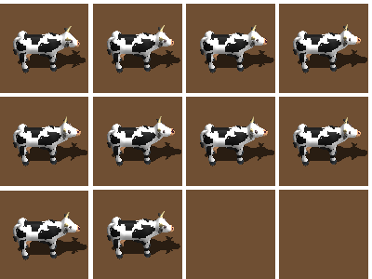
Moo Images
From Reiner's Tilesets: http://reinerstileset.4players.de/englisch.htm

Slide 18
Preparing Images
Draw or download images.
Place the images in the program directory or a subdirectory of the main program.
Name the images sequentially (moo01.bmp, moo02.bmp, and so on).
Modify the images in the editor, if necessary (trim excess blank space, add transparency, or rotate).

Slide 19
Building the Cow Sprite
See cowMooFast.py.
Demonstrates image swapping.
Change the image every frame.
The animation speed will be changed in the next example.

Slide 20
Building the Cow Sprite
Requires a mainly ordinary init.
loadImages() handles images.
self.frame indicates which frame of animation is currently showing.
class Cow(pygame.sprite.Sprite):
def __init__(self):
pygame.sprite.Sprite.__init__(self)
self.loadImages()
self.image = self.imageStand
self.rect = self.image.get_rect()
self.rect.center = (320, 240)
self.frame = 0

Slide 21
Loading the Images
def loadImages(self):
self.imageStand = <next line wrapped for display>
pygame.image.load("cowImages/stopped0002.bmp")
self.imageStand = self.imageStand.convert()
transColor = self.imageStand.get_at((1, 1))
self.imageStand.set_colorkey(transColor)
self.mooImages = []
for i in range(10):
imgName = "cowImages/muuuh e000%d.bmp" % i
tmpImage = pygame.image.load(imgName)
tmpImage = tmpImage.convert()
transColor = tmpImage.get_at((1, 1))
tmpImage.set_colorkey(transColor)
self.mooImages.append(tmpImage)

Slide 22
How loadImages() Works
ImageStand is the default image, loaded in the normal way.
It (like all images in the function) is converted and given a transparent background.
mooImages is an empty list.
Create a for loop to build ten images.
Use interpolation to determine each file name.

Slide 23
More on loadImages()
Create a temporary image.
Convert the temporary image and set its colorkey.
Add the temporary image to the mooImages list.

Slide 24
Updating the Cow
Increment frame counter.
Use the frame to determine which element of mooImages to display.
Copy that image to the sprite's main image property.
def update(self):
self.frame += 1
if self.frame >= len(self.mooImages):
self.frame = 0
self.image = self.mooImages[self.frame]

Slide 25
Delaying Your Animation
The game loop runs at 30 fps.
The cow moos three times per second.
That's too fast for most animations.
You can swap animation frames after every two or three game frames for a more reasonable animation.

Slide 26
Using a Delayed Animation
See cowMooDelay.py.
Only the update() function changes.
def update(self):
self.pause += 1
if self.pause >= self.delay:
#reset pause and advance animation
self.pause = 0
self.frame += 1
if self.frame >= len(self.mooImages):
self.frame = 0
self.image = self.mooImages[self.frame]

Slide 27
How the Delay Works
self.delay indicates how many game frames to skip before switching animation frames.
self.pause counts from zero to self.delay.
When self.pause == self.delay:
  The animation frame is advanced.
  self.pause is set back to zero.

Slide 28
Why Not Just Lower the Frame Rate?
You could simply change the IDEA code to clock.tick(10) to slow down the animation.
That will slow everything down.
You want to keep the overall game speed fast and smooth.
Slow down only the part that needs a delay.

Slide 29
Making a Multi-State Sprite
Games can have multiple states.
So can sprites.
The cow can have a standing and mooing state.
See cowMoo.py again.
The default state is standing.
Pressing the spacebar causes the cow to switch to the mooing state.

Slide 30
Initializing a Multi-State Cow
class Cow(pygame.sprite.Sprite):
def __init__(self):
pygame.sprite.Sprite.__init__(self)
self.STANDING = 0
self.MOOING = 1
self.loadImages()
self.image = self.imageStand
self.rect = self.image.get_rect()
self.rect.center = (320, 240)
self.frame = 0
self.delay = 3
self.pause = 0
self.state = self.STANDING
pygame.mixer.init()
self.moo = pygame.mixer.Sound("moo.ogg")

Slide 31
Notes on cowMoo init()
State constants:
State attribute (determines current state):
Initialize mixer to add sound effects.
Load moo sound as an attribute:
self.STANDING = 0
self.MOOING = 1
self.state = self.STANDING
pygame.mixer.init()
self.moo = pygame.mixer.Sound("moo.ogg")

Slide 32
Responding to the Spacebar
Check the spacebar in event-handling code.
If the user presses the spacebar:
  Change the cow's state to MOOING.
  Play the moo sound.
for event in pygame.event.get():
if event.type == pygame.QUIT:
keepGoing = False
elif event.type == pygame.KEYDOWN:
if event.key == pygame.K_SPACE:
cow.state = cow.MOOING
cow.moo.play()

Slide 33
Updating the
Multi-State Cow
Modify update() to handle multiple states.
The standing state will simply show the standing cow image.
The mooing state progresses through the moo animation.
At the end of the moo animation, the state reverts to standing.

Slide 34
The cowMoo update() Method
def update(self):
if self.state == self.STANDING:
self.image = self.imageStand
else:
self.pause += 1
if self.pause > self.delay:
#reset pause and advance animation
self.pause = 0
self.frame += 1
if self.frame >= len(self.mooImages):
self.frame = 0
self.state = self.STANDING
self.image = self.imageStand
else:
self.image = self.mooImages[self.frame]

Slide 35
Using a Composite Image
The cow images were all separate files.
Sometimes an image is combined.

Slide 36
Animating a Composite Image
You can extract several sub-images from one main image.
Use a variation of blit to extract images from a master image.
See chopper.py.

Slide 37
Extracting Image Details
The image is heli.bmp from Ari's spritelib.
Open the file in an image viewer.
Examine the size and position of each sub-sprite.
Create a chart.

Slide 38
Chopper Image Data
Image # | Left | Top | Width | Height
0 | 2 | 78 | 128 | 64
1 | 134 | 78 | 128 | 64
2 | 266 | 78 | 128 | 64
3 | 398 | 78 | 128 | 64

Slide 39
Extracting a Subsurface
Use a variant of blit():
surfaceA: Surface copying from
surfaceB: Surface copying to
position: Where you want the copy to go on surfaceB
offset: Upper-left corner of the image you want to extract from surfaceA
size: Size of image extracted from surfaceA
surfaceB.blit(surfaceA, position, (offset, size))

Slide 40
Chopper loadImages()
def loadImages(self):
imgMaster = pygame.image.load("heli.bmp")
imgMaster = imgMaster.convert()
self.imgList = []
imgSize = (128, 64)
offset = ((2, 78), (134, 78), (266, 78), (398, 78))
for i in range(4):
tmpImg = pygame.Surface(imgSize)
tmpImg.blit(imgMaster, (0, 0), (offset[i], imgSize))
transColor = tmpImg.get_at((1, 1))
tmpImg.set_colorkey(transColor)
self.imgList.append(tmpImg)

Slide 41
How Chopper loadImages() Works
Load the master image into a local variable.
Create an empty list.
Place the image size in a variable.
Make a list of positions.
Make a for loop.
Create a temporary surface.
blit the sub-image onto a temporary surface.
Set the colorkey.
Add the temporary image to the image list.

Slide 42
Rotating a Sprite
Sometimes you want a sprite to be facing in a particular direction.
You can use the pygame.transform.rotate() function to rotate any image.
Python measures angles mathematically:
  0 degrees is East.
  Measurements increase counter-clockwise.

Slide 43
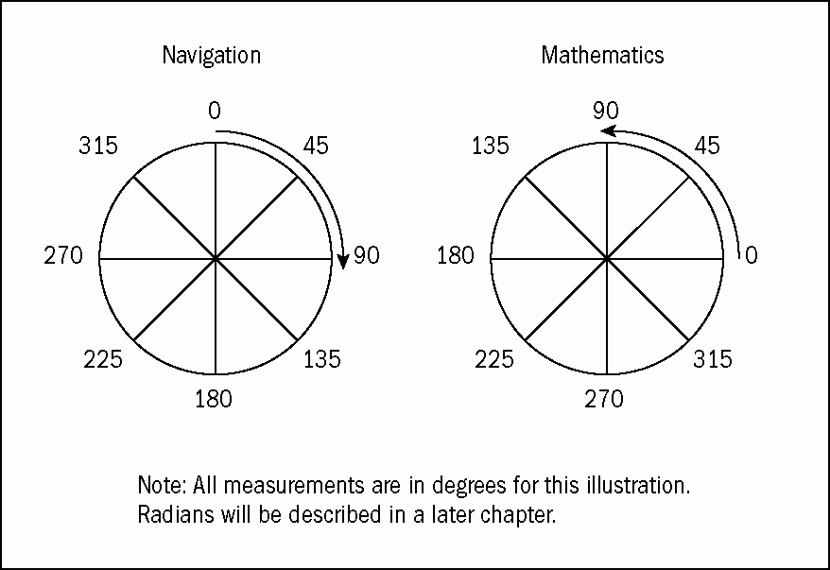
Mathematical Angle Measurements

Slide 44
Tips for Rotated Images
They should be viewed from above.
The light source should be head-on.
Smaller is better. Rotation is computationally expensive.
The default orientation is to East.

Slide 45
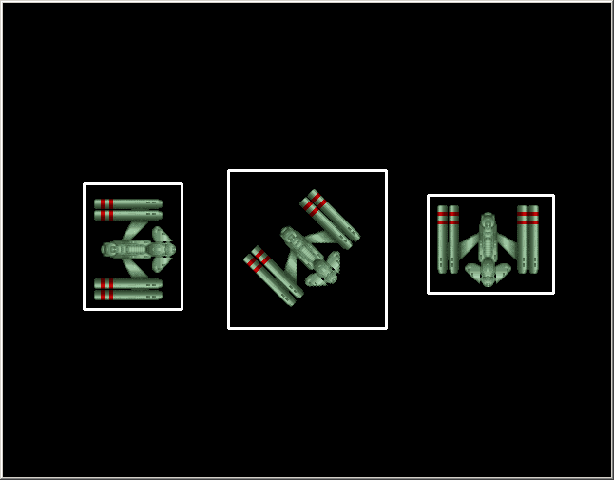
Rotation and Bounding Rectangles
When a sprite rotates, its size might change.

Slide 46
The Changing Size Issue
See drawBounds.py for a real-time example.
This program draws a sprite and draws a rectangle around its bounding box.
When the box changes size, its center should stay in the same place.
You'll write code to ensure this is true.

Slide 47
Building a Rotating Sprite
See rotate.py.
class Ship(pygame.sprite.Sprite):
def __init__(self):
pygame.sprite.Sprite.__init__(self)
self.imageMaster = pygame.image.load("ship.bmp")
self.imageMaster = self.imageMaster.convert()
self.image = self.imageMaster
self.rect = self.image.get_rect()
self.rect.center = (320, 240)
self.dir = 0

Slide 48
Creating a Master
Image in init()
The ship image is loaded to imageMaster (a new attribute).
All rotated images will be derived from this master image. This eliminates "copy of a copy" deterioration.
Store the sprite's direction in the dir attribute.

Slide 49
Updating the Rotated Ship
Update has moved sprites in previous programs.
This update keeps the sprite in the same position.
It calculates a new image based on the sprite's dir property.

Slide 50
The update() Code
Store the current center.
Rotate the imageMaster to make a new image.
Determine the new image size.
Move back to the original center.
def update(self):
oldCenter = self.rect.center
self.image = pygame.transform.rotate(self.imageMaster,
self.dir)
self.rect = self.image.get_rect()
self.rect.center = oldCenter

Slide 51
Turning the Sprite
The sprite has methods to manage turning.
Each method changes the angle and checks for boundaries.
def turnLeft(self):
self.dir += 45
if self.dir > 360:
self.dir = 45
def turnRight(self):
self.dir -= 45
if self.dir < 0:
self.dir = 315

Slide 52
Reading the Keyboard
Modify the event handler to read keyboard input.
while keepGoing:
clock.tick(30)
for event in pygame.event.get():
if event.type == pygame.QUIT:
keepGoing = False
elif event.type == pygame.KEYDOWN:
if event.key == pygame.K_LEFT:
ship.turnLeft()
elif event.key == pygame.K_RIGHT:
ship.turnRight()

Slide 53
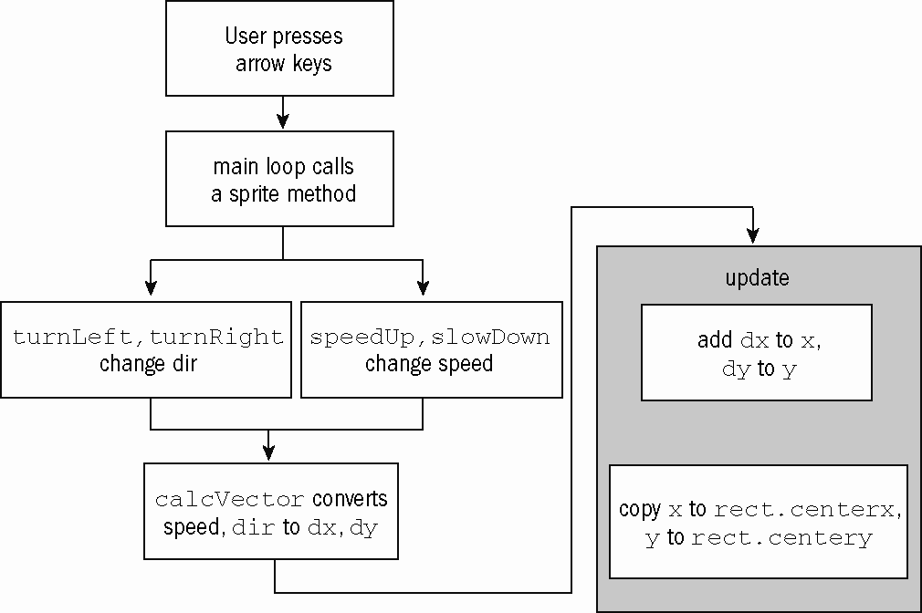
Data Flow Overview for move8dir.py

Slide 54
Moving in Eight Directions
The arrow keys change speed and direction.
Speed and direction are used to determine dx and dy.
dx and dy are used to move the sprite as usual.
See move8dir.py.

Slide 55
Building the Moving Ship
Build a sprite in init().
Add dir, speed, dx, and dy attributes.
self.x = self.rect.centerx
self.y = self.rect.centery
self.dir = 0
self.speed = 0
self.dx = 0
self.dy = 0

Slide 56
Updating the Ship
The only new element is calcVector().
def update(self):
oldCenter = self.rect.center
self.image = pygame.transform.rotate(self.imageMaster,
self.dir)
self.rect = self.image.get_rect()
self.rect.center = oldCenter
self.calcVector()
self.x += self.dx
self.y += self.dy
self.checkBounds()
self.rect.centerx = self.x
self.rect.centery = self.y

Slide 57
Direction Values
Direction | Degrees | dx | dy
East | 0 | 1 | 0
Northeast | 45 | .7 | -.7
North | 90 | 0 | -1
Northwest | 135 | -.7 | -.7
West | 180 | -1 | 0
Southwest | 225 | -.7 | .7
South | 270 | 0 | 1
Southeast | 315 | .7 | .7

Slide 58
Notes on dx and dy Calculations
Degrees are calculated using mathematical notation.
dx and dy move one unit in a given direction.
Multiply dx and dy by speed to obtain any other speed.

Slide 59
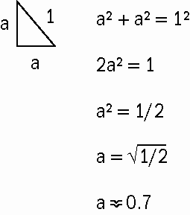
Why are Diagonals .7?

Slide 60
Calculating the Vectors
def calcVector(self):
if self.dir == 0:
self.dx = 1
self.dy = 0
elif self.dir == 45:
self.dx = .7
self.dy = -.7
elif self.dir == 90:
self.dx = 0
self.dy = -1
elif self.dir == 135:
self.dx = -.7
self.dy = -.7
elif self.dir == 180:
self.dx = -1
self.dy = 0
elif self.dir == 225:
self.dx = -.7
self.dy = .7
elif self.dir == 270:
self.dx = 0
self.dy = 1
elif self.dir == 315:
self.dx = .7
self.dy = .7
else:
print "something went wrong here"
self.dx *= self.speed
self.dy *= self.speed

Slide 61
Accepting User Input
Pass control to methods.
while keepGoing:
clock.tick(30)
for event in pygame.event.get():
if event.type == pygame.QUIT:
keepGoing = False
elif event.type == pygame.KEYDOWN:
if event.key == pygame.K_LEFT:
ship.turnLeft()
elif event.key == pygame.K_RIGHT:
ship.turnRight()
elif event.key == pygame.K_UP:
ship.speedUp()
elif event.key == pygame.K_DOWN:
ship.slowDown()

Slide 62
Managing Input
Sprite methods change dir and speed.
def turnLeft(self):
self.dir += 45
if self.dir == 360:
self.dir = 0
def speedUp(self):
self.speed += 1
if self.speed > 8:
self.speed = 8
def turnRight(self):
self.dir -= 45
if self.dir < 0:
self.dir = 315
def slowDown(self):
self.speed -= 1
if self.speed < -3:
self.speed = -3

Slide 63
Combining Motion with Animation
You can combine movement with image-swapping.
See cowEast.py.
The animated cow walks toward the East and wraps.
There’s nothing new here. You’re just combining ideas learned earlier.

Slide 64
Building the Final
Moving Cow
You now can build cow.py.
It incorporates the following:
  Keyboard input
  Eight-direction travel
  Fluid animation in each direction
The hardest part is keeping track of all the images. Multidimensional lists are the secret.

Slide 65
Building a
Two-Dimensional Array
Each direction is an animation of eight images.
There are eight directions.
Build an image list, which is a list of lists.
Each of the sub-lists is a list of images.
self.image = self.imgList[self.dir][self.frame]

Slide 66
Setting Up Direction Constants
Use integers to store basic directions.
The integers will be used to load pictures and manage motion.
#direction constants
EAST = 0
NORTHEAST = 1
NORTH = 2
NORTHWEST = 3
WEST = 4
SOUTHWEST = 5
SOUTH = 6
SOUTHEAST = 7

Slide 67
Creating tuples to
Manage dx and dy
It's more convenient to store dx and dy values in tuples.
Now calcVector() doesn't need an if-elif structure.
self.dxVals = (1, .7, 0, -.7, -1, -.7, 0, .7)
self.dyVals = (0, -.7, -1, -.7, 0, .7, 1, .7)
def calcVector(self):
self.dx = self.dxVals[self.dir]
self.dy = self.dyVals[self.dir]
self.dx *= self.speed
self.dy *= self.speed

Slide 68
Building a List of Images
Begin with a list of the filenames (without specifying image numbers yet).
fileBase = [
"cowImages/walking e000",
"cowImages/walking ne000",
"cowImages/walking n000",
"cowImages/walking nw000",
"cowImages/walking w000",
"cowImages/walking sw000",
"cowImages/walking s000",
"cowImages/walking se000"
]

Slide 69
Complete the Image Structure
Make a list of images for each direction.
Append these images to the imgList.
for dir in range(8):
tempList = []
tempFile = fileBase[dir]
for frame in range(8):
imgName = "%s%d.bmp" % (tempFile, frame)
tmpImg = pygame.image.load(imgName)
tmpImg.convert()
tranColor = tmpImg.get_at((0, 0))
tmpImg.set_colorkey(tranColor)
tempList.append(tmpImg)
self.imgList.append(tempList)

Slide 70
Modifying update()
Use dir and frame to select an image.
def update(self):
self.pause -= 1
if self.pause <= 0:
self.pause = self.delay
self.frame += 1
if self.frame > 7:
self.frame = 0
self.calcVector()
self.image = self.imgList[self.dir][self.frame]
self.rect.centerx += self.dx
self.rect.centery += self.dy
self.checkBounds()

Slide 71
Discussion Questions
What boundary algorithms are used in common games?
How can multi-image animation make a more realistic sprite?
What's the best way to handle large amounts of data (as described in this chapter)?
What two techniques were used to determine dx and dy based on direction?

Slide 72
Summary
You should now understand
  Examining different boundary-checking procedures
  Animating sprites with multiple images
  Adding animation delays
  Making a sprite respond to multiple states
  Rotating and resizing an image
  Moving in multiple directions
  Calculating basic motion vectors
  Building a complex multi-state animated sprite

Slide 73
Next Lecture
Movement

Slide 74
References
Andy Harris, “Game Programming, The L Line, The Express Line to Learning”; Wiley, 2007

