Slide 1


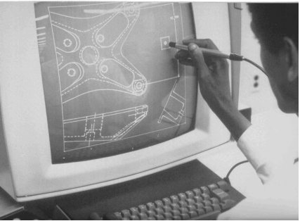
CSE 411
Computer Graphics
Lecture #10 3D Object Representations
Prepared & Presented by Asst. Prof. Dr. Samsun M. BAŞARICI
Notes:
1

Slide 2
Objectives
HB Ch. 13-15 & 23, GVS Ch. 8 & 10
Platonic Solids
Polyhedra
Splines & B-splines
Bézier Curves
Blobby Objects
Predefined Objects in GL, GLU and GLUT
GLU Quadric-Surface Functions
Spline Representations
Fractals

Slide 3
3D Object Representations
Graphics scenes contain many different kinds of objects and material surfaces
  Trees, flowers, clouds, rocks, water, bricks, wood paneling, rubber, paper, marble, steel, glass, plastic, etc.

Slide 4
3D Object Representations (cont.)
We have several techniques
  Polygon and quadric surfaces provide descriptions for simple objects like polyhedrons and ellipsoids
  Spline surfaces and constructive solid geometry techniques are useful for designing curved surfaces like aircraft wings, gears, engine parts, etc.
  Procedural methods, such as fractals, can be used to model terrain features, clouds, grass, etc.

Slide 5
Predefined Objects
There are some predefined objects in OpenGL, so not everything must be created from scratch
In fact, in many cases, these objects can be used and even deformed into other shapes that are handy to use
We will look at wire frame
  Polyhedra
  Polyhedron functions
  Quadric Surfaces
  Superquadrics

Slide 6
Polyhedra
A set of surface polygons that enclose an interior is a polyhedron.
Many graphics systems store all object descriptions as sets of surface polygons.
The reason is that rendering is faster when you are dealing with linear equations defining the objects.
Some systems, like OpenGL, allow Bezier and spline surfaces, but even these are often converted to polygonal representations before going down the pipeline.
Consequently, polyhedra are often referred to as standard graphics objects.

Slide 7
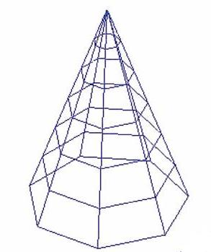
Generating Polyhedra in OpenGL
Method 1
  We can define polygon faces and generate the curved surfaces from them. if we approximate the surface with polygon patches
  This process is referred
  to as surface tessellation
  or fitting the surface with
  a polygon mesh.

Slide 8
Generating Polyhedra in OpenGL (cont.)
In fitting polygons to a surface, we are not limited to using GL_POLYGON
We can also use
  GL_TRIANGLES
  GL_TRIANGLE_STRIP
  GL_TRIANGLE_FAN
  GL_QUADS
  GL_QUAD_STRIP

Slide 9
Generating Polyhedra in OpenGL (cont.)
Method 2
  Use predefined regular polyhedra from the GLUT and GLU libraries.
  We will look at the GLUT library functions first.

Slide 10
The Regular Polyhedron Functions
These are called the Platonic solids – all faces of the regular polyhedron are identical regular polygons.
There are precisely 5 of these in 3-dimensional space

Slide 11
The Platonic Solids
Regular tetrahedron (or triangular pyramid) has 4 faces
Regular hexahedron (or cube) with 6 faces
Regular octahedron with 8 faces
Regular dodecahedron with 12 faces
Regular icosahedron with 20 faces

Slide 12
GLUT Library of Polyhedron Functions
All are defined in model coordinates so they are specified around the origin.
5 functions produce wire frames which can be easily used
Ex: glutWireX(), where X is one of the names Cube, Tetrahedron, Octahedron, Dodecahedron, or Icosahedron (with the first letter capitalized).
5 functions produce polyhedra facets as shaded fill areas - the characteristics of these are determined by material and lighting properties.
  Ex: glutSolidX(), where X is as above.

Slide 13
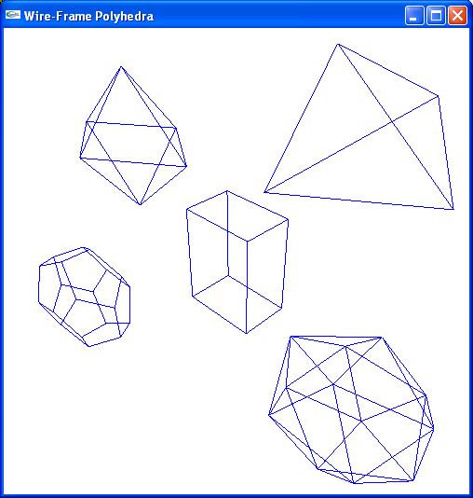
GLUT Library of Polyhedron Functions (cont.)
Example: ch13Polyhedron.cpp

Slide 14
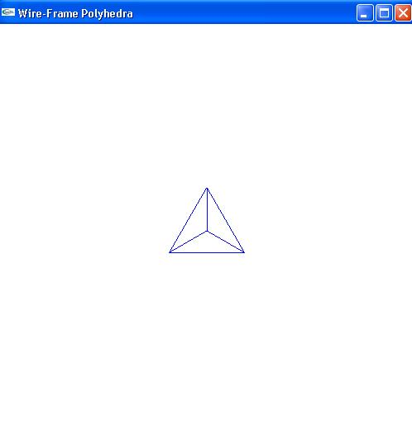
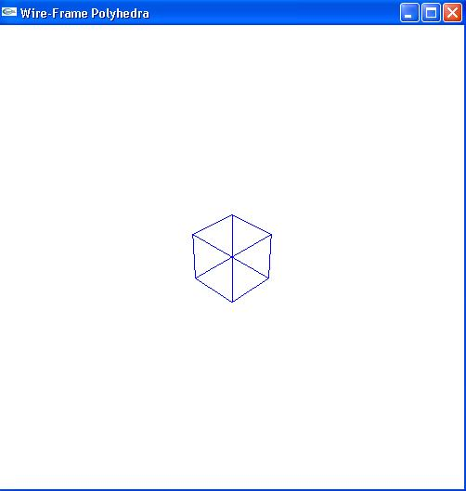
glutWireTetrahedron() and glutWireCube(1.0)
4 faces
6 faces

Slide 15
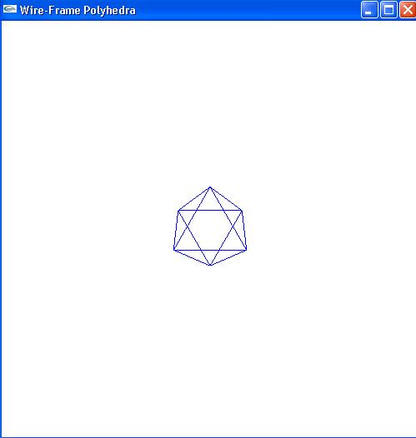
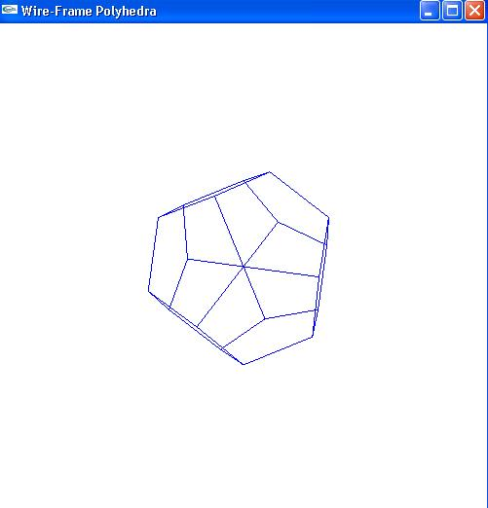
glutWireOctahedron() and glutWireDodecahedron()
8 faces
12 faces

Slide 16
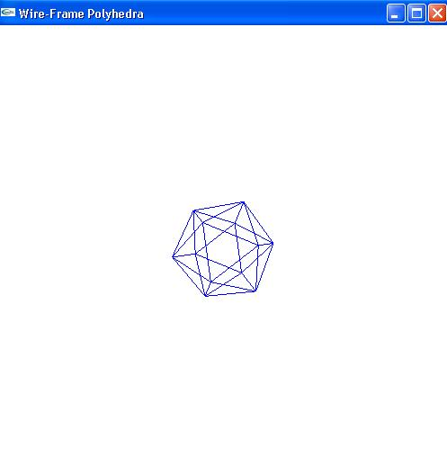
glutWireIcosahedron()
20 faces

Slide 17
Quadric Surfaces
Defined by second degree equations or quadratics.
Include
  Spheres
  Ellipsoids
  Tori
  Paraboloids
  Hyperboloids
  Cones
  Cylinders
See http://en.wikipedia.org/wiki/Quadric for pictures of these.

Slide 18
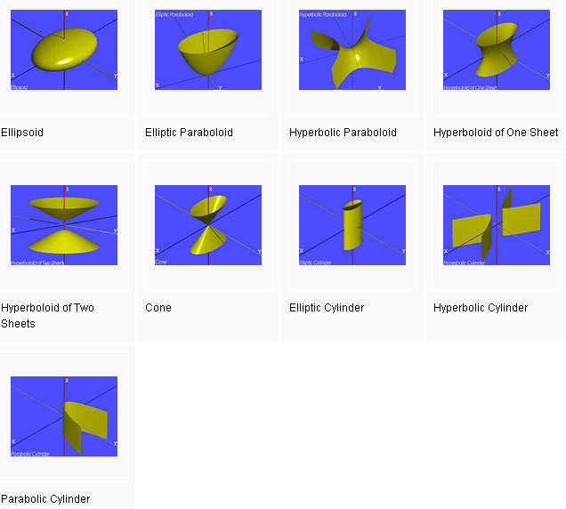
Quadric Surfaces (cont.)
(from http://en.wikipedia.org/wiki/Quadric)

Slide 19
GLUT Quadric Functions – for Solids, Substitute Solid for Wire
glutWireSphere(radius, slices, stacks);
glutWireCone(base, height, slices, stacks);
glutWireTorus(innerRadius, outerRadius, nsides, rings);
and the following is provided also!
glutWireTeapot(size);

Slide 20
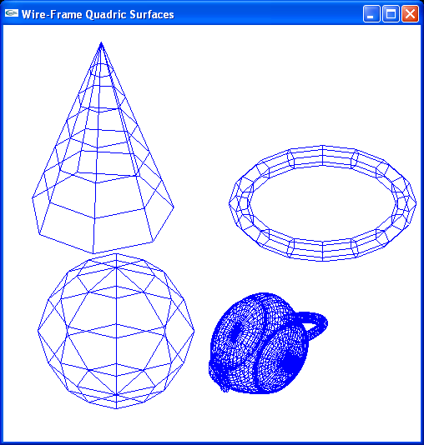
GLUT Quadric Functions

Slide 21
GLU Quadric-Surface Functions
GLUquadricObj *sphere1;
sphere1=gluNewQuadric( );
gluQuadricDrawStyle(sphere1, GLU_LINE);
gluSphere(sphere1, r, nLongitudes, nLatitudes);

Slide 22
GLU Quadric-Surface Functions (cont.)
gluQuadricDrawStyle(sphere1, GLU_LINE);
  GLU_POINT
  GLU_LINE
  GLU_SILHOUETTE
  GLU_FILL

Slide 23
GLU Quadric-Surface Functions (cont.)
void gluSphere (GLUquadricObj *qobj, GLdouble radius,GLint slices, GLint stacks);
void gluCylinder (GLUquadricObj *qobj, GLdouble baseRadius,GLdouble topRadius, GLdouble height,GLint slices, GLint stacks);
void gluDisk (GLUquadricObj *qobj, GLdouble innerRadius,GLdouble outerRadius, GLint slices, GLint rings);

Slide 24
GLU Quadric-Surface Functions (cont.)
void gluPartialDisk (GLUquadricObj *qobj, GLdouble innerRadius,GLdouble outerRadius, GLint slices, GLint rings,GLdouble startAngle, GLdouble sweepAngle);
Example: quadric.c

Slide 25
WHY IS THE TEAPOT POPULAR?
In the early days, there were no 3D modeling packages
  Everything was digitized by hand or sketched on graph paper and the numbers entered by using a text editor.
  If you were working on texture mapping algorithms, ray tracing, lighting models, etc., then any source of free data was welcome.
Moreover, the teapot is a useful test object to test. It
  Is instantly recognizable
  Has complex topology
  Self-shadows
  There are hidden surface issues
  Has both convex and concave surfaces - as well as saddle points
  Doesn't take much storage space
Folklore says that some of the early pioneers of computer graphics could type the teapot from memory!

Slide 26
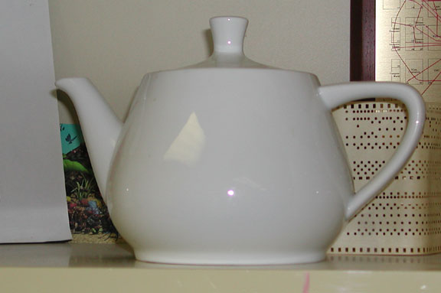
The Utah Teapot
The real teapot---
The teapot was donated to the Boston Computer Museum but now resides in the Ephemera collection of the Computer History Museum where it's catalogued as "Teapot used for Computer Graphics rendering" catalogue number X00398.1984.

Slide 27
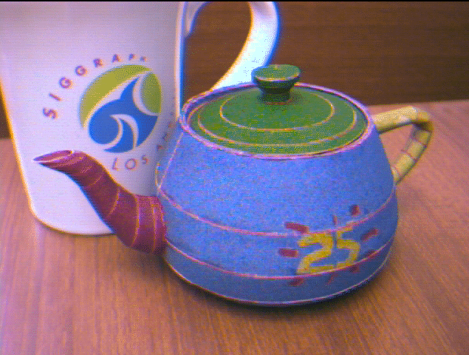
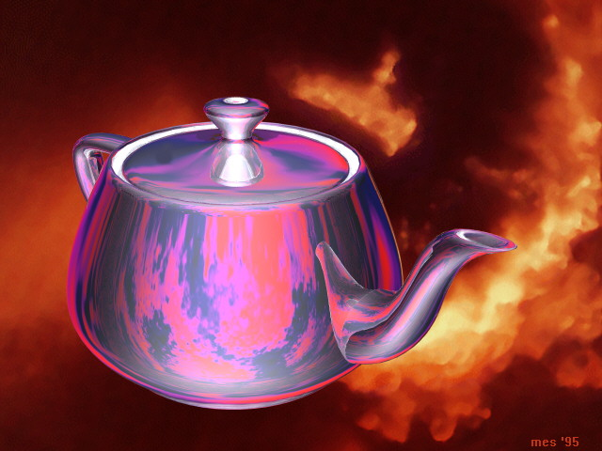
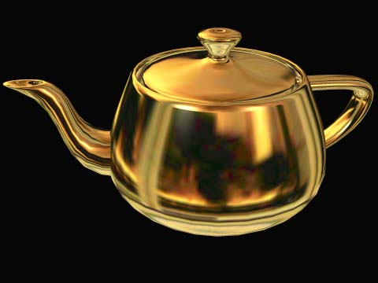
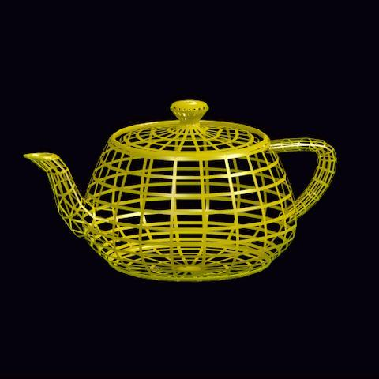
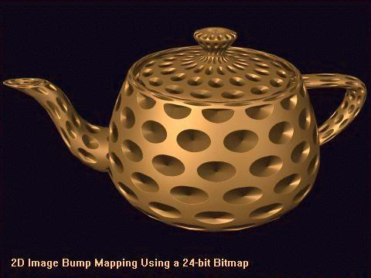
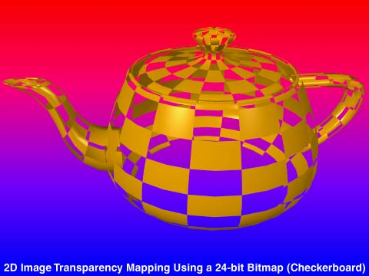
Many Versions of Teapots
From Steve Baker’s History of the Teapot site: http://www.sjbaker.org/teapot/index.html

Slide 28
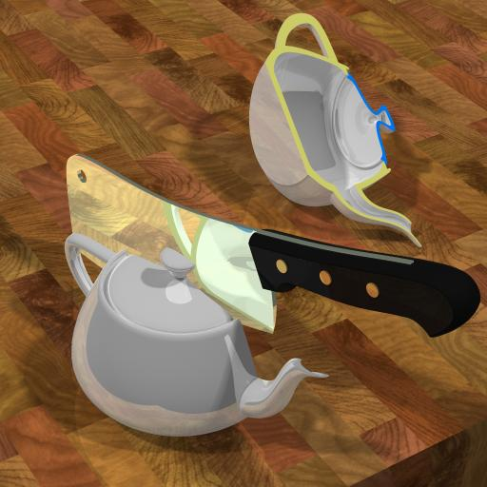
%^$@ Teapot!
From Steve Baker’s History of the Teapot site: http://www.sjbaker.org/teapot/index.html.

Slide 29
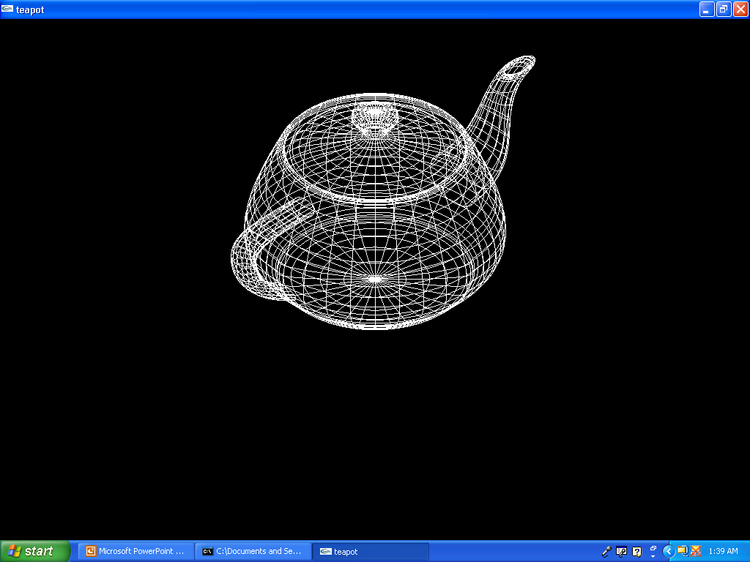
Wireframe

Slide 30
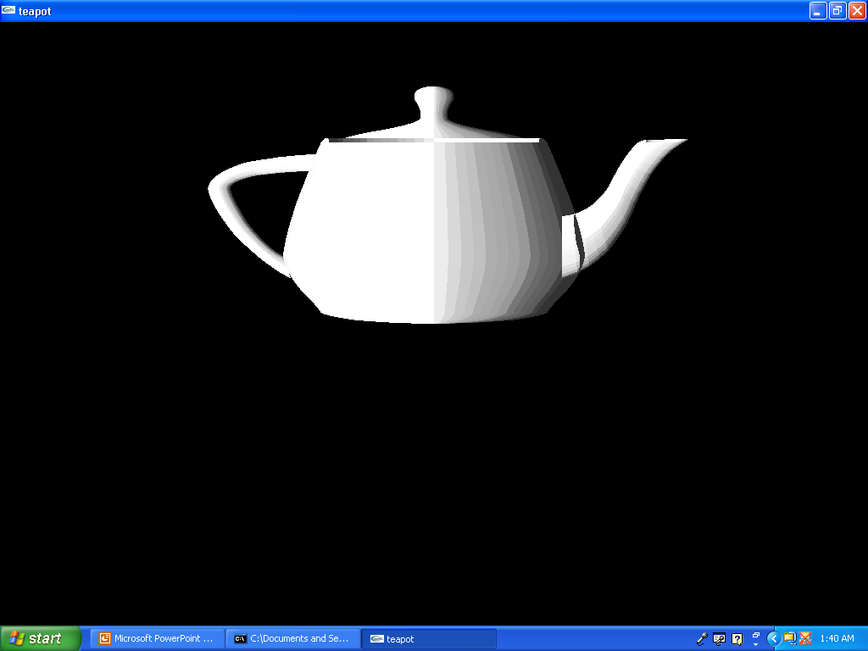
Faceted Shading

Slide 31
Textured and Rotating

Slide 32
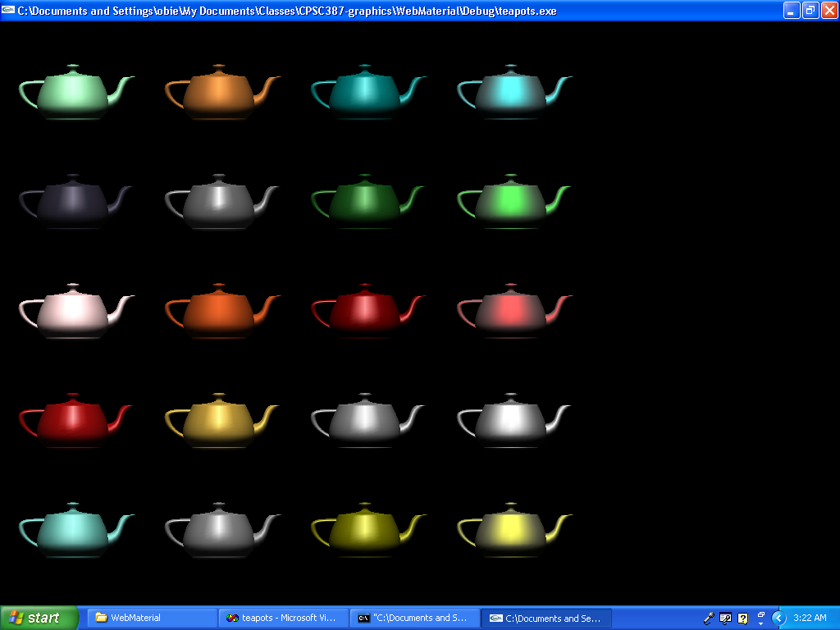
Multiple Teapots of Various Materials
teapots.c

Slide 33
Spline Representations
Splines are used to design curve and surface shapes like automobile bodies, aircraft surfaces, etc.
Control points
  Set of coordinates used to specify a curve, which indicate the general shape of the curve
Interpolation
  All the control points are connected
Approximate
  Some or all control points are not on the curve path

Slide 34
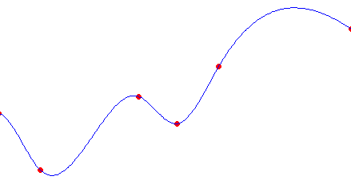
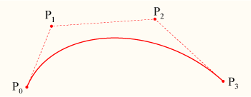
Spline Representations (cont.)
Interpolated
Approximate

Slide 35
Bézier Spline Curves
Developed by French engineer Pierre Bézier for use in the design of Renault automobile bodies
Easy to implement
  Widely used in CAD systems, graphics, drawing and painting packages

Slide 36
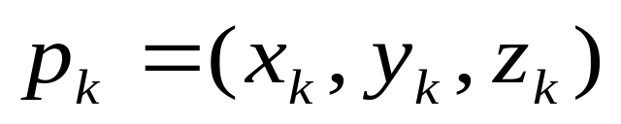
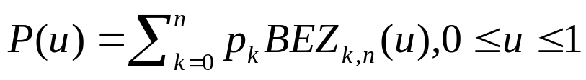
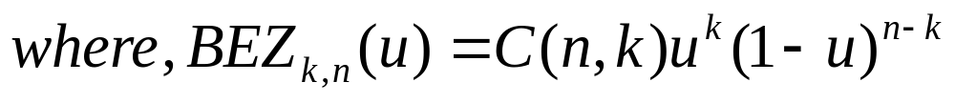
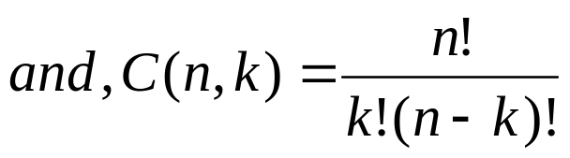
Bézier Curve Equations
Suppose we have n +1 control points, denoted as
where k varying from 0 to n
The approximating Bezier function between p₀ and p_{n} called P(u) can be calculated as

Slide 37
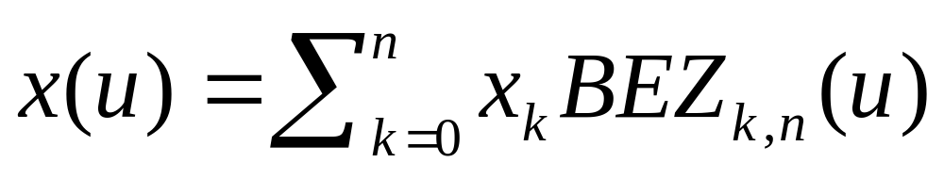
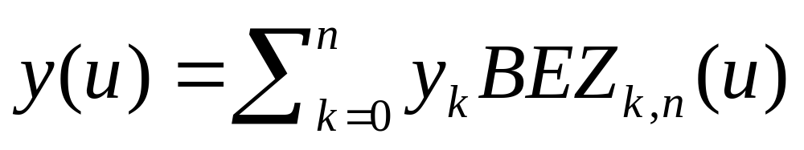
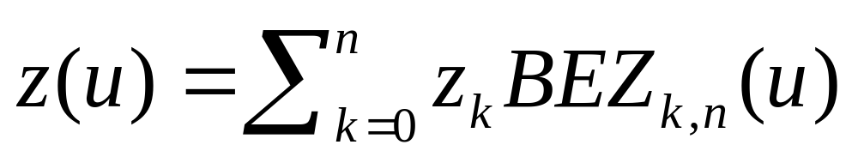
Bézier Curve Equations (cont.)
Individual curve coordinates can be obtained as:

Slide 38
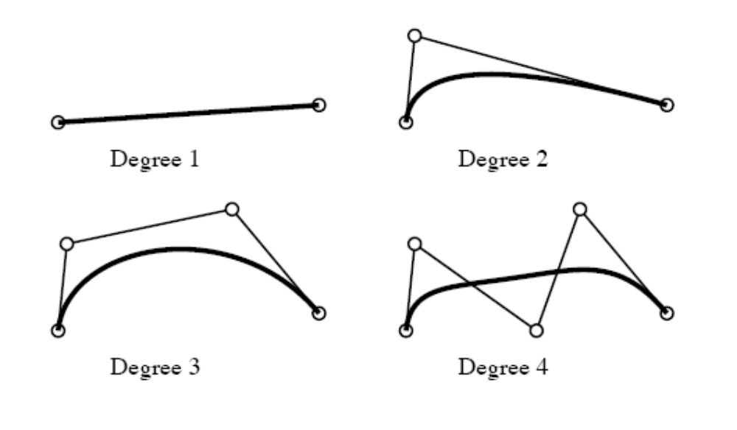
Bézier Spline Curves
Bezier curves of different degrees

Slide 39
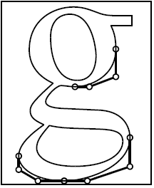
Bézier Spline Curves (cont.)
A common use for Bezier curves is in font definition

Slide 40
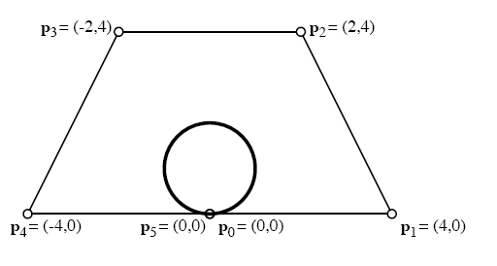
Bézier Spline Curves (cont.)
If we specify the first and the last control point as the same point, we can generate a closed Bezier curve

Slide 41
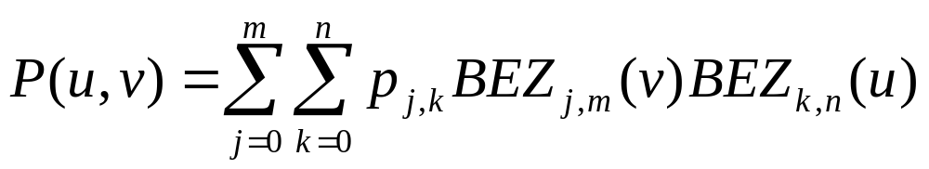
Bézier Surfaces
Two sets of Bezier curves can be used to design an object surface
with p_{j,k} specifying the location of (m+1) by (n+1) control points

Slide 42
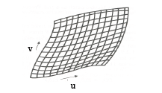
Bézier Surfaces (cont.)
u and v parameters

Slide 43
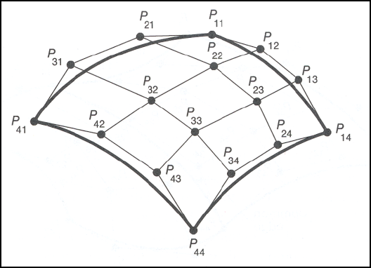
Bézier Surfaces (cont.)
An example Bezier surface

Slide 44
OpenGL Approximation Spline Functions
Bezier splines and B-splines can be displayed using OpenGL functions
The core library contains Bezier functions, and GLU has B-spline functions
Bezier functions are often hardware implemented

Slide 45
OpenGL Bézier-Spline Curve Functions
We specify parameters and activate the routines for Bezier-curve display with
    glMap1*(GL_MAP1_VERTEX_3, uMin, uMax, stride, nPts, *ctrlPts);
    glEnable(GL_MAP1_VERTEX_3);
and deactivate with
    glDisable(GL_MAP1_VERTEX_3);
  uMin and uMax are typically 0 and 1.0
  stride=3 for 3D
  nPts is the number of control points
  ctrlPts is the array of control points

Slide 46
OpenGL Bézier-Spline Curve Functions (cont.)
After setting parameters, we need to evaluate positions along the spline path and display the resulting curve. To calculate coordinate positions we use
glEvalCoord1*(uValue);
where uValue is assigned some value in the interval from uMin to uMax

Slide 47
Example OpenGL Code
GLfloat ctrlPts [4][3] = { {-40.0, 40.0, 0.0}, {-10.0, 200.0, 0.0},
{10.0, -200.0, 0.0}, {40.0, 40.0, 0.0} };
glMap1f (GL_MAP1_VERTEX_3, 0.0, 1.0, 3, 4, *ctrlPts);
glEnable (GL_MAP1_VERTEX_3);
GLint k;
glColor3f (0.0, 0.0, 1.0); // Set line color to blue.
glBegin (GL_LINE_STRIP); // Generate Bezier "curve".
for (k = 0; k <= 50; k++)
glEvalCoord1f (GLfloat (k) / 50.0);
glEnd ( );
glColor3f (1.0, 0.0, 0.0); // Set point color to red.
glPointSize (5.0); // Set point size to 5.0.
glBegin (GL_POINTS); // Plot control points.
for (k = 0; k < 4; k++)
glVertex3fv (&ctrlPts [k][0]);
glEnd ( );
prog8OGLBezierCurve.cpp

Slide 48
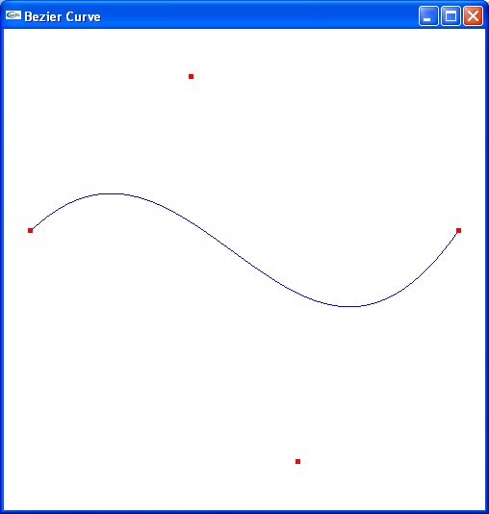
Example OpenGL Code (cont.)
ch14OGLBezierCurve.cpp

Slide 49
OpenGL Bézier-Spline Surface Functions
We specify parameters and activate the routines for Bezier surface display with
    glMap2*(GL_MAP2_VERTEX_3, uMin, uMax, uStride, nuPts, vMin, vMax, vStride, nvPts, *ctrlPts);
    glEnable(GL_MAP2_VERTEX_3);
and deactivate with
    glDisable(GL_MAP2_VERTEX_3);
  uMin, uMax, vMin and vMax are typically 0 and 1.0
  stride=3 for 3D
  nuPts and nvPts are the size of the array
  ctrlPts is the double subscripted array of control points

Slide 50
Example OpenGL Code
GLfloat ctrlpoints[4][4][3] = {
{{-1.5, -1.5, 4.0}, {-0.5, -1.5, 2.0},
{0.5, -1.5, -1.0}, {1.5, -1.5, 2.0}},
{{-1.5, -0.5, 1.0}, {-0.5, -0.5, 3.0},
{0.5, -0.5, 0.0}, {1.5, -0.5, -1.0}},
{{-1.5, 0.5, 4.0}, {-0.5, 0.5, 0.0},
{0.5, 0.5, 3.0}, {1.5, 0.5, 4.0}},
{{-1.5, 1.5, -2.0}, {-0.5, 1.5, -2.0},
{0.5, 1.5, 0.0}, {1.5, 1.5, -1.0}}
};
glMap2f(GL_MAP2_VERTEX_3, 0, 1, 3, 4, 0, 1, 12, 4, &ctrlpoints[0][0][0]);
glEnable(GL_MAP2_VERTEX_3);
for (j = 0; j <= 8; j++) {
glBegin(GL_LINE_STRIP);
for (i = 0; i <= 30; i++)
glEvalCoord2f((GLfloat)i/30.0, (GLfloat)j/8.0);
glEnd();
glBegin(GL_LINE_STRIP);
for (i = 0; i <= 30; i++)
glEvalCoord2f((GLfloat)j/8.0, (GLfloat)i/30.0);
glEnd();
}
bezsurf.c

Slide 51
Example OpenGL Code (cont.)
bezsurf.cpp

Slide 52
Fractal Geometry Methods
Geometry methods can be used to model objects with smooth surfaces and regular shapes
BUT are inadequate to model irregular objects like
  shorelines,
  mountains,
  trees,
  clouds, etc

Slide 53
Fractal Geometry Methods (cont)
Typically used to model objects with following properties:
Irregular
Randomly jagged, but constrained
Non-fluid
On zooming in, the shape becomes more irregular
On zooming out, the shape becomes less irregular

Slide 54
Fractal Geometry Methods (cont.)
A fractal object has two basic characteristics
  Infinite detail at every point
    If we zoom in, we see more detail of the object
  Self-similarity between object parts and the overall features of the object

Slide 55
Fractal Generation Procedures
A fractal object is generated by repeatedly applying a specified transformation function to points within a region of space
If P₀=(x₀,y₀,z₀) then
  P₁=F(P₀ ), P₂=F(P₁ ), P₃=F(P₂ ), …
Transformation function can be applied to points or to a set of primitives such as lines, curves, color areas or surfaces

Slide 56
KOCH CURVE- One of the Simplest Examples
Fractals start with an initiator, which is a given geometric shape, and iteratively apply a generator, which is a pattern.
KOCH curve initiator is
KOCH curve generator is

Slide 57
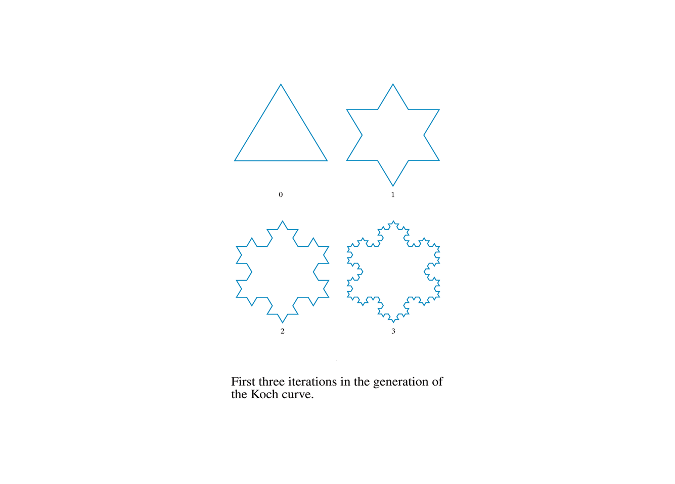
KOCH curve

Slide 58
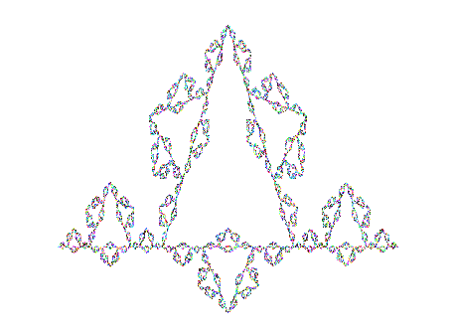
Koch Curve
At level k, the length is (4/3)^{k} so in the limit, the
length of the curve approaches infinity.

Slide 59
KOCH CURVE- One of the Simplest Examples (cont.)
Step 0: length = 1, s = 1/3
Step 1: length = 4/3, s = 1/9
Scaling factor s is applied.
This continues iteratively, where at each level, the
segments are divided into thirds and the same
pattern is repeated.
The definition of the curve requires that this be
repeated forever.

Slide 60
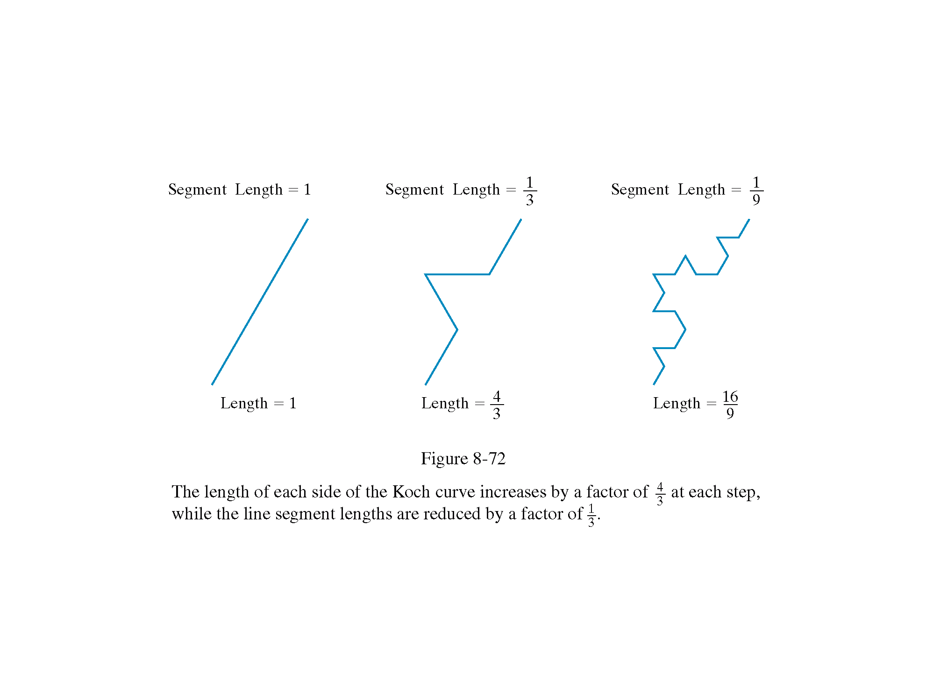
KOCH curve

Slide 61
Self Squaring Fractals
Another method for generating fractals is to repeatedly apply a transformation function to points in complex space
A complex number can be represented as z = x + iy where x and y are real numbers and i² = -1
A function rich in fractals is the squaring transformation
z’=f(z) = λz (1 - z)

Slide 62
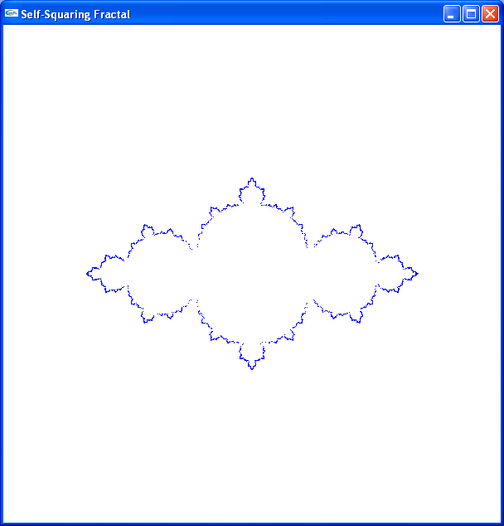
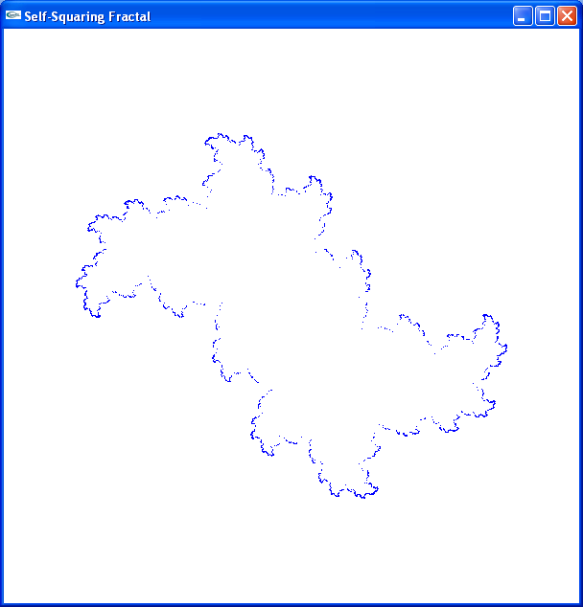
Self Squaring Fractals
λ = 3
λ = 2 + i
ch23SelfSquareFractal.cpp

Slide 63
Mandelbrot Set
Squaring functions were difficult to analyze without the aid of a computer
Using more sophisticated computer graphics techniques, Benoit Mandelbrot studied this function and found the set of points known as Mandelbrot set

Slide 64
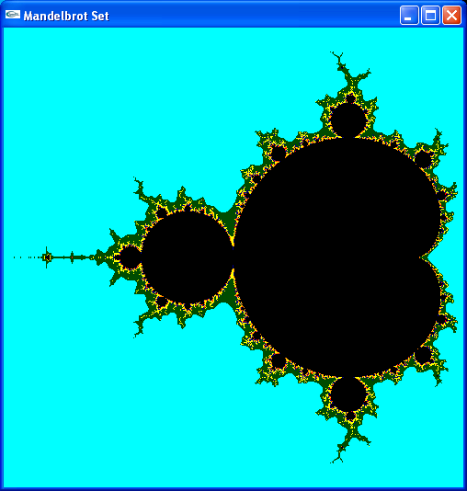
Mandelbrot Set (cont.)
ch23MandelbrotSet.cpp

Slide 65
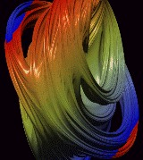
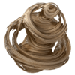
OTHER FRACTAL IMAGES
Quaternion generated Julian Sets in 3D space

Slide 66
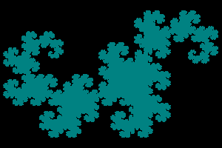
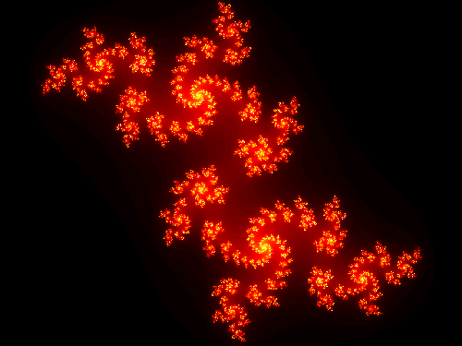

OTHER FRACTAL IMAGES (cont.)
Various colorings of dragon curves

Slide 67
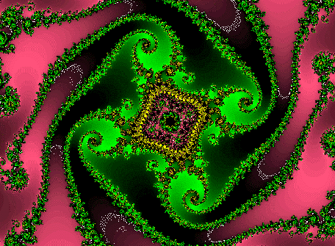
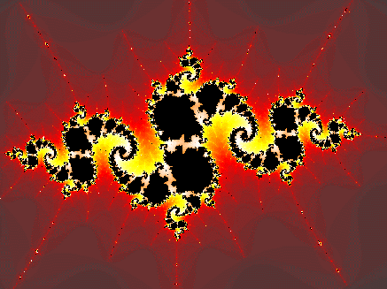
OTHER FRACTAL IMAGES (cont.)
Each is produced by following a fractal generating algorithm and selecting colors to represent points with certain properties.

Slide 68


OTHER FRACTAL IMAGES (cont.)
Trees and bushes generated by fractals

Slide 69
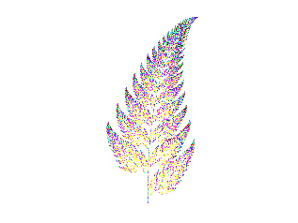

OTHER MODIFICATIONS PRODUCE

Slide 70

A Fractal Texture Mapped Onto A Sphere

Slide 71

and, some interesting fractals in stereo-depth formats ...

Slide 72


Slide 73


Slide 74



Stereo-depth views at this excellent fractal gallery
Basis for orange stereo-depth view
Basis for purple stereo-depth view
Basis for green stereo-depth view

Slide 75
References
Donald Hearn, M. Pauline Baker, Warren R. Carithers, “Computer Graphics with OpenGL, 4th Edition”; Pearson, 2011
Sumanta Guha, “Computer Graphics Through OpenGL: From Theory to Experiments”, CRC Press, 2010
Edward Angel, “Interactive Computer Graphics. A Top-Down Approach Using OpenGL”, Addison-Wesley, 2005
75

