Slide 1


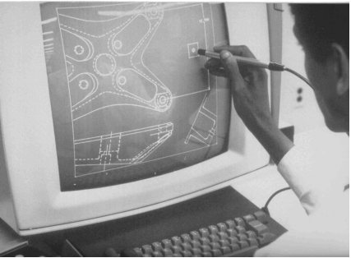
CSE 411
Computer Graphics
Lecture #1 Introduction, overview and OpenGL
Prepared & Presented by Asst. Prof. Dr. Samsun M. BAŞARICI

Slide 2


Objectives
Acknowledge the importance of graphics
Know the application areas of computer graphics
Understand the principles of input and output devices for computer graphics
Install and use OpenGL

Slide 3
Computer Graphics Applications
Graphs and charts
Computer Aided Design (CAD)
Virtual Reality Environments
Data visualizations
Education & Training
Computer Art
Entertainment
Image processing
Graphical User Interfaces

Slide 4
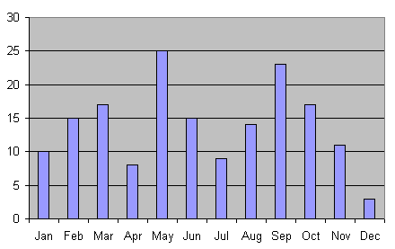
Graphs and charts

Slide 5
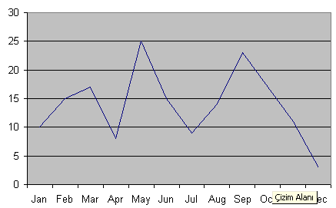
Graphs and charts (cont.)

Slide 6
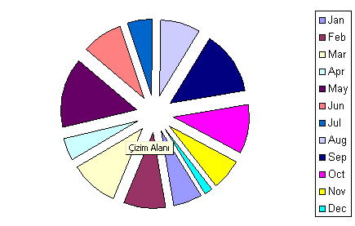
Graphs and charts (cont.)

Slide 7
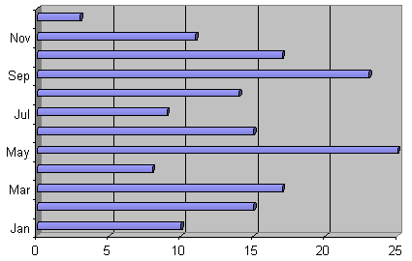
Graphs and charts (cont.)

Slide 8
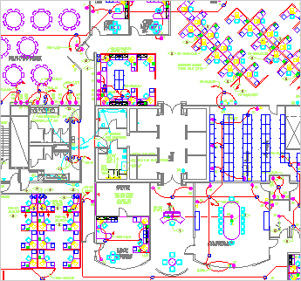
Computer Aided Design (CAD) or Computer Aided Drafting & Desing (CADD)
From www.autodesk.com

Slide 9
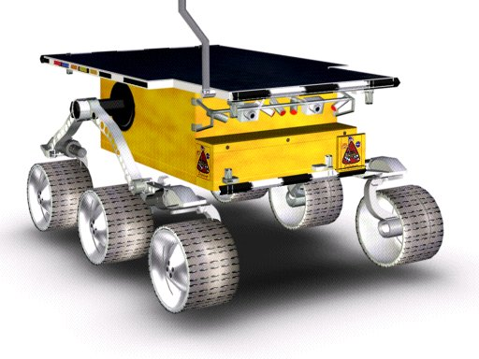
Computer Aided Design (CAD)
From www.amabilis.com

Slide 10
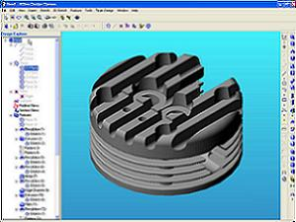
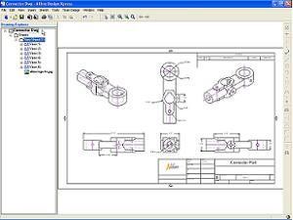
Computer Aided Design (CAD)
From www.alibre.com

Slide 11
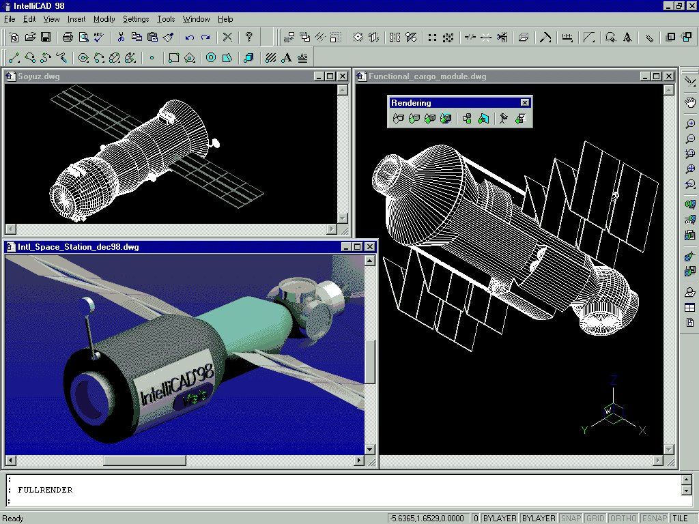
Computer Aided Design (CAD) (cont.)
From www.intellicad.org

Slide 12
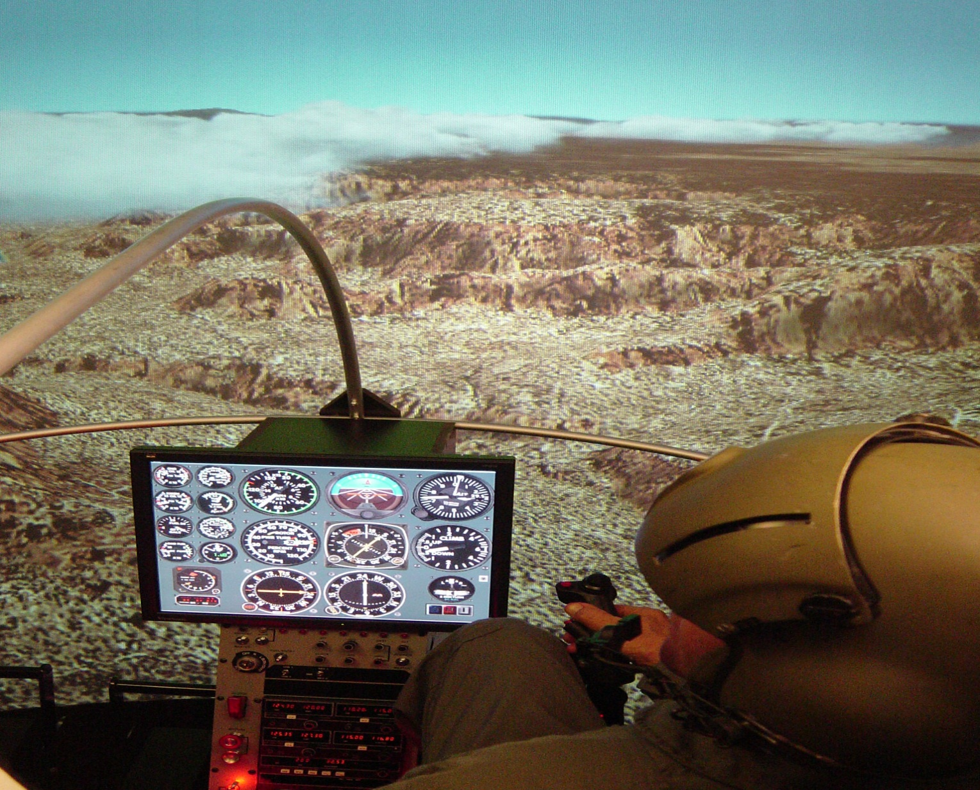
Virtual Reality Environments
From www.flyit.com

Slide 13
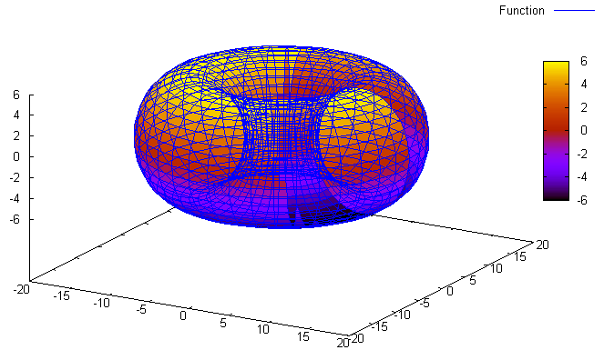
Data visualizations
Plotted with Maxima (maxima.sourceforge.net)

Slide 14
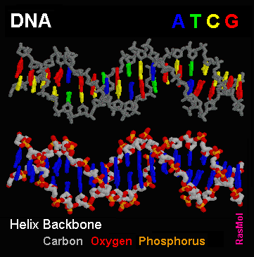
Data visualizations
From molvis.sdsc.edu/dna

Slide 15
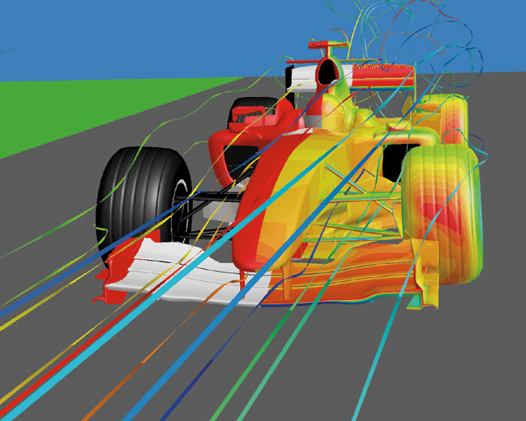
Data visualizations
Aerodynamic simulation of the Ferrari F1 car body showing
pressure contours and pathlines (from www.fluent.com)

Slide 16
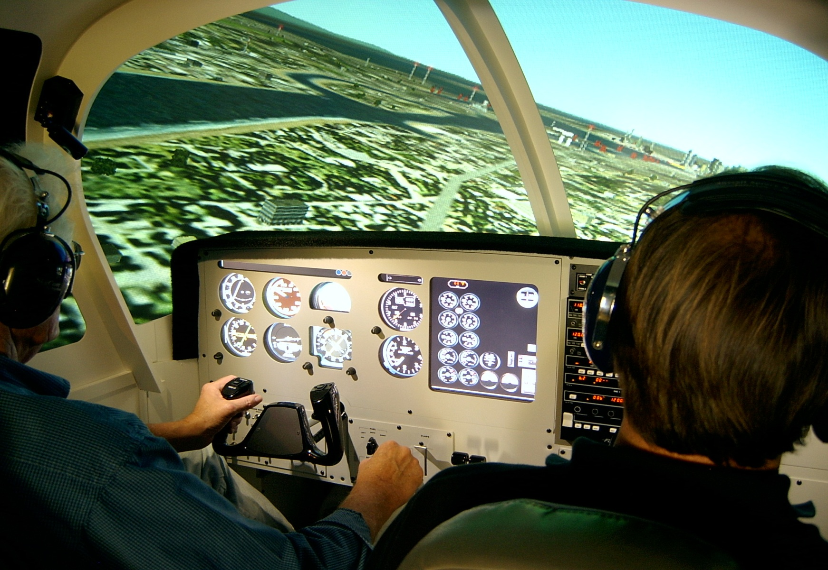
Education & Training
From www.flyit.com

Slide 17

Computer Art
From www.blender.org

Slide 18

Computer Art (cont.)
From www.blender.org

Slide 19

Computer Art (cont.)
From moca.virtual.museum

Slide 20

Entertainment

Slide 21

Entertainment (cont.)

Slide 22

Entertainment (cont.)

Slide 23
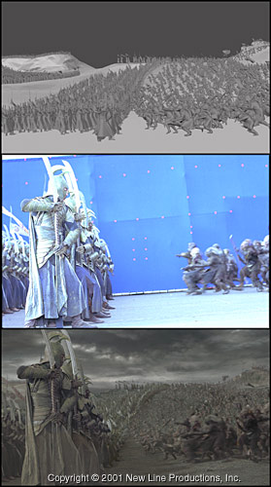
Entertainment (cont.)

Slide 24
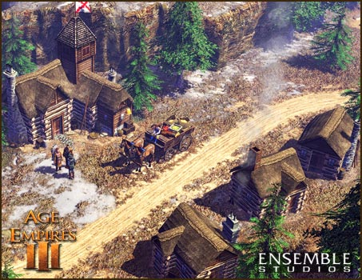
Entertainment (cont.)
From www.microsoft.com

Slide 25
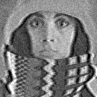

Image processing
From www.ph.tn.tudelft.nl

Slide 26
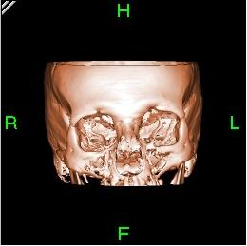
Image processing (cont.)
From www.wikipedia.org

Slide 27
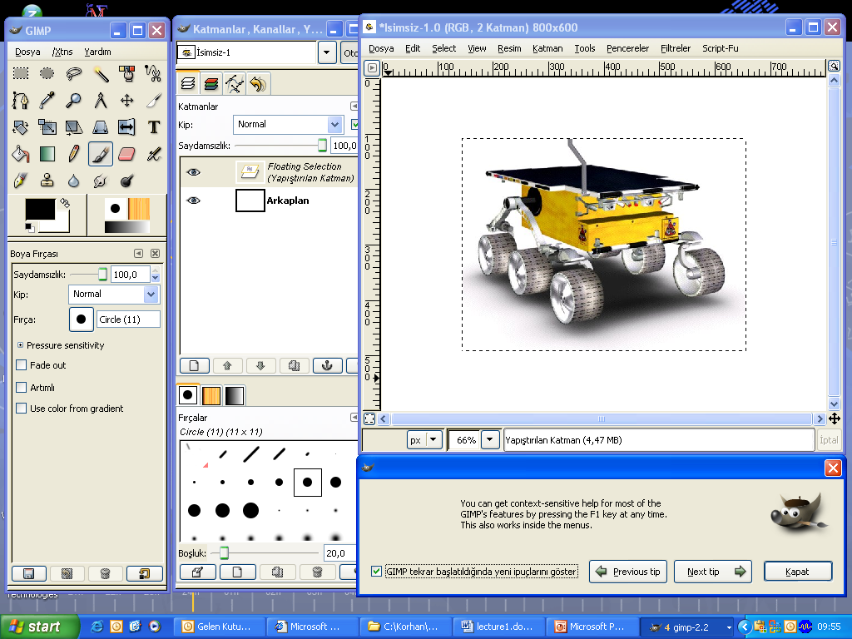
Graphical User Interfaces

Slide 28
Overview of Graphics Systems
Video Display Devices
Raster Scan Systems
Graphics Workstations and Viewing Devices
Input Devices
Hard Copy Devices
Graphics Networks
Graphics on the Internet
Graphics Software

Slide 29
Overview
Programmer’s Model of (Interactive) Graphics
Application
Data
Structure/Model
Application
Program
Graphics
System
Display
Device
Graphics Devices
-Output Devices
(Display Screen; View Surface)
-Input Devices
(Interaction Devices)

Slide 30
Graphics Devices
Output Devices
  CRT Displays
  Hard Copy Devices
Input Devices
  Locator
  Stroke
  String (Keyboard)
  Valuator
  Choice (Button)
  Pick
CPU
DP
Display
Input
Hard Copy

Slide 31
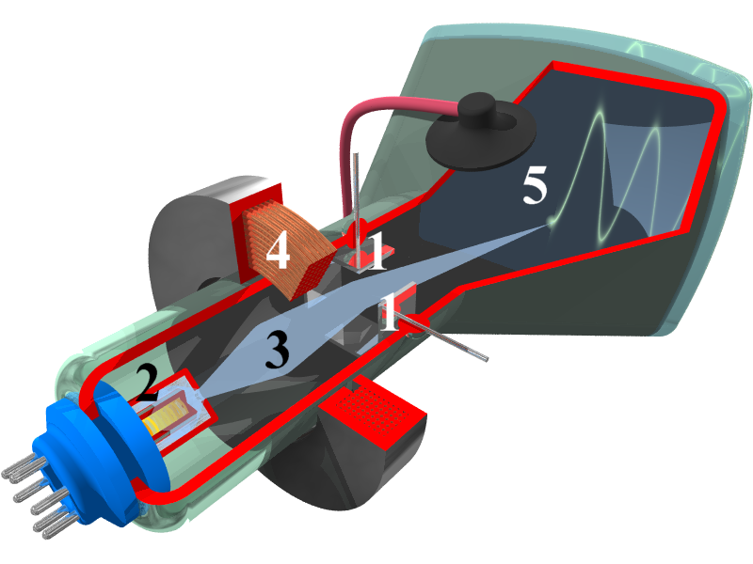
Cathode Ray Tube
Illustration showing the interior of a cathode-ray tube for use in an oscilloscope. Numbers in the picture indicate: 1.Deflection voltage electrodes 2.Electron gun
3. Electron beam 4.Focusing coil 5.Phosphor-coated inner side of the screen
from wikipedia.org

Slide 32
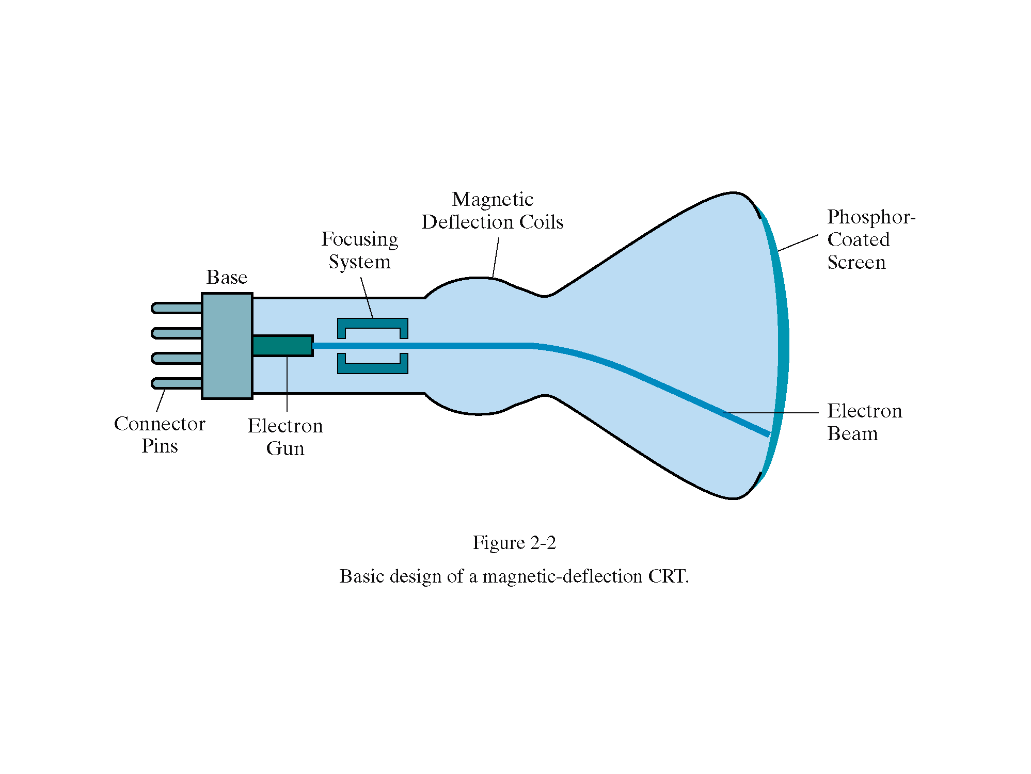
Cathode Ray Tube (cont.)
Diagram of a CRT tube
from HB

Slide 33
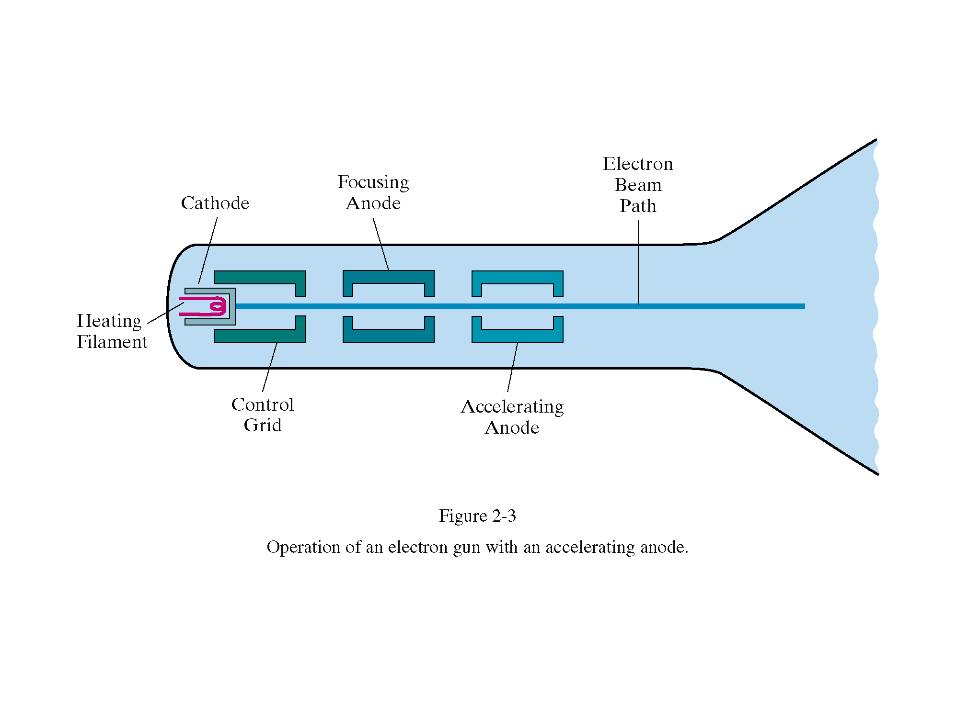
Cathode Ray Tube (cont.)
from HB

Slide 34
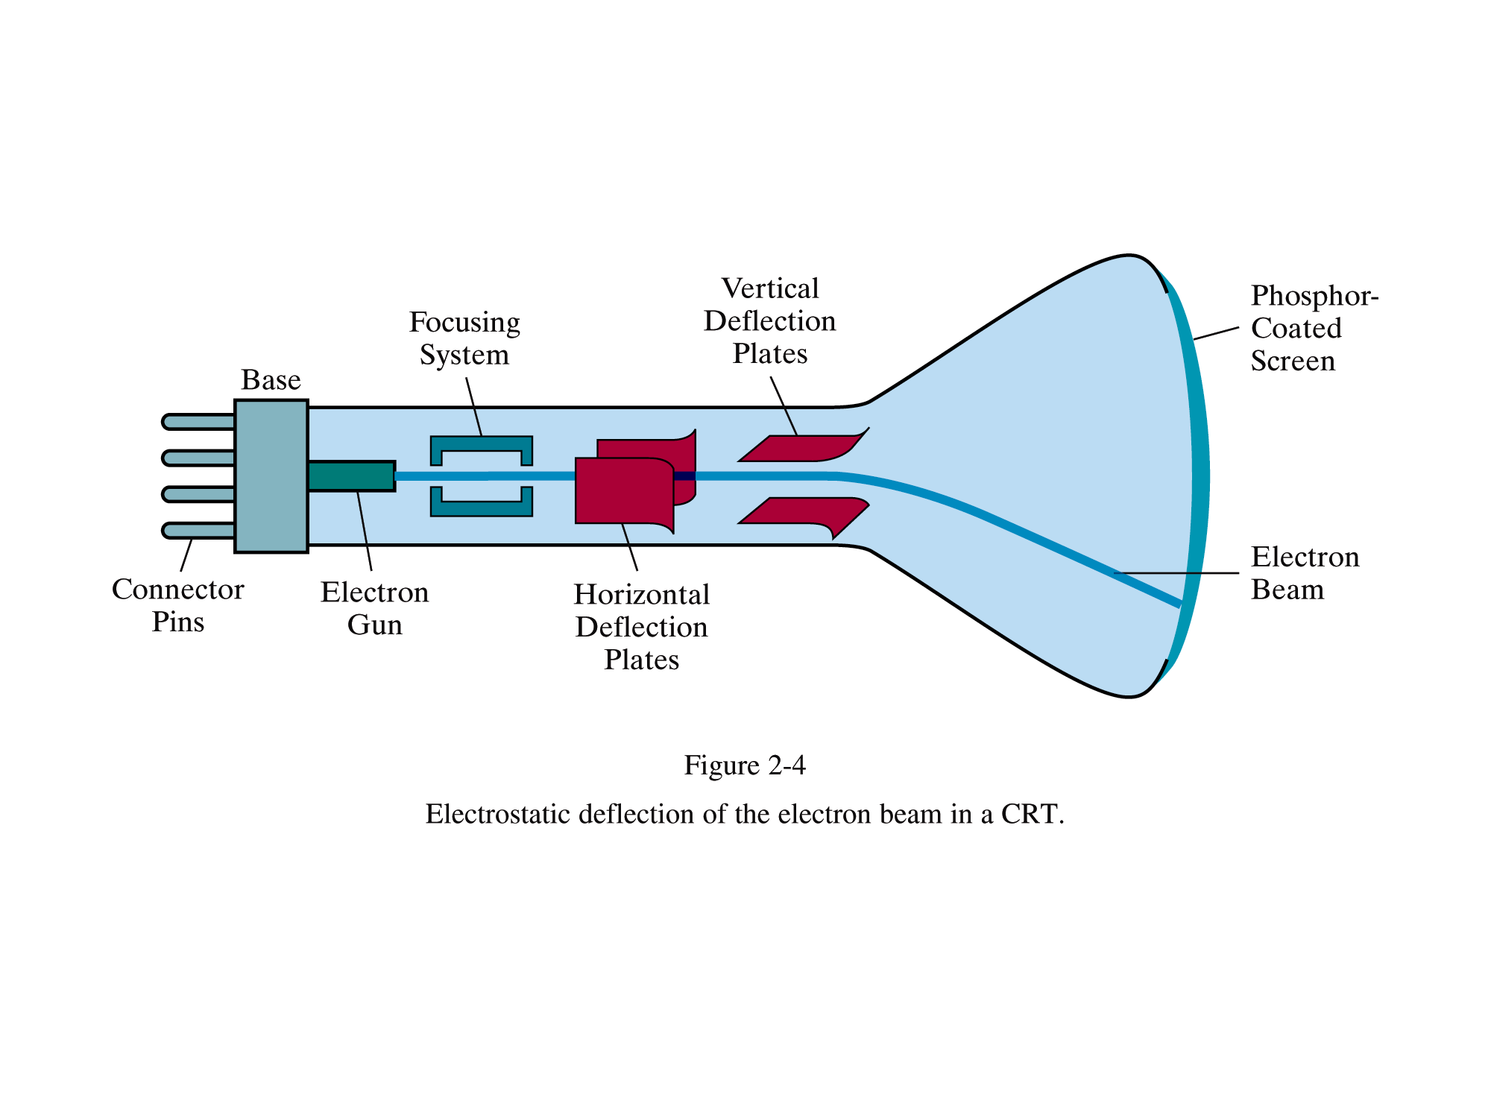
Cathode Ray Tube (cont.)

Slide 35
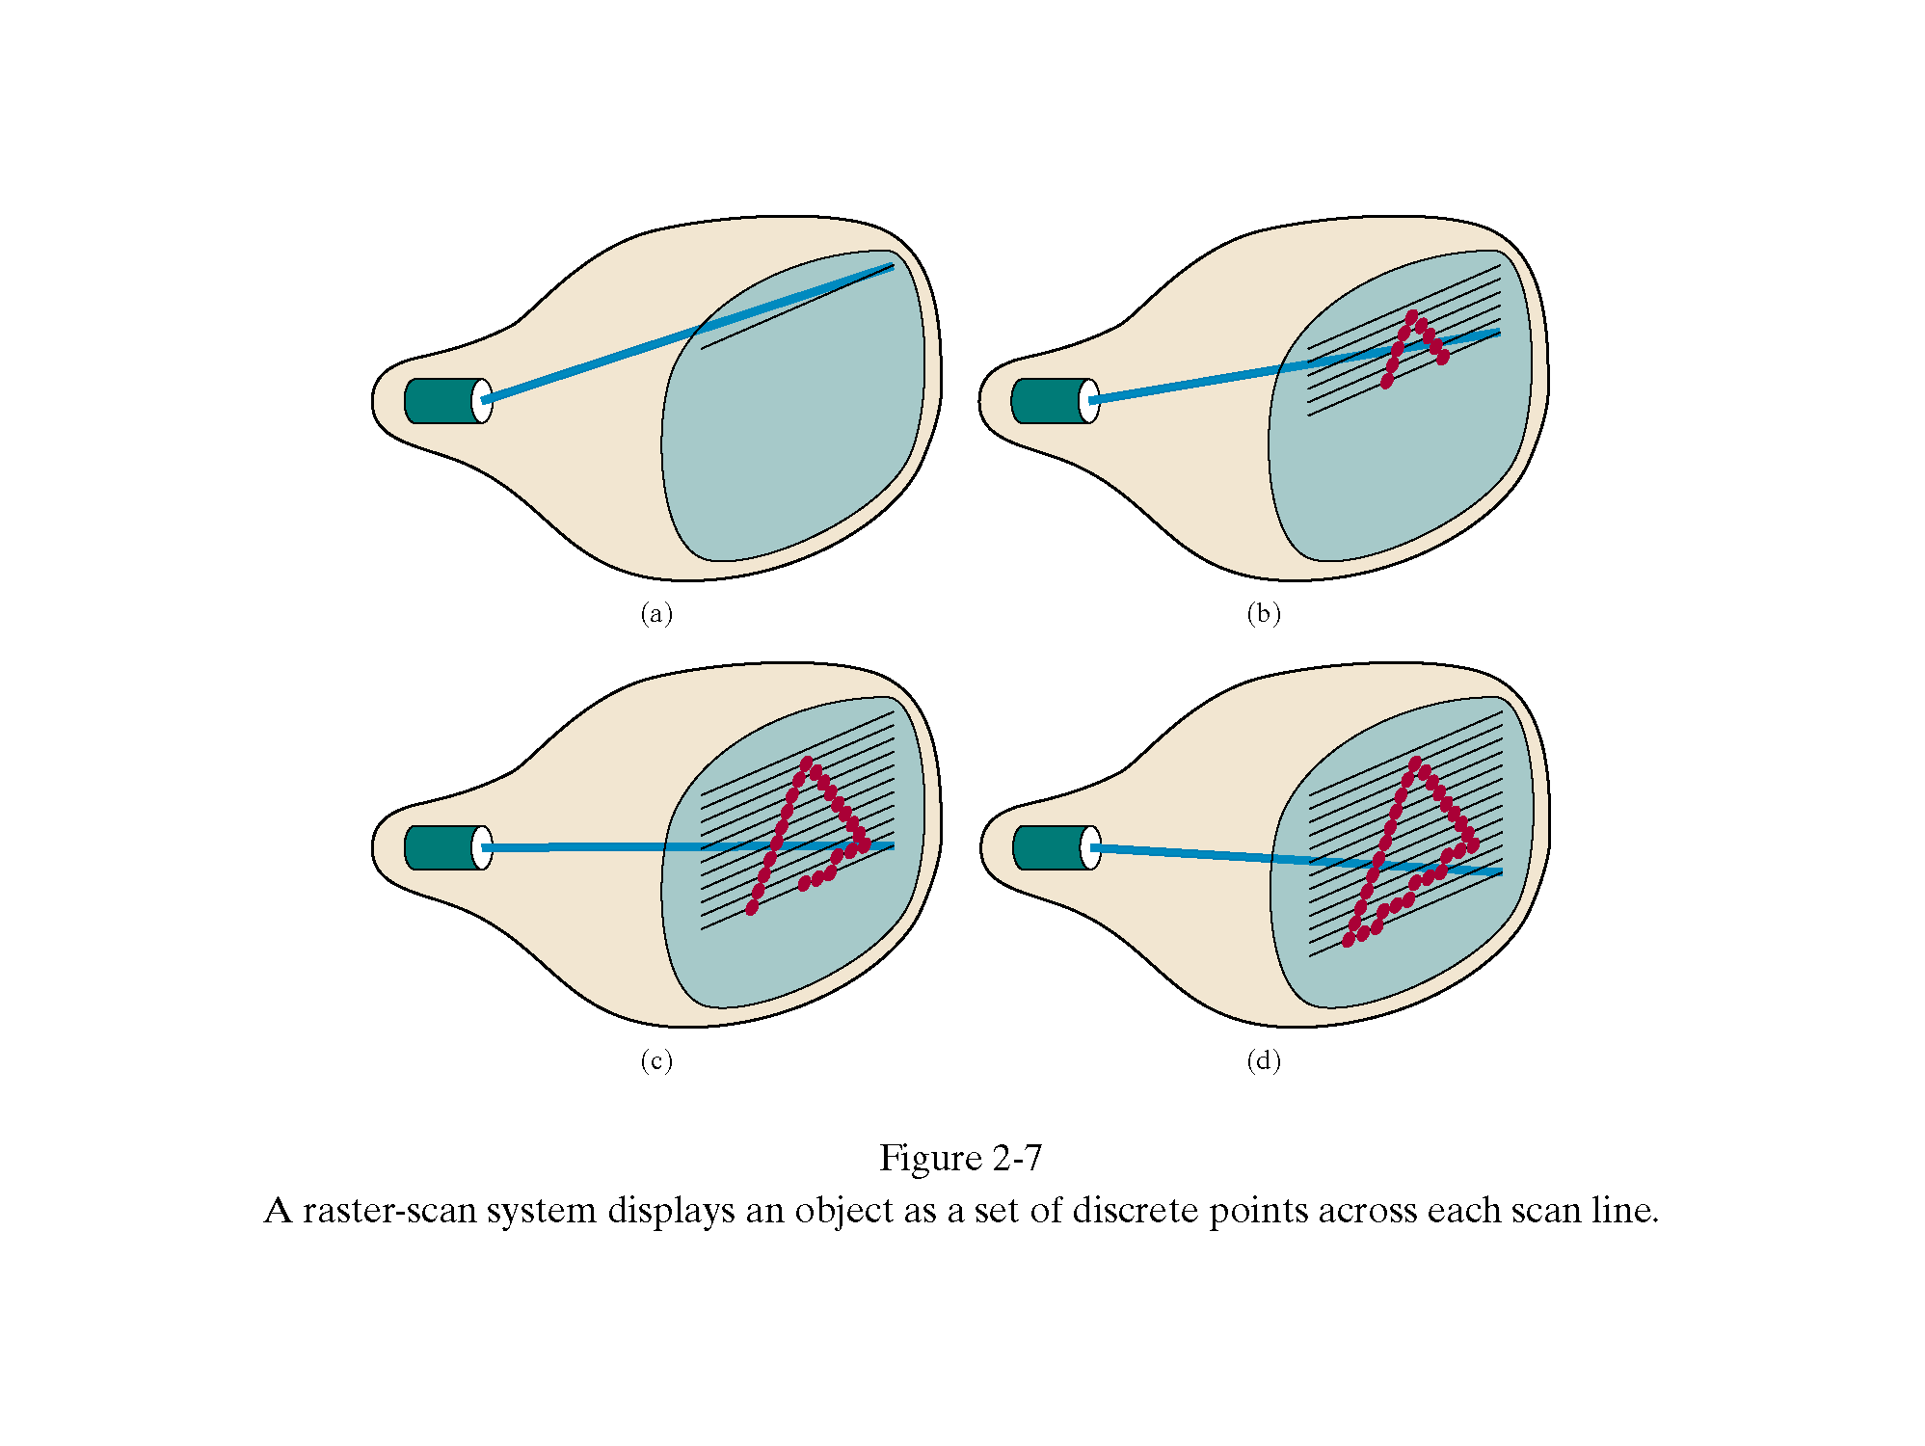
Raster Scan Display

Slide 36
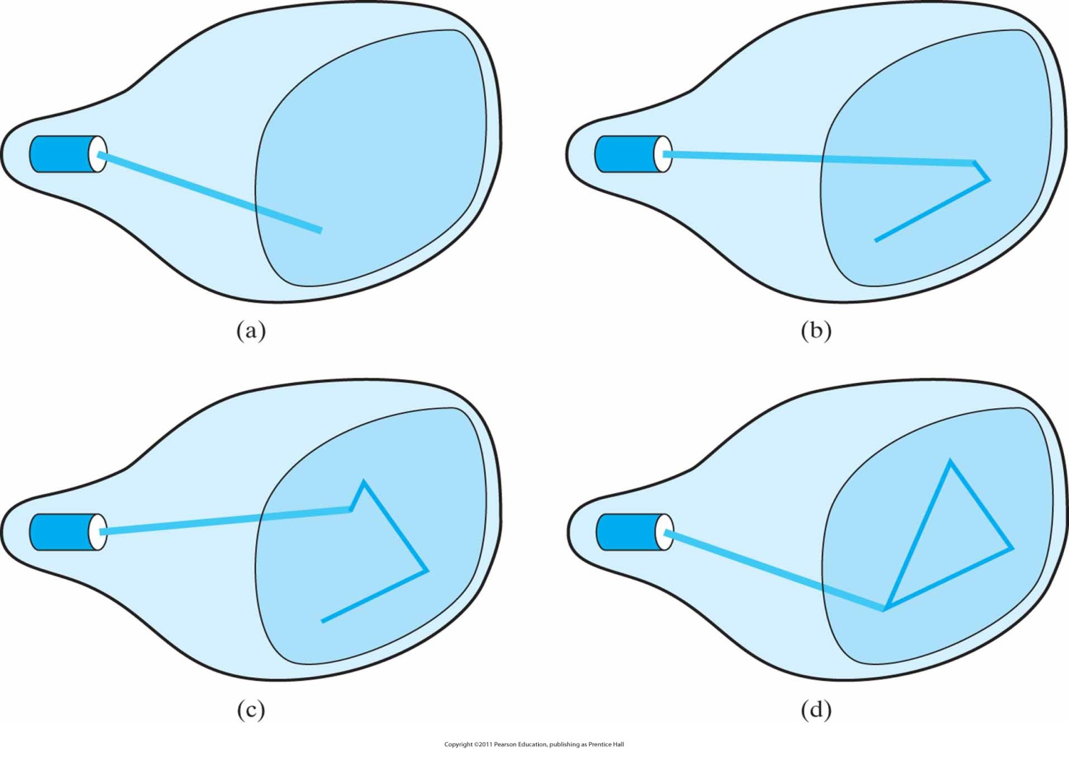
Random Scan Display (cont.)
Draws the component lines of an object in any specified order.

Slide 37
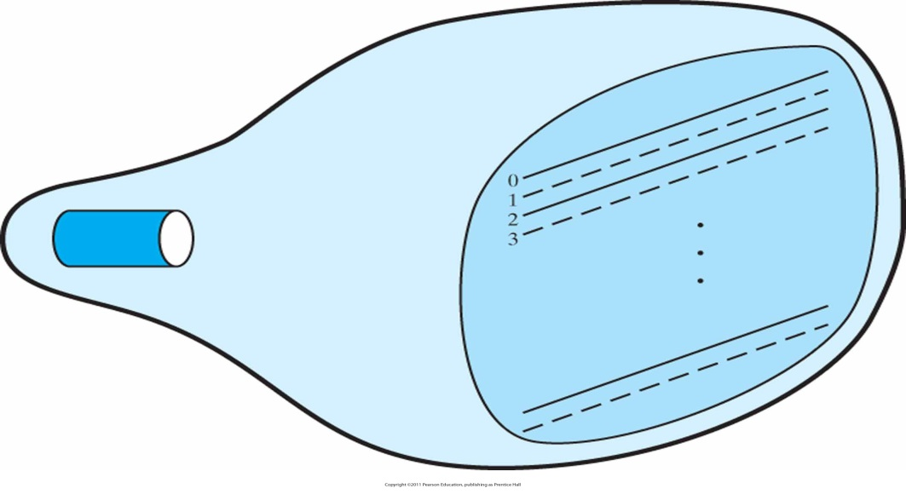
Interlacing
1
2
3
4
5
6
7
8
First, all points on the even-numbered (solid) scan lines are displayed; then all points along the odd-numbered (dashed) lines are displayed.

Slide 38
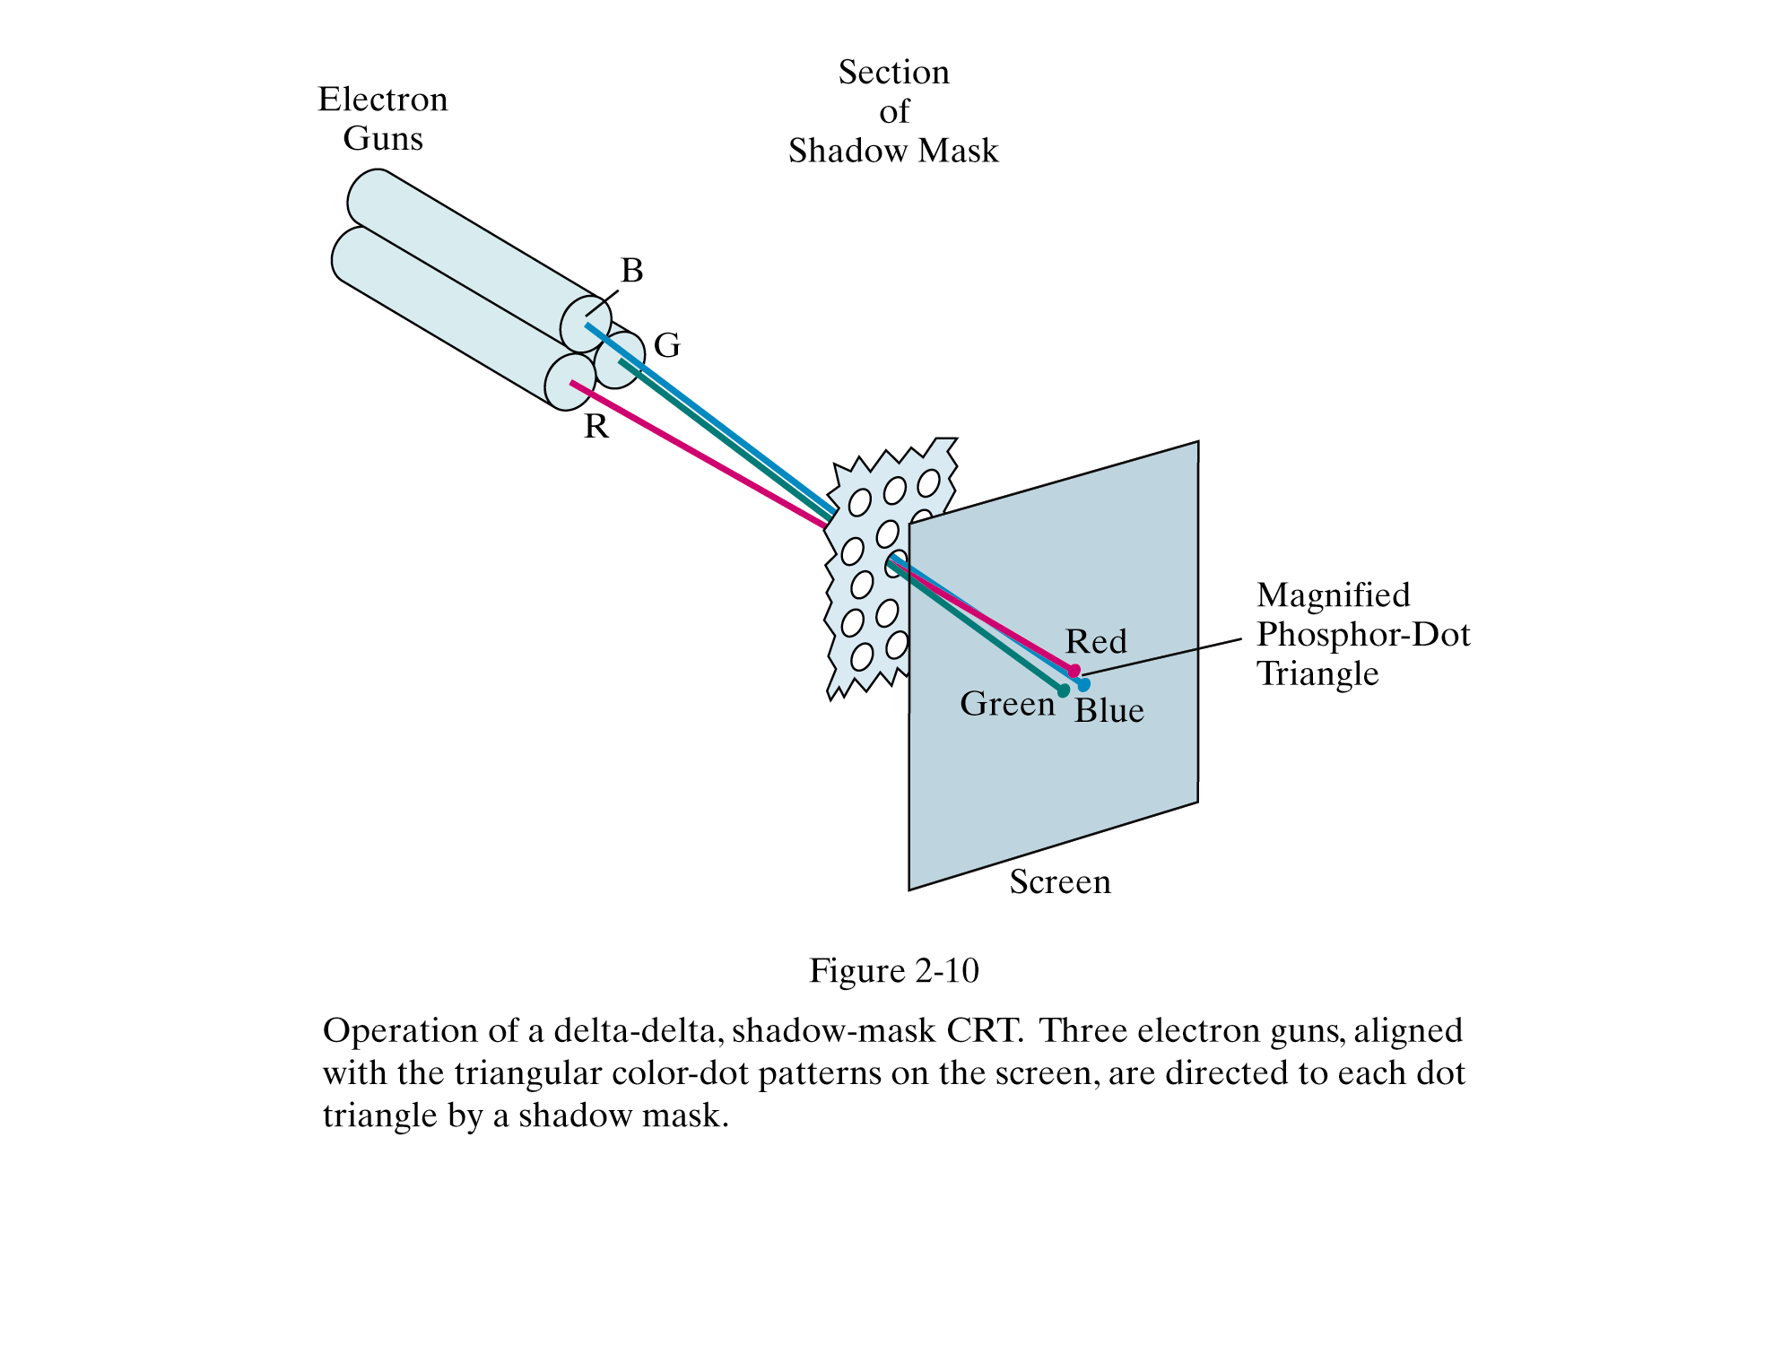
Color Cathode Ray Tube

Slide 39
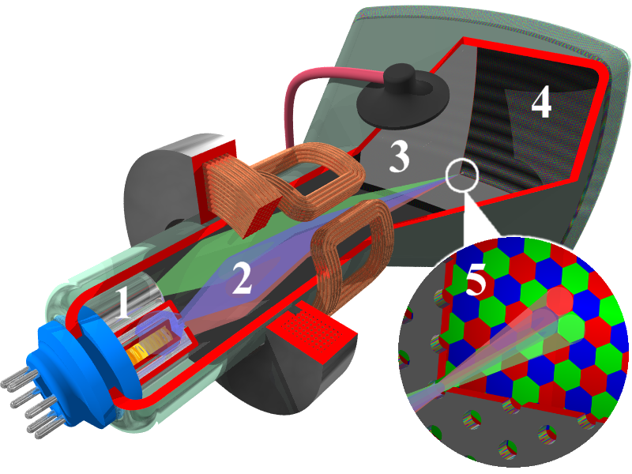
Color Cathode Ray Tube (cont.)
Illustration showing the interior of a cathode-ray tube for color televisions and monitors.
Numbers in the picture indicates:
1.Electron guns 2.Electron beams 3. Mask for separating beams for red, green and blue part of displayed image 4. Phosphor layer with red, green, and blue zones
5.Close-up of the phosphor-coated inner side of the screen
from wikipedia.org

Slide 40
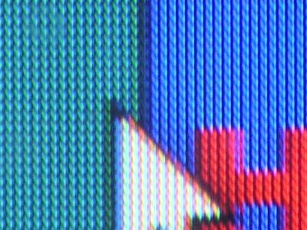
Cathode Ray Tube
Aperture grille CRT close-up
from wikipedia.org

Slide 41
Phosphor
Persistence: How long a phosphor continues to emit light after the electron beam is removed
The persistence of a phosphor is defined as the time it takes for emitted light to decay to 1/10 of its original intensity
Persistence Refresh rate
Is higher persistence always better ?
No !!!
Why ?

Slide 42
Persistence
need refreshing
Intensity
10 %
Time
persistence
  Fluorescence
  Phosphorescence
Refresh rate
  # of times/sec a picture is redrawn
  required to be flicker-free
  60 Hz for raster scan displays
  For refresh displays, it depends on picture complexity !!!
  Why ?

Slide 43
Sharpness
inter-dot distance
dot pitch
dot size, spot size
energy
1
spot size
Resolution = 1 / spot size
However, informally
# of points / scan line
# of lines / frame
Addressability = 1 / inter-dot distance
0.5 ~ 0.6
distance
electron beam

Slide 44
Aspect Ratio
The aspect ratio of vertical points to horizontal points necessary to produce equal length of lines in both direction on screen
4/3 = 1.33...
l
l
Note
  Sometimes, aspect ratio is stated in terms of the ratio of horizontal to vertical points
  3/4 = 0.75

Slide 45
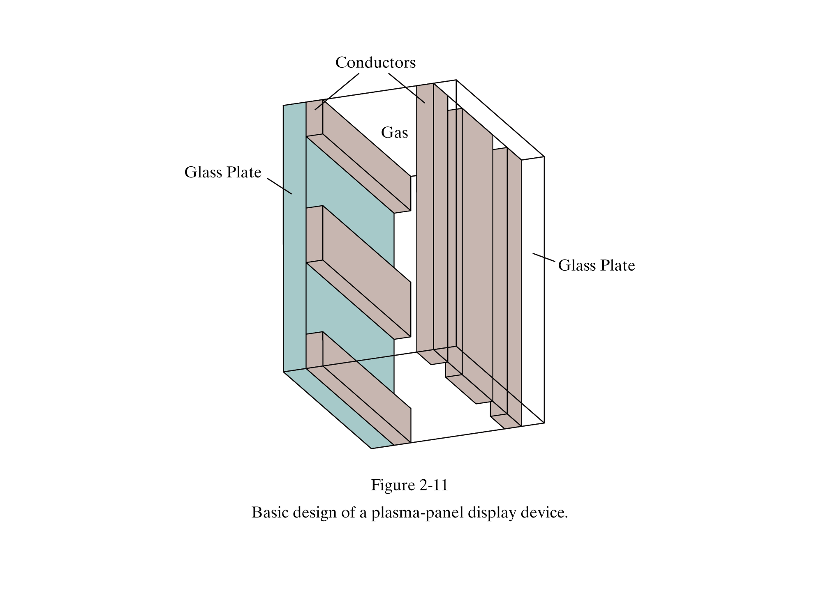
Flat-Panel Displays: Plasma

Slide 46
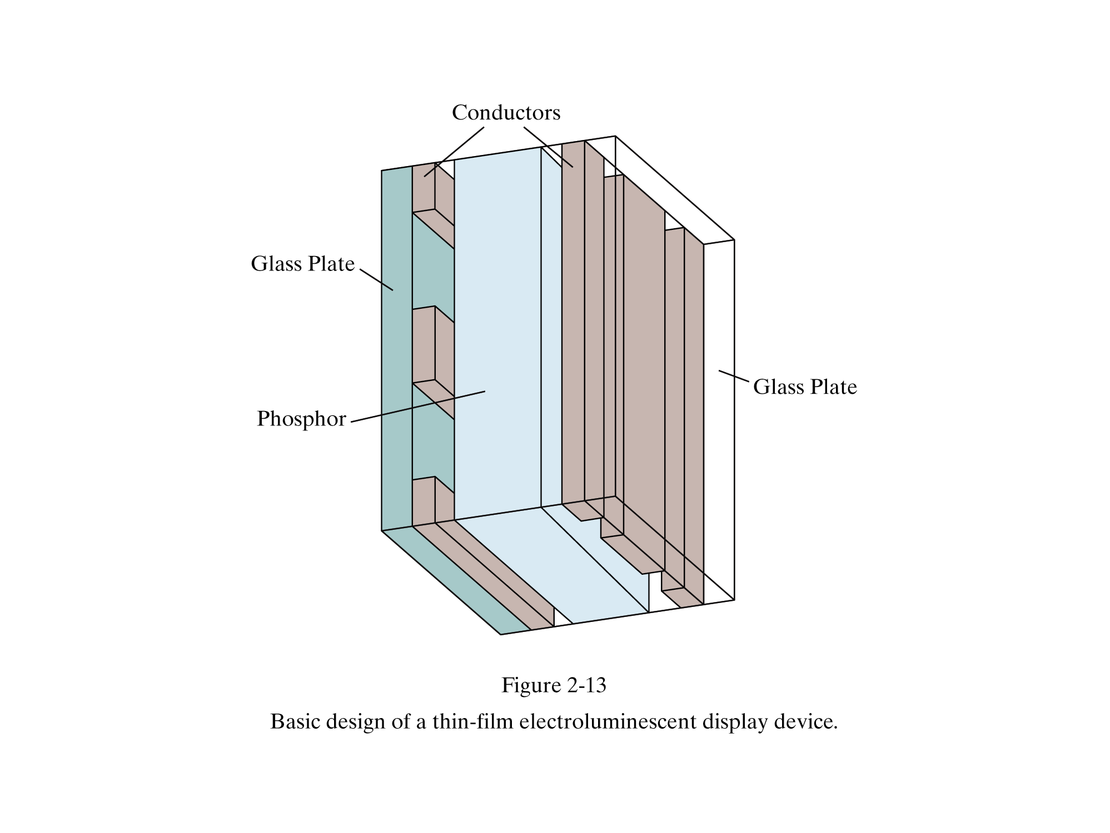
Flat-Panel Displays

Slide 47
LCD ( Liquid Crystal Display ) Basics
Viewing
direction
Reflective
layer
Horizontal
polarizer
Horizontal
grid wires
Liquid-
crystal
layer
Vertical
grid wires
Vertical
polarizer

Slide 48
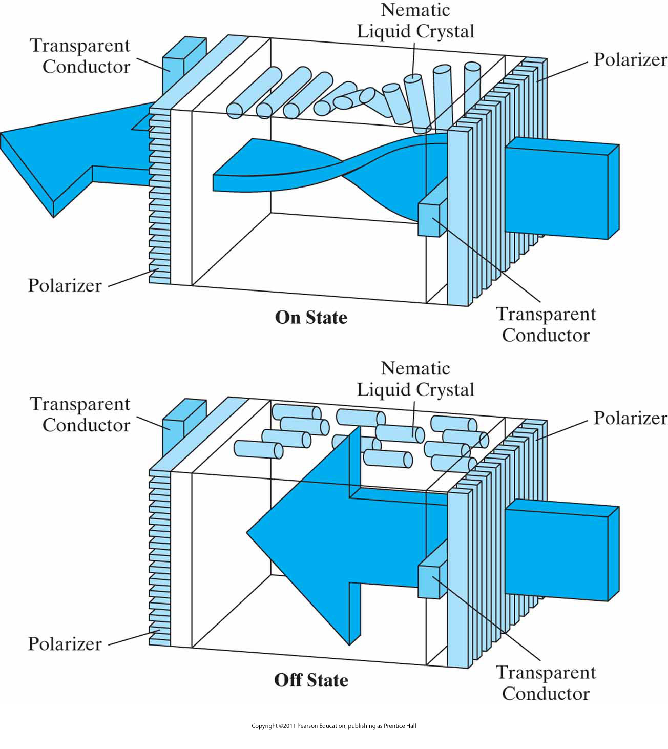
Flat-Panel Displays: LCD

Slide 49
Color TFT (Thin Film Transistor) LCD
Color ?
Color Filter
Liquid Crystal
TFT
TFT (Thin Film Transistor)
using a transistor at each grid point
causing the crystals to change their state quickly
controlling the degree to which the state has been changed
holding the state until it changes

Slide 50
Three Dimensional Viewing Devices
For the display of 3D scenes
Reflects a CRT image from a vibrating, flexible mirror
Allows to walk around an object or scene and view it from different sides

Slide 51
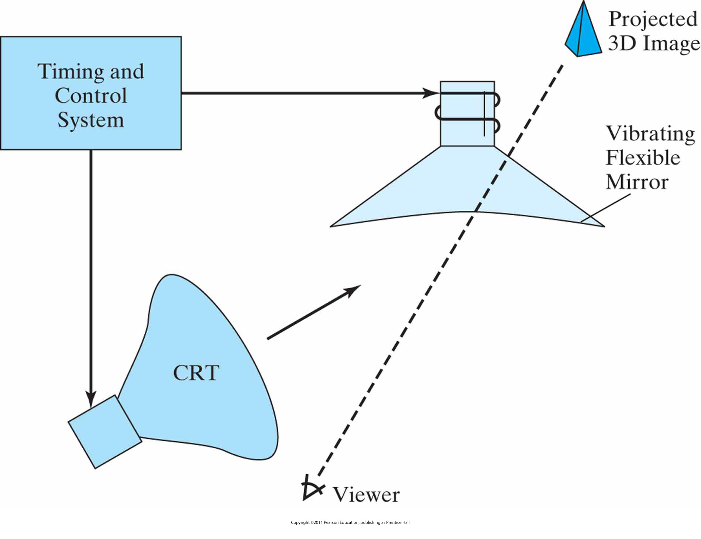
3D Display System
Operation of a three-dimensional display system using a vibrating mirror that changes focal length to match the depths of points in a scene.

Slide 52
Stereoscopic and Virtual-Reality Systems
Not true 3D images, but provides a 3D effect.
Uses two views of a scene along the lines of right and left eye. Gives perception of a scene depth when right view is seen from right eye and left scene is seen from left eye (stereoscopic effect). Display each view at alternate refresh cycles.

Slide 53
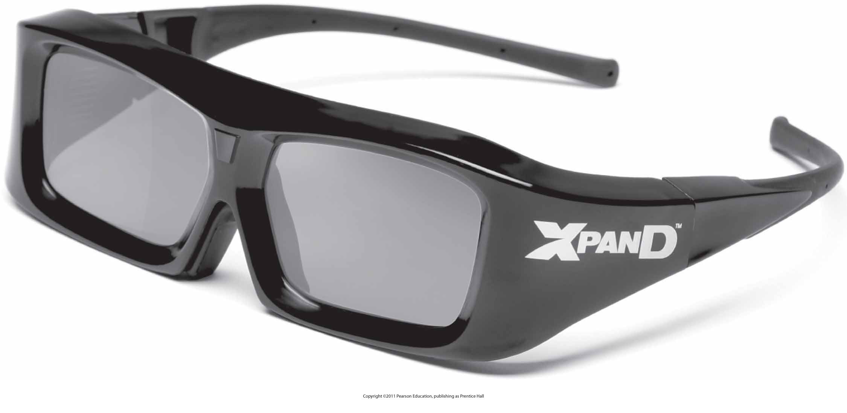
Glasses for viewing a stereoscopic scene in 3D. (Courtesy of XPAND, X6D USA Inc.)

Slide 54
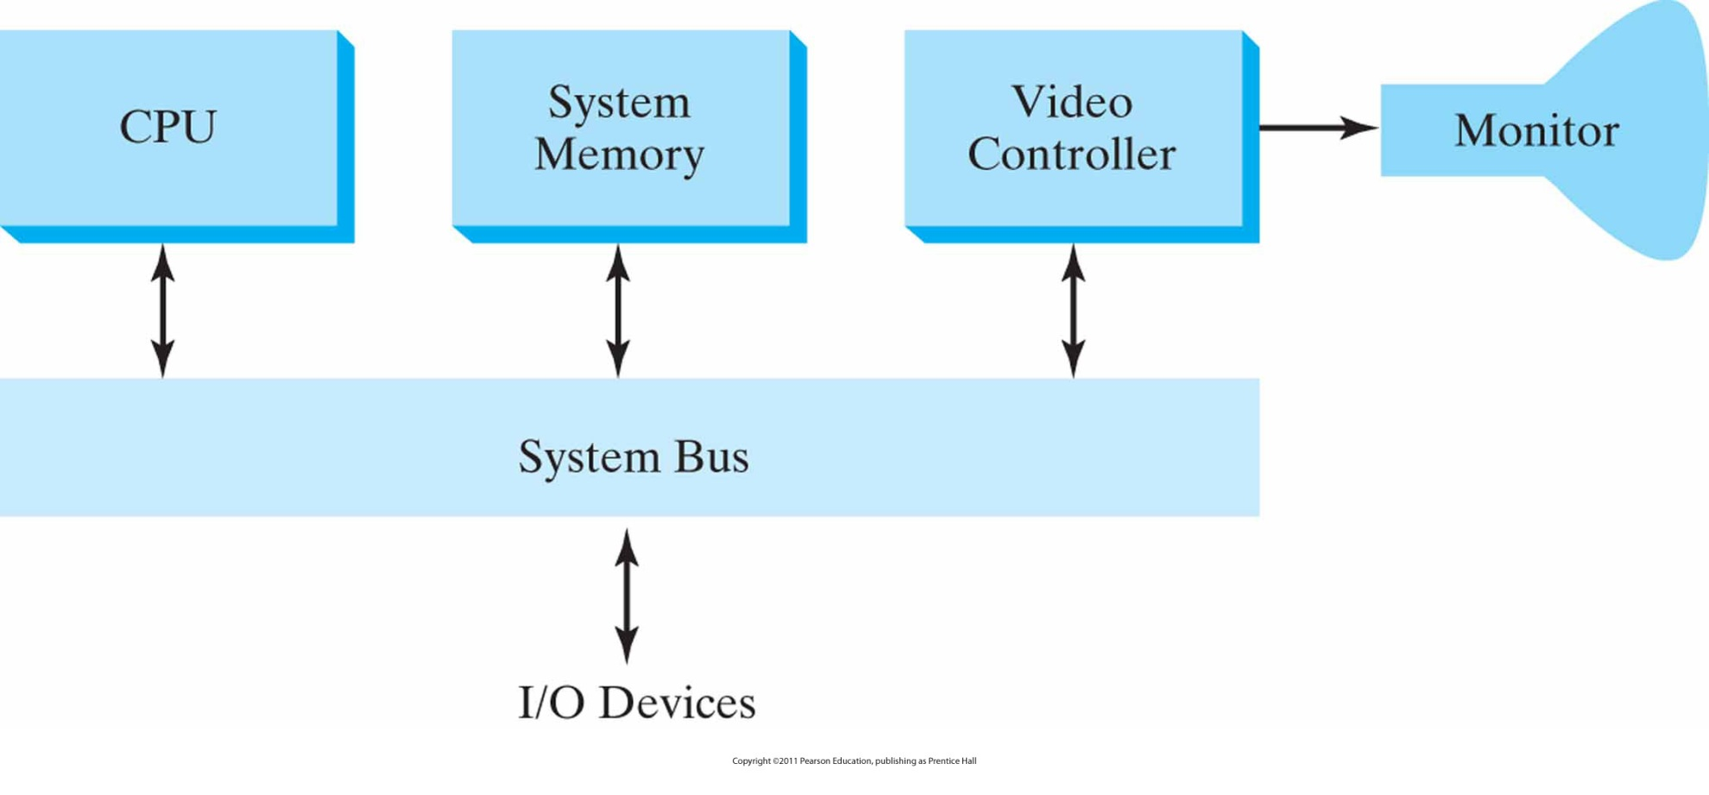
Architecture of a simple raster-graphics system

Slide 55
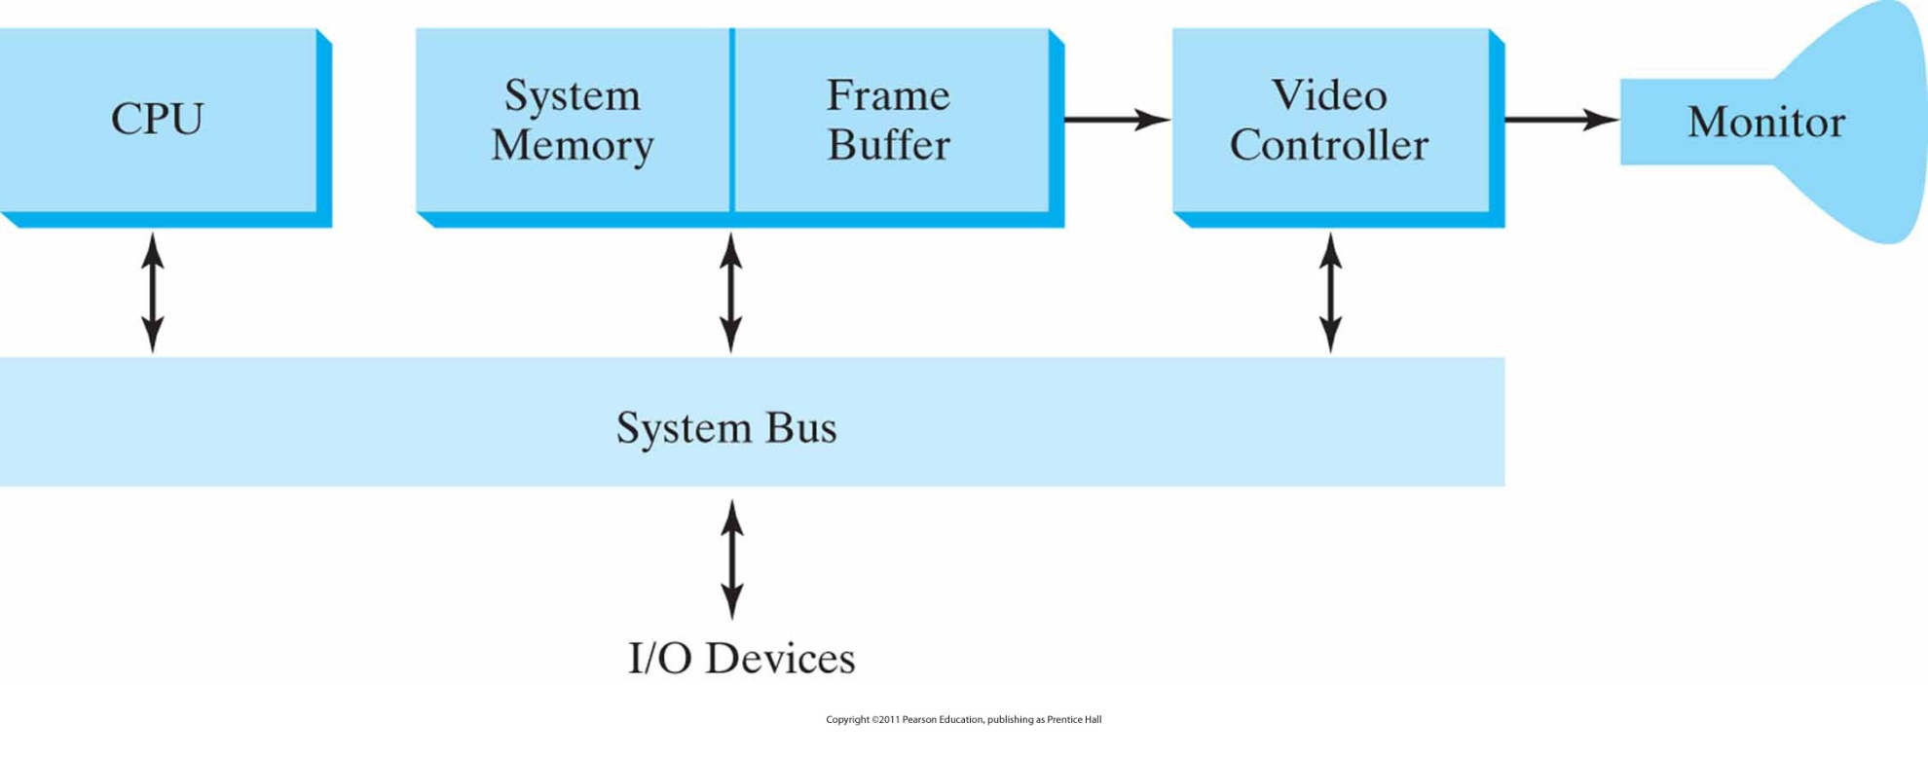
Architecture of a raster system
with a fixed portion of the system memory reserved for the frame buffer.

Slide 56
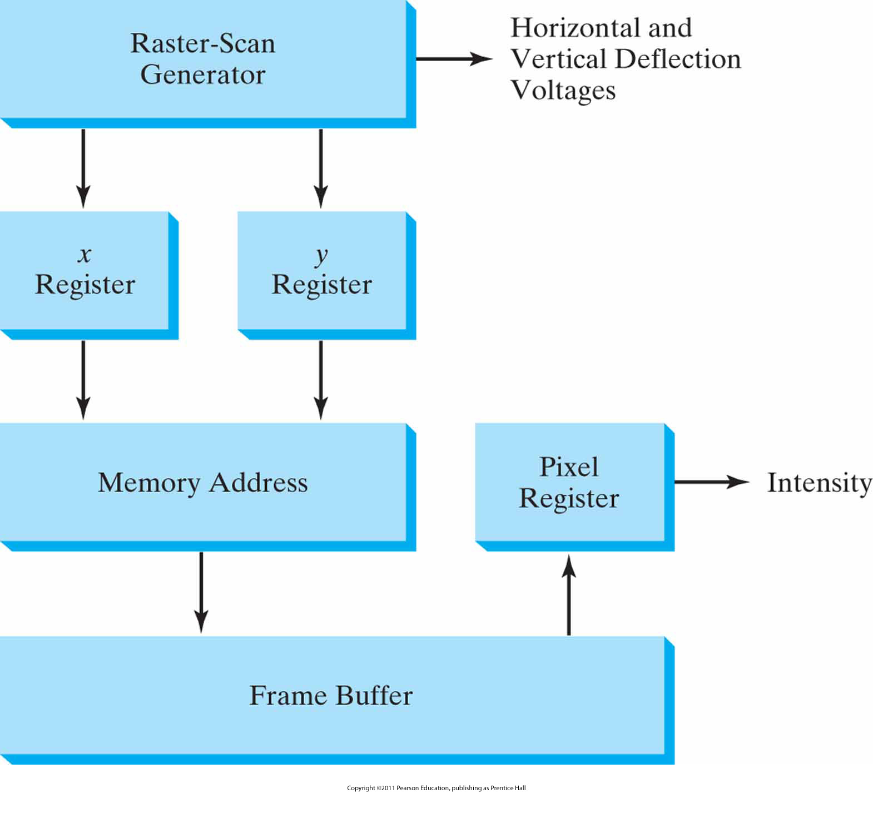
Basic video-controller refresh operations

Slide 57
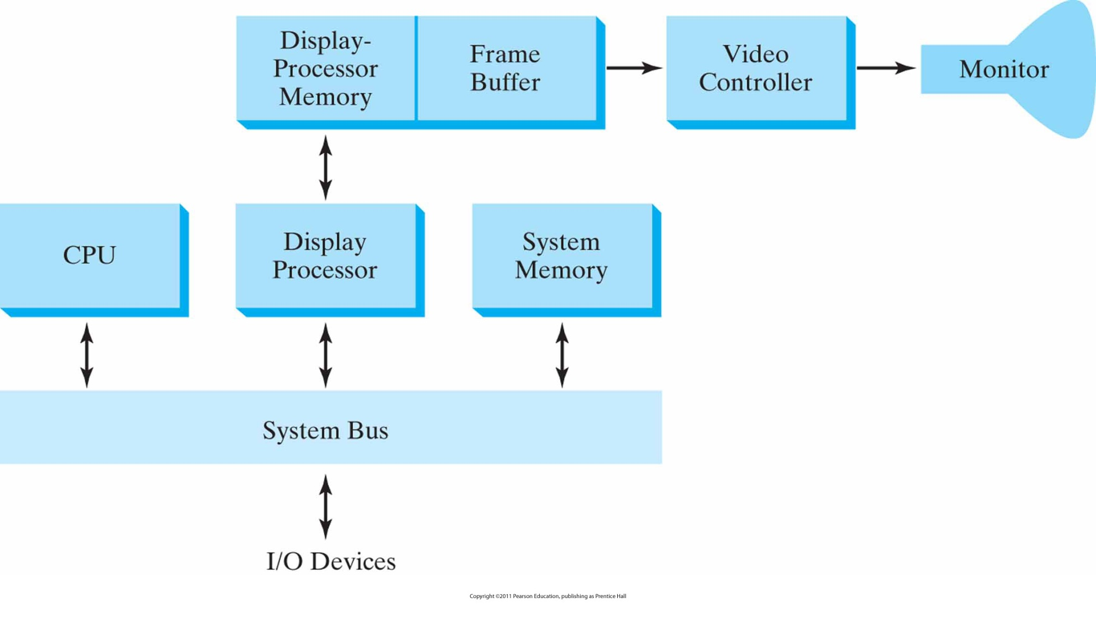
Architecture of a raster-graphics system with a display processor.

Slide 58
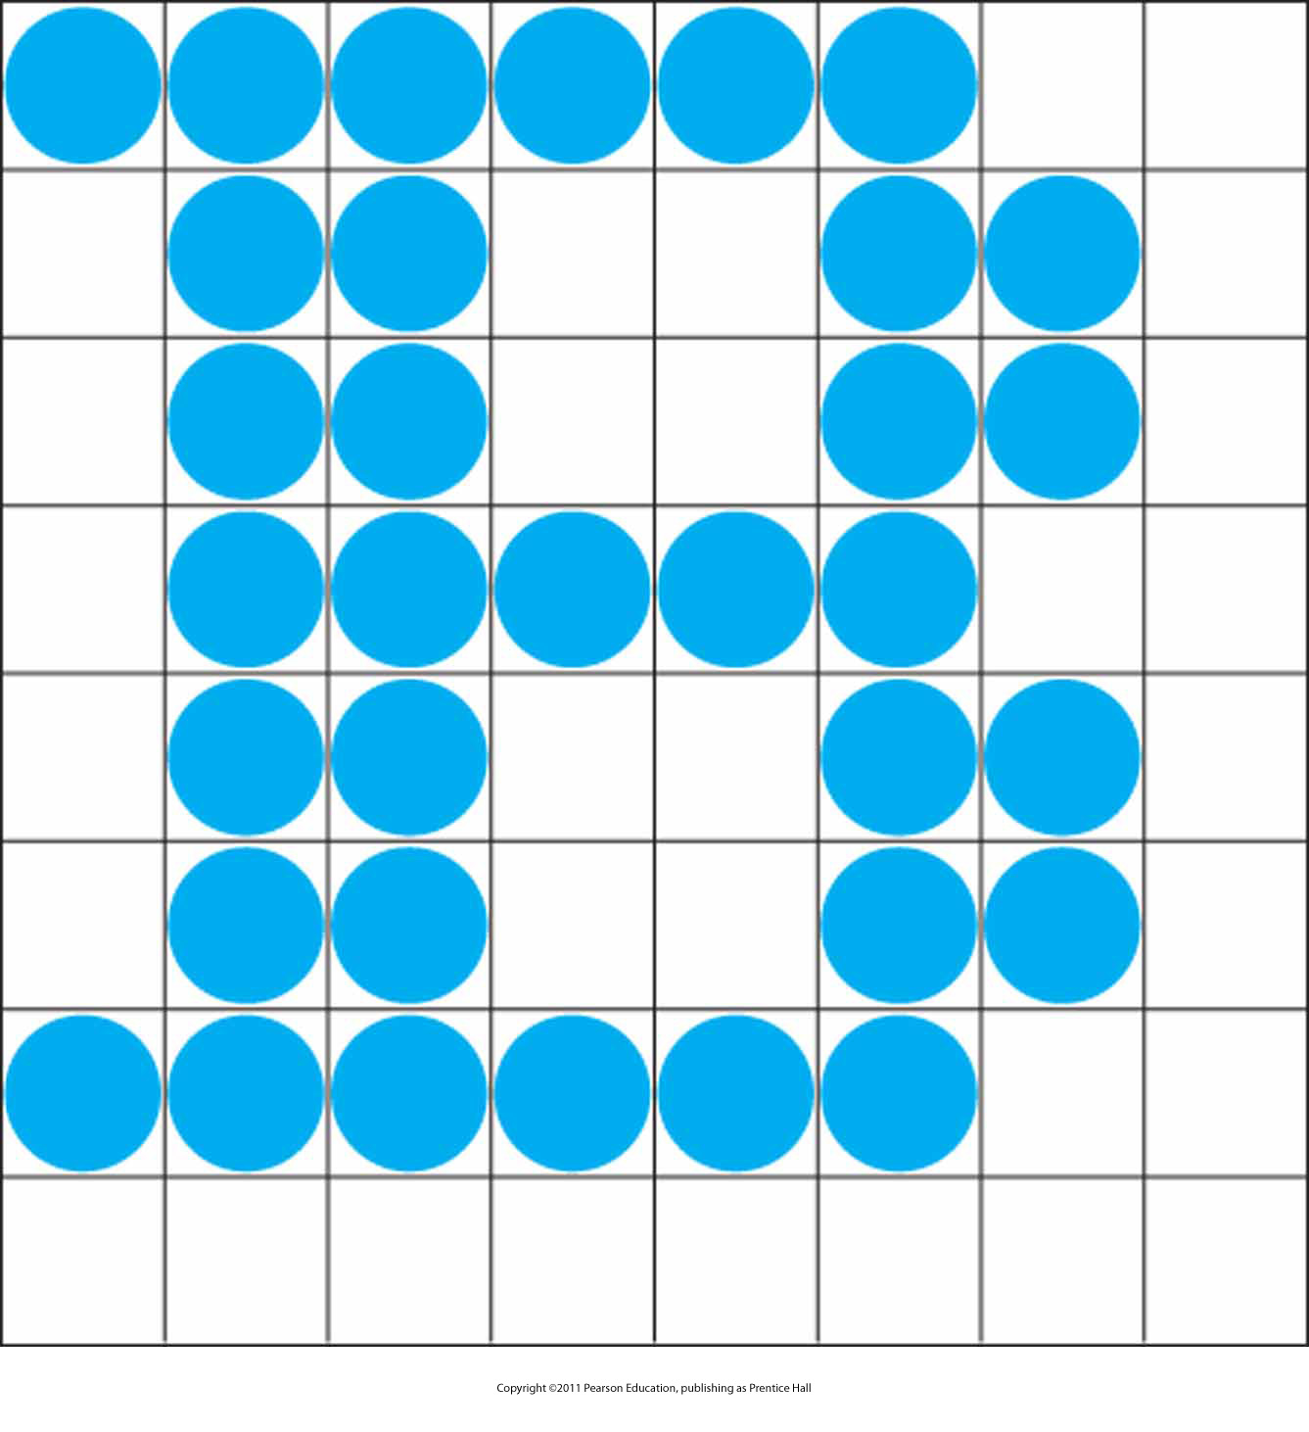
A character defined as a rectangular grid of pixel positions.

Slide 59

A character defined as an outline shape.

Slide 60
Input Devices/Method
Physical Devices
Logical Devices
Input Mode
  Request mode
  Event mode
  Sample mode

Slide 61
Input Devices
Input devices
  Keyboards, button boxes, dials
  Mouse devices
  Trackballs and spaceballs
  Joysticks
  Data gloves
  Digitizers
  Image scanners
  Touch panels
  Light pens
  Voice systems

Slide 62
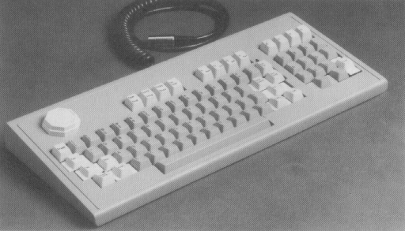
Physical Devices
Keyboards

Slide 63
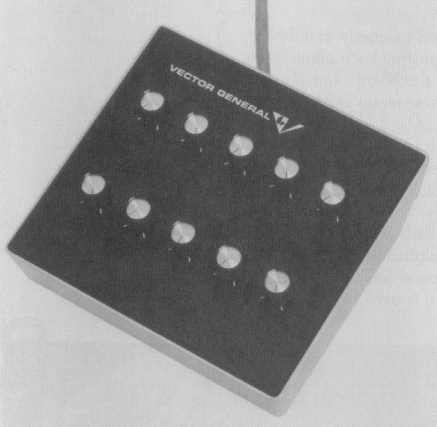
Physical Devices (cont.)
Dials

Slide 64
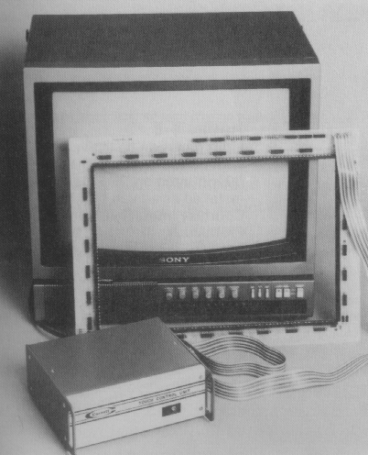
Physical Devices (cont.)
Touch Panels

Slide 65
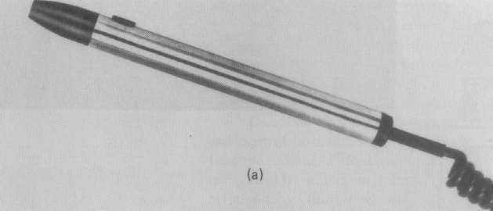
Physical Devices (cont.)
Light Pen

Slide 66
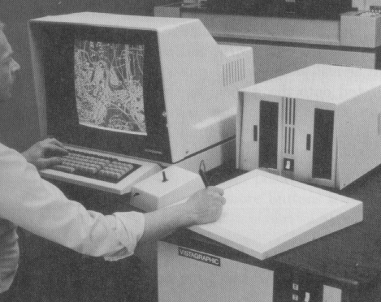
Physical Devices (cont.)
Graphics Tablets

Slide 67
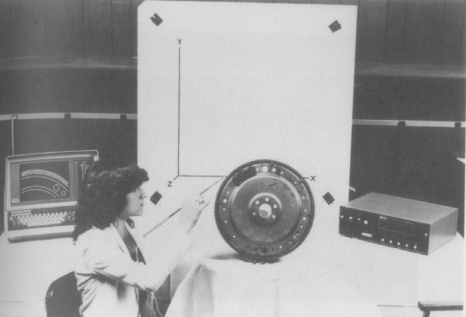
Physical Devices (cont.)
3D-Tablet

Slide 68
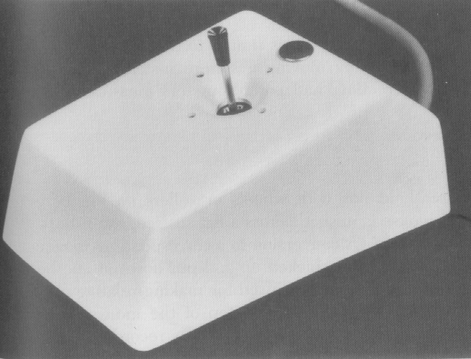
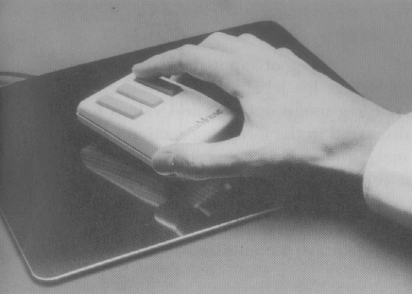
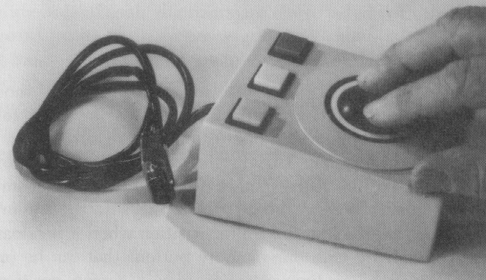
Physical Devices (cont.)
Joystick / Mouse / Trackball

Slide 69
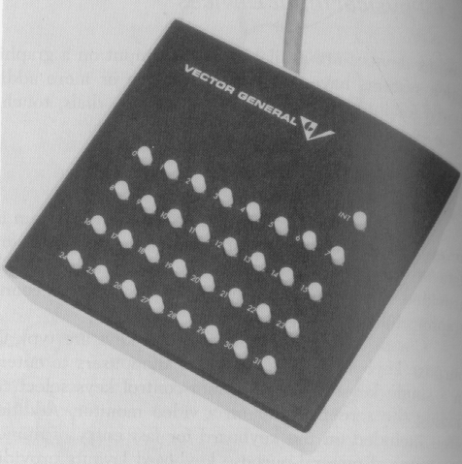
Physical Devices (cont.)
Button

Slide 70

Physical Devices (cont.)
Voice Systems

Slide 71
Logical Devices
Locator
Stroke
String
Valuator
Choice
Pick

Slide 72

Locator Devices / Stroke Devices

Slide 73
String Devices
y +
(a)
y - axis
(b)

Slide 74
Valuator Devices
1
90
0.5
0
0
180
0
5000
-0.5
-1
270

Slide 75
Choice Devices
  Button
  Menu Selection

Slide 76
Hard-copy Devices
Hard-copy devices
  Plotters
    2D moving pen with stationary paper
    1D pen and 1D moving paper
  Printers
    Impact devices
      Inked ribbon
    Non impact devices
      Laser, ink-jet, xerographic, electrostatic, electrothermal.

Slide 77
Graphics Software
Graphics software
  Special purpose
    For non programmers
    CAD, CAM, painting, animation
  General programming packages
    C, C++, Java, …
    Library of graphics functions (OpenGL)
      Picture components (lines, shapes, …)
      Transformations (color, texture, shading, rotating, …)

Slide 78
Coordinate Representations
To generate a picture using a programming package, we first need to give the geometric descriptions of the objects – location and shape
For example, a box is specified by the positions of its corners, a sphere is specified by its center position and radius

Slide 79
Coordinate Representation
Cartesian coordinates
  Modeling coordinates (local, master)
  in the reference frame of each object
  World coordinates
  in the scene reference frame
  Viewing coordinates
  view we want of a scene
  Normalized (device) coordinates
  normalized between –1 and 1 or 0 and 1
  Device coordinates (screen coordinates)

Slide 80

A Cartesian reference frame
with origin at the lower-left corner of a video monitor.

Slide 81

Coordinate System Transformations
The transformation sequence from modeling coordinates to device coordinates for a three-dimensional scene. Object shapes can be individually defined in modeling-coordinate reference systems. Then the shapes are positioned within the world-coordinate scene. Next, world-coordinate specifications are transformed through the viewing pipeline to viewing and projection coordinates and then to normalized coordinates. At the final step, individual device drivers transfer the normalized-coordinate representation of the scene to the output devices for display.

Slide 82
Coordinate Transformations
(x_{mc}, y_{mc}, z_{mc}) → (x_{wc}, y_{wc}, z_{wc}) → (x_{vc}, y_{vc}, z_{vc}) → (x_{pc}, y_{pc}, z_{pc}) → (x_{nc}, y_{nc}, z_{nc}) → (x_{dc}, y_{dc})

Slide 83

Example OpenGL Window
A 400 by 300 display window at position (50, 100) relative to the top-left corner of the video display.

Slide 84

Example Display Window

Slide 85
Graphics Functions
Graphics Output Primitives
  Character strings, lines, filled color areas (usually polygons)
  Basic tools for constructing pictures
Attributes
  Color, line style, text style, area filling patterns
Geometric Transformations
  Change size, position or orientation of an object

Slide 86
Graphics Functions
Viewing Transformations
  Select a view of the scene, type of projection to be used, location of the view on the video monitor
Input functions
  Control and process data flow from interactive devices
Control operations
  Clear the screen display area, initialize parameters

Slide 87
Introduction to OpenGL
First part of Silicon Graphics graphics workstations (formerly GL)
De facto graphics standard
Became hardware independent in early 1990s and named as OpenGL
Developed especially for 3D scenes
2D scenes as projections where z-coordinate is 0.

Slide 88
OpenGL
Graphics rendering API (Application Programmer’s Interface)
  A software interface to graphics hardware
  Generation of high-quality color images composed of geometric and image primitives
  Window system independent
  Operating system independent
  Close to the hardware
    Algorithms and implementations are important
Notes:
OpenGL is a library for doing computer graphics. By using it, you can create interactive applications which render high-quality color images composed of 3D geometric objects and images.
OpenGL is window and operating system independent. As such, the part of your application which does rendering is platform independent. However, in order for OpenGL to be able to render, it needs a window to draw into. Generally, this is controlled by the windowing system on whatever platform you’re working on.

Slide 89
OpenGL and the Windowing System
OpenGL is concerned only with rendering
  It is window system independent
  No input functions
OpenGL must interact with the underlying OS and windowing system
  Need minimal interface which may be system dependent
    Done through additional libraries: AGL (Apple), GLX (X-Window), WGL(Windows)

Slide 90
GLU and GLUT
GLU (OpenGL Utility Library)
  Part of OpenGL
  Provides NURBS (splines), etc.
GLUT (OpenGL Utility Toolkit)
  A portable windowing API
  Not officially part of OpenGL
  Extremely useful for helping to create images quickly without worrying about the underlying windowing system being used
Notes:
As mentioned, OpenGL is window and operating system independent. To integrate it into various window systems, additional libraries are used to modify a native window into an OpenGL capable window. Every window system has its own unique library and functions to do this. Some examples are:
GLX for the X Windows system, common on Unix platforms
AGL for the Apple Macintosh
WGL for Microsoft Windows
OpenGL also includes a utility library, GLU, to simplify common tasks such as: rendering quadric surfaces (i.e. spheres, cones, cylinders, etc. ), working with NURBS and curves, and concave polygon tessellation.
Finally to simplify programming and window system dependence, we’ll be using the freeware library, GLUT. GLUT, written by Mark Kilgard, is a public domain window system independent toolkit for making simple OpenGL applications. It simplifies the process of creating windows, working with events in the window system and handling animation.

Slide 91

The OpenGL version 4 pipeline.

Slide 92
Basic OpenGL Syntax
Function names are prefixed with gl for core library, glu for GLU, glut for GLUT library
  glBegin, glClear, gluOrtho2D,glutInit
Constants
  GL_2D, GL_RGB, GLUT_SINGLE
Data types
  GLbyte, GLshort, GLint, GLfloat, GLdouble

Slide 93
OpenGL Command Formats
glVertex3fv( v )
Number of
components
Data Type
Vector
b - byte
ub - unsigned byte
s - short
us - unsigned short
i - int
ui - unsigned int
f - float
d - double
omit “v” for
scalar form
glVertex2f( x, y )
2 - (x,y)
3 - (x,y,z)
4 - (x,y,z,w)
Notes:
The OpenGL API calls are designed to accept almost any basic data type, which is reflected in the calls name. Knowing how the calls are structured makes it easy to determine which call should be used for a particular data format and size.
For instance, vertices from most commercial models are stored as three component floating point vectors. As such, the appropriate OpenGL command to use is glVertex3fv( coords ).
As mentioned before, OpenGL uses homogenous coordinates to specify vertices. For glVertex*() calls which don’t specify all the coordinates
( i.e. glVertex2f()), OpenGL will default z = 0.0, and w = 1.0 .

Slide 94

Display Window

Slide 95
Sample Program
#include <GL/glut.h>
// (or others, depending on the system in use)
void init (void)
{
glClearColor (1.0, 1.0, 1.0, 0.0); // Set display-window color to white.
glMatrixMode (GL_PROJECTION); // Set projection parameters.
gluOrtho2D (0.0, 200.0, 0.0,150.0);
}
Notes:
Here’s an example of the main part of a GLUT based OpenGL application. This is the model that we’ll use for most of our programs in the course.
The glutInitDisplayMode() and glutCreateWindow() functions compose the window configuration step.
We then call the init() routine, which contains our one-time initialization. Here we initialize any OpenGL state and other program variables that we might need to use during our program that remain constant throughout the program’s execution.
Next, we register the callback routines that we’re going to use during our program.
Finally, we enter the event processing loop, which interprets events and calls our respective callback routines.

Slide 96
Sample Program (cont.)
void lineSegment (void)
{
glClear (GL_COLOR_BUFFER_BIT);
// Clear display window.
glColor3f (1.0, 0.0, 0.0);
// Set line segment color to red.
glBegin (GL_LINES);
glVertex2i (180, 15);
// Specify line-segment geometry.
glVertex2i (10, 145);
glEnd ( );
glFlush ( );
// Process all OpenGL routines as quickly as possible.
}
Notes:
Here’s an example of the main part of a GLUT based OpenGL application. This is the model that we’ll use for most of our programs in the course.
The glutInitDisplayMode() and glutCreateWindow() functions compose the window configuration step.
We then call the init() routine, which contains our one-time initialization. Here we initialize any OpenGL state and other program variables that we might need to use during our program that remain constant throughout the program’s execution.
Next, we register the callback routines that we’re going to use during our program.
Finally, we enter the event processing loop, which interprets events and calls our respective callback routines.

Slide 97
Sample Program (cont.)
void main (int argc, char** argv)
{
glutInit (&argc, argv); // Initialize GLUT.
glutInitDisplayMode (GLUT_SINGLE | GLUT_RGB); // Set display mode.
glutInitWindowPosition (50, 100);
// Set top-left display-window position.
glutInitWindowSize (400, 300);
// Set display-window width and height.
glutCreateWindow ("An Example OpenGL Program"); // Create display window.
init ( );
// Execute initialization procedure.
glutDisplayFunc (lineSegment);
// Send graphics to display window.
glutMainLoop ( );
// Display everything and wait.
}
Notes:
Here’s an example of the main part of a GLUT based OpenGL application. This is the model that we’ll use for most of our programs in the course.
The glutInitDisplayMode() and glutCreateWindow() functions compose the window configuration step.
We then call the init() routine, which contains our one-time initialization. Here we initialize any OpenGL state and other program variables that we might need to use during our program that remain constant throughout the program’s execution.
Next, we register the callback routines that we’re going to use during our program.
Finally, we enter the event processing loop, which interprets events and calls our respective callback routines.

Slide 98

Output
Notes:
Here’s an example of the main part of a GLUT based OpenGL application. This is the model that we’ll use for most of our programs in the course.
The glutInitDisplayMode() and glutCreateWindow() functions compose the window configuration step.
We then call the init() routine, which contains our one-time initialization. Here we initialize any OpenGL state and other program variables that we might need to use during our program that remain constant throughout the program’s execution.
Next, we register the callback routines that we’re going to use during our program.
Finally, we enter the event processing loop, which interprets events and calls our respective callback routines.

Slide 99
Specifying Geometric Primitives
Primitives are specified using
      glBegin( primType );
      glVertex…
      …
      glEnd();
  primType determines how vertices are combined

Slide 100

Geometric Primitive Types

Slide 101
Geometric Primitive Types (cont.)
GL_POINTS : Draws a point at each of the n vertices.
GL_LINES : Draws a series of unconnected line segments. Segments are drawn between v0 and v1, between v2 and v3, and so on. If n is odd, the last segment is drawn between vn-3 and vn-2, and vn-1 is ignored.

Slide 102
Geometric Primitive Types (cont.)
GL_LINE_STRIP : Draws a line segment from v0 to v1, then from v1 to v2, and so on, finally drawing the segment from vn-2 to vn-1. Thus, a total of n-1 line segments are drawn. Nothing is drawn unless n is larger than 1. There are no restrictions on the vertices describing a line strip (or a line loop); the lines can intersect arbitrarily.
GL_LINE_LOOP : Same as GL_LINE_STRIP, except that a final line segment is drawn from vn-1 to v0, completing a loop.

Slide 103
Geometric Primitive Types (cont.)
GL_TRIANGLES : Draws a series of triangles (three-sided polygons) using vertices v0, v1, v2, then v3, v4, v5, and so on. If n isn't an exact multiple of 3, the final one or two vertices are ignored.
GL_TRIANGLE_STRIP : Draws a series of triangles (three-sided polygons) using vertices v0, v1, v2, then v2, v1, v3 (note the order), then v2, v3, v4, and so on. The ordering is to ensure that the triangles are all drawn with the same orientation so that the strip can correctly form part of a surface. Preserving the orientation is important for some operations, such as culling. (See "Reversing and Culling Polygon Faces") n must be at least 3 for anything to be drawn.

Slide 104
Geometric Primitive Types (cont.)
GL_TRIANGLE_FAN :Same as GL_TRIANGLE_STRIP, except that the vertices are v0, v1, v2, then v0, v2, v3, then v0, v3, v4, and so on.
GL_QUADS : Draws a series of quadrilaterals (four-sided polygons) using vertices v0, v1, v2, v3, then v4, v5, v6, v7, and so on. If n isn't a multiple of 4, the final one, two, or three vertices are ignored.

Slide 105
Geometric Primitive Types (cont.)
GL_QUAD_STRIP : Draws a series of quadrilaterals (four-sided polygons) beginning with v0, v1, v3, v2, then v2, v3, v5, v4, then v4, v5, v7, v6, and so on (see Figure 2-7). n must be at least 4 before anything is drawn. If n is odd, the final vertex is ignored.
GL_POLYGON :Draws a polygon using the points v0, ... , vn-1 as vertices. n must be at least 3, or nothing is drawn. In addition, the polygon specified must not intersect itself and must be convex. If the vertices don't satisfy these conditions, the results are unpredictable.

Slide 106

Valid and Invalid Polygons

Slide 107

Next Lecture
Graphics Output Primitives

Slide 108
References
Donald Hearn, M. Pauline Baker, Warren R. Carithers, “Computer Graphics with OpenGL, 4th Edition”; Pearson, 2011
Jonas Gomez, Luiz Velho, Maria Costa Sousa, “Computer Graphics: Theory and Practice”, CRC Press, 2012
Sumanta Guha, “Computer Graphics Through OpenGL: From Theory to Experiments”, CRC Press, 2010
Jeffrey J. McConnell, “Computer Graphics: Theory into Practice”, Jones & Bartlett Pub., 2005
Kelvin Sung, Peter Shirley, Steven Baer, “Essentials of Interactive Computer Graphics: Concepts and Implementation”, CRC Press, 2008
Richard S. Wright, Nicholas Haemel, Graham Sellers, Benjamin Lipchak, “OpenGL SuperBible: Comprehensive Tutorial and Reference”, Addison-Wesley, 2010
Edward Angel, “Interactive Computer Graphics. A Top-Down Approach Using OpenGL”, Addison-Wesley, 2005
Wikipedia and other internet resources

