Slide 1


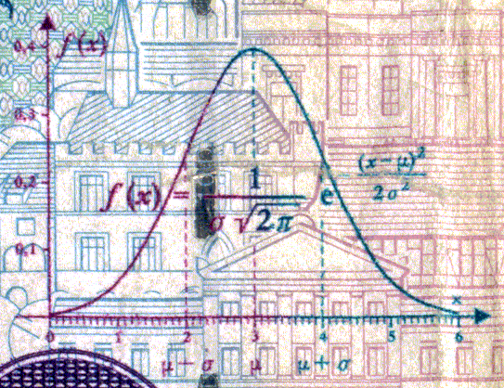
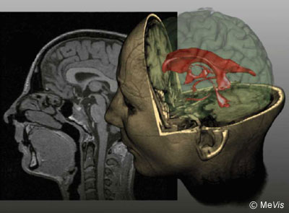
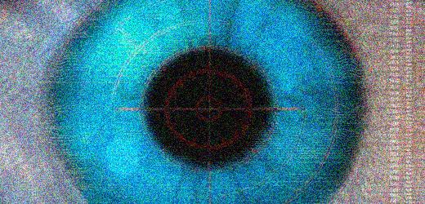
CSE 307
Basics of Image Processing
Lecture #1 Introduction and Motivation
Prepared & Presented by Asst. Prof. Dr. Samsun M. BAŞARICI

Slide 2


Objectives
What is image processing?
What are the main applications of image processing?
What is an image?
What is a digital image?
What are the goals of image processing algorithms?
What are the most common image processing operations?

Slide 3
Objectives (cont.)
Which hardware and software components are typically needed to build an image processing system?
What is a machine vision system and what are its main components?
Why is it so hard to emulate the performance of the human visual system (HVS) using cameras and computers?

Slide 4




People remember
10% of what they read
20% of what they hear
30% of what they see
50% of what they hear and see
80% of what they hear, see and say
90% of what they hear, see, say and touch

Slide 5
Motivation
Vision is our most developed sense
The ability to guide our actions and engage our cognitive abilities based on visual input is a remarkable trait of the human species…
  … but much of “how exactly we do what we do” remains to be discovered.
“A picture is worth a thousand words.”
The ability to automatically extract semantic information from an image is an open and actively investigated research problem.

Slide 6
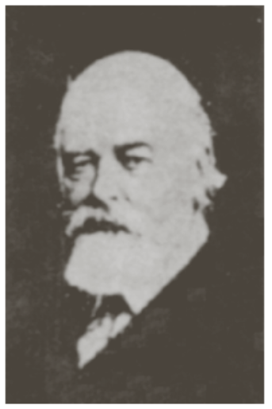
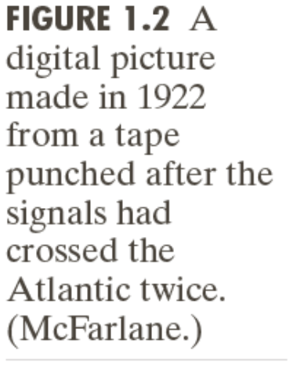
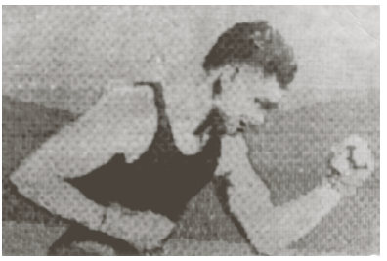
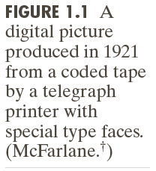
History
First application: In the newspaper industry. Time required to transport a picture across the Atlantic from one week to 3 hours!
(following images are taken from DIP)

Slide 7
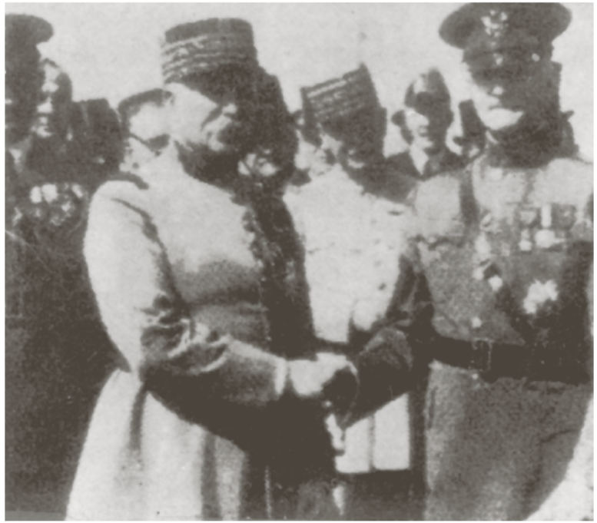
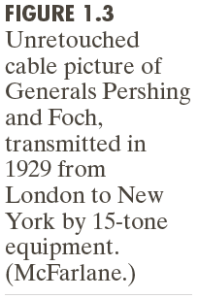
History (cont.)
This system was based on coding images in five levels of gray.
In 1929 the number of distinct gray levels was increased to 15.

Slide 8
History (cont.)
The previous three examples are not considered in the context of dip since computers are not involved in the underlying processes.
The history of dip starts with the development of the digital computers.
The first computers that can be used for image processing tasks appeared in the early 1960.

Slide 9
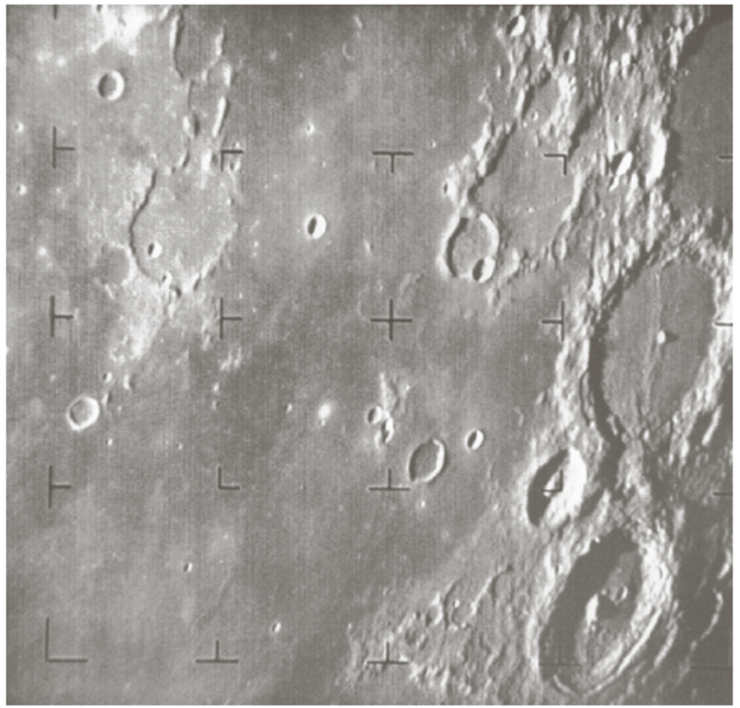
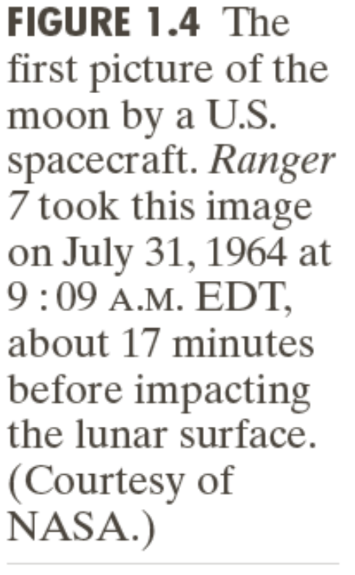
History (cont.)
Computers were used for improving space images at the Jet Propolsion Laboratory, California in 1964.

Slide 10
History (cont.)
In parallel to space applications, dip techniques began in late 1960 to be used in medical imaging and astronomy.
The invention of Computerized Tomography(CT) in 1970s was the most important application of dip in medical diagnosis. (won 1979 nobel prize)

Slide 11
History (cont.)
The field of image processing have grown rapidly. Applications include
  Geography
  Archeology
  Physics
  Nuclear biology
  Defence industry

Slide 12
Examples of applications
Medical applications: PET, CAT scans, MRI and fMRI, etc.
Industrial applications
Consumer electronics
Military applications
Law enforcement and security
Internet, particularly the Web.

Slide 13
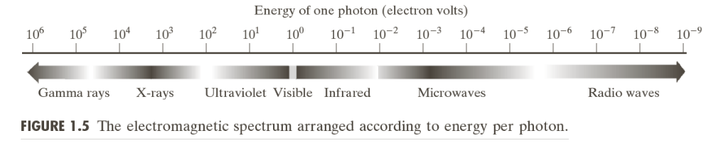
Examples of applications (cont.)
Today, dip techniqes are used widely.
One way to classify these applications according to the source of the image(e.g., visual, X-ray,...etc).
The principal energy sources are
  Electromagnetic enery spectrum
  Acoustic
  Ultrasonic
  Electronic (electron beams used in electron microscopy)

Slide 14
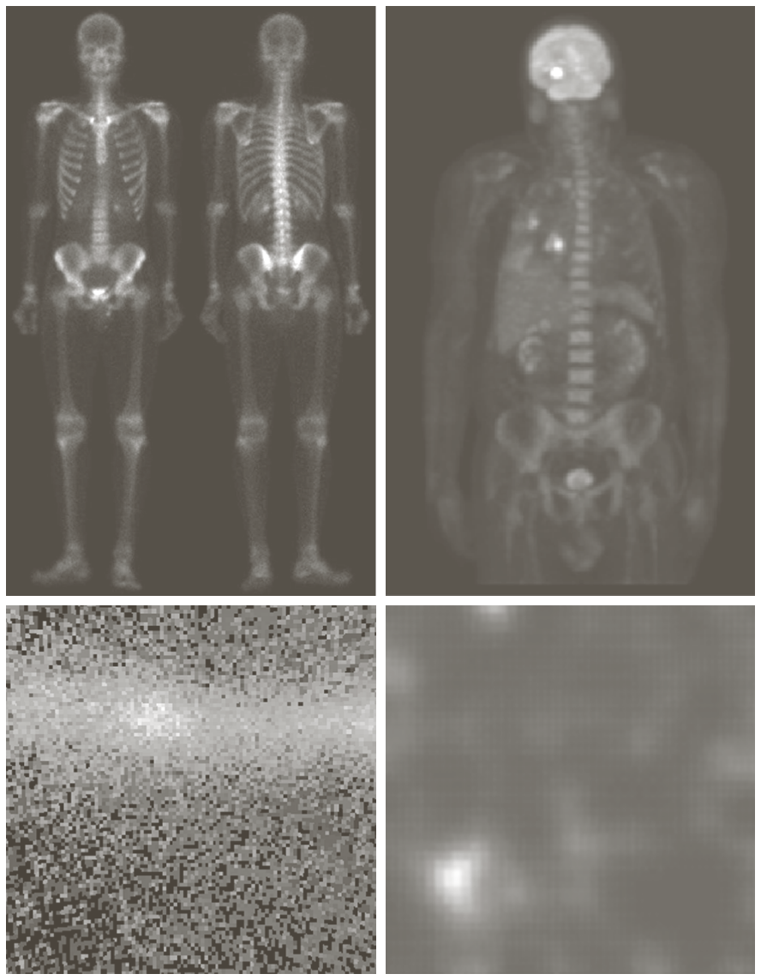
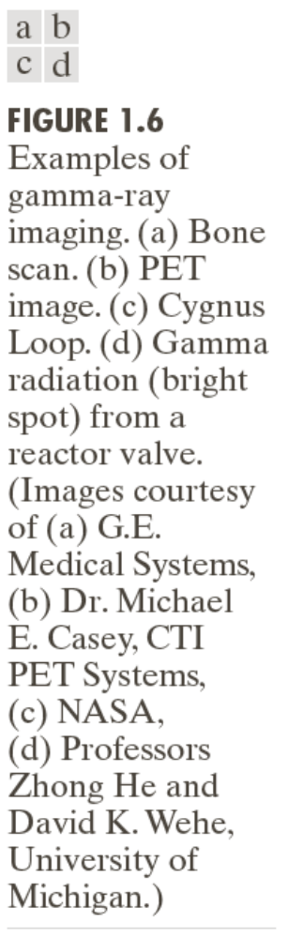
Gamma-ray imaging

Slide 15
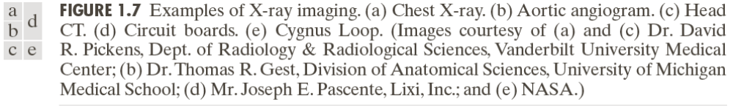
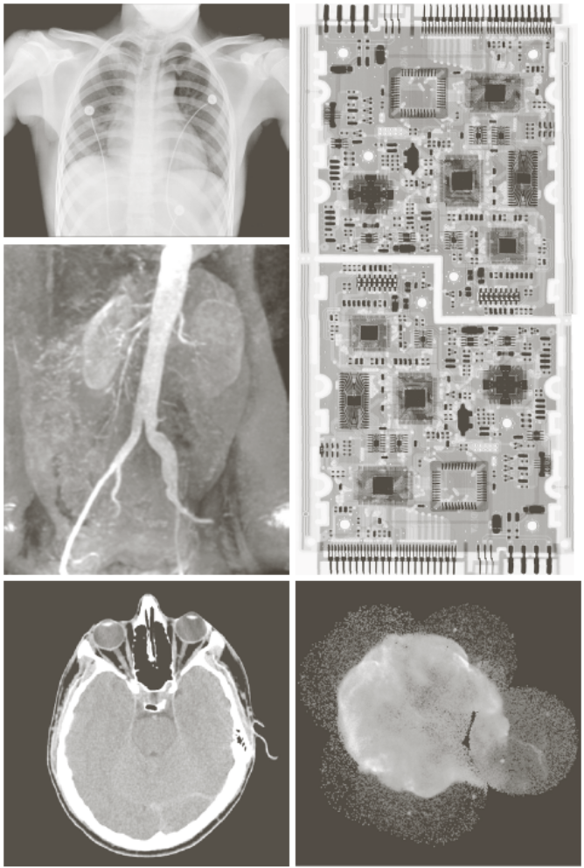
X-ray imaging

Slide 16
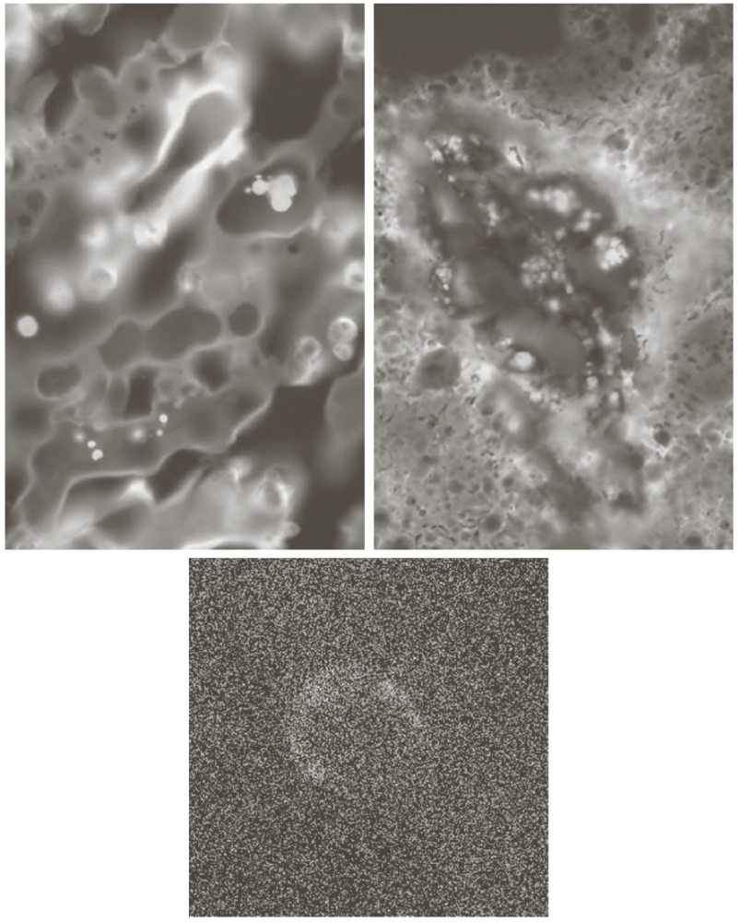
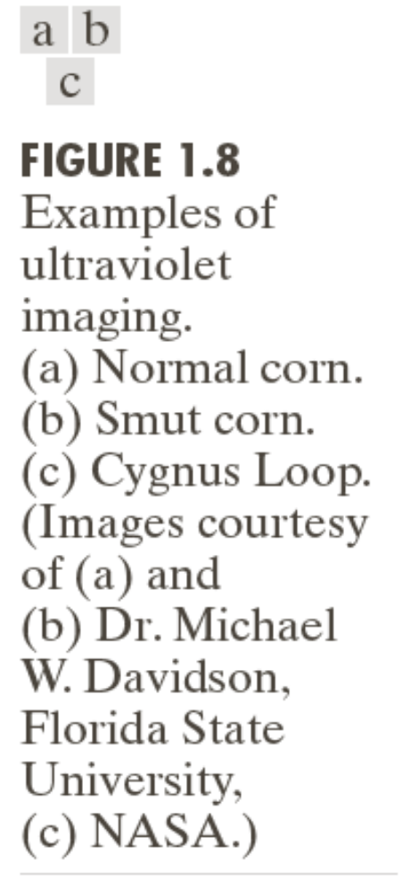
Imaging in the Ultraviolet band

Slide 17
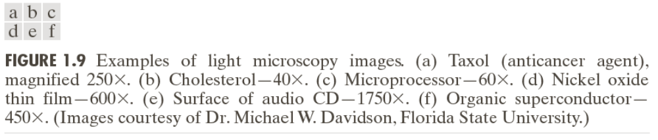
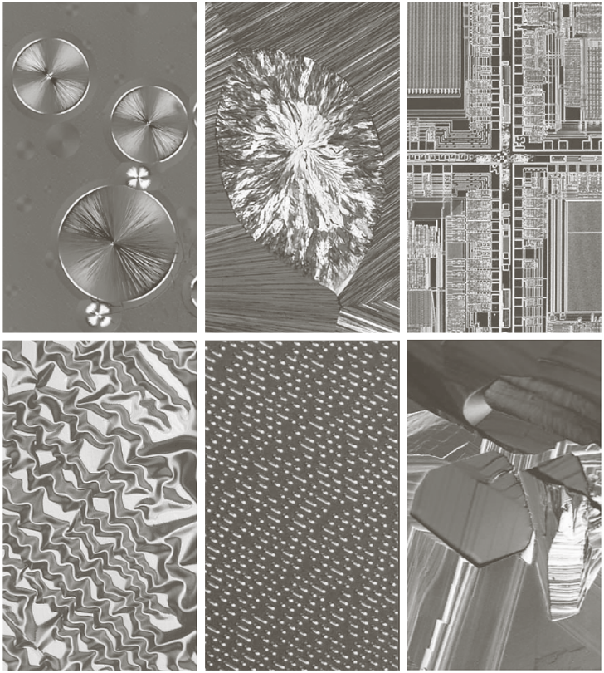
Imaging in the visible and infrared bands

Slide 18
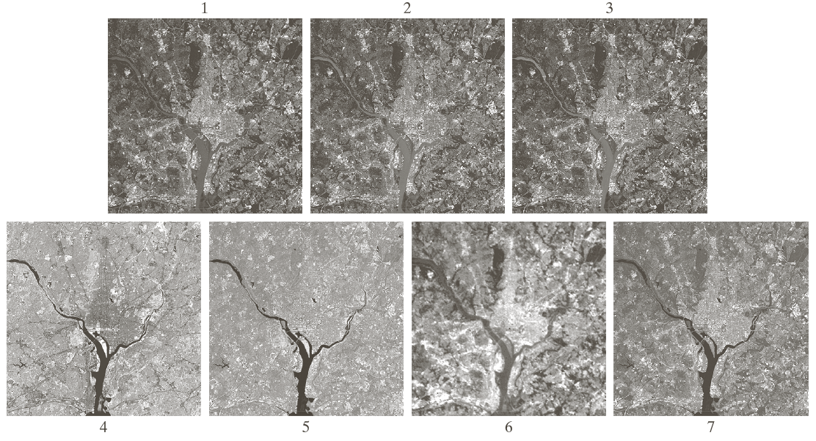
Imaging in the visible and infrared bands (cont.)

Slide 19
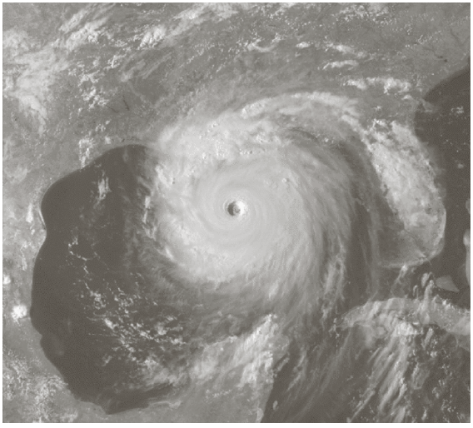
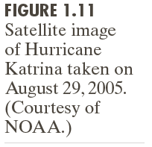
Imaging in the visible and infrared bands (cont.)

Slide 20
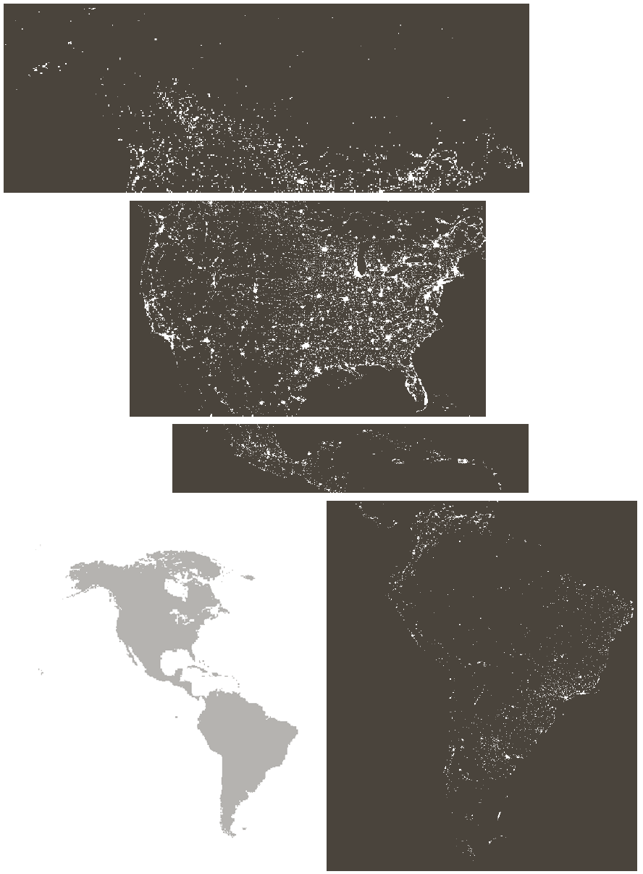
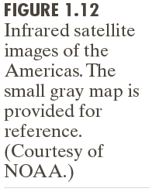
Imaging in the visible and infrared bands (cont.)

Slide 21

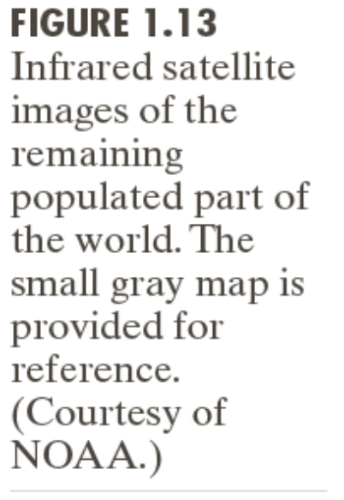
Imaging in the visible and infrared bands (cont.)

Slide 22
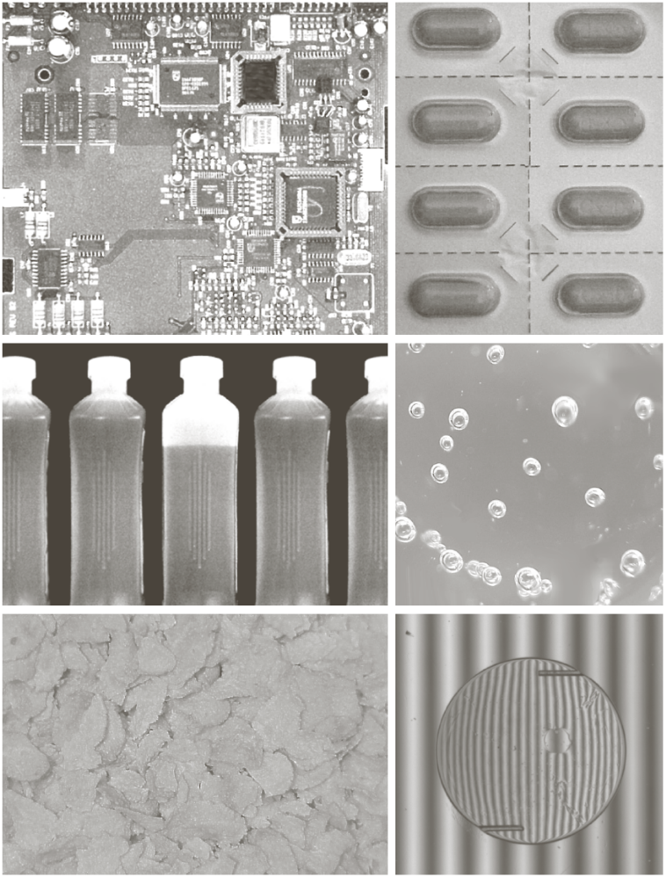
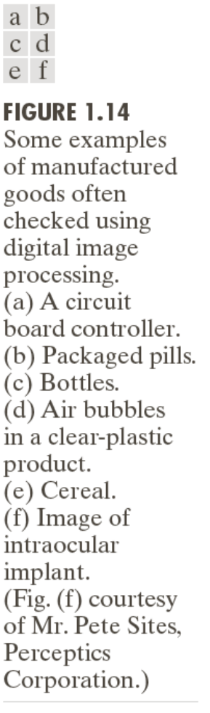
Imaging in the visible and infrared bands (cont.)

Slide 23
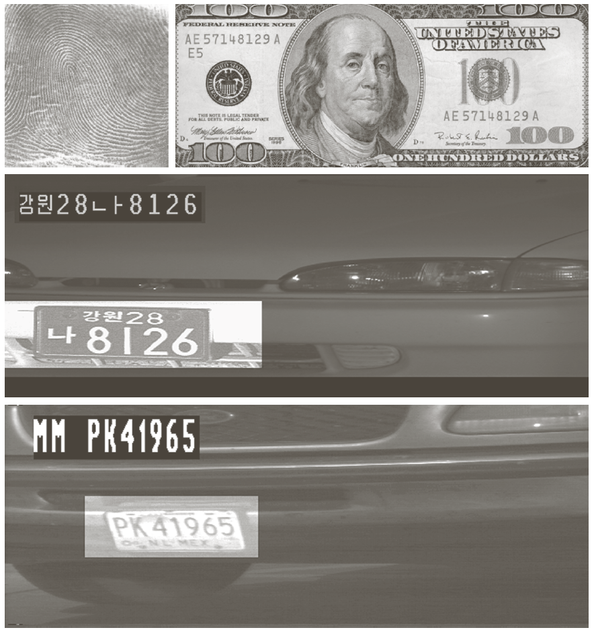
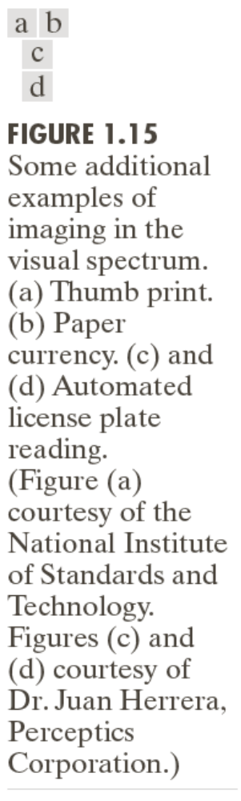
Imaging in the visible and infrared bands (cont.)

Slide 24
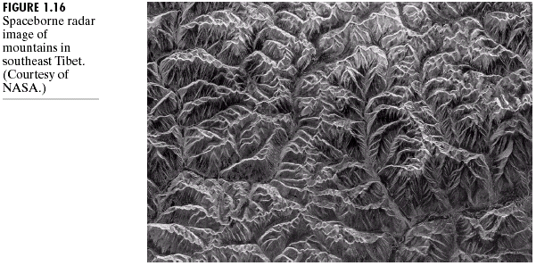
Imaging in the microwave band

Slide 25
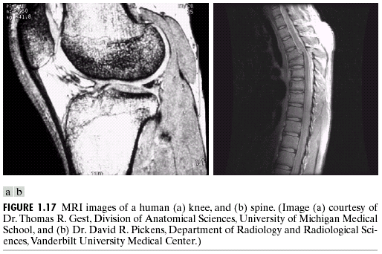
Imaging in the radio band

Slide 26
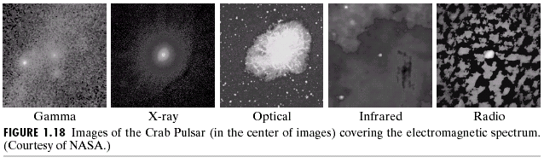
Other Imaging examples

Slide 27
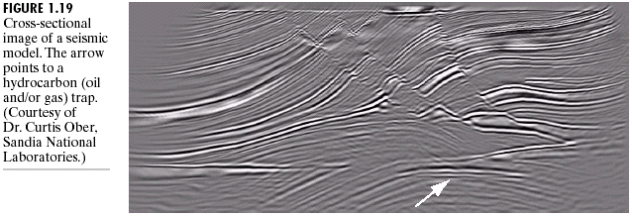
Other Imaging examples (cont.)

Slide 28
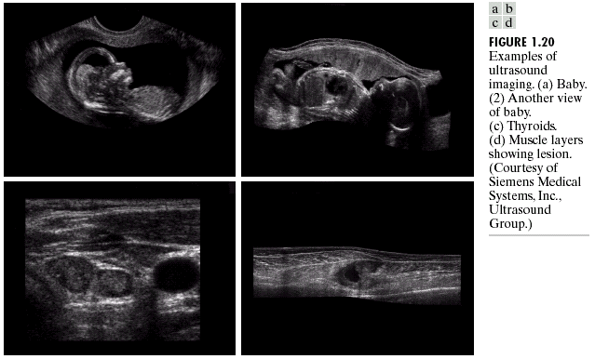
Other Imaging examples (cont.)

Slide 29
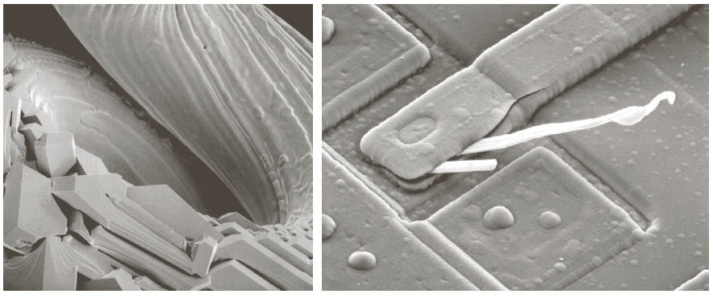
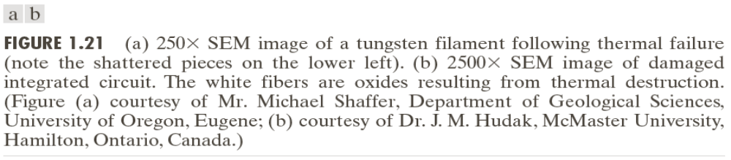
Other Imaging examples (cont.)

Slide 30
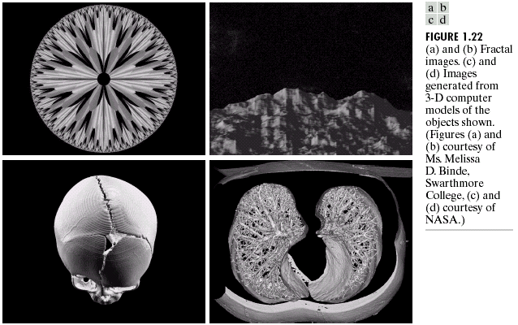
Other Imaging examples (cont.)

Slide 31
Basic concepts
What is an image?
  According to "Webster’s Encyclopedic Unabridged Dictionary of the English Language (1989)" or "The Random House Dictionary of the English Language-The Unabridged Edition (1981)" ‘image’ has more than 20 meanings like;
    "a physical likeliness or representation of a person, animal or thing, photographed, painted, sculptured, or otherwise made visible"
    "an optical counterpart or appearance of an object"
    "a mental representation"
    "Math. the point or set of points in the range corresponding to a designated point in the domain of a given function"
    …

Slide 32
Basic concepts (cont.)
Same applies to process
  "a systematic series of actions directed to some end"
  "a continuous action, operation, or series of changes taking place in a definite manner"
  "the condition of being carried on"
  …

Slide 33
Basic concepts (cont.)
What is an image?
  A visual representation of an object, a person, or a scene produced by an optical device such as a mirror, a lens, or a camera.
A few remarks:
  This representation is typically 2D, although it usually corresponds to one of infinitely many projections of a real world, 3D object or scene.
  This definition implicitly assumes the existence of a light source illuminating the scene, which is a requirement for the image to be produced.
  An image means something, in other words, it is not a random arrangements of dark and bright points.

Slide 34
Basic concepts (cont.)
What is a digital image?
  A digital image is a representation of a two-dimensional image using a finite number of points, usually referred to as picture elements, or pixels.
A few remarks:
  Each pixel is represented by one or more numerical values:
    for monochrome (grayscale) images, a single value representing the intensity of the pixel (usually in a [0, 255] range) is enough;
    for color images, three values (usually representing the amount of red (R), green (G), and blue (B)) are required.

Slide 35
Basic concepts (cont.)
What is digital image processing?
  It is the science of modifying digital images by means of a digital computer.
A few remarks:
  Since both the images and the computers that process them are digital in nature, we will focus exclusively on digital image processing in this book.
  The changes that take place in the images are usually performed automatically and rely on carefully designed algorithms to carry out such tasks.

Slide 36
Basic concepts (cont.)
What are the goals of image processing algorithms?
  Image processing algorithms are usually designed to improve the suitability of the image in order to either:
    enable human interpretation, or
    make it more suitable to further analysis and automatic extraction of some of its contents.
  Sometimes these goals can be at odds with each other.
    Example:
      Sharpening an image to allow inspection of additional fine-grained details (better for human viewing)
        vs.
      Blurring an image to reduce the amount of irrelevant information (better for a machine vision solution).

Slide 37
Basic concepts (cont.)
3 levels of image processing operations:
  Low-level: primitive operations (e.g., noise reduction, contrast enhancement, etc.) where both the input and output are images.
  Mid-level: extraction of attributes (e.g., edges, contours, regions, etc.) from images.
  High-level: analysis and interpretation of the contents of a scene.

Slide 38
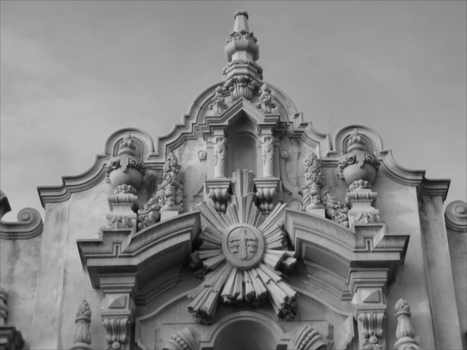

Examples of image processing in action
Sharpening (all following images are taken from PIVPUM)

Slide 39
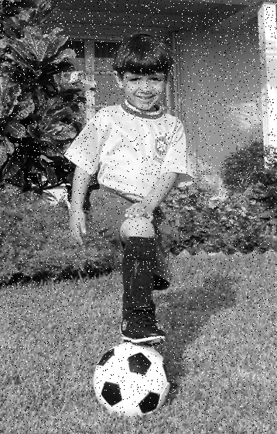

Examples of image processing in action (cont.)
Noise removal

Slide 40
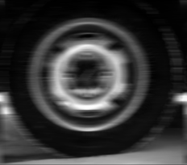
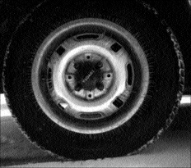
Examples of image processing in action (cont.)
Deblurring

Slide 41
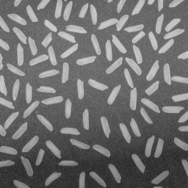

Examples of image processing in action (cont.)
Edge extraction

Slide 42
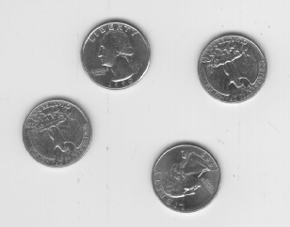
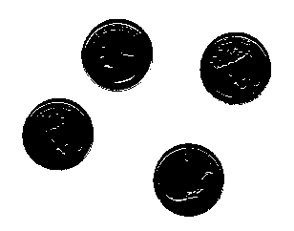
Examples of image processing in action (cont.)
Binarization

Slide 43
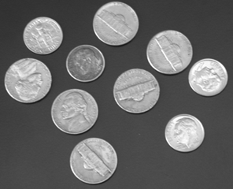

Examples of image processing in action (cont.)
Blurring

Slide 44
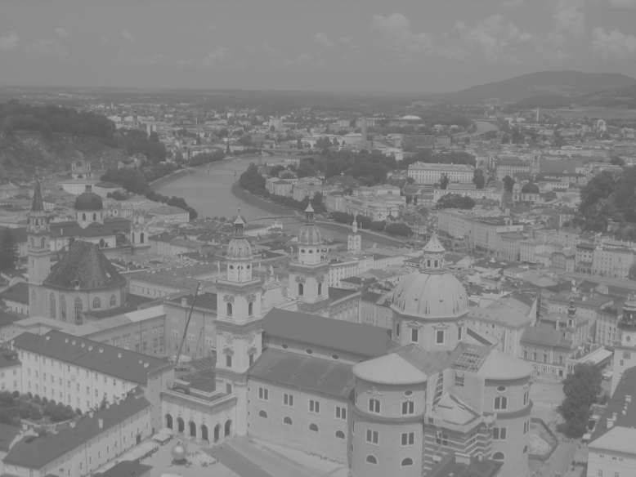
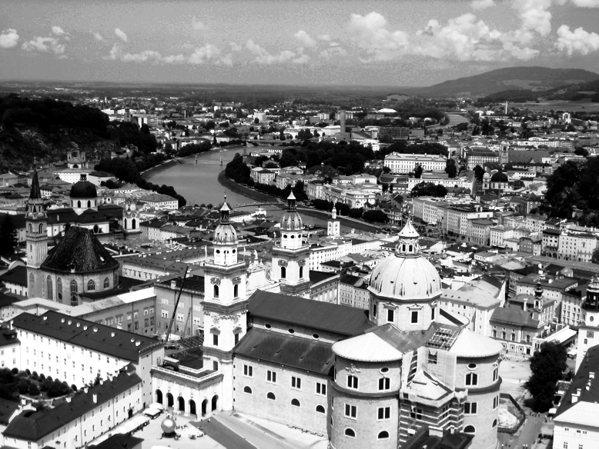
Examples of image processing in action (cont.)
Contrast enhancement

Slide 45
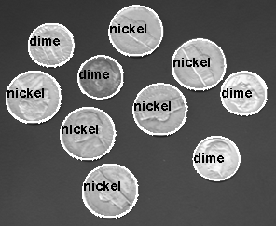
Examples of image processing in action (cont.)
Object segmentation and labeling

Slide 46
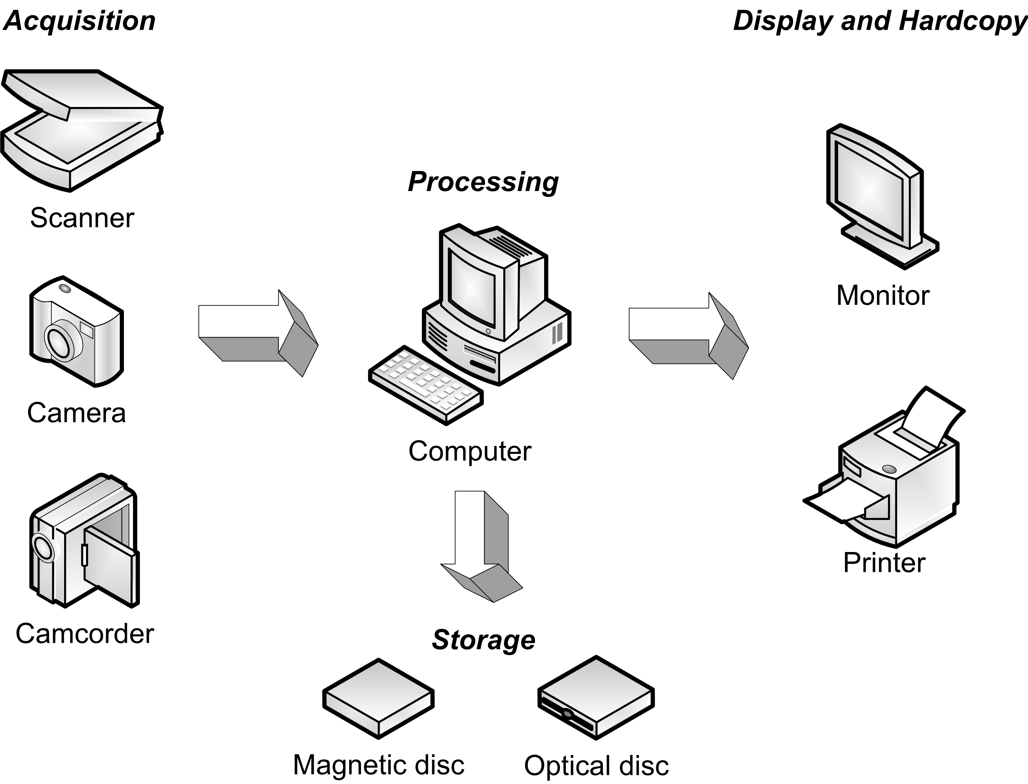
Computer Imaging Systems

Slide 47

Computer Imaging Systems (cont.)

Slide 48
Computer Imaging Systems (cont.)
Hardware
  Acquisition devices: scanners, sensors, cameras, camcorders, etc.
  Processing equipment: computers, workstations, specialized hardware, etc.
  Display and hardcopy devices: monitors, printers, etc.
  Storage devices: magnetic disks, optical disks, etc.
Software
  Modules that perform specialized tasks, e.g.:
    MATLAB and its toolboxes.
    Java, ImageJ, and its plugins.
    OpenCV

Slide 49

Machine Vision Systems

Slide 50
MVS vs. HVS
Why is it so hard to emulate the performance of the human visual system (HVS) using cameras and computers?
  Very large database of images and associated concepts
  Very high speed
  Ability to work under a wide range of conditions
      Most MVS must impose numerous constraints on the operating conditions of the scene to improve their chances of success.

Slide 51
Summary
You should now know
  What an image is
  The scope of image processing
  The history of image processing
  The most common IP operations
  Appreciate HVS and MVS

Slide 52
Next Lecture
The Fundamentals: Definitions & Basics

Slide 53
References
Rafael C. Gonzalez, Richard E. Woods “Digital Image Processing, 4th Ed.”; Pearson, 2018, (DIP)
Rafael C. Gonzalez, Richard E. Woods, Steven L. Eddins “Digital Image Processing Using MATLAB”; Pearson, 2004, (DIPUM)
Oge Marques, “Practical Image and Video Processing Using MATLAB”; Wiley, 2011, (PIVPUM)
Maria Petrou, Costas Petrou “Image Processing: The Fundamentals, 2nd Ed.”; Wiley, 2010
Chris Solomon, Toby Breckon “Fundamentals of Digital Image Processing: A Practical Approach with Examples in MATLAB”; Wiley, 2011

