Slide 1


CSE306 Operating Systems
Lecture #1
Introduction and a Brief History of OS
Prepared & Presented by Asst. Prof. Dr. Samsun M. BAŞARICI

Slide 2
Topics covered
Introduction to OS
  What is an operating system?
  Machine cycle
  History of OS
Computer hardware review
OS concepts
  Processes
  Deadlocks
  Files
  …
System Calls
Interrupts
Management
Modes of OS

Slide 3
What is Operating System?
It is a program!
It is the first piece of software to run after boot
It coordinates the execution of all other software
  User programs
It provides various common services needed by users and applications
Exploits the hardware resources of one or more processors
Provides a set of services to system users
Manages secondary memory and I/O devices

Slide 4
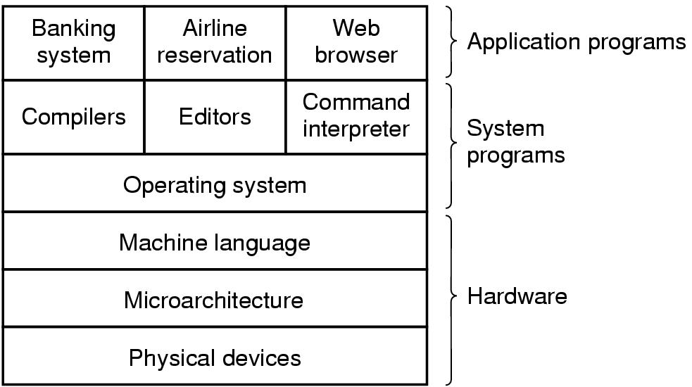
Introduction
A computer system consists of
  hardware
  system programs
  application programs

Slide 5
Basic Elements
Processor
Main Memory
I/O Modules
System Bus
Notes:
At a top level, a computer consists of processor, memory, and I/O components, with one or more modules of each type. These components are interconnected in some fashion to achieve the main function of the computer, which is to execute programs. Thus, there are four main structural elements:
Processor
I/O Modules
Main Memory
System Bus

Slide 6
Processor
Controls the operation of the computer
Performs the data processing functions
Referred to as the Central Processing Unit (CPU)
Notes:
Processor : Controls the operation of the computer and performs its data processing functions. When there is only one processor, it is often referred to as the central processing unit (CPU).

Slide 7
Main Memory
Stores data and programs
Typically volatile
  Contents of the memory is lost when the computer is shut down
Referred to as real memory or primary memory
Notes:
Main memory : Stores data and programs. This memory is typically volatile; that is, when the computer is shut down, the contents of the memory are lost. In contrast, the contents of disk memory are retained even when the computer system is shut down. Main memory is also referred to as real memory or primary memory.

Slide 8
I/O Modules
Move data between the computer and its external environment
Secondary memory devices (e.g. disks)
Communications equipment
Terminals
Notes:
I/O modules : Move data between the computer and its external environment. The external environment consists of a variety of devices, including secondary
memory devices (e.g., disks), communications equipment, and terminals.

Slide 9
System Bus
  Provides for communication among processors, main memory, and I/O modules
Notes:
System bus : Provides for communication among processors, main memory, and I/O modules.

Slide 10
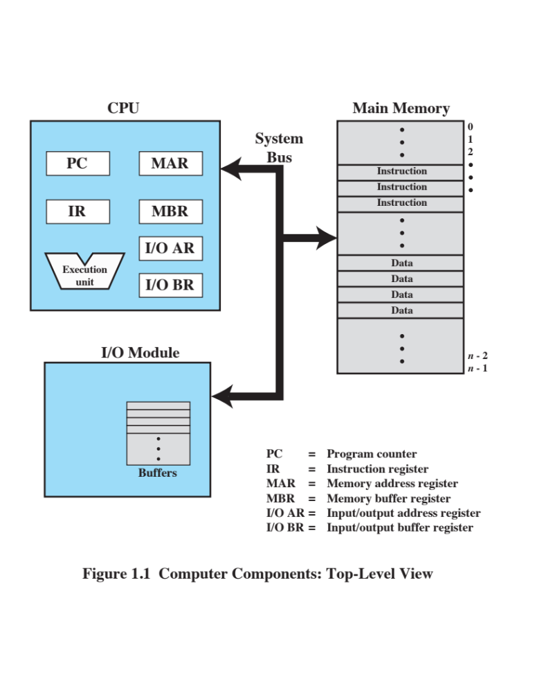
Notes:
Figure 1.1 depicts these top-level components. One of the processor’s functions is to exchange data with memory. For this purpose, it typically makes use of two internal (to the processor) registers: a memory address register (MAR), which specifies the address in memory for the next read or write; and a memory buffer register (MBR), which contains the data to be written into memory or which receives the data read from memory. Similarly, an I/O address register (I/OAR) specifies a particular I/O device. An I/O buffer register (I/OBR) is used for the exchange of data between an I/O module and the processor.
A memory module consists of a set of locations, defined by sequentially numbered addresses. Each location contains a bit pattern that can be interpreted as either an instruction or data. An I/O module transfers data from external devices to processor and memory, and vice versa. It contains internal buffers for temporarily holding data until they can be sent on.

Slide 11
Microprocessor
  Invention that brought about desktop and handheld computing
  Contains a processor on a single chip
  Fastest general purpose processors
  Multiprocessors
  Each chip (socket) contains multiple processors (cores)
Notes:
The hardware revolution that brought about desktop and handheld computing was the invention of the microprocessor, which contained a processor on a single chip. Though originally much slower than multichip processors, microprocessors have continually evolved to the point that they are now much faster for most computations due to the physics involved in moving information around in sub-nanosecond timeframes.
Not only have microprocessors become the fastest general purpose processors available, they are now multiprocessors; each chip (called a socket) contains multiple processors (called cores), each with multiple levels of large memory caches, and multiple logical processors sharing the execution units of each core. As of 2010, it is not unusual for even a laptop to have 2 or 4 cores, each with 2 hardware threads, for a total of 4 or 8 logical processors.

Slide 12
Graphical Processing
Units (GPU’s)
  Provide efficient computation on arrays of data using Single-Instruction Multiple Data (SIMD) techniques pioneered in supercomputers
  No longer used just for rendering advanced graphics
    Also used for general numerical processing
        Physics simulations for games
        Computations on large spreadsheets
Notes:
Although processors provide very good performance for most forms of computing, there is increasing demand for numerical computation. Graphical Processing Units (GPUs) provide efficient computation on arrays of data using Single-Instruction Multiple Data (SIMD) techniques pioneered in supercomputers. GPUs are no longer used just for rendering advanced graphics, but they are also used for general numerical processing, such as physics simulations for games or computations on large spreadsheets. Simultaneously, the CPUs themselves are gaining the capability of operating on arrays of data—with increasingly powerful vector units integrated into the processor architecture of the x86 and AMD64 families.
Processors and GPUs are not the end of the computational story for the modern PC.

Slide 13
Digital Signal Processors
(DSPs)
  Deal with streaming signals such as audio or video
  Used to be embedded in I/O devices like modems
      Are now becoming first-class computational devices, especially in handhelds
  Encoding/decoding speech and video (codecs)
  Provide support for encryption and security
Notes:
Digital Signal Processors (DSPs) are also present, for dealing with streaming signals—such as audio or video. DSPs used to be embedded in I/O devices, like modems, but they are now becoming first-class computational devices, especially in handhelds. Other specialized computational devices (fixed function units) co-exist with the CPU to support other standard computations, such as encoding/decoding speech and video (codecs), or providing support for encryption and security.

Slide 14
System on a Chip
(SoC)
To satisfy the requirements of handheld devices, the classic microprocessor is giving way to the SoC
    Other components of the system, such as DSPs, GPUs, I/O devices (such as codecs and radios) and main memory, in addition to the CPUs and caches, are on the same chip
Notes:
To satisfy the requirements of handheld devices, the classic microprocessor is giving way to the System on a Chip (SoC), where not just the CPUs and caches are on the same chip, but also many of the other components of the system, such as DSPs, GPUs, I/O devices (such as radios and codecs), and main memory.

Slide 15
Instruction Execution
A program consists of a set of instructions stored in memory
Processor reads (fetches) instructions from memory
Processor executes each instruction
Two steps
Notes:
A program to be executed by a processor consists of a set of instructions stored in memory. In its simplest form, instruction processing consists of two steps: The processor reads ( fetches ) instructions from memory one at a time and executes each instruction. Program execution consists of repeating the process of instruction fetch and instruction execution. Instruction execution may involve several operations and depends on the nature of the instruction.

Slide 16
How the CPU Executes Instructions?
Four steps performed for each instruction
  Machine cycle: the amount of time needed to execute an instruction
  Personal computers execute in less than one millionth of a second
  Supercomputers execute in less than one trillionth of a second
Each CPU has its own instruction set
  those instructions that CPU can understand and execute

Slide 17
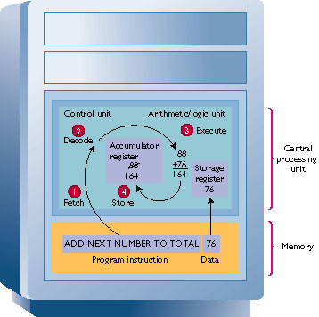
The Machine Cycle
The time required to retrieve, execute, and store an operation
Components
  Instruction time
  Execution time
System clock synchronizes operations

Slide 18
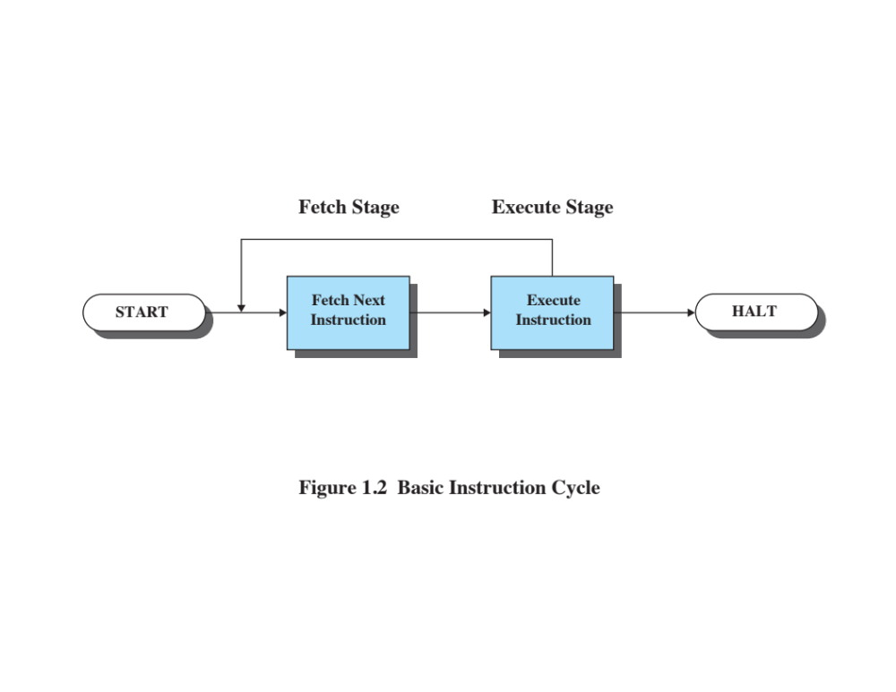
Notes:
The processing required for a single instruction is called an instruction cycle. Using a simplified two-step description, the instruction cycle is depicted in Figure 1.2 . The two steps are referred to as the fetch stage and the execute stage. Program execution halts only if the processor is turned off, some sort of unrecoverable error occurs, or a program instruction that halts the processor is encountered.

Slide 19
Instruction Fetch and Execute
The processor fetches an instruction from memory
Typically the program counter (PC) holds the address of the next instruction to be fetched
      PC is incremented after each fetch
Notes:
At the beginning of each instruction cycle, the processor fetches an instruction from memory. Typically, the program counter (PC) holds the address of the next instruction to be fetched. Unless instructed otherwise, the processor always increments the PC after each instruction fetch so that it will fetch the next instruction in sequence (i.e., the instruction located at the next higher memory address).
For example, consider a simplified computer in which each instruction occupies one
16-bit word of memory. Assume that the program counter is set to location 300.
The processor will next fetch the instruction at location 300. On succeeding instruction
cycles, it will fetch instructions from locations 301, 302, 303, and so on. This
sequence may be altered, as explained subsequently.

Slide 20
Instruction Time
Also called I-time
Control unit gets instruction from memory and puts it into a register
Control unit decodes instruction and determines the memory location of needed data

Slide 21
Instruction Register (IR)
Fetched instruction is loaded into Instruction Register (IR)
Processor interprets the instruction and performs required action:
      Processor-memory
      Processor-I/O
      Data processing
      Control
Notes:
The fetched instruction is loaded into the instruction register (IR). The instruction contains bits that specify the action the processor is to take. The processor interprets the instruction and performs the required action. In general, these actions fall into four categories:
• Processor-memory: Data may be transferred from processor to memory or from memory to processor.
• Processor-I/O: Data may be transferred to or from a peripheral device by transferring between the processor and an I/O module.
• Data processing: The processor may perform some arithmetic or logic operation on data.
• Control: An instruction may specify that the sequence of execution be altered. For example, the processor may fetch an instruction from location 149, which
specifies that the next instruction be from location 182. The processor sets the
program counter to 182. Thus, on the next fetch stage, the instruction will be
fetched from location 182 rather than 150.
An instruction’s execution may involve a combination of these actions.

Slide 22
Execution Time
Control unit moves data from memory to registers in ALU
  ALU executes instruction on the data
Control unit stores result of operation in memory or in a register

Slide 23
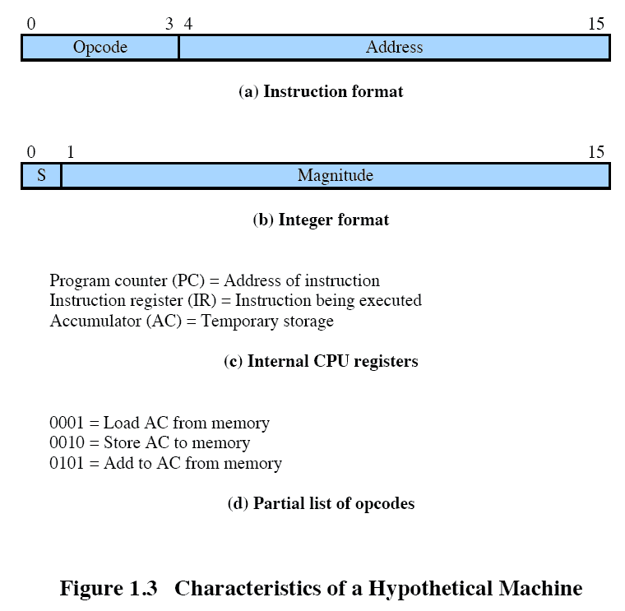
Notes:
Consider a simple example using a hypothetical processor that includes the characteristics listed in Figure 1.3 . The processor contains a single data register, called the accumulator (AC). Both instructions and data are 16 bits long, and memory is organized as a sequence of 16-bit words. The instruction format provides 4 bits for the opcode, allowing as many as 2⁴ =16 different opcodes (represented by a single hexadecimal digit). The opcode defines the operation the processor is to perform. With the remaining 12 bits of the instruction format, up to 2¹² =4,096 (4K) words of memory (denoted by three hexadecimal digits) can be directly addressed.

Slide 24
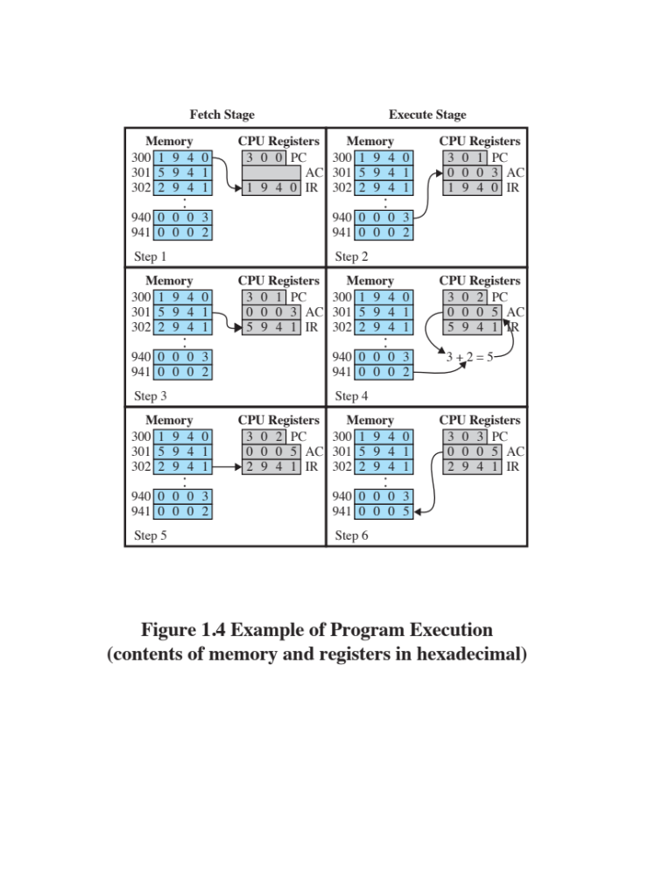
Notes:
Figure 1.4 illustrates a partial program execution, showing the relevant portions of memory and processor registers. The program fragment shown adds the contents of the memory word at address 940 to the contents of the memory word at address 941 and stores the result in the latter location. Three instructions, which can be described as three fetch and three execute stages, are required:
The PC contains 300, the address of the first instruction. This instruction (the value 1940 in hexadecimal) is loaded into the IR and the PC is incremented. Note that this process involves the use of a memory address register (MAR) and a memory buffer register (MBR). For simplicity, these intermediate registers are not shown.
2. The first 4 bits (first hexadecimal digit) in the IR indicate that the AC is to be loaded from memory. The remaining 12 bits (three hexadecimal digits) specify the address, which is 940.
3. The next instruction (5941) is fetched from location 301 and the PC is incremented.
4. The old contents of the AC and the contents of location 941 are added and the result is stored in the AC.
5. The next instruction (2941) is fetched from location 302 and the PC is incremented.
6. The contents of the AC are stored in location 941.
In this example, three instruction cycles, each consisting of a fetch stage and
an execute stage, are needed to add the contents of location 940 to the contents
of 941. With a more complex set of instructions, fewer instruction cycles would be
needed. Most modern processors include instructions that contain more than one
address. Thus the execution stage for a particular instruction may involve more than
one reference to memory. Also, instead of memory references, an instruction may
specify an I/O operation.

Slide 25
What is an Operating System?
It is an extended machine
  Hides the messy details which must be performed
  Presents user with a virtual machine, easier to use
It is a resource manager
  Each program gets time with the resource
  Each program gets space on the resource

Slide 26
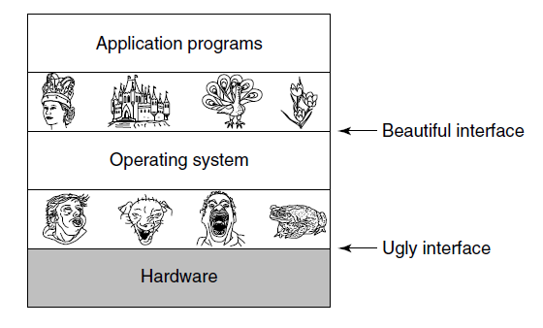
The Operating System as an Extended Machine
Operating systems turn ugly hardware into beautiful abstractions.

Slide 27
The Operating System as a Resource Manager
Top down view
  Provide abstractions to application programs
Bottom up view
  Manage pieces of complex system
Alternative view
  Provide orderly, controlled allocation of resources

Slide 28
Evolution of Operating Systems
A major OS will evolve over time for a number of reasons:
Hardware upgrades
New types of hardware
New services
Fixes
Notes:
A major OS will evolve over time for a number of reasons:
• Hardware upgrades plus new types of hardware: For example, early versions
of UNIX and the Macintosh OS did not employ a paging mechanism because
they were run on processors without paging hardware. Subsequent versions
of these operating systems were modified to exploit paging capabilities. Also,
the use of graphics terminals and page-mode terminals instead of line-at-a time
scroll mode terminals affects OS design. For example, a graphics terminal
typically allows the user to view several applications at the same time through
“windows” on the screen. This requires more sophisticated support in the OS.
• New services: In response to user demand or in response to the needs of system
managers, the OS expands to offer new services. For example, if it is found
to be difficult to maintain good performance for users with existing tools, new
measurement and control tools may be added to the OS.
• Fixes: Any OS has faults. These are discovered over the course of time and
fixes are made. Of course, the fix may introduce new faults.
The need to change an OS regularly places certain requirements on its design.
An obvious statement is that the system should be modular in construction, with
clearly defined interfaces between the modules, and that it should be well documented.
For large programs, such as the typical contemporary OS, what might be
referred to as straightforward modularization is inadequate [DENN80a]. That is,
much more must be done than simply partitioning a program into modules. We
return to this topic later in this chapter.

Slide 29
Evolution of Operating Systems
Stages include:
Serial Processing
Simple Batch Systems
Multiprogrammed Batch Systems
Time Sharing Systems
Notes:
In attempting to understand the key requirements for an OS and the significance of the major features of a contemporary OS, it is useful to consider how operating systems have evolved over the years.

Slide 30
History of Operating Systems (1)
First generation 1945 - 1955
  vacuum tubes, plug boards
Second generation 1955 - 1965
  transistors, batch systems
Third generation 1965 – 1980
  ICs and multiprogramming
Fourth generation 1980 – present
  personal computers

Slide 31
Serial Processing
Earliest Computers:
Problems:
No operating system
    Programmers interacted directly with the computer hardware
Computers ran from a console with display lights, toggle switches, some form of input device, and a printer
Users have access to the computer in “series”
Scheduling:
  Most installations used a hardcopy sign-up sheet to reserve computer time
      Time allocations could run short or long, resulting in wasted computer time
      Setup time
  A considerable amount of time was spent on setting up the program to run
Notes:
With the earliest computers, from the late 1940s to the mid-1950s, the programmer
interacted directly with the computer hardware; there was no OS. These computers
were run from a console consisting of display lights, toggle switches, some form of
input device, and a printer. Programs in machine code were loaded via the input
device (e.g., a card reader). If an error halted the program, the error condition was
indicated by the lights. If the program proceeded to a normal completion, the output
appeared on the printer.
These early systems presented two main problems:
• Scheduling : Most installations used a hardcopy sign-up sheet to reserve computer
time. Typically, a user could sign up for a block of time in multiples of a
half hour or so. A user might sign up for an hour and finish in 45 minutes; this
would result in wasted computer processing time. On the other hand, the user
might run into problems, not finish in the allotted time, and be forced to stop
before resolving the problem.
• Setup time: A single program, called a job , could involve loading the compiler
plus the high-level language program (source program) into memory,
saving the compiled program (object program) and then loading and linking
together the object program and common functions. Each of these steps could
involve mounting or dismounting tapes or setting up card decks. If an error
occurred, the hapless user typically had to go back to the beginning of the
setup sequence. Thus, a considerable amount of time was spent just in setting
up the program to run.
This mode of operation could be termed serial processing , reflecting the fact
that users have access to the computer in series. Over time, various system software
tools were developed to attempt to make serial processing more efficient. These
include libraries of common functions, linkers, loaders, debuggers, and I/O driver
routines that were available as common software for all users.

Slide 32
Simple Batch Systems
Early computers were very expensive
    Important to maximize processor utilization
Monitor
    User no longer has direct access to processor
    Job is submitted to computer operator who batches them together and places them on an input device
    Program branches back to the monitor when finished
Notes:
Early computers were very expensive, and therefore it was important to maximize
processor utilization. The wasted time due to scheduling and setup time was
unacceptable.
To improve utilization, the concept of a batch OS was developed. It appears
that the first batch OS (and the first OS of any kind) was developed in the mid-1950s
by General Motors for use on an IBM 701 [WEIZ81]. The concept was subsequently
refined and implemented on the IBM 704 by a number of IBM customers. By the
early 1960s, a number of vendors had developed batch operating systems for their
computer systems. IBSYS, the IBM OS for the 7090/7094 computers, is particularly
notable because of its widespread influence on other systems.
The central idea behind the simple batch-processing scheme is the use of a
piece of software known as the monitor . With this type of OS, the user no longer has
direct access to the processor. Instead, the user submits the job on cards or tape to a
computer operator, who batches the jobs together sequentially and places the entire
batch on an input device, for use by the monitor. Each program is constructed to
branch back to the monitor when it completes processing, at which point the monitor
automatically begins loading the next program.

Slide 33
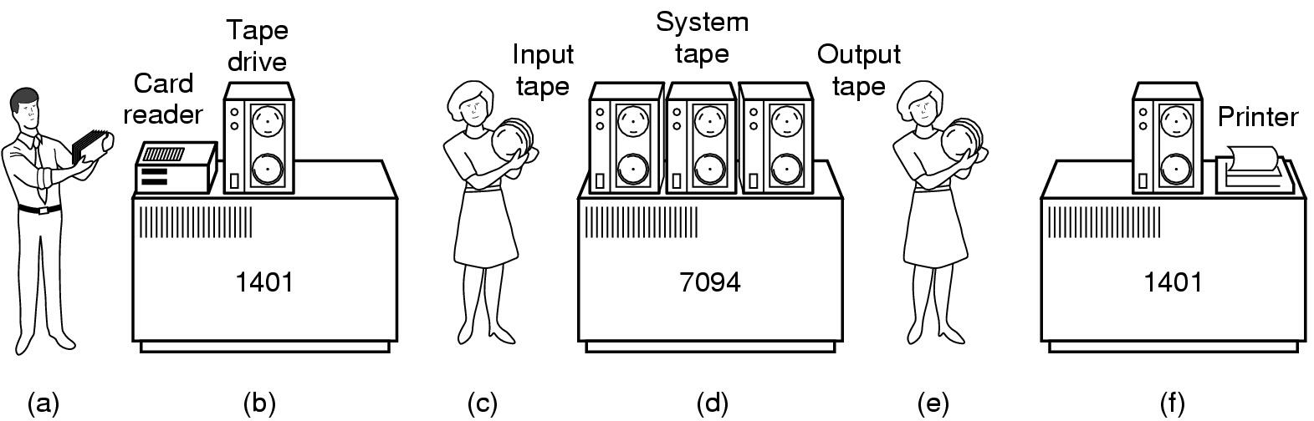
History of Operating Systems (2)
Early batch system
  bring cards to 1401
  read cards to tape
  put tape on 7094 which does computing
  put tape on 1401 which prints output

Slide 34
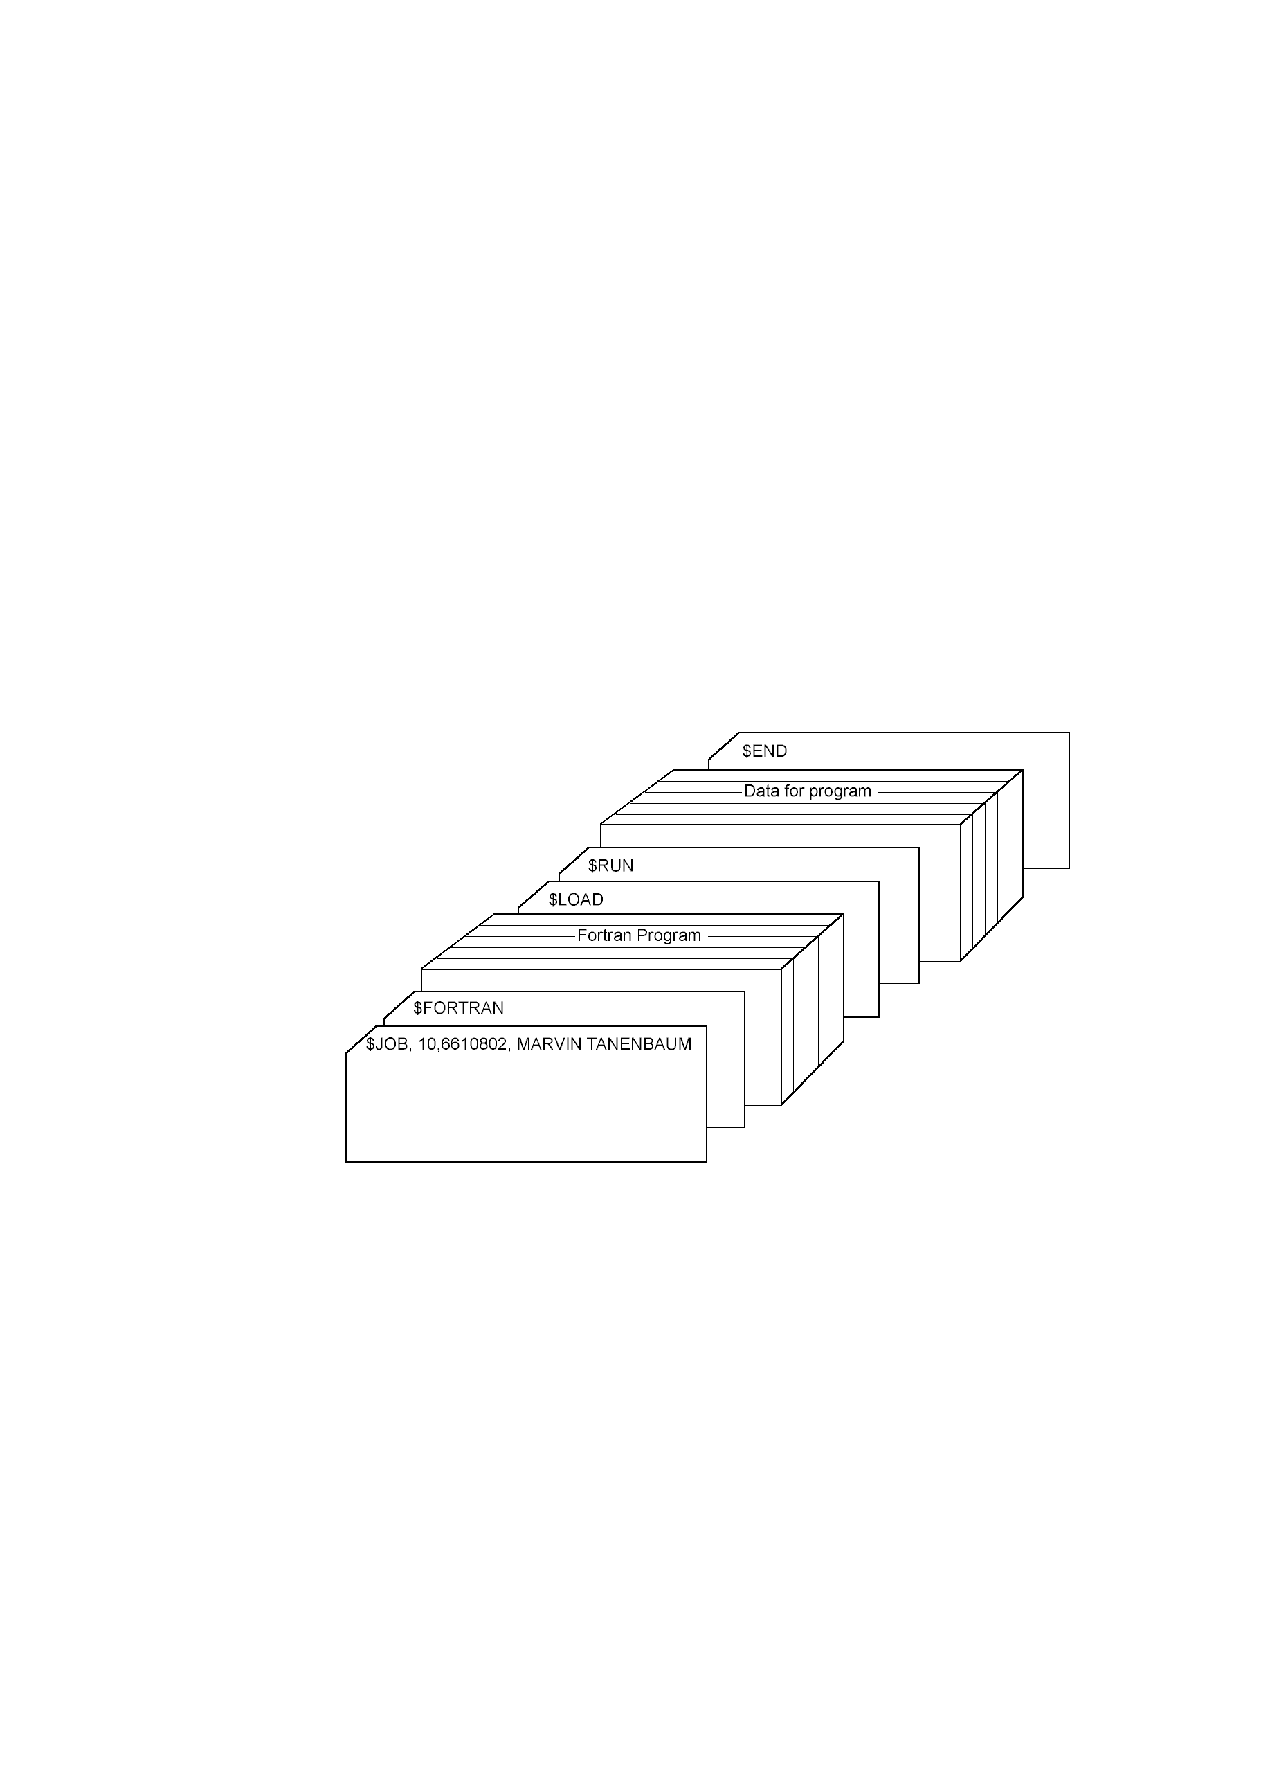
History of Operating Systems (3)
Structure of a typical FMS job – 2nd generation

Slide 35
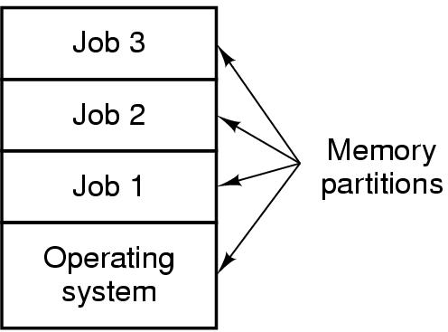
History of Operating Systems (4)
Multiprogramming system
  three jobs in memory – 3rd generation

Slide 36
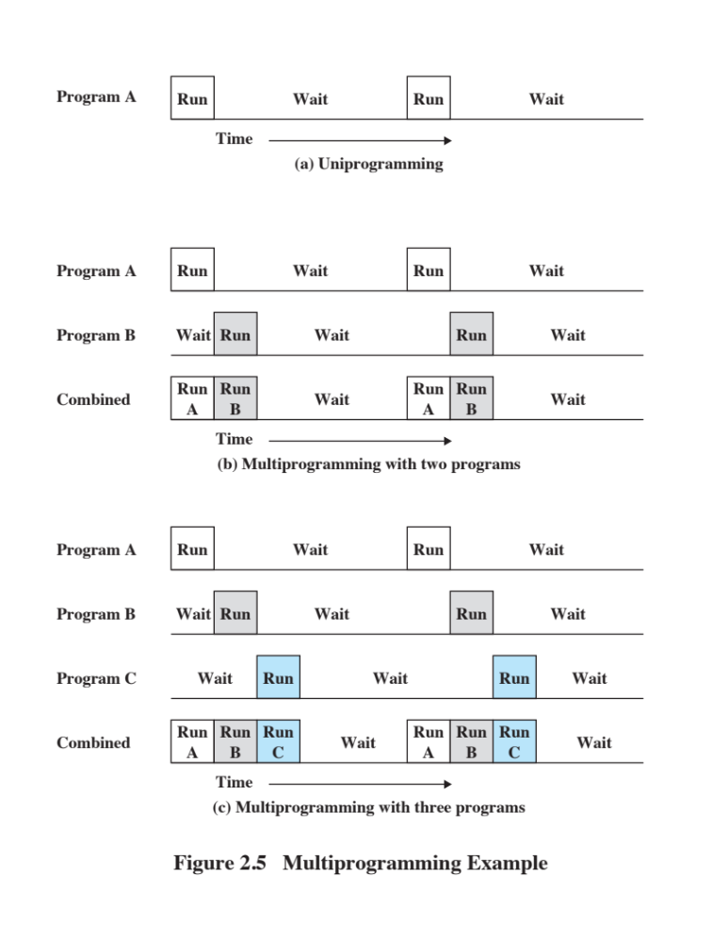
Uniprogramming
The processor spends a certain amount of time executing, until it reaches an I/O instruction; it must then wait until that I/O instruction concludes before proceeding
Notes:
Figure 2.5a illustrates this situation, where we have a single program, referred to as uniprogramming.
The processor spends a certain amount of time executing, until it reaches an I/O instruction.
It must then wait until that I/O instruction concludes before proceeding.

Slide 37
Multiprogramming
There must be enough memory to hold the OS (resident monitor) and one user program
When one job needs to wait for I/O, the processor can switch to the other job, which is likely not waiting for I/O
Notes:
This inefficiency is not necessary. We know that there must be enough
memory to hold the OS (resident monitor) and one user program. Suppose that
there is room for the OS and two user programs. When one job needs to wait for
I/O, the processor can switch to the other job, which is likely not waiting for I/O
( Figure 2.5b ).

Slide 38
Multiprogramming
    Also known as multitasking
    Memory is expanded to hold three, four, or more programs and switch among all of them
Notes:
Furthermore, we might expand memory to hold three, four, or more
programs and switch among all of them ( Figure 2.5c ). The approach is known as
multiprogramming , or multitasking . It is the central theme of modern operating
systems.

Slide 39
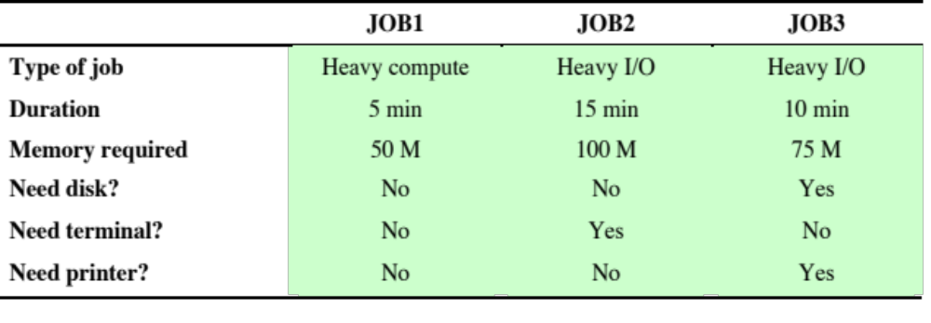
Multiprogramming Example
Sample Program Execution Attributes
Notes:
To illustrate the benefit of multiprogramming, we give a simple example.
Consider a computer with 250 Mbytes of available memory (not used by the OS),
a disk, a terminal, and a printer. Three programs, JOB1, JOB2, and JOB3, are
submitted for execution at the same time, with the attributes listed in Table 2.1 .
We assume minimal processor requirements for JOB2 and JOB3 and continuous
disk and printer use by JOB3. For a simple batch environment, these jobs will be
executed in sequence. Thus, JOB1 completes in 5 minutes. JOB2 must wait until
the 5 minutes are over and then completes 15 minutes after that. JOB3 begins after
20 minutes and completes at 30 minutes from the time it was initially submitted.

Slide 40
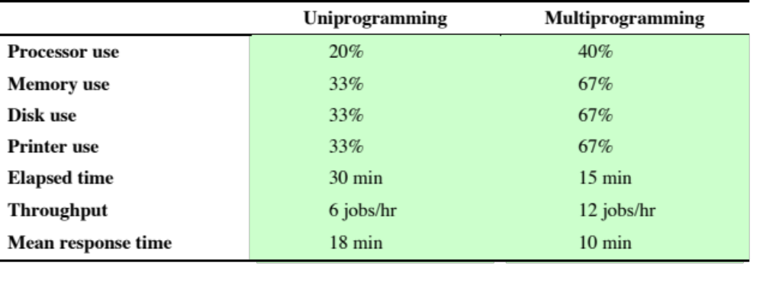
Effects of Multiprogramming on Resource Utilization
Notes:
The average resource utilization, throughput, and response times are shown in the
uniprogramming column of Table 2.2 .

Slide 41
Time-Sharing Systems
Can be used to handle multiple interactive jobs
Processor time is shared among multiple users
Multiple users simultaneously access the system through terminals, with the OS interleaving the execution of each user program in a short burst or quantum of computation
Notes:
Just as multiprogramming allows the processor to handle multiple batch jobs
at a time, multiprogramming can also be used to handle multiple interactive jobs. In
this latter case, the technique is referred to as time sharing , because processor time is
shared among multiple users. In a time-sharing system, multiple users simultaneously
access the system through terminals, with the OS interleaving the execution of each
user program in a short burst or quantum of computation. Thus, if there are n users
actively requesting service at one time, each user will only see on the average 1/ n
of the effective computer capacity, not counting OS overhead. However, given the
relatively slow human reaction time, the response time on a properly designed system
should be similar to that on a dedicated computer.

Slide 42
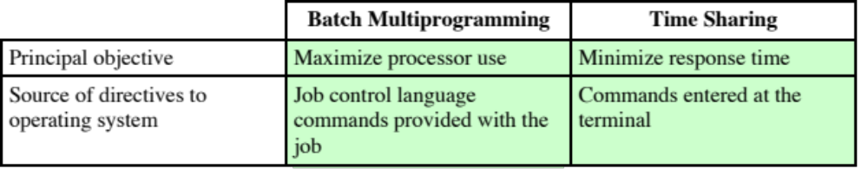
Batch Multiprogramming versus Time Sharing
Notes:
Both batch processing and time sharing use multiprogramming. The key
differences are listed in Table 2.3 .

Slide 43
Compatible Time-Sharing System (CTSS)
One of the first time-sharing operating systems
  Developed at MIT by a group known as Project MAC
  The system was first developed for the IBM 709 in 1961
  Ran on a computer with 32,000 36-bit words of main memory, with the resident monitor consuming 5000 of that
  Utilized a technique known as time slicing
      System clock generated interrupts at a rate of approximately one every 0.2 seconds
      At each clock interrupt the OS regained control and could assign the processor to another user
      Thus, at regular time intervals the current user would be preempted and another user loaded in
      To preserve the old user program status for later resumption, the old user programs and data were written out to disk before the new user programs and data were read in
      Old user program code and data were restored in main memory when that program was next given a turn
Notes:
One of the first time-sharing operating systems to be developed was the
Compatible Time-Sharing System (CTSS) [CORB62], developed at MIT by a
group known as Project MAC (Machine-Aided Cognition, or Multiple-Access
Computers). The system was first developed for the IBM 709 in 1961 and later
transferred to an IBM 7094.
Compared to later systems, CTSS is primitive. The system ran on a computer
with 32,000 36-bit words of main memory, with the resident monitor consuming 5000
of that. When control was to be assigned to an interactive user, the user’s program
and data were loaded into the remaining 27,000 words of main memory. A program
was always loaded to start at the location of the 5000th word; this simplified
both the monitor and memory management. A system clock generated interrupts
at a rate of approximately one every 0.2 seconds. At each clock interrupt, the OS
regained control and could assign the processor to another user. This technique is
known as time slicing . Thus, at regular time intervals, the current user would be
preempted and another user loaded in. To preserve the old user program status for
later resumption, the old user programs and data were written out to disk before the
new user programs and data were read in. Subsequently, the old user program code
and data were restored in main memory when that program was next given a turn.

Slide 44
Major Achievements
Operating Systems are among the most complex pieces of software ever developed
Major advances in development include:
    Processes
    Memory management
    Information protection and security
    Scheduling and resource management
    System structure
Notes:
Operating systems are among the most complex pieces of software ever developed.
This reflects the challenge of trying to meet the difficult and in some cases
competing objectives of convenience, efficiency, and ability to evolve. [DENN80a]
proposes that there have been four major theoretical advances in the development
of operating systems:
• Processes
• Memory management
• Information protection and security
• Scheduling and resource management
Each advance is characterized by principles, or abstractions, developed to
meet difficult practical problems. Taken together, these five areas span many of
the key design and implementation issues of modern operating systems. The brief
review of these five areas in this section serves as an overview of much of the rest
of the text.

Slide 45
The Operating System Zoo
Mainframe operating systems
Server operating systems
Multiprocessor operating systems
Personal computer operating systems
Real-time operating systems
Embedded operating systems
Smart card operating systems

Slide 46
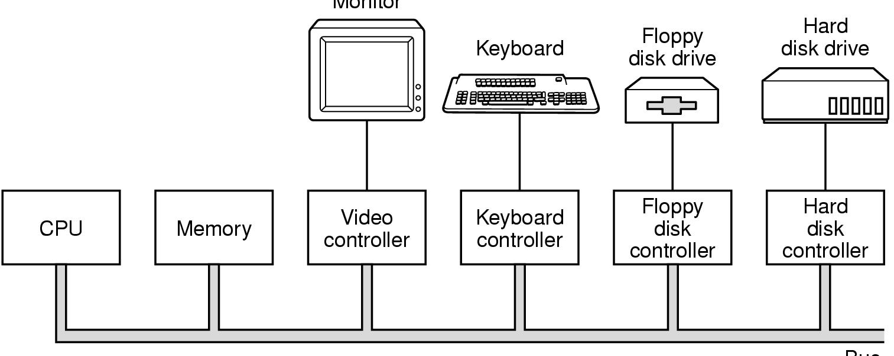
Computer Hardware Review (1)
Monitor
Bus
Components of a simple personal computer

Slide 47
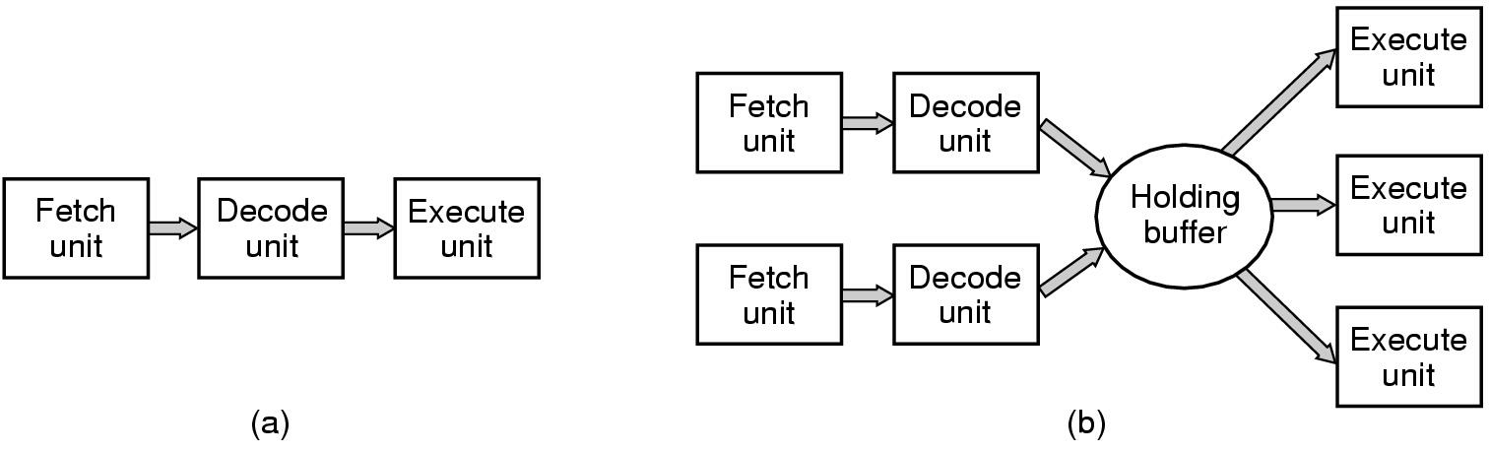
Computer Hardware Review (2)
(a) A three-stage pipeline
(b) A superscalar CPU

Slide 48
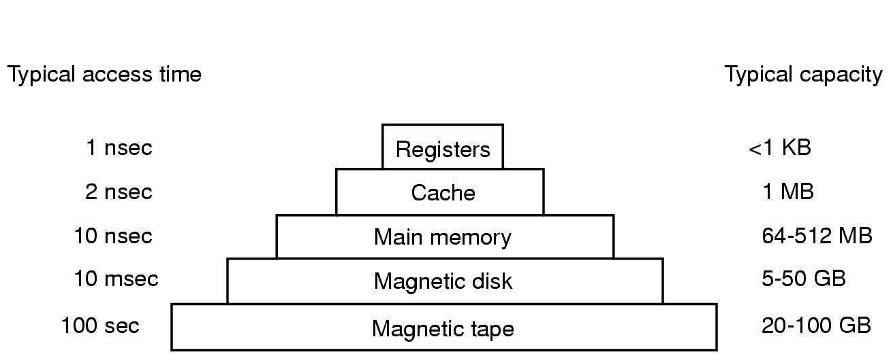
Computer Hardware Review (3)
Typical memory hierarchy
  numbers shown are rough approximations

Slide 49
Memory Hierarchy
Design constraints on a computer’s memory
    How much?
    How fast?
    How expensive?
If the capacity is there, applications will likely be developed to use it
Memory must be able to keep up with the processor
Cost of memory must be reasonable in relationship to the other components
Notes:
The design constraints on a computer’s memory can be summed up by three questions: How much? How fast? How expensive?
The question of how much is somewhat open ended. If the capacity is there, applications will likely be developed to use it. The question of how fast is, in a sense, easier to answer. To achieve greatest performance, the memory must be able to keep up with the processor. That is, as the processor is executing instructions, we would not want it to have to pause waiting for instructions or operands. The final question must also be considered. For a practical system, the cost of memory must be reasonable in relationship to other components.

Slide 50
Memory Relationships
Faster access time = greater cost per bit
Greater capacity = smaller cost per bit
Greater capacity = slower access speed
Notes:
As might be expected, there is a trade-off among the three key characteristics of memory: namely, capacity, access time, and cost. A variety of technologies are used to implement memory systems, and across this spectrum of technologies, the following relationships hold:
• Faster access time, greater cost per bit
• Greater capacity, smaller cost per bit
• Greater capacity, slower access speed
The dilemma facing the designer is clear. The designer would like to use memory technologies that provide for large-capacity memory, both because the capacity is needed and because the cost per bit is low. However, to meet performance requirements, the designer needs to use expensive, relatively lower-capacity memories with fast access times.

Slide 51
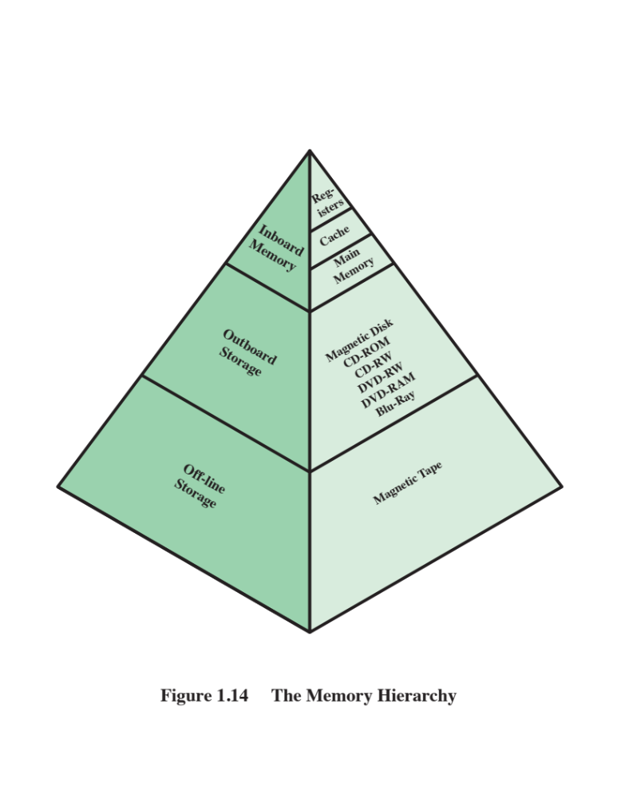
The Memory Hierarchy
Going down the hierarchy:
  Decreasing cost per bit
  Increasing capacity
  Increasing access time
  Decreasing frequency of access to the memory by the processor
Notes:
The way out of this dilemma is to not rely on a single memory component or technology, but to employ a memory hierarchy . A typical hierarchy is illustrated in
Figure 1.14 . As one goes down the hierarchy, the following occur:
a. Decreasing cost per bit
b. Increasing capacity
c. Increasing access time
d. Decreasing frequency of access to the memory by the processor
Thus, smaller, more expensive, faster memories are supplemented by larger, cheaper, slower memories. The key to the success of this organization is the decreasing
frequency of access at lower levels. We will examine this concept in greater detail later in this chapter, when we discuss the cache, and when we discuss virtual
memory later in this book. A brief explanation is provided at this point.
Suppose that the processor has access to two levels of memory. Level 1 contains 1,000 bytes and has an access time of 0.1 μs; level 2 contains 100,000 bytes and has an access time of 1 μs. Assume that if a byte to be accessed is in level 1, then the processor accesses it directly. If it is in level 2, then the byte is first transferred to level 1 and then accessed by the processor. For simplicity, we ignore the time required for the processor to determine whether the byte is in level 1 or level 2.

Slide 52
Principle of Locality
Memory references by the processor tend to cluster
Data is organized so that the percentage of accesses to each successively lower level is substantially less than that of the level above
Can be applied across more than two levels of memory
Notes:
The basis for the validity of condition (d) is a principle known as locality of reference [DENN68]. During the course of execution of a program, memory references by the processor, for both instructions and data, tend to cluster. Programs typically contain a number of iterative loops and subroutines. Once a loop or subroutine is entered, there are repeated references to a small set of instructions. Similarly, operations on tables and arrays involve access to a clustered set of data bytes. Over a long period of time, the clusters in use change, but over a short period of time, the processor is primarily working with fixed clusters of memory references.
Accordingly, it is possible to organize data across the hierarchy such that the percentage of accesses to each successively lower level is substantially less than that of the level above. Consider the two-level example already presented. Let level 2 memory contain all program instructions and data. The current clusters can be temporarily placed in level 1. From time to time, one of the clusters in level 1 will have to be swapped back to level 2 to make room for a new cluster coming in to level 1. On average, however, most references will be to instructions and data contained in level 1.
This principle can be applied across more than two levels of memory. The fastest, smallest, and most expensive type of memory consists of the registers internal to the processor. Typically, a processor will contain a few dozen such registers, although some processors contain hundreds of registers. Skipping down two levels, main memory is the principal internal memory system of the computer. Each location in main memory has a unique address, and most machine instructions refer to one or more main memory addresses. Main memory is usually extended with a higher-speed, smaller cache. The cache is not usually visible to the programmer or, indeed, to the processor. It is a device for staging the movement of data between main memory and processor registers to improve performance.

Slide 53
Cache Memory
Invisible to the OS
Interacts with other memory management hardware
Processor must access memory at least once per instruction cycle
Processor execution is limited by memory cycle time
Exploit the principle of locality with a small, fast memory
Notes:
Although cache memory is invisible to the OS, it interacts with other memory management hardware. Furthermore, many of the principles used in virtual memory schemes (discussed in Chapter 8 ) are also applied in cache memory.
On all instruction cycles, the processor accesses memory at least once, to fetch the instruction, and often one or more additional times, to fetch operands and/ or store results. The rate at which the processor can execute instructions is clearly limited by the memory cycle time (the time it takes to read one word from or write one word to memory). This limitation has been a significant problem because of the persistent mismatch between processor and main memory speeds: Over the years, processor speed has consistently increased more rapidly than memory access speed. We are faced with a trade-off among speed, cost, and size. Ideally, main memory should be built with the same technology as that of the processor registers, giving memory cycle times comparable to processor cycle times. This has always been too expensive a strategy. The solution is to exploit the principle of locality by providing a small, fast memory between the processor and main memory, namely the cache.

Slide 54
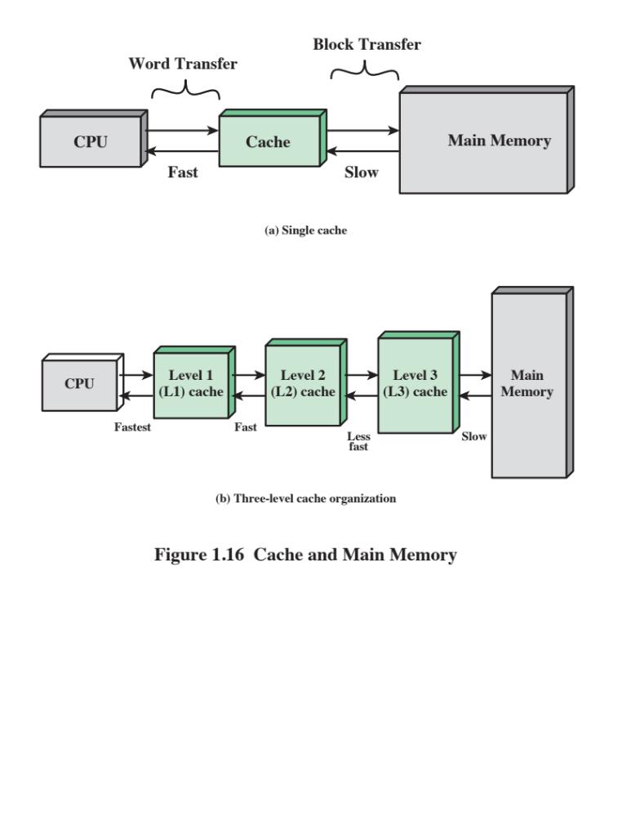
Notes:
Cache memory is intended to provide memory access time approaching that of the fastest memories available and at the same time support a large memory size that has the price of less expensive types of semiconductor memories. The concept is illustrated in Figure 1.16a . There is a relatively large and slow main memory together with a smaller, faster cache memory. The cache contains a copy of a portion of main memory. When the processor attempts to read a byte or word of memory, a check is made to determine if the byte or word is in the cache. If so, the byte or word is delivered to the processor. If not, a block of main memory, consisting of some fixed number of bytes, is read into the cache and then the byte or word is delivered to
the processor. Because of the phenomenon of locality of reference, when a block of data is fetched into the cache to satisfy a single memory reference, it is likely that many of the near-future memory references will be to other bytes in the block.
Figure 1.16b depicts the use of multiple levels of cache. The L2 cache is slower and typically larger than the L1 cache, and the L3 cache is slower and typically larger than the L2 cache.

Slide 55
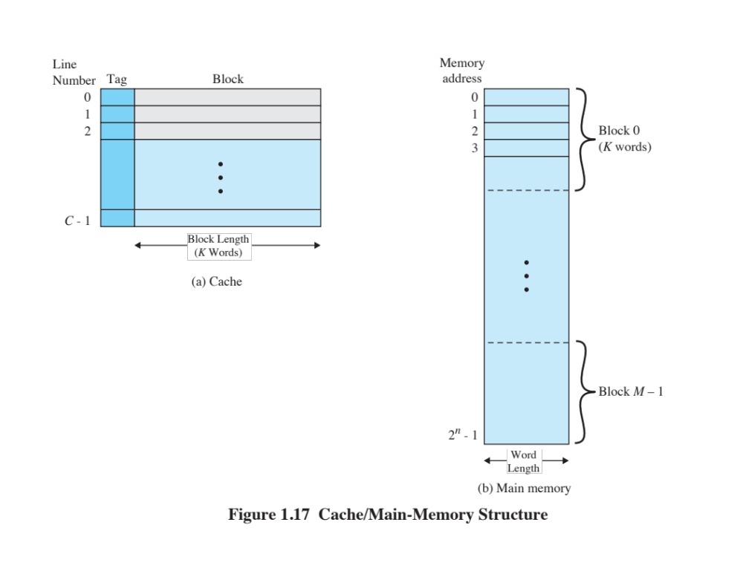
Notes:
Figure 1.17 depicts the structure of a cache/main memory system. Main memory consists of up to 2 ^{n} addressable words, with each word having a unique n –bit address. For mapping purposes, this memory is considered to consist of a number of fixed-length blocks of K words each. That is, there are M = 2^{n}/K blocks. Cache consists of C slots (also referred to as lines ) of K words each, and the number of slots is considerably less than the number of main memory blocks (C<<M) . Some subset of the blocks of main memory resides in the slots of the cache. If a word in a block of memory that is not in the cache is read, that block is transferred to one of the slots of the cache. Because there are more blocks than slots, an individual slot cannot be uniquely and permanently dedicated to a particular block. Therefore, each slot includes a tag that identifies which particular block is currently being stored. The tag is usually some number of higher-order bits of the address and refers to all addresses that begin with that sequence of bits.

Slide 56
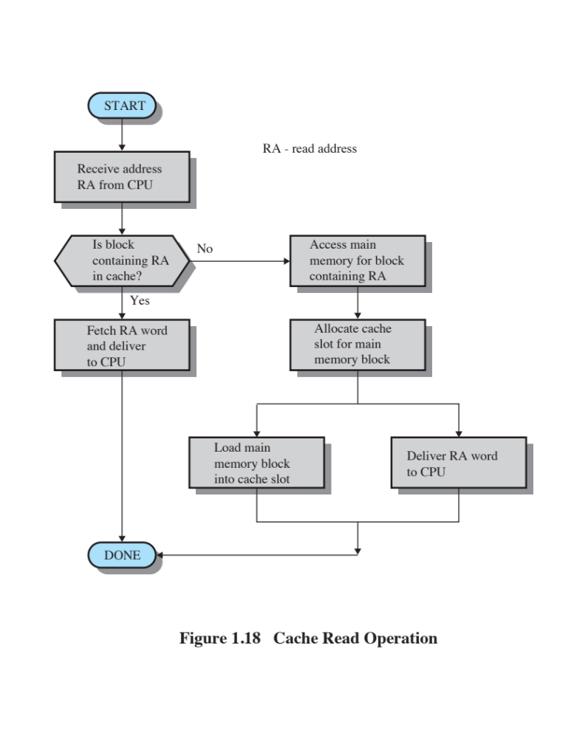
Notes:
Figure 1.18 illustrates the read operation. The processor generates the address, RA, of a word to be read. If the word is contained in the cache, it is delivered to the processor. Otherwise, the block containing that word is loaded into the cache and the word is delivered to the processor.

Slide 57
Cache Design
Main categories are:
Cache size
Block size
Mapping function
Write policy
Number of cache levels
Replacement algorithm
Notes:
A detailed discussion of cache design is beyond the scope of this book. Key elements are briefly summarized here. We will see that similar design issues must be addressed in dealing with virtual memory and disk cache design. They fall into the following categories:
• Cache size
• Block size
• Mapping function
• Replacement algorithm
• Write policy
• Number of cache levels

Slide 58
Cache and Block Size
Cache Size
Small caches have significant impact on performance
Block Size
The unit of data exchanged between cache and main memory
Notes:
We have already dealt with the issue of cache size . It turns out that reasonably small caches can have a significant impact on performance. Another size issue is that of block size : the unit of data exchanged between cache and main memory. As the block size increases from very small to larger sizes, the hit ratio will at first increase because of the principle of locality: the high probability that data in the vicinity of a referenced word are likely to be referenced in the near future. As the block size increases, more useful data are brought into the cache. The hit ratio will begin to decrease, however, as the block becomes even bigger and the probability of using the newly fetched data becomes less than the probability of reusing the data that have to be moved out of the cache to make room for the new block.

Slide 59
Mapping Function
Determines which cache location the block will occupy
Two constraints affect design:
When one block is read in, another may have to be replaced
The more flexible the mapping function, the more complex is the circuitry required to search the cache
Notes:
When a new block of data is read into the cache, the mapping function determines which cache location the block will occupy. Two constraints affect the design of the mapping function. First, when one block is read in, another may have to be replaced. We would like to do this in such a way as to minimize the probability that we will replace a block that will be needed in the near future. The more flexible the mapping function, the more scope we have to design a replacement algorithm to maximize the hit ratio. Second, the more flexible the mapping function, the more complex is the circuitry required to search the cache to determine if a given block is in the cache.

Slide 60
Replacement Algorithm
  Least Recently Used (LRU) Algorithm
  Effective strategy is to replace a block that has been in the cache the longest with no references to it
  Hardware mechanisms are needed to identify the least recently used block
Chooses which block to replace when a new block is to be loaded into the cache
Notes:
The replacement algorithm chooses, within the constraints of the mapping function, which block to replace when a new block is to be loaded into the cache and the cache already has all slots filled with other blocks. We would like to replace the block that is least likely to be needed again in the near future. Although it is impossible to identify such a block, a reasonably effective strategy is to replace the block that has been in the cache longest with no reference to it. This policy is referred to as the least-recently-used (LRU) algorithm. Hardware mechanisms are needed to identify the least-recently-used block.

Slide 61
Write Policy
Dictates when the memory write operation takes place
Can occur every time the block is updated
Can occur when the block is replaced
Minimizes write operations
Leaves main memory in an obsolete state
Notes:
If the contents of a block in the cache are altered, then it is necessary to write it back to main memory before replacing it. The write policy dictates when the memory write operation takes place. At one extreme, the writing can occur every time that the block is updated. At the other extreme, the writing occurs only when the block is replaced. The latter policy minimizes memory write operations but leaves main memory in an obsolete state. This can interfere with multiple-processor operation and with direct memory access by I/O hardware modules.
Finally, it is now commonplace to have multiple levels of cache, labeled L1
(cache closest to the processor), L2, and in many cases a third level L3. A discussion
of the performance benefits of multiple cache levels is beyond our scope; see
[STAL16] for a discussion.

Slide 62
Secondary Memory
Also referred to as auxiliary memory
External
Nonvolatile
Used to store program and data files
Notes:
The three forms of memory just described are, typically, volatile and employ semiconductor technology. The use of three levels exploits the fact that semiconductor memory comes in a variety of types, which differ in speed and cost. Data are stored more permanently on external mass storage devices, of which the most common are hard disk and removable media, such as removable disk, tape, and optical storage. External, nonvolatile memory is also referred to as secondary memory or auxiliary memory . These are used to store program and data files, and are usually visible to the programmer only in terms of files and records, as opposed to individual bytes or words. A hard disk is also used to provide an extension to main memory known as virtual memory, which is discussed in Chapter 8 .

Slide 63
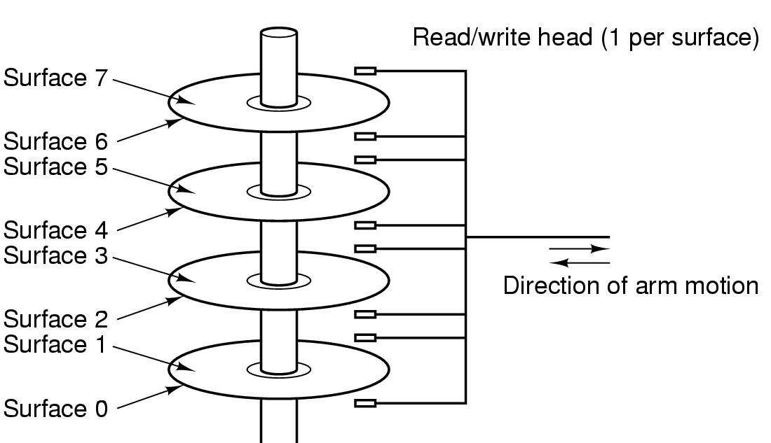
Computer Hardware Review (4)
Structure of a disk drive

Slide 64
I/O Techniques
When the processor encounters an instruction relating to I/O, it executes that instruction by issuing a command to the appropriate I/O module
Three techniques are possible for I/O operations:
Programmed I/O
Interrupt-Driven I/O
Direct Memory Access (DMA)
Notes:
When the processor is executing a program and encounters an instruction relating to I/O, it executes that instruction by issuing a command to the appropriate I/O module.
Three techniques are possible for I/O operations: programmed I/O, interrupt-driven I/O, and direct memory access (DMA).

Slide 65
Programmed I/O
The I/O module performs the requested action then sets the appropriate bits in the I/O status register
The processor periodically checks the status of the I/O module until it determines the instruction is complete
With programmed I/O the performance level of the entire system is severely degraded
Notes:
In the case of programmed I/O , the I/O module performs the requested action and then sets the appropriate bits in the I/O status register but takes no further action to alert the processor. In particular, it does not interrupt the processor. Thus, after the I/O instruction is invoked, the processor must take some active role in determining when the I/O instruction is completed. For this purpose, the processor periodically checks the status of the I/O module until it finds that the operation is complete.
With programmed I/O, the processor has to wait a long time for the I/O module of concern to be ready for either reception or transmission of more data. The processor, while waiting, must repeatedly interrogate the status of the I/O module. As a result, the performance level of the entire system is severely degraded.

Slide 66
Interrupt-Driven I/O
Processor issues an I/O command to a module and then goes on to do some other useful work
The processor executes the data transfer and then resumes its former processing
The I/O module will then interrupt the processor to request service when it is ready to exchange data with the processor
More efficient than Programmed I/O but still requires active intervention of the processor to transfer data between memory and an I/O module
Notes:
An alternative, known as interrupt-driven I/O , is for the processor to issue an I/O command to a module and then go on to do some other useful work. The I/O module will then interrupt the processor to request service when it is ready to exchange data with the processor. The processor then executes the data transfer, as before, and then resumes its former processing.

Slide 67
Interrupt-Driven I/O
Drawbacks
Transfer rate is limited by the speed with which the processor can test and service a device
The processor is tied up in managing an I/O transfer
      A number of instructions must be executed for each I/O transfer
Notes:
Interrupt-driven I/O, though more efficient than simple programmed I/O, still requires the active intervention of the processor to transfer data between memory and an I/O module, and any data transfer must traverse a path through the processor. Thus, both of these forms of I/O suffer from two inherent drawbacks:
1. The I/O transfer rate is limited by the speed with which the processor can test and service a device.
2. The processor is tied up in managing an I/O transfer; a number of instructions must be executed for each I/O transfer.

Slide 68
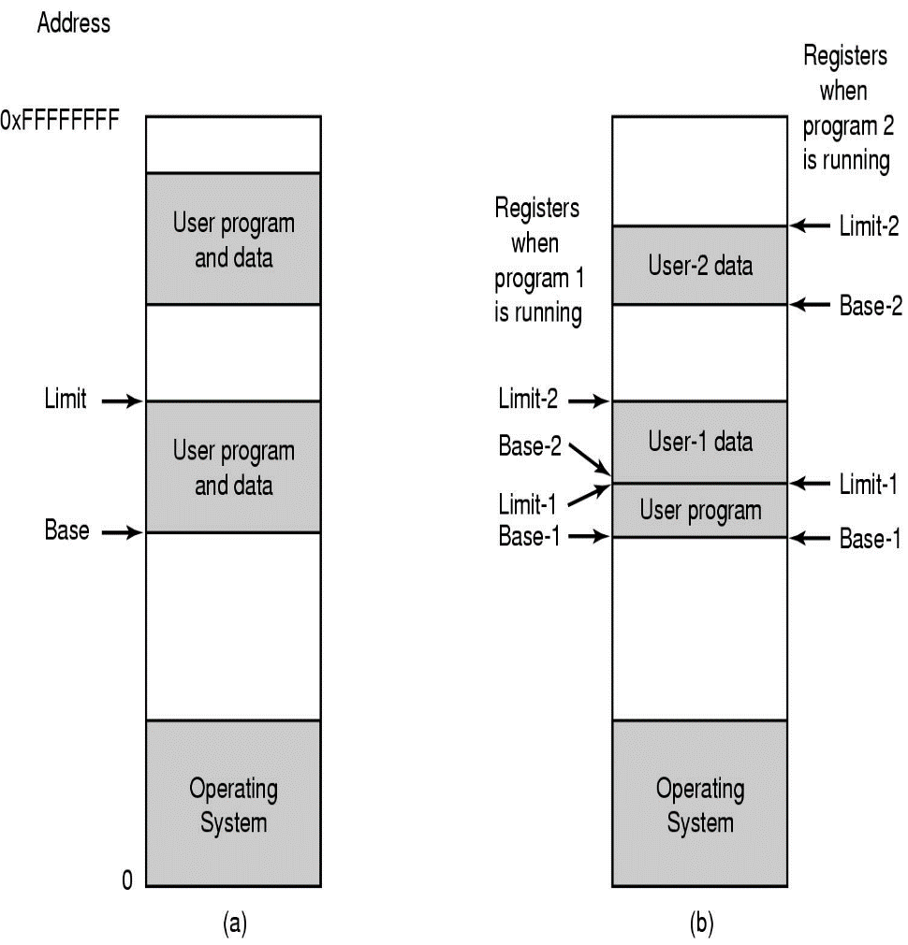
Computer Hardware Review (5)
One base-limit pair and two base-limit pairs

Slide 69
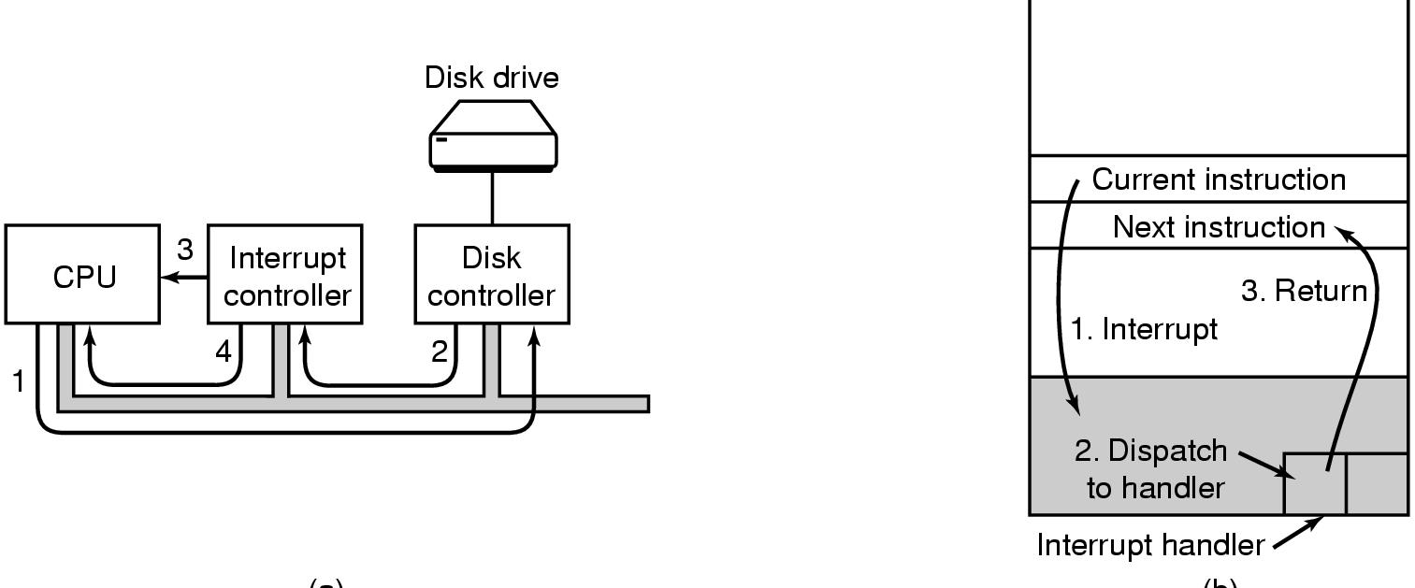
Computer Hardware Review (6)
(a)
(b)
(a) Steps in starting an I/O device and getting interrupt
(b) How the CPU is interrupted

Slide 70
Direct Memory Access
(DMA)
Performed by a separate module on the system bus or incorporated into an I/O module
When the processor wishes to read or write data it issues a command to the DMA module containing:
Whether a read or write is requested
The address of the I/O device involved
The starting location in memory to read/write
The number of words to be read/written
Notes:
When large volumes of data are to be moved, a more efficient technique is required: direct memory access (DMA) . The DMA function can be performed by a separate module on the system bus or it can be incorporated into an I/O module. In either case, the technique works as follows. When the processor wishes to read or write a block of data, it issues a command to the DMA module, by sending to the DMA module the following information:
• Whether a read or write is requested
• The address of the I/O device involved
• The starting location in memory to read data from or write data to
• The number of words to be read or written

Slide 71
Direct Memory Access
Transfers the entire block of data directly to and from memory without going through the processor
    Processor is involved only at the beginning and end of the transfer
    Processor executes more slowly during a transfer when processor access to the bus is required
More efficient than interrupt-driven or programmed I/O
Notes:
The processor then continues with other work. It has delegated this I/O operation to the DMA module, and that module will take care of it. The DMA module transfers the entire block of data, one word at a time, directly to or from memory without going through the processor. When the transfer is complete, the DMA module sends an interrupt signal to the processor. Thus, the processor is involved only at the beginning and end of the transfer.
The DMA module needs to take control of the bus to transfer data to and from memory. Because of this competition for bus usage, there may be times when the processor needs the bus and must wait for the DMA module. Note that this is not an interrupt; the processor does not save a context and do something else. Rather, the processor pauses for one bus cycle (the time it takes to transfer one word across the bus). The overall effect is to cause the processor to execute more slowly during a DMA transfer when processor access to the bus is required. Nevertheless, for a multiple-word I/O transfer, DMA is far more efficient than interrupt-driven or programmed I/O.

Slide 72
Symmetric Multiprocessors
(SMP)
A stand-alone computer system with the following characteristics:
  Two or more similar processors of comparable capability
  Processors share the same main memory and are interconnected by a bus or other internal connection scheme
  Processors share access to I/O devices
  All processors can perform the same functions
  The system is controlled by an integrated operating system that provides interaction between processors and their programs at the job, task, file, and data element levels
Notes:
An SMP can be defined as a stand-alone computer system with the following characteristics:
1. There are two or more similar processors of comparable capability.
2. These processors share the same main memory and I/O facilities and are interconnected by a bus or other internal connection scheme, such that memory access time is approximately the same for each processor.
3. All processors share access to I/O devices, either through the same channels or through different channels that provide paths to the same device.
4. All processors can perform the same functions (hence the term symmetric ).
5. The system is controlled by an integrated operating system that provides interaction between processors and their programs at the job, task, file, and
data element levels.
Points 1 to 4 should be self-explanatory. Point 5 illustrates one of the contrasts with a loosely coupled multiprocessing system, such as a cluster. In the latter, the physical unit of interaction is usually a message or complete file. In an SMP, individual data elements can constitute the level of interaction, and there can be a high degree of cooperation between processes.

Slide 73
SMP Advantages
Performance
A system with multiple processors will yield greater performance if work can be done in parallel
Availability
The failure of a single processor does not halt the machine
Incremental Growth
An additional processor can be added to enhance performance
Scaling
Vendors can offer a range of products with different price and performance characteristics
Notes:
An SMP organization has a number of potential advantages over a uniprocessor organization, including the following:
• Performance: If the work to be done by a computer can be organized so that some portions of the work can be done in parallel, then a system with multiple processors will yield greater performance than one with a single processor of the same type.
Availability: In a symmetric multiprocessor, because all processors can perform the same functions, the failure of a single processor does not halt the machine. Instead, the system can continue to function at reduced performance.
• Incremental growth: A user can enhance the performance of a system by adding an additional processor.
• Scaling: Vendors can offer a range of products with different price and performance characteristics based on the number of processors configured in the system.
It is important to note that these are potential, rather than guaranteed, benefits. The operating system must provide tools and functions to exploit the parallelism in an SMP system. An attractive feature of an SMP is that the existence of multiple processors is transparent to the user. The operating system takes care of scheduling of tasks on individual processors and of synchronization among processors.

Slide 74
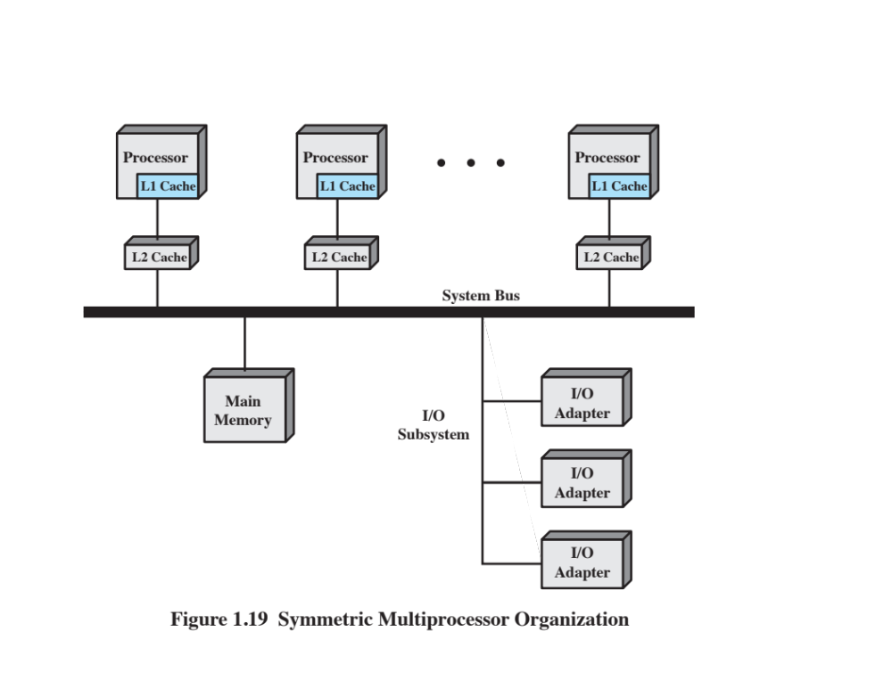
Notes:
Figure 1.19 illustrates the general organization of an SMP.
There are multiple processors, each of which contains its own control unit, arithmetic logic unit, and registers. Each processor has access to a shared main memory and the I/O devices through some form of interconnection mechanism; a shared bus is a common facility. The processors can communicate with each other through memory (messages and status information left in shared address spaces). It may also be possible for processors to exchange signals directly. The memory is often organized so that multiple simultaneous accesses to separate blocks of memory are possible.
In modern computers, processors generally have at least one level of cache memory that is private to the processor. This use of cache introduces some new design considerations. Because each local cache contains an image of a portion of main memory, if a word is altered in one cache, it could conceivably invalidate a word in another cache. To prevent this, the other processors must be alerted that an update has taken place. This problem is known as the cache coherence problem and is typically addressed in hardware rather than by the OS.

Slide 75
Multicore Computer
Also known as a chip multiprocessor
Combines two or more processors (cores) on a single piece of silicon (die)
    Each core consists of all of the components of an independent processor
In addition, multicore chips also include L2 cache and in some cases L3 cache
Notes:
A multicore computer, also known as a chip multiprocessor , combines two or more processors (called cores) on a single piece of silicon (called a die). Typically, each core consists of all of the components of an independent processor, such as registers, ALU, pipeline hardware, and control unit, plus L1 instruction and data caches. In addition to the multiple cores, contemporary multicore chips also include L2 cache and, in some cases, L3 cache.
The motivation for the development of multicore computers can be summed up as follows. For decades, microprocessor systems have experienced a steady, usually exponential, increase in performance. This is partly due to hardware trends, such as an increase in clock frequency and the ability to put cache memory closer to the processor because of the increasing miniaturization of microcomputer components. Performance has also been improved by the increased complexity of processor design to exploit parallelism in instruction execution and memory access. In brief, designers have come up against practical limits in the ability to achieve greater performance by means of more complex processors. Designers have found that the best way to improve performance to take advantage of advances in hardware is to put multiple processors and a substantial amount of cache memory on a single chip. A detailed discussion of the rationale for this trend is beyond our scope, but is summarized in Appendix C .

Slide 76
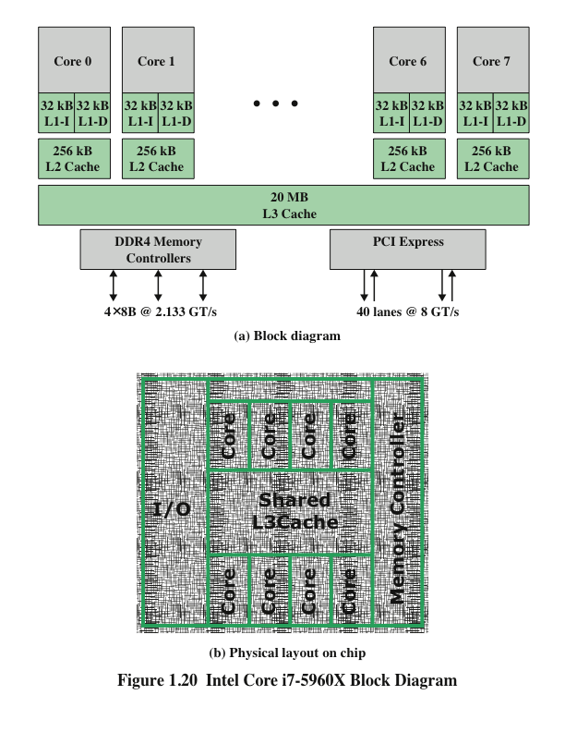
Notes:
An example of a multicore system is the Intel Core i7-5960X, which includes
six x86 processors, each with a dedicated L2 cache, and with a shared L3 cache
(Figure 1.20a). One mechanism Intel uses to make its caches more effective is
prefetching, in which the hardware examines memory access patterns and attempts to
fill the caches speculatively with data that’s likely to be requested soon. Figure 1.20b
shows the physical layout of the 5960X in its chip.
The Core i7-5960X chip supports two forms of external communications to
other chips. The DDR4 memory controller brings the memory controller for the
DDR (double data rate) main memory onto the chip. The interface supports four
channels that are 8 bytes wide for a total bus width of 256 bits, for an aggregate data
rate of up to 64 GB/s. With the memory controller on the chip, the Front Side Bus is
eliminated. The PCI Express is a peripheral bus. It enables high-speed communications
among connected processor chips. The PCI Express link operates at 8 GT/s
(transfers per second). At 40 bits per transfer, that adds up to 40 GB/s.

Slide 77
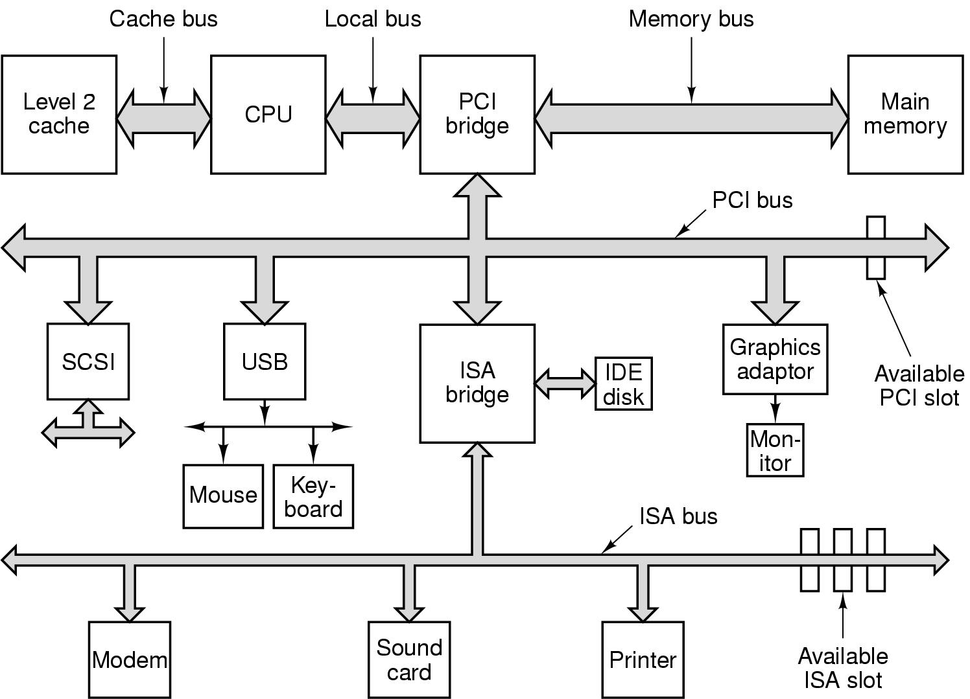
Computer Hardware Review (7)
Structure of a large Pentium system

Slide 78
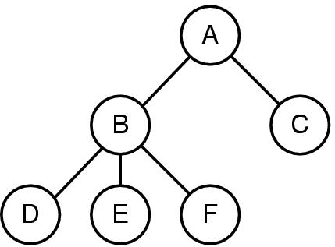
Operating System Concepts (1):
Processes
A process tree
  A created two child processes, B and C
  B created three child processes, D, E, and F

Slide 79
Process
Fundamental to the structure of operating systems
A process can be defined as:
A program in execution
An instance of a running program
The entity that can be assigned to, and executed on, a processor
A unit of activity characterized by a single sequential thread of execution, a current state, and an associated set of system resources
Notes:
Central to the design of operating systems is the concept of process. This term was
first used by the designers of Multics in the 1960s [DALE68]. It is a somewhat
more general term than job. Many definitions have been given for the term process ,
including
• A program in execution
• An instance of a program running on a computer
• The entity that can be assigned to and executed on a processor
• A unit of activity characterized by a single sequential thread of execution, a
current state, and an associated set of system resources

Slide 80
Causes of Errors
Improper synchronization
  It is often the case that a routine must be suspended awaiting an event elsewhere in the system
  Improper design of the signaling mechanism can result in loss or duplication
Nondeterminate program operation
  When programs share memory, and their execution is interleaved by the processor, they may interfere with each other by overwriting common memory areas in unpredictable ways
  The order in which programs are scheduled may affect the outcome of any particular program
Failed mutual exclusion
  More than one user or program attempts to make use of a shared resource at the same time
  There must be some sort of mutual exclusion mechanism that permits only one routine at a time to perform an update against the file
Deadlocks
  It is possible for two or more programs to be hung up waiting for each other
Notes:
The principal tool available to system programmers in developing the early
multiprogramming and multiuser interactive systems was the interrupt. The activity
of any job could be suspended by the occurrence of a defined event, such as an I/O
completion. The processor would save some sort of context (e.g., program counter
and other registers) and branch to an interrupt-handling routine, which would determine
the nature of the interrupt, process the interrupt, and then resume user processing
with the interrupted job or some other job.
The design of the system software to coordinate these various activities turned
out to be remarkably difficult. With many jobs in progress at any one time, each of
which involved numerous steps to be performed in sequence, it became impossible
to analyze all of the possible combinations of sequences of events. In the absence of
some systematic means of coordination and cooperation among activities, programmers
resorted to ad hoc methods based on their understanding of the environment
that the OS had to control. These efforts were vulnerable to subtle programming
errors whose effects could be observed only when certain relatively rare sequences
of actions occurred. These errors were difficult to diagnose because they needed to
be distinguished from application software errors and hardware errors. Even when
the error was detected, it was difficult to determine the cause, because the precise
conditions under which the errors appeared were very hard to reproduce. In general
terms, there are four main causes of such errors [DENN80a]:
Improper synchronization:
It is often the case that a routine must be suspended
awaiting an event elsewhere in the system. For example, a program that initiates
an I/O read must wait until the data are available in a buffer before proceeding.
In such cases, a signal from some other routine is required. Improper design
of the signaling mechanism can result in signals being lost or duplicate signals
being received.
Failed mutual exclusion:
It is often the case that more than one user or program
will attempt to make use of a shared resource at the same time. For example,
two users may attempt to edit the same file at the same time. If these accesses
are not controlled, an error can occur. There must be some sort of mutual exclusion
mechanism that permits only one routine at a time to perform an update
against the file. The implementation of such mutual exclusion is difficult to
verify as being correct under all possible sequences of events.
Nondeterminate program operation:
The results of a particular program normally
should depend only on the input to that program and not on the activities
of other programs in a shared system. But when programs share memory, and
their execution is interleaved by the processor, they may interfere with each
other by overwriting common memory areas in unpredictable ways. Thus, the
order in which various programs are scheduled may affect the outcome of any
particular program.
Deadlocks:
It is possible for two or more programs to be hung up waiting for
each other. For example, two programs may each require two I/O devices to perform
some operation (e.g., disk to tape copy). One of the programs has seized
control of one of the devices and the other program has control of the other
device. Each is waiting for the other program to release the desired resource.
Such a deadlock may depend on the chance timing of resource allocation and
release.

Slide 81
Components of a Process
A process contains three components:
  An executable program
  The associated data needed by the program (variables, work space, buffers, etc.)
  The execution context (or “process state”) of the program
  The execution context is essential:
  It is the internal data by which the OS is able to supervise and control the process
  Includes the contents of the various process registers
  Includes information such as the priority of the process and whether the process is waiting for the completion of a particular I/O event
Notes:
We can think of a process as consisting of three components:
• An executable program
• The associated data needed by the program (variables, work space, buffers, etc.)
• The execution context of the program
This last element is essential.
The execution context, or process state, is the internal data by which the OS is able to supervise and control the process.
This internal information is separated from the process, because the OS has information not permitted to the process.
The context includes all of the information that the OS needs to manage the process and that the processor needs to execute the process properly including:
contents of the various processor registers, such as the program counter and data registers
And information of use to the OS, such as the priority of the process and whether the process is waiting for the completion of a particular I/O event.

Slide 82
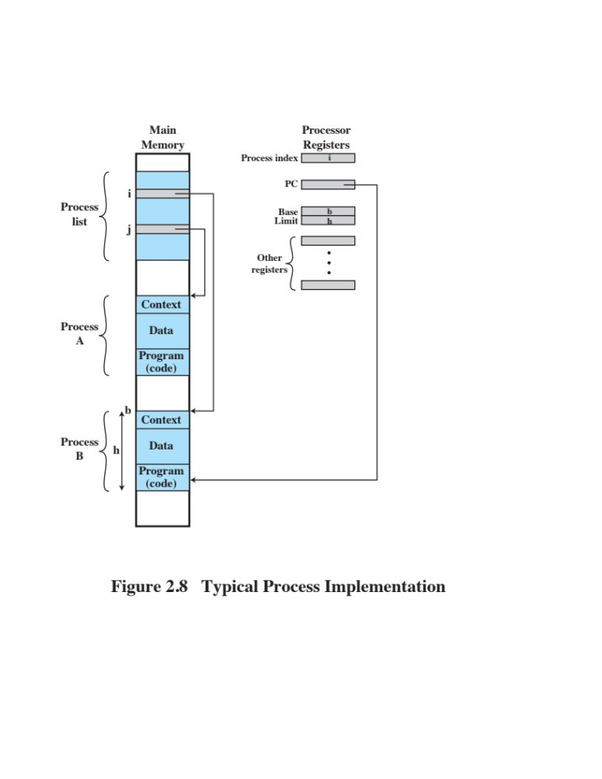
Process Management
The entire state of the process at any instant is contained in its context
New features can be designed and incorporated into the OS by expanding the context to include any new information needed to support the feature
Notes:
Figure 2.8 indicates a way in which processes may be managed. Two processes,
A and B, exist in portions of main memory. That is, a block of memory is
allocated to each process that contains the program, data, and context information.
Each process is recorded in a process list built and maintained by the OS. The
process list contains one entry for each process, which includes a pointer to the
location of the block of memory that contains the process. The entry may also
include part or all of the execution context of the process. The remainder of the
execution context is stored elsewhere, perhaps with the process itself (as indicated
in Figure 2.8 ) or frequently in a separate region of memory. The process index
register contains the index into the process list of the process currently controlling
the processor. The program counter points to the next instruction in that process
to be executed. The base and limit registers define the region in memory occupied
by the process: The base register is the starting address of the region of memory
and the limit is the size of the region (in bytes or words). The program counter and
all data references are interpreted relative to the base register and must not exceed
the value in the limit register. This prevents interprocess interference.
In Figure 2.8 , the process index register indicates that process B is executing.
Process A was previously executing but has been temporarily interrupted. The
contents of all the registers at the moment of A’s interruption were recorded in its
execution context. Later, the OS can perform a process switch and resume execution
of process A. The process switch consists of storing the context of B and restoring
the context of A. When the program counter is loaded with a value pointing into A’s
program area, process A will automatically resume execution.

Slide 83
Memory Management
The OS has five principal storage management responsibilities:
Process isolation
Long-term storage
Protection and access control
Support of modular programming
Automatic allocation and management
Notes:
The needs of users can be met best by a computing environment that supports
modular programming and the flexible use of data. System managers need efficient
and orderly control of storage allocation. The OS, to satisfy these requirements, has
five principal storage management responsibilities:
• Process isolation: The OS must prevent independent processes from interfering
with each other’s memory, both data and instructions.
• Automatic allocation and management: Programs should be dynamically
allocated across the memory hierarchy as required. Allocation should be
transparent to the programmer. Thus, the programmer is relieved of concerns
relating to memory limitations, and the OS can achieve efficiency by assigning
memory to jobs only as needed.
• Support of modular programming: Programmers should be able to define program
modules, and to create, destroy, and alter the size of modules dynamically.
• Protection and access control: Sharing of memory, at any level of the memory
hierarchy, creates the potential for one program to address the memory space
of another. This is desirable when sharing is needed by particular applications.
At other times, it threatens the integrity of programs and even of the OS itself.
The OS must allow portions of memory to be accessible in various ways by
various users.
• Long-term storage: Many application programs require means for storing
information for extended periods of time, after the computer has been
powered down.

Slide 84
Virtual Memory
A facility that allows programs to address memory from a logical point of view, without regard to the amount of main memory physically available
Conceived to meet the requirement of having multiple user jobs reside in main memory concurrently
Notes:
Typically, operating systems meet these requirements with virtual memory
and file system facilities. The file system implements a long-term store, with information
stored in named objects, called files. The file is a convenient concept for the
programmer and is a useful unit of access control and protection for the OS.
Virtual memory is a facility that allows programs to address memory from
a logical point of view, without regard to the amount of main memory physically
available. Virtual memory was conceived to meet the requirement of having multiple
user jobs reside in main memory concurrently, so that there would not be a hiatus
between the execution of successive processes while one process was written out
to secondary store and the successor process was read in.

Slide 85
Paging
Allows processes to be comprised of a number of fixed-size blocks, called pages
Program references a word by means of a virtual address, consisting of a page number and an offset within the page
Each page of a process may be located anywhere in main memory
The paging system provides for a dynamic mapping between the virtual address used in the program and a real address (or physical address) in main memory
Notes:
Because processes vary
in size, if the processor switches among a number of processes it is difficult to pack
them compactly into main memory. Paging systems were introduced, which allow
processes to be comprised of a number of fixed-size blocks, called pages. A program
references a word by means of a virtual address consisting of a page number
and an offset within the page. Each page of a process may be located anywhere
in main memory. The paging system provides for a dynamic mapping between the
virtual address used in the program and a real address , or physical address, in main
memory.

Slide 86
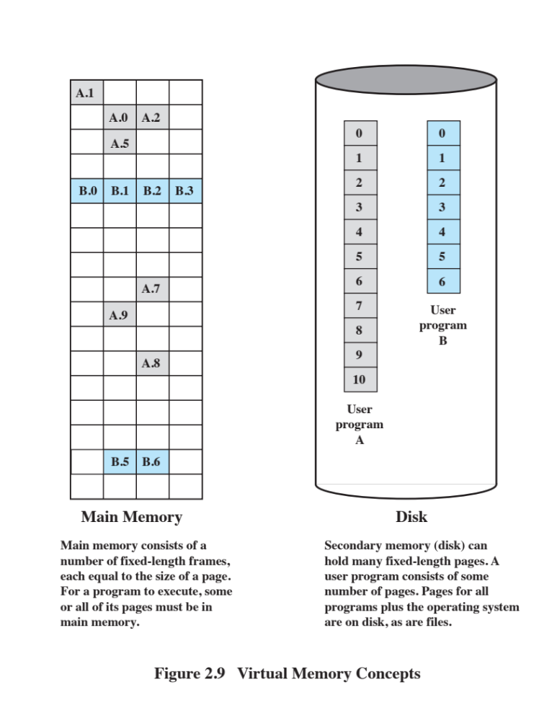
Notes:
With dynamic mapping hardware available, the next logical step was to
eliminate the requirement that all pages of a process reside in main memory simultaneously.
All the pages of a process are maintained on disk. When a process is
executing, some of its pages are in main memory. If reference is made to a page
that is not in main memory, the memory management hardware detects this and
arranges for the missing page to be loaded. Such a scheme is referred to as virtual
memory and is depicted in Figure 2.9 .
The processor hardware, together with the OS, provides the user with a
“virtual processor” that has access to a virtual memory. This memory may be a
linear address space or a collection of segments, which are variable-length blocks
of contiguous addresses. In either case, programming language instructions can
reference program and data locations in the virtual memory area. Process isolation
can be achieved by giving each process a unique, nonoverlapping virtual memory.
Memory sharing can be achieved by overlapping portions of two virtual memory
spaces. Files are maintained in a long-term store. Files and portions of files may be
copied into the virtual memory for manipulation by programs.

Slide 87
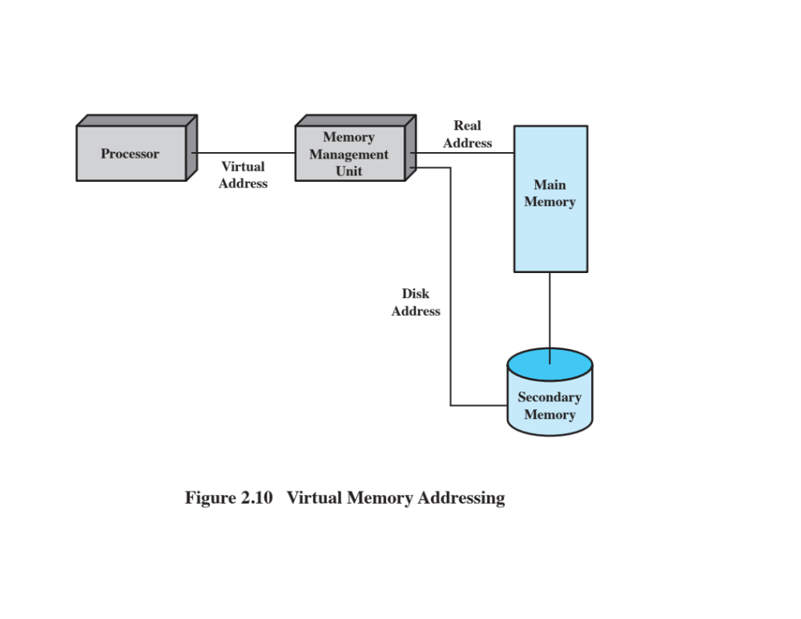
Notes:
Figure 2.10 highlights the addressing concerns in a virtual memory scheme.
Storage consists of directly addressable (by machine instructions) main memory
and lower-speed auxiliary memory that is accessed indirectly by loading blocks
into main memory. Address translation hardware (memory management unit) is
interposed between the processor and memory. Programs reference locations using
virtual addresses, which are mapped into real main memory addresses. If a reference
is made to a virtual address not in real memory, then a portion of the contents
of real memory is swapped out to auxiliary memory and the desired block of data
is swapped in. During this activity, the process that generated the address reference
must be suspended. The OS designer needs to develop an address translation mechanism
that generates little overhead and a storage allocation policy that minimizes
the traffic between memory levels.

Slide 88
Information Protection and Security
The nature of the threat that concerns an organization will vary greatly depending on the circumstances
The problem involves controlling access to computer systems and the information stored in them
Main issues
Availability
Confidentiality
Data integrity
Authenticity
Notes:
The growth in the use of time-sharing systems and, more recently, computer networks
has brought with it a growth in concern for the protection of information.
The nature of the threat that concerns an organization will vary greatly depending
on the circumstances. However, there are some general-purpose tools that can be
built into computers and operating systems that support a variety of protection and
security mechanisms. In general, we are concerned with the problem of controlling
access to computer systems and the information stored in them.
Much of the work in security and protection as it relates to operating systems
can be roughly grouped into four categories:
• Availability: Concerned with protecting the system against interruption.
• Confidentiality: Assures that users cannot read data for which access is
unauthorized.
• Data integrity: Protection of data from unauthorized modification.
• Authenticity: Concerned with the proper verification of the identity of users
and the validity of messages or data.

Slide 89
Scheduling and Resource Management
Fairness
Differential responsiveness
Efficiency
Key responsibility of an OS is managing resources
Resource allocation policies must consider:
Notes:
A key responsibility of the OS is to manage the various resources available to it (main memory space, I/O devices, processors) and to schedule their use by the various active processes.
Any resource allocation and scheduling policy must consider three factors:
Fairness:
Typically, we would like all processes that are competing for the use
of a particular resource to be given approximately equal and fair access to that
resource. This is especially so for jobs of the same class, that is, jobs of similar
demands.
Differential responsiveness:
On the other hand, the OS may need to discriminate
among different classes of jobs with different service requirements. The OS
should attempt to make allocation and scheduling decisions to meet the total
set of requirements. The OS should also make these decisions dynamically. For
example, if a process is waiting for the use of an I/O device, the OS may wish
to schedule that process for execution as soon as possible; the process can then
immediately use the device and then release it for later demands from other
processes.
Efficiency:
The OS should attempt to maximize throughput, minimize response
time, and, in the case of time sharing, accommodate as many users as possible.
These criteria conflict; finding the right balance for a particular situation is an
ongoing problem for OS research.
Scheduling and resource management are essentially operations-research
problems and the mathematical results of that discipline can be applied. In addition,
measurement of system activity is important to be able to monitor performance and
make adjustments.

Slide 90
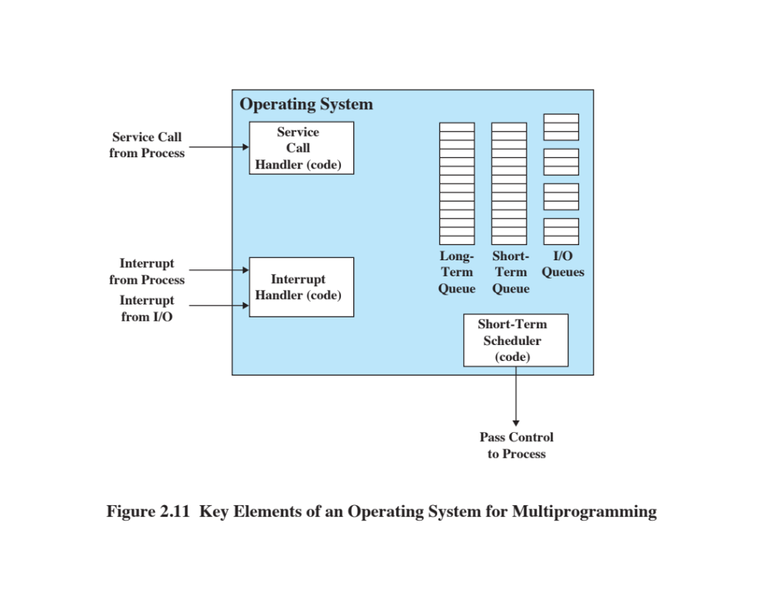
Notes:
Figure 2.11 suggests the major elements of the OS involved in the scheduling
of processes and the allocation of resources in a multiprogramming environment.
The OS maintains a number of queues, each of which is simply a list of processes
waiting for some resource. The short-term queue consists of processes that are in
main memory (or at least an essential minimum portion of each is in main memory)
and are ready to run as soon as the processor is made available. Any one of these
processes could use the processor next. It is up to the short-term scheduler, or
dispatcher, to pick one. A common strategy is to give each process in the queue
some time in turn; this is referred to as a round-robin technique. In effect, the
round-robin technique employs a circular queue. Another strategy is to assign
priority levels to the various processes, with the scheduler selecting processes in
priority order.
The long-term queue is a list of new jobs waiting to use the processor. The
OS adds jobs to the system by transferring a process from the long-term queue to
the short-term queue. At that time, a portion of main memory must be allocated
to the incoming process. Thus, the OS must be sure that it does not overcommit
memory or processing time by admitting too many processes to the system. There
is an I/O queue for each I/O device. More than one process may request the use of
the same I/O device. All processes waiting to use each device are lined up in that
device’s queue. Again, the OS must determine which process to assign to an available
I/O device.
The OS receives control of the processor at the interrupt handler if an interrupt
occurs. A process may specifically invoke some OS service, such as an I/O
device handler by means of a service call. In this case, a service call handler is the
entry point into the OS. In any case, once the interrupt or service call is handled, the
short-term scheduler is invoked to pick a process for execution.
The foregoing is a functional description; details and modular design of this
portion of the OS will differ in various systems. Much of the research and development
effort in operating systems has been directed at picking algorithms and data
structures for this function that provide fairness, differential responsiveness, and
efficiency.

Slide 91
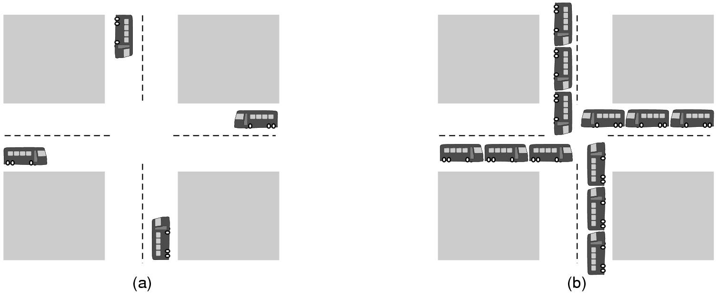
Operating System Concepts (2):
Deadlocks
A potential deadlock.
(b) an actual deadlock.

Slide 92
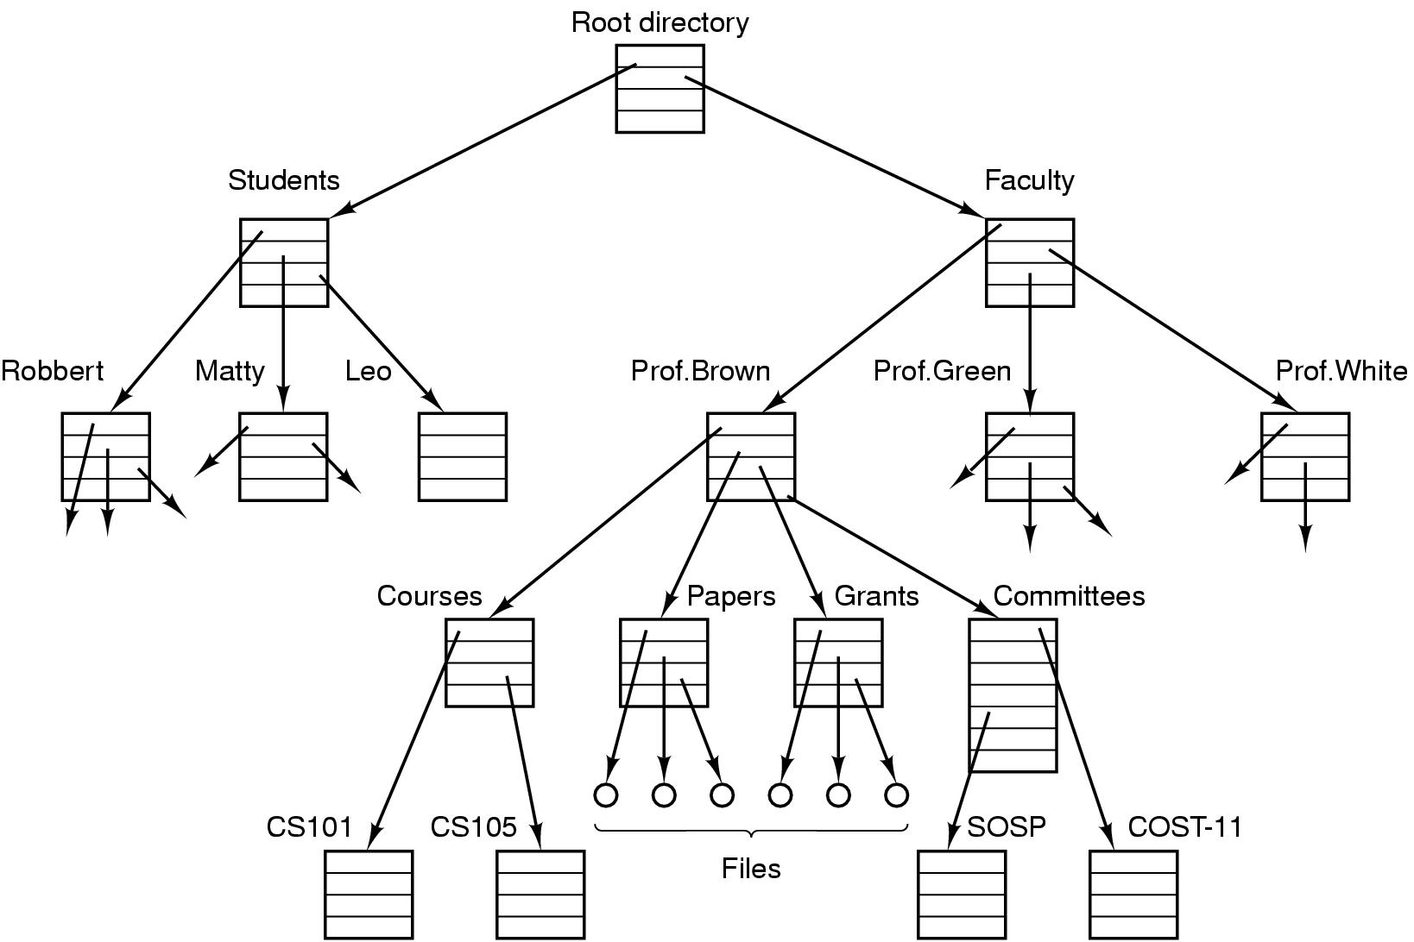
Operating System Concepts (3):
Files
File system for a university department

Slide 93
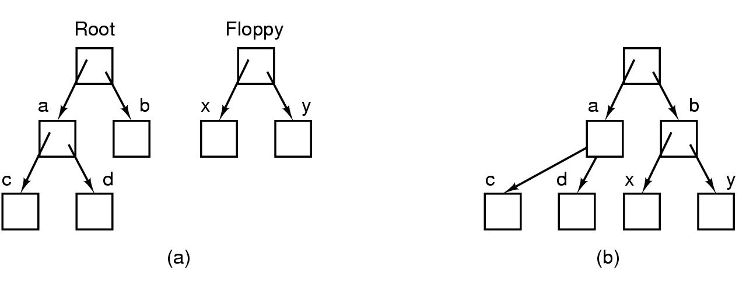
Operating System Concepts (4)
Before mounting,
  files on floppy are inaccessible
After mounting floppy on b,
  files on floppy are part of file hierarchy

Slide 94
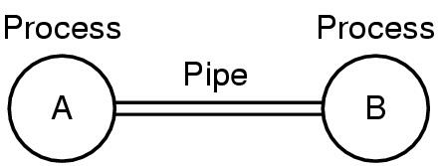
Operating System Concepts (5)
Two processes connected by a pipe

Slide 95
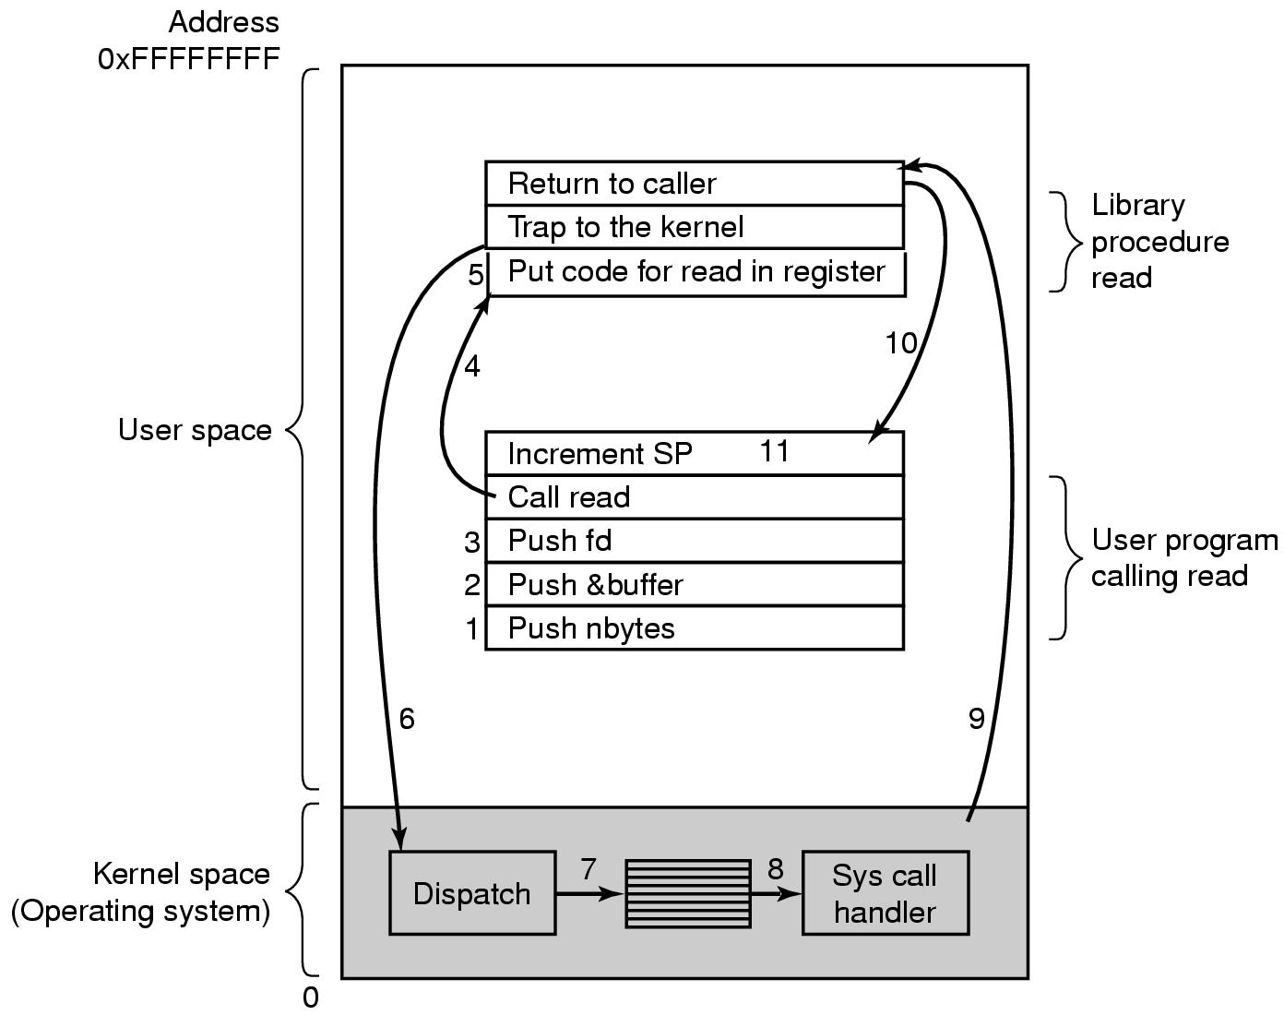
Steps in Making a System Call
There are 11 steps in making the system call
read (fd, buffer, nbytes)

Slide 96
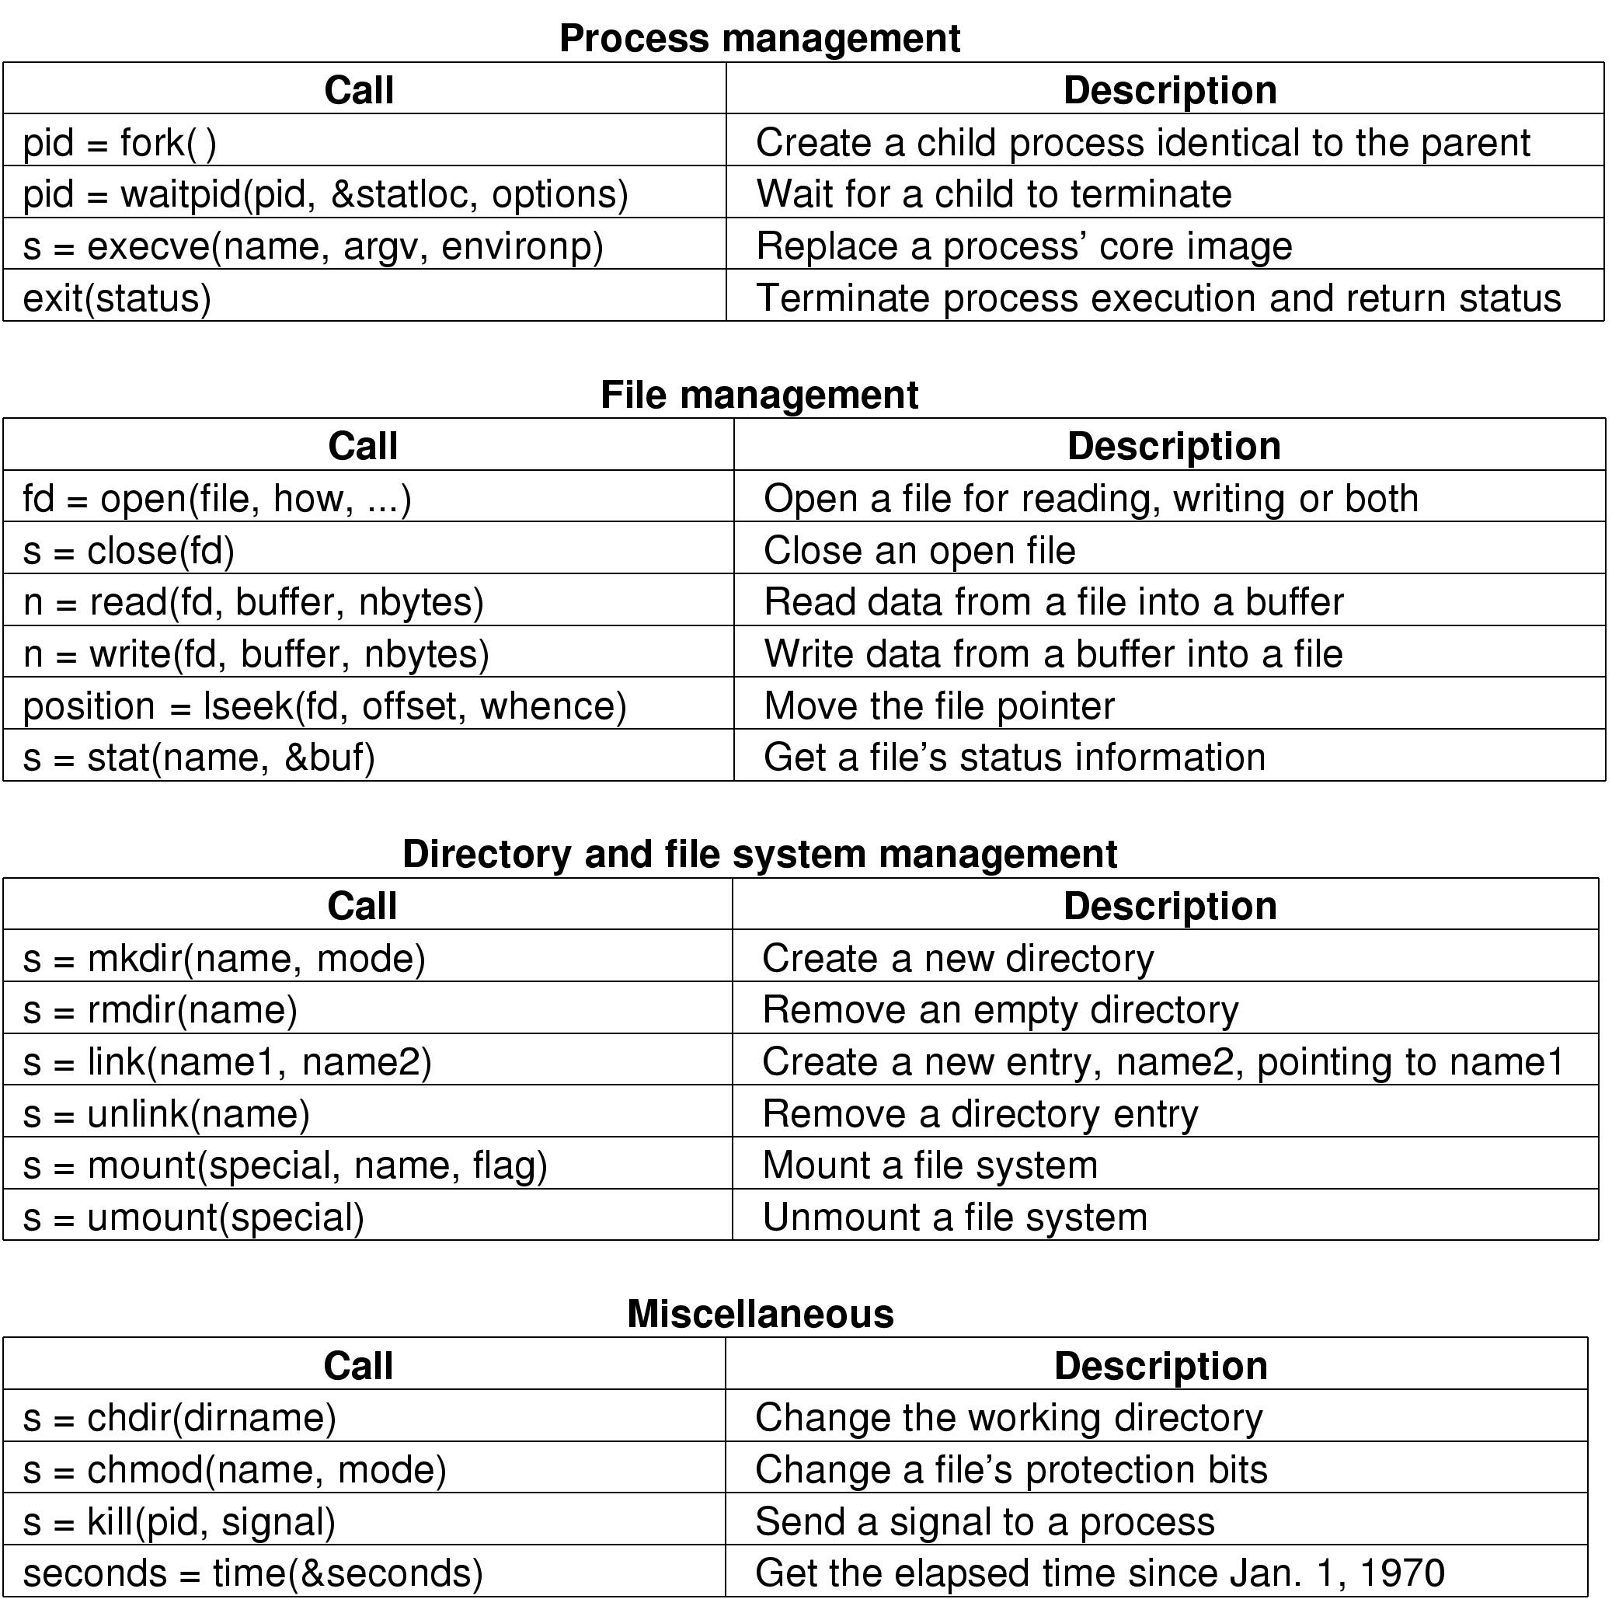
Some System Calls For Process Management

Slide 97
Some System Calls For File Management

Slide 98
Some System Calls For Directory Management

Slide 99
Some System Calls For Miscellaneous Tasks

Slide 100
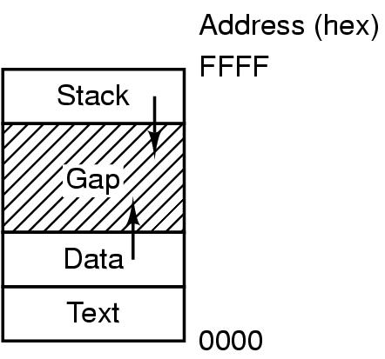
System Calls (1)
Processes have three segments: text, data, stack

Slide 101

System Calls (2)
(a) Two directories before linking /usr/jim/memo to ast's directory
(b) The same directories after linking

Slide 102
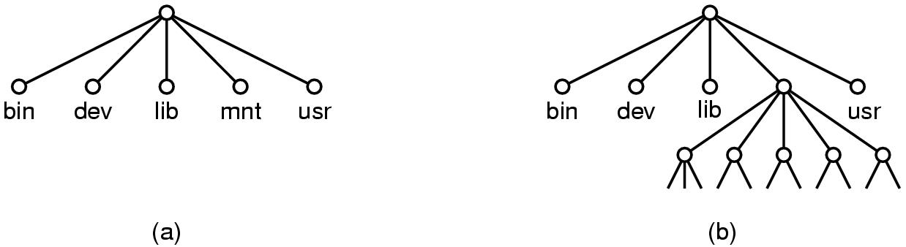
System Calls (3)
(a) File system before the mount
(b) File system after the mount

Slide 103
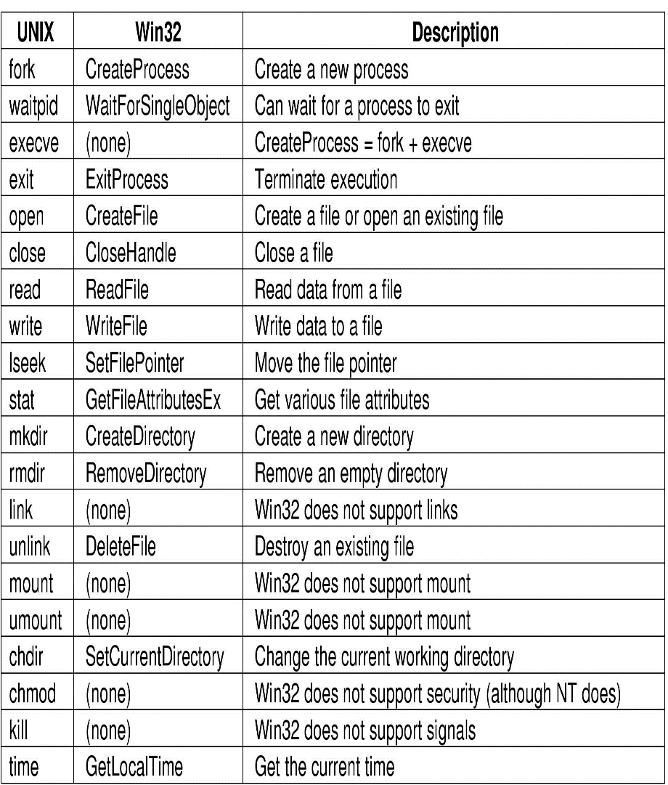
System Calls (4)
Some Win32 API calls

Slide 104
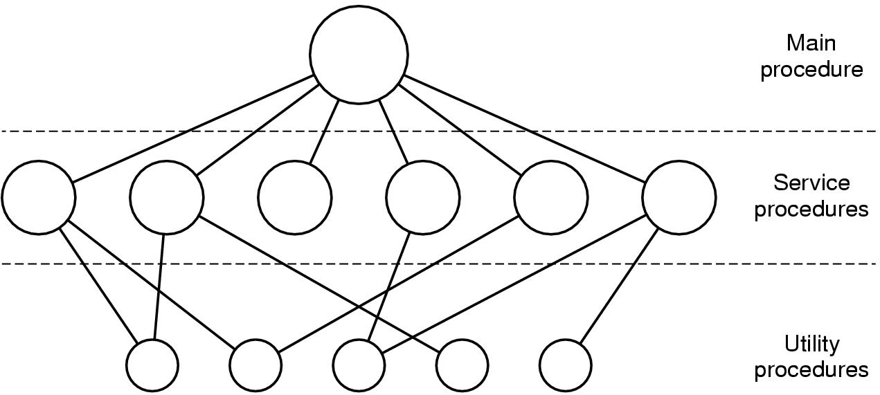
Operating System Structure (1):
Monolithic System
Simple structuring model for a monolithic system

Slide 105
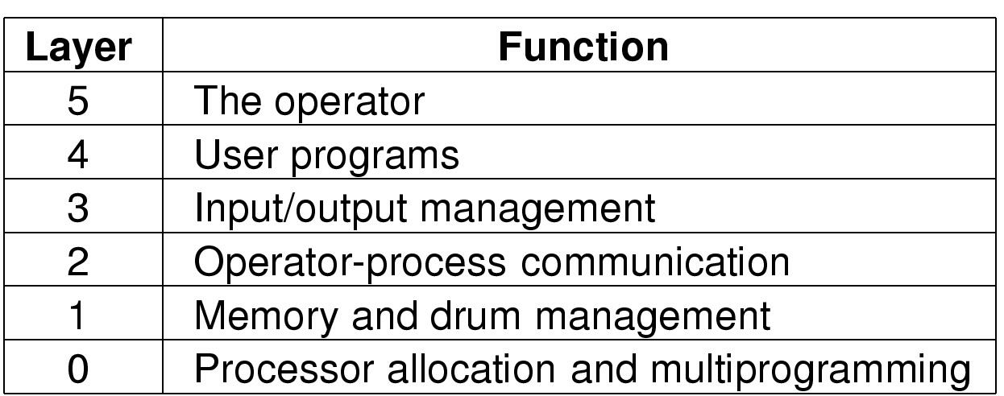
Operating System Structure (2):
Layered System
Structure of the THE operating system

Slide 106
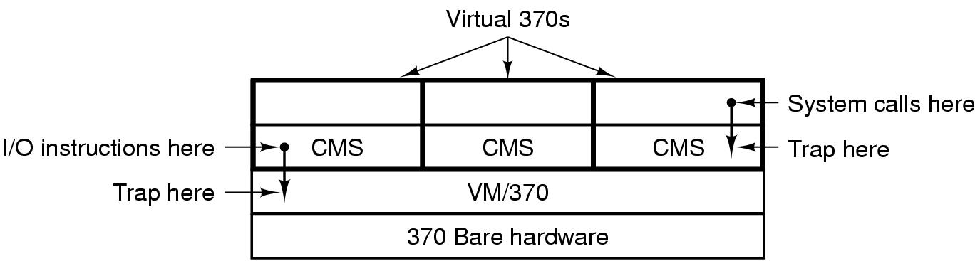
Operating System Structure (3):
Virtual Machines
Structure of VM/370 with CMS

Slide 107
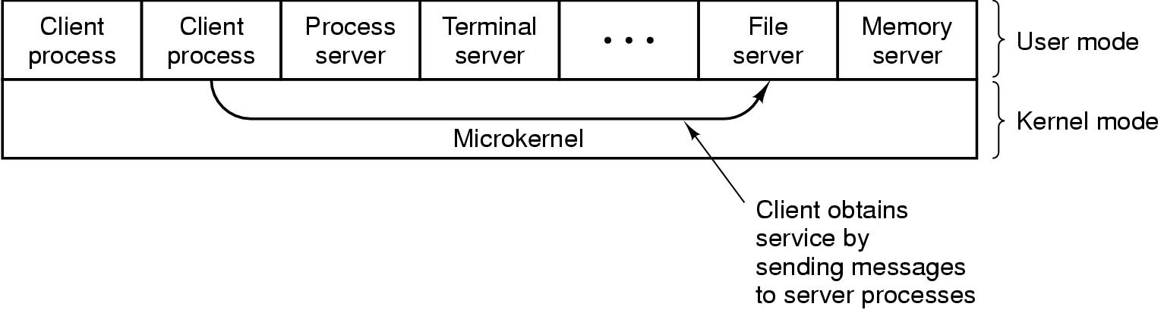
Operating System Structure (4):
Client-Server
The client-server model

Slide 108
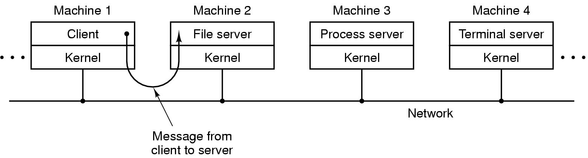
Operating System Structure (5):
Client-Server (distributed)
The client-server model in a distributed system

Slide 109
Different Architectural Approaches
Different approaches and design elements have been tried:
Microkernel architecture
Multithreading
Symmetric multiprocessing
Distributed operating systems
Object-oriented design
Demands on operating systems require new ways of organizing the OS
Notes:
The rate of change in the demands on operating systems requires not just modifications and enhancements to existing architectures but new ways of organizing the OS.
A wide range of different approaches and design elements has been tried in both experimental and commercial operating systems, but much of the work fits into the following categories:
• Microkernel architecture
• Multithreading
• Symmetric multiprocessing
• Distributed operating systems
• Object-oriented design

Slide 110
Microkernel Architecture
Assigns only a few essential functions to the kernel:
  The approach:
Address space management
Interprocess communication (IPC)
Basic scheduling
Simplifies implementation
Provides flexibility
Well suited to a distributed environment
Notes:
Most operating systems, until recently, featured a large monolithic kernel .
Most of what is thought of as OS functionality is provided in these large kernels,
including scheduling, file system, networking, device drivers, memory management,
and more. Typically, a monolithic kernel is implemented as a single process, with
all elements sharing the same address space. A microkernel architecture assigns
only a few essential functions to the kernel, including address spaces, interprocess
communication (IPC), and basic scheduling. Other OS services are provided by
processes, sometimes called servers, that run in user mode and are treated like any
other application by the microkernel. This approach decouples kernel and server
development. Servers may be customized to specific application or environment
requirements. The microkernel approach simplifies implementation, provides flexibility,
and is well suited to a distributed environment. In essence, a microkernel
interacts with local and remote server processes in the same way, facilitating construction
of distributed systems.

Slide 111
Multithreading
Thread
Dispatchable unit of work
Includes a processor context and its own data area for a stack
Executes sequentially and is interruptible
Process
A collection of one or more threads and associated system resources
By breaking a single application into multiple threads, a programmer has greater control over the modularity of the application and the timing of application-related events
Technique in which a process, executing an application, is divided into threads that can run concurrently
Notes:
Multithreading is a technique in which a process, executing an application, is
divided into threads that can run concurrently. We can make the following distinction:
• Thread: A dispatchable unit of work. It includes a processor context (which
includes the program counter and stack pointer) and its own data area for a
stack (to enable subroutine branching). A thread executes sequentially and is
interruptible so that the processor can turn to another thread.
• Process : A collection of one or more threads and associated system resources
(such as memory containing both code and data, open files, and devices). This
corresponds closely to the concept of a program in execution. By breaking
a single application into multiple threads, the programmer has great control
over the modularity of the application and the timing of application-related
events.
Multithreading is useful for applications that perform a number of essentially
independent tasks that do not need to be serialized. An example is a database server
that listens for and processes numerous client requests. With multiple threads running
within the same process, switching back and forth among threads involves
less processor overhead than a major process switch between different processes.
Threads are also useful for structuring processes that are part of the OS kernel as
described in subsequent chapters.

Slide 112
Symmetric
Multiprocessing (SMP)
Term that refers to a computer hardware architecture and also to the OS behavior that exploits that architecture
The OS of an SMP schedules processes or threads across all of the processors
The OS must provide tools and functions to exploit the parallelism in an SMP system
Multithreading and SMP are often discussed together, but the two are independent facilities
An attractive feature of an SMP is that the existence of multiple processors is transparent to the user
Notes:
Symmetric multiprocessing (SMP) is a term that refers to a computer hardware
architecture (described in Chapter 1 ) and also to the OS behavior that exploits
that architecture. The OS of an SMP schedules processes or threads across all of the
processors.
Multithreading and SMP are often discussed together, but the two are
independent facilities. Even on a uniprocessor system, multithreading is useful for
structuring applications and kernel processes. An SMP system is useful even for
nonthreaded processes, because several processes can run in parallel. However, the
two facilities complement each other and can be used effectively together.
An attractive feature of an SMP is that the existence of multiple processors is
transparent to the user. The OS takes care of scheduling of threads or processes on
individual processors and of synchronization among processors.

Slide 113
SMP Advantages
Performance
More than one process can be running simultaneously, each on a different processor
Availability
Failure of a single process does not halt the system
Incremental Growth
Performance of a system can be enhanced by adding an additional processor
Scaling
Vendors can offer a range of products based on the number of processors configured in the system
Notes:
SMP has a number of potential advantages over uniprocessor architecture,
including the following:
• Performance: If the work to be done by a computer can be organized so that
some portions of the work can be done in parallel, then a system with multiple
processors will yield greater performance than one with a single processor of
the same type. This is illustrated in Figure 2.12 . With multiprogramming, only
one process can execute at a time; meanwhile all other processes are waiting
for the processor. With multiprocessing, more than one process can be running
simultaneously, each on a different processor.
• Availability: In a symmetric multiprocessor, because all processors can perform
the same functions, the failure of a single processor does not halt the
system. Instead, the system can continue to function at reduced performance.
• Incremental growth: A user can enhance the performance of a system by adding
an additional processor.
• Scaling: Vendors can offer a range of products with different price and performance
characteristics based on the number of processors configured in the
system.
It is important to note that these are potential, rather than guaranteed, benefits. The
OS must provide tools and functions to exploit the parallelism in an SMP system.

Slide 114
OS Design
Distributed Operating System
Object-Oriented Design
Provides the illusion of a single main memory space and a single secondary memory space plus other unified access facilities, such as a distributed file system
State of the art for distributed operating systems lags that of uniprocessor and SMP operating systems
Lends discipline to the process of adding modular extensions to a small kernel
Enables programmers to customize an operating system without disrupting system integrity
Also eases the development of distributed tools and full-blown distributed operating systems
Notes:
A different problem is to provide the appearance of a single
system for a cluster of separate computers—a multicomputer system. In this
case, we are dealing with a collection of entities (computers), each with its own
main memory, secondary memory, and other I/O modules. A distributed operating
system provides the illusion of a single main memory space and a single secondary
memory space, plus other unified access facilities, such as a distributed file system.
Although clusters are becoming increasingly popular, and there are many cluster
products on the market, the state of the art for distributed operating systems lags
that of uniprocessor and SMP operating systems. We examine such systems in
Part Eight.
Another innovation in OS design is the use of object-oriented technologies.
Object-oriented design lends discipline to the process of adding modular extensions
to a small kernel. At the OS level, an object-based structure enables programmers
to customize an OS without disrupting system integrity. Object orientation also
eases the development of distributed tools and full-blown distributed operating
systems.

Slide 115
Fault Tolerance
Refers to the ability of a system or component to continue normal operation despite the presence of hardware or software faults
Typically involves some degree of redundancy
Intended to increase the reliability of a system
    Typically comes with a cost in financial terms or performance
The extent adoption of fault tolerance measures must be determined by how critical the resource is
Notes:
Fault tolerance refers to the ability of a system or component to continue normal
operation despite the presence of hardware or software faults. This typically involves
some degree of redundancy. Fault tolerance is intended to increase the reliability
of a system. Typically, increased fault tolerance, and therefore increased reliability,
comes with a cost, either in financial terms or performance, or both. Thus, the extent
adoption of fault tolerance measures must be determined by how critical the
resource is.

Slide 116
Faults
Are defined by the IEEE Standards Dictionary as an erroneous hardware or software state resulting from:
    Component failure
    Operator error
    Physical interference from the environment
    Design error
    Program error
    Data structure error
The standard also states that a fault manifests itself as:
    A defect in a hardware device or component
    An incorrect step, process, or data definition in a computer program
Notes:
The IEEE Standards Dictionary defines a fault as an erroneous hardware or software
state resulting from component failure, operator error, physical interference
from the environment, design error, program error, or data structure error. The
standard also states that a fault manifests itself as (1) a defect in a hardware device
or component; for example, a short circuit or broken wire, or (2) an incorrect step,
process, or data definition in a computer program.

Slide 117
Fault Categories
Permanent
    A fault that, after it occurs, is always present
    The fault persists until the faulty component is replaced or repaired
Temporary
    A fault that is not present all the time for all operating conditions
    Can be classified as
        Transient – a fault that occurs only once
        Intermittent – a fault that occurs at multiple, unpredictable times
Notes:
We can group faults into the following categories:
• Permanent: A fault that, after it occurs, is always present. The fault persists
until the faulty component is replaced or repaired. Examples include disk
head crashes, software bugs, and a burnt-out communications component.
• Temporary: A fault that is not present all the time for all operating conditions.
Temporary faults can be further classified as follows:
— Transient: A fault that occurs only once. Examples include bit transmission
errors due to an impulse noise, power supply disturbances, and radiation
that alters a memory bit.
— Intermittent: A fault that occurs at multiple, unpredictable times. An example
of an intermittent fault is one caused by a loose connection.
In general, fault tolerance is built into a system by adding redundancy.
Methods of redundancy include the following:
• Spatial (physical) redundancy: Physical redundancy involves the use of multiple
components that either perform the same function simultaneously or are
configured so that one component is available as a backup in case of the failure
of another component. An example of the former is the use of multiple
parallel circuitry with the majority result produced as output. An example of
the latter is a backup name server on the Internet.
• Temporal redundancy: Temporal redundancy involves repeating a function or
operation when an error is detected. This approach is effective with temporary
faults but not useful for permanent faults. An example is the retransmission of
a block of data when an error is detected, such as is done with data link control
protocols.
• Information redundancy: Information redundancy provides fault tolerance by
replicating or coding data in such a way that bit errors can be both detected and
corrected. An example is the error-control coding circuitry used with memory
systems, and error-correction techniques used with RAID disks, described in
subsequent chapters.

Slide 118
Methods of Redundancy
Spatial (physical) redundancy
Involves the use of multiple components that either perform the same function simultaneously or are configured so that one component is available as a backup in case of the failure of another component
Temporal redundancy
Involves repeating a function or operation when an error is detected
Is effective with temporary faults but not useful for permanent faults
Information redundancy
Provides fault tolerance by replicating or coding data in such a way that bit errors can be both detected and corrected
Notes:
In general, fault tolerance is built into a system by adding redundancy.
Methods of redundancy include the following:
• Spatial (physical) redundancy: Physical redundancy involves the use of multiple
components that either perform the same function simultaneously or are
configured so that one component is available as a backup in case of the failure
of another component. An example of the former is the use of multiple
parallel circuitry with the majority result produced as output. An example of
the latter is a backup name server on the Internet.
• Temporal redundancy: Temporal redundancy involves repeating a function or
operation when an error is detected. This approach is effective with temporary
faults but not useful for permanent faults. An example is the retransmission of
a block of data when an error is detected, such as is done with data link control
protocols.
• Information redundancy: Information redundancy provides fault tolerance by
replicating or coding data in such a way that bit errors can be both detected and
corrected. An example is the error-control coding circuitry used with memory
systems, and error-correction techniques used with RAID disks, described in
subsequent chapters.

Slide 119
Operating System
Mechanisms
A number of techniques can be incorporated into OS software to support fault tolerance:
      Process isolation
      Concurrency controls
      Virtual machines
      Checkpoints and rollbacks
Notes:
A number of techniques can be incorporated into OS software to support fault tolerance.
A number of examples will be evident throughout the book. The following
list provides examples:
• Process isolation: As was mentioned earlier in this chapter, processes are
generally isolated from one another in terms main memory, file access, and
flow of execution. The structure provided by the OS for managing processes
provides a certain level of protection for other processes from a process that
produces a fault.
• Concurrency controls: Chapters 5 and 6 discuss of the difficulties and faults
that can occur when processes communicate or cooperate. These chapters also
discuss techniques used to ensure correct operation and to recover from fault
conditions, such as deadlock.
• Virtual machines: Virtual machines, discussed in Chapter 14, provide a greater
degree of application isolation and hence fault isolation. Virtual machines can
also be used to provide redundancy, with one virtual machine serving as a
backup for another.
• Checkpoints and rollbacks: A checkpoint is a copy of an application’s state
saved in some storage that is immune to the failures under consideration. A
rollback restarts the execution from a previously saved checkpoint. When a
failure occurs, the application’s state is rolled back to the previous checkpoint
and restarted from there. This technique can be used to recover from transient
as well as permanent hardware failures and certain types of software failures.
Database and transaction processing systems typically have such capabilities
built in.
A much wider array of techniques could be discussed, but a full treatment oOS fault tolerance is beyond our scope.

Slide 120
Symmetric Multiprocessor OS Considerations
A multiprocessor OS must provide all the functionality of a multiprogramming system plus additional features to accommodate multiple processors
Key design issues:
Simultaneous concurrent processes or threads
Kernel routines need to be reentrant to allow several processors to execute the same kernel code simultaneously
Scheduling
Any processor may perform scheduling, which complicates the task of enforcing a scheduling policy
Synchronization
With multiple active processes having potential access to shared address spaces or shared I/O resources, care must be taken to provide effective synchronization
Memory management
The reuse of physical pages is the biggest problem of concern
Reliability and fault tolerance
The OS should provide graceful degradation in the face of processor failure
Notes:
In an SMP system, the kernel can execute on any processor, and typically each
processor does self-scheduling from the pool of available processes or threads.
The kernel can be constructed as multiple processes or multiple threads, allowing
portions of the kernel to execute in parallel. The SMP approach complicates the OS.
The OS designer must deal with the complexity due to sharing resources (like data
structures) and coordinating actions (like accessing devices) from multiple parts of
the OS executing at the same time. Techniques must be employed to resolve and
synchronize claims to resources.
An SMP operating system manages processor and other computer resources
so that the user may view the system in the same fashion as a multiprogramming
uniprocessor system. A user may construct applications that use multiple processes
or multiple threads within processes without regard to whether a single processor
or multiple processors will be available. Thus, a multiprocessor OS must provide all
the functionality of a multiprogramming system plus additional features to accommodate
multiple processors. The key design issues include the following:
• Simultaneous concurrent processes or threads: Kernel routines need to be
reentrant to allow several processors to execute the same kernel code simultaneously.
With multiple processors executing the same or different parts of the
kernel, kernel tables and management structures must be managed properly
to avoid data corruption or invalid operations.
• Scheduling: Any processor may perform scheduling, which complicates the
task of enforcing a scheduling policy and assuring that corruption of the scheduler
data structures is avoided. If kernel-level multithreading is used, then the
opportunity exists to schedule multiple threads from the same process simultaneously
on multiple processors. Multiprocessor scheduling is examined in
Chapter 10 .
• Synchronization: With multiple active processes having potential access to
shared address spaces or shared I/O resources, care must be taken to provide
effective synchronization. Synchronization is a facility that enforces mutual
exclusion and event ordering. A common synchronization mechanism used in
multiprocessor operating systems is locks, described in Chapter 5 .
• Memory management: Memory management on a multiprocessor must deal
with all of the issues found on uniprocessor computers and is discussed in Part
Three. In addition, the OS needs to exploit the available hardware parallelism
to achieve the best performance. The paging mechanisms on different processors
must be coordinated to enforce consistency when several processors
share a page or segment and to decide on page replacement. The reuse of
physical pages is the biggest problem of concern; that is, it must be guaranteed
that a physical page can no longer be accessed with its old contents before the
page is put to a new use.
Reliability and fault tolerance: The OS should provide graceful degradation
in the face of processor failure. The scheduler and other portions of the OS
must recognize the loss of a processor and restructure management tables
accordingly.
Because multiprocessor OS design issues generally involve extensions to
solutions to multiprogramming uniprocessor design problems, we do not treat
multiprocessor operating systems separately. Rather, specific multiprocessor issues
are addressed in the proper context throughout this book.

Slide 121
Multicore OS Considerations
The design challenge for a many-core multicore system is to efficiently harness the multicore processing power and intelligently manage the substantial on-chip resources efficiently
Potential for parallelism exists at three levels:
Hardware parallelism within each core processor, known as instruction level parallelism
Potential for multiprogramming and multithreaded execution within each processor
Potential for a single application to execute in concurrent processes or threads across multiple cores
Notes:
The considerations for multicore systems include all the design issues discussed so
far in this section for SMP systems. But additional concerns arise. The issue is one
of the scale of the potential parallelism. Current multicore vendors offer systems
with up to eight cores on a single chip. With each succeeding processor technology
generation, the number of cores and the amount of shared and dedicated cache
memory increases, so that we are now entering the era of “many-core” systems.
The design challenge for a many-core multicore system is to efficiently
harness the multicore processing power and intelligently manage the substantial
on-chip resources efficiently. A central concern is how to match the inherent parallelism
of a many-core system with the performance requirements of applications.
The potential for parallelism in fact exists at three levels in contemporary multicore
system. First, there is hardware parallelism within each core processor, known as
instruction level parallelism, which may or may not be exploited by application programmers
and compilers. Second, there is the potential for multiprogramming and
multithreaded execution within each processor. Finally, there is the potential for
a single application to execute in concurrent processes or threads across multiple
cores. Without strong and effective OS support for the last two types of parallelism
just mentioned, hardware resources will not be efficiently used.
In essence, then, since the advent of multicore technology, OS designers have
been struggling with the problem of how best to extract parallelism from computing
workloads. A variety of approaches are being explored for next-generation operating
systems. We introduce two general strategies in this section and consider some
details in later chapters.

Slide 122
Grand Central Dispatch (GCD)
Is a multicore support capability
    Once a developer has identified something that can be split off into a separate task, GCD makes it as easy and noninvasive as possible to actually do so
In essence, GCD is a thread pool mechanism, in which the OS maps tasks onto threads representing an available degree of concurrency
Provides the extension to programming languages to allow anonymous functions, called blocks, as a way of specifying tasks
Makes it easy to break off the entire unit of work while maintaining the existing order and dependencies between subtasks
Notes:
Most applications can, in principle, be
subdivided into multiple tasks that can execute in parallel, with these tasks then
being implemented as multiple processes, perhaps each with multiple threads. The
difficulty is that the developer must decide how to split up the application work into
independently executable tasks. That is, the developer must decide what pieces can
or should be executed asynchronously or in parallel. It is primarily the compiler and
the programming language features that support the parallel programming design
process. But, the OS can support this design process, at minimum, by efficiently
allocating resources among parallel tasks as defined by the developer.
One of the most effective initiatives to support developers is Grand Central
Dispatch (GCD), implemented in the latest release of the UNIX-based Mac OS X
and the iPhone iOS operating systems. GCD is a multicore support capability. It does
not help the developer decide how to break up a task or application into separate
concurrent parts. But once a developer has identified something that can be split off
into a separate task, GCD makes it as easy and noninvasive as possible to actually
do so.
In essence, GCD is a thread pool mechanism, in which the OS maps tasks onto
threads representing an available degree of concurrency (plus threads for blocking
on I/O). Windows also has a thread pool mechanism (since 2000), and thread
pools have been heavily used in server applications for years. What is new in GCD
is the extension to programming languages to allow anonymous functions (called
blocks) as a way of specifying tasks. GCD is hence not a major evolutionary step.
Nevertheless, it is a new and valuable tool for exploiting the available parallelism of
a multicore system.
One of Apple’s slogans for GCD is “islands of serialization in a sea of concurrency.”
That captures the practical reality of adding more concurrency to run-of-the-mill
desktop applications. Those islands are what isolate developers from the thorny
problems of simultaneous data access, deadlock, and other pitfalls of multithreading.
Developers are encouraged to identify functions of their applications that would be
better executed off the main thread, even if they are made up of several sequential or
otherwise partially interdependent tasks. GCD makes it easy to break off the entire
unit of work while maintaining the existing order and dependencies between subtasks.
In later chapters, we look at some of the details of GCD.

Slide 123
Virtual Machine Approach
Allows one or more cores to be dedicated to a particular process and then leave the processor alone to devote its efforts to that process
Multicore OS could then act as a hypervisor that makes a high-level decision to allocate cores to applications but does little in the way of resource allocation beyond that
Notes:
An alternative approach is to recognize that
with the ever-increasing number of cores on a chip, the attempt to multiprogram
individual cores to support multiple applications may be a misplaced use of
resources [JACK10]. If instead, we allow one or more cores to be dedicated to a
particular process and then leave the processor alone to devote its efforts to that
process, we avoid much of the overhead of task switching and scheduling decisions.
The multicore OS could then act as a hypervisor that makes a high-level decision
to allocate cores to applications but does little in the way of resource allocation
beyond that.
The reasoning behind this approach is as follows. In the early days of computing,
one program was run on a single processor. With multiprogramming,
each application is given the illusion that it is running on a dedicated processor.
Multiprogramming is based on the concept of a process, which is an abstraction of
an execution environment. To manage processes, the OS requires protected space,
free from user and program interference. For this purpose, the distinction between
kernel mode and user mode was developed. In effect, kernel mode and user mode
abstracted the processor into two processors. With all these virtual processors, however,
come struggles over who gets the attention of the real processor. The overhead
of switching between all these processors starts to grow to the point where responsiveness
suffers, especially when multiple cores are introduced. But with many-core
systems, we can consider dropping the distinction between kernel and user mode.
In this approach, the OS acts more like a hypervisor. The programs themselves take
on many of the duties of resource management. The OS assigns an application a
processor and some memory, and the program itself, using metadata generated by
the compiler, would best know how to use these resources.

Slide 124
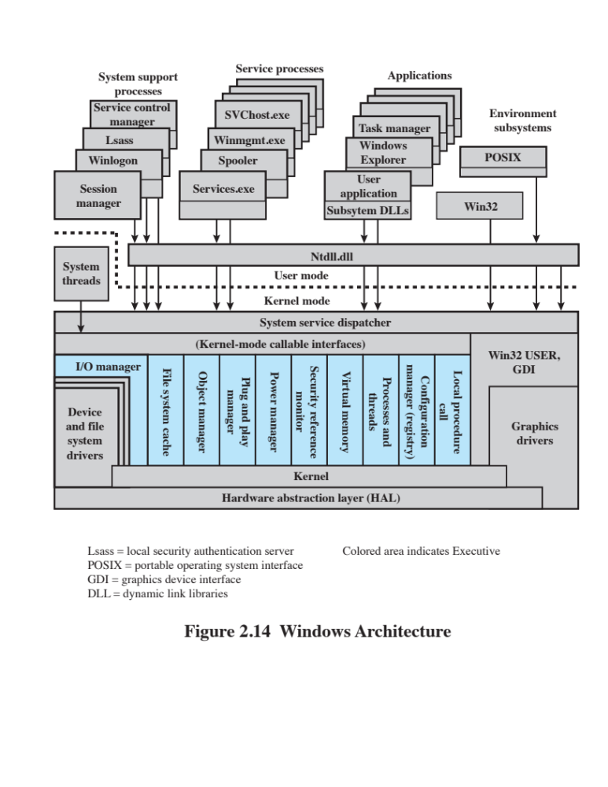
Notes:
Microsoft initially used the name Windows in 1985, for an operating environment
extension to the primitive MS-DOS operating system, which was a successful
OS used on early personal computers. This Windows/MS-DOS combination
was ultimately replaced by a new version of Windows, known as Windows NT,
first released in 1993, and intended for laptop and desktop systems. Although the
basic internal architecture has remained roughly the same since Windows NT, the
OS has continued to evolve with new functions and features. The latest release,
at the time of this writing, is Windows 10. Windows 10 incorporates features from
the preceding desktop/laptop release, Windows 8.1, as well as from versions of
Windows intended for mobile devices and small devices for the Internet of Things
(IoT). Windows 10 also incorporates software from the Xbox One system. The
resulting unified Windows 10 supports desktops, laptops, smart phones, tablets,
and Xbox One.
Figure 2.14 illustrates the overall structure of Windows. As with virtually all operating
systems, Windows separates application-oriented software from the core OS
software. The latter, which includes the Executive, the Kernel, device drivers, and
the hardware abstraction layer, runs in kernel mode. Kernel-mode software has access
to system data and to the hardware. The remaining software, running in user
mode, has limited access to system data.
Windows has a highly modular architecture.
Each system function is managed by just one component of the OS. The rest of the
OS and all applications access that function through the responsible component using
standard interfaces. Key system data can only be accessed through the appropriate
function. In principle, any module can be removed, upgraded, or replaced without
rewriting the entire system or its standard application program interfaces (APIs)

Slide 125
Kernel-Mode Components of Windows
Executive
    Contains the core OS services, such as memory management, process and thread management, security, I/O, and interprocess communication
Kernel
    Controls execution of the processors. The Kernel manages thread scheduling, process switching, exception and interrupt handling, and multiprocessor synchronization
Hardware Abstraction Layer (HAL)
    Maps between generic hardware commands and responses and those unique to a specific platform and isolates the OS from platform-specific hardware differences
Device Drivers
    Dynamic libraries that extend the functionality of the Executive. These include hardware device drivers that translate user I/O function calls into specific hardware device I/O requests and software components for implementing file systems, network protocols, and any other system extensions that need to run in kernel mode
Windowing and Graphics System
    Implements the GUI functions, such as dealing with windows, user interface controls, and drawing
Notes:
The kernel-mode components of Windows are the following:
• Executive: Contains the core OS services, such as memory management, process
and thread management, security, I/O, and interprocess communication.
• Kernel: Controls execution of the processors. The Kernel manages thread
scheduling, process switching, exception and interrupt handling, and multiprocessor
synchronization. Unlike the rest of the Executive and the user level,
the Kernel’s own code does not run in threads.
• Hardware abstraction layer (HAL): Maps between generic hardware commands
and responses and those unique to a specific platform. It isolates
the OS from platform-specific hardware differences. The HAL makes each
computer’s system bus, direct memory access (DMA) controller, interrupt
controller, system timers, and memory controller look the same to the
Executive and Kernel components. It also delivers the support needed for
SMP, explained subsequently.
• Device drivers: Dynamic libraries that extend the functionality of the
Executive. These include hardware device drivers that translate user I/O function
calls into specific hardware device I/O requests and software components
for implementing file systems, network protocols, and any other system extensions
that need to run in kernel mode.
• Windowing and graphics system: Implements the GUI functions, such as dealing
with windows, user interface controls, and drawing.
The Windows Executive includes components for specific system functions
and provides an API for user-mode software. Following is a brief description of
each of the Executive modules:
• I/O manager: Provides a framework through which I/O devices are accessible
to applications, and is responsible for dispatching to the appropriate device
drivers for further processing. The I/O manager implements all the Windows
I/O APIs and enforces security and naming for devices, network protocols,
and file systems (using the object manager). Windows I/O is discussed in
Chapter 11 .
• Cache manager: Improves the performance of file-based I/O by causing
recently referenced file data to reside in main memory for quick access, and
deferring disk writes by holding the updates in memory for a short time before
sending them to the disk in more efficient batches.
• Object manager: Creates, manages, and deletes Windows Executive objects
that are used to represent resources such as processes, threads, and synchronization
objects. It enforces uniform rules for retaining, naming, and setting the
security of objects. The object manager also creates the entries in each processes’
handle table, which consist of access control information and a pointer
to the object. Windows objects are discussed later in this section.
• Plug-and-play manager: Determines which drivers are required to support a
particular device and loads those drivers.
Power manager: Coordinates power management among various devices
and can be configured to reduce power consumption by shutting down idle
devices, putting the processor to sleep, and even writing all of memory to disk
and shutting off power to the entire system.
• Security reference monitor: Enforces access-validation and audit-generation
rules. The Windows object-oriented model allows for a consistent and uniform
view of security, right down to the fundamental entities that make up the
Executive. Thus, Windows uses the same routines for access validation and
for audit checks for all protected objects, including files, processes, address
spaces, and I/O devices. Windows security is discussed in Chapter 15 .
• Virtual memory manager: Manages virtual addresses, physical memory, and
the paging files on disk. Controls the memory management hardware and data
structures which map virtual addresses in the process’s address space to physical
pages in the computer’s memory. Windows virtual memory management is
described in Chapter 8 .
• Process/thread manager: Creates, manages, and deletes process and thread
objects. Windows process and thread management are described in Chapter 4 .
• Configuration manager: Responsible for implementing and managing the
system registry, which is the repository for both system-wide and per-user
settings of various parameters.
• Advanced local procedure call (ALPC) facility: Implements an efficient crossprocess
procedure call mechanism for communication between local processes
implementing services and subsystems. Similar to the remote procedure call
(RPC) facility used for distributed processing.

Slide 126
Windows Executive
I/O manager
Provides a framework through which I/O devices are accessible to applications, and is responsible for dispatching to the appropriate device drivers for further processing
Cache manager
Improves the performance of file-based I/O by causing recently referenced file data to reside in main memory for quick access, and by deferring disk writes by holding the updates in memory for a short time before sending them to the disk in more efficient batches
Object manager
Creates, manages, and deletes Windows Executive objects that are used to represent resources such as processes, threads, and synchronization objects and enforces uniform rules for retaining, naming, and setting the security of objects
Plug-and-play manager
Determines which drivers are required to support a particular device and loads those drivers
Power manager
Coordinates power management among devices
Notes:
The Windows Executive includes components for specific system functions and
provides an API for user-mode software. Following is a brief description of each of
the Executive modules:
• I/O manager: Provides a framework through which I/O devices are accessible
to applications, and is responsible for dispatching to the appropriate device
drivers for further processing. The I/O manager implements all the Windows
I/O APIs and enforces security and naming for devices, network protocols,
and file systems (using the object manager). Windows I/O is discussed in
Chapter 11.
• Cache manager: Improves the performance of file-based I/O by causing recently
referenced file data to reside in main memory for quick access, and by deferring
disk writes by holding the updates in memory for a short time before sending
them to the disk in more efficient batches.
• Object manager: Creates, manages, and deletes Windows Executive objects that
are used to represent resources such as processes, threads, and synchronization
objects. It enforces uniform rules for retaining, naming, and setting the security
of objects. The object manager also creates the entries in each process’s handle
table, which consist of access control information and a pointer to the object.
Windows objects are discussed later in this section.
• Plug-and-play manager: Determines which drivers are required to support a
particular device and loads those drivers.
• Power manager: Coordinates power management among various devices and
can be configured to reduce power consumption by shutting down idle devices,
putting the processor to sleep, and even writing all of memory to disk and shutting
off power to the entire system.

Slide 127
Windows Executive
Security reference monitor
Enforces access-validation and audit-generation rules
Virtual memory manager
Manages virtual addresses, physical memory, and the paging files on disk and controls the memory management hardware and data structures which map virtual addresses in the process’s address space to physical pages in the computer’s memory
Process/thread manager
Creates, manages, and deletes process and thread objects
Configuration manager
Responsible for implementing and managing the system registry, which is the repository for both system-wide and per-user settings of various parameters
Advanced local procedure call (ALPC) facility
Implements an efficient cross-process procedure call mechanism for communication between local processes implementing services and subsystems
Notes:
• Security reference monitor: Enforces access-validation and audit-generation
rules. The Windows object-oriented model allows for a consistent and uniform
view of security, right down to the fundamental entities that make up the Executive.
Thus, Windows uses the same routines for access validation and for audit
checks for all protected objects, including files, processes, address spaces, and
I/O devices. Windows security is discussed in Chapter 15.
• Virtual memory manager: Manages virtual addresses, physical memory, and
the paging files on disk. Controls the memory management hardware and data
structures which map virtual addresses in the process’s address space to physical
pages in the computer’s memory. Windows virtual memory management is
described in Chapter 8.
• Process/thread manager: Creates, manages, and deletes process and thread
objects. Windows process and thread management are described in Chapter 4.
• Configuration manager: Responsible for implementing and managing the system
registry, which is the repository for both system-wide and per-user settings
of various parameters.
• Advanced local procedure call (ALPC) facility: Implements an efficient cross-process
procedure call mechanism for communication between local processes
implementing services and subsystems. Similar to the remote procedure call
(RPC) facility used for distributed processing.

Slide 128
User-Mode Processes
Windows supports four basic types of user-mode processes:
Special System Processes
User-mode services needed to manage the system
Service Processes
The printer spooler, event logger, and user-mode components that cooperate with device drivers, and various network services
Environment Subsystems
Provide different OS personalities (environments)
User Applications
Executables (EXEs) and DLLs that provide the functionality users run to make use of the system
Notes:
USER-MODE PROCESSES
Four basic types of user-mode processes are supported by Windows:
• Special system processes: User-mode services needed to manage the system,
such as the session manager, the authentication subsystem, the service manager,
and the logon process.
• Service processes: The printer spooler, the event logger, user-mode components
that cooperate with device drivers, various network services, and many,
many others. Services are used by both Microsoft and external software developers
to extend system functionality as they are the only way to run background
user-mode activity on a Windows system.
• Environment subsystems: Provide different OS personalities (environments).
The supported subsystems are Win32 and POSIX. Each environment subsystem
includes a subsystem process shared among all applications using the
subsystem and dynamic link libraries (DLLs) that convert the user application
calls to ALPC calls on the subsystem process, and/or native Windows calls.
• User applications: Executables (EXEs) and DLLs that provide the functionality
users run to make use of the system. EXEs and DLLs are generally targeted
at a specific environment subsystem; although some of the programs that are
provided as part of the OS use the native system interfaces (NT API). There is
also support for running 32-bit programs on 64-bit systems.

Slide 129
Client/Server Model
Windows OS services, environmental subsystems, and applications are all structured using the client/server model
  Common in distributed systems, but can be used internal to a single system
  Processes communicate via RPC
Advantages:
  It simplifies the Executive
  It improves reliability
  It provides a uniform means for applications to communicate with services via RPCs without restricting flexibility
  It provides a suitable base for distributed computing
Notes:
The Windows OS services, the environment subsystems, and the applications are
structured using the client/server computing model, which is a common model for
distributed computing and which is discussed in Part Six. This same architecture can
be adopted for use internally to a single system, as is the case with Windows.
The native NT API is a set of kernel-based services which provide the core
abstractions used by the system, such as processes, threads, virtual memory, I/O,
and communication. Windows provides a far richer set of services by using the
client/server model to implement functionality in user-mode processes. Both the
environment subsystems and the Windows user-mode services are implemented as
processes that communicate with clients via RPC. Each server process waits for a
request from a client for one of its services (e.g., memory services, process creation
services, or networking services). A client, which can be an application program
or another server program, requests a service by sending a message. The message
is routed through the Executive to the appropriate server. The server performs
the requested operation and returns the results or status information by means of
another message, which is routed through the Executive back to the client.
Advantages of a client/server architecture include the following:
• It simplifies the Executive. It is possible to construct a variety of APIs implemented
in user-mode servers without any conflicts or duplications in the
Executive. New APIs can be added easily.
• It improves reliability. Each new server runs outside of the kernel, with its
own partition of memory, protected from other servers. A single server can
fail without crashing or corrupting the rest of the OS.
• It provides a uniform means for applications to communicate with services via
RPCs without restricting flexibility. The message-passing process is hidden
from the client applications by function stubs, which are small pieces of code
which wrap the RPC call. When an application makes an API call to an environment
subsystem or a service, the stub in the client application packages the
parameters for the call and sends them as a message to the server process that
implements the call.
• It provides a suitable base for distributed computing. Typically, distributed
computing makes use of a client/server model, with remote procedure calls
implemented using distributed client and server modules and the exchange of
messages between clients and servers. With Windows, a local server can pass
a message on to a remote server for processing on behalf of local client applications.
Clients need not know whether a request is being serviced locally or
remotely. Indeed, whether a request is serviced locally or remotely can change
dynamically based on current load conditions and on dynamic configuration
changes.

Slide 130
Threads and SMP
Two important characteristics of Windows are its support for threads and for symmetric multiprocessing (SMP)
  OS routines can run on any available processor, and different routines can execute simultaneously on different processors
  Windows supports the use of multiple threads of execution within a single process. Multiple threads within the same process may execute on different processors simultaneously
  Server processes may use multiple threads to process requests from more than one client simultaneously
  Windows provides mechanisms for sharing data and resources between processes and flexible interprocess communication capabilities
Notes:
Two important characteristics of Windows are its support for threads and for
symmetric multiprocessing (SMP), both of which were introduced in Section 2.4 .
[RUSS11] lists the following features of Windows that support threads and SMP:
• OS routines can run on any available processor, and different routines can
execute simultaneously on different processors.
• Windows supports the use of multiple threads of execution within a single
process. Multiple threads within the same process may execute on different
processors simultaneously.
• Server processes may use multiple threads to process requests from more than
one client simultaneously.
• Windows provides mechanisms for sharing data and resources between processes
and flexible interprocess communication capabilities.

Slide 131
Windows Objects
Encapsulation
Object class and instance
Inheritance
Polymorphism
Windows draws heavily on the concepts of object-oriented design
Key object-oriented concepts used by Windows are:
Notes:
Though the core of Windows is written in C, the design principles followed draw
heavily on the concepts of object-oriented design. This approach facilitates the sharing
of resources and data among processes and the protection of resources from
unauthorized access. Among the key object-oriented concepts used by Windows are
the following:
• Encapsulation: An object consists of one or more items of data, called
attributes, and one or more procedures that may be performed on those data,
called services. The only way to access the data in an object is by invoking one
of the object’s services. Thus, the data in the object can easily be protected
from unauthorized use and from incorrect use (e.g., trying to execute a nonexecutable
piece of data).
• Object class and instance: An object class is a template that lists the attributes
and services of an object and defines certain object characteristics. The OS can
create specific instances of an object class as needed. For example, there is a
single process object class and one process object for every currently active
process. This approach simplifies object creation and management.
• Inheritance: Although the implementation is hand coded, the Executive uses
inheritance to extend object classes by adding new features. Every Executive
class is based on a base class which specifies virtual methods that support
creating, naming, securing, and deleting objects. Dispatcher objects are
Executive objects that inherit the properties of an event object, so they can
use common synchronization methods. Other specific object types, such as the
device class, allow classes for specific devices to inherit from the base class,
and add additional data and methods.
• Polymorphism: Internally, Windows uses a common set of API functions to
manipulate objects of any type; this is a feature of polymorphism, as defined
in Appendix D . However, Windows is not completely polymorphic because
there are many APIs that are specific to a single object type.

Slide 132
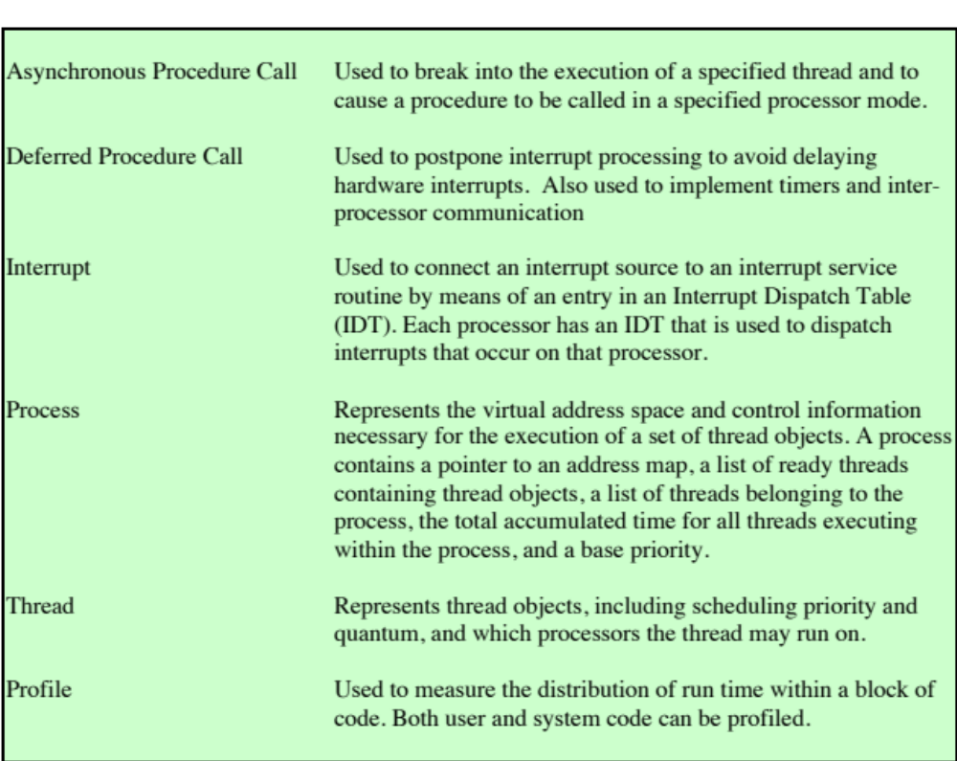
Windows Kernel Control Objects
Notes:
There are two categories of objects used by Windows for synchronizing the
use of the processor:
• Dispatcher objects: The subset of Executive objects which threads can wait on
to control the dispatching and synchronization of thread-based system operations.
These are described in Chapter 6 .
• Control objects: Used by the Kernel component to manage the operation of
the processor in areas not managed by normal thread scheduling. Table 2.5
lists the Kernel control objects.
Windows is not a full-blown object-oriented OS. It is not implemented in
an object-oriented language. Data structures that reside completely within one
Executive component are not represented as objects. Nevertheless, Windows illustrates
the power of object-oriented technology and represents the increasing trend
toward the use of this technology in OS design.

Slide 133
Traditional UNIX Systems
Developed at Bell Labs and became operational on a PDP-7 in 1970
The first notable milestone was porting the UNIX system from the PDP-7 to the PDP-11
    First showed that UNIX would be an OS for all computers
Next milestone was rewriting UNIX in the programming language C
    Demonstrated the advantages of using a high-level language for system code
    Was described in a technical journal for the first time in 1974
    First widely available version outside Bell Labs was Version 6 in 1976
    Version 7, released in 1978, is the ancestor of most modern UNIX systems
    Most important of the non-AT&T systems was UNIX BSD (Berkeley Software Distribution), running first on PDP and then on VAX computers
Notes:
UNIX was initially developed at Bell Labs and became operational on a PDP-7
in 1970. Work on UNIX at Bell Labs, and later elsewhere, produced a series of versions
of UNIX. The first notable milestone was porting the UNIX system from the
PDP-7 to the PDP-11. This was the first hint that UNIX would be an OS for all
computers. The next important milestone was the rewriting of UNIX in the programming
language C. This was an unheard-of strategy at the time. It was generally felt
that something as complex as an OS, which must deal with time-critical events, had
to be written exclusively in assembly language. Reasons for this attitude include the
following:
• Memory (both RAM and secondary store) was small and expensive by today’s
standards, so effective use was important. This included various techniques for
overlaying memory with different code and data segments, and self-modifying
code.
• Even though compilers had been available since the 1950s, the computer
industry was generally skeptical of the quality of automatically generated
code. With resource capacity small, efficient code, both in terms of time and
space, was essential.
• Processor and bus speeds were relatively slow, so saving clock cycles could
make a substantial difference in execution time.
The C implementation demonstrated the advantages of using a high-level
language for most if not all of the system code. Today, virtually all UNIX implementations
are written in C.
These early versions of UNIX were popular within Bell Labs. In 1974, the
UNIX system was described in a technical journal for the first time [RITC74]. This
spurred great interest in the system. Licenses for UNIX were provided to commercial
institutions as well as universities. The first widely available version outside Bell
Labs was Version 6, in 1976. The follow-on Version 7, released in 1978, is the ancestor
of most modern UNIX systems. The most important of the non-AT&T systems
to be developed was done at the University of California at Berkeley, called UNIX
BSD (Berkeley Software Distribution), running first on PDP and then VAX computers.
AT&T continued to develop and refine the system. By 1982, Bell Labs had
combined several AT&T variants of UNIX into a single system, marketed commercially
as UNIX System III. A number of features was later added to the OS to
produce UNIX System V.

Slide 134
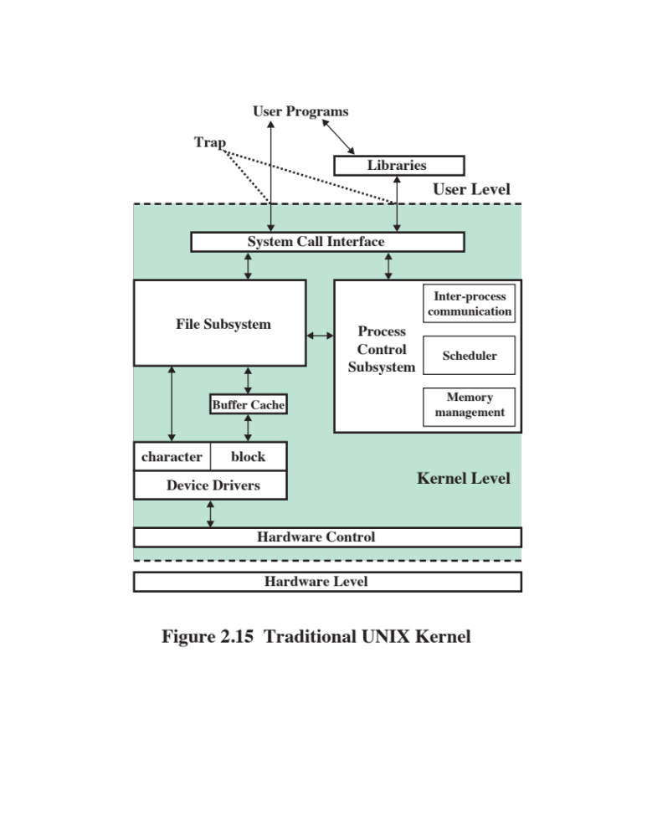
Notes:
The classic UNIX architecture can be pictured as in three levels: hardware, kernel,
and user. The OS is often called the system kernel, or simply the kernel, to emphasize
its isolation from the user and applications. It interacts directly with the hardware. It is
the UNIX kernel that we will be concerned with in our use of UNIX as an example in
this book. UNIX also comes equipped with a number of user services and interfaces
that are considered part of the system. These can be grouped into the shell, which
supports system calls from applications, other interface software, and the components
of the C compiler (compiler, assembler, loader). The level above this consists of user
applications and the user interface to the C compiler.
A look at the kernel is provided in Figure 2.15. User programs can invoke OS
services either directly or through library programs. The system call interface is the
boundary with the user and allows higher-level software to gain access to specific
kernel functions. At the other end, the OS contains primitive routines that interact
directly with the hardware. Between these two interfaces, the system is divided into
two main parts, one concerned with process control and the other concerned with file
management and I/O. The process control subsystem is responsible for memory management,
the scheduling and dispatching of processes, and the synchronization and
interprocess communication of processes. The file system exchanges data between
memory and external devices either as a stream of characters or in blocks. To achieve
this, a variety of device drivers are used. For block-oriented transfers, a disk cache
approach is used: A system buffer in main memory is interposed between the user
address space and the external device.
The description in this subsection has dealt with what might be termed traditional
UNIX systems ; [VAHA96] uses this term to refer to System V Release 3
(SVR3), 4.3BSD, and earlier versions. The following general statements may be made
about a traditional UNIX system. It is designed to run on a single processor and lacks
the ability to protect its data structures from concurrent access by multiple processors.
Its kernel is not very versatile, supporting a single type of file system, process scheduling
policy, and executable file format. The traditional UNIX kernel is not designed to
be extensible and has few facilities for code reuse. The result is that, as new features
were added to the various UNIX versions, much new code had to be added, yielding
a bloated and unmodular kernel.

Slide 135
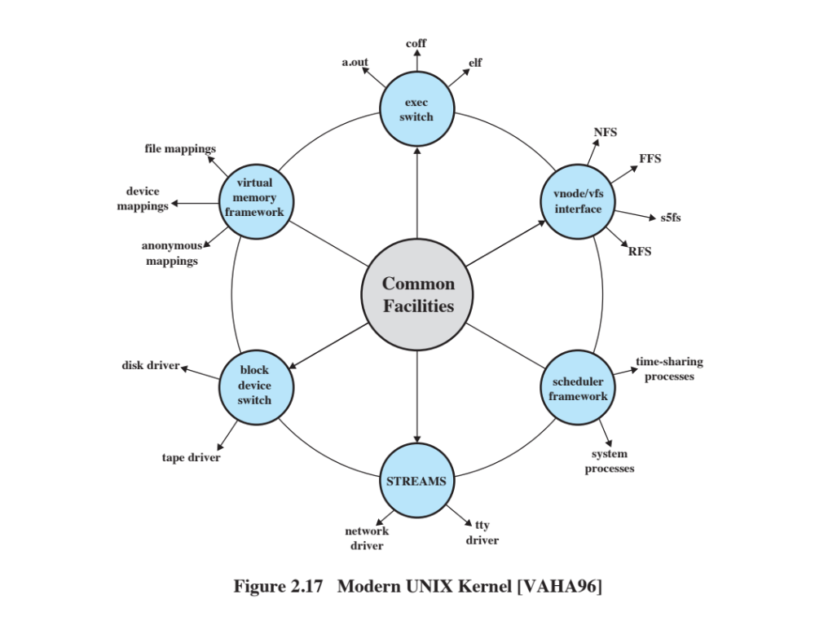
Figure 2.16 Modern UNIX Kernel
Notes:
As UNIX evolved, the number of different implementations proliferated, each providing
some useful features. There was a need to produce a new implementation that
unified many of the important innovations, added other modern OS design features,
and produced a more modular architecture. Typical of the modern UNIX kernel is
the architecture depicted in Figure 2.16 . There is a small core of facilities, written in
a modular fashion, that provide functions and services needed by a number of OS
processes. Each of the outer circles represents functions and an interface that may
be implemented in a variety of ways.

Slide 136

Notes:
Some examples of modern UNIX systems (see Figure 2.17).

Slide 137
System V Release 4 (SVR4)
Developed jointly by AT&T and Sun Microsystems
Combines features from SVR3, 4.3BSD, Microsoft Xenix System V, and SunOS
New features in the release include:
    Real-time processing support
    Process scheduling classes
    Dynamically allocated data structures
    Virtual memory management
    Virtual file system
    Preemptive kernel
Notes:
SVR4, developed jointly by AT&T and Sun Microsystems, combines features from
SVR3, 4.3BSD, Microsoft Xenix System V, and SunOS. It was almost a total rewrite
of the System V kernel and produced a clean, if complex, implementation. New features
in the release include real-time processing support, process scheduling classes,
dynamically allocated data structures, virtual memory management, virtual file system,
and a preemptive kernel.
SVR4 draws on the efforts of both commercial and academic designers and
was developed to provide a uniform platform for commercial UNIX deployment. It
has succeeded in this objective and is perhaps the most important UNIX variant. It
incorporates most of the important features ever developed on any UNIX system
and does so in an integrated, commercially viable fashion. SVR4 runs on processors
ranging from 32-bit microprocessors up to supercomputers.

Slide 138
BSD
Berkeley Software Distribution
4.xBSD is widely used in academic installations and has served as the basis of a number of commercial UNIX products
4.4BSD was the final version of BSD to be released by Berkeley
There are several widely used, open-source versions of BSD
    FreeBSD
        Popular for Internet-based servers and firewalls
        Used in a number of embedded systems
    NetBSD
        Available for many platforms
        Often used in embedded systems
    OpenBSD
        An open-source OS that places special emphasis on security
Notes:
The Berkeley Software Distribution (BSD) series of UNIX releases have played
a key role in the development of OS design theory. 4.xBSD is widely used in academic
installations and has served as the basis of a number of commercial UNIX
products. It is probably safe to say that BSD is responsible for much of the popularity
of UNIX and that most enhancements to UNIX first appeared in BSD versions.
4.4BSD was the final version of BSD to be released by Berkeley, with the design
and implementation organization subsequently dissolved. It is a major upgrade
to 4.3BSD and includes a new virtual memory system, changes in the kernel structure,
and a long list of other feature enhancements.
There are several widely used, open-source versions of BSD. FreeBSD
is popular for Internet-based servers and firewalls and is used in a number of
embedded systems. NetBSD is available for many platforms, including largescale
server systems, desktop systems, and handheld devices, and is often used in
embedded systems. OpenBSD is an open-source OS that places special emphasis
on security.
The latest version of the Macintosh OS, Mac OS X, is based on FreeBSD 5.0
and the Mach 3.0 microkernel.

Slide 139
Solaris 11
Oracle’s SVR4-based UNIX release
Provides all of the features of SVR4 plus a number of more advanced features such as:
    A fully preemptable, multithreaded kernel
    Full support for SMP
    An object-oriented interface to file systems
Notes:
Solaris is Oracle’s SVR4-based UNIX release, with the latest version being 11. Solaris
provides all of the features of SVR4 plus a number of more advanced features, such
as a fully preemptable, multithreaded kernel, full support for SMP, and an object oriented
interface to file systems.

Slide 140
LINUX Overview
Started out as a UNIX variant for the IBM PC
Linus Torvalds, a Finnish student of computer science, wrote the initial version
Linux was first posted on the Internet in 1991
Today it is a full-featured UNIX system that runs on virtually all platforms
Is free and the source code is available
Key to the success of Linux has been the availability of free software packages under the auspices of the Free Software Foundation (FSF)
Highly modular and easily configured
Notes:
Linux started out as a UNIX variant for the IBM PC (Intel 80386) architecture. Linus
Torvalds, a Finnish student of computer science, wrote the initial version. Torvalds
posted an early version of Linux on the Internet in 1991. Since then, a number of people,
collaborating over the Internet, have contributed to the development of Linux, all
under the control of Torvalds. Because Linux is free and the source code is available,
it became an early alternative to other UNIX workstations, such as those offered by
Sun Microsystems and IBM. Today, Linux is a full-featured UNIX system that runs
on virtually all platforms.
Key to the success of Linux has been the availability of free software packages
under the auspices of the Free Software Foundation (FSF). FSF’s goal is stable, platform-
independent software that is free, high quality, and embraced by the user community.
FSF’s GNU project² provides tools for software developers, and the GNU
Public License (GPL) is the FSF seal of approval. Torvalds used GNU tools in developing
his kernel, which he then released under the GPL. Thus, the Linux distributions
that you see today are the product of FSF’s GNU project, Torvald’s individual effort,
and the efforts of many collaborators all over the world.
In addition to its use by many individual developers, Linux has now made significant
penetration into the corporate world. This is not only because of the free
software but also because of the quality of the Linux kernel. Many talented developers
have contributed to the current version, resulting in a technically impressive
product. Moreover, Linux is highly modular and easily configured. This makes it easy
to squeeze optimal performance from a variety of hardware platforms. Plus, with the
source code available, vendors can tweak applications and utilities to meet specific
requirements. There are also commercial companies like Red Hat and Canonical,
which provide highly professional and reliable support for their Linux-based distributions
for long periods of time. Throughout this book, we will provide details of Linux
kernel internals based on Linux kernel 4.7, released in 2016.
A large part of the success of the Linux Operating System is due to its development
model. Code contributions are handled by one main mailing list, called LKML
(Linux Kernel Mailing List). Apart from it, there are many other mailing lists, each
dedicated to a Linux kernel subsystem (like the netdev mailing list for networking,
the linux-pci for the PCI subsystem, the linux-acpi for the ACPI subsystem, and a
great many more). The patches which are sent to these mailing lists should adhere to
strict rules (primarily the Linux Kernel coding style conventions), and are reviewed
by developers all over the world who are subscribed to these mailing lists. Anyone
can send patches to these mailing lists; statistics (for example, those published in
the lwn.net site from time to time) show that many patches are sent by developers
from big famous commercial companies like Intel, Red Hat, Google, Samsung, and
more. Also many maintainers are employees of commercial companies (like David
Miller, the network maintainer, who works for Red Hat). Many times such patches
are fixed according to feedback and discussions over the mailing list, and are resent
and reviewed again. Eventually the maintainer decides whether to accept or reject
patches; and each subsystem maintainer sends from time to time a pull request of
his tree to the main kernel tree, which is handled by Linus Torvalds. Linus himself
releases a new kernel version in about every 7–10 weeks, and each such release has
about 5–8 release candidates (RC) versions.
We should mention that it is interesting to try to understand why other opensource
operating systems, like various flavors of BSD or OpenSolaris, did not have the
success and popularity which Linux has; there can be many reasons for that; and for
sure, the openness of the development model of Linux contributed to its popularity
and success; but this topic is out of the scope of this book.

Slide 141
Modular Structure
Loadable Modules
Linux development is global and done by a loosely associated group of independent developers
Although Linux does not use a microkernel approach, it achieves many of the potential advantages of the approach by means of its particular modular architecture
Linux is structured as a collection of modules, a number of which can be automatically loaded and unloaded on demand
Relatively independent blocks
A module is an object file whose code can be linked to and unlinked from the kernel at runtime
A module is executed in kernel mode on behalf of the current process
Have two important characteristics:
    Dynamic linking
    Stackable modules
Notes:
Most UNIX kernels are monolithic. Recall from earlier in this chapter that a monolithic
kernel is one that includes virtually all of the OS functionality in one large block
of code that runs as a single process with a single address space. All the functional
components of the kernel have access to all of its internal data structures and routines.
If changes are made to any portion of a typical monolithic OS, all the modules and
routines must be relinked and reinstalled and the system rebooted before the changes
can take effect. As a result, any modification, such as adding a new device driver or file
system function, is difficult. This problem is especially acute for Linux, for which development
is global and done by a loosely associated group of independent developers.
Although Linux does not use a microkernel approach, it achieves many of the
potential advantages of this approach by means of its particular modular architecture.
Linux is structured as a collection of modules, a number of which can be automatically
loaded and unloaded on demand. These relatively independent blocks are
referred to as loadable modules [GOYE99]. In essence, a module is an object file
whose code can be linked to and unlinked from the kernel at runtime. Typically, a
module implements some specific function, such as a file system, a device driver, or
some other feature of the kernel’s upper layer. A module does not execute as its own
process or thread, although it can create kernel threads for various purposes as necessary.
Rather, a module is executed in kernel mode on behalf of the current process.
Thus, although Linux may be considered monolithic, its modular structure overcomes
some of the difficulties in developing and evolving the kernel.
The Linux loadable modules have two important characteristics:
Dynamic linking: A kernel module can be loaded and linked into the kernel while the kernel is already in memory and executing.
A module can also be unlinked and removed from memory at any time.
Saves kernel memory.
Stackable modules: The modules are arranged in a hierarchy.
Individual modules serve as libraries when they are referenced by client modules higher up in the hierarchy, and as clients when they reference modules further down.
Dynamic linking [FRAN97] facilitates configuration and saves kernel memory.
In Linux, a user program or user can explicitly load and unload kernel modules using
the insmod or modprobe and rmmod commands. The kernel itself monitors the need
for particular functions and can load and unload modules as needed. With stackable
modules, dependencies between modules can be defined. This has two benefits:
1. Code common to a set of similar modules (e.g., drivers for similar hardware)
can be moved into a single module, reducing replication.
2. The kernel can make sure that needed modules are present, refraining from
unloading a module on which other running modules depend, and loading any
additional required modules when a new module is loaded.

Slide 142

Notes:
Figure 2.18 is an example that illustrates the structures used by Linux to manage
modules. The figure shows the list of kernel modules after only two modules have been
loaded: FAT and VFAT. Each module is defined by two tables: the module table and
the symbol table (kernel_symbol). The module table includes the following elements:
• *name: The module name
• refcnt: Module counter. The counter is incremented when an operation involving
the module’s functions is started and decremented when the operation
terminates.
• num_syms: Number of exported symbols.
• *syms: Pointer to this module’s symbol table.
The symbol table lists symbols that are defined in this module and used
elsewhere.

Slide 143

Notes:
Figure 2.19, taken from [MOSB02], shows the main components of a typical Linux
kernel implementation. The figure shows several processes running on top of the kernel.
Each box indicates a separate process, while each squiggly line with an arrowhead
represents a thread of execution. The kernel itself consists of an interacting collection
of components, with arrows indicating the main interactions. The underlying hardware
is also depicted as a set of components with arrows indicating which kernel components
use or control which hardware components. All of the kernel components, of
course, execute on the processor but, for simplicity, these relationships are not shown.

Slide 144

Linux Signals
Table 2.6 Some Linux Signals
Notes:
Briefly, the principal kernel components are the following:
• Signals: The kernel uses signals to call into a process. For example, signals are
used to notify a process of certain faults, such as division by zero. Table 2.6 gives
a few examples of signals.

Slide 145

Table 2.7 Some Linux System Calls (page 1 of 2)
Notes:
• System calls: The system call is the means by which a process requests a specific
kernel service. There are several hundred system calls, which can be roughly
grouped into six categories: file system, process, scheduling, interprocess communication,
socket (networking), and miscellaneous. Table 2.7 defines a few
examples in each category.
• Processes and scheduler: Creates, manages, and schedules processes.
• Virtual memory: Allocates and manages virtual memory for processes.
• File systems: Provide a global, hierarchical namespace for files, directories, and
other file-related objects and provide file system functions.
• Network protocols: Support the Sockets interface to users for the TCP/IP protocol
suite.
• Character device drivers: Manage devices that require the kernel to send or
receive data one byte at a time, such as terminals, modems, and printers.
• Block device drivers: Manage devices that read and write data in blocks, such
as various forms of secondary memory (magnetic disks, CD-ROMs, etc.).
• Network device drivers: Manage network interface cards and communications
ports that connect to network devices, such as bridges and routers.
• Traps and faults: Handle traps and faults generated by the processor, such as
a memory fault.
• Physical memory: Manages the pool of page frames in real memory and allocates
pages for virtual memory.
• Interrupts Handle interrupts from peripheral devices.

Slide 146

Table 2.7 Some Linux System Calls (page 2 of 2)

Slide 147
Android Operating System
A Linux-based system originally designed for mobile phones
The most popular mobile OS
Development was done by Android Inc., which was bought by Google in 2005
1st commercial version (Android 1.0) was released in 2008
Most recent version is Android 7.0 (Nougat)
Android has an active community of developers and enthusiasts who use the Android Open Source Project (AOSP) source code to develop and distribute their own modified versions of the operating system
The open-source nature of Android has been the key to its success
Notes:
The Android operating system is a Linux-based system originally designed for
touchscreen mobile devices such as smartphones and tablet computers. It is the most
popular mobile OS by a wide margin: Android handsets outsell Apple’s iPhones
globally by about 4 to 1 [MORR16]. But this is just one element in the increasing
dominance of Android: Increasingly, it is the OS behind virtually any device with a
computer chip other than servers and PCs. Android is a widely used
OS for the “Internet of things,” a term that refers to the expanding interconnection
of smart devices, ranging from appliances to tiny sensors.
Initial Android OS development was done by Android, Inc., which was bought
by Google in 2005. The first commercial version, Android 1.0, was released in 2008.
As of this writing, the most recent version is Android 7.0 (Nougat). Android has an
active community of developers and enthusiasts who use the Android Open Source
Project (AOSP) source code to develop and distribute their own modified versions
of the operating system. The open-source nature of Android has been the key to its
success.

Slide 148

Notes:
Android is defined as a software stack that includes a modified version of the Linux
kernel, middleware, and key applications. Figure 2.20 shows the Android software
architecture in some detail. Thus, Android should be viewed as a complete software
stack–not just an OS.
All the applications that the user interacts with directly are part
of the application layer. This includes a core set of general-purpose applications,
such as an e-mail client, SMS program, calendar, maps, browser, contacts, and other
applications commonly standard with any mobile device. Applications are typically
implemented in Java. A key goal of the open-source Android architecture is to make
it easy for developers to implement new applications for specific devices and specific
end user requirements. Using Java enables developers to be relieved of hardware specific
considerations and idiosyncrasies, as well as tap into Java’s higher-level
language features, such as predefined classes. Figure 2.20 shows examples of the
types of base applications found on an Android platform.

Slide 149
Application Framework
Provides high-level building blocks accessible through standardized API’s that programmers use to create new apps
  Architecture is designed to simplify the reuse of components
Key components:
Activity Manager
Manages lifecycle of applications
Responsible for starting, stopping, and resuming the various applications
Window Manager
Java abstraction of the underlying Surface Manager
Allows applications to declare their client area and use features like the status bar
Package Manager
Installs and removes applications
Telephony Manager
Allows interaction with phone, SMS, and MMS services
Notes:
The Application Framework layer provides high-level
building blocks, accessible through standardized APIs, that programmers use to
create new apps. The architecture is designed to simplify the reuse of components.
Some of the key Application Framework components are:
• Activity Manager: Manages lifecycle of applications. It is responsible for starting,
stopping, and resuming the various applications.
• Window Manager: Java abstraction of the underlying Surface Manager. The
Surface Manager handles the frame buffer interaction and low-level drawing,
whereas the Window Manager provides a layer on top of it, to allow applications
to declare their client area and use features like the status bar.
• Package Manager: Installs and removes applications
• Telephony Manager: Allows interaction with phone, SMS, and MMS services

Slide 150
Application Framework
(cont.)
Content Providers
These functions encapsulate application data that need to be shared between applications such as contacts
Resource Manager
Manages application resources, such as localized strings and bitmaps
View System
Provides the user interface (UI) primitives as well as UI Events
Location Manager
Allows developers to tap into location-based services, whether by GPS, cell tower IDs, or local Wi-Fi databases
Notification Manager
Manages events, such as arriving messages and appointments
XMPP
Provides standardized messaging functions between applications
Notes:
• Content Providers: These functions encapsulate application data that need to
be shared between applications, such as contacts.
Resource Manager: Manages application resources, such as localized strings
and bitmaps
• View System: Provides the user interface (UI) primitives, such as Buttons, listboxes,
date pickers, and other controls, as well as UI Events (such as touch
and gestures)
• Location Manager: Allows developers to tap into location-based services,
whether by GPS, cell tower IDs, or local Wi-Fi databases
• Notification Manager: Manages events, such as arriving messages and
appointments
• XMPP: Provides standardized messaging (also, Chat) functions between
applications

Slide 151
System Libraries
Collection of useful system functions written in C or C++ and used by various components of the Android system
Called from the application framework and applications through a Java interface
Exposed to developers through the Android application framework
Some of the key system libraries include:
    Surface Manager
    OpenGL
    Media Framework
    SQL Database
    Browser Engine
    Bionic LibC
Notes:
The layer below the Application Framework consists of two
parts: System Libraries and Android Runtime. The System Libraries component
is a collection of useful system functions, written in C or C++ and used by various
components of the Android system. They are called from the application framework
and applications through a Java interface. These features are exposed to developers
through the Android application framework. Some of the key system libraries
include the following:
• Surface Manager: Android uses a compositing window manager similar to
Vista or Compiz, but it is much simpler. Instead of drawing directly to the
screen buffer, your drawing commands go into off-screen bitmaps that are then
combined with other bitmaps to form the display the user sees. This lets the
system create all sorts of interesting effects such as see-through windows and
fancy transitions.
• OpenGL: OpenGL (Open Graphics Library) is a cross-language, multiplatform
API for rendering 2D and 3D computer graphics. OpenGL/ES (OpenGL for
embedded systems) is a subset of OpenGL designed for embedded systems.
• Media Framework: The Media Framework supports video recording and playing
in many formats, including AAC, AVC (H.264), H.263, MP3, and MPEG-4.
• SQL Database: Android includes a lightweight SQLite database engine, for
storing persistent data. SQLite is discussed in a subsequent section.
• Browser Engine: For fast display of HTML content, Android uses the WebKit
library, which is essentially the same library used in Safari and iPhone. It was also
the library used for the Google Chrome browser until Google switched to Blink.
• Bionic LibC: This is a stripped-down version of the standard C system library,
tuned for embedded Linux-based devices. The interface is the standard Java
Native Interface (JNI).

Slide 152
Android Runtime
Most Android software is mapped into a bytecode format which is then transformed into native instructions on the device itself
Earlier releases of Android used a scheme known as Dalvik, however Dalvik has a number of limitations in terms of scaling up to larger memories and multicore architectures
More recent releases of Android rely on a scheme known as Android runtime (ART)
ART is fully compatible with Dalvik’s existing bytecode format so application developers do not need to change their coding to be executable under ART
Each Android application runs in its own process, with its own instance of the Dalvik VM
Notes:
Most operating systems used on mobile devices, such as iOS and Windows, use software
that is compiled directly to the specific hardware platform. In contrast, most
Android software is mapped into a bytecode format, which is then transformed into
native instructions on the device itself. Earlier releases of Android used a scheme
known as Dalvik. However, Dalvik has a number of limitations in terms of scaling up
to larger memories and multicore architectures, so more recent releases of Android
rely on a scheme known as Android runtime (ART). ART is fully compatible with
Dalvik’s existing bytecode format, dex (Dalvik Executable), so application developers
do not need to change their coding to be executable under ART. We first look at
Dalvik and then examine ART.
The Dalvik VM (DVM) executes files in the
.dex format, a format that is optimized for efficient storage and memory-mappable
execution. The VM can run classes compiled by a Java language compiler that
have been transformed into its native format using the included “dx” tool. The VM
runs on top of Linux kernel, which it relies on for underlying functionality (such
as threading and low-level memory management). The Dalvik core class library is
intended to provide a familiar development base for those used to programming
with Java Standard Edition, but it is geared specifically to the needs of a small
mobile device.
Each Android application runs in its own process, with its own instance of
the Dalvik VM. Dalvik has been written so that a device can run multiple VMs
efficiently.
The DVM runs applications and code written in Java. A
standard Java compiler turns source code (written as text files) into bytecode. The
bytecode is then compiled into a .dex file that the DVM can read and use. In essence,
class files are converted into .dex files (much like a jar file if one were using the
standard Java VM) and then read and executed by the DVM. Duplicate data used
in class files are included only once in the .dex file, which saves space and uses less
overhead. The executable files can be modified again when an application is installed
to make things even more optimized for mobile.
ART is the current application runtime used by
Android, introduced with Android version 4.4 (KitKat). When Android was designed
initially, it was designed for single core (with minimal multithreading support in hardware)
and low-memory devices, for which, Dalvik seemed a suitable runtime. However, in
recent times, the devices that run Android have multicore processors and more memory
(at a relatively cheaper cost), which made Google to re-think the runtime design
to provide developers/users a richer/smoother experience by making use of the
available high-end hardware.

Slide 153

Notes:
For both Dalvik and ART, all Android applications written in Java are compiled
to dex bytecode. While Dalvik uses dex bytecode format for portability, it has
to be converted (compiled) to machine code to be actually run by a processor. The
Dalvik runtime did this conversion from dex bytecode to native machine code when
the application ran, and this process was called JIT (just-in-time compilation). Since
JIT compiles only a part of the code, it has a smaller memory footprint and uses less
physical space on the device. (Only the dex files are stored in the permanent storage
as opposed to the actual machine code.) Dalvik identifies the section of code that
runs frequently and caches the compiled code for this once, so that the subsequent
executions of this section of code are faster. The pages of physical memory that store
the cached code are not swappable/pageable; so this also adds a bit to the memory
pressure if the system is already in such a state. Even with these optimizations, Dalvik
has to do JIT-compilation every time the app is run, which consumes a considerable
amount of processor resources. Note that the processor is not only being used for
actually running the app but also for converting the dex bytecode to native code,
thereby draining more power. This processor usage was also the reason for poor user
interface experience in some heavy usage applications when they start.
To overcome some of these issues, and to make more effective use of the
available high-end hardware, Android introduced ART. ART also executes dex
bytecode but instead of compiling the bytecode at runtime, ART compiles the
bytecode to native machine code during install time of the app. This is called aheadof-
time (AOT) compilation. ART uses the “dex2oat” tool to do this compilation at
install time. The output of the tool is a file that is then executed when the application
runs.
Figure 2.21 shows the life cycle of an APK, an application package that comes
from the developer to the user. The cycle begins with source code being compiled
into .dex format and combined with any appropriate support code to form an APK.
On the user side, the received APK is unpacked. The resources and native code are
generally installed directly into the application directory. The .dex code, however,
requires further processing, both in the case of Dalvik and of ART. In Dalvik, a function
called dexopt is applied to the dex file to produce an optimized version of dex
(odex) referred to as quickened dex; the objective is to make the dex code execute
more quickly on the dex interpreter. In ART, the dex2oat function does the same sort
of optimization as dexopt; it also compiles the dex code to produce native code on
the target device. The output of the dex2oat function is an Executable and Linkable
Format (ELF) file, which runs directly without an interpreter.

Slide 154
Advantages and Disadvantages of Using ART
Advantages
Disadvantages
Reduces startup time of applications as native code is directly executed
Improves battery life because processor usage for JIT is avoided
Lesser RAM footprint is required for the application to run as there is no storage required for JIT cache
There are a number of Garbage Collection optimizations and debug enhancements that went into ART
Because the conversion from bytecode to native code is done at install time, application installation takes more time
On the first fresh boot or first boot after factory reset, all applications installed on a device are compiled to native code using dex2opt, therefore the first boot can take significantly longer to reach Home Screen compared to Dalvik
The native code thus generated is stored on internal storage that requires a significant amount of additional internal storage space
Notes:
The benefits of using ART include the following:
• Reduces startup time of applications as native code is directly executed.
• Improves battery life because processor usage for JIT is avoided.
• Lesser RAM footprint is required for the application to run (as there is no
storage required for JIT cache). Moreover, because there is no JIT code cache,
which is non-pageable, this provides flexibility of RAM usage when there is a
low-memory scenario.
• There are a number of Garbage Collection optimizations and debug enhancements
that went into ART.
Some potential disadvantages of ART:
• Because the conversion from bytecode to native code is done at install time,
application installation takes more time. For Android developers who load an
app a number of times during testing, this time may be noticeable.
• On the first fresh boot or first boot after factory reset, all applications installed
on a device are compiled to native code using dex2opt. Therefore, the first boot
can take significantly longer (in the order of 3–5 seconds) to reach Home Screen
compared to Dalvik.
• The native code thus generated is stored on internal storage that requires a
significant amount of additional internal storage space.

Slide 155

Notes:
It is useful to illustrate Android from the perspective of an application developer,
as shown in Figure 2.22. This system architecture is a simplified abstraction of the
software architecture shown in Figure 2.20. Viewed in this fashion, Android consists
of the following layers:
• Applications and Framework: Application developers are primarily concerned
with this layer and the APIs that allow access to lower-layer services.
• Binder IPC: The Binder Inter-Process Communication mechanism allows the
application framework to cross process boundaries and call into the Android
system services code. This basically allows high-level framework APIs to interact
with Android’s system services.
• Android System Services: Most of the functionality exposed through the application
framework APIs invokes system services that in turn access the underlying
hardware and kernel functions. Services can be seen as being organized
in two groups. Media services deal with playing and recording media. System
services handle system-level functionalities such as power management, location
management, and notification management.
• Hardware Abstraction Layer (HAL): The HAL provides a standard interface
to kernel-layer device drivers, so that upper-layer code need not be
concerned with the details of the implementation of specific drivers and
hardware. The HAL is virtually unchanged from that in a standard Linux
distribution. This layer is used to abstract the device-specific capabilities
(which are supported by hardware and exposed by the Kernel) from the user
space. The user space could either be Android’s Services or Applications. The
purpose of HAL is to keep the user space consistent with respect to various
devices. Also, vendors can make their own enhancement and put it in their
HAL layer without impacting the user space. An example for this is the HwC
(Hardware Composer), which is a vendor-specific HAL implementation that
understands the rendering capabilities of the underlying hardware. Surface
manager seamlessly works with various implementations of the HwC from
different vendors.
• Linux Kernel: Linux kernel is tailored to meet the demands of a mobile
environment.

Slide 156
Activities
An activity is a single visual user interface component, including things such as menu selections, icons, and checkboxes
Every screen in an application is an extension of the Activity class
Activities use Views to form graphical user interfaces that display information and respond to user actions
Notes:
An activity is a single visual user interface component, including things such as
menu selections, icons, and checkboxes. Every screen in an application is an extension
of the Activity class. Activities use Views to form graphical user interfaces that
display information and respond to user actions. We discuss Activities in Chapter 4.

Slide 157
Power Management
Alarms
Wakelocks
Implemented in the Linux kernel and is visible to the app developer through the AlarmManager in the RunTime core libraries
Is implemented in the kernel so that an alarm can trigger even if the system is in sleep mode
    This allows the system to go into sleep mode, saving power, even though there is a process that requires a wake up
Prevents an Android system from entering into sleep mode
These locks are requested through the API whenever an application requires one of the managed peripherals to remain powered on
An application can hold one of the following wakelocks:
    Full_Wake_Lock
    Partial_Wake_Lock
    Screen_Dim_Wake_Lock
    Screen_Bright_Wake_Lock
Notes:
Android adds two features to the Linux kernel to enhance the ability to perform
power management: alarms and wakelocks.
The Alarms capability is implemented in the Linux kernel and is visible to the
app developer through the AlarmManager in the RunTime core libraries. Through
the AlarmManager, an app can request a timed wake-up service. The Alarms facility
is implemented in the kernel so that an alarm can trigger even if the system is
in sleep mode. This allows the system to go into sleep mode, saving power, even
though there is a process that requires a wake up.
The wakelock facility prevents an Android system from entering into sleep
mode. An application can hold one of the following wakelocks:
• Full_Wake_Lock: Processor on, full screen brightness, keyboard bright
• Partial_Wake_Lock: Processor on, screen off, keyboard off
• Screen_Dim_Wake_Lock: Processor on, screen dim, keyboard off
• Screen_Bright_Wake_Lock: Processor on, screen bright, keyboard off
These locks are requested through the API whenever an application requires
one of the managed peripherals to remain powered on. If no wakelock exists, which
locks the device, then it is powered off to conserve battery life.
These kernel objects are made visible to apps in user space by means of /sys/
power/wavelock files. The wake_lock and wake_unlock files can be used to define
and toggle a lock by writing to the corresponding file.

Slide 158
What is Operating System? Continue
An operating system is a layer of software which takes care of technical aspects of a computer’s operation.
It shields the user from low level details of the machine’s operation and provides frequently needed facilities.
We can take it as being the software which already installed on a machine, before you add anything of your own

Slide 159
The Operating System controls the machine
gcc
gdb
User
OS Kernel
grep
diff
Application
Hard
ware
Operating System
date
vi
Hardware
xterm
emacs
netscape

Slide 160
A better picture
Many applications
Application
System calls
One Operating
System
Operating
System
Machine
instructions
Privileged
instructions
One Hardware
Hardware

Slide 161

Operating System
A set of programs that lies between applications software and the hardware
  Manages computer’s resources (CPU, peripheral devices)
  Establishes a user interface
    Determines how user interacts with operating system
  Provides and executes services for applications software

Slide 162
Operating System
A program that controls the execution of application programs
An interface between applications and hardware
Main objectives of an OS:
Convenience
Efficiency
Ability to evolve
Notes:
An OS is a program that controls the execution of application programs and acts as
an interface between applications and the computer hardware. It can be thought of
as having three objectives:
• Convenience: An OS makes a computer more convenient to use.
• Efficiency: An OS allows the computer system resources to be used in an efficient
manner.
• Ability to evolve: An OS should be constructed in such a way as to permit the
effective development, testing, and introduction of new system functions without
interfering with service.

Slide 163

Notes:
The hardware and software used in providing applications to a user can be viewed
in a layered or hierarchical fashion, as depicted in Figure 2.1 . The user of those
applications, the end user, generally is not concerned with the details of computer
hardware. Thus, the end user views a computer system in terms of a set of applications.
An application can be expressed in a programming language and is developed
by an application programmer. If one were to develop an application program as a
set of machine instructions that is completely responsible for controlling the computer
hardware, one would be faced with an overwhelmingly complex undertaking.
To ease this chore, a set of system programs is provided. Some of these programs
are referred to as utilities, or library programs. These implement frequently used
functions that assist in program creation, the management of files, and the control of
I/O devices. A programmer will make use of these facilities in developing an application,
and the application, while it is running, will invoke the utilities to perform
certain functions. The most important collection of system programs comprises the
OS. The OS masks the details of the hardware from the programmer and provides
the programmer with a convenient interface for using the system. It acts as mediator,
making it easier for the programmer and for application programs to access and
use those facilities and services.

Slide 164
Operating System Services
Program development
Program execution
Access I/O devices
Controlled access to files
System access
Error detection and response
Accounting
Notes:
Briefly, the OS typically provides services in the following areas:
• Program development: The OS provides a variety of facilities and services,
such as editors and debuggers, to assist the programmer in creating programs.
Typically, these services are in the form of utility programs that, while not
strictly part of the core of the OS, are supplied with the OS and are referred to
as application program development tools.
• Program execution: A number of steps need to be performed to execute a
program. Instructions and data must be loaded into main memory, I/O devices
and files must be initialized, and other resources must be prepared. The OS
handles these scheduling duties for the user.
• Access to I/O devices: Each I/O device requires its own peculiar set of instructions
or control signals for operation. The OS provides a uniform interface
that hides these details so that programmers can access such devices using simple
reads and writes.
• Controlled access to files: For file access, the OS must reflect a detailed understanding
of not only the nature of the I/O device (disk drive, tape drive) but
also the structure of the data contained in the files on the storage medium.
In the case of a system with multiple users, the OS may provide protection
mechanisms to control access to the files.
• System access: For shared or public systems, the OS controls access to the
system as a whole and to specific system resources. The access function must
provide protection of resources and data from unauthorized users and must
resolve conflicts for resource contention.
• Error detection and response: A variety of errors can occur while a computer
system is running. These include internal and external hardware errors, such
as a memory error, or a device failure or malfunction; and various software
errors, such as division by zero, attempt to access forbidden memory location,
and inability of the OS to grant the request of an application. In each case,
the OS must provide a response that clears the error condition with the least
impact on running applications. The response may range from ending the program
that caused the error, to retrying the operation, to simply reporting the
error to the application.
• Accounting: A good OS will collect usage statistics for various resources and
monitor performance parameters such as response time. On any system, this
information is useful in anticipating the need for future enhancements and in
tuning the system to improve performance. On a multiuser system, the information
can be used for billing purposes.

Slide 165
Key Interfaces
Instruction set architecture (ISA)
Application binary interface (ABI)
Application programming interface (API)
Notes:
Figure 2.1 also indicates three key interfaces in a typical computer system:
• Instruction set architecture (ISA) : The ISA defines the repertoire of machine
language instructions that a computer can follow. This interface is the boundary
between hardware and software. Note that both application programs
and utilities may access the ISA directly. For these programs, a subset of the
instruction repertoire is available (user ISA). The OS has access to additional
machine language instructions that deal with managing system resources
(system ISA).
• Application binary interface (ABI) : The ABI defines a standard for binary
portability across programs. The ABI defines the system call interface to
the operating system and the hardware resources and services available in a
system through the user ISA.
• Application programming interface (API) : The API gives a program access
to the hardware resources and services available in a system through the user
ISA supplemented with high-level language (HLL) library calls. Any system
calls are usually performed through libraries. Using an API enables application
software to be ported easily, through recompilation, to other systems that
support the same API.

Slide 166
The OS is a reactive program
It is idly waiting for events
  If there is no active program, idle loop!
When an event happens, the OS reacts
  It handles the event
    E.g., schedules another application to run
The event handling must take as little time as possible
Event types
  Interrupts and system calls

Slide 167
A typical scenario
OS executes and chooses (schedules) an application to run
Application runs
  CPU executes app’s instructions
  OS is not involved
The system clock interrupts the CPU
  Clock interrupt handler is executed
  The handler is an OS function

Slide 168
A typical scenario (cont.)
In handler: OS may choose another application to run
  Context switch
The chosen application runs directly on the hardware
The app. performs a system call to read from a file

Slide 169
A typical scenario (cont.)
The sys. call causes a trap into the OS
  OS sets up the things for I/O and puts the application to sleep
  OS schedules another application to run
The third application runs
Note: At any given time only one program is running:
  OS or a user application

Slide 170
The running application state diagram
Interrupt/
System call
Ready
To run
Schedule
Application
code
runs
I/O
completed
OS runs
Wait for
I/O completion
Sleep
Resume execution
of the app. code

Slide 171
The OS performs
Resource Management
Resources for user programs
  CPU, main memory, disk space
OS internal resources
  Disk space for paging memory (swap space)
  Entries in system tables
    Process table, open file table
  Statically allocated

Slide 172
Operating System as Resource Manager
Functions in the same way as ordinary computer software
Program, or suite of programs, executed by the processor
Frequently relinquishes control and must depend on the processor to allow it to regain control
Notes:
The OS, as a control mechanism is unusual in two respects:
• The OS functions in the same way as ordinary computer software; that is, it is
a program or suite of programs executed by the processor.
• The OS frequently relinquishes control and must depend on the processor to
allow it to regain control.
Like other computer programs, the OS provides instructions for the processor.
The key difference is in the intent of the program. The OS directs the processor
in the use of the other system resources and in the timing of its execution of other
programs. But in order for the processor to do any of these things, it must cease
executing the OS program and execute other programs. Thus, the OS relinquishes
control for the processor to do some “useful” work and then resumes control long
enough to prepare the processor to do the next piece of work. The mechanisms
involved in all this should become clear as the chapter proceeds.

Slide 173

Notes:
Figure 2.2 suggests the main resources that are managed by the OS. A portion
of the OS is in main memory. This includes the kernel , or nucleus , which contains
the most frequently used functions in the OS and, at a given time, other portions
of the OS currently in use. The remainder of main memory contains user programs
and data. The memory management hardware in the processor and the OS jointly
control the allocation of main memory, as we shall see. The OS decides when an I/O
device can be used by a program in execution and controls access to and use of files.
The processor itself is a resource, and the OS must determine how much processor
time is to be devoted to the execution of a particular user program.

Slide 174
CPU management
How to share one CPU among many processes
Time slicing:
  Each process is run for a short while and then preempted
Scheduling:
  The decision about which application to run next

Slide 175
Memory management
Programs need main memory frames to store their code, data and stack
The total amount of memory used by currently running programs usually exceed the available main memory
Solution: paging
  Temporarily unused pages are stored on disk (swapped out)
  When they are needed again, they are brought back into the memory (swapped in)

Slide 176
The OS supports abstractions
Creates an illusion that each application got the whole machine to run on
  In reality: an application can be preempted, wait for I/O, have its pages being swapped out, etc…
File and file system
  Data on disks are stored in blocks
  Disk controllers can only write/read blocks

Slide 177
Hardware support for OS
Support for bootstrap
Support for executing certain instructions in a protected mode
Support for interrupts
Support for handling interrupts
Support for system calls
Support for other services

Slide 178
CPU execution modes
CPU supports (at least) 2 execution modes:
User mode
  The code of the user programs
Kernel (supervisor, privileged, monitor, system) mode
  The code of OS
The execution mode is indicated by a bit in the processor status word (PSW)

Slide 179
Kernel Mode
Almost unrestricted control of the hardware:
  Special CPU instructions
  Unrestricted access to memory, disk, etc…

Slide 180
Instructions available only in the Kernel mode
To load/store special CPU registers
    E.g., registers used to define the accessible memory addresses
      isolate simultaneously active applications from one another
To map memory pages to the address space of a specific process
Instructions to set the interrupt priority level
Instructions to activate I/O devices

Slide 181
Protecting Kernel mode
OS code executes in the Kernel mode
  Interrupt, system call
Only the OS code is allowed to be executed in the Kernel mode
The user code must never be executed in the Kernel mode
  The program counter (PC) is set to point to the OS code when the CPU goes to the Kernel mode

Slide 182
Switching to the Kernel mode
Change the bit in the PSW
Set PC to point to the appropriate OS code
  The interrupt handler code
  The system call code

Slide 183
Interrupts
Interrupts is the way by which hardware informs OS of special conditions that require OS’ attention
Interrupt causes the CPU not to execute the next instruction
Instead, the control is passed to OS
Mechanism by which other modules may interrupt the normal sequencing of the processor
Provided to improve processor utilization
  Most I/O devices are slower than the processor
  Processor must pause to wait for device
  Wasteful use of the processor

Slide 184
Handling interrupts
Interrupt handler is a piece of the OS code intended to do something about the condition which caused the interrupt
  Pointers to the interrupt handlers are stored in the interrupt vector
  The interrupt vector is stored at a pre-defined memory location

Slide 185
Handling Interrupts (cont.)
When an interrupt occurs:
  The CPU enters kernel mode, and
  Passes control to the appropriate interrupt handler
  The handler address is found using the interrupt number as an index into the interrupt vector:
    Jump &int[interrupt#]

Slide 186
Interrupt vector
The interrupt vector address and the interrupt numbering is a part of the hardware specification
Operating system loads handler addresses into the interrupt vector during the boot

Slide 187
Interrupt types
Asynchronous interrupts are generated by external devices at unpredictable times
Internal (synchronous) interrupts are generated synchronously by CPU as a result of an exceptional condition
  An error condition
  A temporary problem

Slide 188
Classes of Interrupts
Program: Generated by some condition that occurs as a result of an instruction execution, such as arithmetic overflow, division by zero, attempt to execute an illegal machine instruction, and reference outside a user's allowed memory space.
Timer: Generated by a timer within the processor. This allows the operating system to perform certain functions on a regular basis.
I/O: Generated by an I/O controller, to signal normal completion of an operation or to signal a variety of error conditions.
Hardware failure: Generated by a failure, such as power failure or memory parity error.
Notes:
Table 1.1 lists the most common classes of interrupts.

Slide 189

Flow of Control
Without Interrupts
Notes:
To give a specific example, consider a PC that operates at 1 GHz, which would allow roughly 10⁹ instructions per second. A typical hard disk has a rotational speed of 7200 revolutions per minute for a half-track rotation time of 4 ms, which is 4 million times slower than the processor.
Figure 1.5a illustrates this state of affairs. The user program performs a series of WRITE calls interleaved with processing. The solid vertical lines represent segments of code in a program. Code segments 1, 2, and 3 refer to sequences of instructions that do not involve I/O. The WRITE calls are to an I/O routine that is a system utility and that will perform the actual I/O operation. The I/O program consists of three sections:
• A sequence of instructions, labeled 4 in the figure, to prepare for the actual I/O operation. This may include copying the data to be output into a special buffer and preparing the parameters for a device command.
• The actual I/O command. Without the use of interrupts, once this command is issued, the program must wait for the I/O device to perform the requested function (or periodically check the status, or poll, the I/O device). The program might wait by simply repeatedly performing a test operation to determine if the I/O operation is done.
• A sequence of instructions, labeled 5 in the figure, to complete the operation. This may include setting a flag indicating the success or failure of the operation.
The dashed line represents the path of execution followed by the processor; that is, this line shows the sequence in which instructions are executed. Thus, after the first WRITE instruction is encountered, the user program is interrupted and execution continues with the I/O program. After the I/O program execution is complete, execution resumes in the user program immediately following the WRITE Instruction.
Because the I/O operation may take a relatively long time to complete, the I/O program is hung up waiting for the operation to complete; hence, the user program is stopped at the point of the WRITE call for some considerable period of time.

Slide 190

Short I/O Wait
X = interrupt occurs during course of execution of user program
Notes:
With interrupts, the processor can be engaged in executing other instructions while an I/O operation is in progress. Consider the flow of control in Figure 1.5b . As before, the user program reaches a point at which it makes a system call in the form of a WRITE call. The I/O program that is invoked in this case consists only of the preparation code and the actual I/O command. After these few instructions have been executed, control returns to the user program. Meanwhile, the external device is busy accepting data from computer memory and printing it. This I/O operation is conducted concurrently with the execution of instructions in the user program.
When the external device becomes ready to be serviced, that is, when it is ready to accept more data from the processor, the I/O module for that external device sends an interrupt request signal to the processor. The processor responds by suspending operation of the current program; branching off to a routine to service that particular I/O device, known as an interrupt handler; and resuming the original execution after the device is serviced. The points at which such interrupts occur are indicated by X in Figure 1.5b . Note that an interrupt can occur at any point in the main program, not just at one specific instruction.

Slide 191
Long I/O Wait
Notes:
Figure 1.5c Long I/O Wait.

Slide 192

Notes:
For the user program, an interrupt suspends the normal sequence of execution. When the interrupt processing is completed, execution resumes ( Figure 1.6 ). Thus, the user program does not have to contain any special code to accommodate interrupts; the processor and the OS are responsible for suspending the user program and then resuming it at the same point.

Slide 193

Notes:
To accommodate interrupts, an interrupt stage is added to the instruction cycle, as shown in Figure 1.7 (compare Figure 1.2 ). In the interrupt stage, the processor checks to see if any interrupts have occurred, indicated by the presence of an interrupt signal. If no interrupts are pending, the processor proceeds to the fetch stage and fetches the next instruction of the current program. If an interrupt is pending, the processor suspends execution of the current program and executes an interrupt handler routine. The interrupt-handler routine is generally part of the OS. Typically, this routine determines the nature of the interrupt and performs whatever actions are needed. In the example we have been using, the handler determines which I/O module generated the interrupt and may branch to a program that will write more data out to that I/O module. When the interrupt-handler routine is completed, the processor can resume execution of the user program at the point of interruption.
It is clear that there is some overhead involved in this process. Extra instructions must be executed (in the interrupt handler) to determine the nature of the interrupt and to decide on the appropriate action. Nevertheless, because of the relatively large amount of time that would be wasted by simply waiting on an I/O operation, the processor can be employed much more efficiently with the use of interrupts.

Slide 194

Notes:
To appreciate the gain in efficiency, consider Figure 1.8 , which is a timing diagram based on the flow of control in Figures 1.5a and 1.5b . Figures 1.5b and 1.8 assume that the time required for the I/O operation is relatively short: less than the time to complete the execution of instructions between write operations in the user program. The more typical case, especially for a slow device such as a printer, is that the I/O operation will take much more time than executing a sequence of user instructions. Figure 1.5c indicates this state of affairs. In this case, the user program reaches the second WRITE call before the I/O operation spawned by the first call is complete. The result is that the user program is hung up at that point.

Slide 195

Notes:
When the preceding I/O operation is completed, this new WRITE call may be processed, and a new I/O operation may be started. Figure 1.9 shows the timing for this situation with and without the use of interrupts. We can see that there is still a gain in efficiency because part of the time during which the I/O operation is underway overlaps with the execution of user instructions.

Slide 196

Notes:
An interrupt triggers a number of events, both in the processor hardware and in software. Figure 1.10 shows a typical sequence. When an I/O device completes an I/O operation, the following sequence of hardware events occurs:
The device issues an interrupt signal to the processor.
2. The processor finishes execution of the current instruction before responding to the interrupt, as indicated in Figure 1.7 .
3. The processor tests for a pending interrupt request, determines that there is one, and sends an acknowledgment signal to the device that issued the interrupt. The acknowledgment allows the device to remove its interrupt signal.
4. The processor next needs to prepare to transfer control to the interrupt routine. To begin, it saves information needed to resume the current program at the point of interrupt. The minimum information required is the program status word (PSW) and the location of the next instruction to be executed, which is contained in the program counter (PC). These can be pushed onto a control stack (see Appendix 1B).
5. The processor then loads the program counter with the entry location of the interrupt-handling routine that will respond to this interrupt. Depending on the computer architecture and OS design, there may be a single program, one for each type of interrupt, or one for each device and each type of interrupt. If there is more than one interrupt-handling routine, the processor must determine which one to invoke. This information may have been included in the original interrupt signal, or the processor may have to issue a request to the device that issued the interrupt to get a response that contains the needed information.

Slide 197

Notes:
Once the program counter has been loaded, the processor proceeds to the next instruction cycle, which begins with an instruction fetch. Because the instruction fetch is determined by the contents of the program counter, control is transferred to the interrupt-handler program. The execution of this program results in the following operations:
6. At this point, the program counter and PSW relating to the interrupted program have been saved on the control stack. However, there is other information that is considered part of the state of the executing program. In particular, the contents of the processor registers need to be saved, because these registers may be used by the interrupt handler. So all of these values, plus any other state information, need to be saved. Typically, the interrupt handler will begin by saving the contents of all registers on the stack. Other state information that must be saved is discussed in Chapter 3 . Figure 1.11a shows a simple example. In this case, a user program is interrupted after the instruction at location N. The contents of all of the registers plus the address of the next instruction (N +1) , a total of M words, are pushed onto the control stack. The stack pointer is updated to point to the new top of stack, and the program counter is updated to point to the beginning of the interrupt service routine.
7. The interrupt handler may now proceed to process the interrupt. This includes an examination of status information relating to the I/O operation or other event that caused an interrupt. It may also involve sending additional commands or acknowledgments to the I/O device.
8. When interrupt processing is complete, the saved register values are retrieved from the stack and restored to the registers (e.g., see Figure 1.11b ).
9. The final act is to restore the PSW and program counter values from the stack. As a result, the next instruction to be executed will be from the previously
interrupted program.
It is important to save all of the state information about the interrupted program for later resumption. This is because the interrupt is not a routine called from the program. Rather, the interrupt can occur at any time and therefore at any point in the execution of a user program. Its occurrence is unpredictable..

Slide 198
Multiple Interrupts
An interrupt occurs while another interrupt is being processed
e.g. receiving data from a communications line and printing results at the same time
Two approaches:
Disable interrupts while an interrupt is being processed
Use a priority scheme
Notes:
So far, we have discussed the occurrence of a single interrupt. Suppose, however, that one or more interrupts can occur while an interrupt is being processed. For example, a program may be receiving data from a communications line and printing results at the same time. The printer will generate an interrupt every time that it completes a print operation. The communication line controller will generate an interrupt every time a unit of data arrives. The unit could either be a single character or a block, depending on the nature of the communications discipline. In any case, it is possible for a communications interrupt to occur while a printer interrupt is being processed.

Slide 199

Notes:
Two approaches can be taken to dealing with multiple interrupts. The first is to disable interrupts while an interrupt is being processed. A disabled interrupt simply means that the processor ignores any new interrupt request signal. If an interrupt occurs during this time, it generally remains pending and will be checked by the processor after the processor has reenabled interrupts. Thus, if an interrupt occurs when a user program is executing, then interrupts are disabled immediately. After the interrupt-handler routine completes, interrupts are reenabled before resuming the user program, and the processor checks to see if additional interrupts have occurred. This approach is simple, as interrupts are handled in strict sequential
order ( Figure 1.12a ).
The drawback to the preceding approach is that it does not take into account relative priority or time-critical needs. For example, when input arrives from the communications line, it may need to be absorbed rapidly to make room for more input. If the first batch of input has not been processed before the second batch arrives, data may be lost because the buffer on the I/O device may fill and overflow.
A second approach is to define priorities for interrupts and to allow an interrupt of higher priority to cause a lower–priority interrupt handler to be interrupted ( Figure 1.12b ).

Slide 200

Notes:
As an example of this second approach, consider a system with three I/O devices: a printer, a disk, and a communications line, with increasing priorities of 2, 4, and 5, respectively. Figure 1.13 , based on an example in [TANE06], illustrates a possible sequence. A user program begins at t =0 . At t =10 , a printer interrupt occurs; user information is placed on the control stack and execution continues at the printer interrupt service routine (ISR). While this routine is still executing, at t =15 a communications interrupt occurs. Because the communications line has higher priority than the printer, the interrupt request is honored. The printer ISR is interrupted, its state is pushed onto the stack, and execution continues at the communications ISR. While this routine is executing, a disk interrupt occurs (t 20) . Because this interrupt is of lower priority, it is simply held, and the communications ISR runs to completion.
When the communications ISR is complete (t = 25) , the previous processor state is restored, which is the execution of the printer ISR. However, before even a single instruction in that routine can be executed, the processor honors the higherpriority disk interrupt and transfers control to the disk ISR. Only when that routine is complete (t = 35) is the printer ISR resumed. When that routine completes (t = 40) , control finally returns to the user program.

Slide 201
System calls
Used to request a service from the OS
  A collection of the system calls is the OS API
  Packaged as a library
Typical system calls
  Open/read/write/close the file
  Get the current time
  Create a new process
  Request more memory

Slide 202
Handling system calls
An application executes a special trap (syscall) instruction
  Causes the CPU to enter kernel mode and set PC to a special system entry point (gate routine)
The gate routine address is typically stored in a predefined interrupt vector entry
  Intel architecture: int[80]
  A single entry serves all system calls (why?)

Slide 203
An example
open(“/tmp/foo”):
store the system call number and the parameters in a
predefined kernel memory location;
trap();
retrieve the response from a predefined kernel
memory location;
return the response to the calling application;
trap():
jump &int[80]; // transfer control to the gate routine
Gate routine:
switch(sys_call_num)
{
case OPEN: …
}
USER:
KERNEL:

Slide 204
Other hardware support
Memory management unit (MMU):
  Translating virtual address into a physical address
  Support for “used” (“reference”) bit for memory pages
Direct memory access (DMA)
  Frees the CPU from handling I/O

Slide 205
Next Lecture
Processes & Threads

Slide 206
References
Andrew S. Tanenbaum, Herbert Bos, Modern Operating Systems 4th Global Edition, Pearson, 2015
William Stallings, Operating Systems: Internals and Design Principles, 9th Global Edition, Pearson, 2017

