Slide 1


CSE309 Computer Architecture and Organization
Lecture #1
Computers & Performance
Prepared & Presented by Asst. Prof. Dr. Samsun M. BAŞARICI

Slide 2
Part 1
Computers

Slide 3
Learning Objectives
Appreciate the need for this course
Differentiate between computer architecture and computer organization
Understand the basic concepts
Describe the history of computers
Follow the evolution of Intel x86 architecture
Explain the relationship between structure and function
Summarize the newer approaches and technologies like cloud computing, embedded systems, IoT, etc.
Understand the ARM architecture

Slide 4
Outline
Basic Concepts and Computer Evolution
Organization and architecture
Structure and function
Brief history of computers
  The First Generation: Vacuum tubes
  The Second Generation: Transistors
  The Third Generation: Integrated Circuits
  Later generations
  The evolution of the Intel x86 architecture
  Cloud computing
  Basic concepts
  Cloud services
Embedded systems
  The Internet of things
  Embedded operating systems
  Application processors versus dedicated processors
  Microprocessors versus microcontrollers
  Embedded versus deeply embedded systems
ARM architecture
  ARM evolution
  Instruction set architecture
  ARM products
Notes:
Chapter 1 summary.

Slide 5
The World of Computers
Computers are everywhere
  Cell phones
  Automobiles
  Video games
  Desktops
  …
Each uses software

Slide 6
The Fundamental Question
Why should someone interested in building software study computer architecture to learn about the organization of the underlying hardware?

Slide 7
Why Study Computer Architecture?
Makes it possible to write computer programs that are:
  Faster
  Smaller
  Less prone to errors
Allows programmers to appreciate relative cost of operations and the effect of programming choices
Help programmers debug
It’s a required course ! ☺

Slide 8
The Bad News
Digital hardware:
  Is complex
  Cannot be understood in one course
  Requires background in electricity and electronics

Slide 9
The Good News
It is possible to understand architectural components without knowing low-level technical details.
Programmers need only to know the essentials
  Characteristics of major components
  Role in overall system
  Consequences for programmers

Slide 10
Computer Architecture vs. Computer Organization
Computer Architecture
Attributes of a system visible to the programmer
Have a direct impact on the logical execution of a program
Architectural attributes include:
Instruction set, number of bits used to represent various data types, I/O mechanisms, techniques for addressing memory
Computer Organization
The operational units and their interconnections that realize the architectural specifications
Organizational attributes include:
Hardware details transparent to the programmer, control signals, interfaces between the computer and peripherals, memory technology used
Notes:
In describing computers, a distinction is often made between computer architecture
and computer organization. Although it is difficult to give precise definitions
for these terms, a consensus exists about the general areas covered by each
(e.g., see [VRAN80], [SIEW82], and [BELL78a]); an interesting alternative view
is presented in [REDD76].
Computer architecture refers to those attributes of a system visible to a
programmer or, put another way, those attributes that have a direct impact on
the logical execution of a program. A term that is often used interchangeably with computer
architecture is instruction set architecture (ISA) . The ISA defines instruction
formats, instruction opcodes, registers, instruction and data memory; the effect of
executed instructions on the registers and memory; and an algorithm for controlling
instruction execution. Computer organization refers to the operational
units and their interconnections that realize the architectural specifications.
Examples of architectural attributes include the instruction set, the number of bits
used to represent various data types (e.g., numbers, characters), I/O mechanisms,
and techniques for addressing memory. Organizational attributes include those
hardware details transparent to the programmer, such as control signals; interfaces
between the computer and peripherals; and the memory technology used.
For example, it is an architectural design issue whether a computer will have
a multiply instruction. It is an organizational issue whether that instruction will
be implemented by a special multiply unit or by a mechanism that makes repeated
use of the add unit of the system. The organizational decision may be based on the
anticipated frequency of use of the multiply instruction, the relative speed of the two
approaches, and the cost and physical size of a special multiply unit.
Historically, and still today, the distinction between architecture and organization
has been an important one. Many computer manufacturers offer a family of
computer models, all with the same architecture but with differences in organization.
Consequently, the different models in the family have different price and performance
characteristics. Furthermore, a particular architecture may span many years and
encompass a number of different computer models, its organization changing with
changing technology.

Slide 11
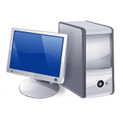
IBM System 370 Architecture
IBM System/370 architecture
  Was introduced in 1970
  Included a number of models
  Could upgrade to a more expensive, faster model without having to abandon original software
  New models are introduced with improved technology, but retain the same architecture so that the customer’s software investment is protected
  Architecture has survived to this day as the architecture of IBM’s mainframe product line
Notes:
A prominent example of both these phenomena is the IBM
System/370 architecture. This architecture was first introduced in 1970 and included
a number of models. The customer with modest requirements could buy a cheaper,
slower model and, if demand increased, later upgrade to a more expensive, faster
model without having to abandon software that had already been developed. Over
the years, IBM has introduced many new models with improved technology to replace
older models, offering the customer greater speed, lower cost, or both. These newer
models retained the same architecture so that the customer’s software investment was
protected. Remarkably, the System/370 architecture, with a few enhancements, has
survived to this day as the architecture of IBM’s mainframe product line.

Slide 12

Structure and Function
Hierarchical system
  Set of interrelated subsystems
  Hierarchical nature of complex systems is essential to both their design and their description
  Designer need only deal with a particular level of the system at a time
  Concerned with structure and function at each level
Structure
  The way in which components relate to each other
Function
  The operation of individual components as part of the structure
Notes:
A computer is a complex system; contemporary computers contain millions of
Elementary electronic components. How, then, can one clearly describe them?
The key is to recognize the hierarchical nature of most complex systems, including
the computer [SIMO96]. A hierarchical system is a set of interrelated subsystems,
each of the latter, in turn, hierarchical in structure until we reach some lowest level
of elementary subsystem.
The hierarchical nature of complex systems is essential to both their design
and their description. The designer need only deal with a particular level of the
system at a time. At each level, the system consists of a set of components and
their interrelationships. The behavior at each level depends only on a simplified,
abstracted characterization of the system at the next lower level. At each level, the
designer is concerned with structure and function:
• Structure: The way in which the components are interrelated.
• Function: The operation of each individual component as part of the structure.
In terms of description, we have two choices: starting at the bottom and building
up to a complete description, or beginning with a top view and decomposing the
system into its subparts. Evidence from a number of fields suggests that the top-down
approach is the clearest and most effective [WEIN75].
The approach taken in this book follows from this viewpoint. The computer
system will be described from the top down. We begin with the major components
of a computer, describing their structure and function, and proceed to successively
lower layers of the hierarchy. The remainder of this section provides a very brief
overview of this plan of attack.

Slide 13
Function
There are four basic functions that a computer can perform:
  Data processing
    Data may take a wide variety of forms and the range of processing requirements is broad
  Data storage
    Short-term
    Long-term
  Data movement
    Input-output (I/O) - when data are received from or delivered to a device (peripheral) that is directly connected to the computer
    Data communications – when data are moved over longer distances, to or from a remote device
  Control
    A control unit manages the computer’s resources and orchestrates the performance of its functional parts in response to instructions
Notes:
Both the structure and functioning of a computer are, in essence, simple. Figure 1.1
depicts the basic functions that a computer can perform. In general terms, there are
only four:
Data Processing. The data may take a wide
variety of forms, and the range of processing requirements is broad. However, we
shall see that there are only a few fundamental methods or types of data processing.
Data Storage. Even if the computer is processing
data on the fly (i.e., data come in and get processed, and the results go out
immediately), the computer must temporarily store at least those pieces of data
that are being worked on at any given moment. Thus, there is at least a short-term
data storage function. Equally important, the computer performs a long-term data
storage function. Files of data are stored on the computer for subsequent retrieval
and update.
Data Movement. The computer’s operating environment consists of devices that serve as
either sources or destinations of data. When data are received from or delivered to
a device that is directly connected to the computer, the process is known as input–
output (I/O), and the device is referred to as a peripheral. When data are moved
over longer distances, to or from a remote device, the process is known as data
communications.
Control. Within the computer, a control unit manages the computer’s resources and orchestrates the
performance of its functional parts in response to those instructions.

Slide 14
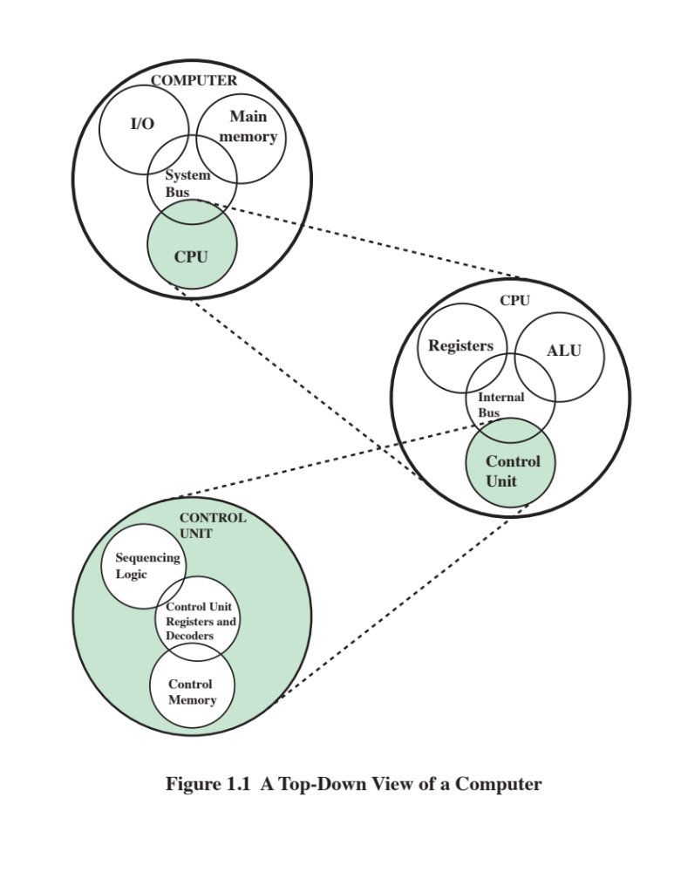
Structure
Notes:
We now look in a general way at the internal structure of a computer. We begin with
a traditional computer with a single processor that employs a microprogrammed
control unit, then examine a typical multicore structure.
Figure 1.1 provides a hierarchical view
of the internal structure of a traditional single-processor computer.

Slide 15
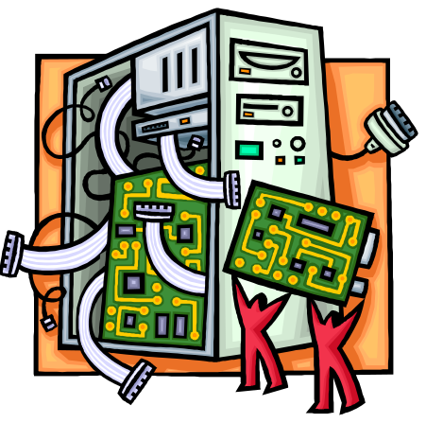
CPU – controls the operation of the computer and performs its data processing functions
Main Memory – stores data
I/O – moves data between the computer and its external environment
System Interconnection – some mechanism that provides for communication among CPU, main memory, and I/O
There are four main structural components
of the computer:
Notes:
There are four main structural components:
• Central processing unit (CPU): Controls the operation of the computer and
performs its data processing functions; often simply referred to as processor.
• Main memory: Stores data.
• I/O: Moves data between the computer and its external environment.
• System interconnection: Some mechanism that provides for communication
among CPU, main memory, and I/O. A common example of system interconnection
is by means of a system bus, consisting of a number of conducting
wires to which all the other components attach.

Slide 16
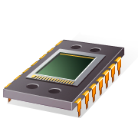
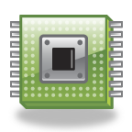
CPU
Control Unit
  Controls the operation of the CPU and hence the computer
  Arithmetic and Logic Unit (ALU)
  Performs the computer’s data processing function
  Registers
  Provide storage internal to the CPU
  CPU Interconnection
  Some mechanism that provides for communication among the control unit, ALU, and registers
Major structural components:
Notes:
There may be one or more of each of the aforementioned components.
Traditionally, there has been just a single processor. In recent years, there has been
increasing use of multiple processors in a single computer. Some design issues relating
to multiple processors crop up and are discussed as the text proceeds; Part Five
focuses on such computers.
Each of these components will be examined in some detail in Part Two.
However, for our purposes, the most interesting and in some ways the most complex
component is the CPU. Its major structural components are as follows:
• Control unit: Controls the operation of the CPU and hence the computer.
• Arithmetic and logic unit (ALU): Performs the computer’s data processing
functions.
• Registers: Provides storage internal to the CPU.
• CPU interconnection: Some mechanism that provides for communication
among the control unit, ALU, and registers.
Part Three covers these components, where we will see that complexity is added by
the use of parallel and pipelined organizational techniques. Finally, there are several
approaches to the implementation of the control unit; one common approach is
a microprogrammed implementation. In essence, a microprogrammed control unit
operates by executing microinstructions that define the functionality of the control
unit. With this approach, the structure of the control unit can be depicted, as in
Figure 1.1. This structure is examined in Part Four.

Slide 17
Multicore Computer Structure
Central processing unit (CPU)
  Portion of the computer that fetches and executes instructions
  Consists of an ALU, a control unit, and registers
  Referred to as a processor in a system with a single processing unit
Core
  An individual processing unit on a processor chip
  May be equivalent in functionality to a CPU on a single-CPU system
  Specialized processing units are also referred to as cores
Processor
  A physical piece of silicon containing one or more cores
  Is the computer component that interprets and executes instructions
  Referred to as a multicore processor if it contains multiple cores
Notes:
As was mentioned, contemporary
computers generally have multiple processors. When these processors all reside
on a single chip, the term multicore computer is used, and each processing unit
(consisting of a control unit, ALU, registers, and perhaps cache) is called a core . To
clarify the terminology, this text will use the following definitions.
■ Central processing unit (CPU) : That portion of a computer that fetches and
executes instructions. It consists of an ALU, a control unit, and registers. In a
system with a single processing unit, it is often simply referred to as a processor .
■ Core : An individual processing unit on a processor chip. A core may be
equivalent in functionality to a CPU on a single-CPU system. Other specialized processing units,
such as one optimized for vector and matrix operations, are also referred to as cores.
■ Processor: A physical piece of silicon containing one or more cores. The
processor is the computer component that interprets and executes instructions.
If a processor contains multiple cores, it is referred to as a multicore
processor .
After about a decade of discussion, there is broad industry consensus on this
usage.

Slide 18
Cache Memory
Multiple layers of memory between the processor and main memory
Is smaller and faster than main memory
Used to speed up memory access by placing in the cache data from main memory that is likely to be used in the near future
A greater performance improvement may be obtained by using multiple levels of cache, with level 1 (L1) closest to the core and additional levels (L2, L3, etc.) progressively farther from the core
Notes:
Another prominent feature of contemporary computers is the use of multiple
layers of memory, called cache memory , between the processor and main memory.
Chapter 4 is devoted to the topic of cache memory. For our purposes in this section,
we simply note that a cache memory is smaller and faster than main memory and is
used to speed up memory access by placing in the cache, data from main memory
that is likely to be used in the near future. A greater performance improvement may
be obtained by using multiple levels of cache, with level 1 (L1) closest to the core
and additional levels (L2, L3, and so on) progressively farther from the core. In this
scheme, level n is smaller and faster than level n + 1.

Slide 19
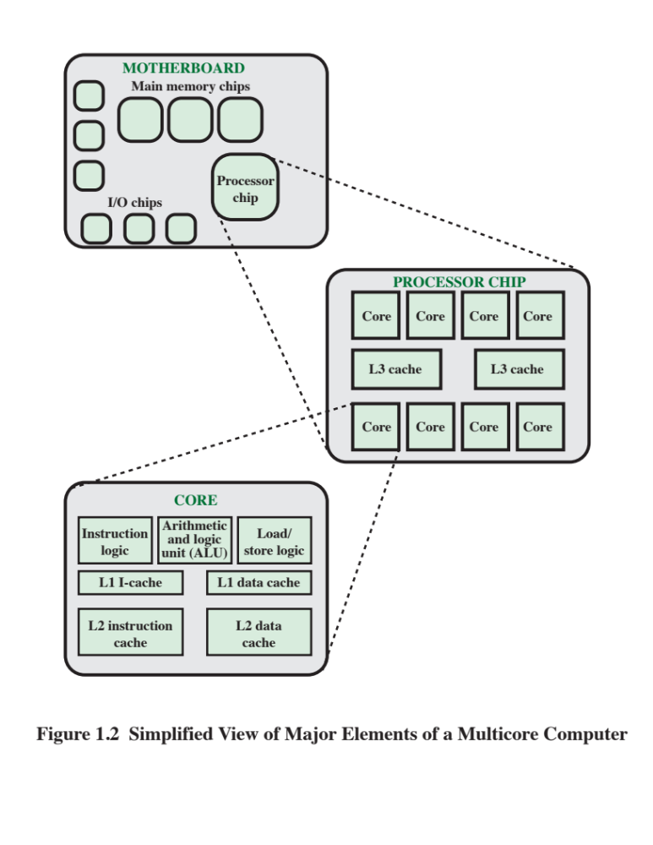
Notes:
Figure 1.2 is a simplified view of the principal components of a typical multicore
computer. Most computers, including embedded computers in smartphones
and tablets, plus personal computers, laptops, and workstations, are housed on a
motherboard. Before describing this arrangement, we need to define some terms.
A printed circuit board is a rigid, flat board that holds and interconnects chips and
other electronic components. The board is made of layers, typically two to ten,
that interconnect components via copper pathways that are etched into the board.
The main printed circuit board (PCB) in a computer is called a system board or
motherboard , while smaller ones that plug into the slots in the main board are
called expansion boards.
The most prominent elements on the motherboard are the chips. A chip is
a single piece of semiconducting material, typically silicon, upon which electronic
circuits and logic gates are fabricated. The resulting product is referred to as an
integrated circuit .
The motherboard contains a slot or socket for the processor chip, which typically
contains multiple individual cores, in what is known as a multicore processor .
There are also slots for memory chips, I/O controller chips, and other key computer
components. For desktop computers, expansion slots enable the inclusion of more
components on expansion boards. Thus, a modern motherboard connects only a
few individual chip components, with each chip containing from a few thousand up
to hundreds of millions of transistors.
Figure 1.2 shows a processor chip that contains eight cores and an L3 cache.
Not shown is the logic required to control operations between the cores and the
cache and between the cores and the external circuitry on the motherboard. The
figure indicates that the L3 cache occupies two distinct portions of the chip surface.
However, typically, all cores have access to the entire L3 cache via the aforementioned
control circuits. The processor chip shown in Figure 1.2 does not represent
any specific product, but provides a general idea of how such chips are laid out.
Next, we zoom in on the structure of a single core, which occupies a portion of
the processor chip. In general terms, the functional elements of a core are:
■ Instruction logic: This includes the tasks involved in fetching instructions and
decoding each instruction to determine the instruction operation and the
memory locations of any operands.
■ Arithmetic and logic unit (ALU): Performs the operation specified by an
instruction.
■ Load/store logic: Manages the transfer of data to and from main memory via
cache.
The core also contains an L1 cache, split between an instruction cache
(I-cache) that is used for the transfer of instructions to and from main memory, and
an L1 data cache, for the transfer of operands and results. Typically, today’s processor
chips also include an L2 cache as part of the core. In many cases, this cache
is also split between instruction and data caches, although a combined, single L2
cache is also used.
Keep in mind that this representation of the layout of the core is only intended
to give a general idea of internal core structure. In a given product, the functional
elements may not be laid out as the three distinct elements shown in Figure 1.2,
especially if some or all of these functions are implemented as part of a microprogrammed
control unit.

Slide 20
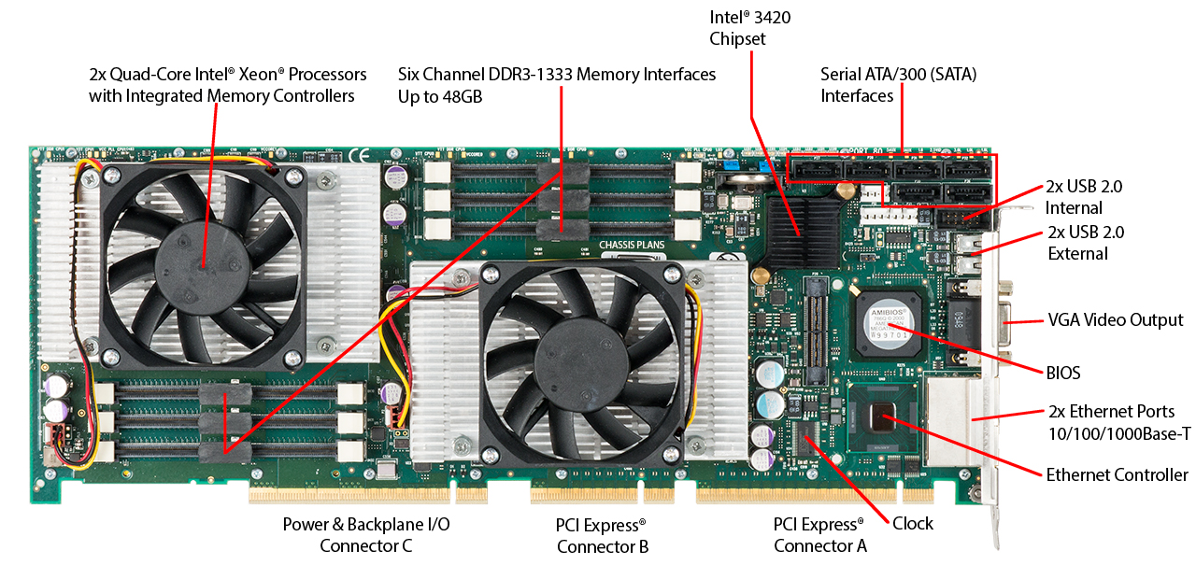
Figure 1.3
Motherboard with Two Intel Quad-Core Xeon Processors
Notes:
It will be instructive to look at some real-
world examples that illustrate the hierarchical structure of computers.
Figure 1.3 is a photograph of the
motherboard for a computer built around two Intel Quad-Core
Xeon processor chips. Many of the elements labeled on the photograph are discussed subsequently
in this book. Here, we mention the most important, in addition to the processor
sockets:
■ PCI-Express slots for a high-end
display adapter and for additional peripherals
(Section 3.6 describes PCIe).
■ Ethernet controller and Ethernet ports for network connections.
■ USB sockets for peripheral devices.
■ Serial ATA (SATA) sockets for connection to disk memory (Section 7.7
discusses Ethernet, USB, and SATA).
■ Interfaces for DDR (double data rate) main memory chips (Section 5.3
discusses DDR).
■ Intel 3420 chipset is an I/O controller for direct memory access operations
between peripheral devices and main memory (Section 7.5 discusses DDR).

Slide 21
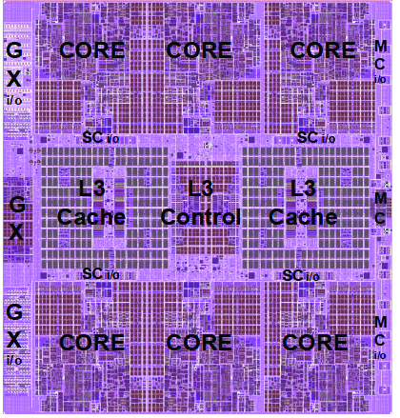
Figure 1.4
zEnterprise EC12 Processor Unit (PU)
Chip Diagram
Notes:
Following our top-down
strategy, as illustrated in Figures 1.1 and 1.2, we can
now zoom in and look at the internal structure of a processor chip. For variety, we
look at an IBM chip instead of the Intel processor chip. Figure 1.4 is a photograph
of the processor chip for the IBM zEnterprise EC12 mainframe computer. This chip
has 2.75 billion transistors. The superimposed labels indicate how the silicon real
estate of the chip is allocated. We see that this chip has six cores, or processors.
In addition, there are two large areas labeled L3 cache, which are shared by all six
processors. The L3 control logic controls traffic between the L3 cache and the cores
and between the L3 cache and the external environment. Additionally, there is storage
control (SC) logic between the cores and the L3 cache. The memory controller
(MC) function controls access to memory external to the chip. The GX I/O bus
controls the interface to the channel adapters accessing the I/O.

Slide 22
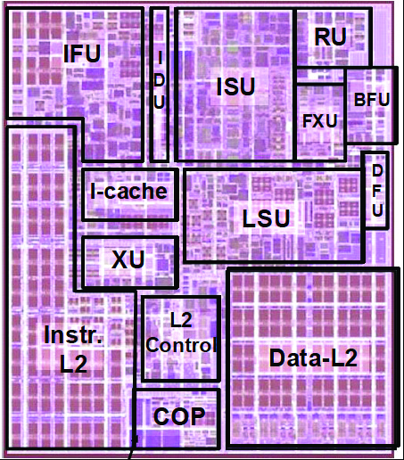
Figure 1.5
zEnterprise
EC12
Core Layout
Notes:
Going down one level deeper, we examine the internal structure of a single
core, as shown in the photograph of Figure 1.5. Keep in mind that this is a portion
of the silicon surface area making up a single-
processor chip. The main sub-areas
within this core area are the following:
■ ISU (instruction sequence unit): Determines the sequence in which instructions
are executed in what is referred to as a superscalar architecture (Chapter 16).
■ IFU (instruction fetch unit): Logic for fetching instructions.
■ IDU (instruction decode unit): The IDU is fed from the IFU buffers, and is
responsible for the parsing and decoding of all z/Architecture operation codes.
■ LSU (load-store unit): The LSU contains the 96-kB L1 data cache1, and manages
data traffic between the L2 data cache and the functional execution
units. It is responsible for handling all types of operand accesses of all lengths,
modes, and formats as defined in the z/Architecture.
■ XU (translation unit): This unit translates logical addresses from instructions
into physical addresses in main memory. The XU also contains a translation
lookaside buffer (TLB) used to speed up memory access. TLBs are discussed
in Chapter 8.
■ FXU (fixed-point unit): The FXU executes fixed-
point arithmetic operations.
■ BFU (binary floating-
point unit): The BFU handles all binary and hexadecimal
Floating-point operations, as well as fixed-point
multiplication operations.
■ DFU (decimal floating-point unit): The DFU handles both fixed-point
and floating-point
operations on numbers that are stored as decimal digits.
■ RU (recovery unit): The RU keeps a copy of the complete state of the system
that includes all registers, collects hardware fault signals, and manages the
hardware recovery actions.
■ COP (dedicated co-
processor): The COP is responsible for data compression
and encryption functions for each core.
■ I-cache: This is a 64-kB L1 instruction cache, allowing the IFU to prefetch
instructions before they are needed.
■ L2 control: This is the control logic that manages the traffic through the two
L2 caches.
■ Data- L2: A 1-MB L2 data cache for all memory traffic other than instructions.
■ Instr-
L2: A 1-MB L2 instruction cache.

Slide 23
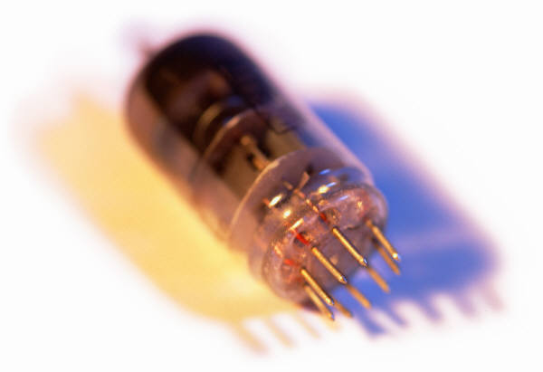
History of Computers
First Generation: Vacuum Tubes
Vacuum tubes were used for digital logic elements and memory
IAS computer
  Fundamental design approach was the stored program concept
    Attributed to the mathematician John von Neumann
    First publication of the idea was in 1945 for the EDVAC
  Design began at the Princeton Institute for Advanced Studies
  Completed in 1952
  Prototype of all subsequent general-purpose computers
Notes:
The first generation of computers used vacuum tubes for digital logic elements and
memory. A number of research and then commercial computers were built using
vacuum tubes. For our purposes, it will be instructive to examine perhaps the most
famous first-generation computer, known as the IAS computer.
A fundamental design approach first implemented in the IAS computer is
known as the stored-program concept . This idea is usually attributed to the mathematician
John von Neumann. Alan Turing developed the idea at about the same time.
The first publication of the idea was in a 1945 proposal by von Neumann for a new
computer, the EDVAC (Electronic Discrete Variable Computer).3
In 1946, von Neumann and his colleagues began the design of a new stored-
program computer, referred to as the IAS computer, at the Princeton Institute for
Advanced Studies. The IAS computer, although not completed until 1952, is the
prototype of all subsequent general-purpose computers.

Slide 24
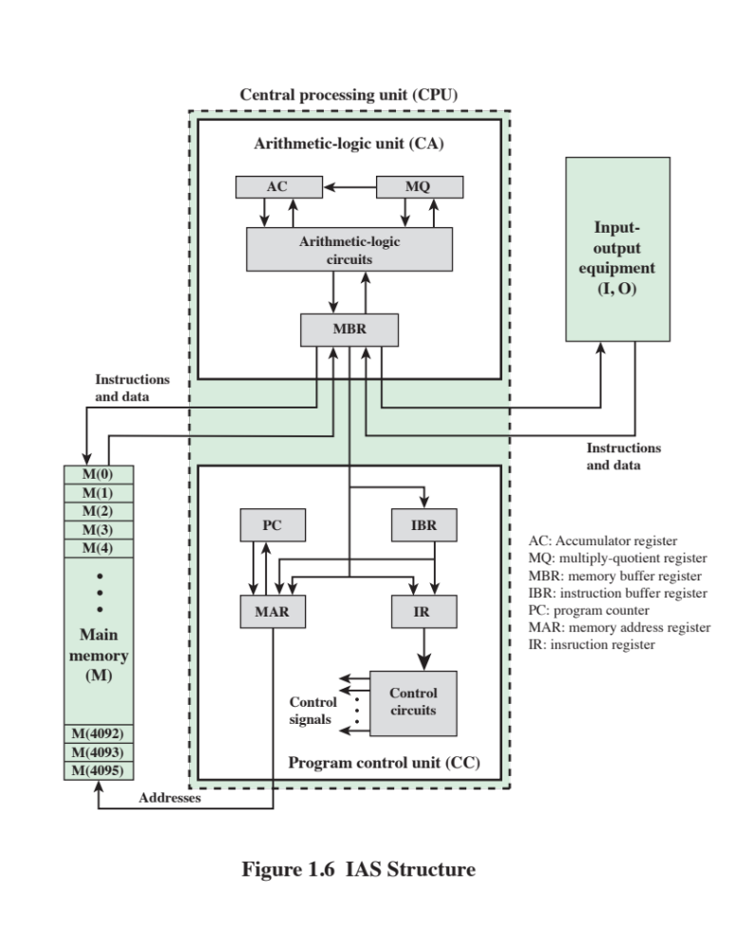
Notes:
Figure 1.6 shows the general structure of the IAS computer (compare with Figure 1.1).
It consists of
• A main memory, which stores both data and instructions
• An arithmetic and logic unit (ALU) capable of operating on binary data
• A control unit, which interprets the instructions in memory and causes them
to be executed
• Input/output (I/O) equipment operated by the control unit
This structure was outlined in von Neumann’s earlier proposal, which is worth
quoting in part at this point [VONN45]:
2.2 First: Since the device is primarily a computer, it will
have to perform the elementary operations of arithmetic most frequently.
These are addition, subtraction, multiplication, and division.
It is therefore reasonable that it should contain specialized
organs for just these operations.
It must be observed, however, that while this principle as such
is probably sound, the specific way in which it is realized requires
close scrutiny. At any rate a central arithmetical part of the device will
probably have to exist, and this constitutes the first specific part: CA .
2.3 Second: The logical control of the device, that is, the
proper sequencing of its operations, can be most efficiently carried
out by a central control organ. If the device is to be elastic ,
that is, as nearly as possible all purpose , then a distinction must
be made between the specific instructions given for and defining
a particular problem, and the general control organs that see to it
that these instructions—no matter what they are—are
carried out. The former must be stored in some way; the latter are represented
by definite operating parts of the device. By the central control we
mean this latter function only, and the organs that perform it form
the second specific part: CC .
2.4 Third: Any device that is to carry out long and complicated
sequences of operations (specifically of calculations) must
have a considerable memory . . .
The instructions which govern a complicated problem may
constitute considerable material, particularly so, if the code is circumstantial
(which it is in most arrangements). This material must
be remembered.
At any rate, the total memory constitutes the third specific
part of the device: M.
2.6 The three specific parts CA, CC (together C), and M correspond
to the associative neurons in the human nervous system. It
remains to discuss the equivalents of the sensory or afferent and the
motor or efferent neurons. These are the input and output organs of
the device. The device must be endowed with the ability to maintain
input and output (sensory and motor) contact with some specific
medium of this type. The medium will be called the outside recording
medium of the device: R .
2.7 Fourth: The device must have organs to transfer information
from R into its specific parts C and M. These organs form its
input , the fourth specific part: I . It will be seen that it is best to make
all transfers from R (by I) into M and never directly from C.
2.8 Fifth: The device must have organs to transfer from its
specific parts C and M into R. These organs form its output , the
fifth specific part: O . It will be seen that it is again best to make all
transfers from M (by O) into R, and never directly from C.

Slide 25
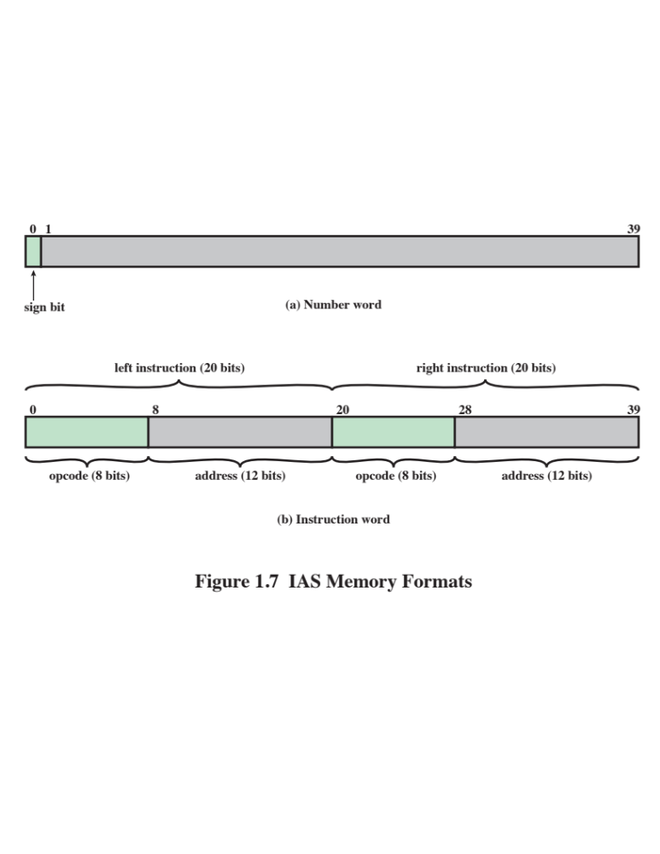
Notes:
With rare exceptions, all of today’s computers have this same general structure
and function and are thus referred to as von Neumann machines . Thus, it is worthwhile
at this point to describe briefly the operation of the IAS computer [BURK46,
GOLD54]. Following [HAYE98], the terminology and notation of von Neumann
are changed in the following to conform more closely to modern usage; the examples
accompanying this discussion are based on that latter text.
The memory of the IAS consists of 4,096 storage locations, called words , of
40 binary digits (bits) each.6 Both data and instructions are stored there. Numbers are
represented in binary form, and each instruction is a binary code. Figure 1.7 illustrates
these formats. Each number is represented by a sign bit and a 39-bit value. A word
may alternatively contain two 20-bit instructions, with each instruction consisting
of an 8-bit operation code (opcode ) specifying the operation to be performed and
a 12-bit address designating one of the words in memory (numbered from 0 to 999).

Slide 26
Registers
Memory buffer register (MBR)
Contains a word to be stored in memory or sent to the I/O unit
Or is used to receive a word from memory or from the I/O unit
Memory address register (MAR)
Specifies the address in memory of the word to be written from or read into the MBR
Instruction register (IR)
Contains the 8-bit opcode instruction being executed
Instruction buffer register (IBR)
Employed to temporarily hold the right-hand instruction from a word in memory
Program counter (PC)
Contains the address of the next instruction pair to be fetched from memory
Accumulator (AC) and multiplier quotient (MQ)
Employed to temporarily hold operands and results of ALU operations
Notes:
The control unit operates the IAS by fetching instructions from memory
and executing them one at a time. We explain these operations with reference to
Figure 1.6. This figure reveals that both the control unit and the ALU contain storage
locations, called registers , defined as follows:
Memory buffer register (MBR): Contains a word to be stored in memory or sent
to the I/O unit, or is used to receive a word from memory or from the I/O unit.
• Memory address register (MAR): Specifies the address in memory of the word
to be written from or read into the MBR.
• Instruction register (IR ): Contains the 8-bit opcode instruction being executed.
• Instruction buffer register (IBR): Employed to hold temporarily the right-hand
instruction from a word in memory.
• Program counter (PC): Contains the address of the next instruction pair to be
fetched from memory.
• Accumulator (AC) and multiplier quotient (MQ): Employed to hold temporarily
operands and results of ALU operations. For example, the result of
multiplying two 40-bit numbers is an 80-bit number; the most significant 40 bits
are stored in the AC and the least significant in the MQ.

Slide 27
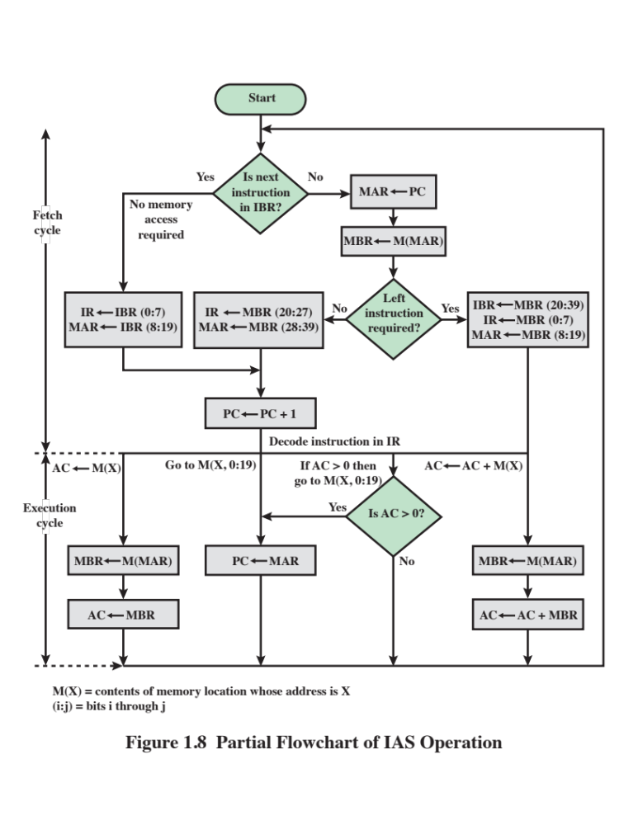
Notes:
The IAS operates by repetitively performing an instruction cycle, as shown in
Figure 1.8. Each instruction cycle consists of two sub-cycles. During the fetch cycle,
the opcode of the next instruction is loaded into the IR and the address portion is
loaded into the MAR. This instruction may be taken from the IBR, or it can be
obtained from memory by loading a word into the MBR, and then down to the IBR,
IR, and MAR.
Why the indirection? These operations are controlled by electronic circuitry
and result in the use of data paths. To simplify the electronics, there is only one
register that is used to specify the address in memory for a read or write and only
one register used for the source or destination.
Once the opcode is in the IR, the execute cycle is performed. Control circuitry
interprets the opcode and executes the instruction by sending out the appropriate
control signals to cause data to be moved or an operation to be performed by the
ALU.

Slide 28
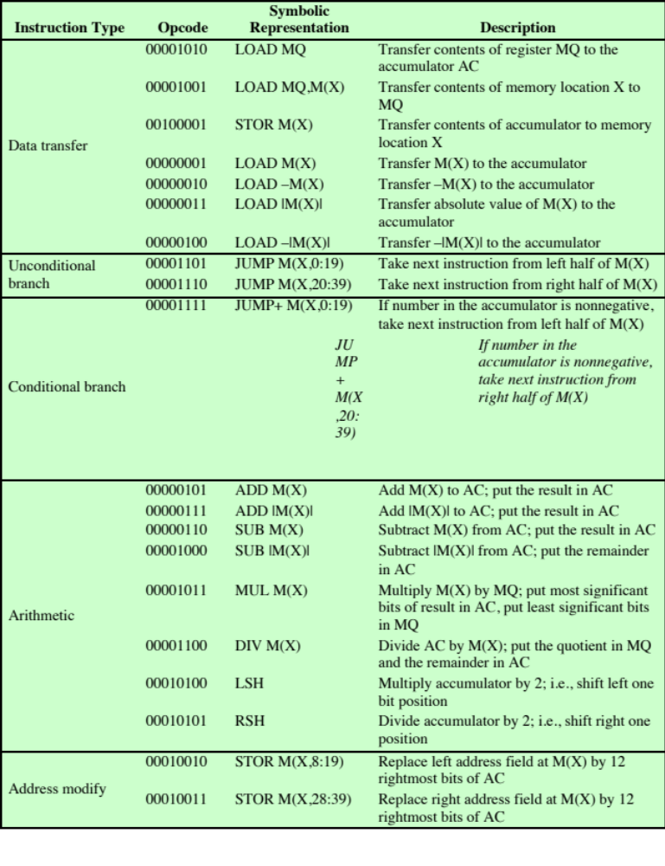
Table 1.1
The IAS
Instruction Set
(Table can be found on page 17 in Stallings.)
Notes:
The IAS computer had a total of 21 instructions, which are listed in Table 1.1.
These can be grouped as follows:
• Data transfer: Move data between memory and ALU registers or between
two ALU registers.
Unconditional branch: Normally, the control unit executes instructions in
sequence from memory. This sequence can be changed by a branch instruction,
which facilitates repetitive operations.
• Conditional branch: The branch can be made dependent on a condition, thus
allowing decision points.
• Arithmetic: Operations performed by the ALU.
• Address modify: Permits addresses to be computed in the ALU and then
inserted into instructions stored in memory. This allows a program considerable
addressing flexibility.
Table 1.1 presents instructions in a symbolic, easy-to-read form. Actually,
each instruction must conform to the format of Figure 1.7b. The opcode portion
(first 8 bits) specifies which of the 21 instructions is to be executed. The address
portion (remaining 12 bits) specifies which of the 4,096 memory locations is to be
involved in the execution of the instruction.

Slide 29
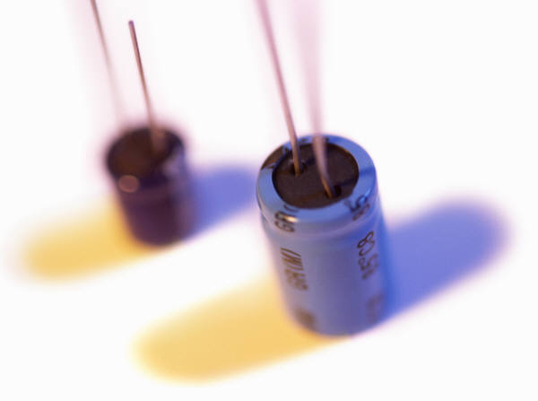
History of Computers
Second Generation: Transistors
  Smaller
  Cheaper
  Dissipates less heat than a vacuum tube
  Is a solid state device made from silicon
  Was invented at Bell Labs in 1947
  It was not until the late 1950’s that fully transistorized computers were commercially available
Notes:
The first major change in the electronic computer came with the replacement of
the vacuum tube by the transistor. The transistor is smaller, cheaper, and dissipates
less heat than a vacuum tube but can be used in the same way as a vacuum tube to
construct computers. Unlike the vacuum tube, which requires wires, metal plates, a
glass capsule, and a vacuum, the transistor is a solid-state device, made from silicon.
The transistor was invented at Bell Labs in 1947 and by the 1950s had launched
an electronic revolution. It was not until the late 1950s, however, that fully transistorized
computers were commercially available. The use of the transistor defines
the second generation of computers.

Slide 30
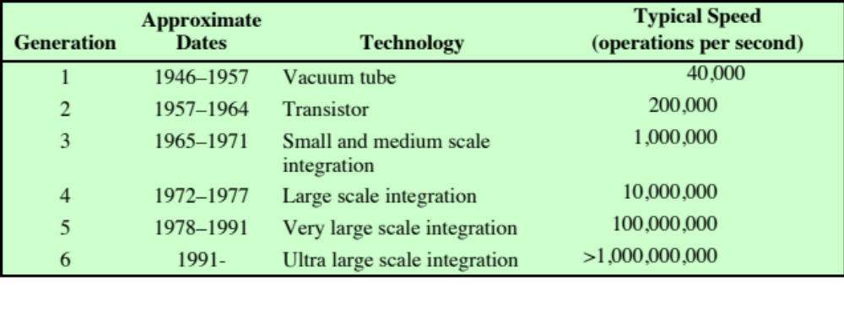
Table 1.2
Computer Generations
Notes:
It has become widely accepted to classify computers into generations based on the fundamental
hardware technology employed (Table 1.2). Each new generation is characterized
by greater processing performance, larger memory capacity, and smaller
size than the previous one.

Slide 31

Second Generation Computers
Introduced:
  More complex arithmetic and logic units and control units
  The use of high-level programming languages
  Provision of system software which provided the ability to:
    Load programs
    Move data to peripherals
    Libraries perform common computations
Notes:
But there are other changes as well. The second generation saw the introduction
of more complex arithmetic and logic units and control units, the use of
high-level programming languages, and the provision of system software with the
computer. In broad terms, system software provided the ability to load programs,
move data to peripherals, and libraries to perform common computations, similar
to what modern operating systems like Windows and Linux do.

Slide 32
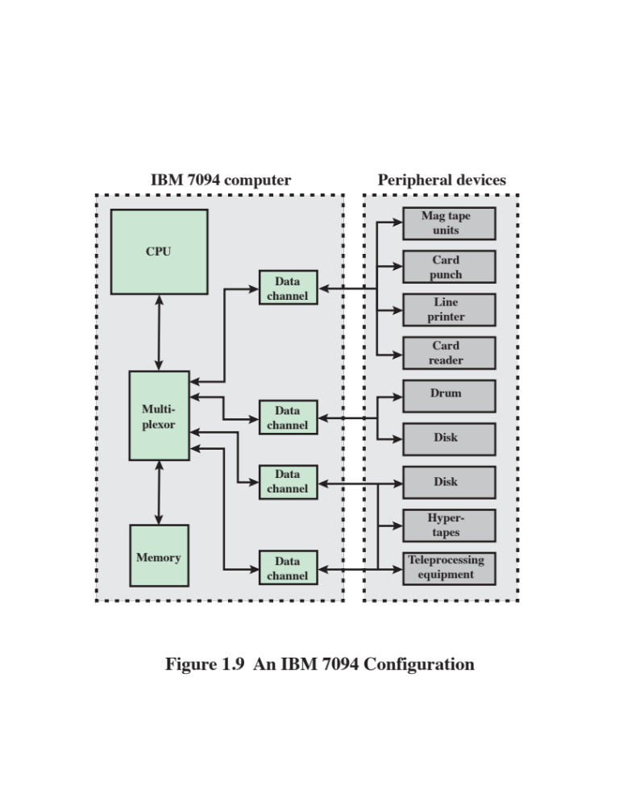
Notes:
It will be useful to examine an important member of the second generation: the
IBM 7094 [BELL71]. From the introduction of the 700 series in 1952 to the introduction
of the last member of the 7000 series in 1964, this IBM product line underwent
an evolution that is typical of computer products. Successive members of the product
line showed increased performance, increased capacity, and/or lower cost.
Also, over the lifetime of this series of computers, the relative speed of the
CPU increased by a factor of 50. Speed improvements are achieved by improved
electronics (e.g., a transistor implementation is faster than a vacuum tube implementation)
and more complex circuitry. For example, the IBM 7094 includes an
Instruction Backup Register, used to buffer the next instruction. The control unit
fetches two adjacent words from memory for an instruction fetch. Except for the
occurrence of a branching instruction, which is relatively infrequent (perhaps 10 to
15%), this means that the control unit has to access memory for an instruction on
only half the instruction cycles. This prefetching significantly reduces the average
instruction cycle time.
Figure 1.9 shows a large (many peripherals) configuration for an IBM 7094,
which is representative of second-generation computers. Several differences from
the IAS computer are worth noting. The most important of these is the use of data
channels . A data channel is an independent I/O module with its own processor and
instruction set. In a computer system with such devices, the CPU does not execute
detailed I/O instructions. Such instructions are stored in a main memory to be
executed by a special-purpose processor in the data channel itself. The CPU initiates
an I/O transfer by sending a control signal to the data channel, instructing it to
execute a sequence of instructions in memory. The data channel performs its task
independently of the CPU and signals the CPU when the operation is complete.
This arrangement relieves the CPU of a considerable processing burden.
Another new feature is the multiplexor , which is the central termination
point for data channels, the CPU, and memory. The multiplexor schedules access
to the memory from the CPU and data channels, allowing these devices to act
independently.

Slide 33
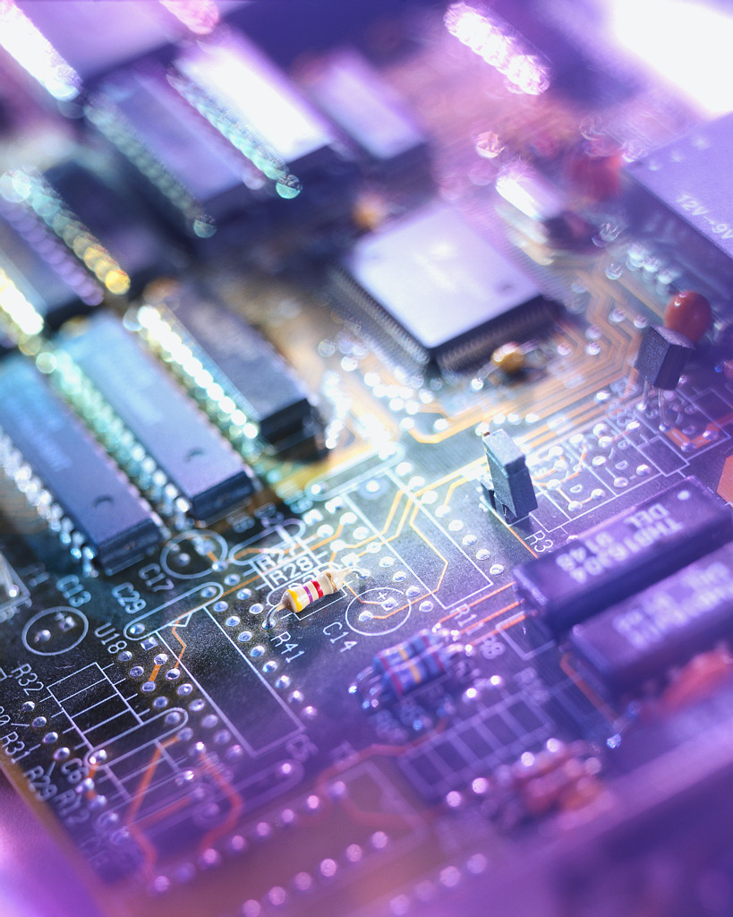
History of Computers
Third Generation: Integrated Circuits
1958 – the invention of the integrated circuit
Discrete component
  Single, self-contained transistor
  Manufactured separately, packaged in their own containers, and soldered or wired together onto masonite-like circuit boards
  Manufacturing process was expensive and cumbersome
  The two most important members of the third generation were the IBM System/360 and the DEC PDP-8
Notes:
A single, self-contained transistor is called a discrete component. Throughout the
1950s and early 1960s, electronic equipment was composed largely of discrete components—
transistors, resistors, capacitors, and so on. Discrete components were
manufactured separately, packaged in their own containers, and soldered or wired
together onto masonite-like circuit boards, which were then installed in computers,
oscilloscopes, and other electronic equipment. Whenever an electronic device called
for a transistor, a little tube of metal containing a pinhead-sized piece of silicon
had to be soldered to a circuit board. The entire manufacturing process, from transistor
to circuit board, was expensive and cumbersome.
These facts of life were beginning to create problems in the computer industry.
Early second-generation computers contained about 10,000 transistors. This
figure grew to the hundreds of thousands, making the manufacture of newer, more
powerful machines increasingly difficult.
In 1958 came the achievement that revolutionized electronics and started the
era of microelectronics: the invention of the integrated circuit. It is the integrated
circuit that defines the third generation of computers. In this section, we provide a
brief introduction to the technology of integrated circuits. Then we look at perhaps
the two most important members of the third generation, both of which were introduced
at the beginning of that era: the IBM System/360 and the DEC PDP-8.

Slide 34
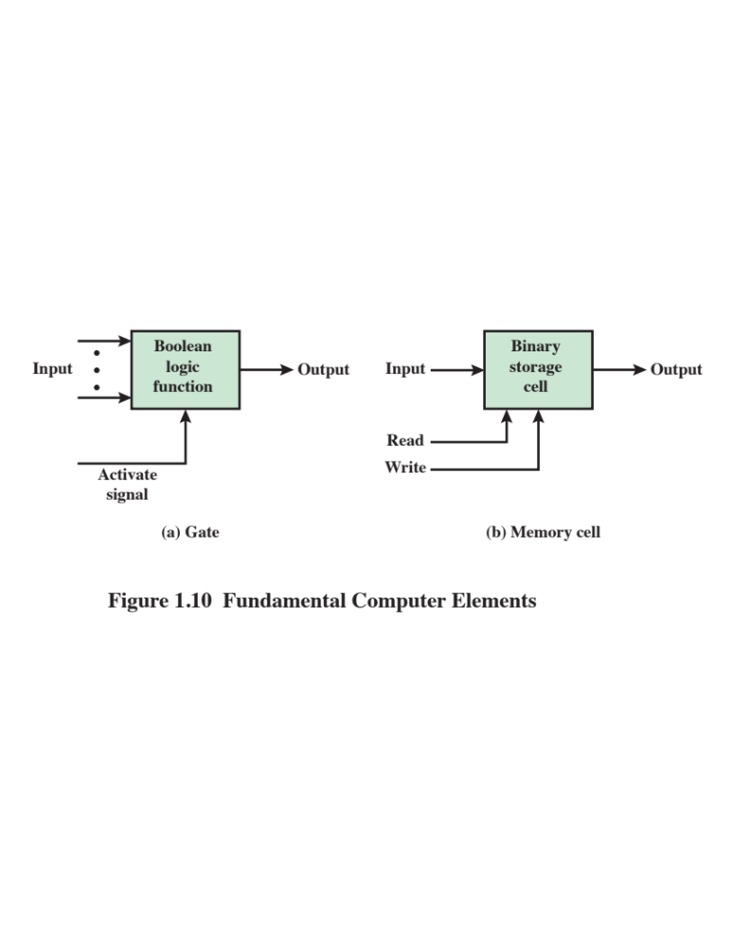
Notes:
Microelectronics means, literally, “small electronics.” Since
the beginnings of digital electronics and the computer industry, there has been a
persistent and consistent trend toward the reduction in size of digital electronic
circuits. Before examining the implications and benefits of this trend, we need to
say something about the nature of digital electronics. A more detailed discussion is
found in Chapter 11.
The basic elements of a digital computer, as we know, must perform storage,
movement, processing, and control functions. Only two fundamental types of components
are required (Figure 1.10): gates and memory cells. A gate is a device that
implements a simple Boolean or logical function, such as IF A AND B ARE TRUE
THEN C IS TRUE (AND gate). Such devices are called gates because they control
data flow in much the same way that canal gates control the flow of water. The
memory cell is a device that can store one bit of data; that is, the device can be in
one of two stable states at any time. By interconnecting large numbers of these
fundamental devices, we can construct a computer.

Slide 35
Integrated
Circuits
A computer consists of gates, memory cells, and interconnections among these elements
The gates and memory cells are constructed of simple digital electronic components
Data storage – provided by memory cells
Data processing – provided by gates
Data movement – the paths among components are used to move data from memory to memory and from memory through gates to memory
Control – the paths among components can carry control signals
Exploits the fact that such components as transistors, resistors, and conductors can be fabricated from a semiconductor such as silicon
Many transistors can be produced at the same time on a single wafer of silicon
Transistors can be connected with a processor metallization to form circuits
Notes:
We can relate this to our four
basic functions as follows:
• Data storage: Provided by memory cells.
• Data processing: Provided by gates.
• Data movement: The paths among components are used to move data from
memory to memory and from memory through gates to memory.
• Control: The paths among components can carry control signals. For example,
a gate will have one or two data inputs plus a control signal input that activates
the gate. When the control signal is ON, the gate performs its function on the
data inputs and produces a data output. Similarly, the memory cell will store
the bit that is on its input lead when the WRITE control signal is ON and will
place the bit that is in the cell on its output lead when the READ control signal
is ON.
Thus, a computer consists of gates, memory cells, and interconnections among these
elements. The gates and memory cells are, in turn, constructed of simple digital
electronic components.
The integrated circuit exploits the fact that such components as transistors,
resistors, and conductors can be fabricated from a semiconductor such as silicon.
It is merely an extension of the solid-state art to fabricate an entire circuit in a tiny
piece of silicon rather than assemble discrete components made from separate
pieces of silicon into the same circuit. Many transistors can be produced at the same
time on a single wafer of silicon. Equally important, these transistors can be connected
with a process of metallization to form circuits.

Slide 36
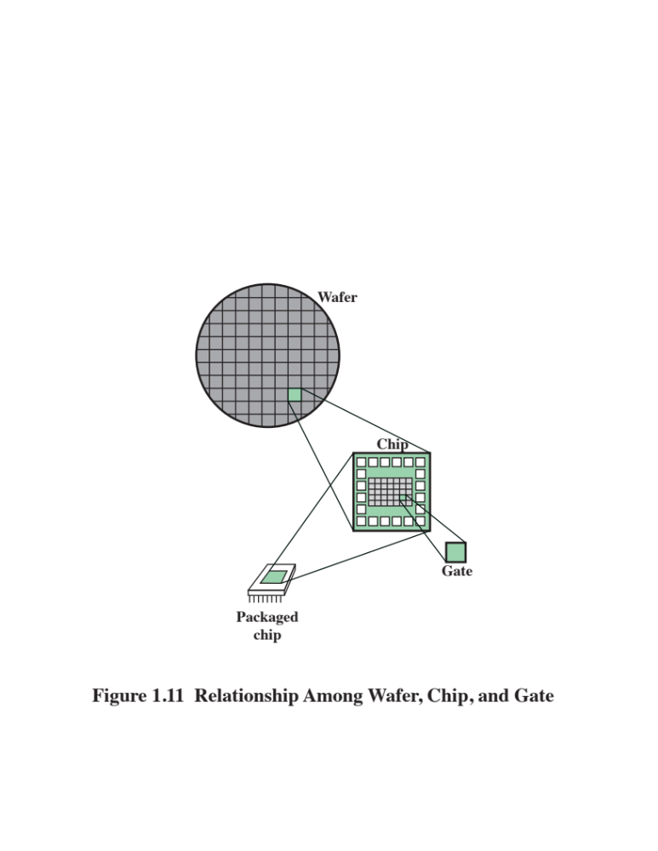
Notes:
Figure 1.11 depicts the key concepts in an integrated circuit. A thin wafer of
silicon is divided into a matrix of small areas, each a few millimeters square. The
identical circuit pattern is fabricated in each area, and the wafer is broken up into
chips. Each chip consists of many gates and/or memory cells plus a number of input
and output attachment points. This chip is then packaged in housing that protects
it and provides pins for attachment to devices beyond the chip. A number of these
packages can then be interconnected on a printed circuit board to produce larger
and more complex circuits.

Slide 37
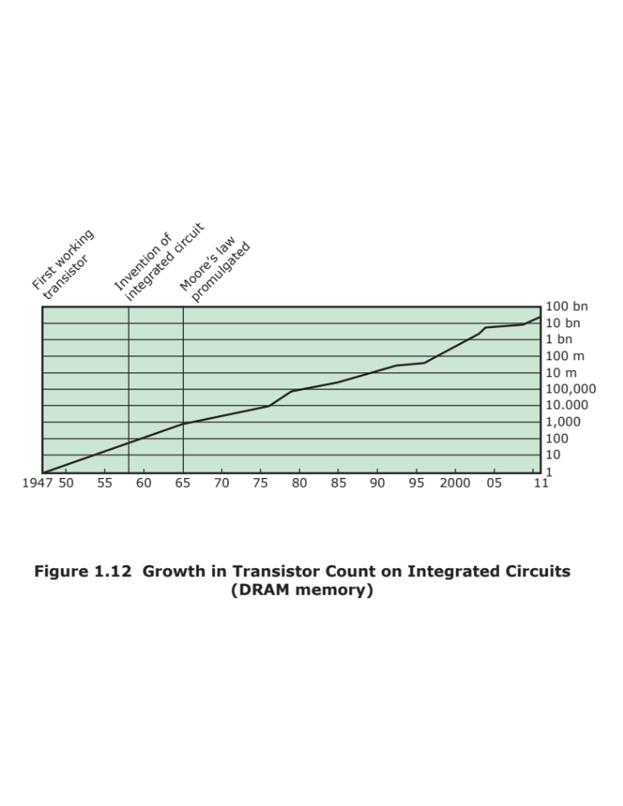
Notes:
Initially, only a few gates or memory cells could be reliably manufactured
and packaged together. These early integrated circuits are referred to as small scale
Integration (SSI). As time went on, it became possible to pack more and more
Components on the same chip. This growth in density is illustrated in Figure 1.12; it is
one of the most remarkable technological trends ever recorded.
This figure reflects the
famous Moore’s law, which was propounded by Gordon Moore, cofounder of Intel,
in 1965 [MOOR65]. Moore observed that the number of transistors that could be
put on a single chip was doubling every year and correctly predicted that this pace
would continue into the near future. To the surprise of many, including Moore, the
pace continued year after year and decade after decade. The pace slowed to a doubling
every 18 months in the 1970s but has sustained that rate ever since.

Slide 38
Moore’s Law
1965; Gordon Moore – co-founder of Intel
Observed number of transistors that could be put on a single chip was doubling every year
The pace slowed to a doubling every 18 months in the 1970’s but has sustained that rate ever since
Consequences of Moore’s law:
The cost of computer logic and memory circuitry has fallen at a dramatic rate
The electrical path length is shortened, increasing operating speed
Computer becomes smaller and is more convenient to use in a variety of environments
Reduction in power and cooling requirements
Fewer interchip connections
Notes:
The consequences of Moore’s law are profound:
1. The cost of a chip has remained virtually unchanged during this period of
rapid growth in density. This means that the cost of computer logic and memory
circuitry has fallen at a dramatic rate.
2. Because logic and memory elements are placed closer together on more
densely packed chips, the electrical path length is shortened, increasing
operating speed.
3. The computer becomes smaller, making it more convenient to place in a
variety of environments.
4. There is a reduction in power and cooling requirements.
5. The interconnections on the integrated circuit are much more reliable than
solder connections. With more circuitry on each chip, there are fewer interchip
connections.

Slide 39
IBM System/360
Announced in 1964
Product line was incompatible with older IBM machines
Was the success of the decade and cemented IBM as the overwhelmingly dominant computer vendor
The architecture remains to this day the architecture of IBM’s mainframe computers
Was the industry’s first planned family of computers
  Models were compatible in the sense that a program written for one model should be capable of being executed by another model in the series
Notes:
By 1964, IBM had a firm grip on the computer market with
its 7000 series of machines. In that year, IBM announced the System/360, a new
family of computer products. Although the announcement itself was no surprise, it
contained some unpleasant news for current IBM customers: the 360 product line
was incompatible with older IBM machines. Thus, the transition to the 360 would be
difficult for the current customer base. This was a bold step by IBM, but one IBM felt
was necessary to break out of some of the constraints of the 7000 architecture and
to produce a system capable of evolving with the new integrated circuit technology
[PADE81, GIFF87]. The strategy paid off both financially and technically. The 360
was the success of the decade and cemented IBM as the overwhelmingly dominant
computer vendor, with a market share above 70%. And, with some modifications
and extensions, the architecture of the 360 remains to this day the architecture
of IBM’s mainframe computers. Examples using this architecture can be found
throughout this text.
The System/360 was the industry’s first planned family of computers. The
family covered a wide range of performance and cost. The models were compatible in the sense that
a program written for one model should be capable of being executed by another
model in the series, with only a difference in the time it takes to execute.

Slide 40
Family Characteristics
Similar or identical instruction set
Similar or identical operating system
Increasing speed
Increasing number of I/O ports
Increasing memory size
Increasing cost
Notes:
The concept of a family of compatible computers was both novel and
extremely successful. A customer with modest requirements and a budget to match
could start with the relatively inexpensive Model 30. Later, if the customer’s needs
grew, it was possible to upgrade to a faster machine with more memory without
sacrificing the investment in already-developed software. The characteristics of a
family are as follows:
• Similar or identical instruction set: In many cases, the exact same set of machine
instructions is supported on all members of the family. Thus, a program that
executes on one machine will also execute on any other. In some cases, the
lower end of the family has an instruction set that is a subset of that of the top
end of the family. This means that programs can move up but not down.
• Similar or identical operating system: The same basic operating system is
available for all family members. In some cases, additional features are added
to the higher-end members.
• Increasing speed: The rate of instruction execution increases in going from
lower to higher family members.
• Increasing number of I /O ports: The number of I/O ports increases in going
from lower to higher family members.
• Increasing memory size: The size of main memory increases in going from
lower to higher family members.
• Increasing cost: At a given point in time, the cost of a system increases in going
from lower to higher family members.
How could such a family concept be implemented? Differences were achieved
based on three factors: basic speed, size, and degree of simultaneity [STEV64]. For
example, greater speed in the execution of a given instruction could be gained by
the use of more complex circuitry in the ALU, allowing suboperations to be carried
out in parallel. Another way of increasing speed was to increase the width of the
data path between main memory and the CPU. On the Model 30, only 1 byte (8 bits)
could be fetched from main memory at a time, whereas 8 bytes could be fetched at
a time on the Model 75.
The System/360 not only dictated the future course of IBM but also had a
profound impact on the entire industry. Many of its features have become standard on
other large computers.

Slide 41
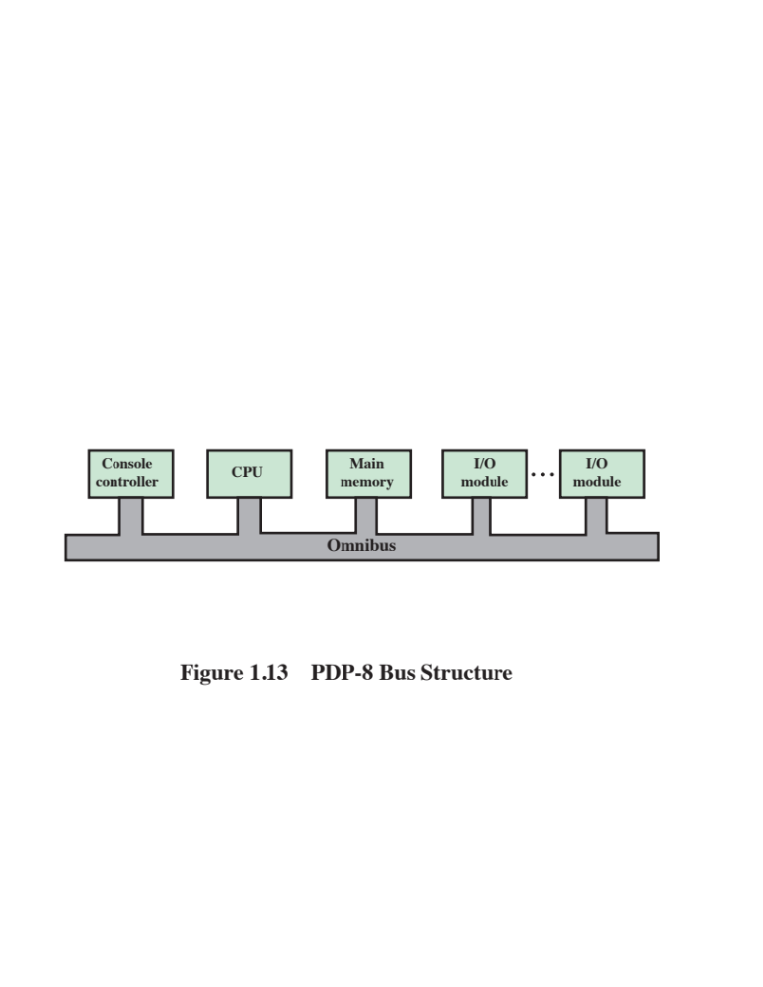
Notes:
In the same year that IBM shipped its first System/360, another
momentous first shipment occurred: PDP-8
from Digital Equipment Corporation(DEC). At a time when the average
computer required an air-conditioned room, the PDP-8
(dubbed a minicomputer by the industry, after the miniskirt of the day)
was small enough that it could be placed on top of a lab bench or be built into
other equipment. It could not do everything the mainframe could, but at $16,000, it
was cheap enough for each lab technician to have one. In contrast, the System/360
series of mainframe computers introduced just a few months before cost hundreds
of thousands of dollars.
The low cost and small size of the PDP-8
enabled another manufacturer to purchase a PDP-8
and integrate it into a total system for resale. These other manufacturers
came to be known as original equipment manufacturers (OEMs) , and the
OEM market became and remains a major segment of the computer marketplace.
In contrast to the central-switched architecture (Figure 1.9) used by IBM on its
700/7000 and 360 systems, later models of the PDP-8
used a structure that became virtually
universal for microcomputers: the bus structure. This is illustrated in Figure 1.13.
The PDP-8 bus, called the Omnibus, consists of 96 separate signal paths, used to carry
control, address, and data signals. Because all system components share a common
set of signal paths, their use can be controlled by the CPU. This architecture is highly
flexible, allowing modules to be plugged into the bus to create various configurations.
It is only in recent years that the bus structure has given way to a structure known as
Point-to-point interconnect, described in Chapter 3.

Slide 42
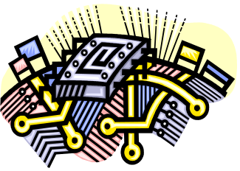
Semiconductor Memory
Microprocessors
LSI
Large
Scale Integration
Later
Generations
VLSI
Very Large Scale Integration
ULSI
Ultra Large
Scale
Integration
Notes:
Beyond the third generation there is less general agreement on defining generations
of computers. Table 1.2 suggests that there have been a number of later generations,
based on advances in integrated circuit technology. With the introduction
of large-scale integration (LSI), more than 1000 components can be placed on a
single integrated circuit chip. Very-large-scale integration (VLSI) achieved more
than 10,000 components per chip, while current ultra-large-scale integration (ULSI)
chips can contain more than one billion components.
With the rapid pace of technology, the high rate of introduction of new products,
and the importance of software and communications as well as hardware, the
classification by generation becomes less clear and less meaningful. In this section,
we mention two of the most important of developments in later generations.

Slide 43
Semiconductor Memory
In 1970 Fairchild produced the first relatively capacious semiconductor memory
Chip was about the size of a single core
Could hold 256 bits of memory
Non-destructive
Much faster than core
In 1974 the price per bit of semiconductor memory dropped below the price per bit of core memory
There has been a continuing and rapid decline in memory cost accompanied by a corresponding increase in physical memory density
Developments in memory and processor technologies changed the nature of computers in less than a decade
Since 1970 semiconductor memory has been through 13 generations
Each generation has provided four times the storage density of the previous generation, accompanied by declining cost per bit and declining access time
Notes:
The first application of integrated circuit technology
to computers was construction of the processor (the control unit and the arithmetic
and logic unit) out of integrated circuit chips. But it was also found that this same
technology could be used to construct memories.
In the 1950s and 1960s, most computer memory was constructed from tiny
rings of ferromagnetic material, each about a sixteenth of an inch in diameter. These
rings were strung up on grids of fine wires suspended on small screens inside the
computer. Magnetized one way, a ring (called a core) represented a one; magnetized
the other way, it stood for a zero. Magnetic-core memory was rather fast; it took as
little as a millionth of a second to read a bit stored in memory. But it was expensive,
bulky, and used destructive readout: The simple act of reading a core erased the data
stored in it. It was therefore necessary to install circuits to restore the data as soon
as it had been extracted.
Then, in 1970, Fairchild produced the first relatively capacious semiconductor
memory. This chip, about the size of a single core, could hold 256 bits of memory. It
was nondestructive and much faster than core. It took only 70 billionths of a second
to read a bit. However, the cost per bit was higher than for that of core.
In 1974, a seminal event occurred: The price per bit of semiconductor memory
dropped below the price per bit of core memory. Following this, there has been a continuing
and rapid decline in memory cost accompanied by a corresponding increase
in physical memory density. This has led the way to smaller, faster machines with
memory sizes of larger and more expensive machines from just a few years earlier.
Developments in memory technology, together with developments in processor technology
to be discussed next, changed the nature of computers in less than a decade.
Although bulky, expensive computers remain a part of the landscape, the computer has
also been brought out to the “end user,” with office machines and personal computers.
Since 1970, semiconductor memory has been through 13 generations: 1K, 4K,
16K, 64K, 256K, 1M, 4M, 16M, 64M, 256M, 1G, 4G, and, as of this writing, 8 Gb
on a single chip (1K = 2¹⁰, 1M = 2²⁰, 1G = 2³⁰). Each generation has provided four
times the storage density of the previous generation, accompanied by declining cost
per bit and declining access time. Densities are projected to reach 16 Gb by 2018 and 32 Gb by 2023
[ITRS14].

Slide 44

Microprocessors
The density of elements on processor chips continued to rise
  More and more elements were placed on each chip so that fewer and fewer chips were needed to construct a single computer processor
1971 Intel developed 4004
  First chip to contain all of the components of a CPU on a single chip
  Birth of microprocessor
1972 Intel developed 8008
  First 8-bit microprocessor
1974 Intel developed 8080
  First general purpose microprocessor
  Faster, has a richer instruction set, has a large addressing capability
Notes:
Just as the density of elements on memory chips has continued
to rise, so has the density of elements on processor chips. As time went on, more
and more elements were placed on each chip, so that fewer and fewer chips were
needed to construct a single computer processor.
A breakthrough was achieved in 1971, when Intel developed its 4004. The
4004 was the first chip to contain all of the components of a CPU on a single chip:
The microprocessor was born.
The 4004 can add two 4-bit numbers and can multiply only by repeated addition.
By today’s standards, the 4004 is hopelessly primitive, but it marked the beginning of
a continuing evolution of microprocessor capability and power.
This evolution can be seen most easily in the number of bits that the processor
deals with at a time. There is no clear-cut measure of this, but perhaps the best measure
is the data bus width: the number of bits of data that can be brought into or sent
out of the processor at a time. Another measure is the number of bits in the accumulator
or in the set of general-purpose registers. Often, these measures coincide, but
not always. For example, a number of microprocessors were developed that operate
on 16-bit numbers in registers but can only read and write 8 bits at a time.
The next major step in the evolution of the microprocessor was the introduction
in 1972 of the Intel 8008. This was the first 8-bit microprocessor and was almost twice
as complex as the 4004.
Neither of these steps was to have the impact of the next major event: the introduction
in 1974 of the Intel 8080. This was the first general-purpose microprocessor.
Whereas the 4004 and the 8008 had been designed for specific applications, the 8080
was designed to be the CPU of a general-purpose microcomputer. Like the 8008, the
8080 is an 8-bit microprocessor. The 8080, however, is faster, has a richer instruction
set, and has a large addressing capability.

Slide 45
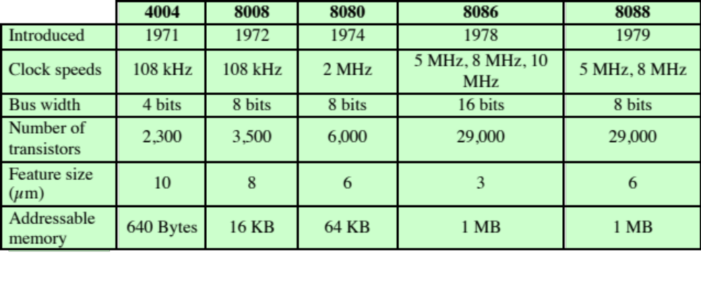
Evolution of Intel Microprocessors
(a) 1970s Processors
Notes:
About the same time, 16-bit microprocessors began to be developed. However, it
was not until the end of the 1970s that powerful, general-purpose 16-bit microprocessors
appeared. One of these was the 8086. The next step in this trend occurred in 1981,
when both Bell Labs and Hewlett-Packard developed 32-bit, single-
chip microprocessors. Intel introduced its own 32-bit microprocessor, the 80386, in 1985 (Table 1.3).

Slide 46
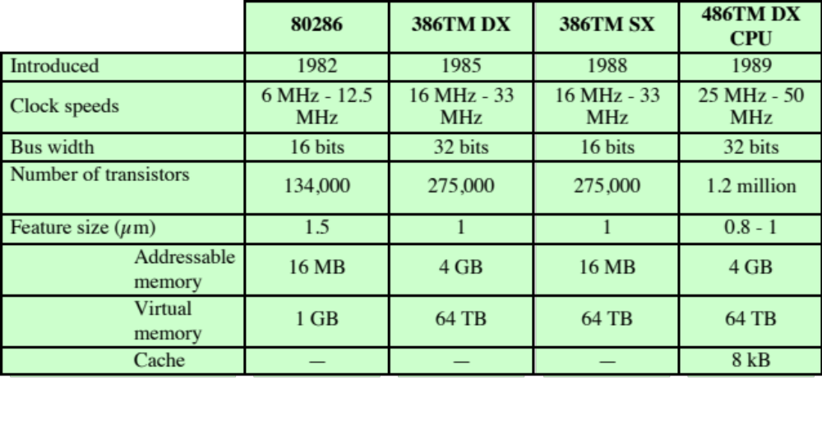
Evolution of Intel Microprocessors (Cont.)
(b) 1980s Processors
Notes:
Table 1.3 (continued)

Slide 47
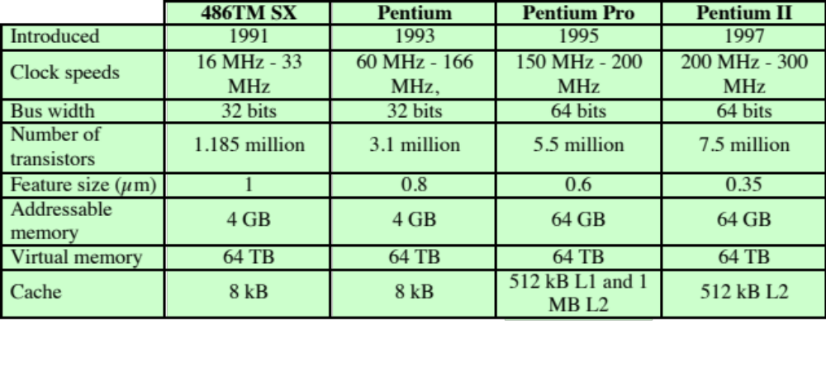
Evolution of Intel Microprocessors (Cont.)
(c) 1990s Processors
Notes:
Table 1.3 (continued)

Slide 48
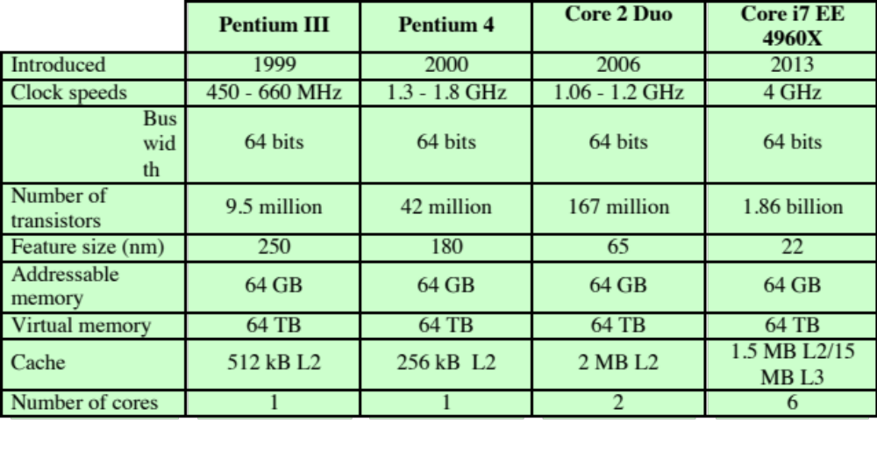
Evolution of Intel Microprocessors (Cont.)
(d) Recent Processors
Notes:
Table 1.3 (continued)

Slide 49
The Evolution of the Intel x86 Architecture
Two processor families are the Intel x86 and the ARM architectures
Current x86 offerings represent the results of decades of design effort on complex instruction set computers (CISCs)
An alternative approach to processor design is the reduced instruction set computer (RISC)
ARM architecture is used in a wide variety of embedded systems and is one of the most powerful and best-designed RISC-based systems on the market
Notes:
Throughout this book, we rely on many concrete examples of computer design and
implementation to illustrate concepts and to illuminate trade-
offs. Numerous systems, both contemporary and historical, provide examples of important computer
architecture design features. But the book relies principally on examples from two
processor families: the Intel x86 and the ARM architectures. The current x86 offerings
represent the results of decades of design effort on complex instruction set
computers (CISCs). The x86 incorporates the sophisticated design principles once
found only on mainframes and supercomputers and serves as an excellent example
of CISC design. An alternative approach to processor design is the reduced instruction
set computer (RISC). The ARM architecture is used in a wide variety of embedded
systems and is one of the most powerful and best-
designed RISC-based systems
on the market. In this section and the next, we provide a brief overview of these two
systems.
In terms of market share, Intel has ranked as the number one maker of microprocessors
for non-embedded systems for decades, a position it seems unlikely to
yield. The evolution of its flagship microprocessor product serves as a good indicator
of the evolution of computer technology in general.
Table 1.3 shows that evolution. Interestingly, as microprocessors have grown
faster and much more complex, Intel has actually picked up the pace. Intel used
to develop microprocessors one after another, every four years. But Intel hopes
to keep rivals at bay by trimming a year or two off this development time, and has
done so with the most recent x86 generations.

Slide 50
Highlights of the Evolution of the Intel Product Line:
8080
World’s first general-purpose microprocessor
8-bit machine, 8-bit data path to memory
Was used in the first personal computer (Altair)
8086
A more powerful 16-bit machine
Has an instruction cache, or queue, that prefetches a few instructions before they are executed
The first appearance of the x86 architecture
The 8088 was a variant of this processor and used in IBM’s first personal computer (securing the success of Intel
80286
Extension of the 8086 enabling addressing a 16-MB memory instead of just 1MB
80386
Intel’s first 32-bit machine
First Intel processor to support multitasking
80486
Introduced the use of much more sophisticated and powerful cache technology and sophisticated instruction pipelining
Also offered a built-in math coprocessor
Notes:
It is worthwhile to list some of the highlights of the evolution of the Intel product
line:
■ 8080: The world’s first general-
purpose microprocessor. This was an 8-bit
machine, with an 8-bit data path to memory. The 8080 was used in the first
personal computer, the Altair.
■ 8086: A far more powerful, 16-bit machine. In addition to a wider data path
and larger registers, the 8086 sported an instruction cache, or queue, that
prefetches a few instructions before they are executed. A variant of this processor,
the 8088, was used in IBM’s first personal computer, securing the success
of Intel. The 8086 is the first appearance of the x86 architecture.
■ 80286: This extension of the 8086 enabled addressing a 16-MB memory instead
of just 1 MB.
■ 80386: Intel’s first 32-bit machine, and a major overhaul of the product. With
a 32-bit architecture, the 80386 rivaled the complexity and power of minicomputers
and mainframes introduced just a few years earlier. This was the first
Intel processor to support multitasking, meaning it could run multiple programs
at the same time.
■ 80486: The 80486 introduced the use of much more sophisticated and powerful
cache technology and sophisticated instruction pipelining. The 80486 also
offered a built-in math coprocessor, offloading complex math operations from
the main CPU.

Slide 51
Highlights of the Evolution of the Intel Product Line: (Cont.)
Pentium
Pentium Pro
Pentium II
Pentium III
Pentium 4
Core
Core 2
Intel introduced the use of superscalar techniques, which allow multiple instructions to execute in parallel
Continued the move into superscalar organization with aggressive use of register renaming, branch prediction, data flow analysis, and speculative execution
Incorporated Intel MMX technology, which is designed specifically to process video, audio, and graphics data efficiently
Incorporated additional floating-point instructions
Streaming SIMD Extensions (SSE)
Includes additional floating-point and other enhancements for multimedia
First Intel x86 micro-core
Extends the Core architecture to 64 bits
Core 2 Quad provides four cores on a single chip
More recent Core offerings have up to 10 cores per chip
An important addition to the architecture was the Advanced Vector Extensions instruction set
Notes:
■ Pentium: With the Pentium, Intel introduced the use of superscalar techniques,
which allow multiple instructions to execute in parallel.
■ Pentium Pro: The Pentium Pro continued the move into superscalar organization
begun with the Pentium, with aggressive use of register renaming, branch
prediction, data flow analysis, and speculative execution.
■ Pentium II: The Pentium II incorporated Intel MMX technology, which is
designed specifically to process video, audio, and graphics data efficiently.
■ Pentium III: The Pentium III incorporates additional floating-
point instructions: The Streaming SIMD Extensions (SSE) instruction set extension added
70 new instructions designed to increase performance when exactly the same
operations are to be performed on multiple data objects. Typical applications
are digital signal processing and graphics processing.
■ Pentium 4: The Pentium 4 includes additional floating-
point and other enhancements for multimedia.
■ Core: This is the first Intel x86 microprocessor with a dual core, referring to
the implementation of two cores on a single chip.
■ Core 2: The Core 2 extends the Core architecture to 64 bits. The Core 2 Quad
provides four cores on a single chip. More recent Core offerings have up to 10
cores per chip. An important addition to the architecture was the Advanced
Vector Extensions instruction set that provided a set of 256-bit, and then 512-
bit, instructions for efficient processing of vector data.
Almost 40 years after its introduction in 1978, the x86 architecture continues to
dominate the processor market outside of embedded systems. Although the organization
and technology of the x86 machines have changed dramatically over the decades,
the instruction set architecture has evolved to remain backward compatible with earlier
versions. Thus, any program written on an older version of the x86 architecture
can execute on newer versions. All changes to the instruction set architecture have
involved additions to the instruction set, with no subtractions. The rate of change has
been the addition of roughly one instruction per month added to the architecture
[ANTH08], so that there are now thousands of instructions in the instruction set.
The x86 provides an excellent illustration of the advances in computer hardware
over the past 35 years. The 1978 8086 was introduced with a clock speed of
5 MHz and had 29,000 transistors. A six-
core Core i7 EE 4960X introduced in 2013
operates at 4 GHz, a speedup of a factor of 800, and has 1.86 billion transistors,
about 64,000 times as many as the 8086. Yet the Core i7 EE 4960X is in only a
slightly larger package than the 8086 and has a comparable cost.

Slide 52
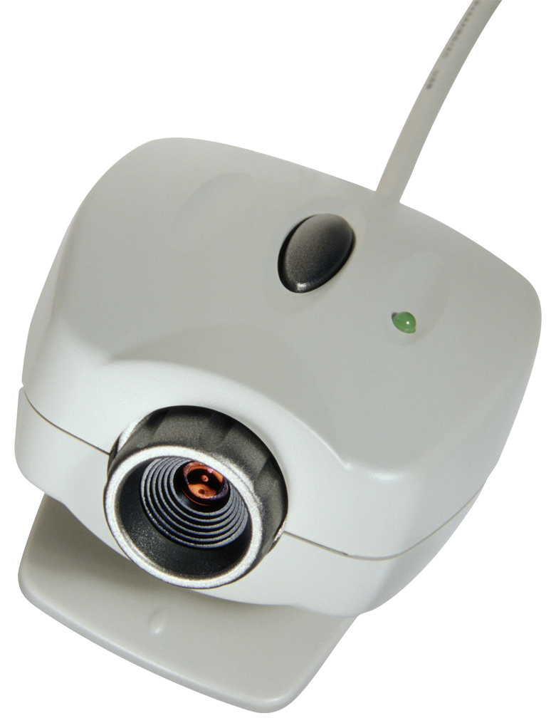
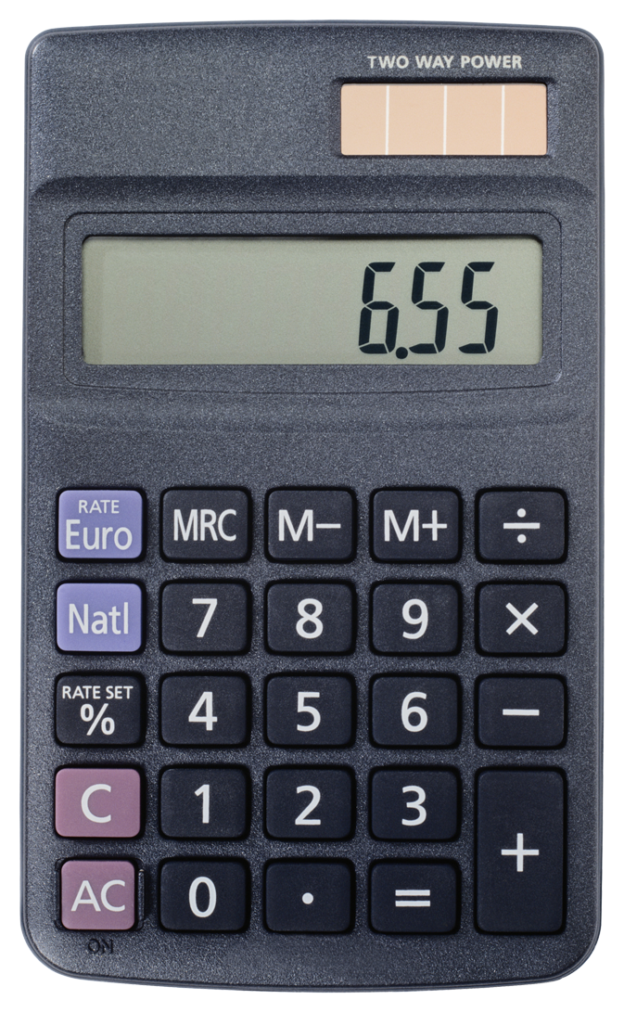
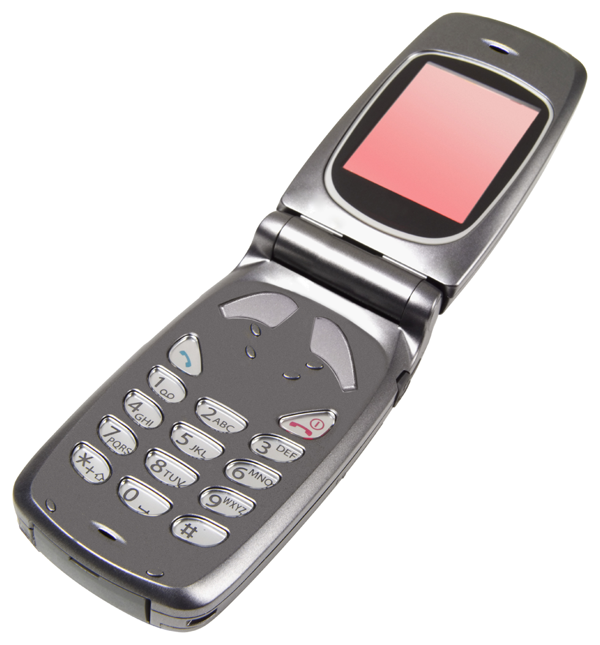
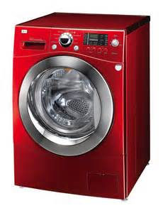
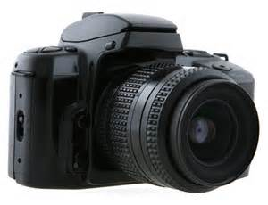
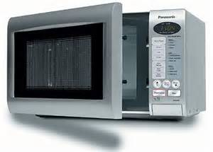
Embedded Systems
The use of electronics and software within a product
Billions of computer systems are produced each year that are embedded within larger devices
Today many devices that use electric power have an embedded computing system
Often embedded systems are tightly coupled to their environment
  This can give rise to real-time constraints imposed by the need to interact with the environment
    Constraints such as required speeds of motion, required precision of measurement, and required time durations, dictate the timing of software operations
  If multiple activities must be managed simultaneously this imposes more complex real-time constraints
Notes:
The term embedded system refers to the use of electronics and software within a
product, as opposed to a general-purpose computer, such as a laptop or desktop
system. Millions of computers are sold every year, including laptops, personal
computers, workstations, servers, mainframes, and supercomputers. In contrast, billions
of computer systems are produced each year that are embedded within larger
devices. Today, many, perhaps most, devices that use electric power have an embedded
computing system. It is likely that in the near future virtually all such devices
will have embedded computing systems.
Types of devices with embedded systems are almost too numerous to list.
Examples include cell phones, digital cameras, video cameras, calculators, microwave
ovens, home security systems, washing machines, lighting systems, thermostats,
printers, various automotive systems (e.g., transmission control, cruise
control, fuel injection, anti-lock brakes, and suspension systems), tennis rackets,
toothbrushes, and numerous types of sensors and actuators in automated systems.
Often, embedded systems are tightly coupled to their environment. This can
give rise to real-time constraints imposed by the need to interact with the environment.
Constraints, such as required speeds of motion, required precision of measurement,
and required time durations, dictate the timing of software operations. If
multiple activities must be managed simultaneously, this imposes more complex
real-time constraints.

Slide 53
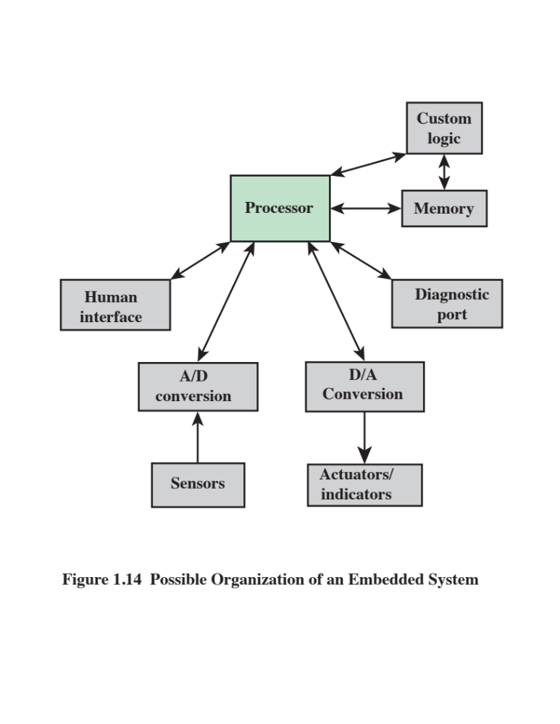
Notes:
Figure 1.14 shows in general terms an embedded system organization. In addition
to the processor and memory, there are a number of elements that differ from
the typical desktop or laptop computer:
■ There may be a variety of interfaces that enable the system to measure, manipulate,
and otherwise interact with the external environment. Embedded systems
often interact (sense, manipulate, and communicate) with external world
through sensors and actuators and hence are typically reactive systems; a reactive
system is in continual interaction with the environment and executes at a
pace determined by that environment.
■ The human interface may be as simple as a flashing light or as complicated as
real-time robotic vision. In many cases, there is no human interface.
■ The diagnostic port may be used for diagnosing the system that is being
controlled—not just for diagnosing the computer.
■ Special-purpose field programmable (FPGA), application-specific
(ASIC), or even nondigital hardware may be used to increase performance or reliability.
■ Software often has a fixed function and is specific to the application.
■ Efficiency is of paramount importance for embedded systems. They are optimized
for energy, code size, execution time, weight and dimensions, and cost.
There are several noteworthy areas of similarity to general-
purpose computer systems as well:
■ Even with nominally fixed function software, the ability to field upgrade to fix
bugs, to improve security, and to add functionality, has become very important
for embedded system, and not just in consumer devices.
■ One comparatively recent development has been of embedded system platforms
that support a wide variety of apps. Good examples of this are smartphones
and audio/visual devices, such as smart TVs.

Slide 54
The Internet of Things (IoT)
Term that refers to the expanding interconnection of smart devices, ranging from appliances to tiny sensors
Is primarily driven by deeply embedded devices
Generations of deployment culminating in the IoT:
  Information technology (IT)
    PCs, servers, routers, firewalls, and so on, bought as IT devices by enterprise IT people and primarily using wired connectivity
  Operational technology (OT)
    Machines/appliances with embedded IT built by non-IT companies, such as medical machinery, SCADA, process control, and kiosks, bought as appliances by enterprise OT people and primarily using wired connectivity
  Personal technology
    Smartphones, tablets, and eBook readers bought as IT devices by consumers exclusively using wireless connectivity and often multiple forms of wireless connectivity
  Sensor/actuator technology
    Single-purpose devices bought by consumers, IT, and OT people exclusively using wireless connectivity, generally of a single form, as part of larger systems
  It is the fourth generation that is usually thought of as the IoT and it is marked by the use of billions of embedded devices
Notes:
It is worthwhile calling out separately one of the major drivers in the proliferation
of embedded systems. The Internet of things (IoT) is a term that refers to the
expanding interconnection of smart devices, ranging from appliances to tiny sensors.
A dominant theme is the embedding of short- range mobile transceivers into a wide
array of gadgets and everyday items, enabling new forms of communication between
people and things, and between things themselves. The Internet now supports the
interconnection of billions of industrial and personal objects, usually through cloud
systems. The objects deliver sensor information, act on their environment, and, in
some cases, modify themselves, to create overall management of a larger system, like
a factory or city.
The IoT is primarily driven by deeply embedded devices (defined below).
These devices are low-bandwidth, low-repetition data-capture, and low-bandwidth
data-usage appliances that communicate with each other and provide data via user
interfaces. Embedded appliances, such as high-resolution
video security cameras, video VoIP phones, and a handful of others, require high-bandwidth
streaming capabilities. Yet countless products simply require packets of data to be intermittently
delivered.
With reference to the end systems supported, the Internet has gone through
roughly four generations of deployment culminating in the IoT:
1. Information technology (IT) : PCs, servers, routers, firewalls, and so on, bought
as IT devices by enterprise IT people and primarily using wired connectivity
2. Operational technology (OT) : Machines/appliances with embedded IT built
by non-IT companies, such as medical machinery, SCADA (supervisory control
and data acquisition), process control, and kiosks, bought as appliances by
enterprise OT people and primarily using wired connectivity
3. Personal technology: Smartphones, tablets, and eBook readers bought as IT
devices by consumers (employees) exclusively using wireless connectivity and
often multiple forms of wireless connectivity
4. Sensor/actuator technology: Single-purpose devices bought by consumers, IT,
and OT people exclusively using wireless connectivity, generally of a single
form, as part of larger systems
It is the fourth generation that is usually thought of as the IoT, and it is marked
by the use of billions of embedded devices.

Slide 55
Embedded
Operating
Systems
Application Processors
versus
Dedicated Processors
There are two general approaches to developing an embedded operating system (OS):
  Take an existing OS and adapt it for the embedded application
  Design and implement an OS intended solely for embedded use
Application processors
  Defined by the processor’s ability to execute complex operating systems
  General-purpose in nature
  An example is the smartphone – the embedded system is designed to support numerous apps and perform a wide variety of functions
Dedicated processor
  Is dedicated to one or a small number of specific tasks required by the host device
  Because such an embedded system is dedicated to a specific task or tasks, the processor and associated components can be engineered to reduce size and cost
Notes:
There are two general approaches to developing an embedded operating system
(OS). The first approach is to take an existing OS and adapt it for the embedded
application. For example, there are embedded versions of Linux, Windows, and
Mac, as well as other commercial and proprietary operating systems specialized for
embedded systems. The other approach is to design and implement an OS intended
solely for embedded use. An example of the latter is TinyOS, widely used in wireless
sensor networks. This topic is explored in depth in [STAL15].
In this subsection, and the next two, we briefly introduce some terms commonly
found in the literature on embedded systems. Application processors are defined
by the processor’s ability to execute complex operating systems, such as Linux,
Android, and Chrome. Thus, the application processor is general-purpose in nature.
A good example of the use of an embedded application processor is the smartphone.
The embedded system is designed to support numerous apps and perform a wide
variety of functions.
Most embedded systems employ a dedicated processor , which, as the name
implies, is dedicated to one or a small number of specific tasks required by the host
device. Because such an embedded system is dedicated to a specific task or tasks,
the processor and associated components can be engineered to reduce size and cost.

Slide 56
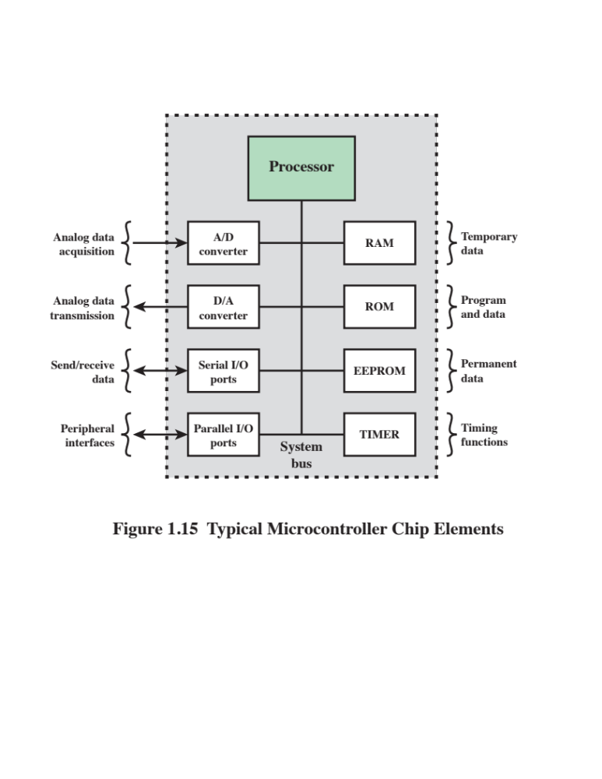
Notes:
As we have seen, early microprocessor chips included registers, an ALU, and some
sort of control unit or instruction processing logic. As transistor density increased, it
became possible to increase the complexity of the instruction set architecture, and
ultimately to add memory and more than one processor. Contemporary microprocessor
chips, as shown in Figure 1.2, include multiple cores and a substantial amount
of cache memory.
A microcontroller chip makes a substantially different use of the logic space
available. Figure 1.15 shows in general terms the elements typically found on a microcontroller
chip. As shown, a microcontroller is a single chip that contains the processor,
non-volatile memory for the program (ROM), volatile memory for input and output
(RAM), a clock, and an I/O control unit. The processor portion of the microcontroller
has a much lower silicon area than other microprocessors and much higher energy efficiency.
We examine microcontroller organization in more detail in Section 1.6.
Also called a “computer on a chip,” billions of microcontroller units are
embedded each year in myriad products from toys to appliances to automobiles. For
example, a single vehicle can use 70 or more microcontrollers. Typically, especially
for the smaller, less expensive microcontrollers, they are used as dedicated processors
for specific tasks. For example, microcontrollers are heavily utilized in automation
processes. By providing simple reactions to input, they can control machinery,
turn fans on and off, open and close valves, and so forth. They are integral parts of
modern industrial technology and are among the most inexpensive ways to produce
machinery that can handle extremely complex functionalities.
Microcontrollers come in a range of physical sizes and processing power. Processors
range from 4-bit to 32-bit architectures. Microcontrollers tend to be much
slower than microprocessors, typically operating in the MHz range rather than the
GHz speeds of microprocessors. Another typical feature of a microcontroller is that
it does not provide for human interaction. The microcontroller is programmed for a
specific task, embedded in its device, and executes as and when required.

Slide 57
Deeply Embedded Systems
Subset of embedded systems
Has a processor whose behavior is difficult to observe both by the programmer and the user
Uses a microcontroller rather than a microprocessor
Is not programmable once the program logic for the device has been burned into ROM
Has no interaction with a user
Dedicated, single-purpose devices that detect something in the environment, perform a basic level of processing, and then do something with the results
Often have wireless capability and appear in networked configurations, such as networks of sensors deployed over a large area
Typically have extreme resource constraints in terms of memory, processor size, time, and power consumption
Notes:
We have, in this section, defined the concept of an embedded system. A subset of
embedded systems, and a quite numerous subset, is referred to as deeply embedded
systems . Although this term is widely used in the technical and commercial
literature, you will search the Internet in vain (or at least I did) for a straightforward
definition. Generally, we can say that a deeply embedded system has a processor
whose behavior is difficult to observe both by the programmer and the user.
A deeply embedded system uses a microcontroller rather than a microprocessor, is
not programmable once the program logic for the device has been burned into ROM
(read-only memory), and has no interaction with a user.
Deeply embedded systems are dedicated, single-purpose devices that detect something in the environment,
perform a basic level of processing, and then do
something with the results. Deeply embedded systems often have wireless capability
and appear in networked configurations, such as networks of sensors deployed
over a large area (e.g., factory, agricultural field). The Internet of things depends
heavily on deeply embedded systems. Typically, deeply embedded systems have
extreme resource constraints in terms of memory, processor size, time, and power
consumption.

Slide 58
ARM
Refers to a processor architecture that has evolved from RISC design principles and is used in embedded systems
Family of RISC-based microprocessors and microcontrollers designed by ARM Holdings, Cambridge, England
Chips are high-speed processors that are known for their small die size and low power requirements
Probably the most widely used embedded processor architecture and indeed the most widely used processor architecture of any kind in the world
Acorn RISC Machine/Advanced RISC Machine
Notes:
The ARM architecture refers to a processor architecture that has evolved from
RISC design principles and is used in embedded systems. Chapter 15 examines
RISC design principles in detail. In this section, we give a brief overview of the
ARM architecture.
ARM is a family of RISC-based
microprocessors and microcontrollers designed
by ARM Holdings, Cambridge, England. The company doesn’t make processors
but instead designs microprocessor and multicore architectures and licenses them
to manufacturers. Specifically, ARM Holdings has two types of licensable products:
processors and processor architectures. For processors, the customer buys the
rights to use ARM-supplied design in their own chips. For a processor architecture,
the customer buys the rights to design their own processor compliant with ARM’s
architecture.
ARM chips are high-speed
processors that are known for their small die size
and low power requirements. They are widely used in smartphones and other handheld
devices, including game systems, as well as a large variety of consumer products.
ARM chips are the processors in Apple’s popular iPod and iPhone devices,
and are used in virtually all Android smartphones as well. ARM is probably the
most widely used embedded processor architecture and indeed the most widely
used processor architecture of any kind in the world [VANC14].
The origins of ARM technology can be traced back to the British-based
Acorn Computers company. In the early 1980s, Acorn was awarded a contract by the British
Broadcasting Corporation (BBC) to develop a new microcomputer architecture
for the BBC Computer Literacy Project. The success of this contract enabled Acorn
to go on to develop the first commercial RISC processor, the Acorn RISC Machine
(ARM). The first version, ARM1, became operational in 1985 and was used for
internal research and development as well as being used as a coprocessor in the
BBC machine.
In this early stage, Acorn used the company VLSI Technology to do the actual
fabrication of the processor chips. VLSI was licensed to market the chip on its own
and had some success in getting other companies to use the ARM in their products,
particularly as an embedded processor.
The ARM design matched a growing commercial need for a high-performance,
Low-power-consumption, small-size, and low-cost
processor for embedded applications.
But further development was beyond the scope of Acorn’s capabilities.
Accordingly, a new company was organized, with Acorn, VLSI, and Apple Computer
as founding partners, known as ARM Ltd. The Acorn RISC Machine became
Advanced RISC Machines.

Slide 59
ARM Products
Cortex-A/Cortex-A50
Cortex-R
Cortex-M
Cortex-M0
Cortex-M0+
Cortex-M3
Cortex-M4
Notes:
ARM Holdings licenses a number of specialized microprocessors and related technologies,
but the bulk of their product line is the Cortex family of microprocessor
architectures. There are three Cortex architectures, conveniently labeled with the
initials A, R, and M.
The Cortex-Aand Cortex-A50
are application processors, intended for mobile devices such as smartphones and eBook readers,
as well as consumer devices such as digital TV and home gateways (e.g., DSL and
cable Internet modems). These processors run at higher clock frequency (over
1 GHz), and support a memory management unit (MMU), which is required for full
feature OSs such as Linux, Android, MS Windows, and mobile OSs. An MMU is
a hardware module that supports virtual memory and paging by translating virtual
addresses into physical addresses; this topic is explored in Chapter 8.
The two architectures use both the ARM and Thumb-2
instruction sets; the principal difference is that the Cortex-A
is a 32-bit machine, and the Cortex-A50 is a 64-bit machine.
The Cortex-R is designed to support real-time applications, in which the
timing of events needs to be controlled with rapid response to events. They can run at
a fairly high clock frequency (e.g., 200MHz to 800MHz) and have very low response
latency. The Cortex-R includes enhancements both to the instruction set and to the
processor organization to support deeply embedded real-time
devices. Most of these
processors do not have MMU; the limited data requirements and the limited number
of simultaneous processes eliminates the need for elaborate hardware and software
support for virtual memory. The Cortex-R
does have a Memory Protection Unit
(MPU), cache, and other memory features designed for industrial applications. An
MPU is a hardware module that prohibits one program in memory from accidentally
accessing memory assigned to another active program. Using various methods, a
protective boundary is created around the program, and instructions within the
program are prohibited from referencing data outside of that boundary.
Examples of embedded systems that would use the Cortex-R
are automotive braking systems, mass storage controllers, and networking and printing devices.
Cortex-M series processors have been developed primarily for the
microcontroller domain where the need for fast, highly deterministic interrupt
management is coupled with the desire for extremely low gate count and
lowest possible power consumption. As with the Cortex-R
series, the Cortex-M architecture has an MPU but no MMU. The Cortex-M
uses only the Thumb-2 instruction set. The market for the Cortex-M
includes IoT devices, wireless sensor/actuator networks used in factories and other enterprises, automotive
body electronics, and so on.
There are currently four versions of the Cortex-M
series:
■ Cortex-M0 :
Designed for 8- and 16-bit applications, this model emphasizes low
cost, ultra low power, and simplicity. It is optimized for small silicon die size
(starting from 12k gates) and use in the lowest cost chips.
■ Cortex-M0+ :
An enhanced version of the M0 that is more energy efficient.
■ Cortex-M3 :
Designed for 16- and 32-bit applications, this model emphasizes
performance and energy efficiency. It also has comprehensive debug and trace
features to enable software developers to develop their applications quickly.
■ Cortex-M4 :
This model provides all the features of the Cortex-M3,
with additional instructions to support digital signal processing tasks.
In this text, we will primarily use the ARM Cortex-M3
as our example embedded
system processor. It is the best suited of all ARM models for general-purpose
microcontroller use. The Cortex-M3 is used by a variety of manufacturers of microcontroller
products. Initial microcontroller devices from lead partners already
combine the Cortex-M3
processor with flash, SRAM, and multiple peripherals to
provide a competitive offering at the price of just $1.

Slide 60
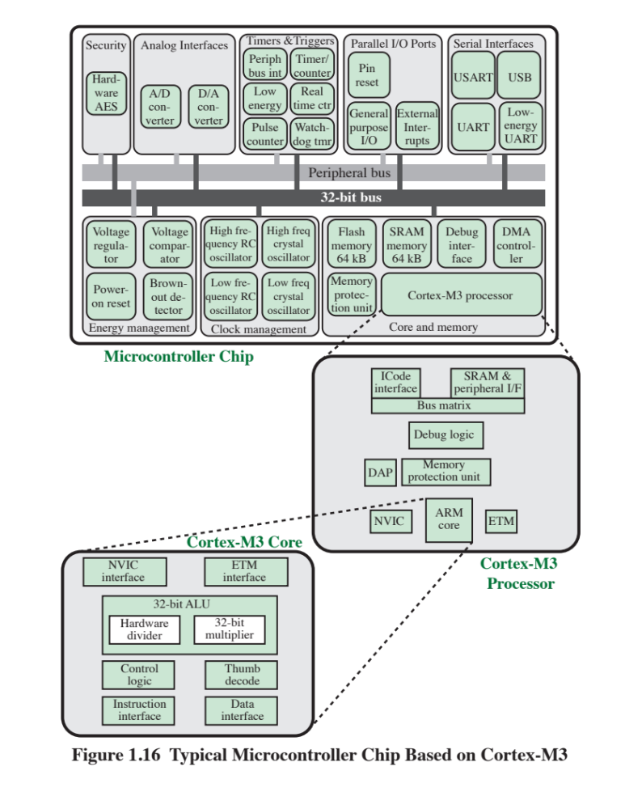
Notes:
Figure 1.16 provides a block diagram of the EFM32 microcontroller from Silicon
Labs. The figure also shows detail of the Cortex-M3
processor and core components.
We examine each level in turn.
The Cortex-M3 core makes use of separate buses for instructions and data.
This arrangement is sometimes referred to as a Harvard architecture, in contrast
with the von Neumann architecture, which uses the same signal buses and memory
for both instructions and data. By being able to read both an instruction and
data from memory at the same time, the Cortex-M3 processor can perform many
operations in parallel, speeding application execution. The core contains a decoder
for Thumb instructions, an advanced ALU with support for hardware multiply and
divide, control logic, and interfaces to the other components of the processor. In
particular, there is an interface to the nested vector interrupt controller (NVIC) and
the embedded trace macrocell (ETM) module.
The core is part of a module called the Cortex-M3
processor . This term is somewhat misleading, because typically in the literature, the terms core and processor
are viewed as equivalent. In addition to the core, the processor includes the
following elements:
■ NVIC : Provides configurable interrupt handling abilities to the processor. It
facilitates low-latency exception and interrupt handling, and controls power
management.
■ ETM : An optional debug component that enables reconstruction of program
execution. The ETM is designed to be a high-speed, low-power debug tool
that only supports instruction trace.
■ Debug access port (DAP) : This provides an interface for external debug
access to the processor.
■ Debug logic : Basic debug functionality includes processor halt, single-
step, processor core register access, unlimited software breakpoints, and full system
memory access.
■ ICode interface : Fetches instructions from the code memory space.
■ SRAM & peripheral interface : Read/write interface to data memory and peripheral
devices.
■ Bus matrix : Connects the core and debug interfaces to external buses on the
microcontroller.
■ Memory protection unit : Protects critical data used by the operating system
from user applications, separating processing tasks by disallowing access
to each other’s data, disabling access to memory regions, allowing memory
regions to be defined as read-only,
and detecting unexpected memory accesses
that could potentially break the system.
The upper part of Figure 1.16 shows the block diagram of a typical microcontroller
built with the Cortex-M3, in this case the EFM32 microcontroller. This
microcontroller is marketed for use in a wide variety of devices, including energy,
gas, and water metering; alarm and security systems; industrial automation devices;
home automation devices; smart accessories; and health and fitness devices. The silicon
chip consists of 10 main areas:
■ Core and memory: This region includes the Cortex-M3
processor, static RAM (SRAM) data memory, and flash memory15 for storing program instructions
and nonvarying application data. Flash memory is nonvolatile (data is not lost
when power is shut off) and so is ideal for this purpose. The SRAM stores
variable data. This area also includes a debug interface, which makes it easy to
reprogram and update the system in the field.
■ Parallel I/O ports: Configurable for a variety of parallel I/O schemes.
■ Serial interfaces: Supports various serial I/O schemes.
■ Analog interfaces : Analog-to-digital and digital-to-analog
logic to support sensors and actuators.
■ Timers and triggers : Keeps track of timing and counts events, generates output
waveforms, and triggers timed actions in other peripherals.
■ Clock management : Controls the clocks and oscillators on the chip. Multiple
clocks and oscillators are used to minimize power consumption and provide
short startup times.
■ Energy management : Manages the various low-energy
modes of operation of the processor and peripherals to provide real-time
management of the energy needs so as to minimize energy consumption.
■ Security : The chip includes a hardware implementation of the Advanced
Encryption Standard (AES).
■ 32-bit bus : Connects all of the components on the chip.
■ Peripheral bus : A network which lets the different peripheral module communicate
directly with each other without involving the processor. This supports
timing-critical operation and reduces software overhead.
Comparing Figure 1.16 with Figure 1.2, you will see many similarities and
the same general hierarchical structure. Note, however, that the top level of a
microcontroller computer system is a single chip, whereas for a multicore computer,
the top level is a motherboard containing a number of chips. Another noteworthy
difference is that there is no cache, neither in the Cortex-M3 processor
nor in the microcontroller as a whole, which plays an important role if the code or
data resides in external memory. Though the number of cycles to read the instruction
or data varies depending on cache hit or miss, the cache greatly improves the
performance when external memory is used. Such overhead is not needed for a
microcontroller.

Slide 61

Cloud Computing
NIST defines cloud computing as:
“A model for enabling ubiquitous, convenient, on-demand network access to a shared pool of configurable computing resources that can be rapidly provisioned and released with minimal management effort or service provider interaction.”
You get economies of scale, professional network management, and professional security management
The individual or company only needs to pay for the storage capacity and services they need
Cloud provider takes care of security
Notes:
Although the general concepts for cloud computing go back to the 1950s, cloud computing
services first became available in the early 2000s, particular targeted at large
enterprises. Since then, cloud computing has spread to small and medium size businesses,
and most recently to consumers. Apple’s iCloud was launched in 2012 and
had 20 million users within a week of launch. Evernote, the cloud-based notetaking
and archiving service, launched in 2008, approached 100 million users in less than
6 years. In this section, we provide a brief overview. Cloud computing is examined in
more detail in Chapter 17.
There is an increasingly prominent trend in many organizations to move a substantial
portion or even all information technology (IT) operations to an Internet-
connected infrastructure known as enterprise cloud computing. At the same time, individual
users of PCs and mobile devices are relying more and more on cloud computing
services to backup data, synch devices, and share, using personal cloud computing.
NIST defines cloud computing, in NIST SP-800-145 (The NIST Definition of Cloud
Computing ), as follows:
Cloud computing: A model for enabling ubiquitous, convenient, on-demand
network access to a shared pool of configurable computing resources (e.g., networks, servers,
storage, applications, and services) that can be rapidly provisioned and released with
minimal management effort or service provider interaction.
Basically, with cloud computing, you get economies of scale, professional network
management, and professional security management. These features can be
attractive to companies large and small, government agencies, and individual PC
and mobile users. The individual or company only needs to pay for the storage capacity
and services they need. The user, be it company or individual, doesn’t have
the hassle of setting up a database system, acquiring the hardware they need, doing
maintenance, and backing up the data—all these are part of the cloud service.
In theory, another big advantage of using cloud computing to store your data
and share it with others is that the cloud provider takes care of security. Alas, the
customer is not always protected. There have been a number of security failures
among cloud providers. Evernote made headlines in early 2013 when it told all of its
users to reset their passwords after an intrusion was discovered.

Slide 62
Cloud Networking
Refers to the networks and network management functionality that must be in place to enable cloud computing
One example is the provisioning of high-performance and/or high-reliability networking between the provider and subscriber
The collection of network capabilities required to access a cloud, including making use of specialized services over the Internet, linking enterprise data center to a cloud, and using firewalls and other network security devices at critical points to enforce access security policies
Cloud Storage
Subset of cloud computing
Consists of database storage and database applications hosted remotely on cloud servers
Enables small businesses and individual users to take advantage of data storage that scales with their needs and to take advantage of a variety of database applications without having to buy, maintain, and manage the storage assets
Notes:
Cloud networking refers to the networks and network management functionality
that must be in place to enable cloud computing. Most cloud computing solutions
rely on the Internet, but that is only a piece of the networking infrastructure.
One example of cloud networking is the provisioning of high-performance
and/or high- reliability networking between the provider and subscriber. In this case, some
or all of the traffic between an enterprise and the cloud bypasses the Internet and
uses dedicated private network facilities owned or leased by the cloud service provider.
More generally, cloud networking refers to the collection of network capabilities
required to access a cloud, including making use of specialized services over
the Internet, linking enterprise data centers to a cloud, and using firewalls and other
network security devices at critical points to enforce access security policies.
We can think of cloud storage as a subset of cloud computing. In essence, cloud
storage consists of database storage and database applications hosted remotely on
cloud servers. Cloud storage enables small businesses and individual users to take
advantage of data storage that scales with their needs and to take advantage of a
variety of database applications without having to buy, maintain, and manage the
storage assets.

Slide 63
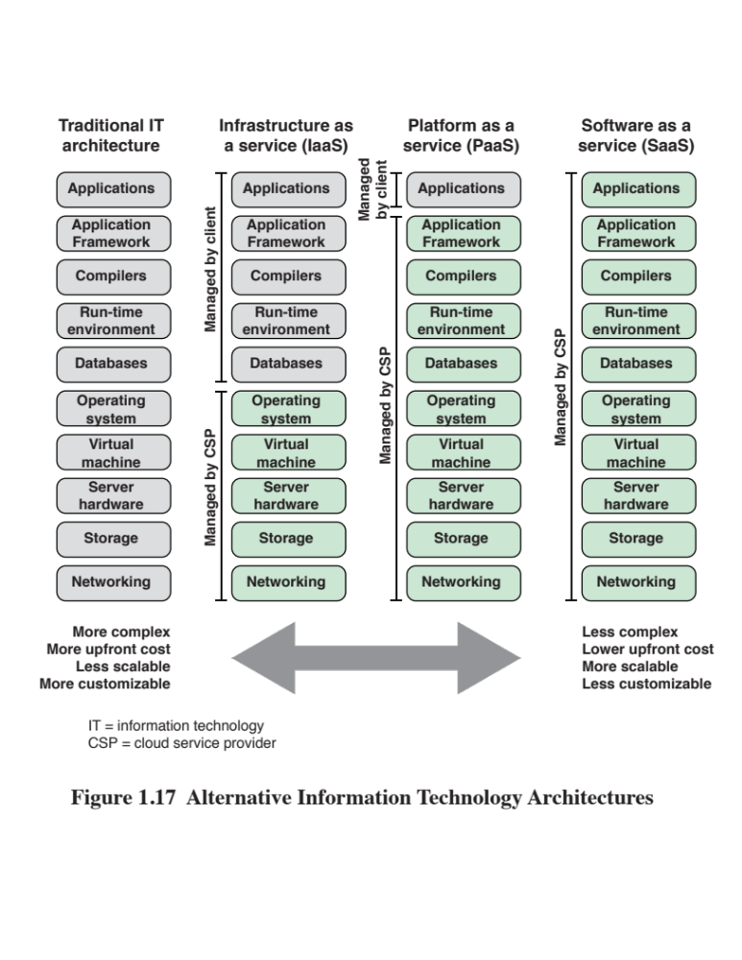
Notes:
The essential purpose of cloud computing is to provide for the convenient rental
of computing resources. A cloud service provider (CSP) maintains computing and
data storage resources that are available over the Internet or private networks.
Customers can rent a portion of these resources as needed. Virtually all cloud service
is provided using one of three models (Figure 1.17): SaaS, PaaS, and IaaS, which
we examine in this section.
Software as a service (SaaS) As the name implies, a SaaS cloud provides
service to customers in the form of software, specifically application software,
running on and accessible in the cloud. SaaS follows the familiar model of Web
services, in this case applied to cloud resources. SaaS enables the customer to use
the cloud provider’s applications running on the provider’s cloud infrastructure. The
applications are accessible from various client devices through a simple interface
such as a Web browser. Instead of obtaining desktop and server licenses for
software products it uses, an enterprise obtains the same functions from the cloud
service. SaaS saves the complexity of software installation, maintenance, upgrades,
and patches. Examples of services at this level are Gmail, Google’s e-mail service,
and Salesforce.com, which help firms keep track of their customers.
Common subscribers to SaaS are organizations that want to provide their
employees with access to typical office productivity software, such as document
management and email. Individuals also commonly use the SaaS model to acquire
cloud resources. Typically, subscriber use specific applications on demand. The
cloud provider also usually offers data-related
features such as automatic backup and data sharing between subscribers.
Platform as a service (PaaS) A PaaS cloud provides service to customers in
the form of a platform on which the customer’s applications can run. PaaS enables
the customer to deploy onto the cloud infrastructure containing customer-
created or acquired applications. A PaaS cloud provides useful software building blocks,
plus a number of development tools, such as programming languages, run-
time environments, and other tools that assist in deploying new applications. In effect,
PaaS is an operating system in the cloud. PaaS is useful for an organization that
wants to develop new or tailored applications while paying for the needed computing
resources only as needed and only for as long as needed. Google App Engine and
the Salesforce1 Platform from Salesforce.com are examples of PaaS.
Infrastructure as a service (IaaS) With IaaS, the customer has access to the
underlying cloud infrastructure. IaaS provides virtual machines and other abstracted
hardware and operating systems, which may be controlled through a service
application programming interface (API). IaaS offers the customer processing,
storage, networks, and other fundamental computing resources so that the customer
is able to deploy and run arbitrary software, which can include operating systems
and applications. IaaS enables customers to combine basic computing services,
such as number crunching and data storage, to build highly adaptable computer
systems. Examples of IaaS are Amazon Elastic Compute Cloud (Amazon EC2) and
Windows Azure.

Slide 64
Part 2
Performance Issues

Slide 65
Learning Objectives
Understand the principles of designing for performance
Appreciate issues related to performance
Differentiate between multicore processors, MICs, GPGPUs
Evaluate Amdahl’s and Little’s Laws
Perform basic measures for computer performance
Calculate different mean values
Understand the need for benchmarking
Explain SPEC

Slide 66
Outline
Performance Issues
Designing for performance
  Microprocessor speed
  Performance balance
  Improvements in chip organization and architecture
Multicore
MICs
GPGPUs
Amdahl’s Law
Little’s Law
  Basic measures of computer performance
  Clock speed
  Instruction execution rate
  Calculating the mean
  Arithmetic mean
  Harmonic mean
  Geometric mean
  Benchmark principles
  SPEC benchmarks
Notes:
Chapter 2 summary.

Slide 67
Designing for Performance
The cost of computer systems continues to drop dramatically, while the performance and capacity of those systems continue to rise equally dramatically
Today’s laptops have the computing power of an IBM mainframe from 10 or 15 years ago
Processors are so inexpensive that we now have microprocessors we throw away
Desktop applications that require the great power of today’s microprocessor-based systems include:
  Image processing
  Three-dimensional rendering
  Speech recognition
  Videoconferencing
  Multimedia authoring
  Voice and video annotation of files
  Simulation modeling
  Businesses are relying on increasingly powerful servers to handle transaction and database processing and to support massive client/server networks that have replaced the huge mainframe computer centers of yesteryear
  Cloud service providers use massive high-performance banks of servers to satisfy high-volume, high-transaction-rate applications for a broad spectrum of clients
Notes:
Year by year, the cost of computer systems continues to drop dramatically, while the
performance and capacity of those systems continue to rise equally dramatically.
Today’s laptops have the computing power of an IBM mainframe from 10 or 15
years ago. Thus, we have virtually “free” computer power. Processors are so inexpensive
that we now have microprocessors we throw away. The digital pregnancy test is
an example (used once and then thrown away). And this continuing technological
revolution has enabled the development of applications of astounding complexity
and power. For example, desktop applications that require the great power of
today’s microprocessor-based systems include
■ Image processing
■ Three-dimensional rendering
■ Speech recognition
■ Videoconferencing
■ Multimedia authoring
■ Voice and video annotation of files
■ Simulation modeling
Workstation systems now support highly sophisticated engineering and scientific
applications and have the capacity to support image and video applications. In addition,
businesses are relying on increasingly powerful servers to handle transaction
and database processing and to support massive client/server networks that have
replaced the huge mainframe computer centers of yesteryear. As well, cloud service
providers use massive high-performance banks of servers to satisfy high-volume,
high-transaction-rate applications for a broad spectrum of clients.
What is fascinating about all this from the perspective of computer organization
and architecture is that, on the one hand, the basic building blocks for today’s
computer miracles are virtually the same as those of the IAS computer from over
50 years ago, while on the other hand, the techniques for squeezing the maximum
performance out of the materials at hand have become increasingly sophisticated.
This observation serves as a guiding principle for the presentation in this
book. As we progress through the various elements and components of a computer,
two objectives are pursued. First, the book explains the fundamental functionality
in each area under consideration, and second, the book explores those techniques
required to achieve maximum performance. In the remainder of this section, we
highlight some of the driving factors behind the need to design for performance.

Slide 68
Microprocessor Speed
Techniques built into contemporary processors include:
Pipelining
Processor moves data or instructions into a conceptual pipe with all stages of the pipe processing simultaneously
Branch prediction
Processor looks ahead in the instruction code fetched from memory and predicts which branches, or groups of instructions, are likely to be processed next
Data flow analysis
Processor analyzes which instructions are dependent on each other’s results, or data, to create an optimized schedule of instructions
Speculative execution
Using branch prediction and data flow analysis, some processors speculatively execute instructions ahead of their actual appearance in the program execution, holding the results in temporary locations, keeping execution engines as busy as possible
Superscalar execution
This is the ability to issue more than one instruction in every processor clock cycle. (In effect, multiple parallel pipelines are used.)
Notes:
What gives Intel x86 processors or IBM mainframe computers such mind-boggling
power is the relentless pursuit of speed by processor chip manufacturers. The evolution
of these machines continues to bear out Moore’s law, mentioned previously. So
long as this law holds, chipmakers can unleash a new generation of chips every three
years—with four times as many transistors. In memory chips, this has quadrupled
the capacity of dynamic random-access memory (DRAM), still the basic technology
for computer main memory, every three years. In microprocessors, the addition of
new circuits, and the speed boost that comes from reducing the distances between
them, has improved performance four- or fivefold every three years or so since Intel
launched its x86 family in 1978.
But the raw speed of the microprocessor will not achieve its potential unless
it is fed a constant stream of work to do in the form of computer instructions.
Anything that gets in the way of that smooth flow undermines the power of the
processor. Accordingly, while the chipmakers have been busy learning how to fabricate
chips of greater and greater density, the processor designers must come up with
ever more elaborate techniques for feeding the monster. Among the techniques
built into contemporary processors are the following:
Pipelining:
The execution of an instruction involves multiple stages of operation,
including fetching the instruction, decoding the opcode, fetching operands,
performing a calculation, and so on. Pipelining enables a processor to
work simultaneously on multiple instructions by performing a different phase
for each of the multiple instructions at the same time. The processor overlaps
operations by moving data or instructions into a conceptual pipe with all
stages of the pipe processing simultaneously. For example, while one instruction
is being executed, the computer is decoding the next instruction. This is
the same principle as seen in an assembly line.
• Branch prediction:
The processor looks ahead in the instruction code fetched
from memory and predicts which branches, or groups of instructions, are likely
to be processed next. If the processor guesses right most of the time, it can
prefetch the correct instructions and buffer them so that the processor is kept
busy. The more sophisticated examples of this strategy predict not just the
next branch but multiple branches ahead. Thus, branch prediction increases
the amount of work available for the processor to execute.
• Superscalar execution:
This is the ability to issue more than one instruction
in every processor clock cycle. In effect, multiple parallel pipelines are used.
• Data flow analysis:
The processor analyzes which instructions are dependent
on each other’s results, or data, to create an optimized schedule of instructions.
In fact, instructions are scheduled to be executed when ready, independent of
the original program order. This prevents unnecessary delay.
• Speculative execution:
Using branch prediction and data flow analysis, some
processors speculatively execute instructions ahead of their actual appearance
in the program execution, holding the results in temporary locations.
This enables the processor to keep its execution engines as busy as possible by
executing instructions that are likely to be needed.
These and other sophisticated techniques are made necessary by the sheer
power of the processor. Collectively they make it possible to execute many instructions
per processor cycle, rather than to take many cycles per instruction.

Slide 69
Performance
Balance
Increase the number of bits that are retrieved at one time by making DRAMs “wider” rather than “deeper” and by using wide bus data paths
Change the DRAM interface to make it more efficient by including a cache or other buffering scheme on the DRAM chip
Reduce the frequency of memory access by incorporating increasingly complex and efficient cache structures between the processor and main memory
Increase the interconnect bandwidth between processors and memory by using higher speed buses and a hierarchy of buses to buffer and structure data flow
  Adjust the organization and
  architecture to compensate
  for the mismatch among the
  capabilities of the various
  components
  Architectural examples
  include:
Notes:
While processor power has raced ahead at breakneck speed, other critical components
of the computer have not kept up. The result is a need to look for performance
balance: an adjusting of the organization and architecture to compensate for the
mismatch among the capabilities of the various components.
The problem created by such mismatches is particularly critical at the
interface between processor and main memory. While processor speed has grown
rapidly, the speed with which data can be transferred between main memory and the
processor has lagged badly. The interface between processor and main memory is
the most crucial pathway in the entire computer because it is responsible for carrying
a constant flow of program instructions and data between memory chips and the
processor. If memory or the pathway fails to keep pace with the processor’s insistent
demands, the processor stalls in a wait state, and valuable processing time is lost.
A system architect can attack this problem in a number of ways, all of which
are reflected in contemporary computer designs. Consider the following examples:
• Increase the number of bits that are retrieved at one time by making DRAMs
“wider” rather than “deeper” and by using wide bus data paths.
• Change the DRAM interface to make it more efficient by including a cache
or other buffering scheme on the DRAM chip.
• Reduce the frequency of memory access by incorporating increasingly complex
and efficient cache structures between the processor and main memory. This
includes the incorporation of one or more caches on the processor chip as well
as on an off-chip cache close to the processor chip.
• Increase the interconnect bandwidth between processors and memory by using
higher-speed buses and a hierarchy of buses to buffer and structure data
flow.

Slide 70
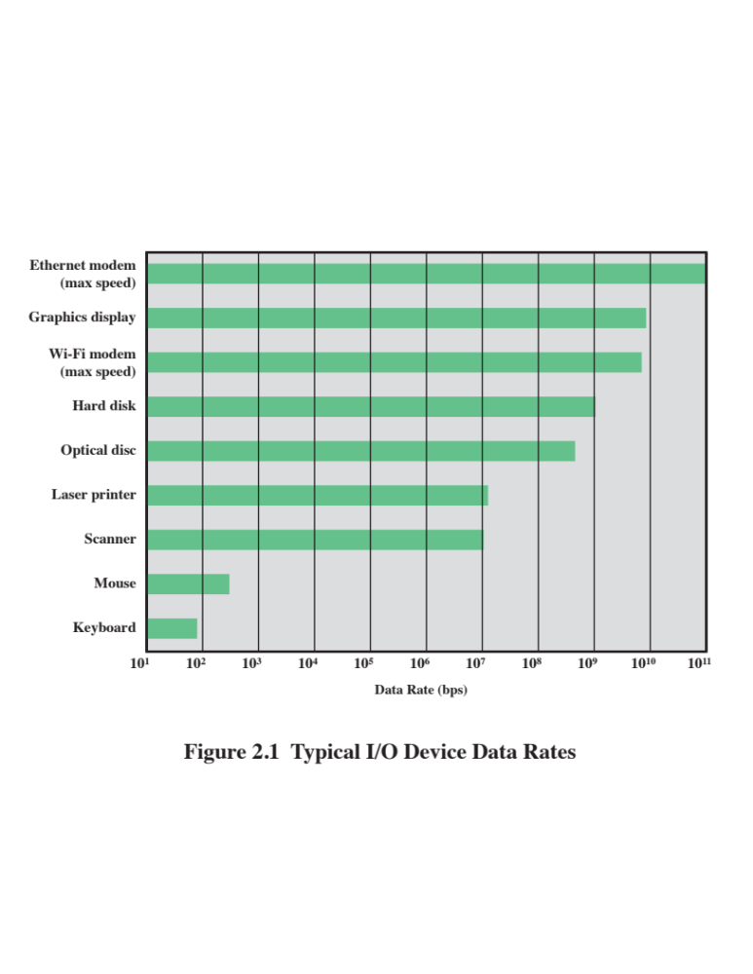
Notes:
Another area of design focus is the handling of I/O devices. As computers
become faster and more capable, more sophisticated applications are developed
that support the use of peripherals with intensive I/O demands. Figure 2.1 gives
some examples of typical peripheral devices in use on personal computers and
workstations. These devices create tremendous data throughput demands. While
the current generation of processors can handle the data pumped out by these
devices, there remains the problem of getting that data moved between processor
and peripheral. Strategies here include caching and buffering schemes plus the
use of higher-speed interconnection buses and more elaborate structures of buses.
In addition, the use of multiple-processor configurations can aid in satisfying I/O
demands.
The key in all this is balance. Designers constantly strive to balance the
throughput and processing demands of the processor components, main memory,
I/O devices, and the interconnection structures. This design must constantly be
rethought to cope with two constantly evolving factors:
• The rate at which performance is changing in the various technology areas
(processor, buses, memory, peripherals) differs greatly from one type of
element to another.
• New applications and new peripheral devices constantly change the nature of
the demand on the system in terms of typical instruction profile and the data
access patterns.
Thus, computer design is a constantly evolving art form. This book attempts to
present the fundamentals on which this art form is based and to present a survey of
the current state of that art.

Slide 71
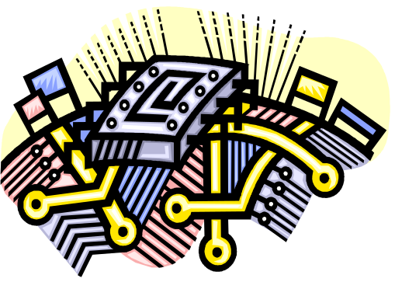
Improvements in Chip Organization and Architecture
Increase hardware speed of processor
  Fundamentally due to shrinking logic gate size
    More gates, packed more tightly, increasing clock rate
    Propagation time for signals reduced
Increase size and speed of caches
  Dedicating part of processor chip
    Cache access times drop significantly
Change processor organization and architecture
  Increase effective speed of instruction execution
  Parallelism
Notes:
As designers wrestle with the challenge of balancing processor performance with that
of main memory and other computer components, the need to increase processor
speed remains. There are three approaches to achieving increased processor speed:
• Increase the hardware speed of the processor. This increase is fundamentally
due to shrinking the size of the logic gates on the processor chip, so that more
gates can be packed together more tightly and to increasing the clock rate.
With gates closer together, the propagation time for signals is significantly
reduced, enabling a speeding up of the processor. An increase in clock rate
means that individual operations are executed more rapidly.
• Increase the size and speed of caches that are interposed between the processor
and main memory. In particular, by dedicating a portion of the processor
chip itself to the cache, cache access times drop significantly.
• Make changes to the processor organization and architecture that increase the
effective speed of instruction execution. Typically, this involves using parallelism
in one form or another.

Slide 72
Problems with Clock Speed and Login Density
Power
  Power density increases with density of logic and clock speed
  Dissipating heat
RC delay
  Speed at which electrons flow limited by resistance and capacitance of metal wires connecting them
  Delay increases as the RC product increases
  As components on the chip decrease in size, the wire interconnects become thinner, increasing resistance
  Also, the wires are closer together, increasing capacitance
Memory latency
  Memory speeds lag processor speeds
Notes:
Traditionally, the dominant factor in performance gains has been in increases
in clock speed due and logic density. However, as clock speed and logic density
increase, a number of obstacles become more significant [INTE04b]:
• Power: As the density of logic and the clock speed on a chip increase, so does
the power density (Watts/cm2). The difficulty of dissipating the heat generated
on high-density, high-speed chips is becoming a serious design issue [GIBB04,
BORK03].
• RC delay: The speed at which electrons can flow on a chip between transistors
is limited by the resistance and capacitance of the metal wires connecting
them; specifically, delay increases as the RC product increases. As components
on the chip decrease in size, the wire interconnects become thinner, increasing
resistance. Also, the wires are closer together, increasing capacitance.
• Memory latency: Memory speeds lag processor speeds, as previously discussed.
Thus, there will be more emphasis on organization and architectural approaches
to improving performance. These techniques are discussed in later chapters of the book.

Slide 73
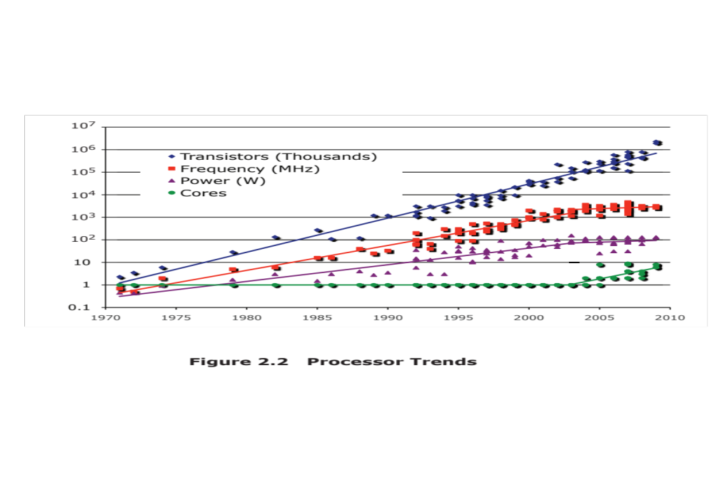
Notes:
Beginning in the late 1980s, and continuing for about 15 years, two main
strategies have been used to increase performance beyond what can be achieved
simply by increasing clock speed. First, there has been an increase in cache capacity.
There are now typically two or three levels of cache between the processor and
main memory. As chip density has increased, more of the cache memory has been
incorporated on the chip, enabling faster cache access. For example, the original
Pentium chip devoted about 10% of on-chip area to caches. Contemporary chips
devote over half of the chip area to caches. And, typically, about three-quarters of the
other half is for pipeline-related control and buffering.
Second, the instruction execution logic within a processor has become increasingly
complex to enable parallel execution of instructions within the processor. Two
noteworthy design approaches have been pipelining and superscalar. A pipeline
works much as an assembly line in a manufacturing plant enabling different stages
of execution of different instructions to occur at the same time along the pipeline. A
superscalar approach in essence allows multiple pipelines within a single processor
so that instructions that do not depend on one another can be executed in parallel.
By the mid to late 90s, both of these approaches were reaching a point of
diminishing returns. The internal organization of contemporary processors is
exceedingly complex and is able to squeeze a great deal of parallelism out of the
instruction stream. It seems likely that further significant increases in this direction
will be relatively modest [GIBB04]. With three levels of cache on the processor
chip, each level providing substantial capacity, it also seems that the benefits from
the cache are reaching a limit.
However, simply relying on increasing clock rate for increased performance
runs into the power dissipation problem already referred to. The faster the clock
rate, the greater the amount of power to be dissipated, and some fundamental physical
limits are being reached.
Figure 2.2 illustrates the concepts we have been discussing. The top line
shows that, as per Moore’s Law, the number of transistors on a single chip continues
to grow exponentially. Meanwhile, the clock speed has leveled off, in order
to prevent a further rise in power. To continue to increase performance, designers
have had to find ways of exploiting the growing number of transistors other than
simply building a more complex processor. The response in recent years has been
the development of the multicore computer chip.

Slide 74
Multicore
The use of multiple processors on the same chip provides the potential to increase performance without increasing the clock rate
Strategy is to use two simpler processors on the chip rather than one more complex processor
With two processors larger caches are justified
As caches became larger it made performance sense to create two and then three levels of cache on a chip
Notes:
With all of the difficulties cited in the preceding paragraphs in mind, designers
have turned to a fundamentally new approach to improving performance: placing
multiple processors on the same chip, with a large shared cache. The use of multiple
processors on the same chip, also referred to as multiple cores, or multicore,
provides the potential to increase performance without increasing the clock rate.
Studies indicate that, within a processor, the increase in performance is roughly
proportional to the square root of the increase in complexity [BORK03]. But if the
software can support the effective use of multiple processors, then doubling the
number of processors almost doubles performance. Thus, the strategy is to use two
simpler processors on the chip rather than one more complex processor.
In addition, with two processors, larger caches are justified. This is important
because the power consumption of memory logic on a chip is much less than that of
processing logic.
As the logic density on chips continues to rise, the trend to both more cores
and more cache on a single chip continues. Two-core chips were quickly followed
by four-core chips, then 8, then 16, and so on. As the caches became larger, it made
performance sense to create two and then three levels of cache on a chip, with the
first-level cache dedicated to an individual processor and levels two and three being
shared by all the processors. It is now common for the second-level
cache to also be private to each core.

Slide 75
Many Integrated Core (MIC)
Graphics Processing Unit (GPU)
MIC
GPU
Leap in performance as well as the challenges in developing software to exploit such a large number of cores
The multicore and MIC strategy involves a homogeneous collection of general purpose processors on a single chip
Core designed to perform parallel operations on graphics data
Traditionally found on a plug-in graphics card, it is used to encode and render 2D and 3D graphics as well as process video
Used as vector processors for a variety of applications that require repetitive computations
Notes:
Chip manufacturers are now in the process of making a huge leap forward
in the number of cores per chip, with more than 50 cores per chip. The leap in
performance as well as the challenges in developing software to exploit such a large
number of cores have led to the introduction of a new term: many integrated core
(MIC).
The multicore and MIC strategy involves a homogeneous collection of
general-purpose processors on a single chip. At the same time, chip manufacturers
are pursuing another design option: a chip with multiple general-purpose processors
plus graphics processing units (GPUs) and specialized cores for video processing
and other tasks. In broad terms, a GPU is a core designed to perform parallel
operations on graphics data. Traditionally found on a plug-in graphics card (display
adapter), it is used to encode and render 2D and 3D graphics as well as process
video.
Since GPUs perform parallel operations on multiple sets of data, they are
increasingly being used as vector processors for a variety of applications that
require repetitive computations. This blurs the line between the GPU and the
CPU [FATA08, PROP11]. When a broad range of applications are supported
by such a processor, the term general-purpose computing on GPUs (GPGPU)
is used.
We explore design characteristics of multicore computers in Chapter 18 and
GPGPUs in Chapter 19.

Slide 76
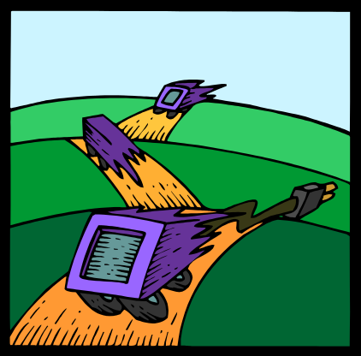
Amdahl’s Law
Gene Amdahl
Deals with the potential speedup of a program using multiple processors compared to a single processor
Illustrates the problems facing industry in the development of multi-core machines
  Software must be adapted to a highly parallel execution environment to exploit the power of parallel processing
Can be generalized to evaluate and design technical improvement in a computer system
Notes:
Computer system designers look for ways to improve system performance by
advances in technology or change in design. Examples include the use of parallel
processors, the use of a memory cache hierarchy, and speedup in memory access
time and I/O transfer rate due to technology improvements. In all of these cases, it is
important to note that a speedup in one aspect of the technology or design does not
result in a corresponding improvement in performance. This limitation is succinctly
expressed by Amdahl’s law.
Amdahl’s law was first proposed by Gene Amdahl in 1967 ([AMDA67],
[AMDA13]) and deals with the potential speedup of a program using multiple processors
compared to a single processor.
Nevertheless, Amdahl’s law illustrates the problems facing industry in the development
of multicore machines with an ever-growing number of cores: The software
that runs on such machines must be adapted to a highly parallel execution environment
to exploit the power of parallel processing.
Amdahl’s law can be generalized to evaluate any design or technical improvement
in a computer system.

Slide 77
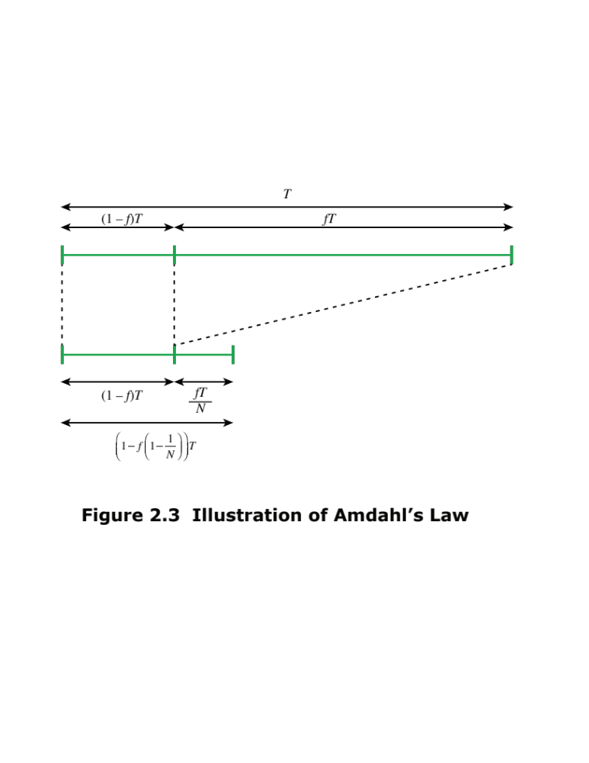
Notes:
Consider a program running on a single processor such that a fraction
(1 – f) of the execution time involves code that is inherently serial and a fraction
f that involves code that is infinitely parallelizable with no scheduling overhead.
Let T be the total execution time of the program using a single processor. Then the
speedup using a parallel processor with N processors that fully exploits the parallel
portion of the program is as follows:
Speedup =
Time to execute program on a single processor
Time to execute program on N parallel processors
=T(1 - f) + Tf
T(1 - f) +Tf
N
= 1
(1 - f) +f
N
This equation is illustrated in Figures 2.3 and 2.4.

Slide 78
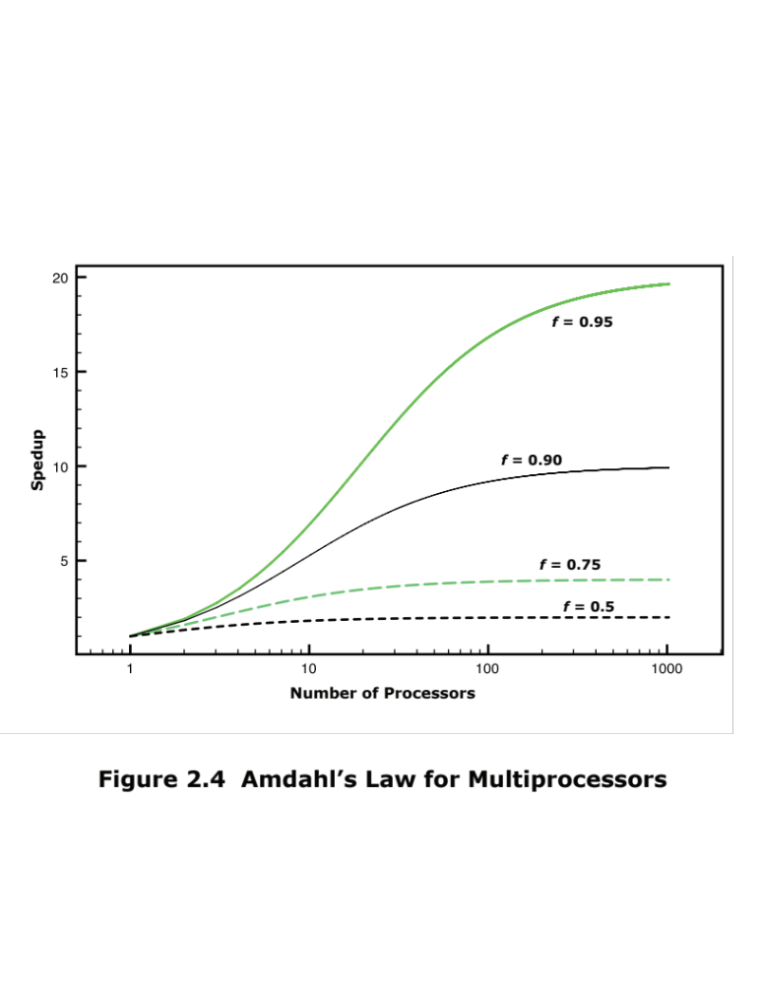
Notes:
Two important conclusions can be
drawn:
1. When f is small, the use of parallel processors has little effect.
2. As N approaches infinity, speedup is bound by 1/(1 – f), so that there are
diminishing returns for using more processors.
These conclusions are too pessimistic, an assertion first put forward in
[GUST88]. For example, a server can maintain multiple threads or multiple tasks
to handle multiple clients and execute the threads or tasks in parallel up to the limit
of the number of processors. Many database applications involve computations on
massive amounts of data that can be split up into multiple parallel tasks.

Slide 79
Little’s Law
Fundamental and simple relation with broad applications
Can be applied to almost any system that is statistically in steady state, and in which there is no leakage
Queuing system
  If server is idle an item is served immediately, otherwise an arriving item joins a queue
  There can be a single queue for a single server or for multiple servers, or multiple queues with one being for each of multiple servers
Average number of items in a queuing system equals the average rate at which items arrive multiplied by the time that an item spends in the system
  Relationship requires very few assumptions
  Because of its simplicity and generality it is extremely useful
Notes:
A fundamental and simple relation with broad applications is Little’s Law
[LITT61, LITT11]. We can apply it to almost any system that is statistically in
steady state, and in which there is no leakage.
Using queuing theory terminology, Little’s Law applies to a queuing system.
The central element of the system is a server, which provides some service to items.
Items from some population of items arrive at the system to be served. If the server
is idle, an item is served immediately. Otherwise, an arriving item joins a waiting
line, or queue. There can be a single queue for a single server, a single queue for
multiple servers, or multiples queues, one for each of multiple servers. When a
server has completed serving an item, the item departs. If there are items waiting in
the queue, one is immediately dispatched to the server. The server in this model can
represent anything that performs some function or service for a collection of items.
Examples: A processor provides service to processes; a transmission line provides a
transmission service to packets or frames of data; and an I/O device provides a read
or write service for I/O requests.
The average number of items in a queuing system equals the average rate at which items arrive multiplied by the average time that an item spends in the system. This relationship requires very few assumptions. We do not need to know what the service time distribution is, what
the distribution of arrival times is, or the order or priority in which items are served.
Because of its simplicity and generality, Little’s Law is extremely useful and has
experienced somewhat of a revival due to the interest in performance problems
related to multi-core computers.

Slide 80
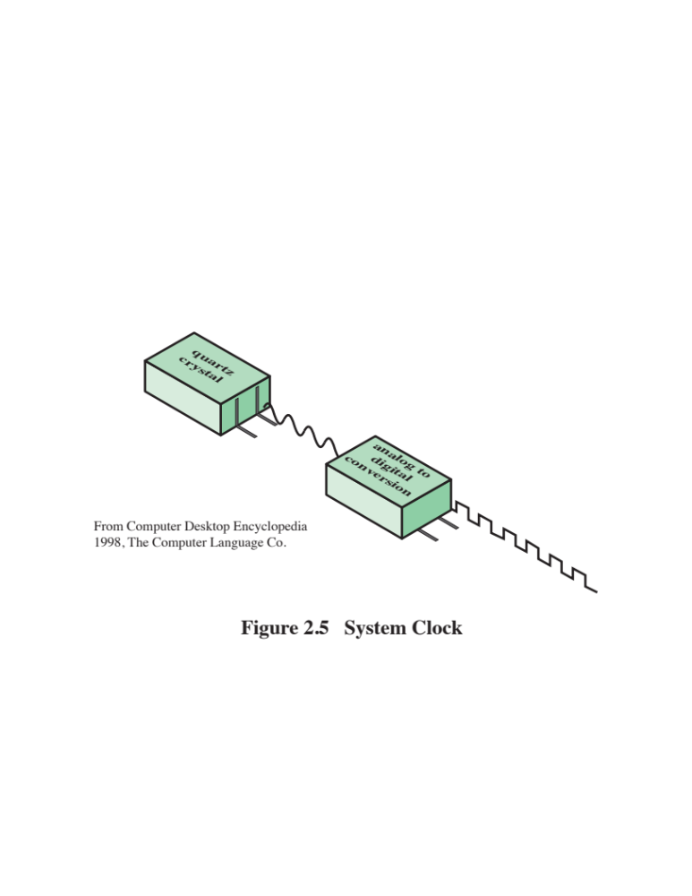
Notes:
Operations performed by a processor, such as fetching an
instruction, decoding the instruction, performing an arithmetic operation, and so
on, are governed by a system clock. Typically, all operations begin with the pulse of
the clock. Thus, at the most fundamental level, the speed of a processor is dictated
by the pulse frequency produced by the clock, measured in cycles per second, or
Hertz (Hz).
Typically, clock signals are generated by a quartz crystal, which generates a
constant sine wave while power is applied. This wave is converted into a digital
voltage pulse stream that is provided in a constant flow to the processor circuitry
(Figure 2.5). For example, a 1-GHz processor receives 1 billion pulses per second.
The rate of pulses is known as the clock rate, or clock speed. One increment, or
pulse, of the clock is referred to as a clock cycle, or a clock tick. The time between
pulses is the cycle time.
The clock rate is not arbitrary, but must be appropriate for the physical layout
of the processor. Actions in the processor require signals to be sent from one processor
element to another. When a signal is placed on a line inside the processor, it
takes some finite amount of time for the voltage levels to settle down so that an
accurate value (1 or 0) is available. Furthermore, depending on the physical layout
of the processor circuits, some signals may change more rapidly than others. Thus,
operations must be synchronized and paced so that the proper electrical signal
(voltage) values are available for each operation.
The execution of an instruction involves a number of discrete steps, such
as fetching the instruction from memory, decoding the various portions of the
instruction, loading and storing data, and performing arithmetic and logical operations.
Thus, most instructions on most processors require multiple clock cycles to
complete. Some instructions may take only a few cycles, while others require dozens.
In addition, when pipelining is used, multiple instructions are being executed simultaneously.
Thus, a straight comparison of clock speeds on different processors does
not tell the whole story about performance.

Slide 81
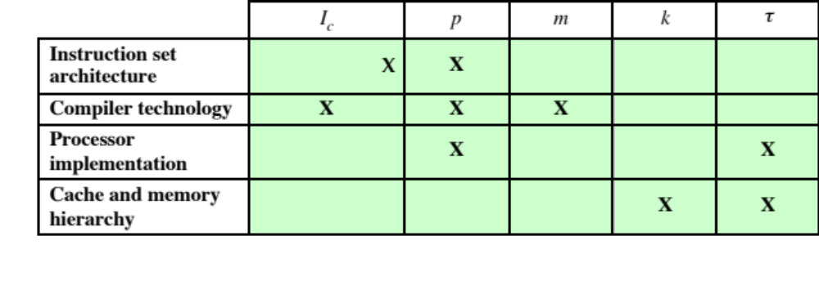
Table 2.1 Performance Factors and System Attributes
Notes:
Table 2.1 is a matrix in which one dimension shows the five
performance factors and the other dimension shows the four system attributes. An
X in a cell indicates a system attribute that affects a performance factor.
A common measure of performance for a processor is the rate at which
instructions are executed, expressed as millions of instructions per second (MIPS),
referred to as the MIPS rate.
Another common performance measure deals only with floating-point instructions.
These are common in many scientific and game applications. Floating-point
performance is expressed as millions of floating-point operations per second
(MFLOPS).

Slide 82
Calculating the Mean
The use of benchmarks to compare systems involves calculating the mean value of a set of data points related to execution time
The three common formulas used for calculating a mean are:
Arithmetic
Geometric
Harmonic
Notes:
In evaluating some aspect of computer system performance, it is often the case that a
single number, such as execution time or memory consumed, is used to characterize
performance and to compare systems. Clearly, a single number can provide only a
very simplified view of a system’s capability. Nevertheless, and especially in the field
of benchmarking, single numbers are typically used for performance comparison
[SMIT88].
As is discussed in Section 2.6, the use of benchmarks to compare systems
involves calculating the mean value of a set of data points related to execution
time. It turns out that there are multiple alternative algorithms that can be used
for calculating a mean value, and this has been the source of some controversy in
the benchmarking field. In this section, we define these alternative algorithms and
comment on some of their properties. This prepares us for a discussion in the next
section of mean calculation in benchmarking.
The three common formulas used for calculating a mean are arithmetic, geometric,
and harmonic.

Slide 83
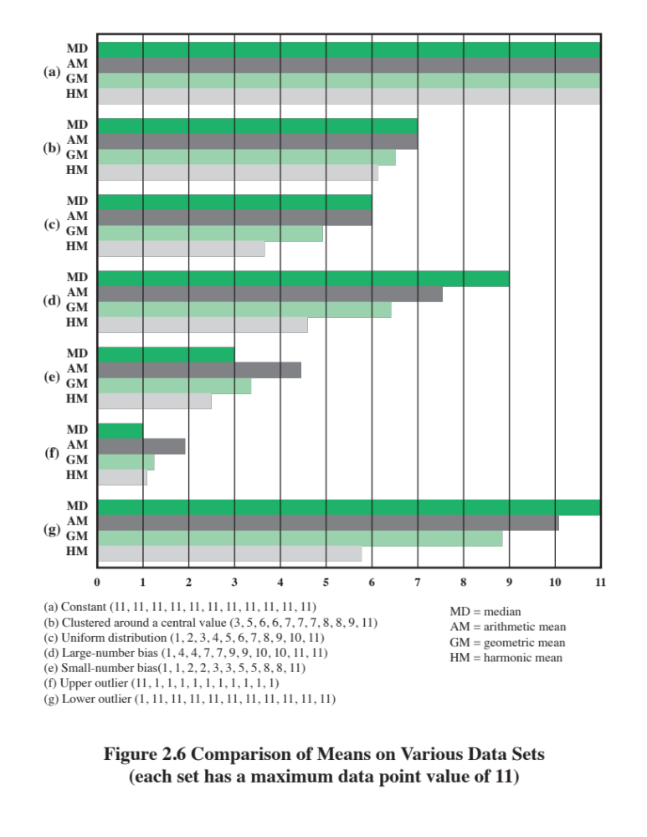
Notes:
Figure 2.6 illustrates the three means applied to various data sets, each
of which has eleven data points and a maximum data point value of 11. The median value
is also included in the chart. Perhaps what stands out the most in this figure is that the HM
has a tendency to produce a misleading result when the data is skewed to larger values or
when there is a small-value outlier.

Slide 84
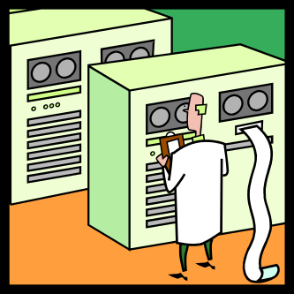
An Arithmetic Mean (AM) is an appropriate measure if the sum of all the measurements is a meaningful and interesting value
The AM is a good candidate for comparing the execution time performance of several systems
Arithmetic
For example, suppose we were interested in using a system
for large-scale simulation studies and wanted to evaluate several alternative products. On each system we could run the simulation multiple times with different input values for each run, and then take the average execution time across all runs. The use of
multiple runs with different inputs should ensure that the results are not heavily biased by some unusual feature of a given input set. The AM of all the runs is a good measure of the system’s performance on simulations, and a good number to use for system comparison.
Mean
The AM used for a time-based variable, such as program execution time, has the important property that it is directly proportional to the total time
  If the total time doubles, the mean value doubles
Notes:
An AM is an appropriate measure if the sum of all the measurements is a meaningful
and interesting value. The AM is a good candidate for comparing the execution time performance
of several systems. For example, suppose we were interested in using a system
for large-scale simulation studies and wanted to evaluate several alternative products.
On each system we could run the simulation multiple times with different input values
for each run, and then take the average execution time across all runs. The use of
multiple runs with different inputs should ensure that the results are not heavily biased
by some unusual feature of a given input set. The AM of all the runs is a good measure of
the system’s performance on simulations, and a good number to use for system comparison.
The AM used for a time-based variable (e.g., seconds), such as program execution
time, has the important property that it is directly proportional to the total
time. So, if the total time doubles, the mean value doubles.

Slide 85
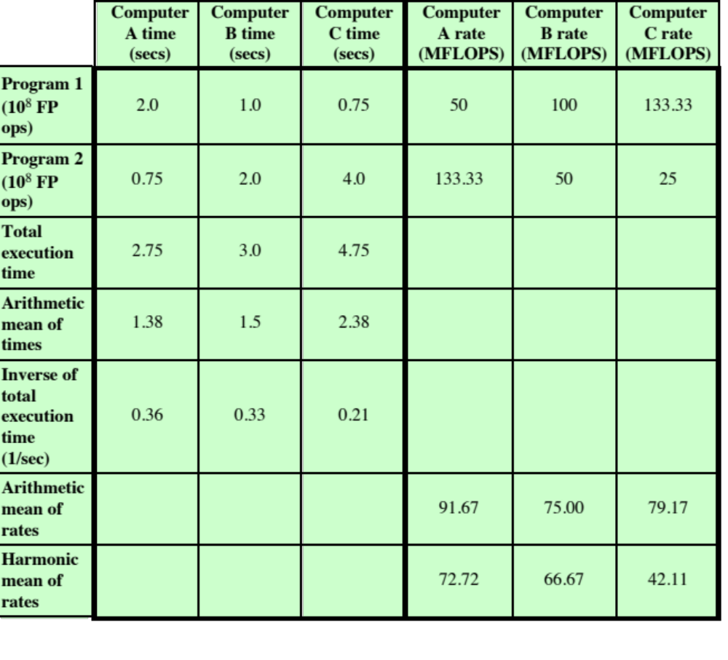
Table 2.2
A Comparison of Arithmetic and
Harmonic Means for Rates
Notes:
A simple numerical example will illustrate the difference between the
two means in calculating a mean value of the rates, shown in Table 2.2. The table compares
the performance of three computers on the execution of two programs. For simplicity, we
assume that the execution of each program results in the execution of 108 floating-point
operations. The left half of the table shows the execution times for each computer running
each program, the total execution time, and the AM of the execution times. Computer
A executes in less total time than B, which executes in less total time than C, and this is
reflected accurately in the AM.
The right half of the table provides a comparison in terms of rates, expressed
in MFLOPS. The rate calculation is straightforward. For example, program 1 executes
100 million floating-point operations. Computer A takes 2 seconds to execute the program
for a MFLOPS rate of 100/2 = 50. Next, consider the AM of the rates. The greatest value
is for computer A, which suggests that A is the fastest computer. In terms of total execution
time, A has the minimum time, so it is the fastest computer of the three. But the AM
of rates shows B as slower than C, whereas in fact B is faster than C. Looking at the HM
values, we see that they correctly reflect the speed ordering of the computers. This confirms
that the HM is preferred when calculating rates.
The reader may wonder why go through all this effort. If we want to compare
execution times, we could simply compare the total execution times of the three
systems. If we want to compare rates, we could simply take the inverse of the total
execution time, as shown in the table. There are two reasons for doing the individual
calculations rather than only looking at the aggregate numbers:
1. A customer or researcher may be interested not only in the overall average
performance but also performance against different types of benchmark programs,
such as business applications, scientific modeling, multimedia applications,
and systems programs. Thus, a breakdown by type of benchmark is
needed as well as a total.
2. Usually, the different programs used for evaluation are weighted differently.
In Table 2.2, it is assumed that the two test programs execute the same number
of operations. If that is not the case, we may want to weight accordingly.
Or different programs could be weighted differently to reflect importance or
priority.

Slide 86
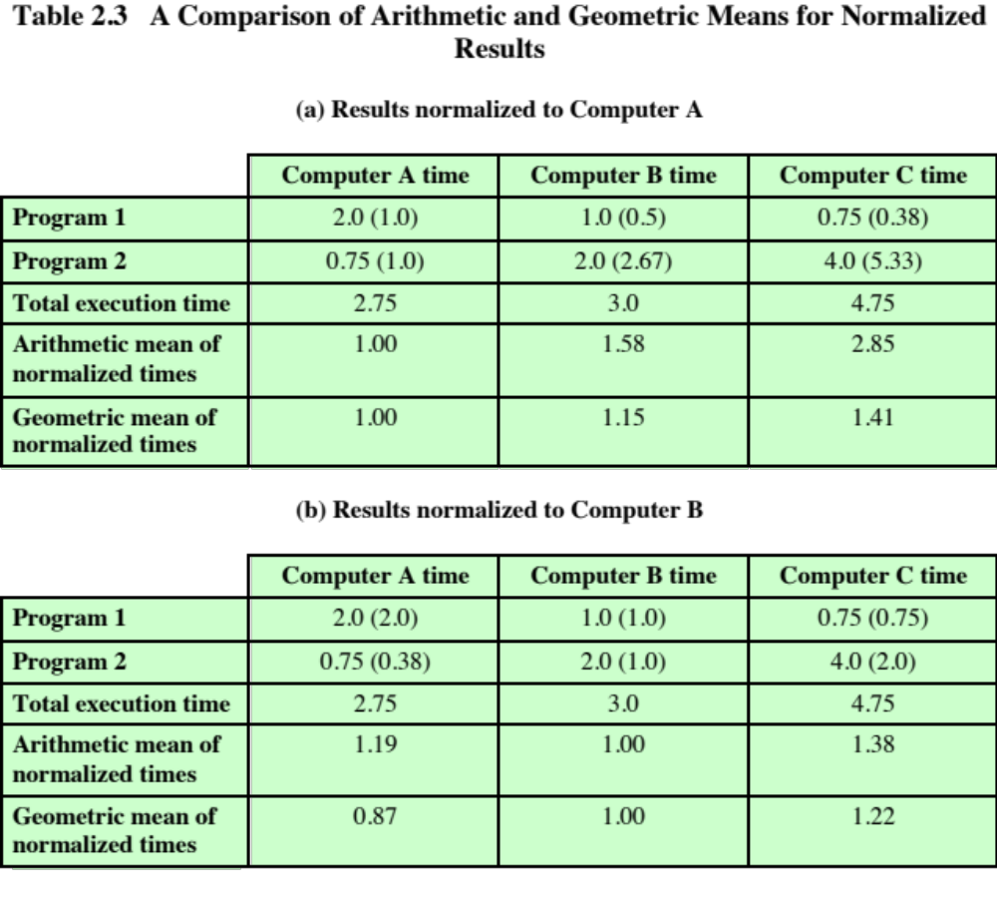
Notes:
A simple example will illustrate the way in which the GM exhibits consistency
for normalized results. In Table 2.3, we use the same performance results as were
used in Table 2.2. In Table 2.3a, all results are normalized to Computer A, and the means
are calculated on the normalized values. Based on total execution time, A is faster than
B, which is faster than C. Both the AMs and GMs of the normalized times reflect this. In
Table 2.3b, the systems are now normalized to B. Again the GMs correctly reflect the relative
speeds of the three computers, but now the AM produces a different ordering.

Slide 87
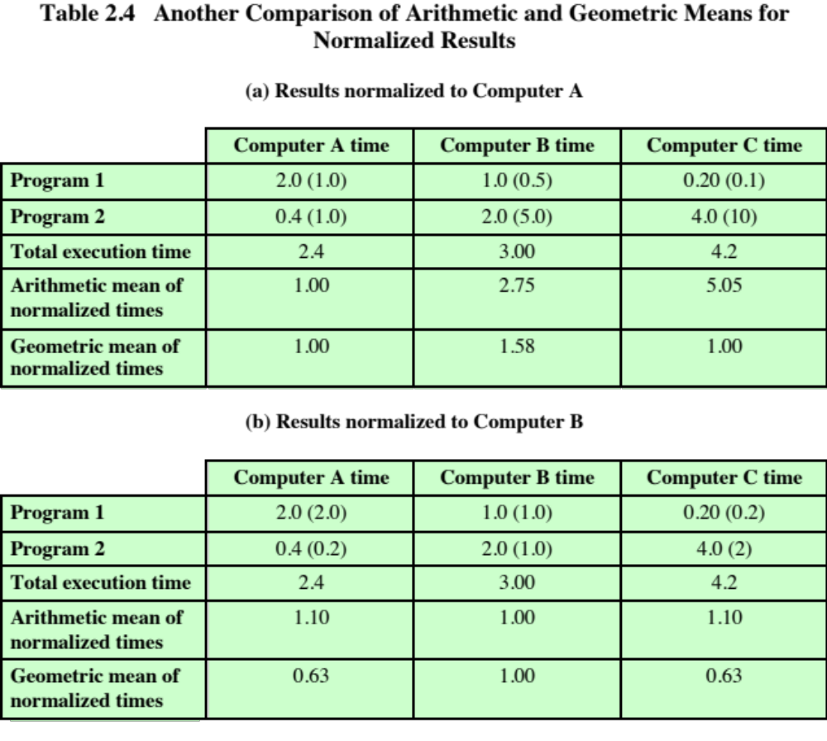
Notes:
Sadly, consistency does not always produce correct results. In Table 2.4, some of the
execution times are altered. Once again, the AM reports conflicting results for the two
normalizations. The GM reports consistent results, but the result is that B is faster than A
and C, which are equal.
SPEC has chosen to use the GM,
for several reasons:
1. As mentioned, the GM gives consistent results regardless of which system is
used as a reference. Because benchmarking is primarily a comparison analysis,
this is an important feature.
2. As documented in [MCMA93], and confirmed in subsequent analyses by SPEC
analysts [MASH04], the GM is less biased by outliers than the HM or AM.
3. [MASH04] demonstrates that distributions of performance ratios are better
modeled by lognormal distributions than by normal ones, because of the generally
skewed distribution of the normalized numbers. This is confirmed in
[CITR06]. And, as shown in Equation (2.5), the GM can be described as the
back-transformed average of a lognormal distribution.

Slide 88

Benchmark Principles
Desirable characteristics of a benchmark program:
  It is written in a high-level language, making it portable across different machines
  It is representative of a particular kind of programming domain or paradigm, such as systems programming, numerical programming, or commercial programming
  It can be measured easily
  It has wide distribution
Notes:
Measures such as MIPS and MFLOPS have proven inadequate to evaluating the performance
of processors. Because of differences in instruction sets, the instruction execution
rate is not a valid means of comparing the performance of different architectures.
Another consideration is that the performance of a given processor on a given
program may not be useful in determining how that processor will perform on a
very different type of application. Accordingly, beginning in the late 1980s and
early 1990s, industry and academic interest shifted to measuring the performance of
systems using a set of benchmark programs. The same set of programs can be run on
different machines and the execution times compared. Benchmarks provide guidance
to customers trying to decide which system to buy and can be useful to vendors
and designers in determining how to design systems to meet benchmark goals.
[WEIC90] lists the following as desirable characteristics of a benchmark program:
1. It is written in a high-level language, making it portable across different machines.
2. It is representative of a particular kind of programming domain or paradigm, such
as systems programming, numerical programming, or commercial programming.
3. It can be measured easily.
4. It has wide distribution.

Slide 89
System Performance Evaluation Corporation (SPEC)
Benchmark suite
  A collection of programs, defined in a high-level language
  Together attempt to provide a representative test of a computer in a particular application or system programming area
  SPEC
  An industry consortium
  Defines and maintains the best known collection of benchmark suites aimed at evaluating computer systems
  Performance measurements are widely used for comparison and research purposes
Notes:
The common need in industry and academic and research
communities for generally accepted computer performance measurements has
led to the development of standardized benchmark suites. A benchmark suite is a
collection of programs, defined in a high-level language, that together attempt to
provide a representative test of a computer in a particular application or system
programming area. The best known such collection of benchmark suites is defined
and maintained by the System Performance Evaluation Corporation (SPEC),
an industry consortium. SPEC performance measurements are widely used for
comparison and research purposes.

Slide 90

SPEC
CPU2006
Best known SPEC benchmark suite
Industry standard suite for processor intensive applications
Appropriate for measuring performance for applications that spend most of their time doing computation rather than I/O
Consists of 17 floating point programs written in C, C++, and Fortran and 12 integer programs written in C and C++
Suite contains over 3 million lines of code
Fifth generation of processor intensive suites from SPEC
Notes:
The best known of the SPEC benchmark suites is SPEC CPU2006. This is the
industry standard suite for processor-intensive applications. That is, SPEC CPU2006 is
appropriate for measuring performance for applications that spend most of their time
doing computation rather than I/O.
The CPU2006 suite is based on existing applications
that have already been ported to a wide variety of platforms by SPEC industry
members. It consists of 17 floating-point programs written in C, C++, and Fortran; and
12 integer programs written in C and C++. The suite contains over 3 million lines of
code. This is the fifth generation of processor-intensive suites from SPEC, replacing
SPEC CPU2000, SPEC CPU95, SPEC CPU92, and SPEC CPU89 [HENN07].
Other SPEC suites include the following:
• SPECjvm98: Intended to evaluate performance of the combined hardware
and software aspects of the Java Virtual Machine (JVM) client platform
• SPECjbb2000 (Java Business Benchmark): A benchmark for evaluating
server-side Java-based electronic commerce applications
• SPECweb99: Evaluates the performance of World Wide Web (WWW) servers
• SPECmail2001: Designed to measure a system’s performance acting as a mail
server

Slide 91

Table 2.5
SPEC
CPU2006
Integer Benchmarks
(Table can be found on page 69 in the textbook.)
Notes:
Table 2.5
SPEC CPU2006 Integer Benchmarks

Slide 92

Table 2.6
SPEC
CPU2006
Floating-Point Benchmarks
(Table can be found on page 70
in the textbook.)
Notes:
Table 2.6
SPEC CPU2006 Floating-Point Benchmarks
SPEC uses a historical Sun system, the “Ultra Enterprise 2,” which was introduced
in 1997, as the reference machine. The reference machine uses a 296-MHz
UltraSPARC II processor. It takes about 12 days to do a rule-conforming run of
the base metrics for CINT2006 and CFP2006 on the CPU2006 reference machine.
Tables 2.5 and 2.6 show the amount of time to run each benchmark using the reference
machine. The tables also show the dynamic instruction counts on the reference
machine, as reported in [PHAN07]. These value are the actual number of instructions
executed during the run of each program.

Slide 93
Terms Used in SPEC Documentation
Benchmark
  A program written in a high-level language that can be compiled and executed on any computer that implements the compiler
System under test
  This is the system to be evaluated
Reference machine
  This is a system used by SPEC to establish a baseline performance for all benchmarks
    Each benchmark is run and measured on this machine to establish a reference time for that benchmark
Base metric
  These are required for all reported results and have strict guidelines for compilation
Peak metric
  This enables users to attempt to optimize system performance by optimizing the compiler output
Speed metric
  This is simply a measurement of the time it takes to execute a compiled benchmark
    Used for comparing the ability of a computer to complete single tasks
Rate metric
  This is a measurement of how many tasks a computer can accomplish in a certain amount of time
    This is called a throughput, capacity, or rate measure
    Allows the system under test to execute simultaneous tasks to take advantage of multiple processors
Notes:
To better understand results published of a system using CPU2006, we define
the following terms used in the SPEC documentation:
■ Benchmark: A program written in a high-level language that can be compiled
and executed on any computer that implements the compiler.
■ System under test: This is the system to be evaluated.
■ Reference machine: This is a system used by SPEC to establish a baseline performance
for all benchmarks. Each benchmark is run and measured on this
machine to establish a reference time for that benchmark. A system under test
is evaluated by running the CPU2006 benchmarks and comparing the results
for running the same programs on the reference machine.
■ Base metric: These are required for all reported results and have strict guidelines
for compilation. In essence, the standard compiler with more or less
default settings should be used on each system under test to achieve comparable
results.
■ Peak metric: This enables users to attempt to optimize system performance by
optimizing the compiler output. For example, different compiler options may
be used on each benchmark, and feedback-directed optimization is allowed.
■ Speed metric: This is simply a measurement of the time it takes to execute a
compiled benchmark. The speed metric is used for comparing the ability of a
computer to complete single tasks.
■ Rate metric: This is a measurement of how many tasks a computer can accomplish
in a certain amount of time; this is called a throughput , capacity, or rate
measure. The rate metric allows the system under test to execute simultaneous
tasks to take advantage of multiple processors.

Slide 94

Notes:
We now consider the specific calculations that are done to assess a system. We
consider the integer benchmarks; the same procedures are used to create a floating-point
benchmark value. For the integer benchmarks, there are 12 programs in the
test suite. Calculation is a three-step process (Figure 2.7):

Slide 95

Notes:
The results for the Sun Blade 1000 are shown in Table 2.7a. One of the
SPEC CPU2006 integer benchmark is 464.h264ref. This is a reference implementation
of H.264/AVC (Advanced Video Coding), the latest state-of-the-art video compression standard.
The Sun Blade 1000 executes this program in a median time of 5259 seconds. The reference
implementation requires 22,130 seconds. The ratio is calculated as: 22,130/5,259 = 4.21.
The speed metric is calculated by taking the twelfth root of the product of the ratios:
(3.18 * 2.96 * 2.98 * 3.91 * 3.17 * 3.61 * 3.51 * 2.01 *
4.21 * 2.43 * 2.75 * 3.42)^{1/12} = 3.12

Slide 96

Notes:
The results for the Sun Blade X6250 are shown in Table 2.7b. This system
has two processor chips, with two cores per chip, for a total of four cores. To get the
rate metric, each benchmark program is executed simultaneously on all four cores, with
the execution time being the time from the start of all four copies to the end of the slowest
run. The speed ratio is calculated as before, and the rate value is simply four times the
speed ratio. The final rate metric is found by taking the geometric mean of the rate values:
(78.63 * 62.97 * 60.87 * 77.29 * 65.87 * 83.68 * 76.70 * 134.98 *
106.65 * 40.39 * 48.41 * 65.40)^{1/12} = 71.59

Slide 97
Summary Part I
Basic Concepts and Computer Evolution
Organization and architecture
Structure and function
Brief history of computers
  The First Generation: Vacuum tubes
  The Second Generation: Transistors
  The Third Generation: Integrated Circuits
  Later generations
  The evolution of the Intel x86 architecture
  Cloud computing
  Basic concepts
  Cloud services
Embedded systems
  The Internet of things
  Embedded operating systems
  Application processors versus dedicated processors
  Microprocessors versus microcontrollers
  Embedded versus deeply embedded systems
ARM architecture
  ARM evolution
  Instruction set architecture
  ARM products
Notes:
Chapter 1 summary.

Slide 98
Summary Part II
Performance Issues
Designing for performance
  Microprocessor speed
  Performance balance
  Improvements in chip organization and architecture
Multicore
MICs
GPGPUs
Amdahl’s Law
Little’s Law
  Basic measures of computer performance
  Clock speed
  Instruction execution rate
  Calculating the mean
  Arithmetic mean
  Harmonic mean
  Geometric mean
  Benchmark principles
  SPEC benchmarks
Notes:
Chapter 2 summary.

Slide 99
Next Lecture
Basics of computer arithmetics and logic design

Slide 100
References
William Stallings; “Computer Organization and Architecture, Designing for Performance”, 10th Global Ed., Pearson, 2016.
Douglas E. Comer; “Essentials of Computer Architecture”, 2nd Ed., Taylor & Francis, 2017.
Samsun M. Başarıcı, Erkan Özefe; “Visuelle Programmierung für die Bildverarbeitung”, VDM Verlag Dr. Müller, 2013.

Slide 101
Additional Material:
History of Computers

Slide 102



First machines
≈ 2400 BC Babylon
Chinese
Greeks
Romans
etc.
Addition, substraction, multiplication, square root, cube root

Slide 103

Computer ?
Term „Computer“:
  1646: Sir Thomas Browne (1605-1682)
  Author
  Medicine
  Religion
  Science
  Esoteric

Slide 104
Computers?
3 Lines
  Formalization
  Calculization
  Mechanization

Slide 105
Ages of Automata
17th Century
France
Clocks, watches, etc.

Slide 106


Upcoming of mechanical machines
1623: Wilhelm Schickard (1592-1635)
  German professor for biblical languages
  Mathematics
  Astronomy
  First draft of a „computer“

Slide 107

Upcoming of mechanical machines
1642: Blaise Pascal (1623-1662)
  French inventor, mathematician, physicist, religious philosopher
  First mechanical machine for computing: Pascaline

Slide 108

Pascaline
2 coupled sets of each 6 dials
Each dial with 10 digits (0,…,9)
Correct handling of carry
Only addition and substraction

Slide 109


Upcoming of mechanical machines
1671: Gottlieb Wilhelm Freiherr von Leibniz (1646-1716)
  German philosopher, scientist, mathematician, physicist, etc.
  Improvement of Pascaline

Slide 110

Big Improvements
Charles Babbage (1792-1871)
  English mathematician, philosopher, mechanical engineer

Slide 111



Difference Engine (1823)
Calculating tables for navigation
Solving polynomials

Slide 112

Analytical Engine (1834)
Designed to perform any mathematical operation
  Mill (ALU)
  Control unit
  Output Unit

Slide 113

Analytical Engine (1834)
Branching
  Jumping forward/backward
Programming
  First Programmer: Ada Byron Lovelace

Slide 114


Programming?
Idea (1805): Weaving loom of Joseph-Marie Jacquard (1752-1834)

Slide 115

New Age
Z1 (1934): Konrad Zuse (1910-1995)

Slide 116

New Age
Z1 (1934): Konrad Zuse (1910-1995)
  First try

Slide 117


New Age
Z3 (1941): First Computer of the world
  Binary represantation of commands and numbers
  Binary switching elements for storage and processing
  Usage of predicate calculus (AND, OR,NOT)
  Floating point represantation of numbers
  Electromagnetical relays (600 for ALU, 1400 for storage units, 64 for 22 bit words)
  Program-controlled (8 channel punch stripes)
  Speed:
    3 seconds for multiplication, division, root extraction

Slide 118
New Age
Z3 (1941): First Computer of the world
  Binary represantation of commands and numbers
  Binary switching elements for storage and processing
  Usage of predicate calculus (AND, OR,NOT)
  Floating point represantation of numbers
  Electromagnetical relays (600 for ALU, 1400 for storage units, 64 for 22 bit words)
  Program-controlled (8 channel punch stripes)
  Speed:
    3 seconds for multiplication, division, root extraction

Slide 119




New Age
Harvard Mark I-Automatic Sequence Controlled Computer ASCC (1944): Howard Hathaway Aiken (1900-1973) at Harvard University Cambridge/Massachusets
  17 m
  5 tons
  Similar Z3 but output also on punched cards

Slide 120

John von neumann (1903-1957)
1945
  “First Draft of a Report on the EDVAC”
  Concepts of Modern Computer Architecture (von Neumann Architecture):
    ALU
    CU
    Storage
    I/O

Slide 121


ENIAC
Electronic Numerical Integrator and Computer (1946)
  Build by: John Presper Eckert (1919-1995) and John William Mauchly (1907-1980)
    Vacuum tubes instead of mechanical storage elements
    1000 times faster than MARK I
    3 m. high
    300 m²
    Tubes has to be changed every 2-3 days

Slide 122

ENIAC
Programming ENIAC:
  6000 switches
  Organize wire connections
  Run a while
  Stop computer
  Reorganize wire connections
  ENIAC-Girls

Slide 123
ENIAC
Main features of ENIAC:
  17468 vacuum tubes
  1500 relays
  174 kW power
  30 t weight
  0.2 ms addition time
  2.8 ms multiplication time

Slide 124

EDVAC (1945)
Electronic Discrete Variable Automatic Computer
Build by John von Neumann
  Modified ENIAC
  Data and programs in same storage

Slide 125


Small steps
1951: First commercial computer by Eckert and Mauchly (Rand Corp.)
  UNIVAC „Universal Automatic Computer“
1954: IBM introduced FORTRAN „Formula Translator“ developed by J. W. Backus
1963: ASCII „American Standard Code for Information Interchange“

Slide 126
A New Era
1958 and 1959: Jack Kilby (1923-2005) (Texas Instruments) and Robert Noyce (1927-1990) (Fairchild Semiconductors) developed independently the integrated circuits IC
1968: Gordon Moore (1929-) and Robert Noyce (both from Fairchild Semiconductors) incorporated Intel (Integrated Electronics) Corporation

Slide 127



A New Era
1969: Datapoint Co. ordered Intel to build an IC for Datapoint 2200 screen controller
1971: Intel 4004 (predecessor of all Pentium processors)

Slide 128




A New Era
1972: Intel 8008
  Successor of 4004
  8 bit data bus
  14 bit adress bus
  Commands for addition, substraction, and logic commands implemented

Slide 129
A New Era
1974: Many different 8 bit processors with 64 kByte address space
  Intel 8080
  Motorola MC 6800
  Intel 8085
  Zilog Z80
  etc.
Modern processors
  32 or 64 bit data and address bus

Slide 130

Typical PC system

Slide 131



History of Computing Hardware
First Generation (Mechanical/Electromechanical) | Calculators | Antikythera mechanism, Difference Engine, Norden bombsight
 | Programmable Devices | Jacquard loom, Analytical Engine, Harvard Mark I, Z3
Second Generation (Vacuum Tubes) | Calculators | Atanasoff – Berry Computer, IBM 604, UNIVAC 60, UNIVAC 120
 | Programmable Devices | ENIAC, EDSAC, EDVAC, UNIVAC I, IBM 701, IBM 702, IBM 650, Z22

Slide 132




History of Computing Hardware
Third Generation (Discrete transistors and SSI, MSI, LSI Integrated circuits) | Mainframes | IBM 7090, IBM 7080, System/360, BUNCH
 | Minicomputer | PDP-8, PDP-11, System/32, System/36
Fourth Generation (VLSI integrated circuits) | Minicomputer | VAX, AS/400
 | 4-bit microcomputer | Intel 4004, Intel 4040
 | 8-bit microcomputer | Intel 8008, Intel 8080, Motorola 6800, Motorola 6809, MOS Technology 6502, Zilog Z80
 | 16-bit microcomputer | 8088, Zilog Z8000, WDC 65816/65802
 | 32-bit microcomputer | 80386, Pentium, 68000, ARM architecture
 | 64-bit microcomputer | x86-64, PowerPC, MIPS, SPARC
 | Embedded computer | 8048, 8051
 | Personal computer | Desktop computer, Home computer, Laptop computer, Personal digital assistant (PDA), Portable computer, Tablet computer, Wearable computer
Theoretical/experimental | Quantum computer, Chemical computer, DNA computing, Optical computer, Spintronics based computer

