Slide 1
CSE202 Database Management Systems
Lecture #1
Prepared & Presented by Asst. Prof. Dr. Samsun M. BAŞARICI

Slide 2
Part 1
Data & Database

Slide 3
Learning Objectives
Explain why humankind’s interest in data goes back to ancient times.
Describe how data needs have historically driven many information technology developments.
Describe the evolution of data storage media during the last century.
Relate the idea of data as a corporate resource that can be used to gain a competitive advantage to the development of the database management systems environment.
Differentiate the types of databases and database applications
Understand the principals of typical DBMS functionality
Explain the main characteristics of the database approach
Know the types of database users
Appraise the advantages of using the database approach
Summarize the historical development of database technology
Know how to extend database capabilities
Estimate when not to use databases

Slide 4
Outline
Data in history
Data storage media (today and in the past)
Types of Databases and Database Applications
Basic Definitions
Typical DBMS Functionality
Example of a Database (UNIVERSITY)
Main Characteristics of the Database Approach
Types of Database Users
Advantages of Using the Database Approach
Historical Development of Database Technology
Extending Database Capabilities
When Not to Use Databases

Slide 5
Data
Data - the foundation of technological activity
Database - a highly organized collection of assembled data
Database Management System - sophisticated software that controls the database and the database environment

Slide 6
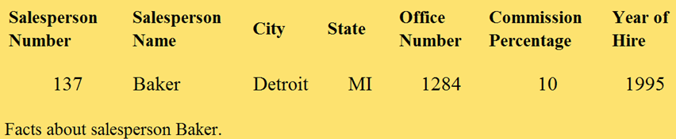
What is Data?
A single piece of data is a single fact about something that interests us.
A fact can be any characteristic of an object.

Slide 7
History of Data
People have been interested in data for at least the past 12,000 years.
Non-computer, primitive methods of data storage and handling.

Slide 8

What is Data? (Cont.)
Shepherds kept track of their flocks with pebbles.
A primitive but legitimate example of data storage and retrieval.

Slide 9

History of Data
Dating back to 8500 B.C., unearthed clay tokens or “counters” may have been used for record keeping in primitive forms of accounting.
Tokens, with special markings on them, were sealed in hollow clay vessels that accompanied commercial goods in transit.

Slide 10
Data Through the Ages
Record-keeping - the recording of data to keep track of how much a person has produced and what it can be bartered or sold for.
With time, different kinds of data were kept
    calendars, census data, surveys, land ownership records, marriage records, records of church contributions, family trees, etc.

Slide 11
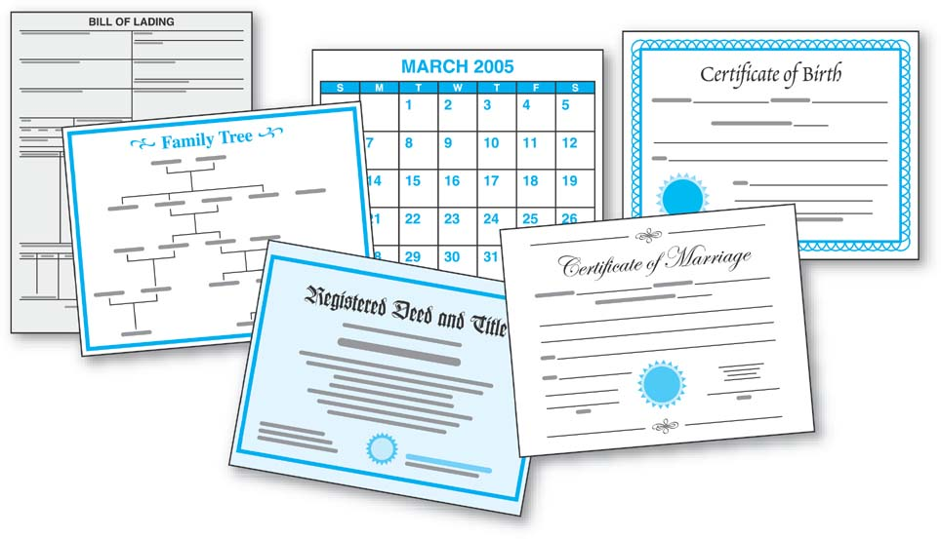
History of Data
Double-entry bookkeeping - originated in the trading centers of fourteenth century Italy.
The earliest known example is from a merchant in Genoa and dates to the year 1340.

Slide 12
Early Data Problems Spawn Calculating Devices
People interested in devices that could “automatically” process their data.
Blaise Pascal produced an adding machine that was an early version of today’s mechanical automobile odometers.

Slide 13
Punched Cards - Data Storage
Invented in 1805 by Joseph Marie Jacquard of France.
Jacquard’s method of storing fabric patterns, a form of graphic data, as holes in punched cards was a very clever means of data storage.
Of great importance for computing devices to follow.

Slide 14
Era of Modern Information Processing
The 1880 U.S. Census took about seven years to compile by hand.
Basing his work on Jacquard’s punched card concept, Herman Hollerith arranged to have the census data stored in punched cards and invented machinery to tabulate them.
In 1896 Hollerith formed the Tabulating Machine Company to produce and commercially market his devices -- this later became IBM.

Slide 15
Era of Modern Information Processing
James Powers developed devices to automatically feed cards into the equipment and to automatically print results.
In 1911 he established the Powers Tabulating Machine Company -- this later became Unisys Corporation.

Slide 16
The Mid-1950s
The introduction of electronic computers.
Witnessed a boom in economic development.
From this point onward, it would be virtually impossible to tie advances in computing devices to specific, landmark data storage and retrieval needs.

Slide 17
Modern Data Storage Media
Punched paper tape - The earliest form of modern data storage, introduced in the 1870s and 1880s.
Punched cards were the only data storage medium used in the increasingly sophisticated electromechanical accounting machines of the 1920s, 1930s, and 1940s.

Slide 18
Modern Data Storage Media
Middle to late 1930s saw the beginning of the era of erasable magnetic storage media.
By late 1940s, early work was done on the use of magnetic tape for recording data.
By 1950, several companies were developing the magnetic tape concept for commercial use.

Slide 19
Modern Data Storage Media
Magnetic Tape - commercially available units in 1952.
Direct Access Magnetic Devices - began to be developed at MIT in the late 1930s and early 1940s.
Magnetic Drum - early 1950s; forerunners of magnetic disk technology.
Magnetic Disk - commercially available in mid 1950s.
Compact Disk (CD) – introduced as a data storage medium in 1985.
Solid-state technology – Flash drives.

Slide 20
Using Data for Competitive Advantage
Data has become indispensable to every kind of modern business and government organization.
Data, the applications that process the data, and the computers on which the applications run are fundamental to every aspect of every kind of endeavor.

Slide 21
Using Data for Competitive Advantage
Data is a corporate resource, possibly the most important corporate resource.
Data can give a company a crucial competitive advantage.
e.g., FedEx had a significant competitive advantage when it first provided access to its package tracking data on its Web site.

Slide 22
Problems in Storing and Accessing Data
Difficult to store and to provide efficient, accurate access to a company’s data.
The volume of data that companies have is massive.
Wal-Mart estimates its data warehouse contains hundreds of terabytes (trillions of characters) of data.

Slide 23
Problems in Storing and Accessing Data
Larger number of people want access to data:
  Employees
  Customers
  Trading partners
Additional issues include: data security, data privacy, and backup and recovery.

Slide 24
Data Security
Involves a company protecting its data from theft, malicious destruction, deliberate attempts at making phony changes to the data.
e.g., someone trying to increase his own bank account balance.

Slide 25
Data Privacy
Ensuring that even employees who normally have access to the company’s data are given access only to the specific data that they need in their work.

Slide 26
Backup and Recovery
The ability to reconstruct data if it is lost or corrupted.
e.g., following a hardware failure
e.g., following a natural disaster

Slide 27
Data Accuracy
The same data is stored several, sometimes many, times within a company’s information system.
When a new application is written, new data files are created to store its data.
Data can be duplicated within a single file and across files.

Slide 28
Data as a Corporate Resource
Data may be the most difficult corporate resource to manage.
We have tremendous volume, billions, trillions, and more individual pieces of data, each piece of which is different from the next.

Slide 29
Data as a Corporate Resource
A new kind of software is required to help manage the data.
Progressively faster hardware is required to keep up with the increasing volume of data and data access demands.
Data management specialists need to be developed and educated.

Slide 30
The Database Environment
Database Management System (DBMS)
New Personnel - database administrator and data management specialist
Fast hardware
Massive data storage facilities

Slide 31
The Database Environment
Encourages data sharing
Helps control data redundancy
Has important improvements in data accuracy
Permits storage of vast volumes of data with acceptable access.

Slide 32
The Database Environment
Allows database queries
Provides tools to control:
  data security
  data privacy
  backup and recovery

Slide 33
Types of Databases and Database Applications
Traditional Applications:
  Numeric and Textual Databases
More Recent Applications:
  Multimedia Databases
  Geographic Information Systems (GIS)
  Biological and Genome Databases
  Data Warehouses
  Mobile databases
  Real-time and Active Databases

Slide 34
Recent Developments (cont.)
Social Networks started capturing a lot of information about people and about communications among people-posts, tweets, photos, videos in systems such as:
- Facebook
- Twitter
- Linked-In
All of the above constitutes data
Search Engines- Google, Bing, Yahoo : collect their own repository of web pages for searching purposes

Slide 35
Recent Developments (cont.)
New Technologies are emerging from the so-called non-database software vendors to manage vast amounts of data generated on the web:
Big Data storage systems involving large clusters of distributed computers (Chapter 25)
NOSQL (Not Only SQL) systems (Chapter 24)
A large amount of data now resides on the “cloud” which means it is in huge data centers using thousands of machines.

Slide 36
Basic Definitions
Database:
  A collection of related data.
Data:
  Known facts that can be recorded and have an implicit meaning.
Mini-world:
  Some part of the real world about which data is stored in a database. For example, student grades and transcripts at a university.
Database Management System (DBMS):
  A software package/ system to facilitate the creation and maintenance of a computerized database.
Database System:
  The DBMS software together with the data itself. Sometimes, the applications are also included.

Slide 37
Impact of Databases and Database Technology
Businesses: Banking, Insurance, Retail, Transportation, Healthcare, Manufacturing
Service Industries: Financial, Real-estate, Legal, Electronic Commerce, Small businesses
Education : Resources for content and Delivery
More recently: Social Networks, Environmental and Scientific Applications, Medicine and Genetics
Personalized Applications: based on smart mobile devices

Slide 38
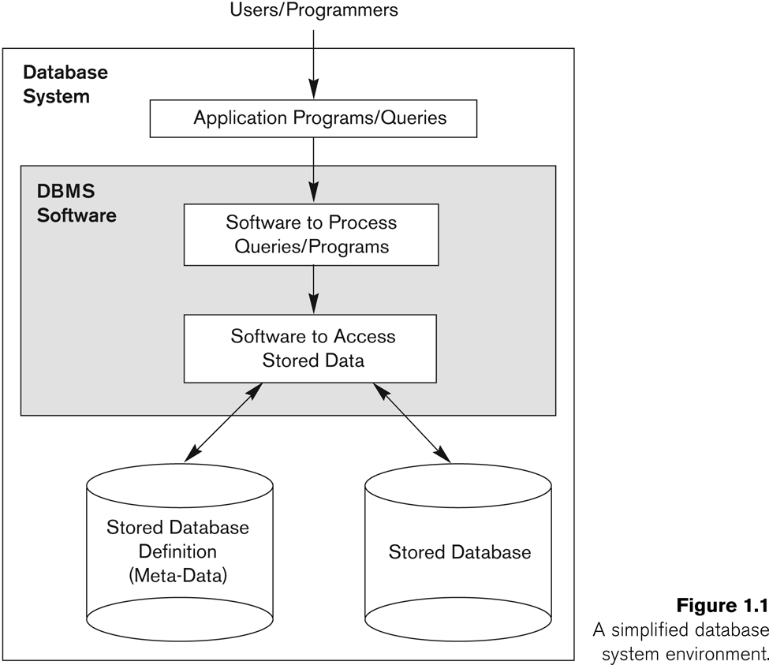
Simplified database system environment

Slide 39
Typical DBMS Functionality
Define a particular database in terms of its data types, structures, and constraints
Construct or Load the initial database contents on a secondary storage medium
Manipulating the database:
  Retrieval: Querying, generating reports
  Modification: Insertions, deletions and updates to its content
  Accessing the database through Web applications
Processing and Sharing by a set of concurrent users and application programs – yet, keeping all data valid and consistent

Slide 40
Database Model Requirements
Persistency
Quantity
PQRI:
Database model
Integrity
Reactivity

Slide 41
Application Activities Against a Database
Applications interact with a database by generating
- Queries: that access different parts of data and formulate the result of a request
- Transactions: that may read some data and “update” certain values or generate new data and store that in the database
Applications must not allow unauthorized users to access data
Applications must keep up with changing user requirements against the database

Slide 42
Additional DBMS Functionality
DBMS may additionally provide:
  Protection or Security measures to prevent unauthorized access
  “Active” processing to take internal actions on data
  Presentation and Visualization of data
  Maintenance of the database and associated programs over the lifetime of the database application
    Called database, software, and system maintenance

Slide 43
Example of a Database
(with a Conceptual Data Model)
Mini-world for the example:
  Part of a UNIVERSITY environment.
Some mini-world entities:
  STUDENTs
  COURSEs
  SECTIONs (of COURSEs)
  (academic) DEPARTMENTs
  INSTRUCTORs

Slide 44
Example of a Database
(with a Conceptual Data Model) (cont.)
Some mini-world relationships:
  SECTIONs are of specific COURSEs
  STUDENTs take SECTIONs
  COURSEs have prerequisite COURSEs
  INSTRUCTORs teach SECTIONs
  COURSEs are offered by DEPARTMENTs
  STUDENTs major in DEPARTMENTs
Note: The above entities and relationships are typically expressed in a conceptual data model, such as the ENTITY-RELATIONSHIP data model (see Chapters 3, 4)

Slide 45
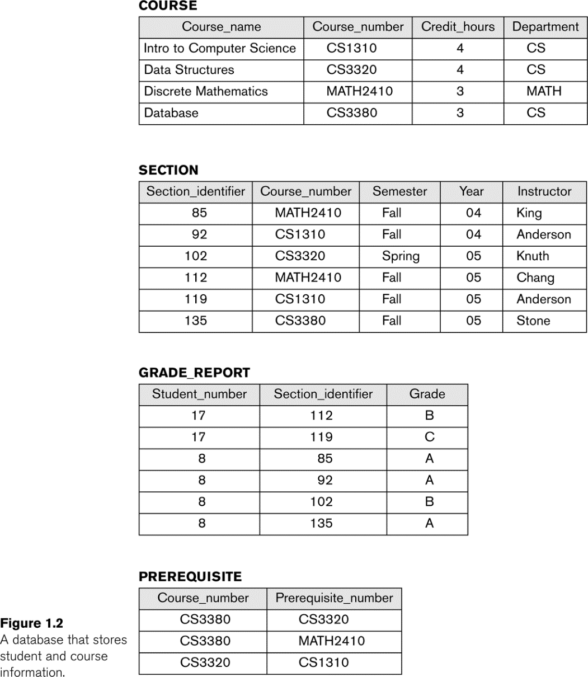
Example of a simple database

Slide 46
Main Characteristics of the Database Approach
Self-describing nature of a database system:
  A DBMS catalog stores the description of a particular database (e.g. data structures, types, and constraints)
  The description is called meta-data*.
  This allows the DBMS software to work with different database applications.
Insulation between programs and data:
  Called program-data independence.
  Allows changing data structures and storage organization without having to change the DBMS access programs.
  -----------------------------------------------------------------------------
  * Some newer systems such as a few NOSQL systems need no meta-data: they store the data definition within its structure making it self describing

Slide 47
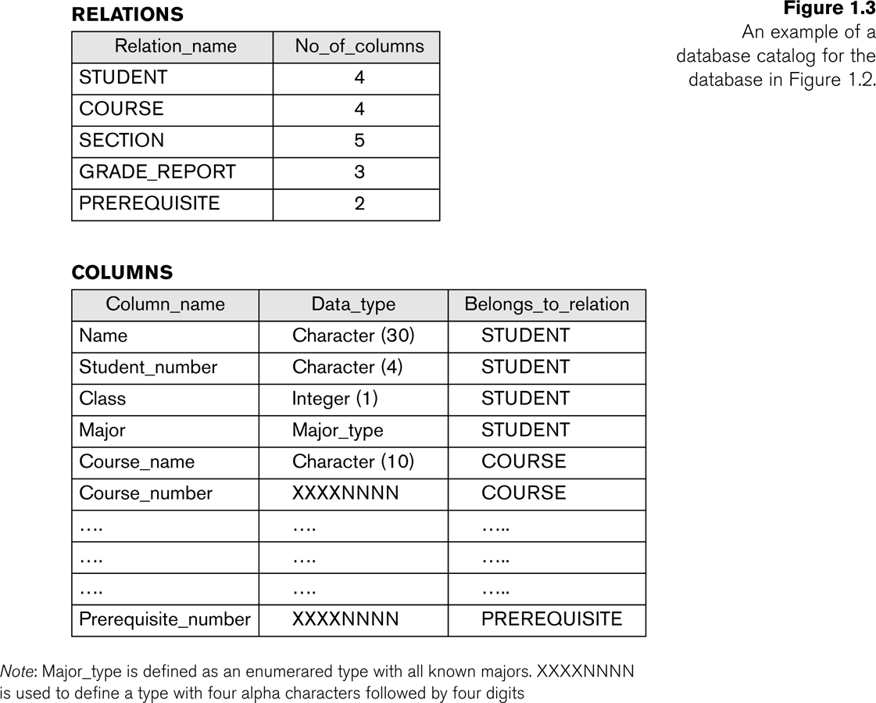
Example of a simplified database catalog

Slide 48
Main Characteristics of the Database Approach (cont.)
Data Abstraction:
  A data model is used to hide storage details and present the users with a conceptual view of the database.
  Programs refer to the data model constructs rather than data storage details
Support of multiple views of the data:
  Each user may see a different view of the database, which describes only the data of interest to that user.

Slide 49
Main Characteristics of the Database Approach (cont.)
Sharing of data and multi-user transaction processing:
  Allowing a set of concurrent users to retrieve from and to update the database.
  Concurrency control within the DBMS guarantees that each transaction is correctly executed or aborted
  Recovery subsystem ensures each completed transaction has its effect permanently recorded in the database
  OLTP (Online Transaction Processing) is a major part of database applications. This allows hundreds of concurrent transactions to execute per second.

Slide 50
Database Users
Users may be divided into
  Those who actually use and control the database content, and those who design, develop and maintain database applications (called “Actors on the Scene”), and
  Those who design and develop the DBMS software and related tools, and the computer systems operators (called “Workers Behind the Scene”).

Slide 51
Database Users – Actors on the Scene
Actors on the scene
  Database administrators:
    Responsible for authorizing access to the database, for coordinating and monitoring its use, acquiring software and hardware resources, controlling its use and monitoring efficiency of operations.
  Database Designers:
    Responsible to define the content, the structure, the constraints, and functions or transactions against the database. They must communicate with the end-users and understand their needs.

Slide 52
Database End Users
Actors on the scene (continued)
  End-users: They use the data for queries, reports and some of them update the database content. End-users can be categorized into:
    Casual: access database occasionally when needed
    Naïve or Parametric: they make up a large section of the end-user population.
      They use previously well-defined functions in the form of “canned transactions” against the database.
      Users of Mobile Apps mostly fall in this category
      Bank-tellers or reservation clerks are parametric users who do this activity for an entire shift of operations.
      Social Media Users post and read information from websites

Slide 53
Database End Users (cont.)
    Sophisticated:
      These include business analysts, scientists, engineers, others thoroughly familiar with the system capabilities.
      Many use tools in the form of software packages that work closely with the stored database.
    Stand-alone:
      Mostly maintain personal databases using ready-to-use packaged applications.
      An example is the user of a tax program that creates its own internal database.
      Another example is a user that maintains a database of personal photos and videos.

Slide 54
Database Users – Actors on the Scene (cont.)
    System Analysts and Application Developers
    This category currently accounts for a very large proportion of the IT work force.
      System Analysts: They understand the user requirements of naïve and sophisticated users and design applications including canned transactions to meet those requirements.
      Application Programmers: Implement the specifications developed by analysts and test and debug them before deployment.
      Business Analysts: There is an increasing need for such people who can analyze vast amounts of business data and real-time data (“Big Data”) for better decision making related to planning, advertising, marketing etc.

Slide 55
Database Users – Actors behind the Scene
    System Designers and Implementors: Design and implement DBMS packages in the form of modules and interfaces and test and debug them. The DBMS must interface with applications, language compilers, operating system components, etc.
    Tool Developers: Design and implement software systems called tools for modeling and designing databases, performance monitoring, prototyping, test data generation, user interface creation, simulation etc. that facilitate building of applications and allow using database effectively.
    Operators and Maintenance Personnel: They manage the actual running and maintenance of the database system hardware and software environment.

Slide 56
Advantages of Using the Database Approach
Controlling redundancy in data storage and in development and maintenance efforts.
  Sharing of data among multiple users.
Restricting unauthorized access to data. Only the DBA staff uses privileged commands and facilities.
Providing persistent storage for program Objects
  E.g., Object-oriented DBMSs make program objects persistent– see Chapter 12.
Providing Storage Structures (e.g. indexes) for efficient Query Processing – see Chapter 17.

Slide 57
Advantages of Using the Database Approach (cont.)
Providing optimization of queries for efficient processing.
Providing backup and recovery services.
Providing multiple interfaces to different classes of users.
Representing complex relationships among data.
Enforcing integrity constraints on the database.
Drawing inferences and actions from the stored data using deductive and active rules and triggers.

Slide 58
Additional Implications of Using the Database Approach
Potential for enforcing standards:
  This is very crucial for the success of database applications in large organizations. Standards refer to data item names, display formats, screens, report structures, meta-data (description of data), Web page layouts, etc.
Reduced application development time:
  Incremental time to add each new application is reduced.

Slide 59
Additional Implications of Using the Database Approach (cont.)
Flexibility to change data structures:
  Database structure may evolve as new requirements are defined.
Availability of current information:
  Extremely important for on-line transaction systems such as shopping, airline, hotel, car reservations.
Economies of scale:
  Wasteful overlap of resources and personnel can be avoided by consolidating data and applications across departments.

Slide 60
Historical Development of Database Technology
Early Database Applications:
  The Hierarchical and Network Models were introduced in mid 1960s and dominated during the seventies.
  A bulk of the worldwide database processing still occurs using these models, particularly, the hierarchical model using IBM’s IMS system.
Relational Model based Systems:
  Relational model was originally introduced in 1970, was heavily researched and experimented within IBM Research and several universities.
  Relational DBMS Products emerged in the early 1980s.

Slide 61
Historical Development of Database Technology (cont.)
Object-oriented and emerging applications:
  Object-Oriented Database Management Systems (OODBMSs) were introduced in late 1980s and early 1990s to cater to the need of complex data processing in CAD and other applications.
    Their use has not taken off much.
  Many relational DBMSs have incorporated object database concepts, leading to a new category called object-relational DBMSs (ORDBMSs)
  Extended relational systems add further capabilities (e.g. for multimedia data, text, XML, and other data types)

Slide 62
Historical Development of Database Technology (cont.)
Data on the Web and E-commerce Applications:
  Web contains data in HTML (Hypertext markup language) with links among pages.
  This has given rise to a new set of applications and E-commerce is using new standards like XML (eXtended Markup Language). (see Ch. 13).
  Script programming languages such as PHP and JavaScript allow generation of dynamic Web pages that are partially generated from a database (see Ch. 11).
    Also allow database updates through Web pages

Slide 63
Extending Database Capabilities
New functionality is being added to DBMSs in the following areas:
  Scientific Applications – Physics, Chemistry, Biology - Genetics
  Earth and Atmospheric Sciences and Astronomy
  XML (eXtensible Markup Language)
  Image Storage and Management
  Audio and Video Data Management
  Data Warehousing and Data Mining – a very major area for future development using new technologies (see Chapters 28-29)
  Spatial Data Management and Location Based Services
  Time Series and Historical Data Management
The above gives rise to new research and development in incorporating new data types, complex data structures, new operations and storage and indexing schemes in database systems.

Slide 64
Extending Database Capabilities (cont.)
Background since the advent of the 21st Century:
  First decade of the 21st century has seen tremendous growth in user generated data and automatically collected data from applications and search engines.
  Social Media platforms such as Facebook and Twitter are generating millions of transactions a day and businesses are interested to tap into this data to “understand” the users
  Cloud Storage and Backup is making unlimited amount of storage available to users and applications

Slide 65
Extending Database Capabilities (cont.)
Emergence of Big Data Technologies and NOSQL databases
  New data storage, management and analysis technology was necessary to deal with the onslaught of data in petabytes a day (10**15 bytes or 1000 terabytes) in some applications – this started being commonly called as “Big Data”.
  Hadoop (which originated from Yahoo) and Mapreduce Programming approach to distributed data processing (which originated from Google) as well as the Google file system have given rise to Big Data technologies (Chapter 25). Further enhancements are taking place in the form of Spark based technology.
  NOSQL (Not Only SQL- where SQL is the de facto standard language for relational DBMSs) systems have been designed for rapid search and retrieval from documents, processing of huge graphs occurring on social networks, and other forms of unstructured data with flexible models of transaction processing (Chapter 24).

Slide 66
When not to use a DBMS
Main inhibitors (costs) of using a DBMS:
  High initial investment and possible need for additional hardware.
  Overhead for providing generality, security, concurrency control, recovery, and integrity functions.
When a DBMS may be unnecessary:
  If the database and applications are simple, well defined, and not expected to change.
  If access to data by multiple users is not required.
When a DBMS may be infeasible:
  In embedded systems where a general purpose DBMS may not fit in available storage

Slide 67
When not to use a DBMS
When no DBMS may suffice:
  If there are stringent real-time requirements that may not be met because of DBMS overhead (e.g., telephone switching systems)
  If the database system is not able to handle the complexity of data because of modeling limitations (e.g., in complex genome and protein databases)
  If the database users need special operations not supported by the DBMS (e.g., GIS and location based services).

Slide 68
Part 2
Database System Concepts and Architecture

Slide 69
Learning Objectives
List data models and their categories
Interpret the history of data models
Understand schemas, instances, and states
Evaluate the Three-Schema Architecture
Appraise data independence
Name DBMS languages and interfaces
Identify database system utilities and tools
Know the difference between centralized and client-server architectures
Classify DBMSs

Slide 70
Outline
Data Models and Their Categories
History of Data Models
Schemas, Instances, and States
Three-Schema Architecture
Data Independence
DBMS Languages and Interfaces
Database System Utilities and Tools
Centralized and Client-Server Architectures
Classification of DBMSs

Slide 71
Data Models
Data Model:
  A set of concepts to describe the structure of a database, the operations for manipulating these structures, and certain constraints that the database should obey.
Data Model Structure and Constraints:
  Constructs are used to define the database structure
  Constructs typically include elements (and their data types) as well as groups of elements (e.g. entity, record, table), and relationships among such groups
  Constraints specify some restrictions on valid data; these constraints must be enforced at all times

Slide 72
Data Models (continued)
Data Model Operations:
  These operations are used for specifying database retrievals and updates by referring to the constructs of the data model.
  Operations on the data model may include basic model operations (e.g. generic insert, delete, update) and user-defined operations (e.g. compute_student_gpa, update_inventory)

Slide 73
Categories of Data Models
Conceptual (high-level, semantic) data models:
  Provide concepts that are close to the way many users perceive data.
    (Also called entity-based or object-based data models.)
Physical (low-level, internal) data models:
  Provide concepts that describe details of how data is stored in the computer. These are usually specified in an ad-hoc manner through DBMS design and administration manuals
Implementation (representational) data models:
  Provide concepts that fall between the above two, used by many commercial DBMS implementations (e.g. relational data models used in many commercial systems).
Self-Describing Data Models:
  Combine the description of data with the data values. Examples include XML, key-value stores and some NOSQL systems.

Slide 74
Schemas versus Instances
Database Schema:
  The description of a database.
  Includes descriptions of the database structure, data types, and the constraints on the database.
Schema Diagram:
  An illustrative display of (most aspects of) a database schema.
Schema Construct:
  A component of the schema or an object within the schema, e.g., STUDENT, COURSE.

Slide 75
Schemas versus Instances
Database State:
  The actual data stored in a database at a particular moment in time. This includes the collection of all the data in the database.
  Also called database instance (or occurrence or snapshot).
    The term instance is also applied to individual database components, e.g. record instance, table instance, entity instance

Slide 76
Database Schema vs. Database State
Database State:
  Refers to the content of a database at a moment in time.
Initial Database State:
  Refers to the database state when it is initially loaded into the system.
Valid State:
  A state that satisfies the structure and constraints of the database.

Slide 77
Database Schema vs. Database State (cont.)
Distinction
  The database schema changes very infrequently.
  The database state changes every time the database is updated.
Schema is also called intension.
State is also called extension.

Slide 78
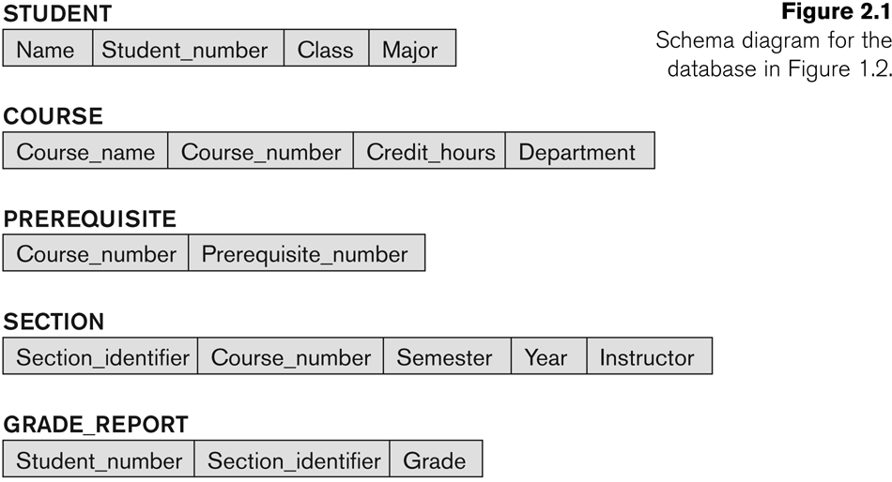
Example of a Database Schema

Slide 79

Example of a database state

Slide 80
Three-Schema Architecture
Proposed to support DBMS characteristics of:
  Program-data independence.
  Support of multiple views of the data.
Not explicitly used in commercial DBMS products, but has been useful in explaining database system organization

Slide 81
Three-Schema Architecture
Defines DBMS schemas at three levels:
  Internal schema at the internal level to describe physical storage structures and access paths (e.g indexes).
    Typically uses a physical data model.
  Conceptual schema at the conceptual level to describe the structure and constraints for the whole database for a community of users.
    Uses a conceptual or an implementation data model.
  External schemas at the external level to describe the various user views.
    Usually uses the same data model as the conceptual schema.

Slide 82
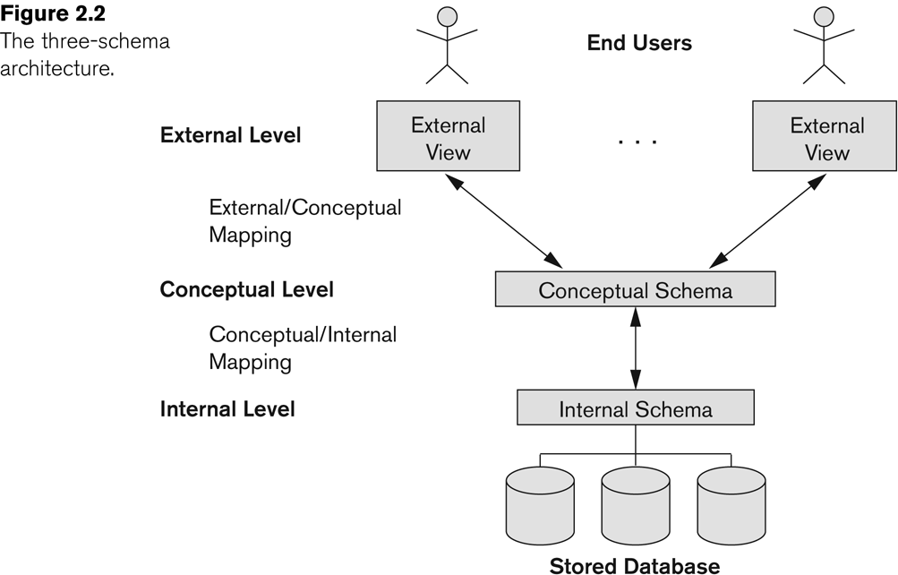
Three-Schema Architecture (cont.)

Slide 83
Three-Schema Architecture (cont.)
Mappings among schema levels are needed to transform requests and data.
  Programs refer to an external schema, and are mapped by the DBMS to the internal schema for execution.
  Data extracted from the internal DBMS level is reformatted to match the user’s external view (e.g. formatting the results of an SQL query for display in a Web page)

Slide 84
Data Independence
Logical Data Independence:
  The capacity to change the conceptual schema without having to change the external schemas and their associated application programs.
Physical Data Independence:
  The capacity to change the internal schema without having to change the conceptual schema.
  For example, the internal schema may be changed when certain file structures are reorganized or new indexes are created to improve database performance

Slide 85
Data Independence (cont.)
When a schema at a lower level is changed, only the mappings between this schema and higher-level schemas need to be changed in a DBMS that fully supports data independence.
The higher-level schemas themselves are unchanged.
  Hence, the application programs need not be changed since they refer to the external schemas.

Slide 86
DBMS Languages
Data Definition Language (DDL)
Data Manipulation Language (DML)
  High-Level or Non-procedural Languages: These include the relational language SQL
    May be used in a standalone way or may be embedded in a programming language
  Low Level or Procedural Languages:
    These must be embedded in a programming language

Slide 87
DBMS Languages (cont.)
Data Definition Language (DDL):
  Used by the DBA and database designers to specify the conceptual schema of a database.
  In many DBMSs, the DDL is also used to define internal and external schemas (views).
  In some DBMSs, separate storage definition language (SDL) and view definition language (VDL) are used to define internal and external schemas.
    SDL is typically realized via DBMS commands provided to the DBA and database designers

Slide 88
DBMS Languages (cont.)
Data Manipulation Language (DML):
  Used to specify database retrievals and updates
  DML commands (data sublanguage) can be embedded in a general-purpose programming language (host language), such as COBOL, C,
  C++, or Java.
    A library of functions can also be provided to access the DBMS from a programming language
  Alternatively, stand-alone DML commands can be applied directly (called a query language).

Slide 89
Types of DML
High Level or Non-procedural Language:
  For example, the SQL relational language
  Are “set”-oriented and specify what data to retrieve rather than how to retrieve it.
  Also called declarative languages.
Low Level or Procedural Language:
  Retrieve data one record-at-a-time;
  Constructs such as looping are needed to retrieve multiple records, along with positioning pointers.

Slide 90
DBMS Interfaces
Stand-alone query language interfaces
  Example: Entering SQL queries at the DBMS interactive SQL interface (e.g. SQL*Plus in ORACLE)
Programmer interfaces for embedding DML in programming languages
User-friendly interfaces
  Menu-based, forms-based, graphics-based, etc.
Mobile Interfaces:interfaces allowing users to perform transactions using mobile apps

Slide 91
DBMS Programming Language Interfaces
Programmer interfaces for embedding DML in a programming languages:
  Embedded Approach: e.g embedded SQL (for C, C++, etc.), SQLJ (for Java)
  Procedure Call Approach: e.g. JDBC for Java, ODBC (Open Databse Connectivity) for other programming languages as API’s (application programming interfaces)
  Database Programming Language Approach: e.g. ORACLE has PL/SQL, a programming language based on SQL; language incorporates SQL and its data types as integral components
  Scripting Languages: PHP (client-side scripting) and Python (server-side scripting) are used to write database programs.

Slide 92
User-Friendly DBMS Interfaces
  Menu-based (Web-based), popular for browsing on the web
  Forms-based, designed for naïve users used to filling in entries on a form
  Graphics-based
    Point and Click, Drag and Drop, etc.
    Specifying a query on a schema diagram
  Natural language: requests in written English
  Combinations of the above:
    For example, both menus and forms used extensively in Web database interfaces

Slide 93
Other DBMS Interfaces
  Natural language: free text as a query
  Speech : Input query and Output response
  Web Browser with keyword search
  Parametric interfaces, e.g., bank tellers using function keys.
  Interfaces for the DBA:
    Creating user accounts, granting authorizations
    Setting system parameters
    Changing schemas or access paths

Slide 94
Database System Utilities
To perform certain functions such as:
  Loading data stored in files into a database. Includes data conversion tools.
  Backing up the database periodically on tape.
  Reorganizing database file structures.
  Performance monitoring utilities.
  Report generation utilities.
  Other functions, such as sorting, user monitoring, data compression, etc.

Slide 95
Other Tools
Data dictionary / repository:
  Used to store schema descriptions and other information such as design decisions, application program descriptions, user information, usage standards, etc.
  Active data dictionary is accessed by DBMS software and users/DBA.
  Passive data dictionary is accessed by users/DBA only.

Slide 96
Other Tools
Application Development Environments and CASE (computer-aided software engineering) tools:
Examples:
  PowerBuilder (Sybase)
  JBuilder (Borland)
  JDeveloper 10G (Oracle)

Slide 97
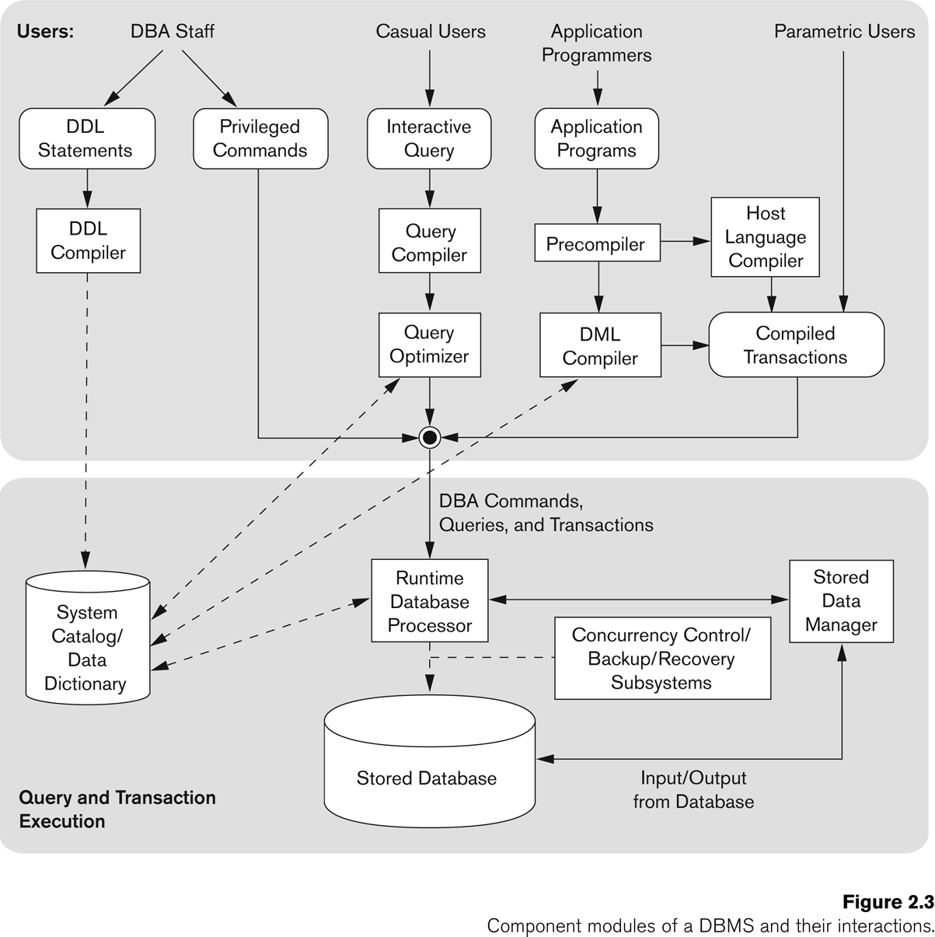
Typical DBMS Component Modules

Slide 98
Centralized and
Client-Server DBMS Architectures
Centralized DBMS:
  Combines everything into single system including- DBMS software, hardware, application programs, and user interface processing software.
  User can still connect through a remote terminal – however, all processing is done at centralized site.

Slide 99
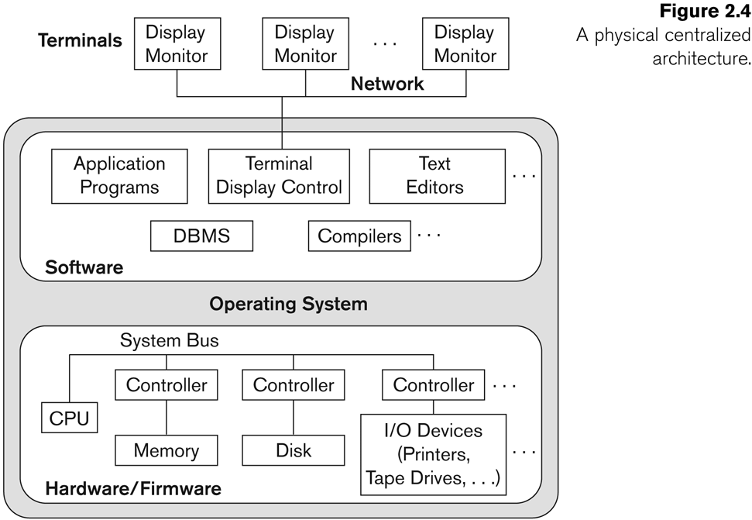
A Physical Centralized Architecture

Slide 100
Basic 2-tier Client-Server Architectures
Specialized Servers with Specialized functions
  Print server
  File server
  DBMS server
  Web server
  Email server
Clients can access the specialized servers as needed

Slide 101
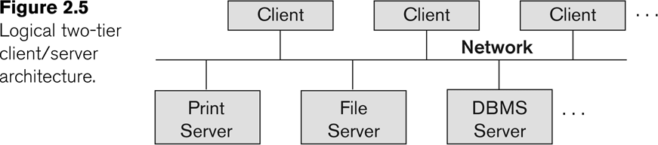
Logical two-tier client server architecture

Slide 102
Clients
Provide appropriate interfaces through a client software module to access and utilize the various server resources.
Clients may be diskless machines or PCs or Workstations with disks with only the client software installed.
Connected to the servers via some form of a network.
  (LAN: local area network, wireless network, etc.)

Slide 103
DBMS Server
Provides database query and transaction services to the clients
Relational DBMS servers are often called SQL servers, query servers, or transaction servers
Applications running on clients utilize an Application Program Interface (API) to access server databases via standard interface such as:
  ODBC: Open Database Connectivity standard
  JDBC: for Java programming access

Slide 104
Two Tier Client-Server Architecture
Client and server must install appropriate client module and server module software for ODBC or JDBC
A client program may connect to several DBMSs, sometimes called the data sources.
In general, data sources can be files or other non-DBMS software that manages data.
See Chapter 10 for details on Database Programming

Slide 105
Three Tier Client-Server Architecture
Common for Web applications
Intermediate Layer called Application Server or Web Server:
  Stores the web connectivity software and the business logic part of the application used to access the corresponding data from the database server
  Acts like a conduit for sending partially processed data between the database server and the client.
Three-tier Architecture Can Enhance Security:
  Database server only accessible via middle tier
  Clients cannot directly access database server
  Clients contain user interfaces and Web browsers
  The client is typically a PC or a mobile device connected to the Web

Slide 106
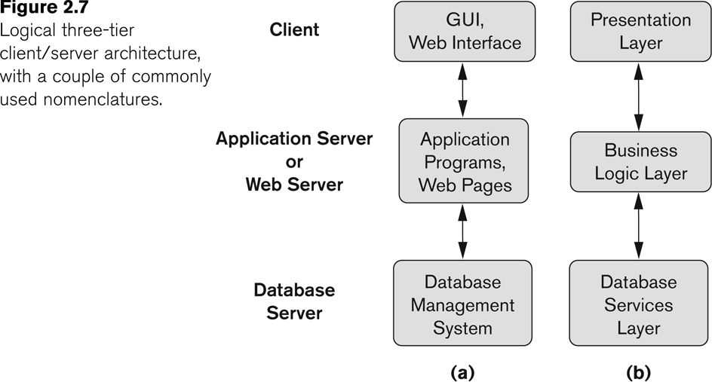
Three-tier client-server architecture

Slide 107
Classification of DBMSs
Based on the data model used
  Legacy: Network, Hierarchical.
  Currently Used: Relational, Object-oriented, Object-relational
  Recent Technologies: Key-value storage systems, NOSQL systems: document based, column-based, graph-based and key-value based. Native XML DBMSs.
Other classifications
  Single-user (typically used with personal computers)
  vs. multi-user (most DBMSs).
  Centralized (uses a single computer with one database) vs. distributed (multiple computers, multiple DBs)

Slide 108
Variations of Distributed DBMSs (DDBMSs)
Homogeneous DDBMS
Heterogeneous DDBMS
Federated or Multidatabase Systems
  Participating Databases are loosely coupled with high degree of autonomy.
Distributed Database Systems have now come to be known as client-server based database systems because:
  They do not support a totally distributed environment, but rather a set of database servers supporting a set of clients.

Slide 109
Cost considerations for DBMSs
Cost Range: from free open-source systems to configurations costing millions of dollars
Examples of free relational DBMSs: MySQL, PostgreSQL, others
Commercial DBMS offer additional specialized modules, e.g. time-series module, spatial data module, document module, XML module
  These offer additional specialized functionality when purchased separately
  Sometimes called cartridges (e.g., in Oracle) or blades
Different licensing options: site license, maximum number of concurrent users (seat license), single user, etc.

Slide 110
Other Considerations
Type of access paths within database system
  E.g.- inverted indexing based (ADABAS is one such system).Fully indexed databases provide access by any keyword (used in search engines)
General Purpose vs. Special Purpose
  E.g.- Airline Reservation systems or many others-reservation systems for hotel/car etc. Are special purpose OLTP (Online Transaction Processing Systems)

Slide 111
Additional Material
History of Data Models

Slide 112
History of Data Models
Network Model
Hierarchical Model
Relational Model
Object-oriented Data Models
Object-Relational Models

Slide 113
History of Data Models
Network Model:
  The first network DBMS was implemented by Honeywell in 1964-65 (IDS System).
  Adopted heavily due to the support by CODASYL (Conference on Data Systems Languages) (CODASYL - DBTG report of 1971).
  Later implemented in a large variety of systems - IDMS (Cullinet - now Computer Associates), DMS 1100 (Unisys), IMAGE (H.P. (Hewlett-Packard)), VAX -DBMS (Digital Equipment Corp., next COMPAQ, now H.P.).

Slide 114
Network Model
Advantages:
  Network Model is able to model complex relationships and represents semantics of add/delete on the relationships.
  Can handle most situations for modeling using record types and relationship types.
  Language is navigational; uses constructs like FIND, FIND member, FIND owner, FIND NEXT within set, GET, etc.
    Programmers can do optimal navigation through the database.

Slide 115
Network Model
Disadvantages:
  Navigational and procedural nature of processing
  Database contains a complex array of pointers that thread through a set of records.
    Little scope for automated “query optimization”

Slide 116
History of Data Models
Hierarchical Data Model:
  Initially implemented in a joint effort by IBM and North American Rockwell around 1965. Resulted in the IMS family of systems.
  IBM’s IMS product had (and still has) a very large customer base worldwide
  Hierarchical model was formalized based on the IMS system
  Other systems based on this model: System 2k (SAS inc.)

Slide 117
Hierarchical Model
Advantages:
  Simple to construct and operate
  Corresponds to a number of natural hierarchically organized domains, e.g., organization (“org”) chart
  Language is simple:
    Uses constructs like GET, GET UNIQUE, GET NEXT, GET NEXT WITHIN PARENT, etc.
Disadvantages:
  Navigational and procedural nature of processing
  Database is visualized as a linear arrangement of records
  Little scope for "query optimization"

Slide 118
History of Data Models
Relational Model:
  Proposed in 1970 by E.F. Codd (IBM), first commercial system in 1981-82.
  Now in several commercial products (e.g. DB2, ORACLE, MS SQL Server, SYBASE, INFORMIX).
  Several free open source implementations, e.g. MySQL, PostgreSQL
  Currently most dominant for developing database applications.
  SQL relational standards: SQL-89 (SQL1), SQL-92 (SQL2), SQL-99, SQL3, …
  Chapters 5 through 11 describe this model in detail

Slide 119
History of Data Models
Object-oriented Data Models:
  Several models have been proposed for implementing in a database system.
  One set comprises models of persistent O-O Programming Languages such as C++ (e.g., in OBJECTSTORE or VERSANT), and Smalltalk (e.g., in GEMSTONE).
  Additionally, systems like O2, ORION (at MCC - then ITASCA), IRIS (at H.P.- used in Open OODB).
  Object Database Standard: ODMG-93, ODMG-version 2.0, ODMG-version 3.0.
  Chapter 12 describes this model.

Slide 120
History of Data Models
Object-Relational Models:
  The trend to mix object models with relational was started with Informix Universal Server.
  Relational systems incorporated concepts from object databases leading to object-relational.
  Exemplified in the versions of Oracle, DB2, and SQL Server and other DBMSs.
  Current trend by Relational DBMS vendors is to extend relational DBMSs with capability to process XML, Text and other data types.
  The term “Object-relational” is receding in the marketplace.

Slide 121
Next Lecture
Data Modeling & ER Model

Slide 122
References
Ramez Elmasri, Shamkant Navathe; “Fundamentals of Database Systems”, 6th Ed., Pearson, 2014.
Mark L. Gillenson; “Fundamentals of Database Management Systems”, 2nd Ed., John Wiley, 2012.
Universität Hamburg, Fachbereich Informatik, Einführung in Datenbanksysteme, Lecture Notes, 1999

