Slide 1


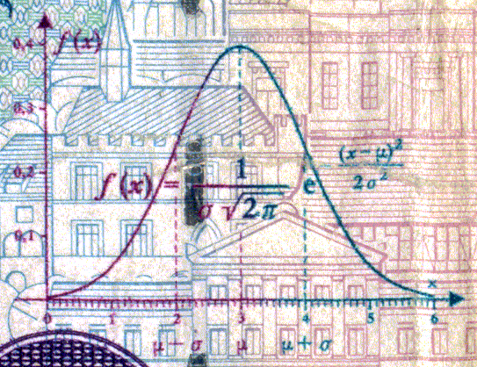
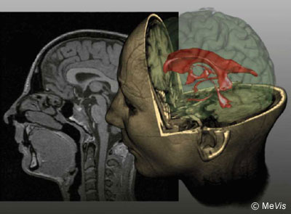

CSE 307
Basics of Image Processing
A Brief Introduction to MATLAB® and IPT
Prepared & Presented by Asst. Prof. Dr. Samsun M. BAŞARICI

Slide 2


Objectives
What is MATLAB and why has it been selected to be the tool of choice for this course?
What programming environment does MATLAB offer?
What are M-files?
What is the difference between MATLAB scripts and functions?
How can I get started in MATLAB?

Slide 3
Objectives (cont.)
How do I read an image from a file using MATLAB?
What are the main data classes used for image representation and how can I convert from one to another?
Why is it important to understand the data class and range of pixel values of images stored in memory?
How do I display an image using MATLAB?
How can I explore the pixel contents of an image?
How do I save an image to a file using MATLAB?

Slide 4
Introduction to MATLAB
MATLAB (MATrix LABoratory): data analysis, prototyping, and visualization tool with built-in support for matrices and matrix operations, excellent graphics capabilities, and a high-level programming language and development environment.
Very popular with engineers, scientists, and researchers in both industry and academia.
Extensive built-in documentation.
Many toolboxes (including the Image Processing Toolbox – coming soon).

Slide 5
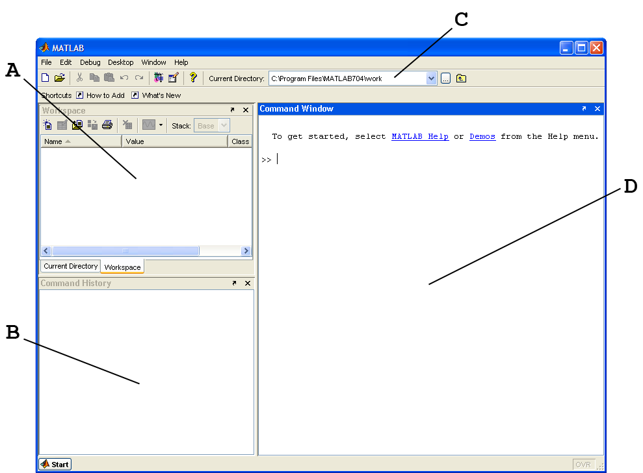
Basic elements of MATLAB
Working environment
Current directory
Workspace variables
Command
history
Command window

Slide 6
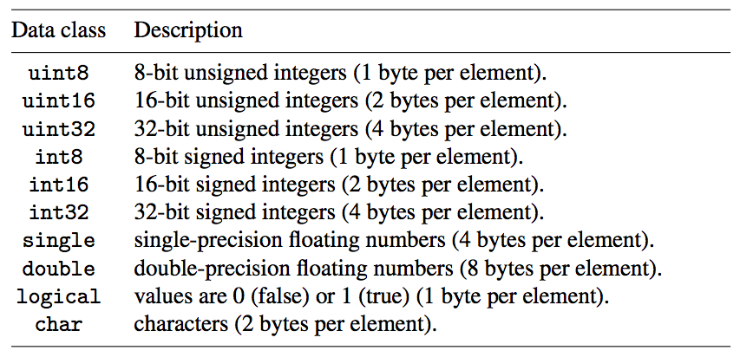
Basic elements of MATLAB (cont.)
Data classes

Slide 7
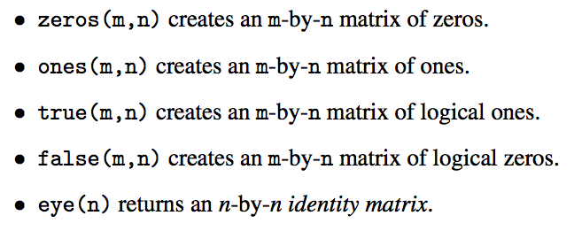
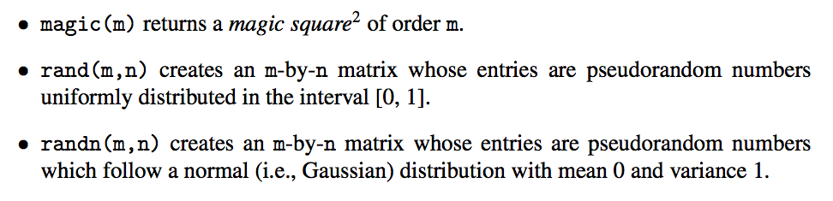
Basic elements of MATLAB (cont.)
Standard arrays

Slide 8
M-files: scripts and functions
M-files in MATLAB can be:
  scripts that simply execute a series of MATLAB commands or statements; or
  functions that can accept arguments (parameters) and produce one or more output values.
Scripts
  An M-file containing a script consists of a sequence of commands to be interpreted and executed.
  In addition to calls to built-in functions, scripts may also contain variable declarations, calls to user-created functions (which may be stored in separate files), decision statements and repetition loops.
  Scripts are usually created using a text editor (e.g., the built-in MATLAB Editor) and stored with a meaningful name and the .m extension.
  Once a script has been created and saved, it can be invoked from the command line simply by typing its name.

Slide 9
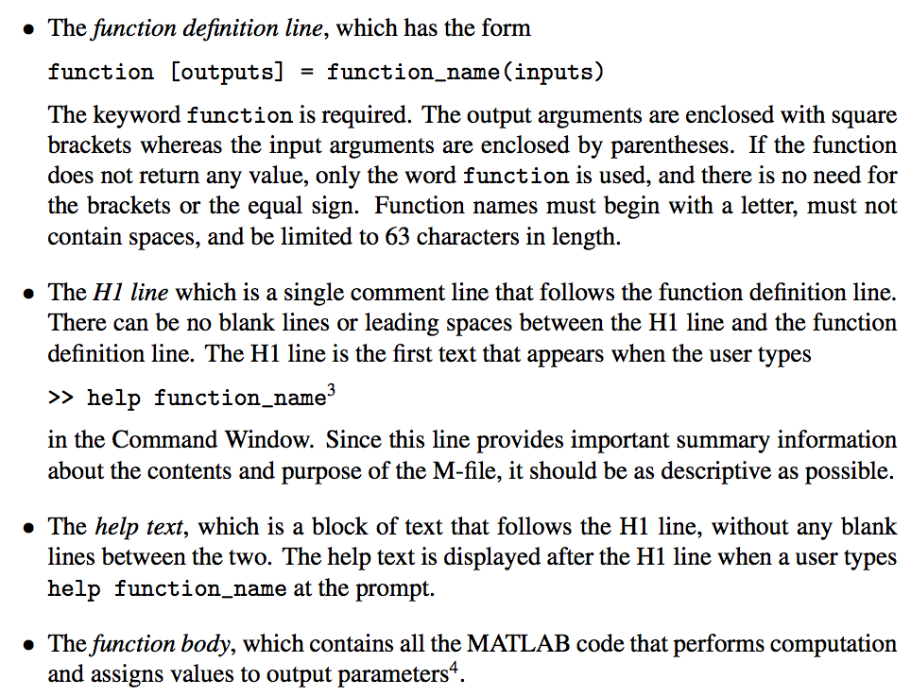
M-files: scripts and functions (cont.)
Functions
  An M-file containing a function has the following structure:

Slide 10
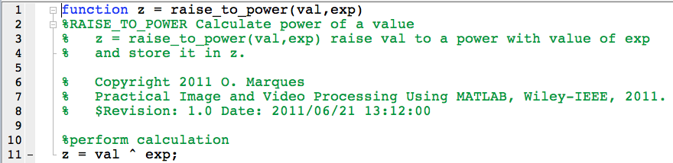
M-files: scripts and functions (cont.)
Functions
  Example

Slide 11
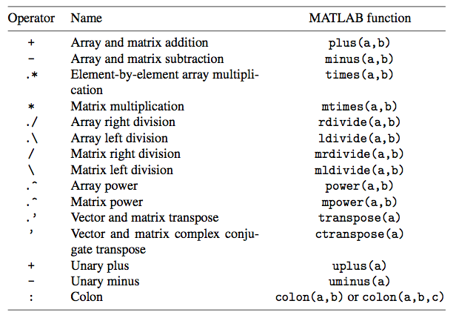
MATLAB array and matrix arithmetic operators

Slide 12
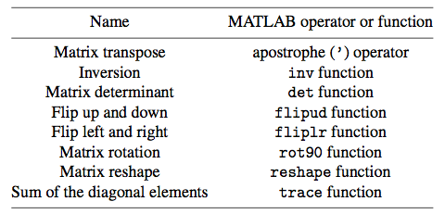
MATLAB specialized matrix operations

Slide 13
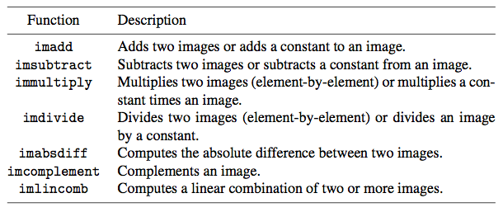
MATLAB specialized arithmetic functions supported by the IPT

Slide 14
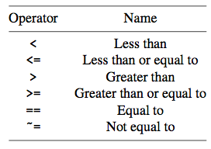
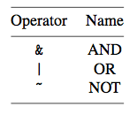
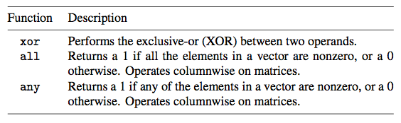
MATLAB relational and logical operators and logical functions

Slide 15
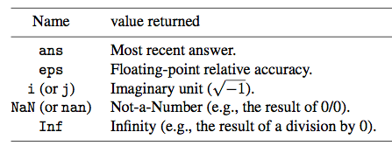
MATLAB selected built-in variables and constants

Slide 16
The Image Processing Toolbox (IPT): essential functions and features
Displaying information about an image file
Reading an image file
Data classes and data conversions
Displaying the contents of an image
Exploring the contents of an image
Writing the resulting image onto a file

Slide 17
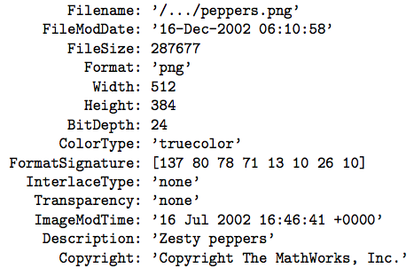
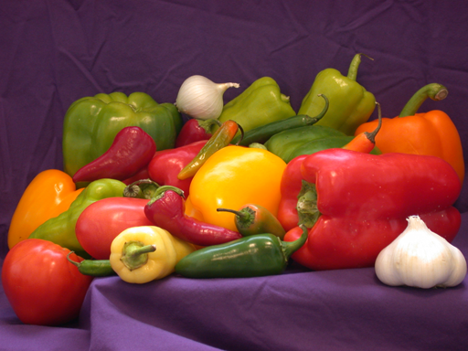
IPT: essential functions and features (cont.)
Displaying information about an image file
  imfinfo
  Example:

Slide 18
IPT: essential functions and features (cont.)
Reading an image file
  imread
  dicomread
  nitfread
  hdrread

Slide 19
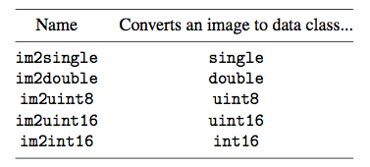
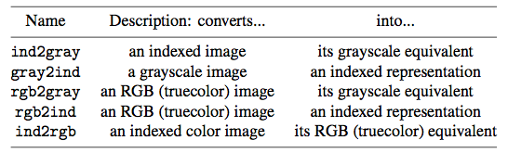
IPT: essential functions and features (cont.)
Data classes and data conversions
  Most common classes for images:
    uint8
    double
    logical
  Image data class conversions

Slide 20
IPT: essential functions and features (cont.)
Displaying the contents of an image
  image: displays an image using the current colormap.
  imagesc: scales image data to the full range of the current colormap and displays the image.
  imshow: displays an image and contains a number of optimizations and optional parameters for property settings associated with image display.
  imtool: displays an image and contains a number of associated tools that can be used to explore the image contents.

Slide 21
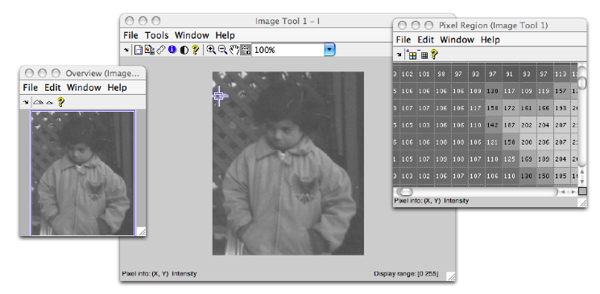
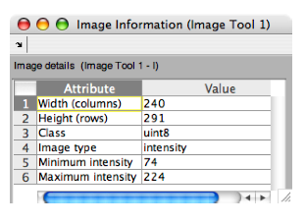
IPT: essential functions and features (cont.)
Exploring the contents of an image
  imtool
    Provides all the image display capabilities of imshow as well as access to other tools for navigating and exploring images, such as the Pixel Region tool, Image Information tool, and the Adjust Contrast tool.

Slide 22
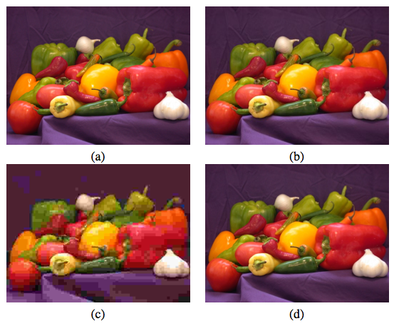
IPT: essential functions and features (cont.)
Writing the resulting image onto a file
  imwrite
Example:
    I = imread('peppers.png');
    imwrite(I, 'pep75.jpg');
    imwrite(I, 'pep05.jpg', 'quality', 5);
    imwrite(I, 'pep95.jpg', 'quality', 95);

Slide 23
Summary
You should now know
  What MATLAB is and how you can use it
  The working principles of the image processing toolbox (IPT) and be able to use it for different basic image processing operations

