Slide 1

Chapter 8
Virtual
Memory
Ninth Edition, Global Edition
William Stallings
Notes:
“Operating Systems: Internal and Design Principles”, 9/e, by William Stallings, Chapter 8 “Virtual Memory”.

Slide 2
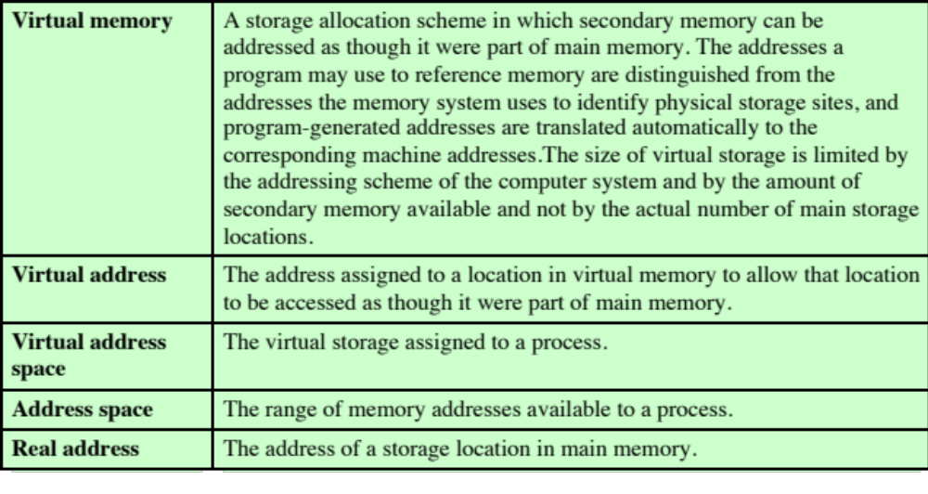

Table 8.1 Virtual Memory Terminology
Notes:
Table 8.1 defines some key terms related to virtual memory.

Slide 3
Hardware and Control Structures
Two characteristics fundamental to memory management:
    All memory references are logical addresses that are dynamically translated into physical addresses at run time
    A process may be broken up into a number of pieces that don’t need to be contiguously located in main memory during execution
    If these two characteristics are present, it is not necessary that all of the pages or segments of a process be in main memory during execution
Notes:
Comparing simple paging and simple segmentation, on the one hand, with fixed and
dynamic partitioning, on the other, we see the foundation for a fundamental breakthrough
in memory management. Two characteristics of paging and segmentation
are the keys to this breakthrough:
1. All memory references within a process are logical addresses that are dynamically
translated into physical addresses at run time. This means that a process may be swapped in and out of main memory such that it occupies different
regions of main memory at different times during the course of execution.
2. A process may be broken up into a number of pieces (pages or segments) and
these pieces need not be contiguously located in main memory during execution.
The combination of dynamic run-time address translation and the use of
a page or segment table permits this.
Now we come to the breakthrough. If the preceding two characteristics are
present, then it is not necessary that all of the pages or all of the segments of a process
be in main memory during execution. If the piece (segment or page) that holds the
next instruction to be fetched and the piece that holds the next data location to be
accessed are in main memory, then at least for a time execution may proceed.

Slide 4
Execution of a Process
Operating system brings into main memory a few pieces of the program
Resident set
    Portion of process that is in main memory
An interrupt is generated when an address is needed that is not in main memory
Operating system places the process in a blocking state
Continued . . .
Notes:
For now, we can talk in general
terms, and we will use the term piece to refer to either page or segment, depending
on whether paging or segmentation is employed. Suppose that it is time to bring a
new process into memory. The operating system begins by bringing in only one or
a few pieces, to include the initial program piece and the initial data piece to which
those instructions refer.
The portion of a process that is actually in main memory
at any time is defined to be the resident set of the process. As the process executes,
things proceed smoothly as long as all memory references are to locations that are
in the resident set. Using the segment or page table, the processor always is able to
determine whether this is so. If the processor encounters a logical address that is
not in main memory, it generates an interrupt indicating a memory access fault. The
operating system puts the interrupted process in a blocking state.

Slide 5
Execution of a Process
Piece of process that contains the logical address is brought into main memory
    Operating system issues a disk I/O Read request
    Another process is dispatched to run while the disk I/O takes place
    An interrupt is issued when disk I/O is complete, which causes the operating system to place the affected process in the Ready state
Notes:
For the execution of this process to proceed later, the operating system will need to
bring into main memory the piece of the process that contains the logical address
that caused the access fault. For this purpose, the operating system issues a disk I/O
read request. After the I/O request has been issued, the operating system can dispatch
another process to run while the disk I/O is performed. Once the desired piece
has been brought into main memory, an I/O interrupt is issued, giving control back
to the operating system, which places the affected process back into a Ready state.

Slide 6
Implications
More processes may be maintained in main memory
    Because only some of the pieces of any particular process are loaded, there is room for more processes
    This leads to more efficient utilization of the processor because it is more likely that at least one of the more numerous processes will be in a Ready state at any particular time
A process may be larger than all of main memory
    If the program being written is too large, the programmer must devise ways to structure the program into pieces that can be loaded separately in some sort of overlay strategy
    With virtual memory based on paging or segmentation, that job is left to the OS and the hardware
    The OS automatically loads pieces of a process into main memory as required
Notes:
There are two implications, the second more startling than the first, and both lead to improved
system utilization:
1. More processes may be maintained in main memory. Because we are only
going to load some of the pieces of any particular process, there is room for
more processes. This leads to more efficient utilization of the processor because
it is more likely that at least one of the more numerous processes will be
in a Ready state at any particular time.
2. A process may be larger than all of main memory. One of the most fundamental
restrictions in programming is lifted. Without the scheme we have
been discussing, a programmer must be acutely aware of how much memory
is available. If the program being written is too large, the programmer must
devise ways to structure the program into pieces that can be loaded separately
in some sort of overlay strategy. With virtual memory based on paging
or segmentation, that job is left to the OS and the hardware. As far as the
programmer is concerned, he or she is dealing with a huge memory, the size associated
with disk storage. The OS automatically loads pieces of a process into
main memory as required.

Slide 7
Real and Virtual Memory
Real memory
Main memory, the actual RAM
Virtual memory
Memory on disk
Allows for effective multiprogramming and relieves the user of tight constraints of main memory
Notes:
Because a process executes only in main memory, that memory is referred to
as real memory . But a programmer or user perceives a potentially much larger memory—
that which is allocated on disk. This latter is referred to as virtual memory .
Virtual memory allows for very effective multiprogramming and relieves the user
of the unnecessarily tight constraints of main memory.

Slide 8
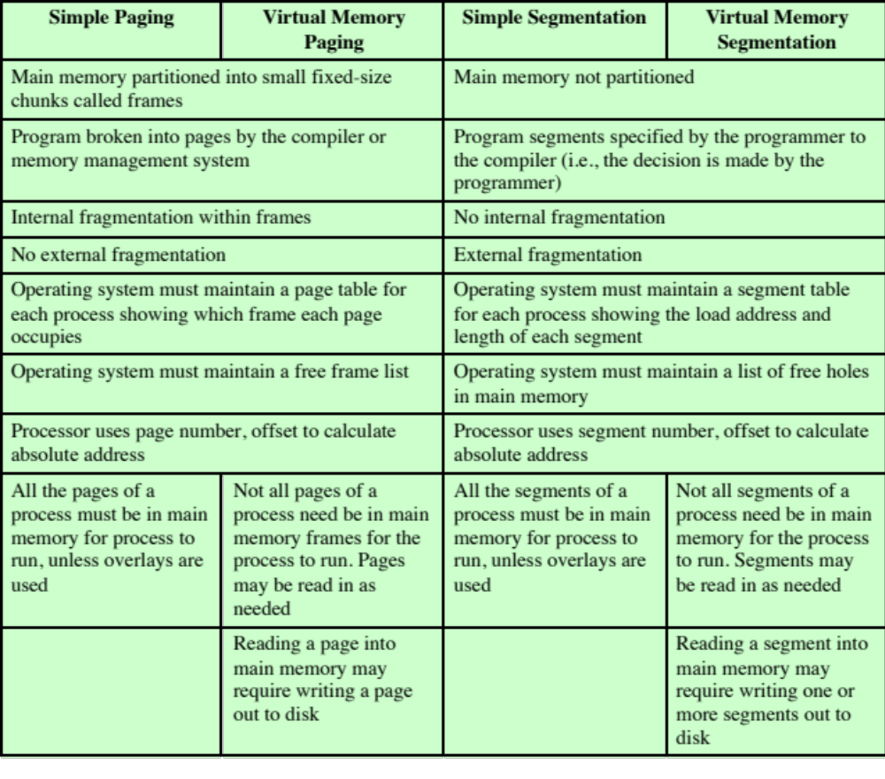
Table 8.2
Characteristics of Paging and Segmentation
Notes:
Table 8.2 summarizes characteristics of paging and segmentation, with and without the use of virtual memory.

Slide 9
Thrashing
A state in which the system spends most of its time swapping process pieces rather than executing instructions
To avoid this, the operating system tries to guess, based on recent history, which pieces are least likely to be used in the near future
Notes:
To understand what the key issue is, and why virtual memory was a matter
of much debate, let us examine again the task of the operating system with respect
to virtual memory. Consider a large process, consisting of a long program plus a
number of arrays of data. Over any short period of time, execution may be confined
to a small section of the program (e.g., a subroutine) and access to perhaps only one
or two arrays of data. If this is so, then it would clearly be wasteful to load in dozens
of pieces for that process when only a few pieces will be used before the program is
suspended and swapped out. We can make better use of memory by loading in just a
few pieces. Then, if the program branches to an instruction or references a data item
on a piece not in main memory, a fault is triggered. This tells the operating system
to bring in the desired piece.
Thus, at any one time, only a few pieces of any given process are in memory,
and therefore more processes can be maintained in memory. Furthermore, time is
saved because unused pieces are not swapped in and out of memory. However, the
operating system must be clever about how it manages this scheme. In the steady
state, practically all of main memory will be occupied with process pieces, so that the
processor and operating system have direct access to as many processes as possible.
Thus, when the operating system brings one piece in, it must throw another out. If it
throws out a piece just before it is used, then it will just have to go get that piece again
almost immediately. Too much of this leads to a condition known as thrashing : The
system spends most of its time swapping pieces rather than executing instructions.
The avoidance of thrashing was a major research area in the 1970s and led to a variety
of complex but effective algorithms. In essence, the operating system tries to guess,
based on recent history, which pieces are least likely to be used in the near future.

Slide 10
Principle of Locality
Program and data references within a process tend to cluster
Only a few pieces of a process will be needed over a short period of time
Therefore it is possible to make intelligent guesses about which pieces will be needed in the future
Avoids thrashing
Notes:
This reasoning is based on belief in the principle of locality , which was introduced
in Chapter 1 (see especially Appendix 1A). To summarize, the principle of
locality states that program and data references within a process tend to cluster.
Hence, the assumption that only a few pieces of a process will be needed over a short
period of time is valid. Also, it should be possible to make intelligent guesses about
which pieces of a process will be needed in the near future, which avoids thrashing.

Slide 11
Support Needed for Virtual Memory
For virtual memory to be practical and effective:
Hardware must support paging and segmentation
Operating system must include software for managing the movement of pages and/or segments between secondary memory and main memory
Notes:
The principle of locality suggests that a virtual memory
scheme may work. For virtual memory to be practical and effective, two ingredients
are needed. First, there must be hardware support for the paging and/or segmentation
scheme to be employed. Second, the operating system must include software
for managing the movement of pages and/or segments between secondary memory
and main memory.

Slide 12
Paging
The term virtual memory is usually associated with systems that employ paging
Use of paging to achieve virtual memory was first reported for the Atlas computer
Each process has its own page table
  Each page table entry (PTE) contains the frame number of the corresponding page in main memory
  A page table is also needed for a virtual memory scheme based on paging
Notes:
The term virtual memory is usually associated with systems that employ paging,
although virtual memory based on segmentation is also used and is discussed next.
The use of paging to achieve virtual memory was first reported for the Atlas computer
[KILB62] and soon came into widespread commercial use.
In the discussion of simple paging, we indicated that each process has its
own page table, and when all of its pages are loaded into main memory, the page table
for a process is created and loaded into main memory. Each page table entry
(PTE) contains the frame number of the corresponding page in main memory. A
page table is also needed for a virtual memory scheme based on paging.

Slide 13
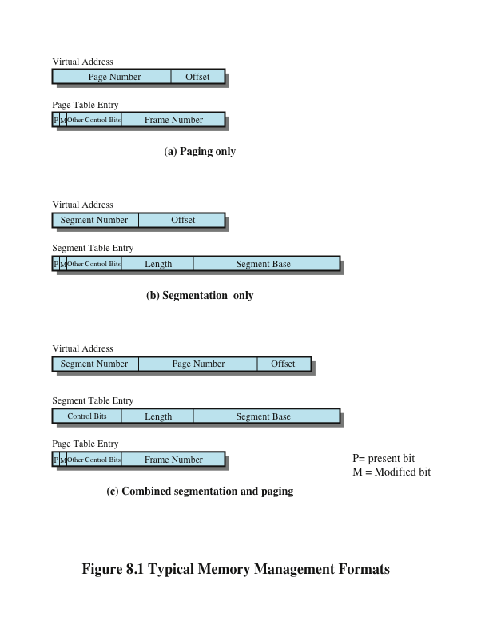
Notes:
Again, it is typical to associate a unique page table with each process. In this case, however,
the page table entries become more complex ( Figure 8.1a ). Because only some of
the pages of a process may be in main memory, a bit is needed in each page table
entry to indicate whether the corresponding page is present (P) in main memory or
not. If the bit indicates that the page is in memory, then the entry also includes the
frame number of that page.
The page table entry includes a modify (M) bit, indicating whether the contents
of the corresponding page have been altered since the page was last loaded
into main memory. If there has been no change, then it is not necessary to write the
page out when it comes time to replace the page in the frame that it currently occupies.
Other control bits may also be present. For example, if protection or sharing is
managed at the page level, then bits for that purpose will be required.

Slide 14
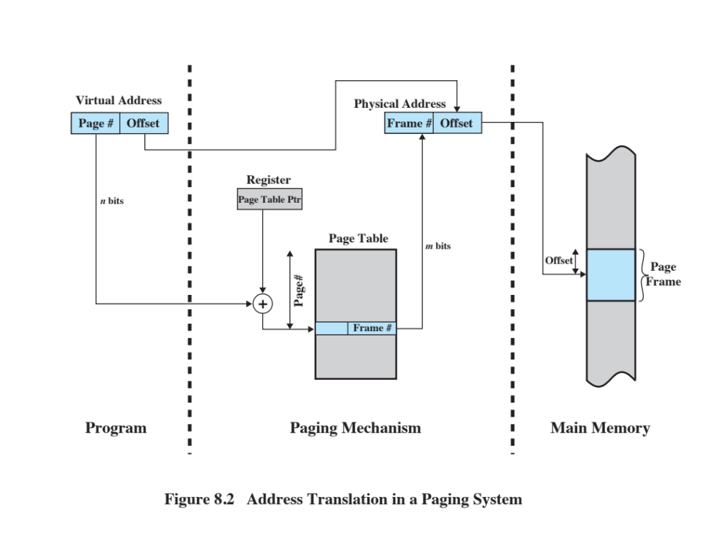
Notes:
The basic mechanism for reading a word from memory
involves the translation of a virtual, or logical, address, consisting of page number
and offset, into a physical address, consisting of frame number and offset, using a
page table. Because the page table is of variable length, depending on the size of the
process, we cannot expect to hold it in registers. Instead, it must be in main memory
to be accessed. Figure 8.2 suggests a hardware implementation. When a particular
process is running, a register holds the starting address of the page table for that
process. The page number of a virtual address is used to index that table and look
up the corresponding frame number. This is combined with the offset portion of the
virtual address to produce the desired real address. Typically, the page number field
is longer than the frame number field ( n > m ). This inequality results from the fact that
the number of pages in a process may exceed the number of frames in main memory.

Slide 15
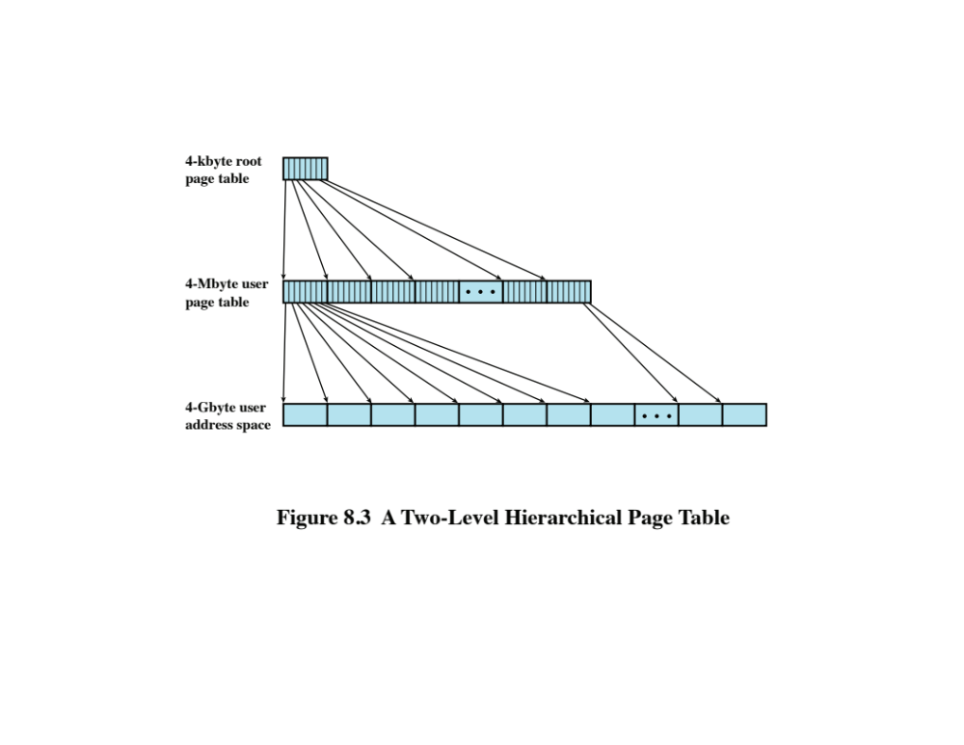
Notes:
Figure 8.3 shows an example of a two-level scheme typical for use with a
32-bit address. If we assume byte-level addressing and 4-kbyte (2 ¹² ) pages, then the
4-Gbyte (2 ³² ) virtual address space is composed of 2 ²⁰ pages. If each of these pages
is mapped by a 4-byte page table entry, we can create a user page table composed of
2 ²⁰ PTEs requiring 4 Mbytes (2 ²² ). This huge user page table, occupying 2 ¹⁰ pages,
can be kept in virtual memory and mapped by a root page table with 2 ¹⁰ PTEs occupying
4 Kbyte (2 ¹² ) of main memory.

Slide 16
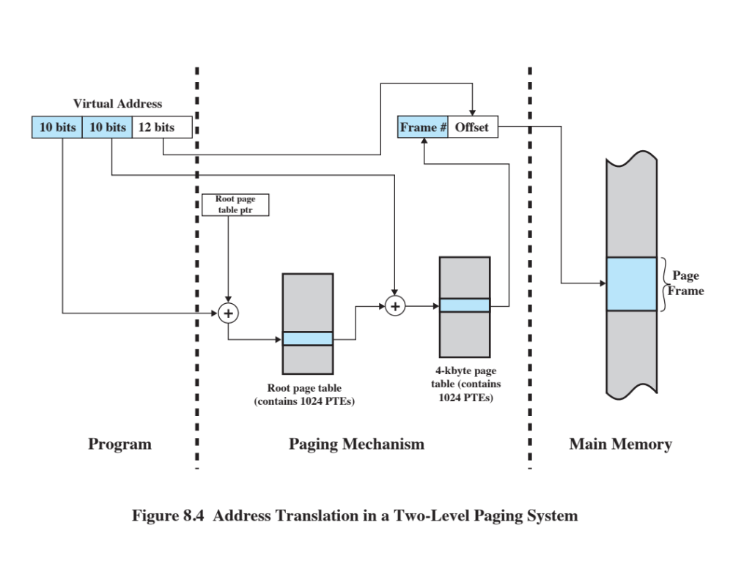
Notes:
Figure 8.4 shows the steps involved in address translation for this scheme.
The root page always remains in main memory. The
first 10 bits of a virtual address are used to index into the root page to find a PTE
for a page of the user page table. If that page is not in main memory, a page fault
occurs. If that page is in main memory, then the next 10 bits of the virtual address
index into the user PTE page to find the PTE for the page that is referenced by the
virtual address.

Slide 17
Inverted Page Table
Page number portion of a virtual address is mapped into a hash value
    Hash value points to inverted page table
Fixed proportion of real memory is required for the tables regardless of the number of processes or virtual pages supported
Structure is called inverted because it indexes page table entries by frame number rather than by virtual page number
Notes:
A drawback of the type of page tables that we have been
discussing is that their size is proportional to that of the virtual address space.
An alternative approach to the use of one or multiple-level page tables is the
use of an inverted page table structure. Variations on this approach are used on
the PowerPC, UltraSPARC, and the IA-64 architecture. An implementation of the
Mach operating system on the RT-PC also uses this technique.
In this approach, the page number portion of a virtual address is mapped into a
hash value using a simple hashing function. The hash value is a pointer to the inverted
page table, which contains the page table entries. There is one entry in the inverted
page table for each real memory page frame rather than one per virtual page. Thus,
a fixed proportion of real memory is required for the tables regardless of the number
of processes or virtual pages supported. Because more than one virtual address may
map into the same hash table entry, a chaining technique is used for managing the
overflow. The hashing technique results in chains that are typically short—between
one and two entries. The page table’s structure is called inverted because it indexes
page table entries by frame number rather than by virtual page number.

Slide 18
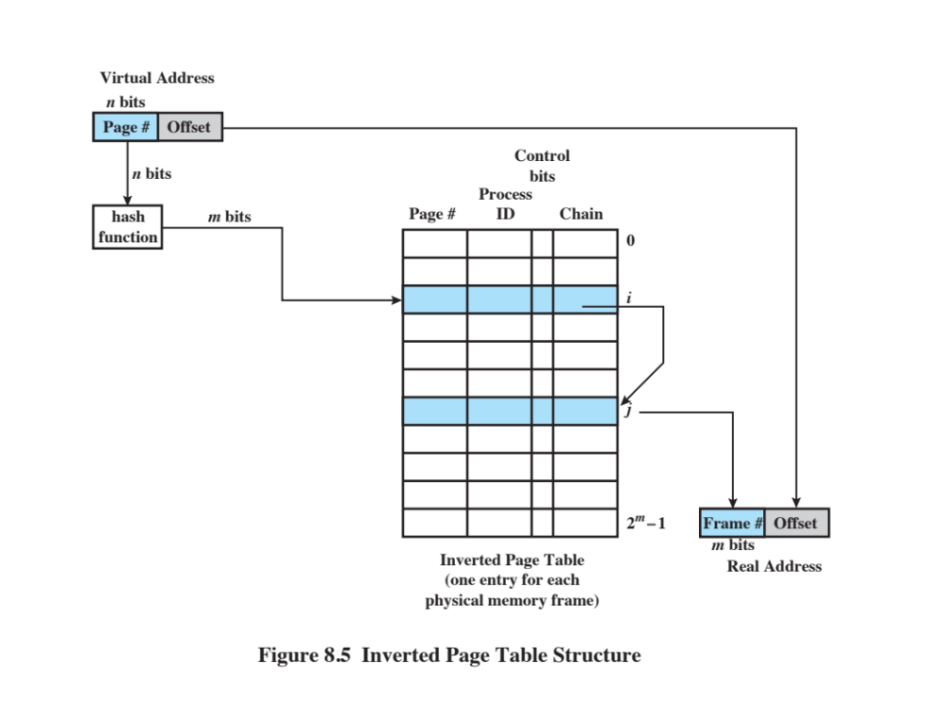
Notes:
Figure 8.5 shows a typical implementation of the inverted page table approach.
For a physical memory size of 2 ^{m} frames, the inverted page table contains 2 ^{m} entries,
so that the i th entry refers to frame i .
In this example, the virtual address includes an n -bit page number, with n > m .
The hash function maps the n -bit page number into an m -bit quantity, which is used
to index into the inverted page table.

Slide 19
Inverted Page Table
Each entry in the page table includes:
Page number
Process identifier
The process that owns this page
Control bits
Includes flags and protection and locking information
Chain pointer
The index value of the next entry in the chain
This is the page number portion of the virtual address
Notes:
Each entry in the page table includes the
following:
• Page number: This is the page number portion of the virtual address.
• Process identifier: The process that owns this page. The combination of page
number and process identifier identify a page within the virtual address space
of a particular process.
• Control bits: This field includes flags, such as valid, referenced, and modified;
and protection and locking information.
• Chain pointer: This field is null (perhaps indicated by a separate bit) if there
are no chained entries for this entry. Otherwise, the field contains the index
value (number between 0 and 2 ^{m} – 1) of the next entry in the chain.

Slide 20
Translation Lookaside
Buffer (TLB)
To overcome the effect of doubling the memory access time, most virtual memory schemes make use of a special high-speed cache called a translation lookaside buffer (TLB)
    This cache functions in the same way as a memory cache and contains those page table entities that have been most recently used
Each virtual memory reference can cause two physical memory accesses:
  One to fetch the page table entry
  One to fetch the data
Notes:
In principle, every virtual memory reference
can cause two physical memory accesses: one to fetch the appropriate page table
entry and one to fetch the desired data. Thus, a straightforward virtual memory
scheme would have the effect of doubling the memory access time. To overcome
this problem, most virtual memory schemes make use of a special high-speed cache
for page table entries, usually called a translation lookaside buffer (TLB) . This
cache functions in the same way as a memory cache (see Chapter 1 ) and contains
those page table entries that have been most recently used.

Slide 21
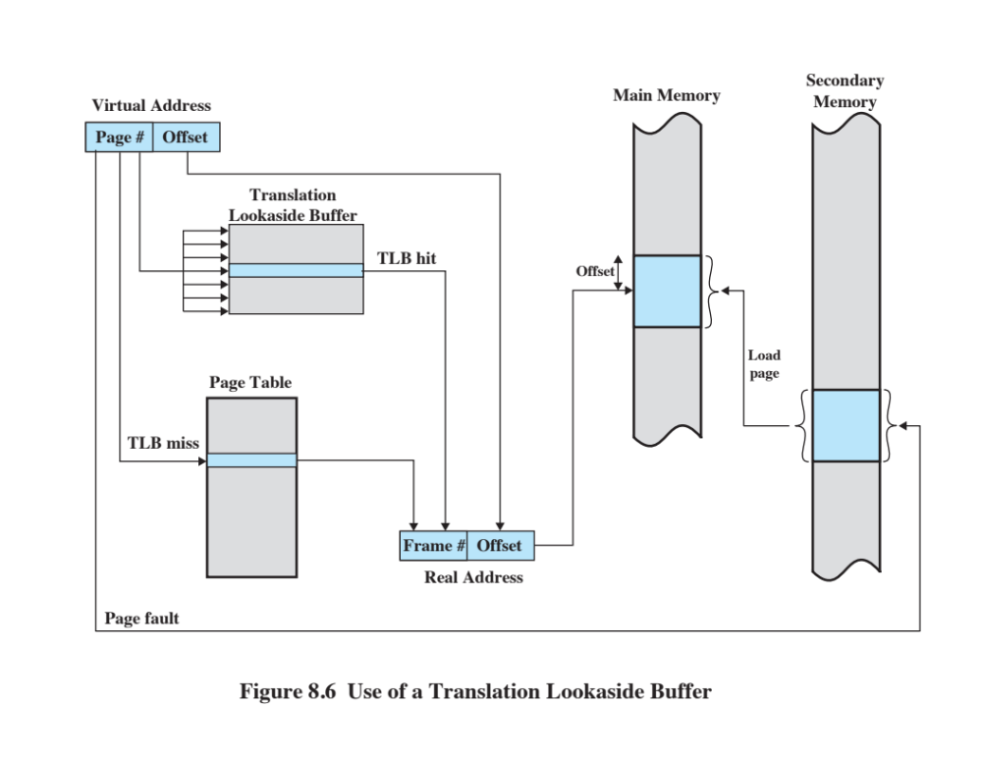
Notes:
The organization of the resulting paging hardware is illustrated in Figure 8.6 . Given a virtual address,
the processor will first examine the TLB. If the desired page table entry is present
( TLB hit ), then the frame number is retrieved and the real address is formed. If the
desired page table entry is not found ( TLB miss ), then the processor uses the page
number to index the process page table and examine the corresponding page table
entry. If the “present bit” is set, then the page is in main memory, and the processor
can retrieve the frame number from the page table entry to form the real address.
The processor also updates the TLB to include this new page table entry. Finally,
if the present bit is not set, then the desired page is not in main memory and a
memory access fault, called a page fault , is issued. At this point, we leave the realm
of hardware and invoke the operating system, which loads the needed page and
updates the page table.

Slide 22
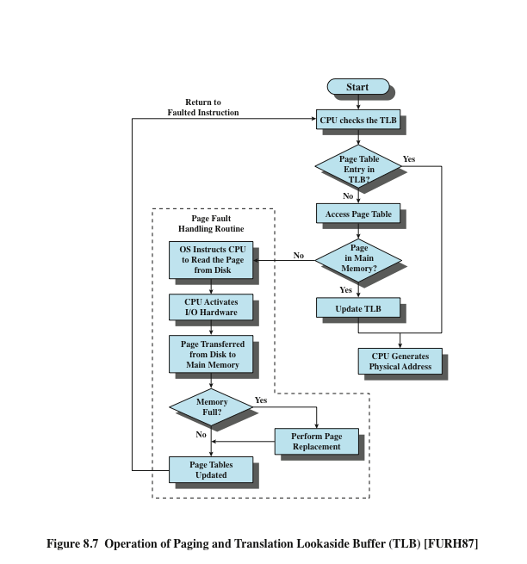
Notes:
Figure 8.7 is a flowchart that shows the use of the TLB. The flowchart shows
that if the desired page is not in main memory, a page fault interrupt causes the
page fault handling routine to be invoked. To keep the flowchart simple, the fact
that the operating system may dispatch another process while disk I/O is underway
is not shown. By the principle of locality, most virtual memory references will be to
locations in recently used pages. Therefore, most references will involve page table
entries in the cache. Studies of the VAX TLB have shown that this scheme can significantly
improve performance [CLAR85, SATY81].

Slide 23
Associative Mapping
The TLB only contains some of the page table entries so we cannot simply index into the TLB based on page number
    Each TLB entry must include the page number as well as the complete page table entry
The processor is equipped with hardware that allows it to interrogate simultaneously a number of TLB entries to determine if there is a match on page number
Notes:
There are a number of additional details concerning the actual organization
of the TLB. Because the TLB contains only some of the entries in a full page table,
we cannot simply index into the TLB based on page number. Instead, each entry
in the TLB must include the page number as well as the complete page table entry.
The processor is equipped with hardware that allows it to interrogate simultaneously
a number of TLB entries to determine if there is a match on page number.
This technique is referred to as associative mapping and is contrasted with the direct
mapping, or indexing, used for lookup in the page table in Figure 8.8 . The design of
the TLB also must consider the way in which entries are organized in the TLB and
which entry to replace when a new entry is brought in. These issues must be considered
in any hardware cache design. This topic is not pursued here; the reader may
consult a treatment of cache design for further details (e.g., [STAL13]).

Slide 24
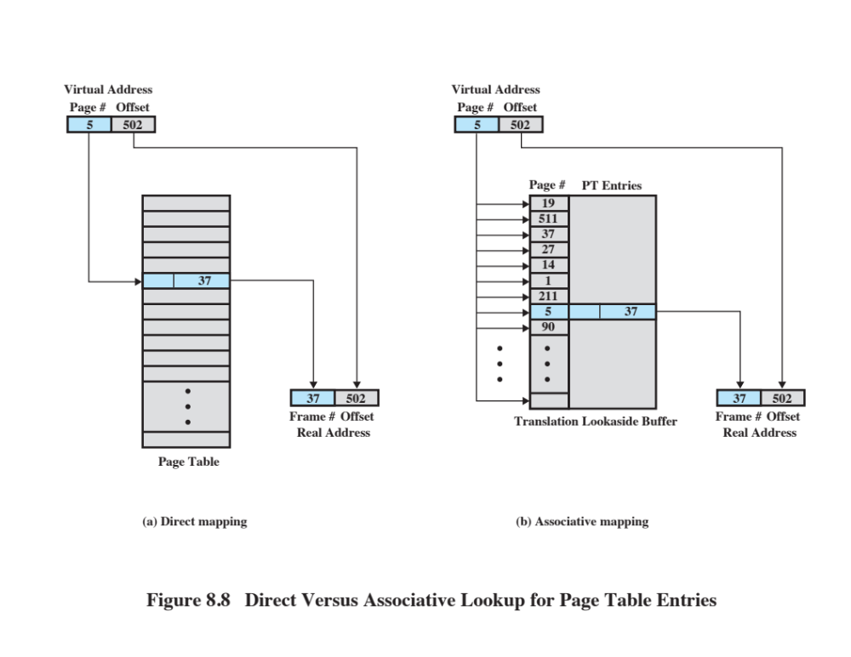
Notes:
Figure 8.8 Direct Versus Associative Lookup for Page Table Entries
This slide contrasts associative mapping with direct mapping or indexing, used for lookup in the page table.
The design of the TLB also must consider the way in which entries are organized in the TLB and which entry to replace when a new entry is brought in.
These issues must be considered in any hardware cache design.

Slide 25
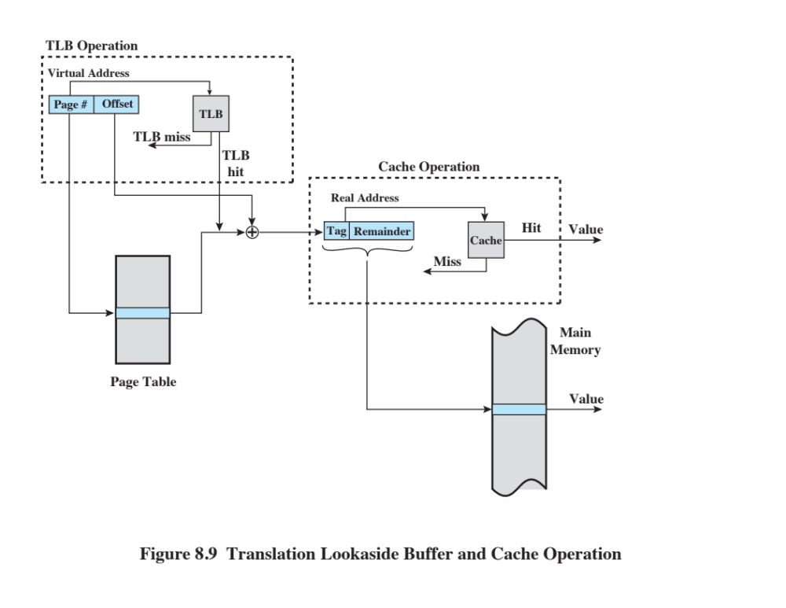
Notes:
Finally, the virtual memory mechanism must interact with the cache system
(not the TLB cache, but the main memory cache). This is illustrated in Figure 8.9 .
A virtual address will generally be in the form of a page number, offset. First, the
memory system consults the TLB to see if the matching page table entry is present.
If it is, the real (physical) address is generated by combining the frame number with
the offset. If not, the entry is accessed from a page table. Once the real address is
generated, which is in the form of a tag and a remainder, the cache is consulted to
see if the block containing that word is present. If so, it is returned to the CPU. If
not, the word is retrieved from main memory.

Slide 26
Page Size
The smaller the page size, the lesser the amount of internal fragmentation
    However, more pages are required per process
    More pages per process means larger page tables
    For large programs in a heavily multiprogrammed environment some portion of the page tables of active processes must be in virtual memory instead of main memory
    The physical characteristics of most secondary-memory devices favor a larger page size for more efficient block transfer of data
Notes:
An important hardware design decision is the size of page to be used.
There are several factors to consider. One is internal fragmentation. Clearly, the
smaller the page size, the lesser is the amount of internal fragmentation. To optimize
the use of main memory, we would like to reduce internal fragmentation. On the
other hand, the smaller the page, the greater is the number of pages required per
process. More pages per process means larger page tables. For large programs in
a heavily multiprogrammed environment, this may mean that some portion of the
page tables of active processes must be in virtual memory, not in main memory.
Thus, there may be a double page fault for a single reference to memory: first to
bring in the needed portion of the page table and second to bring in the process page.
Another factor is that the physical characteristics of most secondary-memory devices,
which are rotational, favor a larger page size for more efficient block transfer of data.

Slide 27
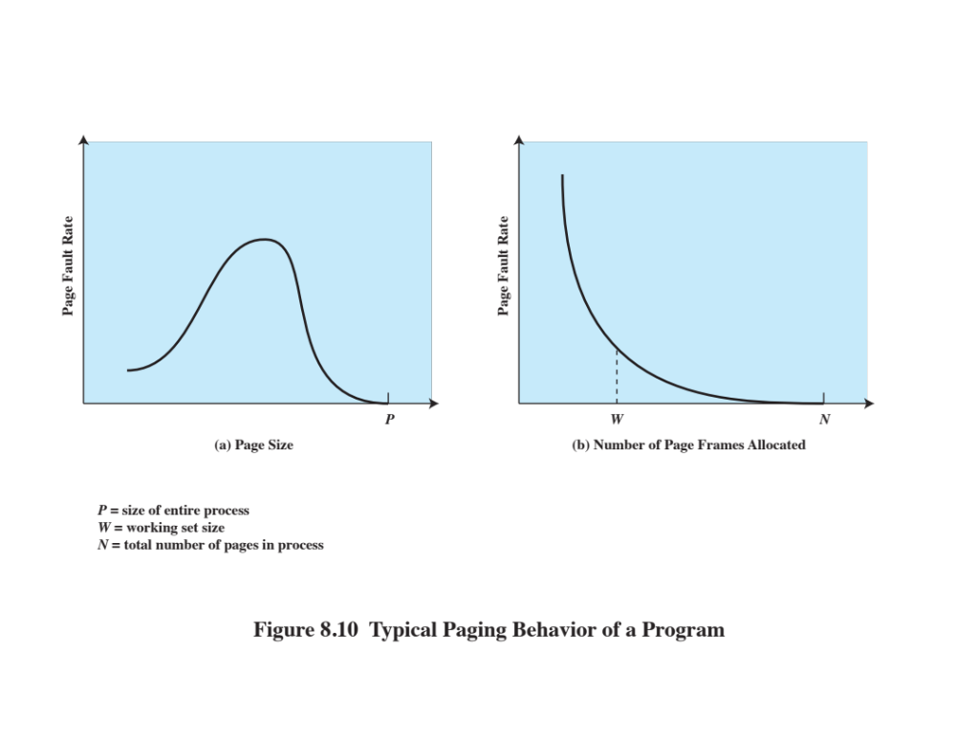
Notes:
Complicating these matters is the effect of page size on the rate at which page
faults occur. This behavior, in general terms, is depicted in Figure 8.10a and is based
on the principle of locality. If the page size is very small, then ordinarily a relatively
large number of pages will be available in main memory for a process. After a time,
the pages in memory will all contain portions of the process near recent references.
Thus, the page fault rate should be low. As the size of the page is increased, each
individual page will contain locations further and further from any particular recent
reference. Thus the effect of the principle of locality is weakened and the page fault
rate begins to rise. Eventually, however, the page fault rate will begin to fall as the
size of a page approaches the size of the entire process (point P in the diagram).
When a single page encompasses the entire process, there will be no page faults.
A further complication is that the page fault rate is also determined by the
number of frames allocated to a process. Figure 8.10b shows that, for a fixed page
size, the fault rate drops as the number of pages maintained in main memory grows.
Thus, a software policy (the amount of memory to allocate to each process) interacts
with a hardware design decision (page size).

Slide 28
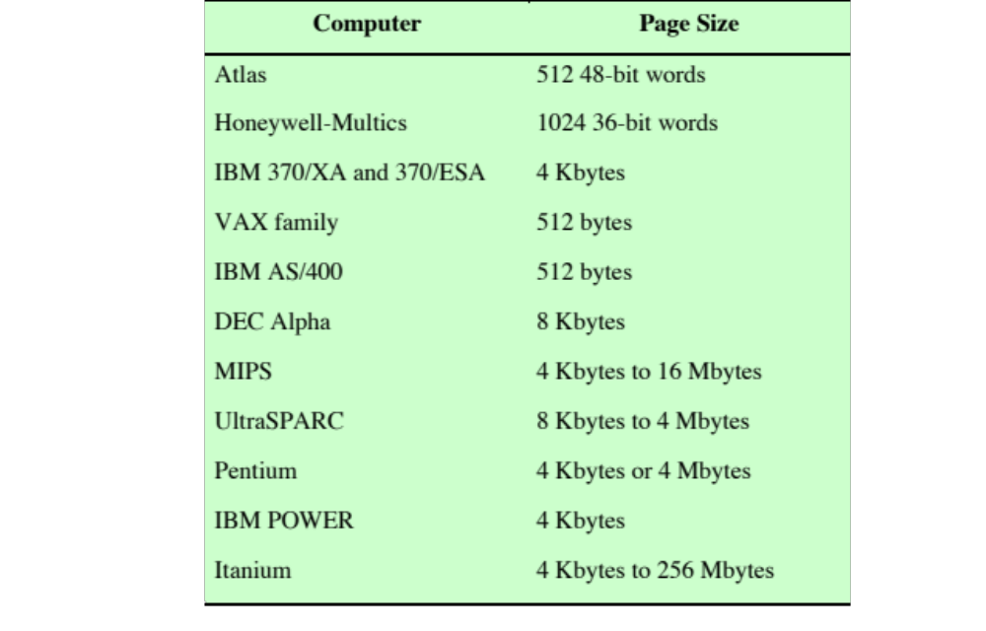
Table 8.3
Example
of Page
Sizes
Notes:
Table 8.3 lists the page sizes used on some machines.

Slide 29
Page Size
The design issue of page size is related to the size of physical main memory and program size
Main memory is getting larger and address space used by applications is also growing
Most obvious on personal computers where applications are becoming increasingly complex
    Contemporary programming techniques used in large programs tend to decrease the locality of references within a process
Notes:
Finally, the design issue of page size is related to the size of physical main memory
and program size. At the same time that main memory is getting larger, the address
space used by applications is also growing. The trend is most obvious on personal
computers and workstations, where applications are becoming increasingly complex.
Furthermore, contemporary programming techniques used in large programs tend to
decrease the locality of references within a process [HUCK93]. For example,
• Object-oriented techniques encourage the use of many small program and
data modules with references scattered over a relatively large number of objects
over a relatively short period of time.
• Multithreaded applications may result in abrupt changes in the instruction
stream and in scattered memory references.
For a given size of TLB, as the memory size of processes grows and as locality
decreases, the hit ratio on TLB accesses declines. Under these circumstances, the
TLB can become a performance bottleneck (e.g., see [CHEN92]).
One way to improve TLB performance is to use a larger TLB with more
entries. However, TLB size interacts with other aspects of the hardware design,
such as the main memory cache and the number of memory accesses per instruction
cycle [TALL92]. The upshot is that TLB size is unlikely to grow as rapidly as main
memory size. An alternative is to use larger page sizes so that each page table entry
in the TLB refers to a larger block of memory. But we have just seen that the use of
large page sizes can lead to performance degradation.
Accordingly, a number of designers have investigated the use of multiple
page sizes [TALL92, KHAL93], and several microprocessor architectures support
multiple pages sizes, including MIPS R4000, Alpha, UltraSPARC, Pentium, and
IA-64. Multiple page sizes provide the flexibility needed to use a TLB effectively.
For example, large contiguous regions in the address space of a process, such as program
instructions, may be mapped using a small number of large pages rather than
a large number of small pages, while thread stacks may be mapped using the small
page size. However, most commercial operating systems still support only one page
size, regardless of the capability of the underlying hardware. The reason for this is
that page size affects many aspects of the operating system; thus, a change to multiple
page sizes is a complex undertaking (see [GANA98] for a discussion).

Slide 30
Segmentation
Segmentation allows the programmer to view memory as consisting of multiple address spaces or segments
Advantages:
  Simplifies handling of growing data structures
  Allows programs to be altered and recompiled independently
  Lends itself to sharing data among processes
  Lends itself to protection
Notes:
Segmentation allows the programmer to view memory as consisting of multiple address spaces or segments.
Segments may be of unequal, indeed dynamic, size.
Memory references consist of a form of address (segment number, offset).
This organization has a number of advantages to the programmer over a nonsegmented address space:
It simplifies the handling of growing data structures.
If the programmer doesn’t know ahead of time how large a particular data structure will become, it is necessary to guess unless dynamic segment sizes are allowed. With segmented virtual memory, the data structure can be assigned its own segment, and the operating system will expand or shrink the segment as needed.
If a segment that needs to be expanded is in main memory and there is insufficient room, the operating system may move the segment to a larger area of main memory, if available, or swap it out. The enlarged segment would be swapped back in at the next opportunity.
2. It allows programs to be altered and recompiled independently,
without requiring the entire set of programs to be relinked and reloaded.
Again, this is accomplished using multiple segments.
3. It lends itself to sharing among processes.
A programmer can place a utility program or a useful table of data in a segment that can be referenced by other processes.
4. It lends itself to protection.
Because a segment can be constructed to contain a well-defined set of programs or data, the programmer or system administrator can assign access privileges in a convenient fashion.

Slide 31
Segment Organization
Each segment table entry contains the starting address of the corresponding segment in main memory and the length of the segment
A bit is needed to determine if the segment is already in main memory
Another bit is needed to determine if the segment has been modified since it was loaded in main memory
Notes:
In the discussion of simple segmentation, we indicated that each
process has its own segment table, and when all of its segments are loaded into main
memory, the segment table for a process is created and loaded into main memory.
Each segment table entry contains the starting address of the corresponding segment
in main memory, as well as the length of the segment. The same device, a segment
table, is needed when we consider a virtual memory scheme based on segmentation.
Again, it is typical to associate a unique segment table with each process. In this
case, however, the segment table entries become more complex ( Figure 8.1b ).
Because only some of the segments of a process may be in main memory, a bit is
needed in each segment table entry to indicate whether the corresponding segment
is present in main memory or not. If the bit indicates that the segment is in memory,
then the entry also includes the starting address and length of that segment.
Another control bit in the segmentation table entry is a modify bit, indicating
whether the contents of the corresponding segment have been altered since the segment
was last loaded into main memory. If there has been no change, then it is not
necessary to write the segment out when it comes time to replace the segment in the
frame that it currently occupies. Other control bits may also be present. For example,
if protection or sharing is managed at the segment level, then bits for that purpose
will be required.

Slide 32
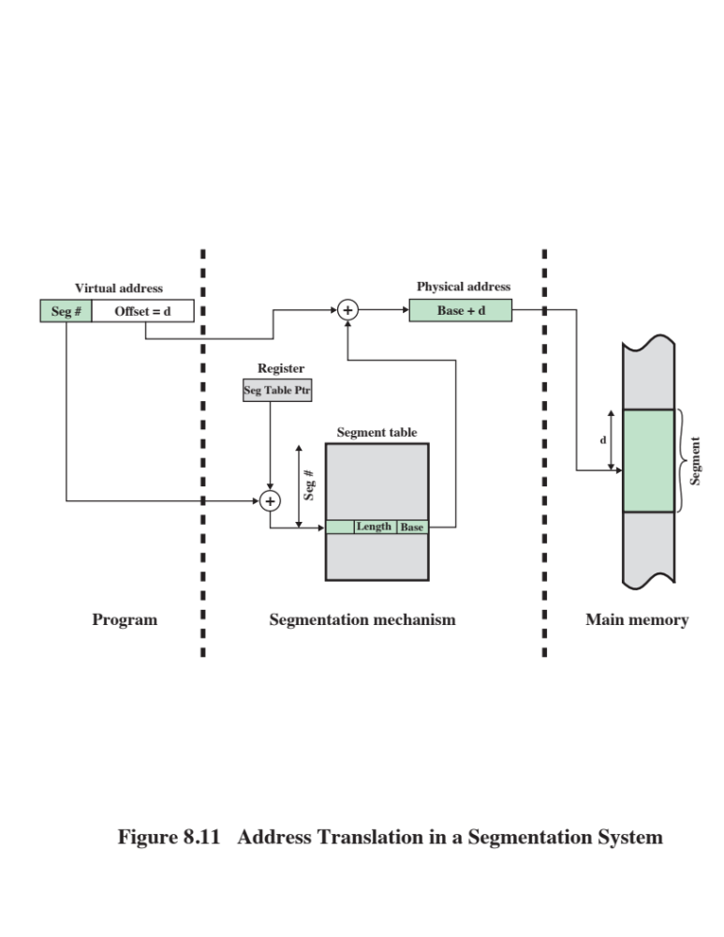
Notes:
The basic mechanism for reading a word from memory involves the translation
of a virtual, or logical, address, consisting of segment number and offset, into a physical
address, using a segment table. Because the segment table is of variable length,
depending on the size of the process, we cannot expect to hold it in registers. Instead,
it must be in main memory to be accessed. Figure 8.11 suggests a hardware implementation
of this scheme (note similarity to Figure 8.2 ). When a particular process
is running, a register holds the starting address of the segment table for that process.
The segment number of a virtual address is used to index that table and look up the
corresponding main memory address for the start of the segment. This is added to
the offset portion of the virtual address to produce the desired real address.

Slide 33
Combined Paging and Segmentation
In a combined paging/segmentation system a user’s address space is broken up into a number of segments. Each segment is broken up into a number of fixed-sized pages which are equal in length to a main memory frame
Segmentation is visible to the programmer
Paging is transparent to the programmer
Notes:
Both paging and segmentation have their strengths. Paging, which is transparent
to the programmer, eliminates external fragmentation and thus provides efficient
use of main memory. In addition, because the pieces that are moved in and out of
main memory are of fixed, equal size, it is possible to develop sophisticated memory
management algorithms that exploit the behavior of programs, as we shall see.
Segmentation, which is visible to the programmer, has the strengths listed earlier,
including the ability to handle growing data structures, modularity, and support
for sharing and protection. To combine the advantages of both, some systems are
equipped with processor hardware and operating system software to provide both.
In a combined paging/segmentation system, a user’s address space is broken
up into a number of segments, at the discretion of the programmer. Each segment
is, in turn, broken up into a number of fixed-size pages, which are equal in length to
a main memory frame. If a segment has length less than that of a page, the segment
occupies just one page. From the programmer’s point of view, a logical address still
consists of a segment number and a segment offset. From the system’s point of view,
the segment offset is viewed as a page number and page offset for a page within the
specified segment.

Slide 34
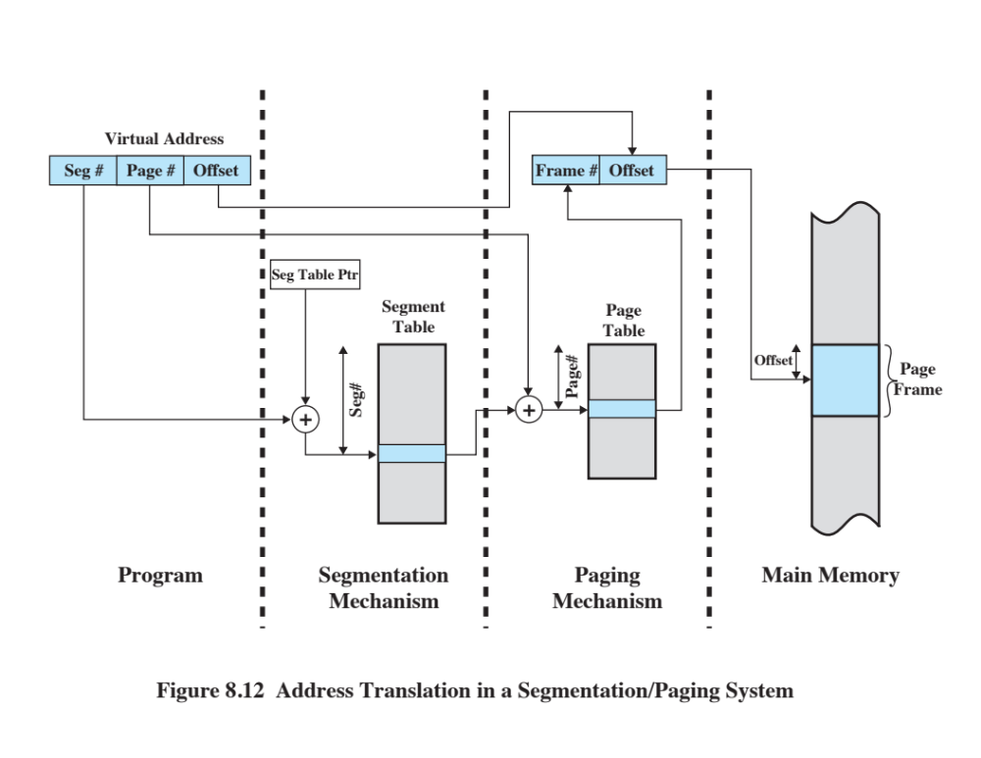
Notes:
Figure 8.12 suggests a structure to support combined paging/segmentation
(note similarity to Figure 8.4 ). Associated with each process is a segment table and
a number of page tables, one per process segment. When a particular process is
running, a register holds the starting address of the segment table for that process.
Presented with a virtual address, the processor uses the segment number portion to
index into the process segment table to find the page table for that segment. Then
the page number portion of the virtual address is used to index the page table and
look up the corresponding frame number. This is combined with the offset portion
of the virtual address to produce the desired real address.

Slide 35
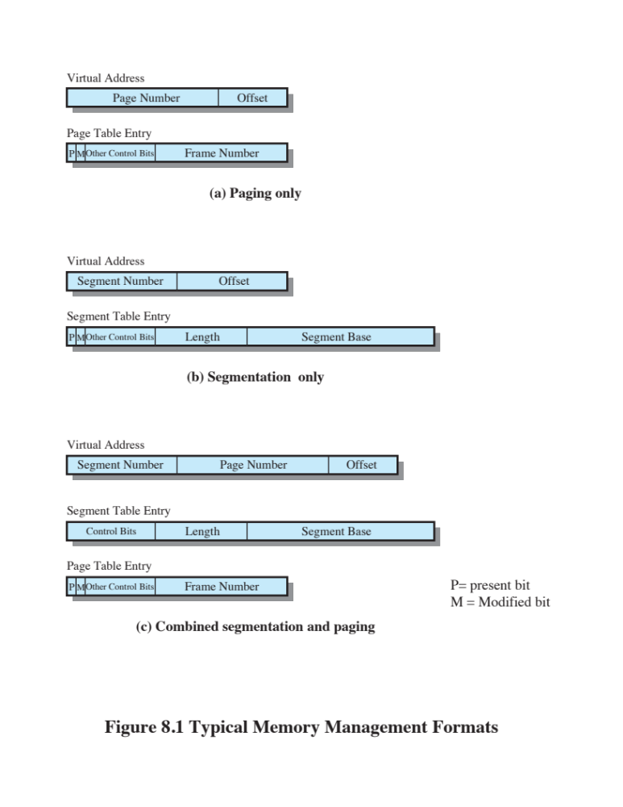
Notes:
Figure 8.1c suggests the segment table entry and page table entry formats. As
before, the segment table entry contains the length of the segment. It also contains
a base field, which now refers to a page table. The present and modified bits are not
needed because these matters are handled at the page level. Other control bits may
be used, for purposes of sharing and protection. The page table entry is essentially
the same as is used in a pure paging system. Each page number is mapped into a corresponding
frame number if the page is present in main memory. The modified bit
indicates whether this page needs to be written back out when the frame is allocated
to another page. There may be other control bits dealing with protection or other
aspects of memory management.

Slide 36
Protection and Sharing
Segmentation lends itself to the implementation of protection and sharing policies
Each entry has a base address and length so inadvertent memory access can be controlled
Sharing can be achieved by segments referencing multiple processes
Notes:
Segmentation lends itself to the implementation of protection and sharing policies.
Because each segment table entry includes a length as well as a base address, a program
cannot inadvertently access a main memory location beyond the limits of a
segment. To achieve sharing, it is possible for a segment to be referenced in the segment
tables of more than one process. The same mechanisms are, of course, available
in a paging system. However, in this case the page structure of programs and
data is not visible to the programmer, making the specification of protection and
sharing requirements more awkward.

Slide 37
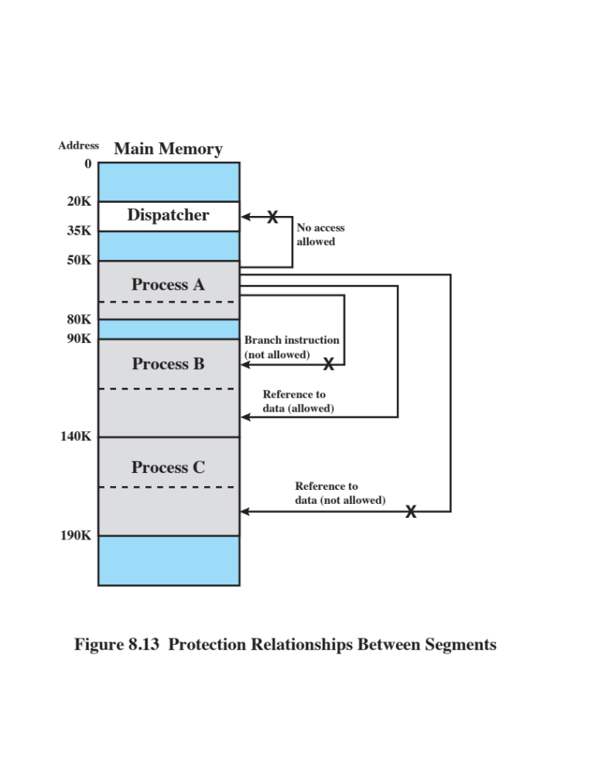
Notes:
Figure 8.13 illustrates the types of protection relationships that can be enforced in such a system.
More sophisticated mechanisms can also be provided. A common scheme is
to use a ring-protection structure, of the type we referred to in Chapter 3 ( Figure
3.18 ). In this scheme, lower-numbered, or inner, rings enjoy greater privilege than
higher-numbered, or outer, rings. Typically, ring 0 is reserved for kernel functions
of the operating system, with applications at a higher level. Some utilities or operating
system services may occupy an intermediate ring. Basic principles of the ring
system are as follows:
1. A program may access only data that reside on the same ring or a less privileged
ring.
2. A program may call services residing on the same or a more privileged ring.

Slide 38
Operating System Software
The design of the memory management portion of an operating system depends on three fundamental areas of choice:
Whether or not to use virtual memory techniques
The use of paging or segmentation or both
The algorithms employed for various aspects of memory management
Notes:
The design of the memory management portion of an operating system depends on
three fundamental areas of choice:
• Whether or not to use virtual memory techniques
• The use of paging or segmentation or both
• The algorithms employed for various aspects of memory management
The choices made in the first two areas depend on the hardware platform available.
Thus, earlier UNIX implementations did not provide virtual memory because the
processors on which the system ran did not support paging or segmentation. Neither
of these techniques is practical without hardware support for address translation
and other basic functions.
Two additional comments about the first two items in the preceding list: First,
with the exception of operating systems for some of the older personal computers,
such as MS-DOS, and specialized systems, all important operating systems provide
virtual memory. Second, pure segmentation systems are becoming increasingly rare.
When segmentation is combined with paging, most of the memory management
issues confronting the operating system designer are in the area of paging. Thus,
we can concentrate in this section on the issues associated with paging.
The choices related to the third item are the domain of operating system software
and are the subject of this section.

Slide 39
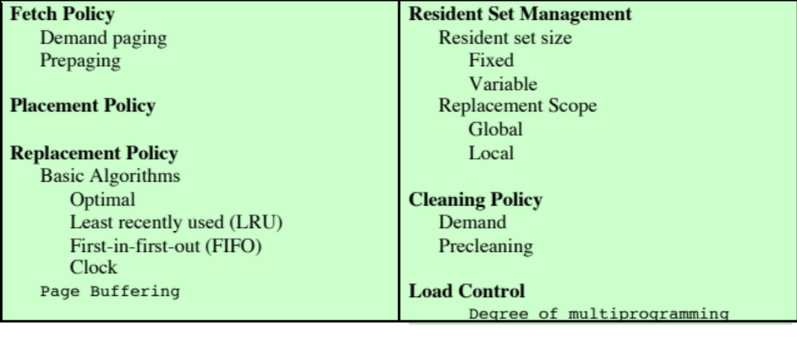
Table 8.4 Operating System Policies for Virtual Memory
Notes:
Table 8.4 lists the key design elements that
we examine. In each case, the key issue is one of performance: We would like to
minimize the rate at which page faults occur, because page faults cause considerable
software overhead. At a minimum, the overhead includes deciding which resident
page or pages to replace, and the I/O of exchanging pages. Also, the operating system
must schedule another process to run during the page I/O, causing a process
switch. Accordingly, we would like to arrange matters so that, during the time that
a process is executing, the probability of referencing a word on a missing page is
minimized. In all of the areas referred to in Table 8.4 , there is no definitive policy
that works best.
As we shall see, the task of memory management in a paging environment
is fiendishly complex. Furthermore, the performance of any particular set
of policies depends on main memory size, the relative speed of main and secondary
memory, the size and number of processes competing for resources, and the execution
behavior of individual programs. This latter characteristic depends on the nature
of the application, the programming language and compiler employed, the style of
the programmer who wrote it, and, for an interactive program, the dynamic behavior
of the user. Thus, the reader must expect no final answers here or anywhere. For
smaller systems, the operating system designer should attempt to choose a set of policies
that seems “good” over a wide range of conditions, based on the current state of
knowledge. For larger systems, particularly mainframes, the operating system should
be equipped with monitoring and control tools that allow the site manager to tune
the operating system to get “good” results based on site conditions.

Slide 40
Fetch Policy
Determines when a page should be brought into memory
Two main types:
Demand Paging
Prepaging
Notes:
The fetch policy determines when a page should be brought into main memory. The
two common alternatives are demand paging and prepaging.

Slide 41
Demand Paging
Demand Paging
  Only brings pages into main memory when a reference is made to a location on the page
  Many page faults when process is first started
  Principle of locality suggests that as more and more pages are brought in, most future references will be to pages that have recently been brought in, and page faults should drop to a very low level
Notes:
With demand paging ,
a page is brought into main memory only when a reference is made to a location on
that page. If the other elements of memory management policy are good, the following
should happen. When a process is first started, there will be a flurry of page
faults. As more and more pages are brought in, the principle of locality suggests that
most future references will be to pages that have recently been brought in. Thus,
after a time, matters should settle down and the number of page faults should drop
to a very low level.

Slide 42
Prepaging
Prepaging
  Pages other than the one demanded by a page fault are brought in
  Exploits the characteristics of most secondary memory devices
  If pages of a process are stored contiguously in secondary memory it is more efficient to bring in a number of pages at one time
  Ineffective if extra pages are not referenced
  Should not be confused with “swapping”
Notes:
With prepaging , pages other than the one demanded by a page fault are
brought in. Prepaging exploits the characteristics of most secondary memory
devices, such as disks, which have seek times and rotational latency. If the pages of
a process are stored contiguously in secondary memory, then it is more efficient to
bring in a number of contiguous pages at one time rather than bringing them in one
at a time over an extended period. Of course, this policy is ineffective if most of the
extra pages that are brought in are not referenced.
The prepaging policy could be employed either when a process first starts up,
in which case the programmer would somehow have to designate desired pages, or
every time a page fault occurs. This latter course would seem preferable because
it is invisible to the programmer.
Prepaging should not be confused with swapping. When a process is swapped
out of memory and put in a suspended state, all of its resident pages are moved out.
When the process is resumed, all of the pages that were previously in main memory
are returned to main memory.

Slide 43
Placement Policy
Determines where in real memory a process piece is to reside
Important design issue in a segmentation system
Paging or combined paging with segmentation placing is irrelevant because hardware performs functions with equal efficiency
For NUMA systems an automatic placement strategy is desirable
Notes:
The placement policy determines where in real memory a process piece is to reside.
In a pure segmentation system, the placement policy is an important design issue;
policies such as best-fit, first-fit, and so on, which were discussed in Chapter 7 , are
possible alternatives. However, for a system that uses either pure paging or paging
combined with segmentation, placement is usually irrelevant because the address
translation hardware and the main memory access hardware can perform their
functions for any page-frame combination with equal efficiency.
There is one area in which placement does become a concern, and this is a
subject of research and development. On a so-called nonuniform memory access
(NUMA) multiprocessor, the distributed, shared memory of the machine can be
referenced by any processor on the machine, but the time for accessing a particular
physical location varies with the distance between the processor and the memory
module. Thus, performance depends heavily on the extent to which data reside
close to the processors that use them [LARO92, BOLO89, COX89]. For NUMA
systems, an automatic placement strategy is desirable to assign pages to the memory
module that provides the best performance.

Slide 44
Replacement Policy
Deals with the selection of a page in main memory to be replaced when a new page must be brought in
      Objective is that the page that is removed be the page least likely to be referenced in the near future
      The more elaborate the replacement policy the greater the hardware and software overhead to implement it
Notes:
In most operating system texts, the treatment of memory management includes a
section entitled “replacement policy,” which deals with the selection of a page in
main memory to be replaced when a new page must be brought in. This topic is
sometimes difficult to explain because several interrelated concepts are involved:
• How many page frames are to be allocated to each active process
• Whether the set of pages to be considered for replacement should be limited
to those of the process that caused the page fault or encompass all the page
frames in main memory
• Among the set of pages considered, which particular page should be selected
for replacement
We shall refer to the first two concepts as resident set management , which is dealt
with in the next subsection, and reserve the term replacement policy for the third
concept, which is discussed in this subsection.
The area of replacement policy is probably the most studied of any area of
memory management. When all of the frames in main memory are occupied and
it is necessary to bring in a new page to satisfy a page fault, the replacement policy
determines which page currently in memory is to be replaced. All of the policies
have as their objective that the page that is removed should be the page least likely
to be referenced in the near future. Because of the principle of locality, there is
often a high correlation between recent referencing history and near-future referencing
patterns. Thus, most policies try to predict future behavior on the basis of
past behavior. One trade-off that must be considered is that the more elaborate and
sophisticated the replacement policy, the greater will be the hardware and software
overhead to implement it.

Slide 45
Frame Locking
When a frame is locked the page currently stored in that frame may not be replaced
  Kernel of the OS as well as key control structures are held in locked frames
  I/O buffers and time-critical areas may be locked into main memory frames
  Locking is achieved by associating a lock bit with each frame
Notes:
One restriction on replacement policy needs to be mentioned
before looking at various algorithms: Some of the frames in main memory may be
locked. When a frame is locked, the page currently stored in that frame may not be
replaced. Much of the kernel of the OS, as well as key control structures, are held in
locked frames. In addition, I/O buffers and other time-critical areas may be locked
into main memory frames. Locking is achieved by associating a lock bit with each
frame. This bit may be kept in a frame table as well as being included in the current
page table.

Slide 46
Basic Algorithms
Algorithms used for the selection of a page to replace:
Optimal
Least recently used (LRU)
First-in-first-out (FIFO)
Clock
Notes:
Regardless of the resident set management strategy (discussed
in the next subsection), there are certain basic algorithms that are used for the
selection of a page to replace. Replacement algorithms that have been discussed in
the literature include
• Optimal
• Least recently used (LRU)
• First-in-first-out (FIFO)
• Clock

Slide 47
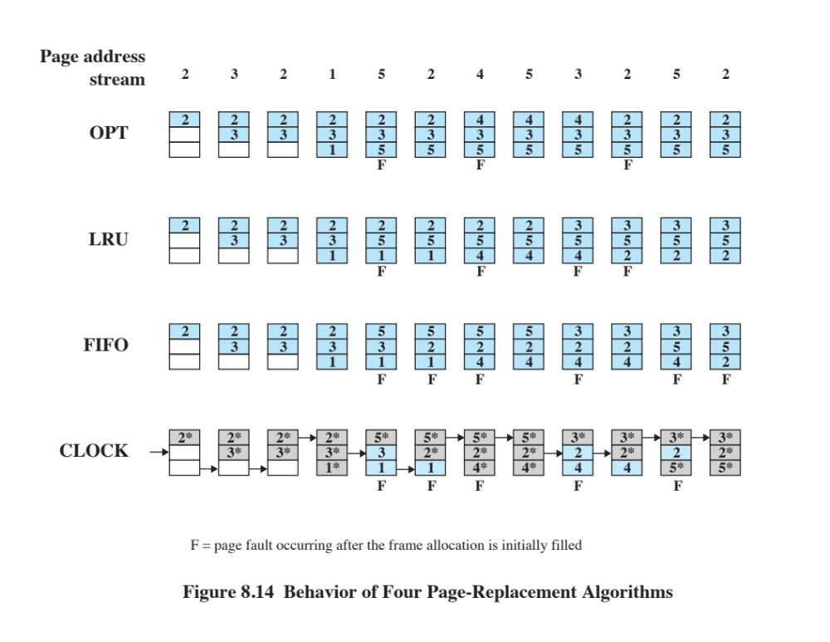
Notes:
The optimal policy selects for replacement that page for which the time to the next
reference is the longest. It can be shown that this policy results in the fewest number of
page faults [BELA66]. Clearly, this policy is impossible to implement, because it would
require the operating system to have perfect knowledge of future events. However, it
does serve as a standard against which to judge real-world algorithms.
Figure 8.14 gives an example of the optimal policy. The example assumes a
fixed frame allocation (fixed resident set size) for this process of three frames. The
execution of the process requires reference to five distinct pages. The page address
stream formed by executing the program is
2 3 2 1 5 2 4 5 3 2 5 2
which means that the first page referenced is 2, the second page referenced is 3, and
so on. The optimal policy produces three page faults after the frame allocation has
been filled.

Slide 48
Least Recently Used (LRU)
Replaces the page that has not been referenced for the longest time
By the principle of locality, this should be the page least likely to be referenced in the near future
Difficult to implement
  One approach is to tag each page with the time of last reference
    This requires a great deal of overhead
Notes:
The least recently used (LRU) policy replaces the page in memory that has
not been referenced for the longest time. By the principle of locality, this should
be the page least likely to be referenced in the near future. And, in fact, the LRU
policy does nearly as well as the optimal policy. The problem with this approach is
the difficulty in implementation. One approach would be to tag each page with the
time of its last reference; this would have to be done at each memory reference,
both instruction and data. Even if the hardware would support such a scheme, the
overhead would be tremendous. Alternatively, one could maintain a stack of page
references, again an expensive prospect.

Slide 49
First-in-First-out (FIFO)
Treats page frames allocated to a process as a circular buffer
Pages are removed in round-robin style
    Simple replacement policy to implement
Page that has been in memory the longest is replaced
Notes:
The first-in-first-out (FIFO) policy treats the page frames allocated to a process
as a circular buffer, and pages are removed in round-robin style. All that is
required is a pointer that circles through the page frames of the process. This is
therefore one of the simplest page replacement policies to implement. The logic
behind this choice, other than its simplicity, is that one is replacing the page that
has been in memory the longest: A page fetched into memory a long time ago may
have now fallen out of use. This reasoning will often be wrong, because there will
often be regions of program or data that are heavily used throughout the life of a
program. Those pages will be repeatedly paged in and out by the FIFO algorithm.

Slide 50
Clock Policy
Requires the association of an additional bit with each frame
    Referred to as the use bit
When a page is first loaded in memory or referenced, the use bit is set to 1
The set of frames is considered to be a circular buffer
Any frame with a use bit of 1 is passed over by the algorithm
Page frames visualized as laid out in a circle
Notes:
The simplest form of clock policy requires the association of an additional
bit with each frame, referred to as the use bit. When a page is first loaded into a
frame in memory, the use bit for that frame is set to 1. Whenever the page is subsequently
referenced (after the reference that generated the page fault), its use bit is
set to 1. For the page replacement algorithm, the set of frames that are candidates
for replacement (this process: local scope; all of main memory: global scope ) is
considered to be a circular buffer, with which a pointer is associated. When a page
is replaced, the pointer is set to indicate the next frame in the buffer after the one
just updated. When it comes time to replace a page, the operating system scans
the buffer to find a frame with a use bit set to 0. Each time it encounters a frame
with a use bit of 1, it resets that bit to 0 and continues on. If any of the frames in
the buffer have a use bit of 0 at the beginning of this process, the first such frame
encountered is chosen for replacement. If all of the frames have a use bit of 1, then
the pointer will make one complete cycle through the buffer, setting all the use bits
to 0, and stop at its original position, replacing the page in that frame. We can see
that this policy is similar to FIFO, except that, in the clock policy, any frame with
a use bit of 1 is passed over by the algorithm. The policy is referred to as a clock
policy because we can visualize the page frames as laid out in a circle. A number of
operating systems have employed some variation of this simple clock policy (e.g.,
Multics [CORB68]).

Slide 51
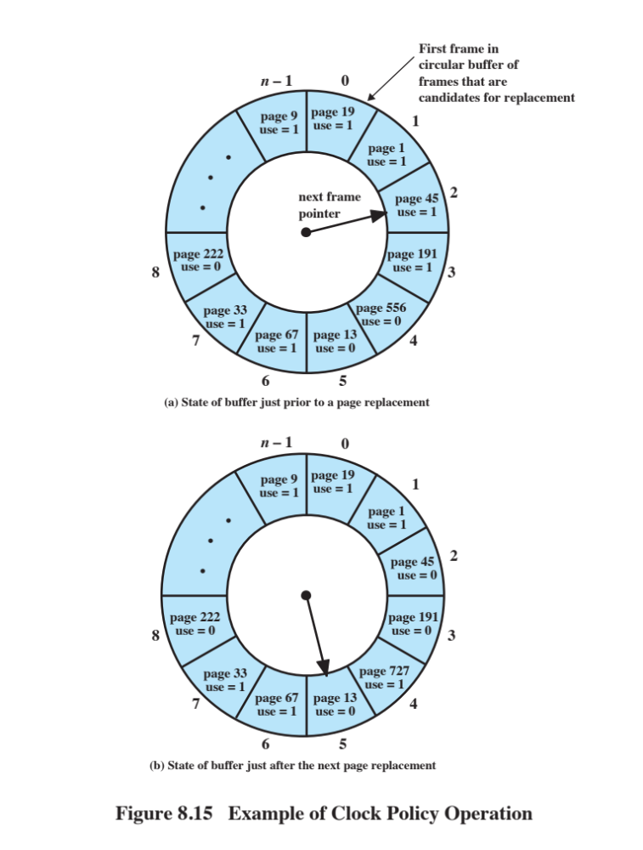
Notes:
Figure 8.15 provides an example of the simple clock policy mechanism. A circular
buffer of n main memory frames is available for page replacement. Just prior
to the replacement of a page from the buffer with incoming page 727 , the next frame
pointer points at frame 2, which contains page 45 . The clock policy is now executed.
Because the use bit for page 45 in frame 2 is equal to 1, this page is not replaced.
Instead, the use bit is set to 0 and the pointer advances. Similarly, page 191 in frame
3 is not replaced; its use bit is set to 0 and the pointer advances. In the next frame,
frame 4, the use bit is set to 0. Therefore, page 556 is replaced with page 727 . The
use bit is set to 1 for this frame and the pointer advances to frame 5, completing the
page replacement procedure.
The behavior of the clock policy is illustrated in Figure 8.14. The presence of an
asterisk indicates that the corresponding use bit is equal to 1, and the arrow indicates
the current position of the pointer. Note the clock policy is adept at protecting frames
2 and 5 from replacement.

Slide 52
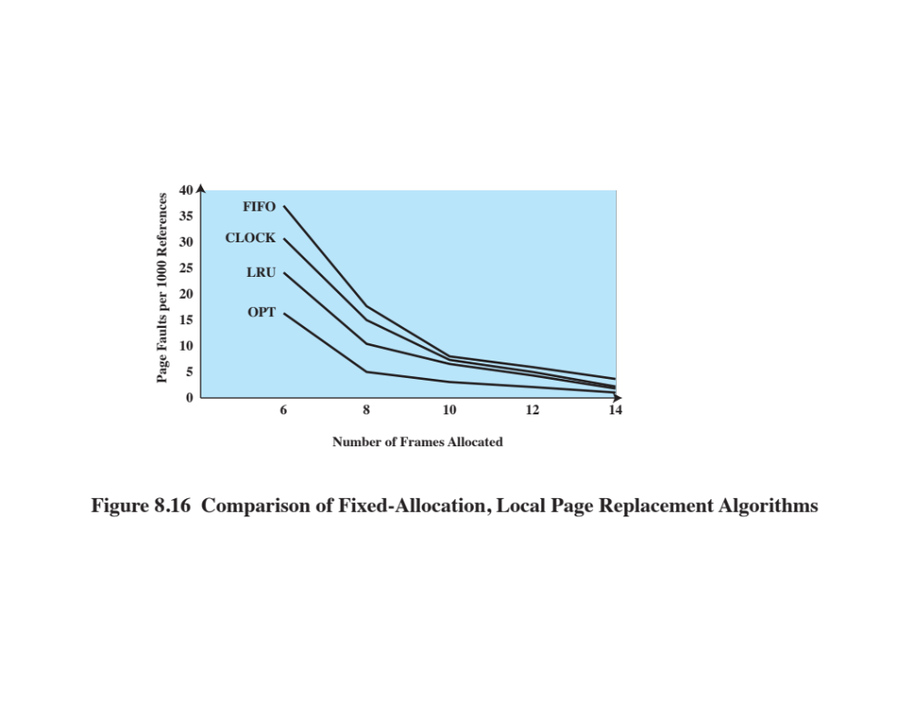
Notes:
Figure 8.16 shows the results of an experiment reported in [BAER80], which
compares the four algorithms that we have been discussing; it is assumed that the
number of page frames assigned to a process is fixed. The results are based on the
execution of 0.25 x 10⁶ references in a FORTRAN program, using a page size of 256
words. Baer ran the experiment with frame allocations of 6, 8, 10, 12, and 14 frames.
The differences among the four policies are most striking at small allocations, with
FIFO being over a factor of 2 worse than optimal. All four curves have the same shape
as the idealized behavior shown in Figure 8.10b . In order to run efficiently, we would
like to be to the right of the knee of the curve (with a small page fault rate) while
keeping a small frame allocation (to the left of the knee of the curve). These two constraints
indicate that a desirable mode of operation would be at the knee of the curve.
The clock algorithm has also been compared to these other algorithms when
a variable allocation and either global or local replacement scope (see the following
discussion of replacement policy) is used [CARR81]. The clock algorithm
was found to approximate closely the performance of LRU.

Slide 53
Page Buffering
A replaced page is not lost, but rather assigned to one of two lists
Free page list
List of page frames available for reading in pages
Modified page list
Pages are written out in clusters
Improves paging performance and allows the use of a simpler page replacement policy
Notes:
Although LRU and the clock policies are superior to FIFO,
they both involve complexity and overhead not suffered with FIFO. In addition,
there is the related issue that the cost of replacing a page that has been modified is
greater than for one that has not, because the former must be written back out to
secondary memory.
An interesting strategy that can improve paging performance and allow
the use of a simpler page replacement policy is page buffering. The VAX VMS
approach is representative. The page replacement algorithm is simple FIFO. To
improve performance, a replaced page is not lost but rather is assigned to one of
two lists: the free page list if the page has not been modified, or the modified page
list if it has. Note that the page is not physically moved about in main memory;
instead, the entry in the page table for this page is removed and placed in either the
free or modified page list.
The free page list is a list of page frames available for reading in pages. VMS
tries to keep some small number of frames free at all times. When a page is to be
read in, the page frame at the head of the list is used, destroying the page that was
there. When an unmodified page is to be replaced, it remains in memory and its
page frame is added to the tail of the free page list. Similarly, when a modified page
is to be written out and replaced, its page frame is added to the tail of the modified
page list.
The important aspect of these maneuvers is that the page to be replaced
remains in memory. Thus if the process references that page, it is returned to the
resident set of that process at little cost. In effect, the free and modified page lists act
as a cache of pages. The modified page list serves another useful function: Modified
pages are written out in clusters rather than one at a time. This significantly reduces
the number of I/O operations and therefore the amount of disk access time.
A simpler version of page buffering is implemented in the Mach operating
system [RASH88]. In this case, no distinction is made between modified and
unmodified pages.

Slide 54
Replacement Policy and Cache Size
With large caches, replacement of pages can have a performance impact
    If the page frame selected for replacement is in the cache, that cache block is lost as well as the page that it holds
    In systems using page buffering, cache performance can be improved with a policy for page placement in the page buffer
    Most operating systems place pages by selecting an arbitrary page frame from the page buffer
Notes:
As discussed earlier, main memory size
is getting larger and the locality of applications is decreasing. In compensation,
cache sizes have been increasing. Large cache sizes, even multimegabyte ones, are
now feasible design alternatives [BORG90]. With a large cache, the replacement of
virtual memory pages can have a performance impact. If the page frame selected
for replacement is in the cache, then that cache block is lost as well as the page that
it holds.
In systems that use some form of page buffering, it is possible to improve
cache performance by supplementing the page replacement policy with a policy for
page placement in the page buffer. Most operating systems place pages by selecting
an arbitrary page frame from the page buffer; typically a first-in-first-out discipline
is used. A study reported in [KESS92] shows that a careful page placement strategy
can result in 10–20% fewer cache misses than naive placement.
Several page placement algorithms are examined in [KESS92]. The details
are beyond the scope of this book, as they depend on the details of cache structure
and policies. The essence of these strategies is to bring consecutive pages into main
memory in such a way as to minimize the number of page frames that are mapped
into the same cache slots.

Slide 55
Resident Set Management
The OS must decide how many pages to bring into main memory
    The smaller the amount of memory allocated to each process, the more processes can reside in memory
    Small number of pages loaded increases page faults
    Beyond a certain size, further allocations of pages will not effect the page fault rate
Notes:
With paged virtual memory, it is not necessary and indeed
may not be possible to bring all of the pages of a process into main memory to
prepare it for execution. Thus, the operating system must decide how many pages to
bring in, that is, how much main memory to allocate to a particular process. Several
factors come into play:
• The smaller the amount of memory allocated to a process, the more processes
that can reside in main memory at any one time. This increases the probability
that the operating system will find at least one ready process at any given time
and hence reduces the time lost due to swapping.
• If a relatively small number of pages of a process are in main memory, then,
despite the principle of locality, the rate of page faults will be rather high (see
Figure 8.10b ).
• Beyond a certain size, additional allocation of main memory to a particular
process will have no noticeable effect on the page fault rate for that process
because of the principle of locality.

Slide 56
Resident Set Size
Fixed-allocation
Variable-allocation
Gives a process a fixed number of frames in main memory within which to execute
  When a page fault occurs, one of the pages of that process must be replaced
Allows the number of page frames allocated to a process to be varied over the lifetime of the process
Notes:
With these factors in mind, two sorts of policies are to be found in contemporary
operating systems. A fixed-allocation policy gives a process a fixed number of
frames in main memory within which to execute. That number is decided at initial
load time (process creation time) and may be determined based on the type of process
(interactive, batch, type of application) or may be based on guidance from the
programmer or system manager. With a fixed-allocation policy, whenever a page
fault occurs in the execution of a process, one of the pages of that process must be
replaced by the needed page.
A variable-allocation policy allows the number of page frames allocated to a
process to be varied over the lifetime of the process. Ideally, a process that is suffering
persistently high levels of page faults, indicating that the principle of locality
only holds in a weak form for that process, will be given additional page frames
to reduce the page fault rate; whereas a process with an exceptionally low page
fault rate, indicating that the process is quite well behaved from a locality point of
view, will be given a reduced allocation, with the hope that this will not noticeably
increase the page fault rate. The use of a variable-allocation policy relates to the
concept of replacement scope, as explained in the next subsection.
The variable-allocation policy would appear to be the more powerful one.
However, the difficulty with this approach is that it requires the operating system to
assess the behavior of active processes. This inevitably requires software overhead
in the operating system and is dependent on hardware mechanisms provided by the
processor platform.

Slide 57
Replacement Scope
The scope of a replacement strategy can be categorized as global or local
  Both types are activated by a page fault when there are no free page frames
Local
Chooses only among the resident pages of the process that generated the page fault
Global
Considers all unlocked pages in main memory
Notes:
The scope of a replacement strategy can be categorized as
global or local. Both types of policies are activated by a page fault when there are no
free page frames. A local replacement policy chooses only among the resident pages
of the process that generated the page fault in selecting a page to replace. A global
replacement policy considers all unlocked pages in main memory as candidates for
replacement, regardless of which process owns a particular page. While it happens
that local policies are easier to analyze, there is no convincing evidence that they
perform better than global policies, which are attractive because of their simplicity
of implementation and minimal overhead [CARR81, MAEK87].

Slide 58
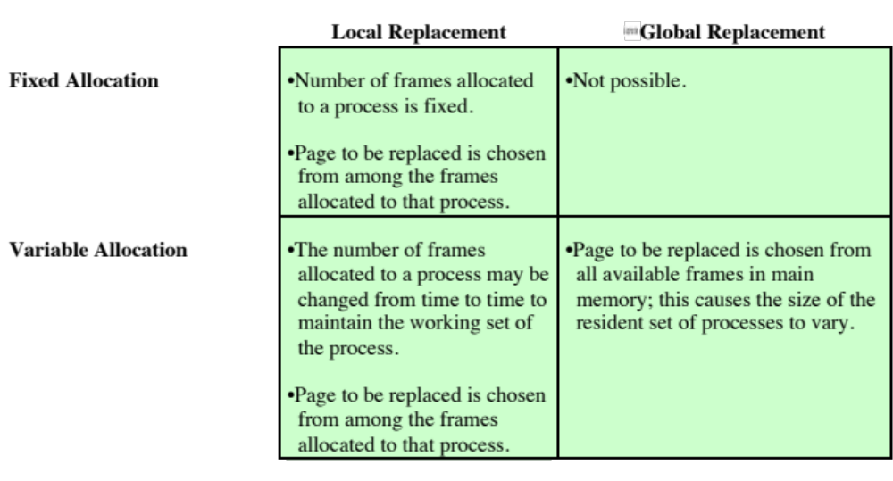
Table 8.5 Resident Set Management
Notes:
There is a correlation between replacement scope and resident set size
( Table 8.5 ). A fixed resident set implies a local replacement policy: To hold the size
of a resident set fixed, a page that is removed from main memory must be replaced
by another page from the same process. A variable-allocation policy can clearly
employ a global replacement policy: The replacement of a page from one process in
main memory with that of another causes the allocation of one process to grow by
one page and that of the other to shrink by one page. We shall also see that variable
allocation and local replacement is a valid combination. We now examine these
three combinations.

Slide 59
Fixed Allocation, Local Scope
Necessary to decide ahead of time the amount of allocation to give a process
If allocation is too small, there will be a high page fault rate
If allocation is too large, there will be too few programs in main memory
Increased processor idle time
Increased time spent in swapping
Notes:
With a fixed-allocation policy, it is necessary to decide ahead of time the amount
of allocation to give to a process. This could be decided on the basis of the type
of application and the amount requested by the program. The drawback to this
approach is twofold: If allocations tend to be too small, then there will be a high page
fault rate, causing the entire multiprogramming system to run slowly. If allocations
tend to be unnecessarily large, then there will be too few programs in main memory
and there will be either considerable processor idle time or considerable time spent
in swapping.

Slide 60
Variable Allocation
Global Scope
Easiest to implement
  Adopted in a number of operating systems
OS maintains a list of free frames
Free frame is added to resident set of process when a page fault occurs
If no frames are available the OS must choose a page currently in memory
One way to counter potential problems is to use page buffering
Notes:
This combination is perhaps the easiest
to implement and has been adopted in a number of operating systems. At any given
time, there are a number of processes in main memory, each with a certain number
of frames allocated to it. Typically, the operating system also maintains a list of
free frames. When a page fault occurs, a free frame is added to the resident set of
a process and the page is brought in. Thus, a process experiencing page faults will
gradually grow in size, which should help reduce overall page faults in the system.
The difficulty with this approach is in the replacement choice. When there
are no free frames available, the operating system must choose a page currently in
memory to replace. The selection is made from among all of the frames in memory,
except for locked frames such as those of the kernel. Using any of the policies
discussed in the preceding subsection, the page selected for replacement can belong
to any of the resident processes; there is no discipline to determine which process
should lose a page from its resident set. Therefore, the process that suffers the
reduction in resident set size may not be optimum.
One way to counter the potential performance problems of a variable-allocation,
global-scope policy is to use page buffering. In this way, the choice of which page to
replace becomes less significant, because the page may be reclaimed if it is referenced
before the next time that a block of pages are overwritten.

Slide 61
Variable Allocation
Local Scope
When a new process is loaded into main memory, allocate to it a certain number of page frames as its resident set
When a page fault occurs, select the page to replace from among the resident set of the process that suffers the fault
Reevaluate the allocation provided to the process and increase or decrease it to improve overall performance
Notes:
The variable-allocation, local-scope
strategy attempts to overcome the problems with a global-scope strategy. It can be
summarized as follows:
1. When a new process is loaded into main memory, allocate to it a certain
number of page frames as its resident set, based on application type, program
request, or other criteria. Use either prepaging or demand paging to fill up the
allocation.
2. When a page fault occurs, select the page to replace from among the resident
set of the process that suffers the fault.
3. From time to time, reevaluate the allocation provided to the process, and
increase or decrease it to improve overall performance.

Slide 62
Variable Allocation
Local Scope
Decision to increase or decrease a resident set size is based on the assessment of the likely future demands of active processes
Key elements:
Criteria used to determine resident set size
The timing of changes
Notes:
With this strategy, the decision to increase or decrease a resident set size is a
deliberate one and is based on an assessment of the likely future demands of active
processes. Because of this evaluation, such a strategy is more complex than a simple
global replacement policy. However, it may yield better performance.
The key elements of the variable-allocation, local-scope strategy are the criteria
used to determine resident set size and the timing of changes. One specific
strategy that has received much attention in the literature is known as the working
set strategy . Although a true working set strategy would be difficult to implement, it
is useful to examine it as a baseline for comparison.
The working set is a concept introduced and popularized by Denning
[DENN68, DENN70, DENN80b]; it has had a profound impact on virtual memory
management design. The working set with parameter for a process at virtual
time t , which we designate as W( t ,Δ ), is the set of pages of that process that have
been referenced in the last Δ virtual time units.

Slide 63
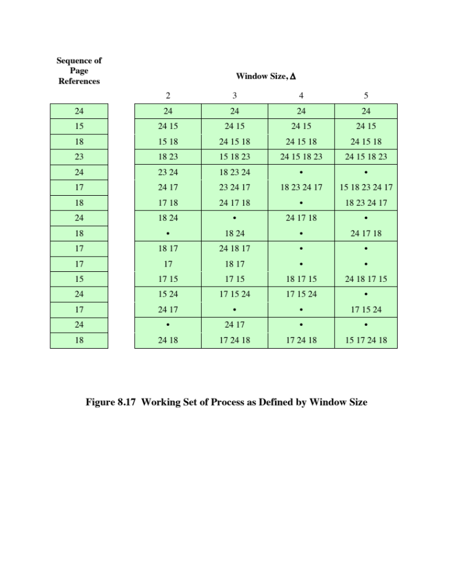
Notes:
Figure 8.17 (based on [BACH86]), shows a sequence of page references for a process.
The dots indicate time units in which the working set does not change. Note that the
larger the window size, the larger is the working set.

Slide 64
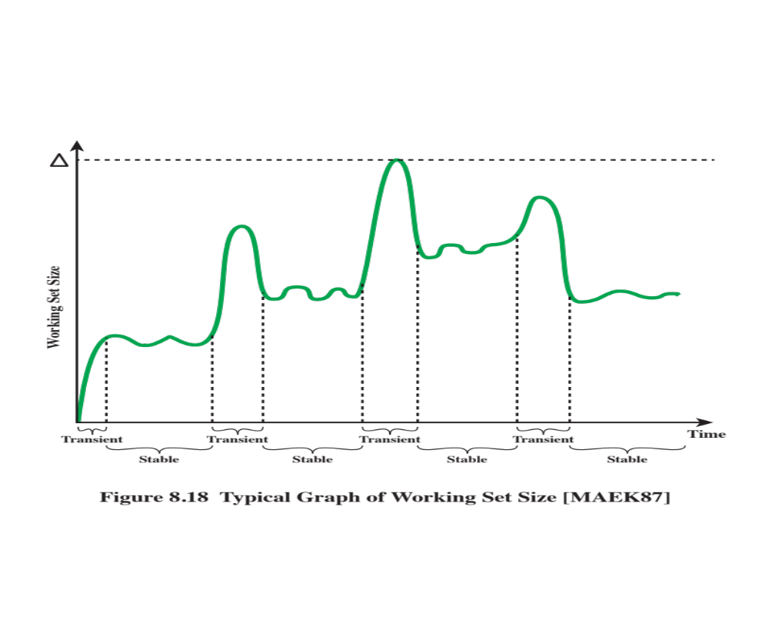
Notes:
Figure 8.18 indicates the way in which the working set size can vary over time
for a fixed value of Δ. For many programs, periods of relatively stable working set
sizes alternate with periods of rapid change. When a process first begins executing,
it gradually builds up to a working set as it references new pages. Eventually,
by the principle of locality, the process should stabilize on a certain set of pages.
Subsequent transient periods reflect a shift of the program to a new locality. During
the transition phase, some of the pages from the old locality remain within the window,
Δ, causing a surge in the size of the working set as new pages are referenced. As
the window slides past these page references, the working set size declines until it
contains only those pages from the new locality.

Slide 65
Page Fault Frequency
(PFF)
Requires a use bit to be associated with each page in memory
Bit is set to 1 when that page is accessed
When a page fault occurs, the OS notes the virtual time since the last page fault for that process
Does not perform well during the transient periods when there is a shift to a new locality
Notes:
An algorithm that follows this strategy is the page fault frequency (PFF) algorithm
[CHU72, GUPT78]. It requires a use bit to be associated with each page in
memory. The bit is set to 1 when that page is accessed. When a page fault occurs, the
operating system notes the virtual time since the last page fault for that process; this
could be done by maintaining a counter of page references. A threshold F is defined.
If the amount of time since the last page fault is less than F , then a page is added to
the resident set of the process. Otherwise, discard all pages with a use bit of 0, and
shrink the resident set accordingly. At the same time, reset the use bit on the remaining
pages of the process to 0. The strategy can be refined by using two thresholds: an
upper threshold that is used to trigger a growth in the resident set size, and a lower
threshold that is used to trigger a contraction in the resident set size.
The time between page faults is the reciprocal of the page fault rate. Although
it would seem to be better to maintain a running average of the page fault rate, the
use of a single time measurement is a reasonable compromise that allows decisions
about resident set size to be based on the page fault rate. If such a strategy is supplemented
with page buffering, the resulting performance should be quite good.
Nevertheless, there is a major flaw in the PFF approach, which is that it does
not perform well during the transient periods when there is a shift to a new locality.
With PFF, no page ever drops out of the resident set before F virtual time units have
elapsed since it was last referenced. During interlocality transitions, the rapid succession
of page faults causes the resident set of a process to swell before the pages
of the old locality are expelled; the sudden peaks of memory demand may produce
unnecessary process deactivations and reactivations, with the corresponding undesirable
switching and swapping overheads.

Slide 66
Variable-Interval Sampled Working Set (VSWS)
Evaluates the working set of a process at sampling instances based on elapsed virtual time
Driven by three parameters:
The minimum duration of the sampling interval
The maximum duration of the sampling interval
The number of page faults that are allowed to occur between sampling instances
Notes:
An approach that attempts to deal with the phenomenon of interlocality transition
with a similar relatively low overhead to that of PFF is the variable-interval
sampled working set (VSWS) policy [FERR83]. The VSWS policy evaluates the
working set of a process at sampling instances based on elapsed virtual time. At the
beginning of a sampling interval, the use bits of all the resident pages for the process
are reset; at the end, only the pages that have been referenced during the interval
will have their use bit set; these pages are retained in the resident set of the process
throughout the next interval, while the others are discarded. Thus the resident set
size can only decrease at the end of an interval. During each interval, any faulted
pages are added to the resident set; thus the resident set remains fixed or grows
during the interval.
The VSWS policy is driven by three parameters:
M : The minimum duration of the sampling interval
L : The maximum duration of the sampling interval
Q : The number of page faults that are allowed to occur between sampling instances
The VSWS policy is as follows:
1. If the virtual time since the last sampling instance reaches L , then suspend the
process and scan the use bits.
2. If, prior to an elapsed virtual time of L , Q page faults occur,
a. If the virtual time since the last sampling instance is less than M , then wait
until the elapsed virtual time reaches M to suspend the process and scan the
use bits.
b. If the virtual time since the last sampling instance is greater than or equal to
M , suspend the process and scan the use bits.
The parameter values are to be selected so that the sampling will normally
be triggered by the occurrence of the Q th page fault after the last scan (case 2b).
The other two parameters (M and L ) provide boundary protection for exceptional
conditions. The VSWS policy tries to reduce the peak memory demands caused by
abrupt interlocality transitions by increasing the sampling frequency, and hence the
rate at which unused pages drop out of the resident set, when the page fault rate
increases. Experience with this technique in the Bull mainframe operating system,
GCOS 8, indicates that this approach is as simple to implement as PFF and more
effective [PIZZ89].

Slide 67
Cleaning Policy
Concerned with determining when a modified page should be written out to secondary memory
Demand Cleaning
A page is written out to secondary memory only when it has been selected for replacement
Precleaning
Allows the writing of pages in batches
Notes:
A cleaning policy is the opposite of a fetch policy; it is concerned with determining
when a modified page should be written out to secondary memory. Two common
alternatives are demand cleaning and precleaning. With demand cleaning , a page is
written out to secondary memory only when it has been selected for replacement.
A precleaning policy writes modified pages before their page frames are needed so
that pages can be written out in batches.
Both precleaning and demand cleaning have drawbacks. With precleaning, a
page is written out but remains in main memory until the page replacement algorithm
dictates that it be removed. Precleaning allows the writing of pages in batches,
but it makes little sense to write out hundreds or thousands of pages only to find
that the majority of them have been modified again before they are replaced. The
transfer capacity of secondary memory is limited and should not be wasted with
unnecessary cleaning operations.
On the other hand, with demand cleaning, the writing of a dirty page is coupled
to, and precedes, the reading in of a new page. This technique may minimize
page writes, but it means that a process that suffers a page fault may have to wait
for two page transfers before it can be unblocked. This may decrease processor
utilization.
A better approach incorporates page buffering. This allows the adoption of the
following policy: Clean only pages that are replaceable, but decouple the cleaning
and replacement operations. With page buffering, replaced pages can be placed on
two lists: modified and unmodified. The pages on the modified list can periodically
be written out in batches and moved to the unmodified list. A page on the unmodified
list is either reclaimed if it is referenced or lost when its frame is assigned to
another page.

Slide 68
Load Control
Determines the number of processes that will be resident in main memory
  Multiprogramming level
Critical in effective memory management
Too few processes, many occasions when all processes will be blocked and much time will be spent in swapping
Too many processes will lead to thrashing
Notes:
Load control is concerned with determining the number of processes that will be resident
in main memory, which has been referred to as the multiprogramming level. The
load control policy is critical in effective memory management. If too few processes
are resident at any one time, then there will be many occasions when all processes
are blocked, and much time will be spent in swapping. On the other hand, if too
many processes are resident, then, on average, the size of the resident set of each
process will be inadequate and frequent faulting will occur. The result is thrashing.

Slide 69
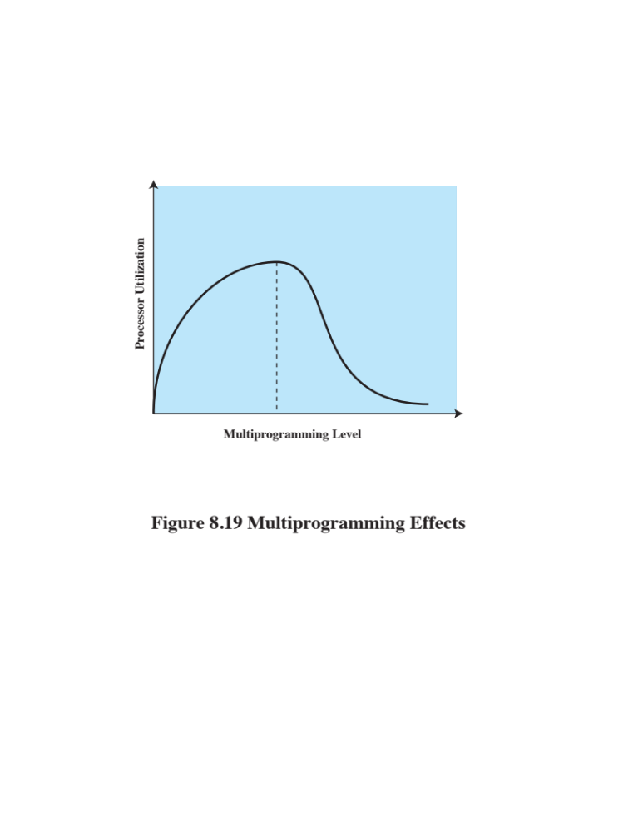
Notes:
Thrashing is illustrated in Figure 8.19 . As the
multiprogramming level increases from a small value, one would expect to see
processor utilization rise, because there is less chance that all resident processes
are blocked. However, a point is reached at which the average resident set is
inadequate. At this point, the number of page faults rises dramatically, and
processor utilization collapses.
There are a number of ways to approach this problem. A working set or PFF
algorithm implicitly incorporates load control. Only those processes whose resident
set is sufficiently large are allowed to execute. In providing the required resident set
size for each active process, the policy automatically and dynamically determines
the number of active programs.
Another approach, suggested by Denning and his colleagues [DENN80b], is
known as the L = S criterion , which adjusts the multiprogramming level so that the
mean time between faults equals the mean time required to process a page fault.
Performance studies indicate that this is the point at which processor utilization
attained a maximum. A policy with a similar effect, proposed in [LERO76], is the
50% criterion , which attempts to keep utilization of the paging device at approximately
50%. Again, performance studies indicate that this is a point of maximum
processor utilization.
Another approach is to adapt the clock page replacement algorithm described
earlier (Figure 8.15). [CARR81] describes a technique, using a global scope, that involves
monitoring the rate at which the pointer scans the circular buffer of frames. If the
rate is below a given lower threshold, this indicates one or both of two circumstances:
1. Few page faults are occurring, resulting in few requests to advance the pointer.
2. For each request, the average number of frames scanned by the pointer is
small, indicating that there are many resident pages not being referenced and
are readily replaceable.
In both cases, the multiprogramming level can safely be increased. On the
other hand, if the pointer scan rate exceeds an upper threshold, this indicates either
a high fault rate or difficulty in locating replaceable pages, which implies that the
multiprogramming level is too high.

Slide 70
Process Suspension
If the degree of multiprogramming is to be reduced, one or more of the currently resident processes must be swapped out
Six possibilities exist:
Lowest-priority process
Faulting process
Last process activated
Process with the smallest resident set
Largest process
Process with the largest remaining execution window
Notes:
If the degree of multiprogramming is to be reduced, one
or more of the currently resident processes must be suspended (swapped out).
[CARR81] lists six possibilities:
• Lowest-priority process: This implements a scheduling policy decision and is
unrelated to performance issues.
• Faulting process: The reasoning is that there is a greater probability that the
faulting task does not have its working set resident, and performance would
suffer least by suspending it. In addition, this choice has an immediate payoff
because it blocks a process that is about to be blocked anyway and it eliminates
the overhead of a page replacement and I/O operation.
• Last process activated: This is the process least likely to have its working set
resident.
• Process with the smallest resident set: This will require the least future effort
to reload. However, it penalizes programs with strong locality.
• Largest process: This obtains the most free frames in an overcommitted
memory, making additional deactivations unlikely soon.
• Process with the largest remaining execution window: In most process scheduling
schemes, a process may only run for a certain quantum of time before
being interrupted and placed at the end of the Ready queue. This approximates
a shortest-processing-time-first scheduling discipline.

Slide 71
UNIX
Intended to be machine independent so its memory management schemes will vary
  Early UNIX: variable partitioning with no virtual memory scheme
  Current implementations of UNIX and Solaris make use of paged virtual memory
SVR4 and Solaris use two separate schemes:
Paging system
Kernel memory allocator
Notes:
Because UNIX is intended to be machine independent, its memory management
scheme will vary from one system to the next. Earlier versions of UNIX simply used
variable partitioning with no virtual memory scheme. Current implementations of
UNIX and Solaris make use of paged virtual memory.
In SVR4 and Solaris, there are actually two separate memory management
schemes.

Slide 72
Paging System and
Kernel Memory Allocator
Paging System
Provides a virtual memory capability that allocates page frames in main memory to processes
Allocates page frames to disk block buffers
Kernel Memory Allocator
Allocates memory for the kernel
Notes:
The paging system provides a virtual memory capability that allocates
page frames in main memory to processes and also allocates page frames to disk
block buffers. Although this is an effective memory management scheme for user
processes and disk I/O, a paged virtual memory scheme is less suited to managing
the memory allocation for the kernel. For this latter purpose, a kernel memory
allocator is used.

Slide 73
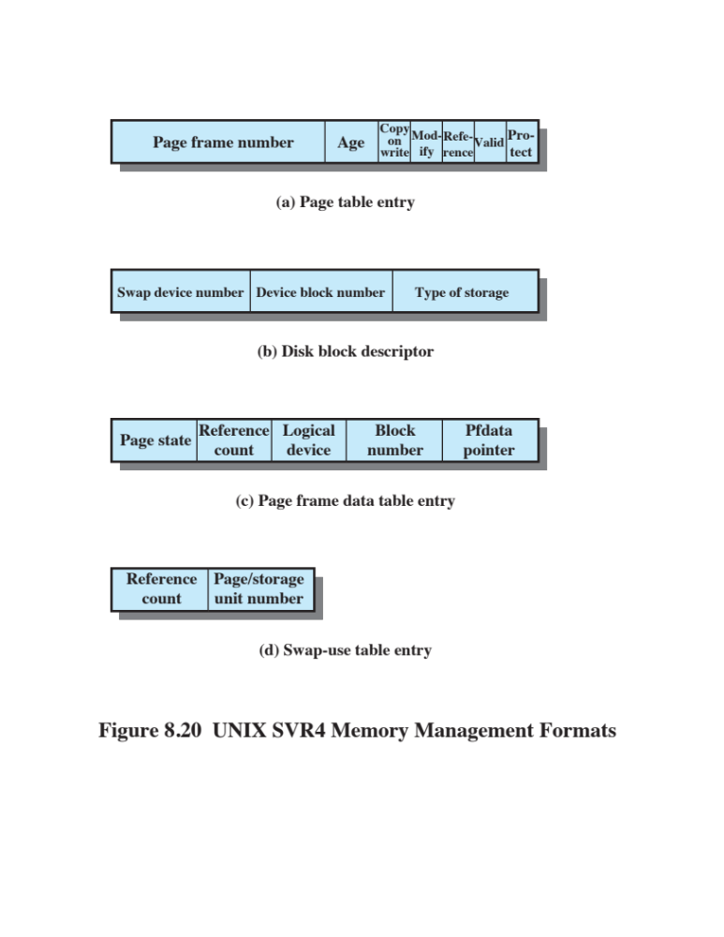
Notes:
For paged virtual memory, UNIX makes use of a number of
data structures that, with minor adjustment, are machine independent ( Figure 8.20
and Table 8.6 ):

Slide 74
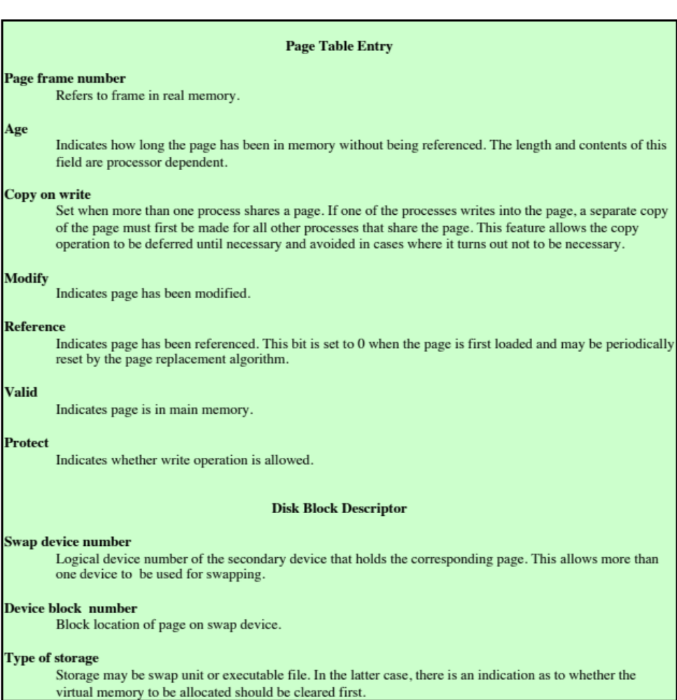
Table 8.6
UNIX SVR4 Memory Management Parameters
(page 1 of 2)
(Table can be found on page 381 in the textbook)
Notes:
For paged virtual memory, UNIX makes use of a number of
data structures that, with minor adjustment, are machine independent ( Figure 8.22
and Table 8.6 ):
Page table : Typically, there will be one page table per process, with one entry
for each page in virtual memory for that process.
• Disk block descriptor: Associated with each page of a process is an entry in
this table that describes the disk copy of the virtual page.
• Page frame data table: Describes each frame of real memory and is indexed by
frame number. This table is used by the replacement algorithm.
• Swap-use table: There is one swap-use table for each swap device, with one
entry for each page on the device.
Most of the fields defined in Table 8.6 are self-explanatory. A few warrant
further comment. The Age field in the page table entry is an indication of how long
it has been since a program referenced this frame. However, the number of bits
and the frequency of update of this field are implementation dependent. Therefore,
there is no universal UNIX use of this field for page replacement policy.
The Type of Storage field in the disk block descriptor is needed for the
following reason: When an executable file is first used to create a new process, only
a portion of the program and data for that file may be loaded into real memory.
Later, as page faults occur, new portions of the program and data are loaded. It is
only at the time of first loading that virtual memory pages are created and assigned
to locations on one of the devices to be used for swapping. At that time, the operating
system is told whether it needs to clear (set to 0) the locations in the page frame
before the first loading of a block of the program or data.

Slide 75
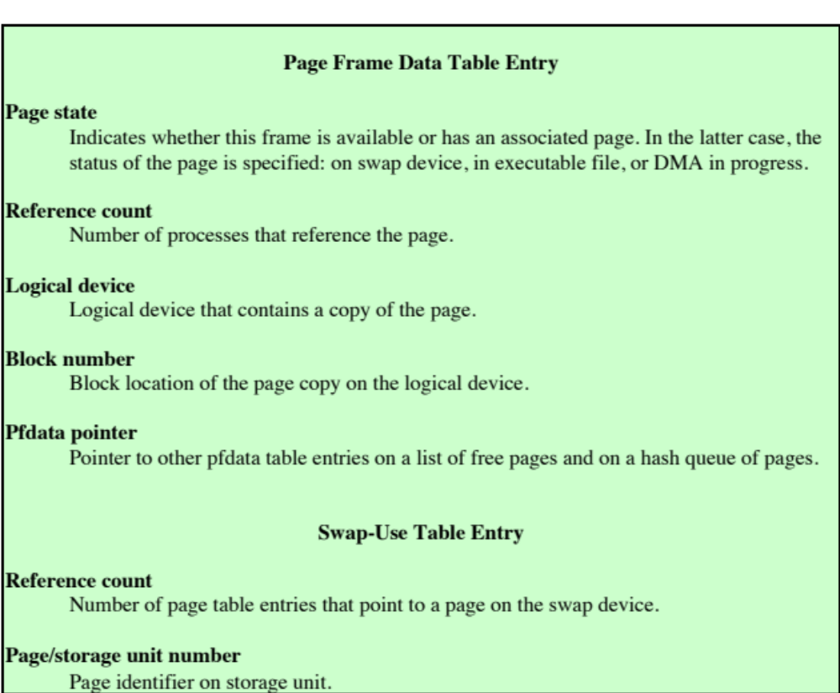
Table 8.6
UNIX SVR4 Memory Management Parameters
(page 2 of 2)
(Table can be found on page 381 in the textbook)
Notes:
Table 8.6 (continued)

Slide 76
Page Replacement
The page frame data table is used for page replacement
Pointers are used to create lists within the table
    All available frames are linked together in a list of free frames available for bringing in pages
    When the number of available frames drops below a certain threshold, the kernel will steal a number of frames to compensate
Notes:
The page frame data table is used for page replacement.
Several pointers are used to create lists within this table. All of the available frames
are linked together in a list of free frames available for bringing in pages. When the
number of available frames drops below a certain threshold, the kernel will steal a
number of frames to compensate.

Slide 77
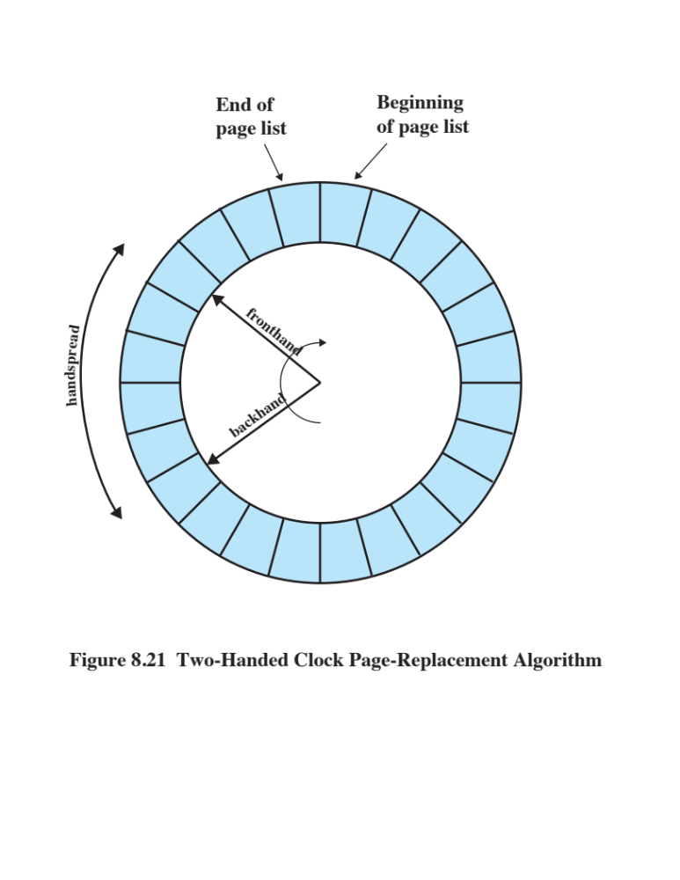
Notes:
The page replacement algorithm used in SVR4 is a refinement of the
clock policy algorithm ( Figure 8.15 ) known as the two-handed clock algorithm
( Figure 8.21 ). The algorithm uses the reference bit in the page table entry for each
page in memory that is eligible (not locked) to be swapped out. This bit is set to 0
when the page is first brought in and set to 1 when the page is referenced for a read
or write. One hand in the clock algorithm, the fronthand, sweeps through the pages
on the list of eligible pages and sets the reference bit to 0 on each page. Sometime
later, the backhand sweeps through the same list and checks the reference bit. If
the bit is set to 1, then that page has been referenced since the fronthand swept by;
these frames are ignored. If the bit is still set to 0, then the page has not been referenced
in the time interval between the visit by fronthand and backhand; these pages
are placed on a list to be paged out.
Two parameters determine the operation of the algorithm:
• Scanrate: The rate at which the two hands scan through the page list, in pages
per second
• Handspread: The gap between fronthand and backhand
These two parameters have default values set at boot time based on the
amount of physical memory. The scanrate parameter can be altered to meet changing
conditions. The parameter varies linearly between the values slowscan and fastscan
(set at configuration time) as the amount of free memory varies between the values
lotsfree and minfree . In other words, as the amount of free memory shrinks, the
clock hands move more rapidly to free up more pages. The handspread parameter
determines the gap between the fronthand and the backhand and therefore, together
with scanrate, determines the window of opportunity to use a page before it is
swapped out due to lack of use.

Slide 78
Kernel Memory Allocator
The kernel generates and destroys small tables and buffers frequently during the course of execution, each of which requires dynamic memory allocation.
Most of these blocks are significantly smaller than typical pages (therefore paging would be inefficient)
Allocations and free operations must be made as fast as possible
Notes:
The kernel generates and destroys small tables and buffers frequently during the
course of execution, each of which requires dynamic memory allocation. [VAHA96]
lists the following examples:
• The pathname translation routing may allocate a buffer to copy a pathname
from user space.
• The allocb() routine allocates STREAMS buffers of arbitrary size.
• Many UNIX implementations allocate zombie structures to retain exit status
and resource usage information about deceased processes.
• In SVR4 and Solaris, the kernel allocates many objects (such as proc structures,
vnodes, and file descriptor blocks) dynamically when needed.
Most of these blocks are significantly smaller than the typical machine page size, and
therefore the paging mechanism would be inefficient for dynamic kernel memory
allocation. For SVR4, a modification of the buddy system, described in Section 7.2,
is used.
In buddy systems, the cost to allocate and free a block of memory is low compared
to that of best-fit or first-fit policies [KNUT97]. However, in the case of kernel
memory management, the allocation and free operations must be made as fast as
possible. The drawback of the buddy system is the time required to fragment and
coalesce blocks.

Slide 79
Lazy Buddy
Technique adopted for SVR4
UNIX often exhibits steady-state behavior in kernel memory demand
  i.e. the amount of demand for blocks of a particular size varies slowly in time
Defers coalescing until it seems likely that it is needed, and then coalesces as many blocks as possible
Notes:
Barkley and Lee at AT&T proposed a variation known as a lazy buddy system
[BARK89], and this is the technique adopted for SVR4. The authors observed that
UNIX often exhibits steady-state behavior in kernel memory demand; that is, the
amount of demand for blocks of a particular size varies slowly in time. Therefore, if
a block of size 2 ^{i} is released and is immediately coalesced with its buddy into a block
of size 2 ^{i +1} , the kernel may next request a block of size 2 ^{i} , which may necessitate
splitting the larger block again. To avoid this unnecessary coalescing and splitting,
the lazy buddy system defers coalescing until it seems likely that it is needed, and
then coalesces as many blocks as possible.
The lazy buddy system uses the following parameters:
N _{i} current number of blocks of size 2 ^{i} .
A _{i} current number of blocks of size 2 ^{i} that are allocated (occupied).
G _{i} current number of blocks of size 2 ^{i} that are globally free; these are blocks
that are eligible for coalescing; if the buddy of such a block becomes
globally free, then the two blocks will be coalesced into a globally free
block of size 2 ^{i +1} . All free blocks (holes) in the standard buddy system
could be considered globally free.
L _{i} current number of blocks of size 2 ^{i} that are locally free; these are blocks that
are not eligible for coalescing. Even if the buddy of such a block becomes
free, the two blocks are not coalesced. Rather, the locally free blocks are
retained in anticipation of future demand for a block of that size.
In general, the lazy buddy system tries to maintain a pool of locally free blocks
and only invokes coalescing if the number of locally free blocks exceeds a threshold.
If there are too many locally free blocks, then there is a chance that there will
be a lack of free blocks at the next level to satisfy demand. Most of the time, when
a block is freed, coalescing does not occur, so there is minimal bookkeeping and
operational costs. When a block is to be allocated, no distinction is made between
locally and globally free blocks; again, this minimizes bookkeeping.

Slide 80
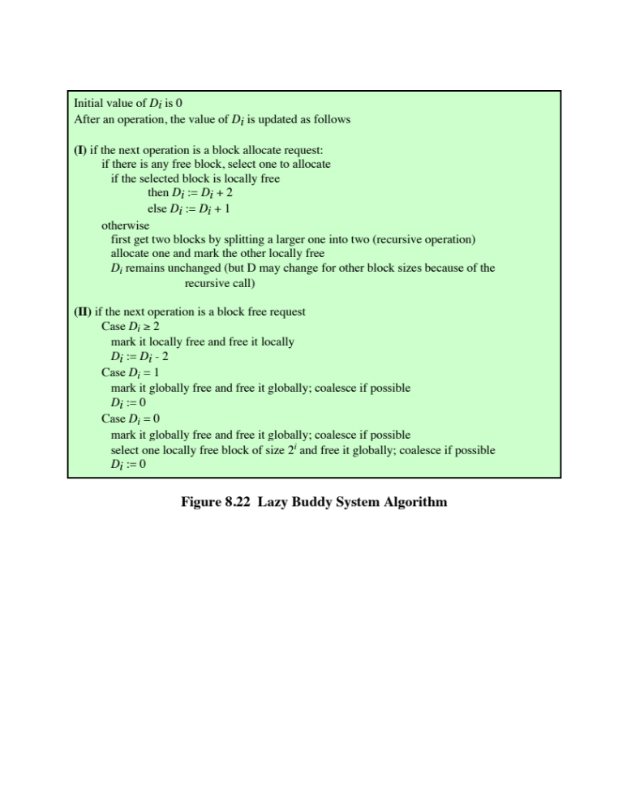
Notes:
The criterion used for coalescing is that the number of locally free blocks
of a given size should not exceed the number of allocated blocks of that size.
This is a reasonable guideline for restricting the growth of
locally free blocks, and experiments in [BARK89] confirm that this scheme results
in noticeable savings.
Figure 8.22 shows the algorithm.

Slide 81
Linux
Memory Management
Shares many characteristics with UNIX
Is quite complex
Two main aspects
Process virtual memory
Kernel memory allocation
Notes:
Linux shares many of the characteristics of the memory management schemes of
other UNIX implementations but has its own unique features. Overall, the Linux
memory management scheme is quite complex [DUBE98].

Slide 82
Linux Virtual Memory
Three level page table structure:
Page directory
Process has a single page directory
Each entry points to one page of the page middle directory
Must be in main memory for an active process
Page middle directory
May span multiple pages
Each entry points to one page in the page table
Page table
May also span multiple pages
Each entry refers to one virtual page of the process
Notes:
Linux makes use of a three-level page table
structure, consisting of the following types of tables (each individual table is the size
of one page):
• Page directory: An active process has a single page directory that is the size
of one page. Each entry in the page directory points to one page of the page
middle directory. The page directory must be in main memory for an active
process.
Page middle directory: The page middle directory may span multiple pages.
Each entry in the page middle directory points to one page in the page table.
• Page table: The page table may also span multiple pages. Each page table
entry refers to one virtual page of the process.

Slide 83
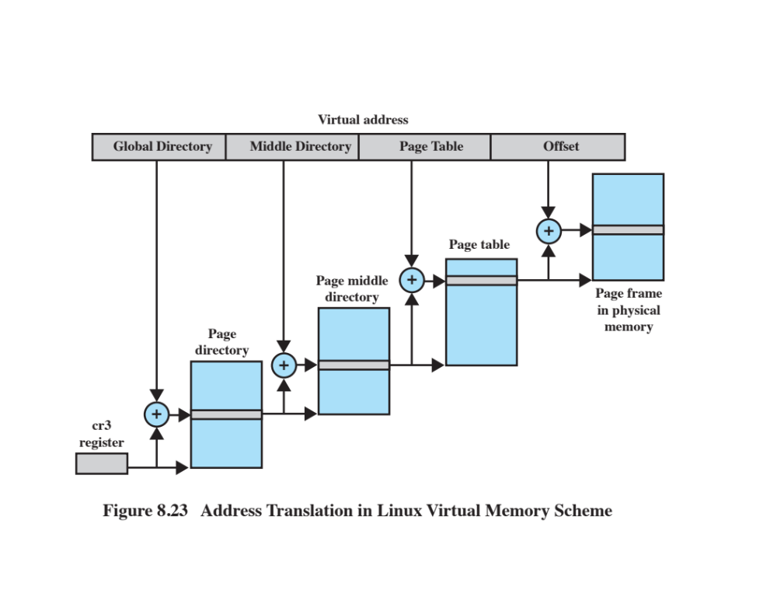
Notes:
To use this three-level page table structure, a virtual address in Linux is viewed
as consisting of four fields ( Figure 8.23 ). The leftmost (most significant) field is used
as an index into the page directory. The next field serves as an index into the page
middle directory. The third field serves as an index into the page table. The fourth
field gives the offset within the selected page of memory.
The Linux page table structure is platform independent and was designed to
accommodate the 64-bit Alpha processor, which provides hardware support for
three levels of paging. With 64-bit addresses, the use of only two levels of pages on
the Alpha would result in very large page tables and directories. The 32-bit
x86 architecture has a two-level hardware paging mechanism. The Linux software
accommodates the two-level scheme by defining the size of the page middle directory
as one. Note that all references to an extra level of indirection are optimized
away at compile time, not at run time. Therefore, there is no performance overhead
for using generic three-level design on platforms which support only two levels in
hardware.

Slide 84
Linux Page Replacement
Based on the clock algorithm
The use bit is replaced with an 8-bit age variable
    Incremented each time the page is accessed
Periodically decrements the age bits
    A page with an age of 0 is an “old” page that has not been referenced in some time and is the best candidate for replacement
A form of least frequently used policy
Notes:
Prior to Linux release 2.6.28, the Linux page
replacement algorithm was based on the clock algorithm described in Section 8.2 (see
Figure 8.15). In the simple clock algorithm, a use bit and a modify bit are associated
with each page in main memory. In the Linux scheme, the use bit was replaced with an
8-bit age variable. Each time that a page is accessed, the age variable is incremented.
In the background, Linux periodically sweeps through the global page pool and
decrements the age variable for each page as it rotates through all the pages in main
memory. A page with an age of 0 is an “old” page that has not been referenced in
some time and is the best candidate for replacement. The larger the value of age, the
more frequently a page has been used in recent times and the less eligible it is for
replacement. Thus, the Linux algorithm was a form of least frequently used policy.

Slide 85
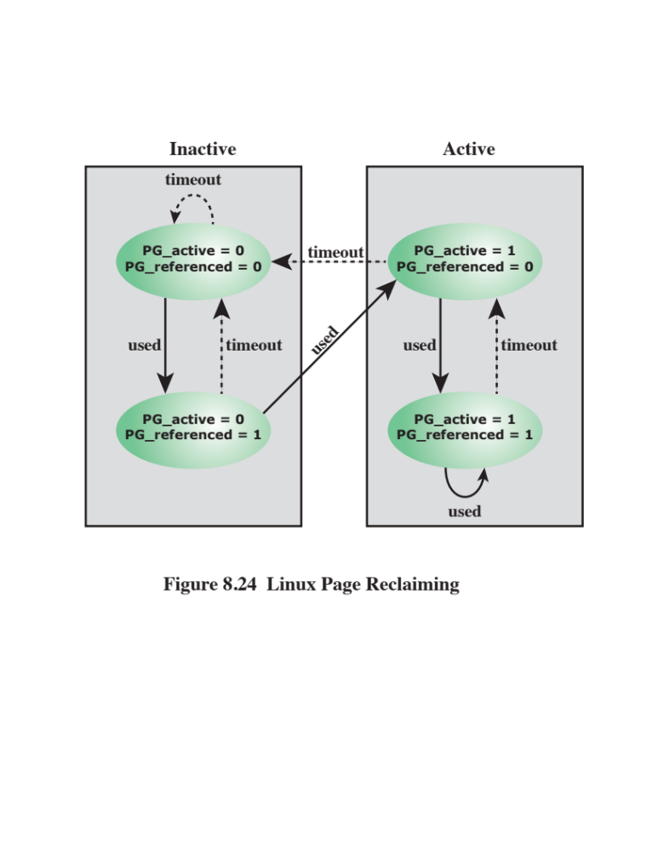
Notes:
We can summarize the steps involved in page management as follows (Figure 8.24):
1. The first time a page on the inactive list is accessed, the PG_referenced flag
is set.
2. The next time that page is accessed, it is moved to the active list. That is, it
takes two accesses for a page to be declared active. More precisely, it takes two
accesses in different scans for a page to become active.
3. If the second access doesn’t happen soon enough, PG_referenced is reset.
4. Similarly, for active pages, two timeouts are required to move the page to the
inactive list.
Pages on the inactive list are then available for page replacement, using an
LRU type of algorithm.

Slide 86
Kernel Memory Allocation
Kernel memory capability manages physical main memory page frames
  Primary function is to allocate and deallocate frames for particular uses
    A buddy algorithm is used so that memory for the kernel can be allocated and deallocated in units of one or more pages
    Page allocator alone would be inefficient because the kernel requires small short-term memory chunks in odd sizes
    Slab allocation
    Used by Linux to accommodate small chunks
Possible owners of a frame include:
User-space processes
Dynamically allocated kernel data
Static kernel code
Page cache
Notes:
The Linux kernel memory capability manages physical main memory page frames.
Its primary function is to allocate and deallocate frames for particular uses. Possible
owners of a frame include user-space processes (i.e., the frame is part of the virtual
memory of a process that is currently resident in real memory), dynamically allocated
kernel data, static kernel code, and the page cache.
The foundation of kernel memory allocation for Linux is the page allocation
mechanism used for user virtual memory management. As in the virtual memory
scheme, a buddy algorithm is used so that memory for the kernel can be allocated
and deallocated in units of one or more pages. Because the minimum amount of
memory that can be allocated in this fashion is one page, the page allocator alone
would be inefficient because the kernel requires small short-term memory chunks
in odd sizes. To accommodate these small chunks, Linux uses a scheme known as
slab allocation [BONW94] within an allocated page. On a x86 machine, the
page size is 4 Kbytes, and chunks within a page may be allocated of sizes 32, 64, 128,
252, 508, 2,040, and 4,080 bytes.
The slab allocator is relatively complex and is not examined in detail here; a
good description can be found in [VAHA96]. In essence, Linux maintains a set of
linked lists, one for each size of chunk. Chunks may be split and aggregated in a
manner similar to the buddy algorithm and moved between lists accordingly.

Slide 87
Windows
Memory Management
Virtual memory manager controls how memory is allocated and how paging is performed
Designed to operate over a variety of platforms
Uses page sizes ranging from 4 Kbytes to 64 Kbytes
Notes:
The Windows virtual memory manager controls how memory is allocated and how
paging is performed. The memory manager is designed to operate over a variety
of platforms and to use page sizes ranging from 4 Kbytes to 64 Kbytes. Intel
and AMD64 platforms have 4 Kbytes per page and Intel Itanium platforms have
8 Kbytes per page.

Slide 88
Windows Virtual Address Map
On 32 bit platforms each user process sees a separate 32 bit address space allowing 4 GB of virtual memory per process
    By default half is reserved for the OS
    Large memory intensive applications run more effectively using 64-bit Windows
    Most modern PCs use the AMD64 processor architecture which is capable of running as either a 32-bit or 64-bit system
Notes:
On 32-bit platforms, each Windows user process sees a separate 32-bit address
space, allowing 4 GB of virtual memory per process. By default, half of this
memory is reserved for the operating system, so each user actually has 2 GB of
available virtual address space and all processes share most of the upper 2 GB of
system space when running in kernel-mode. Large memory intensive applications,
on both clients and servers, can run more effectively using 64-bit Windows. Other
than netbooks, most modern PCs use the AMD64 processor architecture which is
capable of running as either a 32-bit or 64-bit system.

Slide 89
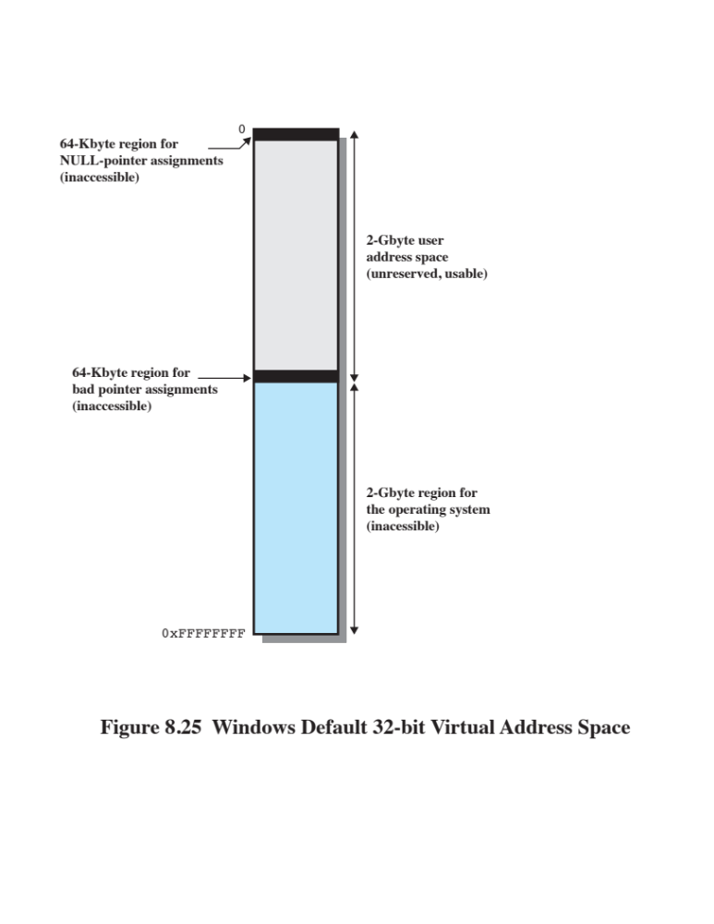
Notes:
Figure 8.25 shows the default virtual address space seen by a normal 32-bit
user process. It consists of four regions:
• 0x00000000 to 0x0000FFFF: Set aside to help programmers catch NULLpointer
assignments.
• 0x00010000 to 0x7FFEFFFF: Available user address space. This space is
divided into pages that may be loaded into main memory.
• 0x7FFF0000 to 0x7FFFFFFF: A guard page inaccessible to the user. This page
makes it easier for the operating system to check on out-of-bounds pointer
references.
• 0x80000000 to 0xFFFFFFFF: System address space. This 2-GB process is
used for the Windows Executive, Kernel, HAL, and device drivers.
• On 64-bit platforms, 8 TB of user address space is available in Windows.

Slide 90
Windows Paging
On creation, a process can make use of the entire user space of almost 2 GB
This space is divided into fixed-size pages managed in contiguous regions allocated on 64 KB boundaries
Regions may be in one of three states:
Available
Reserved
Committed
Notes:
When a process is created, it can in principle make use of the entire user space of
almost 2 GB (or 8 TB on 64-bit Windows). This space is divided into fixed size
pages, any of which can be brought into main memory, but the OS
manages the addresses in contiguous regions allocated on 64-KB boundaries. A
region can be in one of three states:
• Available: addresses not currently used by this process.
• Reserved: addresses that the virtual memory manager has set aside for a process
so they cannot be allocated to another use (e.g., saving contiguous space
for a stack to grow).
• Committed: addresses that the virtual memory manager has initialized for use
by the process to access virtual memory pages. These pages can reside either
on disk or in physical memory. When on disk they can be either kept in files
(mapped pages) or occupy space in the paging file (i.e., the disk file to which it
writes pages when removing them from main memory).
The distinction between reserved and committed memory is useful because
it (1) reduces the amount of total virtual memory space needed by the system,
allowing the page file to be smaller; and (2) allows programs to reserve addresses
without making them accessible to the program or having them charged against
their resource quotas.

Slide 91
Resident Set
Management System
Windows uses variable allocation, local scope
When activated, a process is assigned a data structure to manage its working set
Working sets of active processes are adjusted depending on the availability of main memory
Notes:
The resident set management scheme used by Windows is variable allocation,
local scope (see Table 8.5 ). When a process is first activated, it is assigned data structures
to manage its working set. As the pages needed by the process are brought
into physical memory the memory manager uses the data structures to keep track
of the pages assigned to the process. Working sets of active processes are adjusted
using the following general conventions:
• When main memory is plentiful, the virtual memory manager allows the resident
sets of active processes to grow. To do this, when a page fault occurs, a
new physical page is added to the process but no older page is swapped out,
resulting in an increase of the resident set of that process by one page.
• When memory becomes scarce, the virtual memory manager recovers memory
for the system by removing less recently used pages out of the working sets
of active processes, reducing the size of those resident sets.
• Even when memory is plentiful, Windows watches for large processes that
are rapidly increasing their memory usage. The system begins to remove
pages that have not been recently used from the process. This policy makes
the system more responsive because a new program will not suddenly cause a
scarcity of memory and make the user wait while the system tries to reduce the
resident sets of the processes that are already running.

Slide 92
Android Memory Management
Android includes a number of extensions to the normal Linux kernel memory management facility
These include:
  ASHMem
      This feature provides anonymous shared memory, which abstracts memory as file descriptors
      A file descriptor can be passed to another process to share memory
  Pmem
      This feature allocates virtual memory so that it is physically contiguous
      This feature is useful for hardware that does not support virtual memory
  Low Memory Killer
      This feature enables the system to notify an app or apps that they need to free up memory
      If an app does not cooperate, it is terminated
Notes:
Android includes a number of extensions to the normal Linux kernel memory management
facility. These include the following:
• ASHMem: This feature provides anonymous shared memory, which abstracts
memory as file descriptors. A file descriptor can be passed to another process
to share memory.
• Pmem: This feature allocates virtual memory so that it is physically contiguous.
This feature is useful for hardware that does not support virtual memory.
• Low Memory Killer: Most mobile devices do not have a swap capability (because
of flash memory lifetime considerations). When main memory is exhausted,
the application or applications using the most memory must either
back off their use of memory or be terminated. This feature enables the system
to notify an app or apps that they need to free up memory. If an app does not
cooperate, it is terminated.

Slide 93
Summary
Hardware and control structures
    Locality and virtual memory
    Paging
    Segmentation
    Combined paging and segmentation
    Protection and sharing
OS software
    Fetch policy
    Placement policy
    Replacement policy
    Resident set management
    Cleaning policy
    Load control
UNIX and Solaris memory management
    Paging system
    Kernel memory allocator
Linux memory management
    Linux virtual memory
    Kernel memory allocation
Windows memory management
    Windows virtual address map
    Windows paging
    Windows swapping
Android memory management
Notes:
Summary of Chapter 8.

