Slide 1
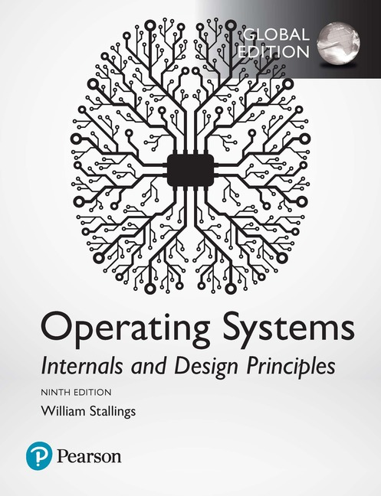
Chapter 10
Multiprocessor, Multicore and Real-Time Scheduling
Ninth Edition, Global Edition
By William Stallings
Notes:
“Operating Systems: Internal and Design Principles”, 9/e, by William Stallings, Chapter 10 “Multiprocessor, Multicore and Real-Time Scheduling”.

Slide 2
Classifications of
Multiprocessor Systems
Loosely coupled or distributed multiprocessor, or cluster
Consists of a collection of relatively autonomous systems, each processor having its own main memory and I/O channels
Functionally specialized processors
There is a master, general-purpose processor;
Tightly coupled multiprocessor
Consists of a set of processors that share a common main memory and are under the integrated control of an operating system
Specialized processors are controlled by the master processor and provide services to it
Notes:
When a computer system contains more than a single processor, several new issues
are introduced into the design of the scheduling function. We begin with a brief
overview of multiprocessors and then look at the rather different considerations
when scheduling is done at the process level and at the thread level.
We can classify multiprocessor systems as follows:
• Loosely coupled or distributed multiprocessor, or cluster: Consists of a collection
of relatively autonomous systems, each processor having its own main
memory and I/O channels. We address this type of configuration in Chapter 16 .
• Functionally specialized processors: An example is an I/O processor. In this
case, there is a master, general-purpose processor; specialized processors are
controlled by the master processor and provide services to it. Issues relating to
I/O processors are addressed in Chapter 11 .
• Tightly coupled multiprocessor: Consists of a set of processors that share a
common main memory and are under the integrated control of an operating
system.

Slide 3
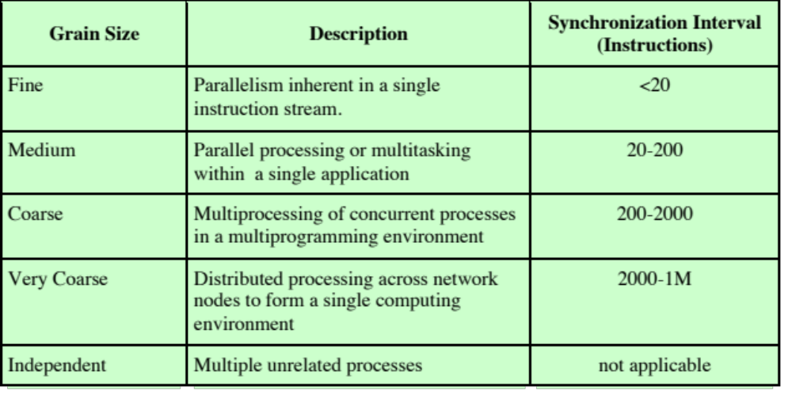
Table 10.1 Synchronization Granularity and Processes
Notes:
A good way of characterizing multiprocessors and placing them in context with
other architectures is to consider the synchronization granularity, or frequency of
synchronization, between processes in a system. We can distinguish five categories
of parallelism that differ in the degree of granularity. These are summarized in
Table 10.1.

Slide 4
Independent Parallelism
Each user is performing a particular application
Multiprocessor provides the same service as a multiprogrammed uniprocessor
Because more than one processor is available, average response time to the users will be shorter
No explicit synchronization among processes
    Each represents a separate, independent application or job
    Typical use is in a time-sharing system
Notes:
With independent parallelism, there is no explicit
synchronization among processes. Each represents a separate, independent
application or job. A typical use of this type of parallelism is in a time-sharing system.
Each user is performing a particular application, such as word processing or using a
spreadsheet. The multiprocessor provides the same service as a multiprogrammed
uniprocessor. Because more than one processor is available, average response time
to the users will be shorter.
It is possible to achieve a similar performance gain by providing each user with
a personal computer or workstation. If any files or information are to be shared,
then the individual systems must be hooked together into a distributed system supported
by a network. This approach is examined in Chapter 16 . On the other hand,
a single, multiprocessor shared system in many instances is more cost-effective than
a distributed system, allowing economies of scale in disks and other peripherals.

Slide 5
Coarse and Very Coarse Grained Parallelism
There is synchronization among processes, but at a very gross level
Easily handled as a set of concurrent processes running on a multiprogrammed uniprocessor
Can be supported on a multiprocessor with little or no change to user software
Notes:
With coarse and very coarse grained
parallelism, there is synchronization among processes, but at a very gross
level. This kind of situation is easily handled as a set of concurrent processes running
on a multiprogrammed uniprocessor and can be supported on a multiprocessor with
little or no change to user software.
A simple example of an application that can exploit the existence of a multiprocessor
is given in [WOOD89]. The authors have developed a program that takes
a specification of files needing recompilation to rebuild a piece of software and
determines which of these compiles (usually all of them) can be run simultaneously.
The program then spawns one process for each parallel compile. The authors report
that the speedup on a multiprocessor actually exceeds what would be expected
by simply adding up the number of processors in use, due to synergies in the disk
buffer caches (a topic explored in Chapter 11 ) and sharing of compiler code, which
is loaded into memory only once.
In general, any collection of concurrent processes that need to communicate or
synchronize can benefit from the use of a multiprocessor architecture. In the case of
very infrequent interaction among processes, a distributed system can provide good
support. However, if the interaction is somewhat more frequent, then the overhead
of communication across the network may negate some of the potential speedup. In
that case, the multiprocessor organization provides the most effective support.

Slide 6
Medium-Grained
Parallelism
Single application can be effectively implemented as a collection of threads within a single process
    Programmer must explicitly specify the potential parallelism of an application
    There needs to be a high degree of coordination and interaction among the threads of an application, leading to a medium-grain level of synchronization
Because the various threads of an application interact so frequently, scheduling decisions concerning one thread may affect the performance of the entire application
Notes:
We saw in Chapter 4 that a single application
can be effectively implemented as a collection of threads within a single process.
In this case, the programmer must explicitly specify the potential parallelism of an
application. Typically, there will need to be rather a high degree of coordination
and interaction among the threads of an application, leading to a medium-grain
level of synchronization.
Whereas independent, very coarse, and coarse-grained parallelism can be supported
on either a multiprogrammed uniprocessor or a multiprocessor with little or
no impact on the scheduling function, we need to reexamine scheduling when dealing
with the scheduling of threads. Because the various threads of an application
interact so frequently, scheduling decisions concerning one thread may affect the
performance of the entire application.

Slide 7
Fine-Grained Parallelism
Represents a much more complex use of parallelism than is found in the use of threads
Is a specialized and fragmented area with many different approaches
Notes:
Fine-grained parallelism represents a much more
complex use of parallelism than is found in the use of threads. Although much
work has been done on highly parallel applications, this is so far a specialized and
fragmented area, with many different approaches.
Chapter 4 provides an example of the use of granularity for the Valve game
software.

Slide 8
Design Issues
Scheduling on a multiprocessor involves three interrelated issues:
Assignment of processes to processors
Use of multiprogramming on individual processors
Actual dispatching of a process
The approach taken will depend on the degree of granularity of applications and on the number of processors available
Notes:
Scheduling on a multiprocessor involves three interrelated issues:
• The assignment of processes to processors
• The use of multiprogramming on individual processors
• The actual dispatching of a process
It is important to keep in mind that the approach taken will depend, in general, on the degree of granularity of the applications and on the number of processors available.

Slide 9
Assignment of
Processes to Processors
Assuming all processors are equal, it is simplest to treat processors as a pooled resource and assign processes to processors on demand
Static or dynamic needs to be determined
If a process is permanently assigned to one processor from activation until its completion, then a dedicated short-term queue is maintained for each processor
Advantage is that there may be less overhead in the scheduling function
Allows group or gang scheduling
    A disadvantage of static assignment is that one processor can be idle, with an empty queue, while another processor has a backlog
    To prevent this situation, a common queue can be used
    Another option is dynamic load balancing
Notes:
If we assume that the architecture
of the multiprocessor is uniform, in the sense that no processor has a particular
physical advantage with respect to access to main memory or to I/O devices, then
the simplest scheduling approach is to treat the processors as a pooled resource and
assign processes to processors on demand. The question then arises as to whether
the assignment should be static or dynamic.
If a process is permanently assigned to one processor from activation until its
completion, then a dedicated short-term queue is maintained for each processor.
An advantage of this approach is that there may be less overhead in the scheduling
function, because the processor assignment is made once and for all. Also, the use
of dedicated processors allows a strategy known as group or gang scheduling, as
discussed later.
A disadvantage of static assignment is that one processor can be idle, with an
empty queue, while another processor has a backlog. To prevent this situation, a
common queue can be used. All processes go into one global queue and are scheduled
to any available processor. Thus, over the life of a process, the process may
be executed on different processors at different times. In a tightly coupled shared memory
architecture, the context information for all processes will be available to
all processors, and therefore the cost of scheduling a process will be independent of
the identity of the processor on which it is scheduled. Yet another option is dynamic
load balancing, in which threads are moved for a queue for one processor to a queue
for another processor; Linux uses this approach.

Slide 10
Assignment of
Processes to Processors
Both dynamic and static methods require some way of assigning a process to a processor
Approaches:
  Master/Slave
  Peer
Notes:
Regardless of whether processes are dedicated to processors, some means is
needed to assign processes to processors. Two approaches have been used: master/
slave and peer.

Slide 11
Master/Slave Architecture
Key kernel functions always run on a particular processor
Master is responsible for scheduling
Slave sends service request to the master
Is simple and requires little enhancement to a uniprocessor multiprogramming operating system
Conflict resolution is simplified because one processor has control of all memory and I/O resources
Disadvantages:
Failure of master brings down whole system
Master can become a performance bottleneck
Notes:
With a master/slave architecture, key kernel functions of the operating
system always run on a particular processor. The other processors may only
execute user programs. The master is responsible for scheduling jobs. Once a process
is active, if the slave needs service (e.g., an I/O call), it must send a request to the
master and wait for the service to be performed. This approach is quite simple and
requires little enhancement to a uniprocessor multiprogramming operating system.
Conflict resolution is simplified because one processor has control of all memory
and I/O resources. There are two disadvantages to this approach: (1) A failure of
the master brings down the whole system, and (2) the master can become a performance
bottleneck.

Slide 12
Peer Architecture
Kernel can execute on any processor
Each processor does self-scheduling from the pool of available processes
Complicates the operating system
Operating system must ensure that two processors do not choose the same process and that the processes are not somehow lost from the queue
Notes:
In a peer architecture, the kernel can execute on any processor, and each
processor does self-scheduling from the pool of available processes. This approach
complicates the operating system. The operating system must ensure that two processors
do not choose the same process and that the processes are not somehow lost
from the queue. Techniques must be employed to resolve and synchronize competing
claims to resources.
There is, of course, a spectrum of approaches between these two extremes. One
approach is to provide a subset of processors dedicated to kernel processing instead
of just one. Another approach is simply to manage the difference between the needs
of kernel processes and other processes on the basis of priority and execution history.

Slide 13
Process Scheduling
In most traditional multiprocessor systems, processes are not dedicated to processors
A single queue is used for all processors
  If some sort of priority scheme is used, there are multiple queues based on priority, all feeding into the common pool of processors
System is viewed as being a multi-server queuing architecture
Notes:
In most traditional multiprocessor systems, processes are not dedicated to processors.
Rather there is a single queue for all processors, or if some sort of priority
scheme is used, there are multiple queues based on priority, all feeding into the
common pool of processors. In any case, we can view the system as being a multiserver
queuing architecture.

Slide 14
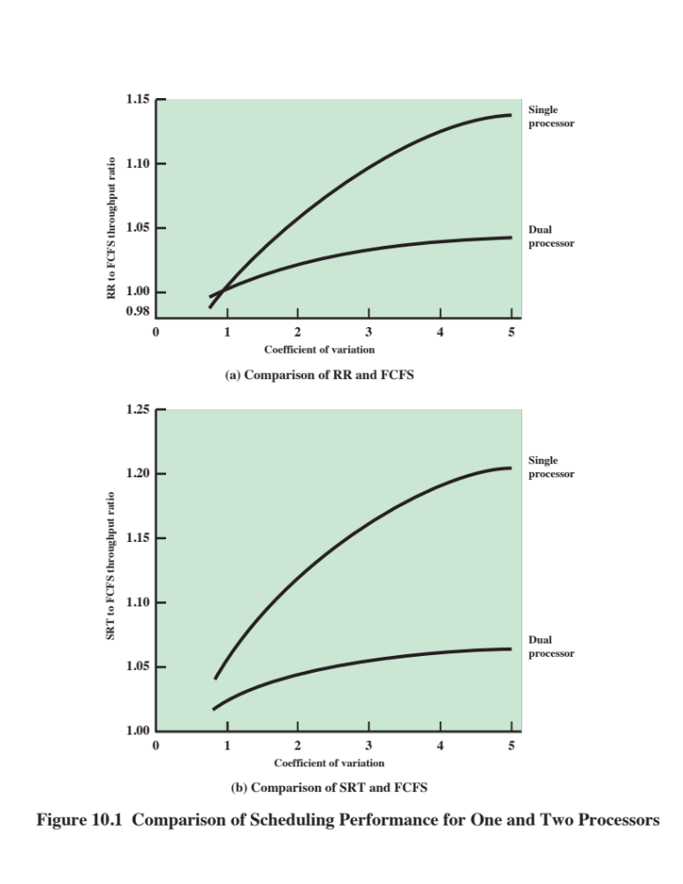
Notes:
Consider the case of a dual-processor system in which each processor of the
dual-processor system has half the processing rate of a processor in the single-processor
system. [SAUE81] reports a queuing analysis that compares FCFS scheduling to round
robin and to shortest remaining time. The study is concerned with process service time,
which measures the amount of processor time a process needs, either for a total job or
the amount of time needed each time the process is ready to use the processor. In the
case of round robin, it is assumed that the time quantum is large compared to context switching
overhead and small compared to mean service time. The results depend on
the variability that is seen in service times. A common measure of variability is the
coefficient of variation, C _{s} . A value of C_{s} = 0 corresponds to the case where there is
no variability: the service times of all processes are equal. Increasing values of C _{s} correspond
to increasing variability among the service times. That is, the larger the value of
C _{s} , the more widely do the values of the services times vary. Values of C _{s} of 5 or more
are not unusual for processor service time distributions.
Figure 10.1a compares round-robin throughput to FCFS throughput as a function
of C_{s}s. Note that the difference in scheduling algorithms is much smaller in the
dual-processor case. With two processors, a single process with long service time is
much less disruptive in the FCFS case; other processes can use the other processor.
Similar results are shown in Figure 10.1b .
The study in [SAUE81] repeated this analysis under a number of assumptions
about degree of multiprogramming, mix of I/O-bound versus CPU-bound processes,
and the use of priorities. The general conclusion is that the specific scheduling
discipline is much less important with two processors than with one. It should be
evident that this conclusion is even stronger as the number of processors increases.
Thus, a simple FCFS discipline or the use of FCFS within a static priority scheme
may suffice for a multiple-processor system.

Slide 15
Thread Scheduling
Thread execution is separated from the rest of the definition of a process
An application can be a set of threads that cooperate and execute concurrently in the same address space
On a uniprocessor, threads can be used as a program structuring aid and to overlap I/O with processing
In a multiprocessor system threads can be used to exploit true parallelism in an application
Dramatic gains in performance are possible in multi-processor systems
Small differences in thread management and scheduling can have an impact on applications that require significant interaction among threads
Notes:
As we have seen, with threads, the concept of execution is separated from the rest of
the definition of a process. An application can be implemented as a set of threads,
which cooperate and execute concurrently in the same address space.
On a uniprocessor, threads can be used as a program structuring aid and to
overlap I/O with processing. Because of the minimal penalty in doing a thread
switch compared to a process switch, these benefits are realized with little cost.
However, the full power of threads becomes evident in a multiprocessor system. In
this environment, threads can be used to exploit true parallelism in an application.
If the various threads of an application are simultaneously run on separate processors,
dramatic gains in performance are possible. However, it can be shown that
for applications that require significant interaction among threads (medium-grain
parallelism), small differences in thread management and scheduling can have a
significant performance impact [ANDE89].

Slide 16
Approaches to
Thread Scheduling
Four approaches for multiprocessor thread scheduling and processor assignment are:
Load Sharing
Gang Scheduling
Dedicated Processor Assignment
Dynamic Scheduling
      Processes are not assigned to a particular processor
      A set of related threads scheduled to run on a set of processors at the same time, on a one-to-one basis
Provides implicit scheduling defined by the assignment of threads to processors
      The number of threads in a process can be altered during the course of execution
Notes:
Among the many proposals for multiprocessor thread scheduling and processor
assignment, four general approaches stand out:
• Load sharing : Processes are not assigned to a particular processor. A global
queue of ready threads is maintained, and each processor, when idle, selects a
thread from the queue. The term load sharing is used to distinguish this strategy
from load-balancing schemes in which work is allocated on a more permanent
basis (e.g., see [FEIT90a]).
• Gang scheduling : A set of related threads is scheduled to run on a set of processors
at the same time, on a one-to-one basis.
• Dedicated processor assignment: This is the opposite of the load-sharing
approach and provides implicit scheduling defined by the assignment of
threads to processors. Each program, for the duration of its execution, is allocated
a number of processors equal to the number of threads in the program.
When the program terminates, the processors return to the general pool for
possible allocation to another program.
• Dynamic scheduling: The number of threads in a process can be altered during
the course of execution.

Slide 17
Load Sharing
Simplest approach and the one that carries over most directly from a uniprocessor environment
    Versions of load sharing:
    First-come-first-served (FCFS)
    Smallest number of threads first
    Preemptive smallest number of threads first
Advantages:
Load is distributed evenly across the processors, assuring that no processor is idle while work is available to do
No centralized scheduler required
The global queue can be organized and accessed using any of the schemes discussed in Chapter 9
Notes:
Load sharing is perhaps the simplest approach and the one that
carries over most directly from a uniprocessor environment. It has several advantages:
• The load is distributed evenly across the processors, assuring that no processor
is idle while work is available to do.
• No centralized scheduler is required; when a processor is available, the
scheduling routine of the operating system is run on that processor to select
the next thread.
The global queue can be organized and accessed using any of the schemes discussed
in Chapter 9 , including priority-based schemes and schemes that consider
execution history or anticipated processing demands.
[LEUT90] analyzes three different versions of load sharing:
• First-come-first-served (FCFS): When a job arrives, each of its threads is
placed consecutively at the end of the shared queue. When a processor becomes
idle, it picks the next ready thread, which it executes until completion
or blocking.
• Smallest number of threads first: The shared ready queue is organized as a priority
queue, with highest priority given to threads from jobs with the smallest
number of unscheduled threads. Jobs of equal priority are ordered according
to which job arrives first. As with FCFS, a scheduled thread is run to completion
or blocking.
• Preemptive smallest number of threads first: Highest priority is given to jobs
with the smallest number of unscheduled threads. An arriving job with a
smaller number of threads than an executing job will preempt threads belonging
to the scheduled job.

Slide 18
Disadvantages of
Load Sharing
Central queue occupies a region of memory that must be accessed in a manner that enforces mutual exclusion
    Can lead to bottlenecks
Preemptive threads are unlikely to resume execution on the same processor
    Caching can become less efficient
If all threads are treated as a common pool of threads, it is unlikely that all of the threads of a program will gain access to processors at the same time
    The process switches involved may seriously compromise performance
Notes:
Using simulation models, the authors report that, over a wide range of job characteristics,
FCFS is superior to the other two policies in the preceding list. Further, the
authors find that some form of gang scheduling, discussed in the next subsection, is
generally superior to load sharing.
There are several disadvantages of load sharing:
• The central queue occupies a region of memory that must be accessed in a
manner that enforces mutual exclusion. Thus, it may become a bottleneck if
many processors look for work at the same time. When there is only a small
number of processors, this is unlikely to be a noticeable problem. However,
when the multiprocessor consists of dozens or even hundreds of processors,
the potential for bottleneck is real.
• Preempted threads are unlikely to resume execution on the same processor. If
each processor is equipped with a local cache, caching becomes less efficient.
• If all threads are treated as a common pool of threads, it is unlikely that all of
the threads of a program will gain access to processors at the same time. If a
high degree of coordination is required between the threads of a program, the
process switches involved may seriously compromise performance.
Despite the potential disadvantages, load sharing is one of the most commonly
used schemes in current multiprocessors.
A refinement of the load-sharing technique is used in the Mach operating
system [BLAC90, WEND89]. The operating system maintains a local run queue
for each processor and a shared global run queue. The local run queue is used by
threads that have been temporarily bound to a specific processor. A processor
examines the local run queue first to give bound threads absolute preference over
unbound threads. As an example of the use of bound threads, one or more processors
could be dedicated to running processes that are part of the operating system.
Another example is that the threads of a particular application could be distributed
among a number of processors; with the proper additional software, this provides
support for gang scheduling, discussed next.

Slide 19
Gang Scheduling
Simultaneous scheduling of the threads that make up a single process
Useful for medium-grained to fine-grained parallel applications whose performance severely degrades when any part of the application is not running while other parts are ready to run
Also beneficial for any parallel application
Benefits:
Synchronization blocking may be reduced, less process switching may be necessary, and performance will increase
Scheduling overhead may be reduced
Notes:
The concept of scheduling a set of processes simultaneously
on a set of processors predates the use of threads. [JONE80] refers to the concept as
group scheduling and cites the following benefits:
• If processes in the group are related or coordinated in some fashion, synchronization
blocking may be reduced, less process switching may be necessary,
and performance will increase.
• A single scheduling decision affects a number of processors and processes at
one time, reducing scheduling overhead.
On the Cm * multiprocessor, the term coscheduling is used [GEHR87].
Coscheduling is based on the concept of scheduling a related set of tasks, called a
task force. The individual elements of a task force tend to be quite small and are
hence close to the idea of a thread.
The term gang scheduling has been applied to the simultaneous scheduling of
the threads that make up a single process [FEIT90b]. Gang scheduling is useful for
medium-grained to fine-grained parallel applications whose performance severely
degrades when any part of the application is not running while other parts are ready
to run. It is also beneficial for any parallel application, even one that is not quite
so performance sensitive. The need for gang scheduling is widely recognized, and
implementations exist on a variety of multiprocessor operating systems.
One obvious way in which gang scheduling improves the performance of a
single application is that process switches are minimized. Suppose one thread of a
process is executing and reaches a point at which it must synchronize with another
thread of the same process. If that other thread is not running, but is in a ready
queue, the first thread is hung up until a process switch can be done on some other
processor to bring in the needed thread. In an application with tight coordination
among threads, such switches will dramatically reduce performance. The simultaneous
scheduling of cooperating threads can also save time in resource allocation. For
example, multiple gang-scheduled threads can access a file without the additional
overhead of locking during a seek, read/write operation.

Slide 20
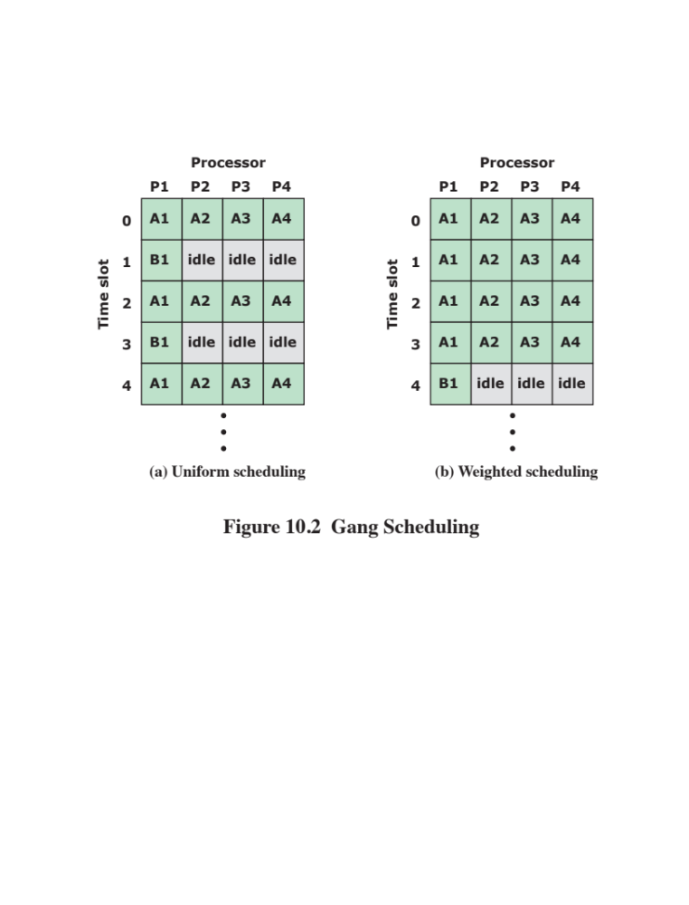

Notes:
The use of gang scheduling creates a requirement for processor allocation.
One possibility is the following. Suppose that we have N processors and M applications,
each of which has N or fewer threads. Then each application could be given
1/ M of the available time on the N processors, using time slicing. [FEIT90a] notes
that this strategy can be inefficient. Consider an example in which there are two
applications, one with four threads and one with one thread. Using uniform time
allocation wastes 37.5% of the processing resource, because when the single-thread
application runs, three processors are left idle (see Figure 10.2 ). If there are several
one-thread applications, these could all be fit together to increase processor utilization.
If that option is not available, an alternative to uniform scheduling is scheduling
that is weighted by the number of threads. Thus, the four-thread application
could be given four-fifths of the time and the one-thread application given only one-fifth
of the time, reducing the processor waste to 15%.

Slide 21
Dedicated Processor Assignment
When an application is scheduled, each of its threads is assigned to a processor that remains dedicated to that thread until the application runs to completion
If a thread of an application is blocked waiting for I/O or for synchronization with another thread, then that thread’s processor remains idle
    There is no multiprogramming of processors
Defense of this strategy:
    In a highly parallel system, with tens or hundreds of processors, processor utilization is no longer so important as a metric for effectiveness or performance
    The total avoidance of process switching during the lifetime of a program should result in a substantial speedup of that program
Notes:
An extreme form of gang scheduling,
suggested in [TUCK89], is to dedicate a group of processors to an application for
the duration of the application. That is, when an application is scheduled, each of
its threads is assigned a processor that remains dedicated to that thread until the
application runs to completion.
This approach would appear to be extremely wasteful of processor time. If
a thread of an application is blocked waiting for I/O or for synchronization with
another thread, then that thread’s processor remains idle: there is no multiprogramming
of processors. Two observations can be made in defense of this strategy:
1. In a highly parallel system, with tens or hundreds of processors, each of which
represents a small fraction of the cost of the system, processor utilization is no
longer so important as a metric for effectiveness or performance.
2. The total avoidance of process switching during the lifetime of a program
should result in a substantial speedup of that program.

Slide 22
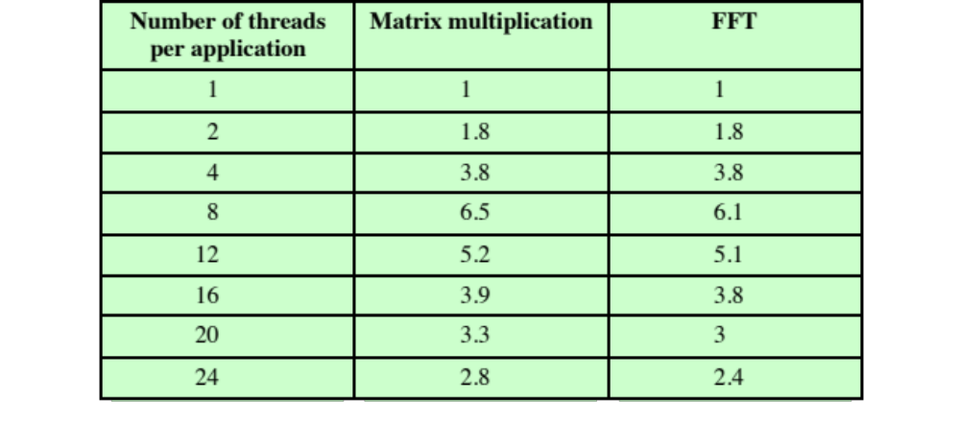
Table 10.2 Application Speedup as a Function of Number of Threads
Notes:
Both [TUCK89] and [ZAHO90] report analyses that support statement 2.
Table 10.2 shows the results of one experiment [TUCK89]. The authors ran two
applications simultaneously (executing concurrently), a matrix multiplication and a
fast Fourier transform (FFT) calculation, on a system with 16 processors. Each application
breaks its problem into a number of tasks, which are mapped onto the threads
executing that application. The programs are written in such a way as to allow the
number of threads to be used to vary. In essence, a number of tasks are defined
and queued by an application. Tasks are taken from the queue and mapped onto
the available threads by the application. If there are fewer threads than tasks, then
leftover tasks remain queued and are picked up by threads as they complete their
assigned tasks. Clearly, not all applications can be structured in this way, but many
numerical problems and some other applications can be dealt with in this fashion.
Table 10.2 shows the speedup for the applications as the number of threads
executing the tasks in each application is varied from 1 to 24. For example, we see
that when both applications are started simultaneously with 24 threads each, the
speedup obtained, compared to using a single thread for each application, is 2.8 for
matrix multiplication and 2.4 for FFT. The figure shows that the performance of
both applications worsens considerably when the number of threads in each application
exceeds eight and thus the total number of processes in the system exceeds the
number of processors. Furthermore, the larger the number of threads the worse the
performance gets, because there is a greater frequency of thread preemption and
rescheduling. This excessive preemption results in inefficiency from many sources,
including time spent waiting for a suspended thread to leave a critical section, time
wasted in process switching, and inefficient cache behavior.
The authors conclude that an effective strategy is to limit the number of active
threads to the number of processors in the system. If most of the applications are
either single thread or can use the task-queue structure, this will provide an effective
and reasonably efficient use of the processor resources.
Both dedicated processor assignment and gang scheduling attack the scheduling
problem by addressing the issue of processor allocation. One can observe that
the processor allocation problem on a multiprocessor more closely resembles the
memory allocation problem on a uniprocessor than the scheduling problem on a
uniprocessor. The issue is how many processors to assign to a program at any given
time, which is analogous to how many page frames to assign to a given process at
any time. [GEHR87] proposes the term activity working set , analogous to a virtual
memory working set, as the minimum number of activities (threads) that must be
scheduled simultaneously on processors for the application to make acceptable
progress. As with memory management schemes, the failure to schedule all of the
elements of an activity working set can lead to processor thrashing. This occurs when
the scheduling of threads whose services are required induces the descheduling of
other threads whose services will soon be needed. Similarly, processor fragmentation
refers to a situation in which some processors are left over when others are
allocated, and the leftover processors are either insufficient in number or unsuitably
organized to support the requirements of waiting applications. Gang scheduling and
dedicated processor allocation are meant to avoid these problems.

Slide 23
Dynamic Scheduling
For some applications it is possible to provide language and system tools that permit the number of threads in the process to be altered dynamically
    This would allow the operating system to adjust the load to improve utilization
Both the operating system and the application are involved in making scheduling decisions
    The scheduling responsibility of the operating system is primarily limited to processor allocation
    This approach is superior to gang scheduling or dedicated processor assignment for applications that can take advantage of it
Notes:
For some applications, it is possible to provide language
and system tools that permit the number of threads in the process to be altered
dynamically. This would allow the operating system to adjust the load to improve
utilization.
[ZAHO90] proposes an approach in which both the operating system and the
application are involved in making scheduling decisions. The operating system is
responsible for partitioning the processors among the jobs. Each job uses the processors
currently in its partition to execute some subset of its runnable tasks by mapping
these tasks to threads. An appropriate decision about which subset to run, as
well as which thread to suspend when a process is preempted, is left to the individual
applications (perhaps through a set of run-time library routines). This approach
may not be suitable for all applications. However, some applications could default
to a single thread while others could be programmed to take advantage of this particular
feature of the operating system.
In this approach, the scheduling responsibility of the operating system is primarily
limited to processor allocation and proceeds according to the following policy.
When a job requests one or more processors (either when the job arrives for the
first time or because its requirements change),
1. If there are idle processors, use them to satisfy the request.
2. Otherwise, if the job making the request is a new arrival, allocate it a single
processor by taking one away from any job currently allocated more than one
processor.
3. If any portion of the request cannot be satisfied, it remains outstanding until
either a processor becomes available for it or the job rescinds the request (e.g.,
if there is no longer a need for the extra processors).
Upon release of one or more processors (including job departure),
4. Scan the current queue of unsatisfied requests for processors. Assign a single
processor to each job in the list that currently has no processors (i.e., to all
waiting new arrivals). Then scan the list again, allocating the rest of the processors
on an FCFS basis.
Analyses reported in [ZAHO90] and [MAJU88] suggest that for applications
that can take advantage of dynamic scheduling, this approach is superior to
gang scheduling or dedicated processor assignment. However, the overhead of this
approach may negate this apparent performance advantage. Experience with actual
systems is needed to prove the worth of dynamic scheduling.

Slide 24
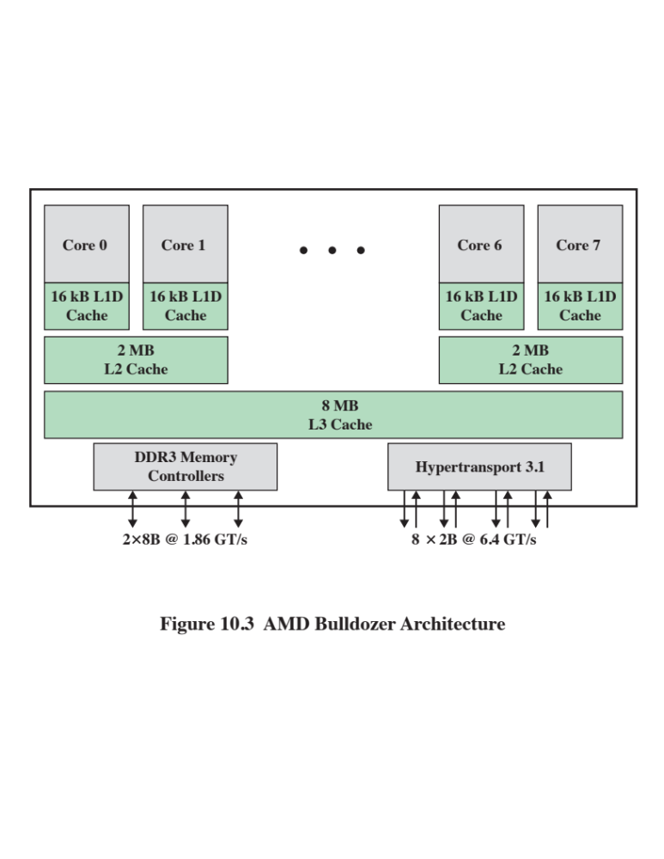
Notes:
The most widely used contemporary OSs, such as Windows and Linux, essentially
treat scheduling in multicore systems in the same fashion as a multiprocessor system.
Such schedulers tend to focus on keeping processors busy by load balancing so
that threads ready to run are evenly distributed among the processors. However, this
strategy is unlikely to produce the desired performance benefits of the multicore
architecture.
As the number of cores per chip increases, a need to minimize access to offchip
memory takes precedence over a desire to maximize processor utilization. The
traditional, and still principal, means of minimizing off-chip memory access is the
use of caches to take advantage of locality. This approach is complicated by some of
the cache architectures used on multicore chips, specifically when a cache is shared
by some but not all of the cores. A good example is the AMD Bulldozer chip, used
in the Operton FX-8000 system, illustrated in Figure 10.3. In this architecture, each
core has a dedicated L1 cache; each pair of cores share an L2 cache; and all cores
share an L3 cache. Compare this with the Intel Core i7-5960X (Figure 1.20), in which
both L1 and L2 caches are dedicated to a single core.
When some but not all cores share a cache, the way in which threads are allocated
to cores during scheduling has a significant effect on performance. Let us define
two cores that share the same L2 cache as adjacent, and otherwise nonadjacent. Thus,
cores 0 and 1 in Figure 10.3 are adjacent, but cores 1 and 2 are nonadjacent. Ideally, if
two threads are going to share memory resources, they should be assigned to adjacent
cores to improve the effects of locality, and if they do not share memory resources
they may be assigned to nonadjacent cores to achieve load balance.

Slide 25
Cache Sharing
Resource contention
Cooperative resource sharing
Threads, if operating on adjacent cores, compete for cache memory locations
If more of the cache is dynamically allocated to one thread, the competing thread necessarily has less cache space available and thus suffers performance degradation
Objective of contention-aware scheduling is to allocate threads to cores to maximize the effectiveness of the shared cache memory and minimize the need for off-chip memory accesses
Multiple threads access the same set of main memory locations
Examples:
  Applications that are multithreaded
  Producer-consumer thread interaction
Notes:
There are in fact two different aspects of cache sharing to take into account:
cooperative resource sharing and resource contention. With cooperative resource
sharing, multiple threads access the same set of main memory locations. Examples
are applications that are multithreaded and producer–consumer thread interaction.
In both these cases, data brought into a cache by one thread need to be accessed by
a cooperating thread. For this case, it is desirable to schedule cooperating threads on
adjacent cores.
The other case is when threads, if operating on adjacent cores, compete for
cache memory locations. Whatever technique is used for cache replacement, such
as least-recently-used (LRU), if more of the cache is dynamically allocated to one
thread, the competing thread necessarily has less cache space available and thus suffers
performance degradation. The objective of contention-aware scheduling is to
allocate threads to cores in such a way as to maximize the effectiveness of the shared
cache memory and therefore to minimize the need for off-chip memory accesses.
The design of algorithms for this purpose is an area of ongoing research and a subject
of some complexity. Accordingly, this area is beyond our scope; see [ZHUR12]
for a recent survey.

Slide 26
Real-Time Systems
The operating system, and in particular the scheduler, is perhaps the most important component
Correctness of the system depends not only on the logical result of the computation but also on the time at which the results are produced
Tasks or processes attempt to control or react to events that take place in the outside world
These events occur in “real time” and tasks must be able to keep up with them
Examples:
Control of laboratory experiments
Process control in industrial plants
Robotics
Air traffic control
Telecommunications
Military command and control systems
Notes:
Real-time computing is becoming an increasingly important discipline. The operating
system, and in particular the scheduler, is perhaps the most important component
of a real-time system. Examples of current applications of real-time systems
include control of laboratory experiments, process control in industrial plants,
robotics, air traffic control, telecommunications, and military command and control
systems. Next-generation systems will include the autonomous land rover,
controllers of robots with elastic joints, systems found in intelligent manufacturing,
the space station, and undersea exploration.
Real-time computing may be defined as that type of computing in which the
correctness of the system depends not only on the logical result of the computation
but also on the time at which the results are produced. We can define a real-time
system by defining what is meant by a real-time process, or task. In general, in a
real-time system, some of the tasks are real-time tasks, and these have a certain
degree of urgency to them. Such tasks are attempting to control or react to events
that take place in the outside world. Because these events occur in “real time,” a
real-time task must be able to keep up with the events with which it is concerned.

Slide 27
Hard and Soft
Real-Time Tasks
Hard real-time task
Soft real-time task
One that must meet its deadline
Otherwise it will cause unacceptable damage or a fatal error to the system
Has an associated deadline that is desirable but not mandatory
It still makes sense to schedule and complete the task even if it has passed its deadline
Notes:
Thus, it is usually possible to associate a deadline with a particular task, where
the deadline specifies either a start time or a completion time. Such a task may be
classified as hard or soft. A hard real-time task is one that must meet its deadline;
otherwise it will cause unacceptable damage or a fatal error to the system. A soft
real-time task has an associated deadline that is desirable but not mandatory; it still
makes sense to schedule and complete the task even if it has passed its deadline.

Slide 28
Periodic and Aperiodic
Tasks
Periodic tasks
  Requirement may be stated as:
    Once per period T
    Exactly T units apart
Aperiodic tasks
  Has a deadline by which it must finish or start
  May have a constraint on both start and finish time
Notes:
Another characteristic of real-time tasks is whether they are periodic or aperiodic.
An aperiodic task has a deadline by which it must finish or start, or it may have
a constraint on both start and finish time. In the case of a periodic task , the requirement
may be stated as “once per period T ” or “exactly T units apart.”

Slide 29
Characteristics of
Real Time Systems
Real-time operating systems have requirements in five general areas:
Determinism
Responsiveness
User control
Reliability
Fail-soft operation
Notes:
Real-time operating systems can be characterized as having unique requirements in
five general areas [MORG92]:
• Determinism
• Responsiveness
• User control
• Reliability
• Fail-soft operation

Slide 30
Determinism
Concerned with how long an operating system delays before acknowledging an interrupt
Operations are performed at fixed, predetermined times or within predetermined time intervals
    When multiple processes are competing for resources and processor time, no system will be fully deterministic
The extent to which an operating system can deterministically satisfy requests depends on:
The speed with which it can respond to interrupts
Whether the system has sufficient capacity to handle all requests within the required time
Notes:
An operating system is deterministic to the extent that it performs operations
at fixed, predetermined times or within predetermined time intervals. When multiple
processes are competing for resources and processor time, no system will be
fully deterministic. In a real-time operating system, process requests for service are
dictated by external events and timings. The extent to which an operating system
can deterministically satisfy requests depends first on the speed with which it can
respond to interrupts and, second, on whether the system has sufficient capacity to
handle all requests within the required time.
One useful measure of the ability of an operating system to function deterministically
is the maximum delay from the arrival of a high-priority device interrupt to when
servicing begins. In non-real-time operating systems, this delay may be in the range of
tens to hundreds of milliseconds, while in real-time operating systems that delay may
have an upper bound of anywhere from a few microseconds to a millisecond.

Slide 31
Responsiveness
Together with determinism make up the response time to external events
    Critical for real-time systems that must meet timing requirements imposed by individuals, devices, and data flows external to the system
Concerned with how long, after acknowledgment, it takes an operating system to service the interrupt
Responsiveness includes:
Amount of time required to initially handle the interrupt and begin execution of the interrupt service routine (ISR)
Amount of time required to perform the ISR
Effect of interrupt nesting
Notes:
A related but distinct characteristic is responsiveness . Determinism is concerned
with how long an operating system delays before acknowledging an interrupt.
Responsiveness is concerned with how long, after acknowledgment, it takes an operating
system to service the interrupt. Aspects of responsiveness include the following:
1. The amount of time required to initially handle the interrupt and begin execution
of the interrupt service routine (ISR). If execution of the ISR requires a
process switch, then the delay will be longer than if the ISR can be executed
within the context of the current process.
2. The amount of time required to perform the ISR. This generally is dependent
on the hardware platform.
3. The effect of interrupt nesting. If an ISR can be interrupted by the arrival of
another interrupt, then the service will be delayed.
Determinism and responsiveness together make up the response time to external
events. Response time requirements are critical for real-time systems, because such
systems must meet timing requirements imposed by individuals, devices, and data
flows external to the system.

Slide 32
User Control
Generally much broader in a real-time operating system than in ordinary operating systems
It is essential to allow the user fine-grained control over task priority
User should be able to distinguish between hard and soft tasks and to specify relative priorities within each class
May allow user to specify such characteristics as:
Paging or process swapping
What processes must always be resident in main memory
What disk transfer algorithms are to be used
What rights the processes in various priority bands have
Notes:
User control is generally much broader in a real-time operating system than
in ordinary operating systems. In a typical non-real-time operating system, the user
either has no control over the scheduling function of the operating system or can
only provide broad guidance, such as grouping users into more than one priority
class. In a real-time system, however, it is essential to allow the user fine-grained
control over task priority. The user should be able to distinguish between hard and
soft tasks and to specify relative priorities within each class. A real-time system may
also allow the user to specify such characteristics as the use of paging or process
swapping, what processes must always be resident in main memory, what disk transfer
algorithms are to be used, what rights the processes in various priority bands
have, and so on.

Slide 33
Reliability
More important for real-time systems than non-real time systems
Real-time systems respond to and control events in real time so loss or degradation of performance may have catastrophic consequences such as:
    Financial loss
    Major equipment damage
    Loss of life
Notes:
Reliability is typically far more important for real-time systems than non-realtime
systems. A transient failure in a non-real-time system may be solved by simply
rebooting the system. A processor failure in a multiprocessor non-real-time system
may result in a reduced level of service until the failed processor is repaired or
replaced. But a real-time system is responding to and controlling events in real time.
Loss or degradation of performance may have catastrophic consequences, ranging
from financial loss to major equipment damage and even loss of life.

Slide 34
Fail-Soft Operation
A characteristic that refers to the ability of a system to fail in such a way as to preserve as much capability and data as possible
Important aspect is stability
    A real-time system is stable if the system will meet the deadlines of its most critical, highest-priority tasks even if some less critical task deadlines are not always met
    The following features are common to most real-time OSs
        A stricter use of priorities than in an ordinary OS, with preemptive scheduling that is designed to meet real-time requirements
        Interrupt latency is bounded and relatively short
        More precise and predictable timing characteristics than general purpose OSs
Notes:
As in other areas the difference between a real-time and a non-real-time operating
system is one of degree. Even a real-time system must be designed to respond
to various failure modes. Fail-soft operation is a characteristic that refers to the
ability of a system to fail in such a way as to preserve as much capability and data as
possible. For example, a typical traditional UNIX system, when it detects a corruption
of data within the kernel, issues a failure message on the system console, dumps
the memory contents to disk for later failure analysis, and terminates execution of
the system. In contrast, a real-time system will attempt either to correct the problem
or minimize its effects while continuing to run. Typically, the system notifies a user
or user process that it should attempt corrective action and then continues operation
perhaps at a reduced level of service. In the event a shutdown is necessary, an
attempt is made to maintain file and data consistency.
An important aspect of fail-soft operation is referred to as stability. A real-time
system is stable if, in cases where it is impossible to meet all task deadlines,
the system will meet the deadlines of its most critical, highest-priority tasks, even if
some less critical task deadlines are not always met.
Although there is a wide variety of real-time OS designs to meet the wide variety
of real-time applications, the following features are common to most real-time
OSs:
• A stricter use of priorities than in an ordinary OS, with preemptive scheduling
that is designed to meet real-time requirements
• Interrupt latency (the amount of time between when a device generates an
interrupt and when that device is serviced) is bounded and relatively short
• More precise and predictable timing characteristics than general purpose OSs
The heart of a real-time system is the short-term task scheduler. In designing
such a scheduler, fairness and minimizing average response time are not paramount.
What is important is that all hard real-time tasks complete (or start) by their
deadline and that as many as possible soft real-time tasks also complete (or start)
by their deadline.
Most contemporary real-time operating systems are unable to deal directly
with deadlines. Instead, they are designed to be as responsive as possible to real-time
tasks so that, when a deadline approaches, a task can be quickly scheduled. From
this point of view, real-time applications typically require deterministic response
times in the several-millisecond to submillisecond span under a broad set of conditions;
leading-edge applications—in simulators for military aircraft, for example—
often have constraints in the range of 10–100 μs [ATLA89].

Slide 35
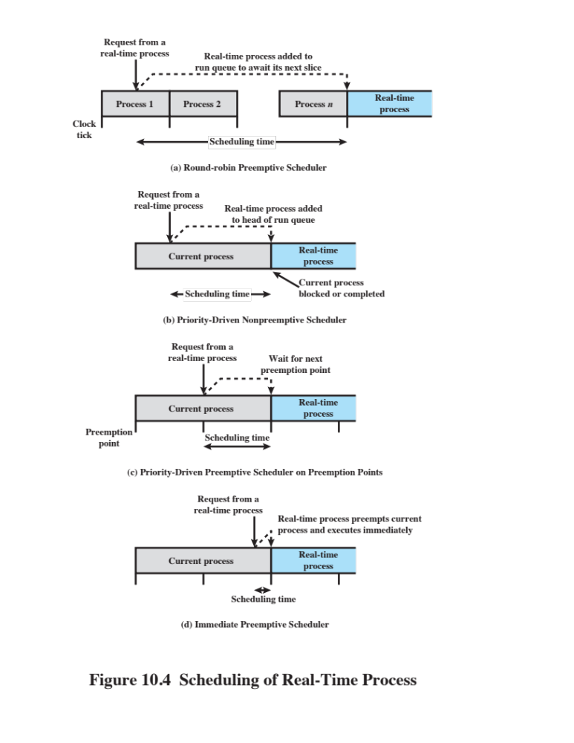
Notes:
Figure 10.4 illustrates a spectrum of possibilities. In a preemptive scheduler that
uses simple round-robin scheduling, a real-time task would be added to the ready
queue to await its next time slice, as illustrated in Figure 10.4a . In this case, the scheduling
time will generally be unacceptable for real-time applications. Alternatively,
in a nonpreemptive scheduler, we could use a priority scheduling mechanism, giving
real-time tasks higher priority. In this case, a real-time task that is ready would
be scheduled as soon as the current process blocks or runs to completion ( Figure
10.4b ). This could lead to a delay of several seconds if a slow, low-priority task were
executing at a critical time. Again, this approach is not acceptable. A more promising
approach is to combine priorities with clock-based interrupts. Preemption points
occur at regular intervals. When a preemption point occurs, the currently running
task is preempted if a higher-priority task is waiting. This would include the preemption
of tasks that are part of the operating system kernel. Such a delay may be on the
order of several milliseconds ( Figure 10.4c ). While this last approach may be adequate
for some real-time applications, it will not suffice for more demanding applications.
In those cases, the approach that has been taken is sometimes referred to as
immediate preemption. In this case, the operating system responds to an interrupt
almost immediately, unless the system is in a critical-code lockout section. Scheduling
delays for a real-time task can then be reduced to 100 μs or less.

Slide 36
Real-Time Scheduling
Scheduling approaches depend on:
Whether a system performs schedulability analysis
If it does, whether it is done statically or dynamically
Whether the result of the analysis itself produces a scheduler plan according to which tasks are dispatched at run time
Notes:
Real-time scheduling is one of the most active areas of research in computer science.
In this subsection, we provide an overview of the various approaches to real-time
scheduling and look at two popular classes of scheduling algorithms.
In a survey of real-time scheduling algorithms, [RAMA94] observes that the
various scheduling approaches depend on (1) whether a system performs schedulability
analysis, (2) if it does, whether it is done statically or dynamically, and
(3) whether the result of the analysis itself produces a schedule or plan according to
which tasks are dispatched at run time.

Slide 37
Classes of Real-Time Scheduling Algorithms
Static table-driven approaches
Performs a static analysis of feasible schedules of dispatching
Result is a schedule that determines, at run time, when a task must begin execution
Static priority-driven preemptive approaches
A static analysis is performed but no schedule is drawn up
Analysis is used to assign priorities to tasks so that a traditional priority-driven preemptive scheduler can be used
Dynamic planning-based approaches
Feasibility is determined at run time rather than offline prior to the start of execution
One result of the analysis is a schedule or plan that is used to decide when to dispatch this task
Dynamic best effort approaches
No feasibility analysis is performed
System tries to meet all deadlines and aborts any started process whose deadline is missed
Notes:
Based on these considerations, the authors
identify the following classes of algorithms:
• Static table-driven approaches: These perform a static analysis of feasible
schedules of dispatching. The result of the analysis is a schedule that determines,
at run time, when a task must begin execution.
• Static priority-driven preemptive approaches: Again, a static analysis is performed,
but no schedule is drawn up. Rather, the analysis is used to assign
priorities to tasks, so that a traditional priority-driven preemptive scheduler
can be used.
• Dynamic planning-based approaches: Feasibility is determined at run time
(dynamically) rather than offline prior to the start of execution (statically).
An arriving task is accepted for execution only if it is feasible to meet its time
constraints. One of the results of the feasibility analysis is a schedule or plan
that is used to decide when to dispatch this task.
• Dynamic best effort approaches: No feasibility analysis is performed. The system
tries to meet all deadlines and aborts any started process whose deadline
is missed.
Static table-driven scheduling is applicable to tasks that are periodic. Input
to the analysis consists of the periodic arrival time, execution time, periodic ending
deadline, and relative priority of each task. The scheduler attempts to develop
a schedule that enables it to meet the requirements of all periodic tasks. This is
a predictable approach but one that is inflexible, because any change to any task
requirements requires that the schedule be redone. Earliest-deadline-first or other
periodic deadline techniques (discussed subsequently) are typical of this category of
scheduling algorithms.
Static priority-driven preemptive scheduling makes use of the priority-driven
preemptive scheduling mechanism common to most non-real-time multiprogramming
systems. In a non-real-time system, a variety of factors might be used to
determine priority. For example, in a time-sharing system, the priority of a process
changes depending on whether it is processor bound or I/O bound. In a real-time
system, priority assignment is related to the time constraints associated with each
task. One example of this approach is the rate monotonic algorithm (discussed
subsequently), which assigns static priorities to tasks based on the length of their
periods.
With dynamic planning-based scheduling , after a task arrives, but before its
execution begins, an attempt is made to create a schedule that contains the previously
scheduled tasks as well as the new arrival. If the new arrival can be scheduled
in such a way that its deadlines are satisfied and that no currently scheduled task
misses a deadline, then the schedule is revised to accommodate the new task.
Dynamic best effort scheduling is the approach used by many real-time systems
that are currently commercially available. When a task arrives, the system
assigns a priority based on the characteristics of the task. Some form of deadline
scheduling, such as earliest-deadline scheduling, is typically used. Typically, the
tasks are aperiodic and so no static scheduling analysis is possible. With this type
of scheduling, until a deadline arrives or until the task completes, we do not know
whether a timing constraint will be met. This is the major disadvantage of this form
of scheduling. Its advantage is that it is easy to implement.

Slide 38
Scheduling Algorithms
Static table-driven scheduling
Applicable to tasks that are periodic
This is a predictable approach but one that is inflexible because any change to any task requirements requires that the schedule be redone
Static priority-driven preemptive scheduling
Makes use of the priority-driven preemptive scheduling mechanism common to most non-real-time multiprogramming systems
Input to the analysis consists of the periodic arrival time, execution time, periodic ending deadline, and relative priority of each task
Earliest-deadline-first or other periodic deadline techniques are typical of this category of scheduling algorithms
In a non-real-time system, a variety of factors might be used to determine priority
In a real-time system, priority assignment is related to the time constraints associated with each task
One example of this approach is the rate monotonic algorithm which assigns static priorities to tasks based on the length of their periods
Notes:
Static table-driven scheduling is applicable to tasks that are periodic. Input
to the analysis consists of the periodic arrival time, execution time, periodic ending
deadline, and relative priority of each task. The scheduler attempts to develop
a schedule that enables it to meet the requirements of all periodic tasks. This is
a predictable approach but one that is inflexible, because any change to any task
requirements requires that the schedule be redone. Earliest-deadline-first or other
periodic deadline techniques (discussed subsequently) are typical of this category of
scheduling algorithms.
Static priority-driven preemptive scheduling makes use of the priority-driven
preemptive scheduling mechanism common to most non-real-time multiprogramming
systems. In a non-real-time system, a variety of factors might be used to
determine priority. For example, in a time-sharing system, the priority of a process
changes depending on whether it is processor bound or I/O bound. In a real-time
system, priority assignment is related to the time constraints associated with each
task. One example of this approach is the rate monotonic algorithm (discussed
subsequently), which assigns static priorities to tasks based on the length of their
periods.

Slide 39
Scheduling Algorithms
Dynamic planning-based scheduling
After a task arrives, but before its execution begins, an attempt is made to create a schedule that contains the previously scheduled tasks as well as the new arrival
Dynamic best effort scheduling
The approach used by many real-time systems that are currently commercially available
If the new arrival can be scheduled in such a way that its deadlines are satisfied and that no currently scheduled task misses a deadline, then the schedule is revised to accommodate the new task
When a task arrives, the system assigns a priority based on the characteristics of the task
Some form of deadline scheduling is typically used
Typically the tasks are aperiodic so no static scheduling analysis is possible
The major disadvantage of this form of scheduling is, that until a deadline arrives or until the task completes, we do not know whether a timing constraint will be met
Its advantage is that it is easy to implement
Notes:
With dynamic planning-based scheduling , after a task arrives, but before its
execution begins, an attempt is made to create a schedule that contains the previously
scheduled tasks as well as the new arrival. If the new arrival can be scheduled
in such a way that its deadlines are satisfied and that no currently scheduled task
misses a deadline, then the schedule is revised to accommodate the new task.
Dynamic best effort scheduling is the approach used by many real-time systems
that are currently commercially available. When a task arrives, the system
assigns a priority based on the characteristics of the task. Some form of deadline
scheduling, such as earliest-deadline scheduling, is typically used. Typically, the
tasks are aperiodic and so no static scheduling analysis is possible. With this type
of scheduling, until a deadline arrives or until the task completes, we do not know
whether a timing constraint will be met. This is the major disadvantage of this form
of scheduling. Its advantage is that it is easy to implement.

Slide 40
Deadline Scheduling
Real-time operating systems are designed with the objective of starting real-time tasks as rapidly as possible and emphasize rapid interrupt handling and task dispatching
Real-time applications are generally not concerned with sheer speed but rather with completing (or starting) tasks at the most valuable times
Priorities provide a crude tool and do not capture the requirement of completion (or initiation) at the most valuable time
Notes:
Most contemporary real-time operating systems are designed with the objective of
starting real-time tasks as rapidly as possible, and hence emphasize rapid interrupt
handling and task dispatching. In fact, this is not a particularly useful metric in evaluating
real-time operating systems. Real-time applications are generally not concerned
with sheer speed but rather with completing (or starting) tasks at the most
valuable times, neither too early nor too late, despite dynamic resource demands
and conflicts, processing overloads, and hardware or software faults. It follows that
priorities provide a crude tool and do not capture the requirement of completion
(or initiation) at the most valuable time.

Slide 41
Information Used for
Deadline Scheduling
Ready time
Time task becomes ready for execution
Starting deadline
Time task must begin
Completion deadline
Time task must be completed
Processing time
Time required to execute the task to completion
Resource requirements
Resources required by the task while it is executing
Priority
Measures relative importance of the task
Subtask scheduler
A task may be decomposed into a mandatory subtask and an optional subtask
Notes:
There have been a number of proposals for more powerful and appropriate
approaches to real-time task scheduling. All of these are based on having additional
information about each task. In its most general form, the following information
about each task might be used:
• Ready time: Time at which task becomes ready for execution. In the case of a
repetitive or periodic task, this is actually a sequence of times that is known in
advance. In the case of an aperiodic task, this time may be known in advance,
or the operating system may only be aware when the task is actually ready.
• Starting deadline: Time by which a task must begin.
• Completion deadline: Time by which a task must be completed. The typical
real-time application will either have starting deadlines or completion deadlines,
but not both.
• Processing time: Time required to execute the task to completion. In some
cases, this is supplied. In others, the operating system measures an exponential
average (as defined in Chapter 9 ). For still other scheduling systems, this
information is not used.
• Resource requirements: Set of resources (other than the processor) required
by the task while it is executing.
• Priority: Measures relative importance of the task. Hard real-time tasks may
have an “absolute” priority, with the system failing if a deadline is missed. If
the system is to continue to run no matter what, then both hard and soft realtime
tasks may be assigned relative priorities as a guide to the scheduler.
• Subtask structure: A task may be decomposed into a mandatory subtask and
an optional subtask. Only the mandatory subtask possesses a hard deadline.
There are several dimensions to the real-time scheduling function when deadlines
are taken into account: which task to schedule next, and what sort of preemption
is allowed. It can be shown, for a given preemption strategy and using either
starting or completion deadlines, that a policy of scheduling the task with the earliest
deadline minimizes the fraction of tasks that miss their deadlines [BUTT99,
HONG89, PANW88]. This conclusion holds both for single-processor and multiprocessor
configurations.

Slide 42
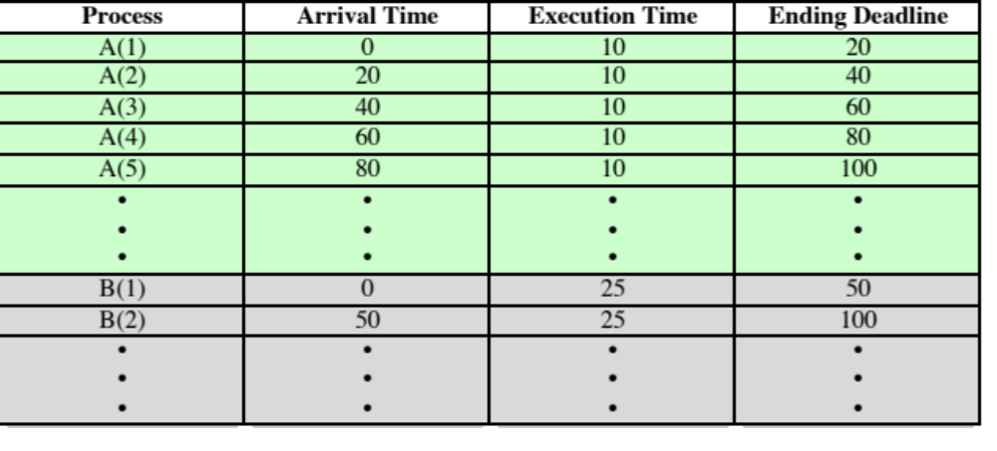
Table 10.3
Execution Profile of Two Periodic Tasks
Notes:
The other critical design issue is that of preemption. When starting deadlines
are specified, then a nonpreemptive scheduler makes sense. In this case, it would be
the responsibility of the real-time task to block itself after completing the mandatory
or critical portion of its execution, allowing other real-time starting deadlines
to be satisfied. This fits the pattern of Figure 10.4b . For a system with completion
deadlines, a preemptive strategy ( Figure 10.4c or 10.4d) is most appropriate. For
example, if task X is running and task Y is ready, there may be circumstances in
which the only way to allow both X and Y to meet their completion deadlines is to
preempt X, execute Y to completion, and then resume X to completion.
As an example of scheduling periodic tasks with completion deadlines, consider
a system that collects and processes data from two sensors, A and B. The deadline for
collecting data from sensor A must be met every 20 ms, and that for B every 50 ms.
It takes 10 ms, including operating system overhead, to process each sample of data
from A and 25 ms to process each sample of data from B. Table 10.3 summarizes the
execution profile of the two tasks.

Slide 43
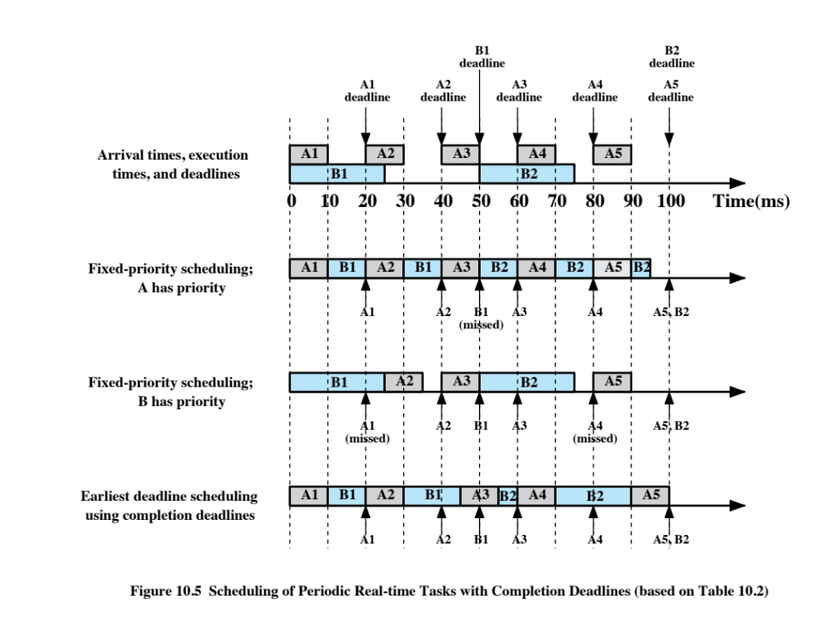
10.3)
Notes:
Figure 10.5 compares three scheduling techniques
using the execution profile of Table 10.3 . The first row of Figure 10.5 repeats the information
in Table 10.3 ; the remaining three rows illustrate three scheduling techniques.
The computer is capable of making a scheduling decision every 10 ms. Suppose
that, under these circumstances, we attempted to use a priority scheduling scheme.
The first two timing diagrams in Figure 10.5 show the result. If A has higher priority,
the first instance of task B is only given 20 ms of processing time, in two 10-ms
chunks, by the time its deadline is reached, and thus fails. If B is given higher priority,
then A will miss its first deadline. The final timing diagram shows the use of earliest-
deadline scheduling. At time t = 0 , both A1 and B1 arrive. Because A1 has the
earliest deadline, it is scheduled first. When A1 completes, B1 is given the processor.
At t = 20 , A2 arrives. Because A2 has an earlier deadline than B1, B1 is interrupted
so that A2 can execute to completion. Then B1 is resumed at t = 30 . At t = 40 , A3
arrives. However, B1 has an earlier ending deadline and is allowed to execute to
completion at t = 45 . A3 is then given the processor and finishes at t = 55 .
In this example, by scheduling to give priority at any preemption point to the
task with the nearest deadline, all system requirements can be met. Because the
tasks are periodic and predictable, a static table-driven scheduling approach is used.

Slide 44
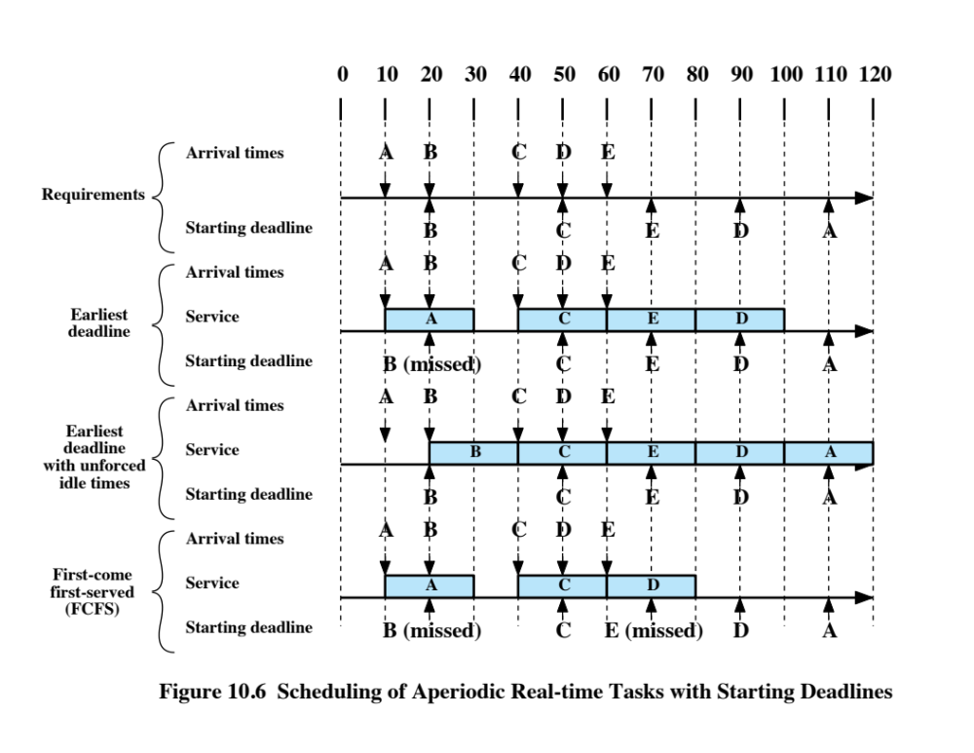
Notes:
Now consider a scheme for dealing with aperiodic tasks with starting deadlines.
The top part of Figure 10.6 shows the arrival times and starting deadlines for
an example consisting of five tasks each of which has an execution time of 20 ms.

Slide 45
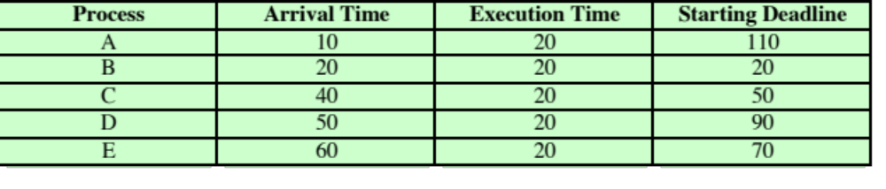
Table 10.4
Execution Profile of Five Aperiodic Tasks
Notes:
Table 10.4 summarizes the execution profile of the five tasks.
A straightforward scheme is to always schedule the ready task with the earliest
deadline and let that task run to completion. When this approach is used in the
example of Figure 10.6 , note that although task B requires immediate service, the
service is denied. This is the risk in dealing with aperiodic tasks, especially with
starting deadlines. A refinement of the policy will improve performance if deadlines
can be known in advance of the time that a task is ready. This policy, referred to as
earliest deadline with unforced idle times, operates as follows: Always schedule the
eligible task with the earliest deadline and let that task run to completion. An eligible
task may not be ready, and this may result in the processor remaining idle even
though there are ready tasks. Note that in our example the system refrains from
scheduling task A even though that is the only ready task. The result is that, even
though the processor is not used to maximum efficiency, all scheduling requirements
are met. Finally, for comparison, the FCFS policy is shown. In this case, tasks
B and E do not meet their deadlines.

Slide 46
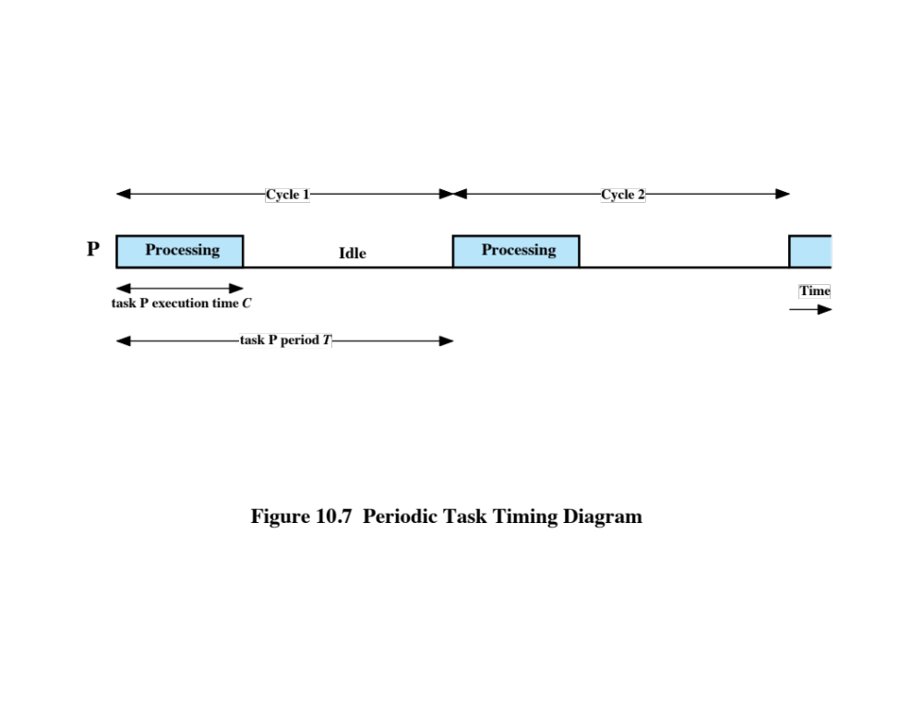
Notes:
One of the more promising methods of resolving multitask scheduling conflicts for
periodic tasks is rate monotonic scheduling (RMS) [LIU73, BRIA99, SHA94]. RMS
assigns priorities to tasks on the basis of their periods.
For RMS, the highest-priority task is the one with the shortest period, the
second highest-priority task is the one with the second shortest period, and so on.
When more than one task is available for execution, the one with the shortest period
is serviced first. If we plot the priority of tasks as a function of their rate, the result is
a monotonically increasing function, hence the name, “rate monotonic
scheduling.”
Figure 10.7 illustrates the relevant parameters for periodic tasks. The task’s
period, T , is the amount of time between the arrival of one instance of the task
and the arrival of the next instance of the task. A task’s rate (in hertz) is simply
the inverse of its period (in seconds). For example, a task with a period of 50 ms
occurs at a rate of 20 Hz. Typically, the end of a task’s period is also the task’s hard
deadline, although some tasks may have earlier deadlines. The execution (or computation)
time, C , is the amount of processing time required for each occurrence of
the task. It should be clear that in a uniprocessor system, the execution time must
be no greater than the period (must have C < T ). If a periodic task is always run to
completion, that is, if no instance of the task is ever denied service because of insufficient
resources, then the utilization of the processor by this task is U = C/T . For
example, if a task has a period of 80 ms and an execution time of 55 ms, its processor
utilization is 55/80 = 0.6875 .

Slide 47
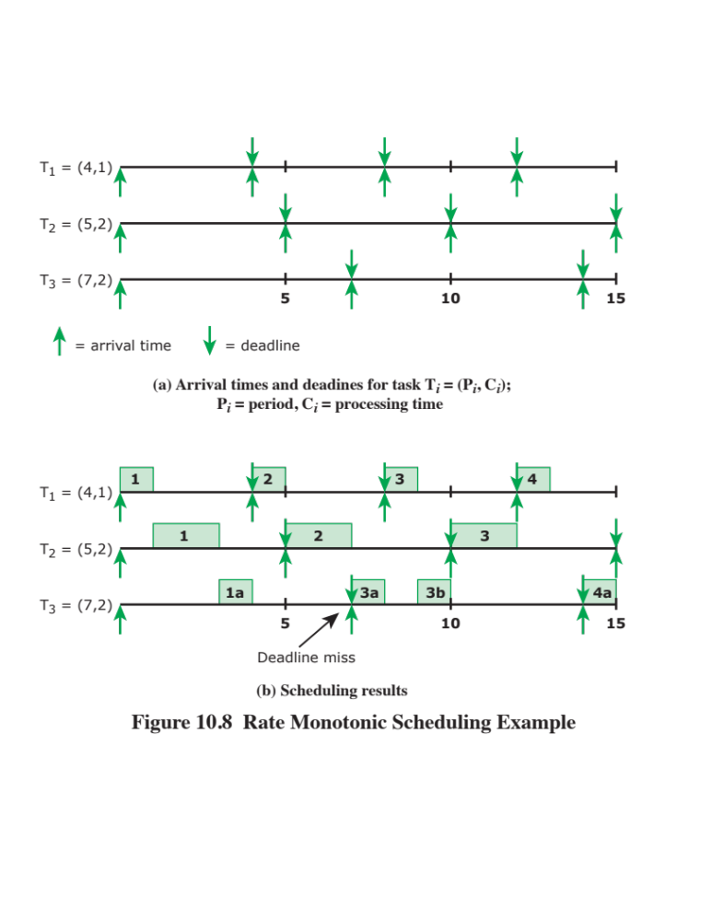
Notes:
Figure 10.8 is a simple example of RMS. Task instances are
numbered sequentially with in tasks. As can be seen, for task 3, the second instance
is not executed because the deadline is missed. The third instance experiences a
preemption but is still able to complete before the deadline.

Slide 48
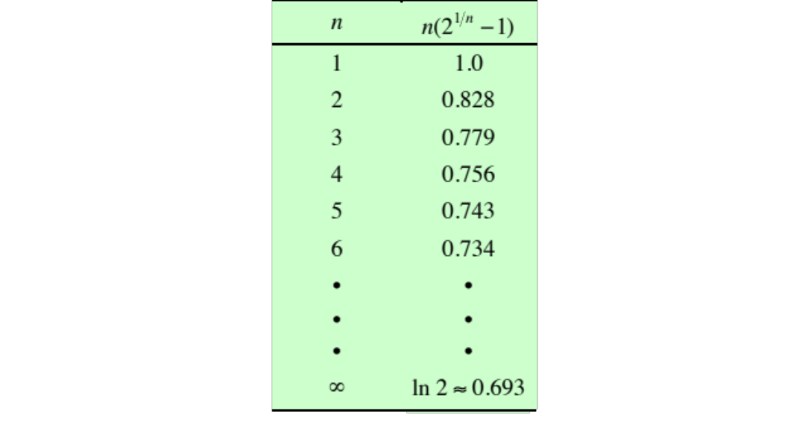
Table 10.5
Value of the RMS Upper Bound
Notes:
One measure of the effectiveness of a periodic scheduling algorithm is whether
or not it guarantees that all hard deadlines are met.
The sum of the processor utilizations of the individual tasks cannot exceed a value of
1, which corresponds to total utilization of the processor. Equation ( 10.1 ) – page 457 in textbook -- provides
a bound on the number of tasks that a perfect scheduling algorithm can successfully
schedule. For any particular algorithm, the bound may be lower.
Table 10.5 gives some values for this upper bound. As the number of tasks increases,
the scheduling bound converges to ln 2 ≈ 0.693 .
It can also be shown that the upper bound of Equation (10.1) holds for earliestdeadline
scheduling. Thus, it is possible to achieve greater overall processor utilization
and therefore accommodate more periodic tasks with earliest-deadline scheduling.
Nevertheless, RMS has been widely adopted for use in industrial applications.

Slide 49
Priority Inversion
Can occur in any priority-based preemptive scheduling scheme
Particularly relevant in the context of real-time scheduling
Best-known instance involved the Mars Pathfinder mission
Occurs when circumstances within the system force a higher priority task to wait for a lower priority task
Unbounded Priority Inversion
The duration of a priority inversion depends not only on the time required to handle a shared resource, but also on the unpredictable actions of other unrelated tasks
Notes:
Priority inversion is a phenomenon that can occur in any priority-based preemptive
scheduling scheme but is particularly relevant in the context of real-time scheduling.
The best-known instance of priority inversion involved the Mars Pathfinder
mission. This rover robot landed on Mars on July 4, 1997 and began gathering and
transmitting voluminous data back to Earth. But a few days into the mission, the
lander software began experiencing total system resets, each resulting in losses of
data. After much effort by the Jet Propulsion Laboratory (JPL) team that built the
Pathfinder, the problem was traced to priority inversion [JONE97].
In any priority scheduling scheme, the system should always be executing the
task with the highest priority. Priority inversion occurs when circumstances within
the system force a higher-priority task to wait for a lower-priority task. A simple
example of priority inversion occurs if a lower-priority task has locked a resource
(such as a device or a binary semaphore) and a higher-priority task attempts to lock
that same resource. The higher-priority task will be put in a blocked state until the
resource is available. If the lower-priority task soon finishes with the resource and
releases it, the higher-priority task may quickly resume and it is possible that no
real-time constraints are violated.
A more serious condition is referred to as an unbounded priority inversion , in
which the duration of a priority inversion depends not only on the time required to
handle a shared resource, but also on the unpredictable actions of other unrelated
tasks. The priority inversion experienced in the Pathfinder software was unbounded
and serves as a good example of the phenomenon.

Slide 50
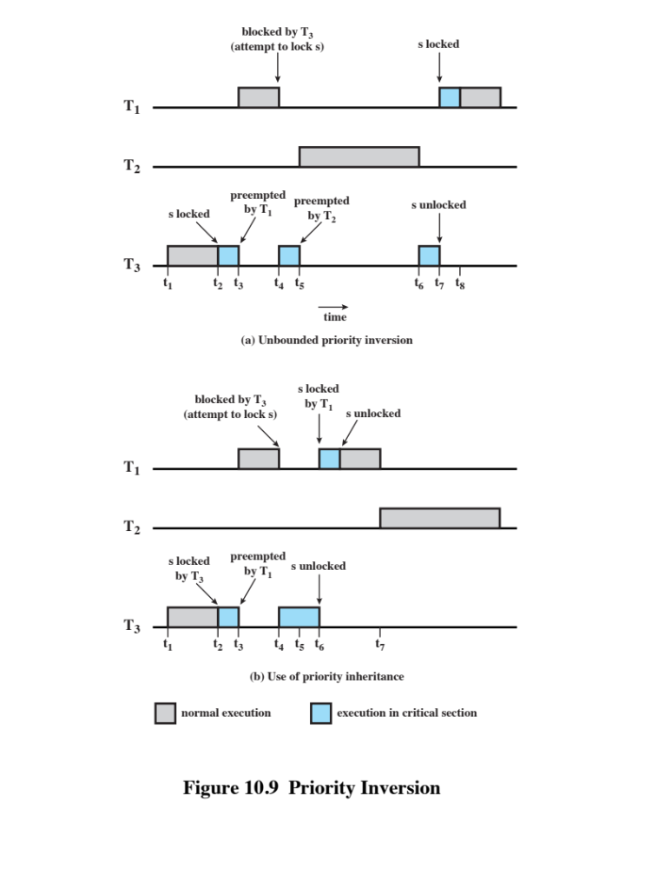
Unbounded Priority Inversion
Notes:
The Pathfinder software included the following three tasks, in decreasing
order of priority:
T ₁ : Periodically checks the health of the spacecraft systems and software
T ₂ : Processes image data
T ₃ : Performs an occasional test on equipment status
After T ₁ executes, it reinitializes a timer to its maximum value. If this timer
ever expires, it is assumed that the integrity of the lander software has somehow
been compromised. The processor is halted, all devices are reset, the software is
completely reloaded, the spacecraft systems are tested, and the system starts over.
This recovery sequence does not complete until the next day. T ₁ and T ₃ share a
common data structure, protected by a binary semaphore s .
Figure 10.9a shows the
sequence that caused the priority inversion:
t ₁ : T ₃ begins executing.
t ₂ : T ₃ locks semaphore s and enters its critical section.
t ₃ : T ₁ , which has a higher priority than T ₃ , preempts T ₃ and begins executing.
t ₄ : T ₁ attempts to enter its critical section but is blocked because the semaphore
is locked by T ₃ ; T ₃ resumes execution in its critical section.
t ₅ : T ₂ , which has a higher priority than T ₃ , preempts T ₃ and begins executing.
t ₆ : T ₂ is suspended for some reason unrelated to T ₁ and T ₃ ; T ₃ resumes.
t ₇ : T ₃ leaves its critical section and unlocks the semaphore. T ₁ preempts T ₃ ,
locks the semaphore and enters its critical section.
In this set of circumstances, T ₁ must wait for both T ₃ and T ₂ to complete and fails to
reset the timer before it expires.
In practical systems, two alternative approaches are used to avoid unbounded
priority inversion: priority inheritance protocol and priority ceiling protocol.

Slide 51
Priority Inheritance
Notes:
The basic idea of priority inheritance is that a lower-priority task inherits
the priority of any higher-priority task pending on a resource they share. This
priority change takes place as soon as the higher-priority task blocks on the
resource; it should end when the resource is released by the lower-priority task.
Figure 10.9b shows that priority inheritance resolves the problem of unbounded
priority inversion illustrated in Figure 10.9a .
The relevant sequence of events is as follows:
t ₁ : T ₃ begins executing.
t ₂ : T ₃ locks semaphore s and enters its critical section.
t ₃ : T ₁ , which has a higher priority than T ₃ , preempts T ₃ and begins executing.
t ₄ : T ₁ attempts to enter its critical section but is blocked because the semaphore
is locked by T ₃ . T ₃ is immediately and temporarily assigned the same
priority as T ₁ . T ₃ resumes execution in its critical section.
t ₅ : T ₂ is ready to execute but, because T ₃ now has a higher priority, T ₂ is unable
to preempt T ₃ .
t ₆ : T ₃ leaves its critical section and unlocks the semaphore: its priority level is
downgraded to its previous default level. T ₁ preempts T ₃ , locks the semaphore,
and enters its critical section.
t ₇ : T ₁ is suspended for some reason unrelated to T ₂ , and T ₂ begins executing.
This was the approach taken to solving the Pathfinder problem.
In the priority ceiling approach, a priority is associated with each resource.
The priority assigned to a resource is one level higher than the priority of its highest priority
user. The scheduler then dynamically assigns this priority to any task that
accesses the resource. Once the task finishes with the resource, its priority returns
to normal.

Slide 52
Linux Scheduling
The three primary Linux scheduling classes are:
  SCHED_FIFO: First-in-first-out real-time threads
  SCHED_RR: Round-robin real-time threads
  SCHED_NORMAL: Other, non-real-time threads
Within each class multiple priorities may be used, with priorities in the real-time classes higher than the priorities for the SCHED_NORMAL class
Notes:
For Linux 2.4 and earlier, Linux provided a real-time scheduling capability
coupled with a scheduler for non-real-time processes that made use of the traditional
UNIX scheduling algorithm described in Section 9.3 . Linux 2.6 includes
essentially the same real-time scheduling capability as previous releases and a substantially
revised scheduler for non-real-time processes. We examine these two
areas in turn.
The three Linux scheduling classes are
• SCHED_FIFO: First-in-first-out real-time threads
• SCHED_RR: Round-robin real-time threads
• SCHED_ NORMAL: Other, non-real-time threads (was called SCHED_OTHER in
older kernels).
Within each class, multiple priorities may be used, with priorities in the real-time
classes higher than the priorities for the SCHED_NORMAL class. The default values are as
follows: Real-time priority classes range from 0 to 99 inclusively, and SCHED_NORMAL
classes range from 100 to 139. A lower number equals a higher priority.

Slide 53
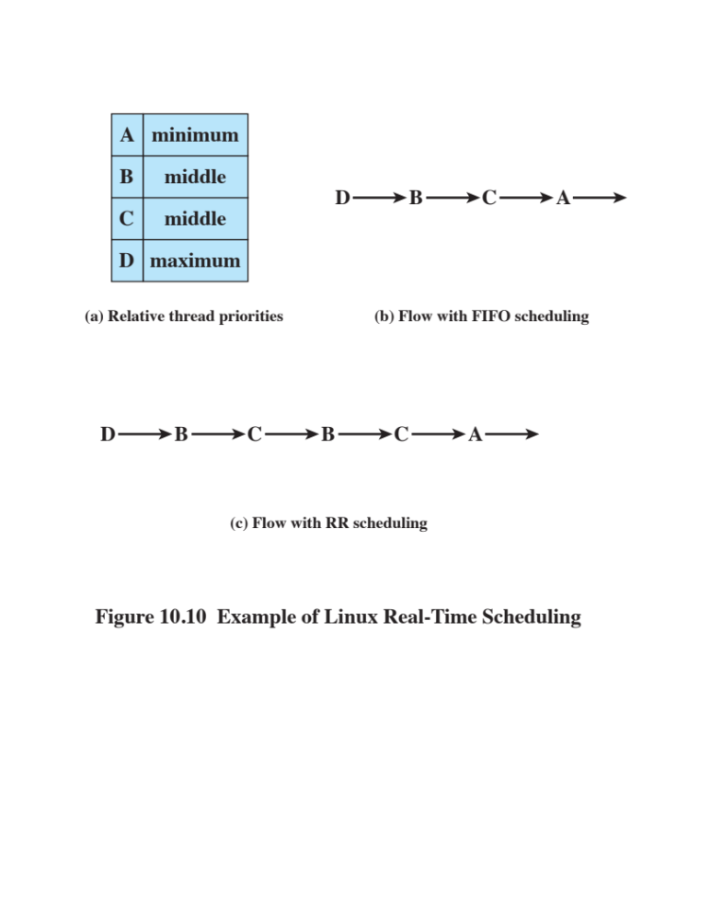
Notes:
Figure 10.10 is an example that illustrates the distinction between FIFO and RR
scheduling. Assume a process has four threads with three relative priorities assigned
as shown in Figure 10.10a . Assume that all waiting sthreads are ready to execute
when the current thread waits or terminates and that no higher-priority thread is
awakened while a thread is executing. Figure 10.10b shows a flow in which all of the
threads are in the SCHED_FIFO class. Thread D executes until it waits or terminates.
Next, although threads B and C have the same priority, thread B starts because it has
been waiting longer than thread C. Thread B executes until it waits or terminates,
then thread C executes until it waits or terminates. Finally, thread A executes.
Figure 10.10c shows a sample flow if all of the threads are in the SCHED_RR
class. Thread D executes until it waits or terminates. Next, threads B and C are time
sliced, because they both have the same priority. Finally, thread A executes.
The final scheduling class is SCHED_NORMAL . A thread in this class can only
execute if there are no real-time threads ready to execute.

Slide 54
Non-Real-Time Scheduling
The Linux 2.4 scheduler for the SCHED_OTHER class did not scale well with increasing number of processors and increasing number of processes
The drawbacks of this scheduler include:
    The Linux 2.4 scheduler uses a single runqueue for all processors in a symmetric multiprocessing system (SMP)
        This means a task can be scheduled on any processor, which can be good for load balancing but bad for memory caches
    The Linux 2.4 scheduler uses a single runqueue lock
        Thus, in an SMP system, the act of choosing a task to execute locks out any other processor from manipulating the runqueues, resulting in idle processors awaiting release of the runqueue lock and decreased efficiency
    Preemption is not possible in the Linux 2.4 scheduler
        This means that a lower-priority task can execute while a higher-priority task waited for it to complete
Notes:
The Linux 2.4 scheduler for the SCHED_OTHER (now called SCHED_NORMAL)
class did not scale well with increasing
number of processors and increasing number of processes. The drawbacks of
this scheduler include the following:
• The Linux 2.4 scheduler uses a single runqueue for all processors in a symmetric
multiprocessing system (SMP). This means a task can be scheduled on any
processor, which can be good for load balancing but bad for memory caches.
For example, suppose a task executed on CPU-1, and its data were in that processor’s
cache. If the task got rescheduled to CPU-2, its data would need to be
invalidated in CPU-1 and brought into CPU-2.
• The Linux 2.4 scheduler uses a single runqueue lock. Thus, in an SMP system,
the act of choosing a task to execute locks out any other processor from
manipulating the runqueues. The result is idle processors awaiting release of
the runqueue lock and decreased efficiency.
• Preemption is not possible in the Linux 2.4 scheduler; this means that a lower priority
task can execute while a higher-priority task waited for it to complete.
To correct these problems, Linux 2.6 uses a completely new priority scheduler
known as the O(1) scheduler. The scheduler is designed so that the time to select
the appropriate process and assign it to a processor is constant, regardless of the
load on the system or the number of processors. However, the O(1) scheduler proved to be
unwieldy in the kernel. The amount of code is large and the algorithms are
complex.

Slide 55
Non-Real-Time Scheduling
Linux 2.6 uses a completely new priority scheduler known as the O(1) scheduler
  The scheduler is designed so the time to select the appropriate process and assign it to a processor is constant regardless of the load on the system or number of processors
The O(1) scheduler proved to be unwieldy in the kernel because the amount of code is large and the algorithms are complex
Notes:
To correct these problems, Linux 2.6 uses a completely new priority scheduler
known as the O(1) scheduler. The scheduler is designed so the time to select the
appropriate process and assign it to a processor is constant, regardless of the load on
the system or the number of processors. However, the O(1) scheduler proved to be
unwieldy in the kernel. The amount of code is large and the algorithms are
complex.

Slide 56
Completely Fair Scheduler (CFS)
Used as a result of the drawbacks of the O(1) scheduler
Models an ideal multitasking CPU on real hardware that provides fair access to all tasks
In order to achieve this goal, the CFS maintains a virtual runtime for each task
    The virtual runtime is the amount of time spent executing so far, normalized by the number of runnable processes
    The smaller a task’s virtual runtime is, the higher is its need for the processor
Includes the concept of sleeper fairness to ensure that tasks that are not currently runnable receive a comparable share of the processor when they eventually need it
Implemented by the fair_sched_class scheduler class
Notes:
As a result of the drawbacks of the O(1) scheduler, from Linux 2.6.23, a new
scheduler, called the Completely Fair Scheduler (CFS), is being used [PABL04].
The CFS models an ideal multitasking CPU on real hardware that provides fair
access to all tasks. In order to achieve this goal, the CFS maintains a virtual runtime
value for each task. The virtual runtime is the amount of time spent executing so
far, normalized by the number of runnable processes. The smaller a task’s virtual
runtime is (i.e., the smaller the amount of time a task has been permitted access to
the processor), the higher is its need for the processor. The CFS also includes the
concept of sleeper fairness to ensure that tasks that are not currently runnable (e.g.,
waiting for I/O) receive a comparable share of the processor when they eventually
need it.
The CFS scheduler is implemented by the fair_sched_class scheduler class.

Slide 57
Red Black Tree
The CFS scheduler is based on using a Red Black tree, as opposed to other schedulers, which are typically based on run queues
This scheme provides high efficiency in inserting, deleting, and searching tasks, due to its O(log N) complexity
A Red Black tree is a type of self-balancing binary search tree that obeys the following rules:
A node is either red or black
The root is black
All leaves (NIL) are black
If a node is red, then both its children are black
Every path from a given node to any of its descendant NIL nodes contains the same number of black nodes
Notes:
It is based on using a Red Black tree, as opposed to other schedulers, which are typically
based on run queues. A Red Black tree is a type of self-balancing binary search tree
that obeys the following rules:
1. A node is either red or black.
2. The root is black.
3. All leaves (NIL) are black.
4. If a node is red, then both its children are black.
5. Every path from a given node to any of its descendant NIL nodes contains the
same number of black nodes.
This scheme provides high efficiency in inserting, deleting, and searching tasks,
due to its O(log N) complexity.

Slide 58
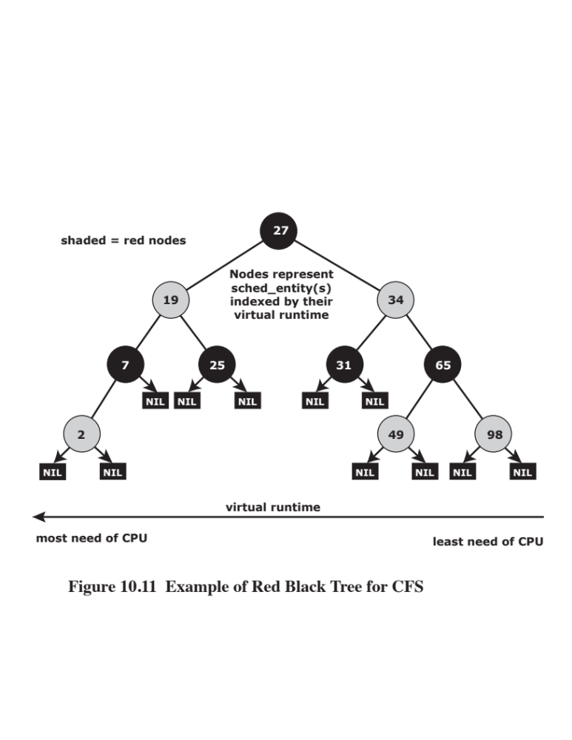
Notes:
Figure 10.11 illustrates a Red Black Tree. The Linux RB tree contaivruntimens information
about runnable processes. The rb_node elements of the tree are embedded in
sched_entity object. The Red Black tree is ordered by vruntime , where the leftmost
node of the tree represents the process that has the lowest , and that has the
highest need for CPU; this node is the first one to be picked by the CPU, and when it
runs, its vruntime is updated according to the time it consumed; so when it is inserted
back into the tree, very likely it will no longer be the one with the lowest vruntime ,
and the tree will be rebalanced to reflect the current state. And this process of rebalancing
will continue with the next process to be picked by the CFS scheduler, and so
on. In this way, the CFS manages a fair scheduling policy.
While an insert operation is being performed in RB tree, the leftmost child
value is cached in sched_entity for fast lookup.
In Kernel 2.6.24, a new feature called CFS group scheduling was introduced.
This feature allows the kernel to schedule a group of tasks as if they were a single
task. Group scheduling is designed to provide fairness when a task spawns many
other tasks.

Slide 59
UNIX SVR4 Scheduling
A complete overhaul of the scheduling algorithm used in earlier UNIX systems
  Major modifications:
      Addition of a preemptable static priority scheduler and the introduction of a set of 160 priority levels divided into three priority classes
      Insertion of preemption points
The new algorithm is designed to give:
Lowest preference to other user-mode processes
Next-highest preference to kernel-mode processes
Highest preference to real-time processes
Notes:
The scheduling algorithm used in UNIX SVR4 is a complete overhaul of the scheduling
algorithm used in earlier UNIX systems (described in Section 9.3 ). The new
algorithm is designed to give highest preference to real-time processes, next-highest
preference to kernel-mode processes, and lowest preference to other user-mode
processes, referred to as time-shared processes.
The two major modifications implemented in SVR4 are as follows:
1. The addition of a preemptable static priority scheduler and the introduction of
a set of 160 priority levels divided into three priority classes.
2. The insertion of preemption points. Because the basic kernel is not preemptive,
it can only be split into processing steps that must run to completion
without interruption. In between the processing steps, safe places known as
preemption points have been identified where the kernel can safely interrupt
processing and schedule a new process. A safe place is defined as a region
of code where all kernel data structures are either updated and consistent or
locked via a semaphore.

Slide 60
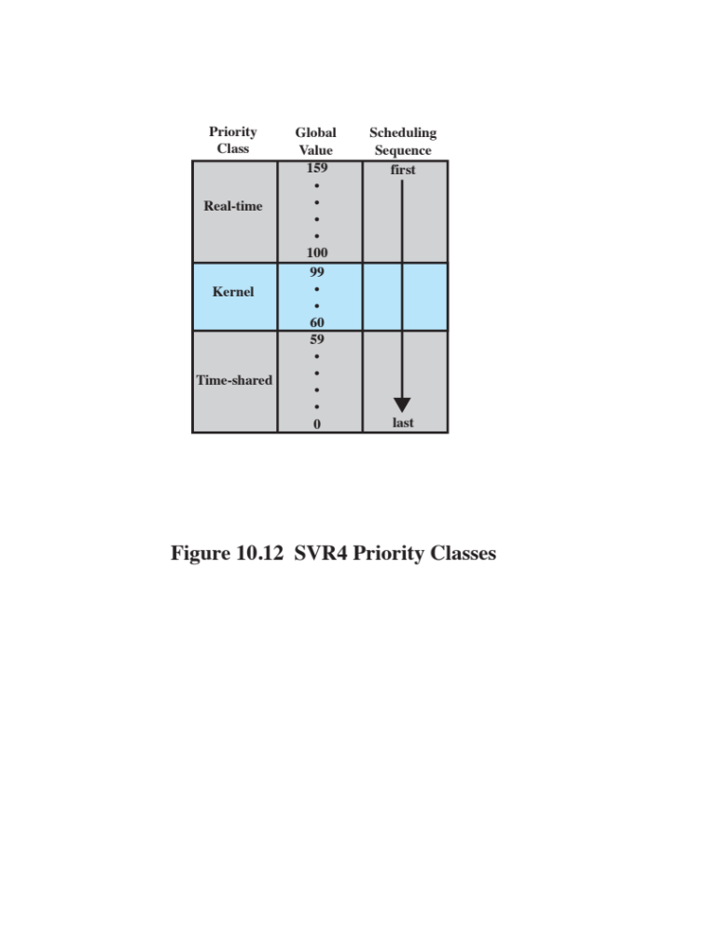
Figure 10.12 SVR4 Dispatch Queues
Notes:
Figure 10.12 illustrates the 160 priority levels defined in SVR4. Each process
is defined to belong to one of three priority classes and is assigned a priority level
within that class.

Slide 61
SVR Priority Classes
Real time
(159 – 100)
Guaranteed to be selected to run before any kernel or time-sharing process
Can make use of preemption points to preempt kernel processes and user processes
Kernel
(99 – 60)
Guaranteed to be selected to run before any time-sharing process, but must defer to real-time processes
Time-shared
(59-0)
Lowest-priority processes, intended for user applications other than real-time applications
Notes:
The classes are as follows:
Real time (159-100): Processes at these priority levels are guaranteed to be
selected to run before any kernel or time-sharing process. In addition, real-time
processes can make use of preemption points to preempt kernel processes and
user processes.
• Kernel (99-60): Processes at these priority levels are guaranteed to be selected
to run before any time-sharing process but must defer to real-time processes.
• Time-shared (59-0): The lowest-priority processes, intended for user applications
other than real-time applications.

Slide 62
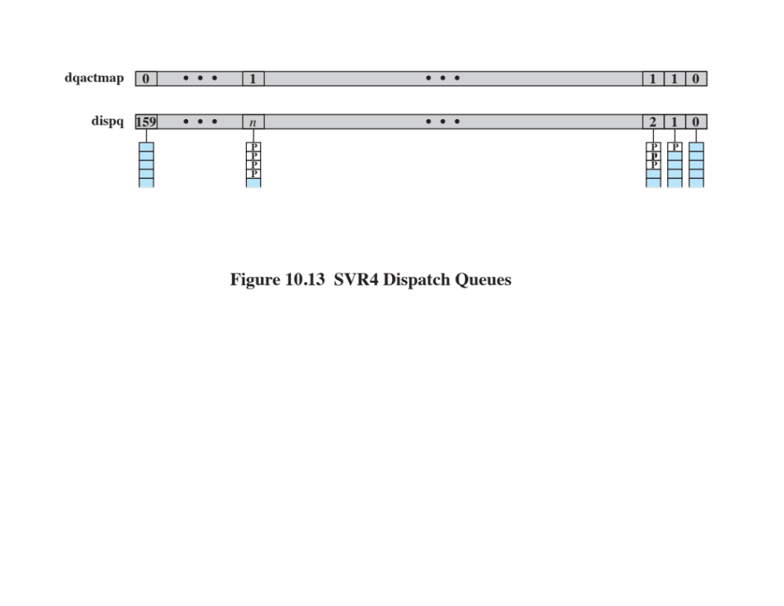
Figure 10.13 SVR Priority Classes
Notes:
Figure 10.13 indicates how scheduling is implemented in SVR4. A dispatch
queue is associated with each priority level, and processes at a given priority level
are executed in round-robin fashion. A bit-map vector, dqactmap , contains one bit
for each priority level; the bit is set to one for any priority level with a nonempty
queue. Whenever a running process leaves the Running state, due to a block, timeslice
expiration, or preemption, the dispatcher checks dqactmap and dispatches a
ready process from the highest-priority nonempty queue. In addition, whenever a
defined preemption point is reached, the kernel checks a flag called kprunrun . If
set, this indicates that at least one real-time process is in the Ready state, and the
kernel preempts the current process if it is of lower priority than the highest-priority
real-time ready process.
Within the time-sharing class, the priority of a process is variable. The scheduler
reduces the priority of a process each time it uses up a time quantum, and it raises its
priority if it blocks on an event or resource. The time quantum allocated to a timesharing
process depends on its priority, ranging from 100 ms for priority 0 to 10 ms
for priority 59. Each real-time process has a fixed priority and a fixed time quantum.

Slide 63
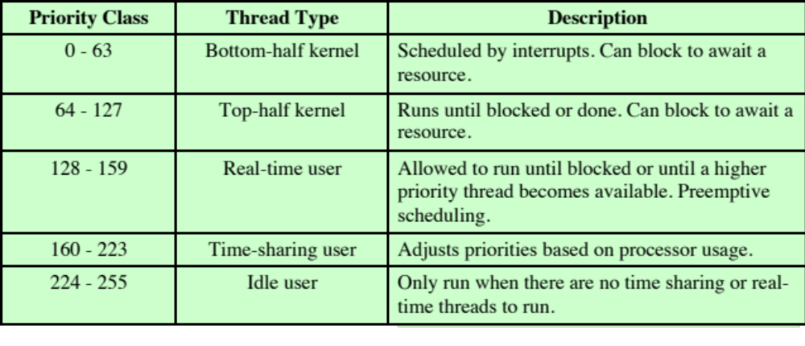
Table 10.6
FreeBSD Thread Scheduling Classes
Note: Lower number corresponds to higher priority
Notes:
The UNIX FreeBSD scheduler is designed to provide a more efficient operation
than previous UNIX schedulers under heavy load and when used on a multiprocessor
or multicore platform. The scheduler is quite complex and here we present on
overview of the most significant design features; for more detail, see [MCKU15]
and [ROBE03].
The underlying priority mechanism in the FreeBSD scheduler is similar to that
of UNIX SVR4. For FreeBSD, five priority classes are defined (see Table 10.6 ); the
first two classes are for kernel-mode threads and the remaining classes for user-mode
threads. Kernel threads execute code that is complied into the kernel’s load image
and operate with the kernel’s privileged execution code.
The highest-priority threads are referred to as bottom-half kernel. Threads in
this class run in the kernel are scheduled based on interrupt priorities. These priorities
are set when the corresponding devices are configured and do not change.
Top-half kernel threads also run in the kernel and execute various kernel functions.
These priorities are set based on predefined priorities and never change.
The next lower priority class is referred to as real-time user. A thread with a
real-time priority is not subject to priority degradation. That is, a real-time thread
maintains the priority it began with and does not drop to a lower priority as a result
of using resources. Next comes the time-sharing user priority class. For threads in
this class, priority is periodically recalculated based on a number of parameters,
including the amount of processor time used, the amount of memory resources
held, and other resource consumption parameters. The lowest range of priorities is
referred to as the idle user class. This class is intended for applications that will only
consume processor time when no other threads are ready to execute.

Slide 64
SMP and Multicore Support
FreeBSD scheduler was designed to provide effective scheduling for a SMP or multicore system
Design goals:
  Address the need for processor affinity in SMP and multicore systems
      Processor affinity – a scheduler that only migrates a thread when necessary to avoid having an idle processor
  Provide better support for multithreading on multicore systems
  Improve the performance of the scheduling algorithm so that it is no longer a function of the number of threads in the system
Notes:
The latest version of the FreeBSD scheduler, introduced with FreeBSD 5.0, was
designed to provide effective scheduling for a SMP or multicore system. The new
scheduler meets three design goals:
• Address the need for processor affinity in SMP and multicore systems. The term
processor affinity refers to a scheduler that only migrates a thread (moves thread
from one processor to another) when necessary to avoid having an idle processor.
• Provide better support for multithreading on multicore systems.
• Improve the performance of the scheduling algorithm, so that it is no longer a
function of the number of threads in the system.
In this subsection, we look at three key features of the new scheduler: queue
structure, interactivity scoring, and thread migration.

Slide 65
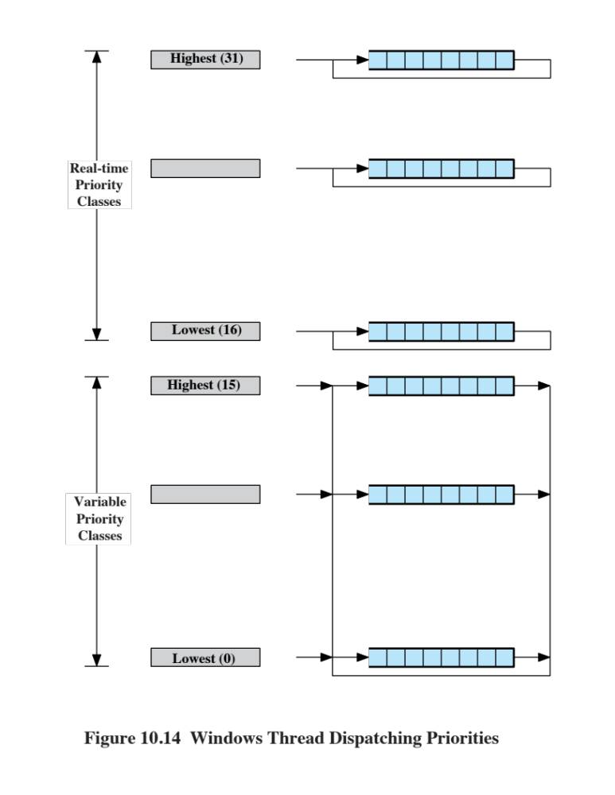
Notes:
The previous version of the FreeBSD schedule used a single
global scheduling queue for all processors that it traverses once per second to
recalculate their priorities. The use of a single list for all threads means that the
performance of the scheduler is dependent on the number of tasks in the system, and
as the number of tasks grows, more processor time must be spent in the scheduler
maintaining the list.
The new scheduler performs scheduling independently for each processor. For
each processor, three queues are maintained. Each of the queues has the structure
shown in Figure 10.14 for SVR4. Two runqueues implement the kernel, real-time,
and time-sharing scheduling classes (priorities 0 through 223). The third queue is
only for the idle class (priorities 224 through 255).
The two runqueues are designated current and next. Every thread that is
granted a timeslice (place in the Ready state) is placed in either the current queue
or the next queue, as explained subsequently, at the appropriate priority for that
thread. The scheduler for a processor selects threads from the current queue in priority
order until the current queue is empty. When the current queue is empty, the
scheduler swaps the current and next queue and begins to schedule threads from the
new current queue. The use of two runqueues guarantees that each thread will be
granted processor time at least once every two queue switches regardless of priority,
avoiding starvation.
Several rules determine the assignment of a thread to either the current queue
or the next queue:
1. Kernel and real-time threads are always inserted onto the current queue.
2. A time-sharing thread is assigned to the current queue if it is interactive (explained
in the next subsection) or to the next queue otherwise. Inserting interactive
threads onto the current queue results in a low interactive response time
for such threads, compared to other time-sharing threads that do not exhibit a
high degree of interactivity.

Slide 66
Interactivity Scoring
A thread is considered to be interactive if the ratio of its voluntary sleep time versus its runtime is below a certain threshold
Interactivity threshold is defined in the scheduler code and is not configurable
Threads whose sleep time exceeds their run time score in the lower half of the range of interactivity scores
Threads whose run time exceeds their sleep time score in the upper half of the range of interactivity scores
Notes:
A thread is considered to be interactive if the ratio of its
voluntary sleep time versus its runtime is below a certain threshold. Interactive threads
typically have high sleep times as they wait for user input. These sleep intervals are
followed by bursts of processor activity as the thread processes the user’s request.
The interactivity threshold is defined in the scheduler code and is not configurable.
The scheduler uses two equations to compute the interactivity score of a
thread.
The result is that threads whose sleep time exceeds their run time score in the
lower half of the range of interactivity scores, and threads whose run time exceeds
their sleep time score in the upper half of the range.

Slide 67
Thread Migration
Processor affinity is when a Ready thread is scheduled onto the last processor that it ran on
    Significant because of local caches dedicated to a single processor
FreeBSD scheduler supports two mechanisms for thread migration to balance load:
Pull Mechanism
An idle processor steals a thread from a nonidle processor
Primarily useful when there is a light or sporadic load or in situations where processes are starting and exiting very frequently
Push Mechanism
A periodic scheduler task evaluates the current load situation and evens it out
Ensures fairness among the runnable threads
Notes:
In general, it is desirable to schedule a Ready thread onto the
last processor that it ran on; this is called processor affinity . The alternative is to allow
a thread to migrate to another processor for its next execution time slice. Processor
affinity is significant because of local caches dedicated to a single processor. When
a thread is run, it may still have data in the cache of its last processor. Changing to
another processor means that the necessary data must be loaded into caches in the
new processor and cache lines from the preceding processor must be invalidated.
On the other hand, processor migration may allow a better load balancing and may
prevent idle periods on some processors while other processor have more work
than they can handle in a timely fashion.
The FreeBSD scheduler supports two mechanisms for thread migration to balance
load: pull and push. With the pull mechanism , and idle processor steals a thread
from a nonidle processor. When a processor has no work to do, it sets a bit in a global
bit-mask indicating that it is idle. When an active processor is about to add work to
its own run queue, it first checks for such idle bits and if a set idle bit is found, passes
the thread to the idle processor. It is primarily useful when there is a light or sporadic
load, or in situations where processes are starting and exiting very frequently.
The pull mechanism is effective in preventing the waste of a processor due
to idleness. But it is not effective, or indeed relevant, in a situation in which every
processor has work to do but the load has developed in an uneven fashion. With
the push mechanism , a periodic scheduler task evaluates the current load situation
and evens it out. Twice per second, this task picks the most-loaded and least-loaded
processors in the system and equalizes their run queues. Push migration ensures
fairness among the runnable threads.

Slide 68
Windows Scheduling
Priorities in Windows are organized into two bands or classes:
Each band consists of 16 priority levels
Threads requiring immediate attention are in the real-time class
    Include functions such as communications and real-time tasks
Real time priority class
All threads have a fixed priority that never changes
All of the active threads at a given priority level are in a round-robin queue
Variable priority class
A thread’s priority begins an initial priority value and then may be temporarily boosted during the thread’s lifetime
Notes:
Windows is designed to be as responsive as possible to the needs of a single user in
a highly interactive environment or in the role of a server. Windows implements a
preemptive scheduler with a flexible system of priority levels that includes round robin
scheduling within each level and, for some levels, dynamic priority variation
on the basis of their current thread activity. Threads are the unit of scheduling in
Windows rather than processes.
Priorities in Windows are organized into two bands, or classes: real time and variable.
Each of these bands consists of 16 priority levels. Threads requiring immediate
attention are in the real-time class, which includes functions such as communications
and real-time tasks.
Overall, because Windows makes use of a priority-driven preemptive scheduler,
threads with real-time priorities have precedence over other threads. When a thread
becomes ready whose priority is higher than the currently executing thread, the lowe rpriority
thread is preempted and the processor given to the higher-priority thread.
Priorities are handled somewhat differently in the two classes ( Figure 10.14 ).
In the real-time priority class , all threads have a fixed priority that never changes.
All of the active threads at a given priority level are in a round-robin queue. In the
variable priority class , a thread’s priority begins an initial priority value and then
may be temporarily boosted (raised) during the thread’s lifetime. There is a FIFO
queue at each priority level; a thread will change queues among the variable priority
classes as its own priority changes. However, a thread at priority level 15 or below is
never boosted to level 16 or any other level in the real-time class.
The initial priority of a thread in the variable priority class is determined by two
quantities: process base priority and thread base priority. The process base priority
is an attribute of the process object, and can take on any value from 1 through 15
(priority 0 is reserved for the Executive’s per-processor idle threads). Each thread
object associated with a process object has a thread base priority attribute that
indicates the thread’s base priority relative to that of the process. The thread’s base
priority can be equal to that of its process or within two levels above or below that of
the process. So, for example, if a process has a base priority of 4 and one of its threads
has a base priority of - 1 , then the initial priority of that thread is 3.

Slide 69
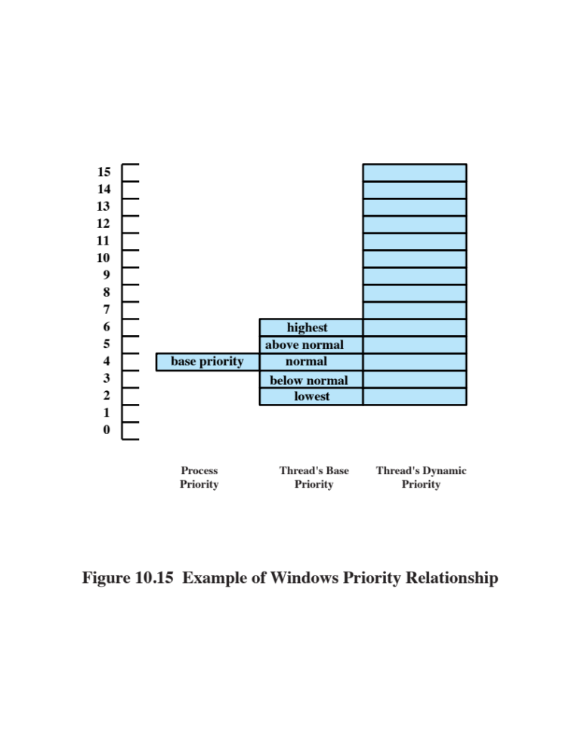
Notes:
Once a thread in the variable priority class has been created, its actual priority,
referred to as the thread’s current priority, may fluctuate within given boundaries.
The current priority may never fall below the thread’s base priority and it may
never exceed 15. Figure 10.15 gives an example. The process object has a base priority
attribute of 4. Each thread object associated with this process object must have
an initial priority of between 2 and 6. Suppose the base priority for thread is 4. Then
the current priority for that thread may fluctuate in the range from 4 through 15
depending on what boosts it has been given. If a thread is interrupted to wait on an
I/O event, the kernel boosts its priority. If a boosted thread is interrupted because
it has used up its current time quantum, the kernel lowers its priority. Thus, processor-
bound threads tend toward lower priorities and I/O-bound threads tend toward
higher priorities. In the case of I/O-bound threads, the kernel boosts the priority
more for interactive waits (e.g., wait on keyboard or mouse) than for other types
of I/O (e.g., disk I/O). Thus, interactive threads tend to have the highest priorities
within the variable priority class.

Slide 70
Multiprocessor Scheduling
Windows supports multiprocessor and multicore hardware configurations
The threads of any process can run on any processor
In the absence of affinity restrictions the kernel dispatcher assigns a ready thread to the next available processor
Multiple threads from the same process can be executing simultaneously on multiple processors
Soft affinity
  Used as a default by the kernel dispatcher
  The dispatcher tries to assign a ready thread to the same processor it last ran on
Hard affinity
  Application restricts its thread execution only to certain processors
If a thread is ready to execute but the only available processors are not in its processor affinity set, then the thread is forced to wait, and the kernel schedules the next available thread
Notes:
Windows supports multiprocessor and multicore hardware configurations. The
threads of any process, including those of the executive, can run on any processor.
In the absence of affinity restrictions, explained in the next paragraph, the kernel
dispatcher assigns a ready thread to the next available processor. This assures that
no processor is idle or is executing a lower-priority thread when a higher-priority
thread is ready. Multiple threads from the same process can be executing simultaneously
on multiple processors.
As a default, the kernel dispatcher uses the policy of soft affinity in assigning
threads to processors: The dispatcher tries to assign a ready thread to the same
processor it last ran on. This helps reuse data still in that processor’s memory caches
from the previous execution of the thread. It is possible for an application to restrict
its thread execution only to certain processors (hard affinity ).
When Windows is run on a single processor, the highest-priority thread is always
active unless it is waiting on an event. If there is more than one thread that
has the same highest priority, then the processor is shared, round robin, among all
the threads at that priority level. In a multiprocessor system with N processors, the
kernel tries to give the N processors to the N highest-priority threads that are ready
to run. The remaining, lower priority, threads must wait until the other threads block
or have their priority decay. Lower-priority threads may also have their priority
boosted to 15 for a very short time if they are being starved, solely to correct instances
of priority inversion.
The foregoing scheduling discipline is affected by the processor affinity attribute
of a thread. If a thread is ready to execute but the only available processors
are not in its processor affinity set, then that thread is forced to wait, and the kernel
schedules the next available thread.

Slide 71
Summary
Multiprocessor and multicore scheduling
  Granularity
  Design issues
  Process scheduling
  Thread scheduling
  Multicore thread scheduling
Linux scheduling
  Real-time scheduling
  Non-real-time scheduling
UNIX FreeBSD scheduling
  Priority classes
  SMP and multicore support
Real-time scheduling
  Background
  Characteristics of real-time operating systems
  Real-time scheduling
  Deadline scheduling
  Rate monotonic scheduling
  Priority inversion
Windows scheduling
  Process and thread priorities
  Multiprocessor scheduling
  UNIX SVR4 scheduling
Notes:
Summary of Chapter 10.

