Slide 1

Chapter 12
File Management
Ninth Edition, Global Edition
By William Stallings
Notes:
“Operating Systems: Internal and Design Principles”, 9/e, by William Stallings, Chapter 12 “File Management”.

Slide 2
Files
Data collections created by users
The File System is one of the most important parts of the OS to a user
Desirable properties of files:
Long-term existence
Files are stored on disk or other secondary storage and do not disappear when a user logs off
Sharable between processes
Files have names and can have associated access permissions that permit controlled sharing
Structure
Files can be organized into hierarchical or more complex structure to reflect the relationships among files
Notes:
From the user’s point of view, one of the most important parts of an operating
system is the file system. The file system provides the resource abstractions typically
associated with secondary storage. The file system permits users to create data
collections, called files, with desirable properties, such as:
• Long-term existence: Files are stored on disk or other secondary storage and
do not disappear when a user logs off.
• Sharable between processes: Files have names and can have associated access
permissions that permit controlled sharing.
• Structure: Depending on the file system, a file can have an internal structure
that is convenient for particular applications. In addition, files can be organized
into hierarchical or more complex structure to reflect the relationships
among files.

Slide 3
File Systems
Provide a means to store data organized as files as well as a collection of functions that can be performed on files
Maintain a set of attributes associated with the file
Typical operations include:
  Create
  Delete
  Open
  Close
  Read
  Write
Notes:
Any file system provides not only a means to store data organized as files, but
a collection of functions that can be performed on files. Typical operations include
the following:
• Create: A new file is defined and positioned within the structure of files.
• Delete: A file is removed from the file structure and destroyed.
• Open: An existing file is declared to be “opened” by a process, allowing the
process to perform functions on the file.
• Close: The file is closed with respect to a process, so that the process no longer
may perform functions on the file, until the process opens the file again.
• Read: A process reads all or a portion of the data in a file.
• Write: A process updates a file, either by adding new data that expands the
size of the file or by changing the values of existing data items in the file.
Typically, a file system maintains a set of attributes associated with the file.
These include owner, creation time, time last modified, access privileges, and so on.

Slide 4
File Structure
Four terms are commonly used when discussing files:
Field
Record
File
Database
Notes:
Four terms are in common use when discussing files:
• Field
• Record
• File
• Database

Slide 5
Structure Terms
Field
File
  Basic element of data
  Contains a single value
  Fixed or variable length
  Collection of similar records
  Treated as a single entity
  May be referenced by name
  Access control restrictions usually apply at the file level
Database
  Collection of related data
  Relationships among elements of data are explicit
  Designed for use by a number of different applications
  Consists of one or more types of files
Record
Collection of related fields that can be treated as a unit by some application program
Fixed or variable length
Notes:
A field is the basic element of data. An individual field contains a single value,
such as an employee’s last name, a date, or the value of a sensor reading. It is characterized
by its length and data type (e.g., ASCII string, decimal). Depending on the
file design, fields may be fixed length or variable length. In the latter case, the field
often consists of two or three subfields: the actual value to be stored, the name of
the field, and, in some cases, the length of the field. In other cases of variable-length
fields, the length of the field is indicated by the use of special demarcation symbols
between fields.
A record is a collection of related fields that can be treated as a unit by some
application program. For example, an employee record would contain such fields
as name, social security number, job classification, date of hire, and so on. Again,
depending on design, records may be of fixed length or variable length. A record
will be of variable length if some of its fields are of variable length or if the number
of fields may vary. In the latter case, each field is usually accompanied by a field
name. In either case, the entire record usually includes a length field.
A file is a collection of similar records. The file is treated as a single entity by
users and applications and may be referenced by name. Files have file names and
may be created and deleted. Access control restrictions usually apply at the file
level. That is, in a shared system, users and programs are granted or denied access
to entire files. In some more sophisticated systems, such controls are enforced at the
record or even the field level.
Some file systems are structured only in terms of fields, not records. In that
case, a file is a collection of fields.
A database is a collection of related data. The essential aspects of a database
are that the relationships that exist among elements of data are explicit and that the
database is designed for use by a number of different applications. A database may
contain all of the information related to an organization or project, such as a business
or a scientific study. The database itself consists of one or more types of files. Usually,
there is a separate database management system that is independent of the operating
system, although that system may make use of some file management programs.

Slide 6
File Management System
Meet the data management needs of the user
Guarantee that the data in the file are valid
Optimize performance
Provide I/O support for a variety of storage device types
Minimize the potential for lost or destroyed data
Provide a standardized set of I/O interface routines to user processes
Provide I/O support for multiple users in the case of multiple-user systems
Notes:
A file management system is that set of system software that provides services to
users and applications in the use of files. Typically, the only way that a user or application
may access files is through the file management system. This relieves the user
or programmer of the necessity of developing special-purpose software for each
application and provides the system with a consistent, well-defined means of controlling
its most important asset. [GROS86] suggests the following objectives for a
file management system:
• To meet the data management needs and requirements of the user, which include
storage of data and the ability to perform the aforementioned operations
• To guarantee, to the extent possible, that the data in the file are valid
• To optimize performance, both from the system point of view in terms of
overall throughput and from the user’s point of view in terms of response time
• To provide I/O support for a variety of storage device types
• To minimize or eliminate the potential for lost or destroyed data
• To provide a standardized set of I/O interface routines to user processes
• To provide I/O support for multiple users, in the case of multiple-user systems

Slide 7
Minimal User Requirements
Each user:
1
Should be able to create, delete, read, write and modify files
2
May have controlled access to other users’ files
3
May control what type of accesses are allowed to the users’ files
4
5
6
Should be able to move data between files
Should be able to back up and recover files in case of damage
Should be able to access his or her files by name rather than by numeric identifier
Notes:
With respect to the first point, meeting user requirements, the extent of such
requirements depends on the variety of applications and the environment in which
the computer system will be used. For an interactive, general-purpose system, the
following constitute a minimal set of requirements:
1. Each user should be able to create, delete, read, write, and modify files.
2. Each user may have controlled access to other users’ files.
3. Each user may control what types of accesses are allowed to the user’s files.
4. Each user should be able to move data between files.
5. Each user should be able to back up and recover the user’s files in case of
damage.
6. Each user should be able to access his or her files by name rather than by
numeric identifier.
These objectives and requirements should be kept in mind throughout our discussion
of file management systems.

Slide 8
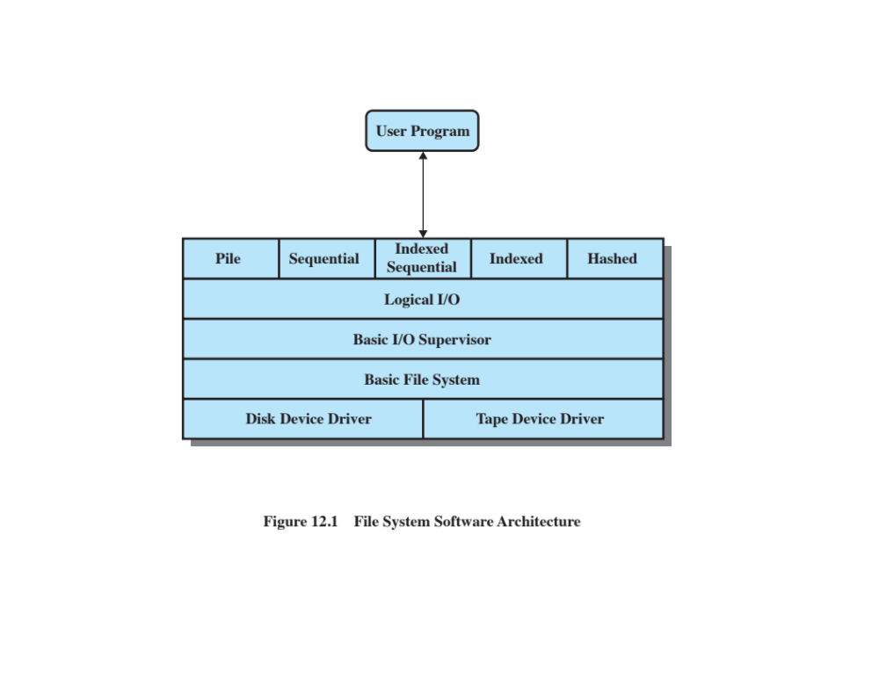
Notes:
One way of getting a feel for the scope of file
management is to look at a depiction of a typical software organization, as suggested
in Figure 12.1 . Of course, different systems will be organized differently, but this
organization is reasonably representative.

Slide 9
Device Drivers
Lowest level
Communicates directly with peripheral devices
Responsible for starting I/O operations on a device
Processes the completion of an I/O request
Considered to be part of the operating system
Notes:
At the lowest level, device drivers
communicate directly with peripheral devices or their controllers or channels. A
device driver is responsible for starting I/O operations on a device and processing
the completion of an I/O request. For file operations, the typical devices controlled
are disk and tape drives. Device drivers are usually considered to be part of the
operating system.

Slide 10
Basic File System
Also referred to as the physical I/O level
Primary interface with the environment outside the computer system
Deals with blocks of data that are exchanged with disk or tape systems
Concerned with the placement of blocks on the secondary storage device
Concerned with buffering blocks in main memory
Does not understand the content of the data or the structure of the files involved
Considered part of the operating system
Notes:
The next level is referred to as the basic file system , or the physical I/O level.
This is the primary interface with the environment outside of the computer system.
It deals with blocks of data that are exchanged with disk or tape systems. Thus, it is
concerned with the placement of those blocks on the secondary storage device and
on the buffering of those blocks in main memory. It does not understand the content
of the data or the structure of the files involved. The basic file system is often
considered part of the operating system.

Slide 11
Basic I/O Supervisor
Responsible for all file I/O initiation and termination
At this level, control structures are maintained that deal with device I/O, scheduling, and file status
Selects the device on which I/O is to be performed
Concerned with scheduling disk and tape accesses to optimize performance
I/O buffers are assigned and secondary memory is allocated at this level
Part of the operating system
Notes:
The basic I/O supervisor is responsible for all file I/O initiation and termination.
At this level, control structures are maintained that deal with device I/O,
scheduling, and file status. The basic I/O supervisor selects the device on which file
I/O is to be performed, based on the particular file selected. It is also concerned
with scheduling disk and tape accesses to optimize performance. I/O buffers are
assigned and secondary memory is allocated at this level. The basic I/O supervisor is
part of the operating system.

Slide 12
Logical I/O
Enables users and applications to access records
Provides general-purpose record I/O capability
Maintains basic data about file
Notes:
Logical I/O enables users and applications to access records. Thus, whereas
the basic file system deals with blocks of data, the logical I/O module deals with file
records. Logical I/O provides a general-purpose record I/O capability and maintains
basic data about files.

Slide 13
Access Method
Level of the file system closest to the user
Provides a standard interface between applications and the file systems and devices that hold the data
Different access methods reflect different file structures and different ways of accessing and processing the data
Notes:
The level of the file system closest to the user is often termed the access
method . It provides a standard interface between applications and the file systems
and devices that hold the data. Different access methods reflect different file structures
and different ways of accessing and processing the data. Some of the most
common access methods are shown in Figure 12.1 , and these are briefly described
in Section 12.2 .

Slide 14
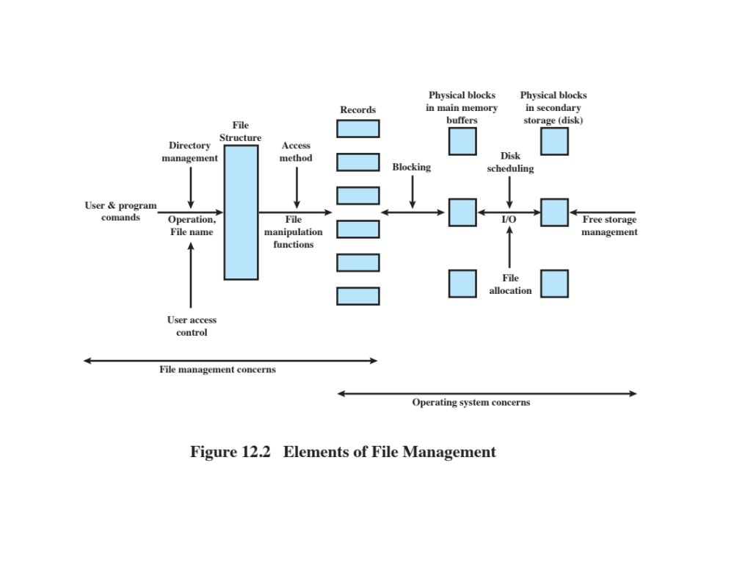
Notes:
Another way of viewing the functions of a file
system is shown in Figure 12.2 . Let us follow this diagram from left to right. Users
and application programs interact with the file system by means of commands for
creating and deleting files and for performing operations on files. Before performing
any operation, the file system must identify and locate the selected file. This requires
the use of some sort of directory that serves to describe the location of all files, plus
their attributes. In addition, most shared systems enforce user access control: Only
authorized users are allowed to access particular files in particular ways. The basic
operations that a user or application may perform on a file are performed at the
record level. The user or application views the file as having some structure that
organizes the records, such as a sequential structure (e.g., personnel records are
stored alphabetically by last name). Thus, to translate user commands into specific
file manipulation commands, the access method appropriate to this file structure
must be employed.
Whereas users and applications are concerned with records or fields, I/O is
done on a block basis. Thus, the records or fields of a file must be organized as a
sequence of blocks for output and unblocked after input. To support block I/O of
files, several functions are needed. The secondary storage must be managed. This
involves allocating files to free blocks on secondary storage and managing free storage
so as to know what blocks are available for new files and growth in existing files.
In addition, individual block I/O requests must be scheduled; this issue was dealt with
in Chapter 11 . Both disk scheduling and file allocation are concerned with optimizing
performance. As might be expected, these functions therefore need to be considered
together. Furthermore, the optimization will depend on the structure of the files and
the access patterns. Accordingly, developing an optimum file management system
from the point of view of performance is an exceedingly complicated task.
Figure 12.2 suggests a division between what might be considered the concerns
of the file management system as a separate system utility and the concerns
of the operating system, with the point of intersection being record processing. This
division is arbitrary; various approaches are taken in various systems.

Slide 15
File Organization and Access
File organization is the logical structuring of the records as determined by the way in which they are accessed
In choosing a file organization, several criteria are important:
  Short access time
  Ease of update
  Economy of storage
  Simple maintenance
  Reliability
Priority of criteria depends on the application that will use the file
Notes:
In this section, we use the term file organization to refer to the logical structuring
of the records as determined by the way in which they are accessed. The physical
organization of the file on secondary storage depends on the blocking strategy and
the file allocation strategy, issues dealt with later in this chapter.
In choosing a file organization, several criteria are important:
• Short access time
• Ease of update
• Economy of storage
• Simple maintenance
• Reliability
The relative priority of these criteria will depend on the applications that will
use the file. For example, if a file is only to be processed in batch mode, with all of
the records accessed every time, then rapid access for retrieval of a single record is
of minimal concern. A file stored on CD-ROM will never be updated, and so ease
of update is not an issue.
These criteria may conflict. For example, for economy of storage, there should be
minimum redundancy in the data. On the other hand, redundancy is a primary means
of increasing the speed of access to data. An example of this is the use of indexes.

Slide 16
File Organization Types
Five of the common file organizations are:
The pile
The sequential file
The indexed sequential file
The indexed file
The direct, or hashed, file
Notes:
The number of alternative file organizations that have been implemented or
just proposed is unmanageably large, even for a book devoted to file systems. In this
brief survey, we will outline five fundamental organizations. Most structures used in
actual systems either fall into one of these categories or can be implemented with a
combination of these organizations. The five organizations, the first four of which
are depicted in Figure 12.3 , are as follows:
The pile
• The sequential file
• The indexed sequential file
• The indexed file
• The direct, or hashed, file

Slide 17
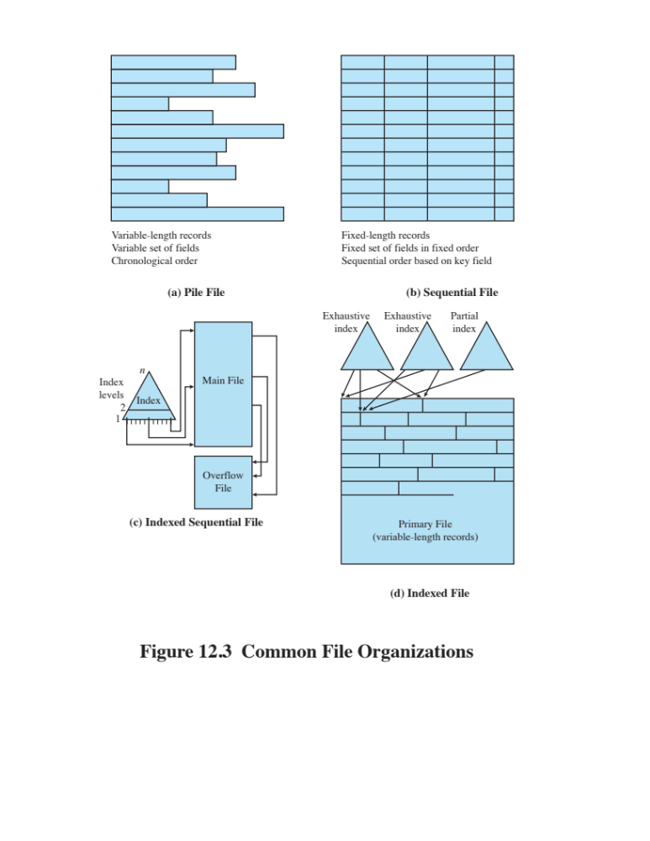
Notes:
The five organizations, the first four of which
are depicted in Figure 12.3, are as follows:
• The pile
• The sequential file
• The indexed sequential file
• The indexed file
• The direct, or hashed, file

Slide 18
The Pile
Least complicated form of file organization
Data are collected in the order they arrive
Each record consists of one burst of data
Purpose is simply to accumulate the mass of data and save it
Record access is by exhaustive search
Notes:
The least-complicated form of file organization may be termed the pile . Data are
collected in the order in which they arrive. Each record consists of one burst of
data. The purpose of the pile is simply to accumulate the mass of data and save it.
Records may have different fields, or similar fields in different orders. Thus, each
field should be self-describing, including a field name as well as a value. The length
of each field must be implicitly indicated by delimiters, explicitly included as a subfield,
or known as default for that field type.
Because there is no structure to the pile file, record access is by exhaustive
search. That is, if we wish to find a record that contains a particular field with a
particular value, it is necessary to examine each record in the pile until the desired
record is found or the entire file has been searched. If we wish to find all records
that contain a particular field or contain that field with a particular value, then the
entire file must be searched.
Pile files are encountered when data are collected and stored prior to processing
or when data are not easy to organize. This type of file uses space well when the
stored data vary in size and structure, is perfectly adequate for exhaustive searches,
and is easy to update. However, beyond these limited uses, this type of file is unsuitable
for most applications.

Slide 19
The Sequential File
Most common form of file structure
A fixed format is used for records
Key field uniquely identifies the record
Typically used in batch applications
Only organization that is easily stored on tape as well as disk
Notes:
The most common form of file structure is the sequential file. In this type of file,
a fixed format is used for records. All records are of the same length, consisting of
the same number of fixed-length fields in a particular order. Because the length and
position of each field are known, only the values of fields need to be stored; the field
name and length for each field are attributes of the file structure.
One particular field, usually the first field in each record, is referred to as the
key field . The key field uniquely identifies the record; thus key values for different
records are always different. Further, the records are stored in key sequence: alphabetical
order for a text key, and numerical order for a numerical key.
Sequential files are typically used in batch applications and are generally
optimum for such applications if they involve the processing of all the records (e.g.,
a billing or payroll application). The sequential file organization is the only one that
is easily stored on tape as well as disk.
For interactive applications that involve queries and/or updates of individual
records, the sequential file provides poor performance. Access requires the sequential
search of the file for a key match. If the entire file, or a large portion of the
file, can be brought into main memory at one time, more efficient search techniques
are possible. Nevertheless, considerable processing and delay are encountered to
access a record in a large sequential file. Additions to the file also present problems.
Typically, a sequential file is stored in simple sequential ordering of the records within
blocks. That is, the physical organization of the file on tape or disk directly matches
the logical organization of the file. In this case, the usual procedure is to place new
records in a separate pile file, called a log file or transaction file. Periodically, a batch
update is performed that merges the log file with the master file to produce a new file
in correct key sequence.
An alternative is to organize the sequential file physically as a linked list. One
or more records are stored in each physical block. Each block on disk contains a
pointer to the next block. The insertion of new records involves pointer manipulation
but does not require that the new records occupy a particular physical block
position. Thus, some added convenience is obtained at the cost of additional
processing and overhead.

Slide 20
Indexed Sequential File
Adds an index to the file to support random access
Adds an overflow file
Greatly reduces the time required to access a single record
Multiple levels of indexing can be used to provide greater efficiency in access
Notes:
A popular approach to overcoming the disadvantages of the sequential file is the
indexed sequential file. The indexed sequential file maintains the key characteristic
of the sequential file: Records are organized in sequence based on a key field. Two
features are added: an index to the file to support random access, and an overflow
file. The index provides a lookup capability to reach quickly the vicinity of a desired
record. The overflow file is similar to the log file used with a sequential file but is
integrated so that a record in the overflow file is located by following a pointer from
its predecessor record.
In the simplest indexed sequential structure, a single level of indexing is
used. The index in this case is a simple sequential file. Each record in the index file
consists of two fields: a key field, which is the same as the key field in the main file,
and a pointer into the main file. To find a specific field, the index is searched to find
the highest key value that is equal to or precedes the desired key value. The search
continues in the main file at the location indicated by the pointer.
To see the effectiveness of this approach, consider a sequential file with
1 million records. To search for a particular key value will require on average one-half
million record accesses. Now suppose that an index containing 1,000 entries
is constructed, with the keys in the index more or less evenly distributed over
the main file. Now it will take on average 500 accesses to the index file followed
by 500 accesses to the main file to find the record. The average search length is
reduced from 500,000 to 1,000.
Additions to the file are handled in the following manner: Each record in
the main file contains an additional field not visible to the application, which is a
pointer to the overflow file. When a new record is to be inserted into the file, it is
added to the overflow file. The record in the main file that immediately precedes
the new record in logical sequence is updated to contain a pointer to the new record
in the overflow file. If the immediately preceding record is itself in the overflow file,
then the pointer in that record is updated. As with the sequential file, the indexed
sequential file is occasionally merged with the overflow file in batch mode.
The indexed sequential file greatly reduces the time required to access a single
record, without sacrificing the sequential nature of the file. To process the entire file
sequentially, the records of the main file are processed in sequence until a pointer
to the overflow file is found, then accessing continues in the overflow file until a null
pointer is encountered, at which time accessing of the main file is resumed where it
left off.
To provide even greater efficiency in access, multiple levels of indexing can be
used. Thus the lowest level of index file is treated as a sequential file and a higher level
index file is created for that file. Consider again a file with 1 million records.
A lower-level index with 10,000 entries is constructed. A higher-level index into
the lower-level index of 100 entries can then be constructed. The search begins at
the higher-level index (average length = 50 accesses) to find an entry point into the
lower-level index. This index is then searched (average length = 50) to find an entry
point into the main file, which is then searched (average length = 50). Thus the average
length of search has been reduced from 500,000 to 1,000 to 150.

Slide 21
Indexed File
Records are accessed only through their indexes
Variable-length records can be employed
Exhaustive index contains one entry for every record in the main file
Partial index contains entries to records where the field of interest exists
Used mostly in applications where timeliness of information is critical
Examples would be airline reservation systems and inventory control systems
Notes:
The indexed sequential file retains one limitation of the sequential file: Effective
processing is limited to that which is based on a single field of the file. For example,
when it is necessary to search for a record on the basis of some other attribute than
the key field, both forms of sequential file are inadequate. In some applications, the
flexibility of efficiently searching by various attributes is desirable.
To achieve this flexibility, a structure is needed that employs multiple indexes,
one for each type of field that may be the subject of a search. In the general indexed
file, the concept of sequentially and a single key are abandoned. Records are
accessed only through their indexes. The result is that there is now no restriction
on the placement of records as long as a pointer in at least one index refers to that
record. Furthermore, variable-length records can be employed.
Two types of indexes are used. An exhaustive index contains one entry for
every record in the main file. The index itself is organized as a sequential file for
ease of searching. A partial index contains entries to records where the field of
interest exists. With variable-length records, some records will not contain all fields.
When a new record is added to the main file, all of the index files must be updated.
Indexed files are used mostly in applications where timeliness of information
is critical and where data are rarely processed exhaustively. Examples are airline
reservation systems and inventory control systems.

Slide 22
Direct or Hashed File
Access directly any block of a known address
Makes use of hashing on the key value
Often used where:
  Very rapid access is required
  Fixed-length records are used
  Records are always accessed one at a time
Examples are:
Directories
Pricing tables
Schedules
Name lists
Notes:
The direct, or hashed, file exploits the capability found on disks to access directly any
block of a known address. As with sequential and indexed sequential files, a key field
is required in each record. However, there is no concept of sequential ordering here.
The direct file makes use of hashing on the key value. This function is explained
in Appendix F . Figure F.1b shows the type of hashing organization with an overflow
file that is typically used in a hash file.
Direct files are often used where very rapid access is required, where fixed length
records are used, and where records are always accessed one at a time.
Examples are directories, pricing tables, schedules, and name lists.

Slide 23
B-Trees
A balanced tree structure with all branches of equal length
Standard method of organizing indexes for databases
Commonly used in OS file systems
Provides for efficient searching, adding, and deleting of items
Notes:
The preceding section referred to the use of an index file to access individual records
in a file or database. For a large file or database, a single sequential file of indexes on
the primary key does not provide for rapid access. To provide more efficient access,
a structured index file is typically used. The simplest such structure is a two-level
organization in which the original file is broken into sections and the upper level
consists of a sequenced set of pointers to the lower-level sections. This structure can
then be extended to more than two levels, resulting in a tree structure. Unless some
discipline is imposed on the construction of the tree index, it is likely to end up with
an uneven structure, with some short branches and some long branches, so that the
time to search the index is uneven. Therefore, a balanced tree structure, with all
branches of equal length, would appear to give the best average performance. Such a
structure is the B-tree, which has become the standard method of organizing indexes
for databases and is commonly used in OS file systems, including those supported by
Mac OS X, Windows, and several Linux file systems. The B-tree structure provides
for efficient searching, adding, and deleting of items.

Slide 24
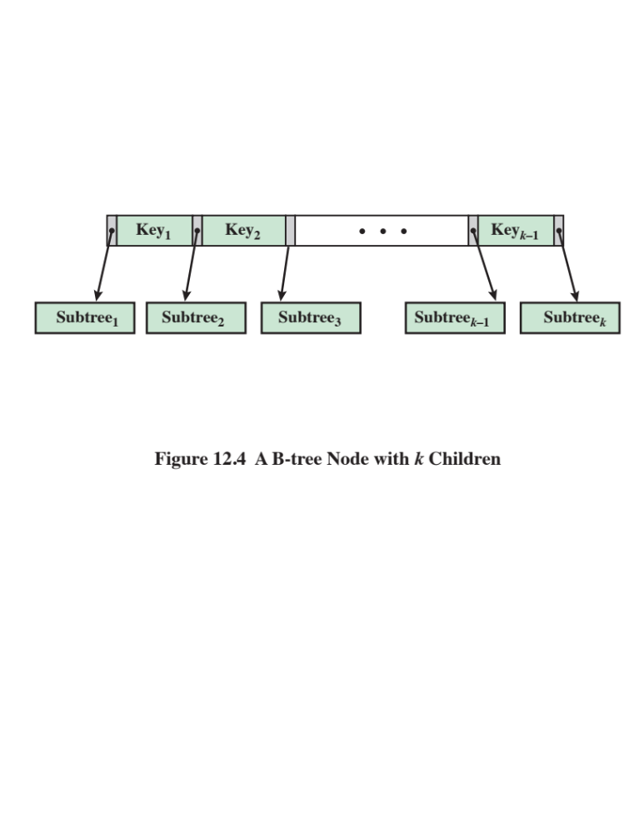
Notes:
Before illustrating the concept of B-tree, let us define a B-tree and its characteristics
more precisely. A B-tree is a tree structure (no closed loops) with the
following characteristics: ( Figure 12.4 )
The tree consists of a number of nodes and leaves.
2. Each node contains at least one key which uniquely identifies a file record,
and more than one pointer to child nodes or leaves. The number of keys and
pointers contained in a node may vary, within limits explained below.
3. Each node is limited to the same number of maximum keys.
4. The keys in a node are stored in nondecreasing order. Each key has an
associated child that is the root of a subtree containing all nodes with keys
less than or equal to the key but greater than the preceding key. A node also
has an additional rightmost child that is the root for a subtree containing
all keys greater than any keys in the node. Thus, each node has one more
pointer than keys.
Figure 12.4 illustrates two levels of a B-tree. The upper level has ( k – 1) keys
and k pointers and satisfies the following relationship:
Key₁ < Key₃ < … < Key _{k-1}
Each pointer points to a node that is the top level of a subtree of this upper level
node. Each of these subtree nodes contains some number of keys and pointers,
unless it is a leaf node.
To search for a key, you start at the root node. If the key you want is in the
node, you’re done. If not, you go down one level. There are three cases:
1. The key you want is less then the smallest key in this node. Take the leftmost
pointer down to the next level.
2. The key you want is greater than the largest key in this node. Take the rightmost
pointer down to the next level.
3. The value of the key is between the values of two adjacent keys in this node.
Take the pointer between these keys down to the next level.

Slide 25
B-Tree Characteristics
  Every node has at most 2d – 1 keys and 2d children or, equivalently, 2d pointers
  Every node, except for the root, has at least d – 1 keys and d pointers, as a result, each internal node, except the root, is at least half full and has at least d children
  The root has at least 1 key and 2 children
  All leaves appear on the same level and contain no information. This is a logical construct to terminate the tree; the actual implementation may differ
  A nonleaf node with k pointers contains k – 1 keys
A B-tree is characterized by its minimum degree d and satisfies the following properties:
Notes:
A B-tree is characterized by its minimum degree d and satisfies the following
properties:
1. Every node has at most 2 d – 1 keys and 2 d children or, equivalently, 2 d pointers.
2. Every node, except for the root, has at least d – 1 keys and d pointers. As a
result, each internal node, except the root, is at least half full and has at least d
children.
3. The root has at least 1 key and 2 children.
4. All leaves appear on the same level and contain no information. This is a
logical construct to terminate the tree; the actual implementation may differ.
For example, each bottom-level node may contain keys alternating with null
pointers.
5. A nonleaf node with k pointers contains k – 1 keys.
Typically, a B-tree has a relatively large branching factor (large number of
children) resulting in a tree of low height.

Slide 26
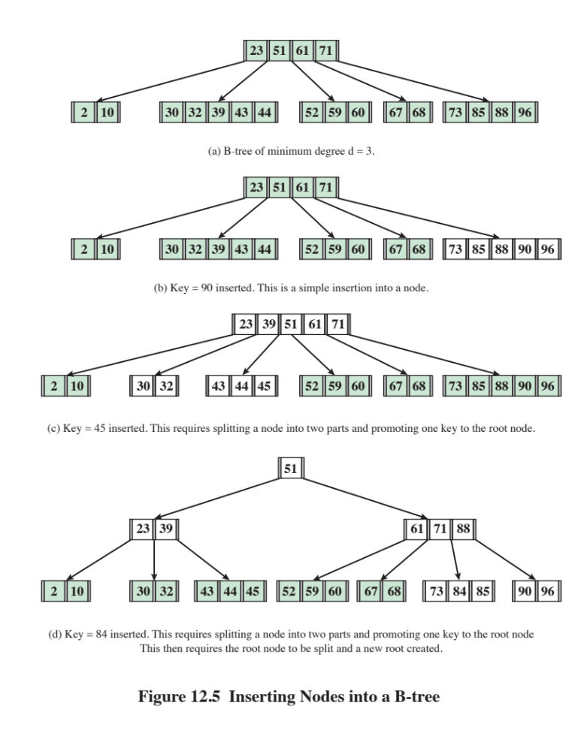
Notes:
For example, consider the tree in Figure 12.5d and the desired key is 84. At
the root level, 84 > 51, so you take the rightmost branch down to the next level.
Here, we have 71 < 84 < 88, so you take the pointer between 71 and 88 down to the
next level, where the key 84 is found. Associated with this key is a pointer to the
desired record. An advantage of this tree structure over other tree structures is that
it is broad and shallow, so that the search terminates quickly. Furthermore, because
it is balanced (all branches from root to leaf are of equal length), there are no long
searches compared to other searches.
The rules for inserting a new key into the B-tree must maintain a balanced
tree. This is done as follows:
1. Search the tree for the key. If the key is not in the tree, then you have reached
a node at the lowest level.
2. If this node has fewer than 2 d – 1 keys, then insert the key into this node in the
proper sequence.
3. If the node is full (having 2 d – 1 keys), then split this node around its median
key into two new nodes with d – 1 keys each and promote the median key to
the next higher level, as described in step 4. If the new key has a value less
than the median key, insert it into the left–hand new node; otherwise insert
it into the right–hand new node. The result is that the original node has been
split into two nodes, one with d – 1 keys and one with d keys.
4. The promoted node is inserted into the parent node following the rules of step
3. Therefore, if the parent node is already full, it must be split and its median
key promoted to the next highest layer.
5. If the process of promotion reaches the root node and the root node is already
full, then insertion again follows the rules of step 3. However, in this case the
median key becomes a new root node and the height of the tree increases by 1.
Figure 12.5 illustrates the insertion process on a B-tree of degree d = 3. In each
part of the figure, the nodes affected by the insertion process are unshaded.

Slide 27

Table 12.1
Information Elements of a File Directory
(Table can be found on page 537 in textbook)
Notes:
Associated with any file management system and collection of files is a file directory.
The directory contains information about the files, including attributes, location,
and ownership. Much of this information, especially that concerned with storage,
is managed by the operating system. The directory is itself a file, accessible by various
file management routines. Although some of the information in directories is
available to users and applications, this is generally provided indirectly by system
routines.
Table 12.1 suggests the information typically stored in the directory for each
file in the system. From the user’s point of view, the directory provides a mapping
between file names, known to users and applications, and the files themselves. Thus,
each file entry includes the name of the file. Virtually all systems deal with different
types of files and different file organizations, and this information is also provided.
An important category of information about each file concerns its storage, including
its location and size. In shared systems, it is also important to provide information
that is used to control access to the file. Typically, one user is the owner of the file
and may grant certain access privileges to other users. Finally, usage information is
needed to manage the current use of the file and to record the history of its usage.

Slide 28
Operations Performed on a Directory
Search
Create files
Delete files
List directory
Update directory
To understand the requirements for a file structure, it is helpful to consider the types of operations that may be performed on the directory:
Notes:
To understand the requirements for a file structure, it is helpful to consider
the types of operations that may be performed on the directory:
• Search: When a user or application references a file, the directory must be
searched to find the entry corresponding to that file.
• Create file: When a new file is created, an entry must be added to the directory.
• Delete file: When a file is deleted, an entry must be removed from the directory.
• List directory: All or a portion of the directory may be requested. Generally,
this request is made by a user and results in a listing of all files owned by that
user, plus some of the attributes of each file (e.g., type, access control information,
usage information).
• Update directory: Because some file attributes are stored in the directory, a
change in one of these attributes requires a change in the corresponding directory
entry.
The simple list is not suited to supporting these operations. Consider the needs
of a single user. The user may have many types of files, including word-processing
text files, graphic files, spreadsheets, and so on. The user may like to have these
organized by project, by type, or in some other convenient way. If the directory is a
simple sequential list, it provides no help in organizing the files and forces the user
to be careful not to use the same name for two different types of files. The problem
is much worse in a shared system. Unique naming becomes a serious problem.
Furthermore, it is difficult to conceal portions of the overall directory from users
when there is no inherent structure in the directory.

Slide 29
Two-Level Scheme
There is one directory for each user and a master directory
Master directory has an entry for each user directory providing address and access control information
Each user directory is a simple list of the files of that user
Names must be unique only within the collection of files of a single user
File system can easily enforce access restriction on directories
Notes:
A start in solving these problems would be to go to a two-level scheme. In
this case, there is one directory for each user, and a master directory. The master
directory has an entry for each user directory, providing address and access control
information. Each user directory is a simple list of the files of that user. This
arrangement means that names must be unique only within the collection of files
of a single user and that the file system can easily enforce access restriction on
directories. However, it still provides users with no help in structuring collections
of files.

Slide 30
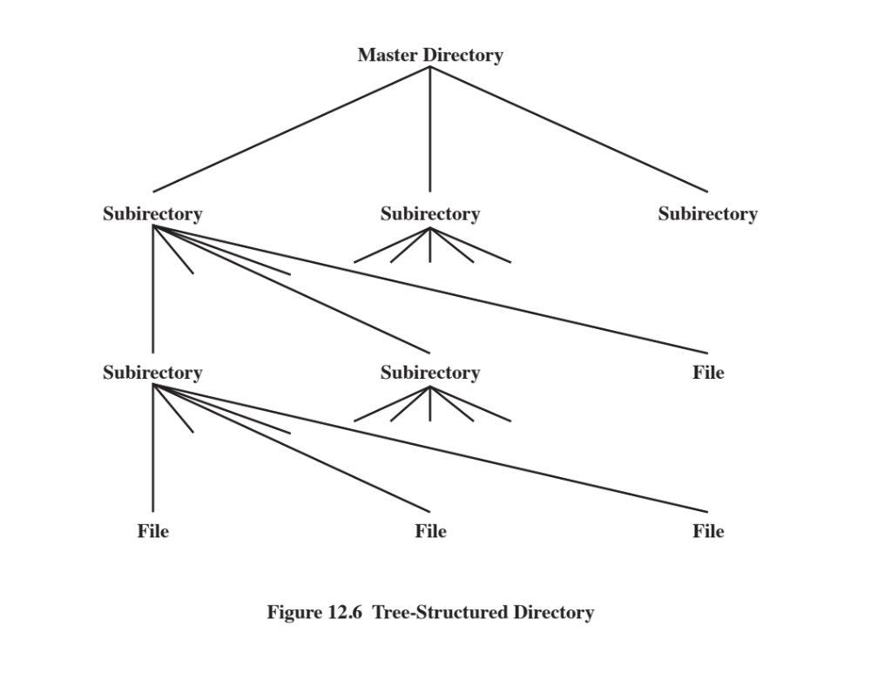
Notes:
A more powerful and flexible approach, and one that is almost universally
adopted, is the hierarchical, or tree-structure, approach ( Figure 12.6 ). As before,
there is a master directory, which has under it a number of user directories. Each of
these user directories, in turn, may have subdirectories and files as entries. This is
true at any level: That is, at any level, a directory may consist of entries for subdirectories
and/or entries for files.
It remains to say how each directory and subdirectory is organized. The simplest
approach, of course, is to store each directory as a sequential file. When directories
may contain a very large number of entries, such an organization may lead to unnecessarily
long search times. In that case, a hashed structure is to be preferred.

Slide 31
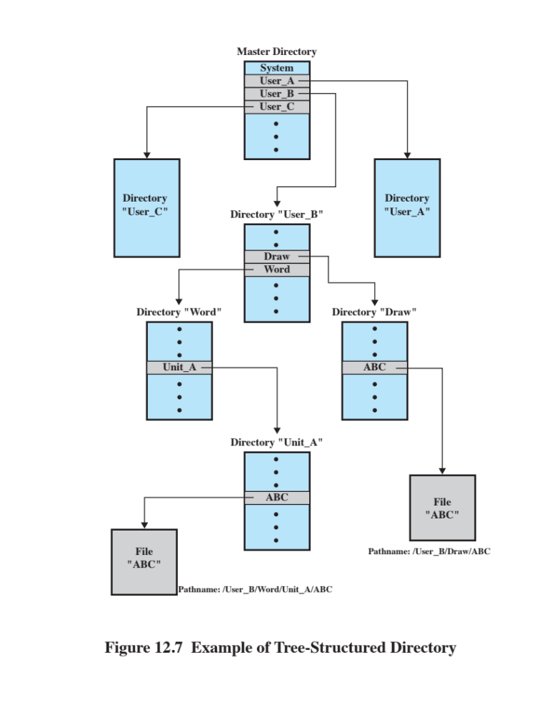
Notes:
Users need to be able to refer to a file by a symbolic name. Clearly, each file in the
system must have a unique name in order that file references be unambiguous. On
the other hand, it is an unacceptable burden on users to require that they provide
unique names, especially in a shared system.
The use of a tree-structured directory minimizes the difficulty in assigning
unique names. Any file in the system can be located by following a path from the
root or master directory down various branches until the file is reached. The series
of directory names, culminating in the file name itself, constitutes a pathname for
the file. As an example, the file in the lower left-hand corner of Figure 12.7 . has the
pathname User_B/Word/Unit_A/ABC . The slash is used to delimit names in the
sequence. The name of the master directory is implicit, because all paths start at
that directory. Note that it is perfectly acceptable to have several files with the same
file name, as long as they have unique pathnames, which is equivalent to saying
that the same file name may be used in different directories. In our example, there
is another file in the system with the file name ABC, but that has the pathname
/User_B/Draw/ABC .
Although the pathname facilitates the selection of file names, it would be awkward
for a user to have to spell out the entire pathname every time a reference is
made to a file. Typically, an interactive user or a process has associated with it a
current directory, often referred to as the working directory . Files are then referenced
relative to the working directory. For example, if the working directory for
user B is “Word,” then the pathname Unit_A/ABC is sufficient to identify the file
in the lower left-hand corner of Figure 12.7 . When an interactive user logs on, or
when a process is created, the default for the working directory is the user home
directory. During execution, the user can navigate up or down in the tree to change
to a different working directory.

Slide 32
File Sharing
Two issues arise when allowing files to be shared among a number of users:
Access rights
Management of simultaneous access
Notes:
In a multiuser system, there is almost always a requirement for allowing files to be
shared among a number of users. Two issues arise: access rights and the management
of simultaneous access.

Slide 33
Access Rights
None
  The user would not be allowed to read the user directory that includes the file
  Knowledge
    The user can determine that the file exists and who its owner is and can then petition the owner for additional access rights
  Execution
    The user can load and execute a program but cannot copy it
  Reading
    The user can read the file for any purpose, including copying and execution
Appending
  The user can add data to the file but cannot modify or delete any of the file’s contents
  Updating
  The user can modify, delete, and add to the file’s data
  Changing protection
  The user can change the access rights granted to other users
  Deletion
  The user can delete the file from the file system
Notes:
The file system should provide a flexible tool for allowing extensive file sharing
among users. The file system should provide a number of options so that the way
in which a particular file is accessed can be controlled. Typically, users or groups
of users are granted certain access rights to a file. A wide range of access rights has
been used. The following list is representative of access rights that can be assigned
to a particular user for a particular file:
• None: The user may not even learn of the existence of the file, much less
access it. To enforce this restriction, the user would not be allowed to read the
user directory that includes this file.
• Knowledge: The user can determine that the file exists and who its owner is.
The user is then able to petition the owner for additional access rights.
• Execution: The user can load and execute a program but cannot copy it.
Proprietary programs are often made accessible with this restriction.
• Reading: The user can read the file for any purpose, including copying and
execution. Some systems are able to enforce a distinction between viewing
and copying. In the former case, the contents of the file can be displayed to the
user, but the user has no means for making a copy.
• Appending: The user can add data to the file, often only at the end, but cannot
modify or delete any of the file’s contents. This right is useful in collecting data
from a number of sources.
• Updating: The user can modify, delete, and add to the file’s data. This normally
includes writing the file initially, rewriting it completely or in part, and removing
all or a portion of the data. Some systems distinguish among different
degrees of updating.
• Changing protection: The user can change the access rights granted to other
users. Typically, this right is held only by the owner of the file. In some systems,
the owner can extend this right to others. To prevent abuse of this mechanism,
the file owner will typically be able to specify which rights can be changed by
the holder of this right.
• Deletion: The user can delete the file from the file system.
These rights can be considered to constitute a hierarchy, with each right implying
those that precede it. Thus, if a particular user is granted the updating right for a
particular file, then that user is also granted the following rights: knowledge, execution,
reading, and appending.

Slide 34
User Access Rights
Owner
Usually the initial creator of the file
Has full rights
May grant rights to others
Specific Users
Individual users who are designated by user ID
User Groups
A set of users who are not individually defined
All
All users who have access to this system
These are public files
Notes:
One user is designated as owner of a given file, usually the person who initially
created a file. The owner has all of the access rights listed previously and may grant
rights to others. Access can be provided to different classes of users:
• Specific user: Individual users who are designated by user ID
• User groups: A set of users who are not individually defined. The system must
have some way of keeping track of the membership of user groups.
• All: All users who have access to this system. These are public files.

Slide 35
Record Blocking
  Fixed-Length Blocking – fixed-length records are used, and an integral number of records are stored in a block
  Internal fragmentation – unused space at the end of each block
Blocks are the unit of I/O with secondary storage
    For I/O to be performed records must be organized as blocks
Given the size of a block, three methods of blocking can be used:
  Variable-Length Spanned Blocking – variable-length records are used and are packed into blocks with no unused space
  Variable-Length Unspanned Blocking – variable-length records are used, but spanning is not employed
Notes:
As indicated in Figure 12.2 , records are the logical unit of access of a structured file,
whereas blocks are the unit of I/O with secondary storage. For I/O to be performed,
records must be organized as blocks.
There are several issues to consider. First, should blocks be of fixed or variable
length? On most systems, blocks are of fixed length. This simplifies I/O, buffer
allocation in main memory, and the organization of blocks on secondary storage.
Second, what should the relative size of a block be compared to the average record
size? The trade-off is this: The larger the block, the more records that are passed
in one I/O operation. If a file is being processed or searched sequentially, this is an
advantage, because the number of I/O operations is reduced by using larger blocks,
thus speeding up processing. On the other hand, if records are being accessed randomly
and no particular locality of reference is observed, then larger blocks result in
the unnecessary transfer of unused records. However, combining the frequency of
sequential operations with the potential for locality of reference, we can say that the
I/O transfer time is reduced by using larger blocks. The competing concern is that
larger blocks require larger I/O buffers, making buffer management more difficult.
Given the size of a block, there are three methods of blocking that can be used:
• Fixed blocking: Fixed-length records are used, and an integral number of
records are stored in a block. There may be unused space at the end of each
block. This is referred to as internal fragmentation.
• Variable-length spanned blocking: Variable-length records are used and are
packed into blocks with no unused space. Thus, some records must span two
blocks, with the continuation indicated by a pointer to the successor block.
Variable-length unspanned blocking: Variable-length records are used, but
spanning is not employed. There is wasted space in most blocks because of the
inability to use the remainder of a block if the next record is larger than the
remaining unused space.

Slide 36
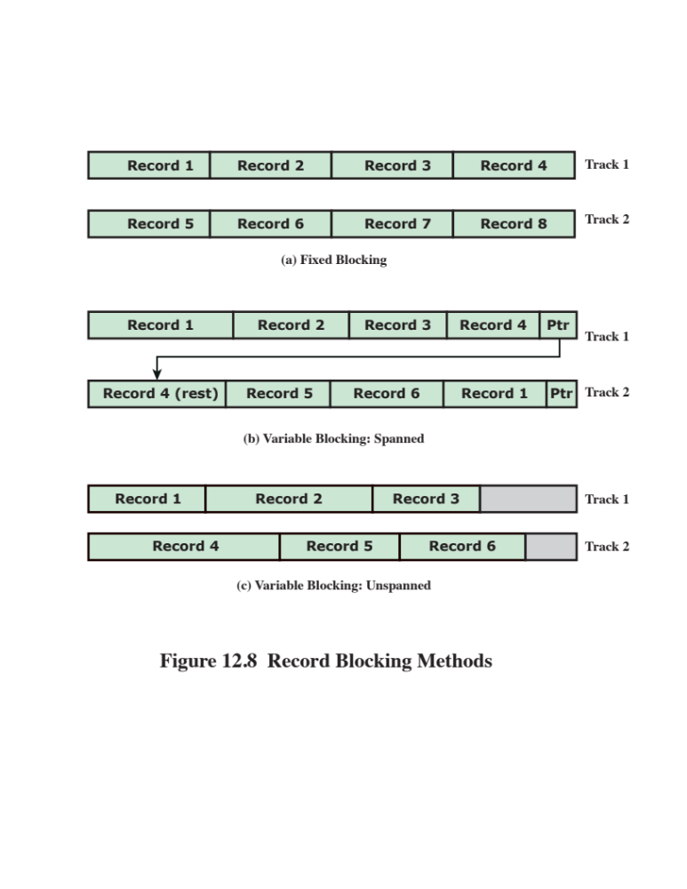
Notes:
Figure 12.8 illustrates these methods assuming that a file is stored in sequential
blocks on a disk. The figure assumes that the file is large enough to span two
tracks. The effect would not be changed if some other file allocation scheme were
used (see Section 12.6 ).
Fixed blocking is the common mode for sequential files with fixed-length
records. Variable-length spanned blocking is efficient of storage and does not limit
the size of records. However, this technique is difficult to implement.
Records that span two blocks require two I/O operations, and files are difficult to update, regardless
of the organization. Variable-length unspanned blocking results in wasted space
and limits record size to the size of a block.

Slide 37
File Allocation
On secondary storage, a file consists of a collection of blocks
The operating system or file management system is responsible for allocating blocks to files
The approach taken for file allocation may influence the approach taken for free space management
Space is allocated to a file as one or more portions (contiguous set of allocated blocks)
File allocation table (FAT)
    Data structure used to keep track of the portions assigned to a file
Notes:
On secondary storage, a file consists of a collection of blocks. The operating system
or file management system is responsible for allocating blocks to files. This raises
two management issues. First, space on secondary storage must be allocated to files,
and second, it is necessary to keep track of the space available for allocation. We
will see that these two tasks are related; that is, the approach taken for file allocation
may influence the approach taken for free space management. Further, we will
see that there is an interaction between file structure and allocation policy.
We begin this section by looking at alternatives for file allocation on a single
disk. Then we look at the issue of free space management, and finally we discuss
reliability.
Several issues are involved in file allocation:
1. When a new file is created, is the maximum space required for the file allocated
at once?
2. Space is allocated to a file as one or more contiguous units, which we shall
refer to as portions. That is, a portion is a contiguous set of allocated blocks.
The size of a portion can range from a single block to the entire file. What size
of portion should be used for file allocation?
3. What sort of data structure or table is used to keep track of the portions
assigned to a file? An example of such a structure is a file allocation table
(FAT) , found on DOS and some other systems.

Slide 38
Preallocation vs
Dynamic Allocation
A preallocation policy requires that the maximum size of a file be declared at the time of the file creation request
For many applications it is difficult to estimate reliably the maximum potential size of the file
    Tends to be wasteful because users and application programmers tend to overestimate size
    Dynamic allocation allocates space to a file in portions as needed
Notes:
A preallocation policy requires
that the maximum size of a file be declared at the time of the file creation request.
In a number of cases, such as program compilations, the production of summary
data files, or the transfer of a file from another system over a communications
network, this value can be reliably estimated. However, for many applications, it
is difficult if not impossible to estimate reliably the maximum potential size of the
file. In those cases, users and application programmers would tend to overestimate
file size so as not to run out of space. This clearly is wasteful from the point of view
of secondary storage allocation. Thus, there are advantages to the use of dynamic
allocation, which allocates space to a file in portions as needed.

Slide 39
Portion Size
In choosing a portion size there is a trade-off between efficiency from the point of view of a single file versus overall system efficiency
Items to be considered:
    Contiguity of space increases performance, especially for Retrieve_Next operations, and greatly for transactions running in a transaction-oriented operating system
    Having a large number of small portions increases the size of tables needed to manage the allocation information
    Having fixed-size portions simplifies the reallocation of space
    Having variable-size or small fixed-size portions minimizes waste of unused storage due to overallocation
Notes:
The second issue listed is that of the size of the portion allocated to a
file. At one extreme, a portion large enough to hold the entire file is allocated. At the
other extreme, space on the disk is allocated one block at a time. In choosing a portion
size, there is a trade-off between efficiency from the point of view of a single file versus
overall system efficiency. [WIED87] lists four items to be considered in the trade-off:
1. Contiguity of space increases performance, especially for Retrieve_Next
operations, and greatly for transactions running in a transaction-oriented
operating system.
2. Having a large number of small portions increases the size of tables needed to
manage the allocation information.
3. Having fixed-size portions (e.g., blocks) simplifies the reallocation of space.
4. Having variable-size or small fixed-size portions minimizes waste of unused
storage due to overallocation.

Slide 40
Alternatives
Two major alternatives:
Variable, large contiguous portions
Blocks
Provides better performance
The variable size avoids waste
The file allocation tables are small
Small fixed portions provide greater flexibility
They may require large tables or complex structures for their allocation
Contiguity has been abandoned as a primary goal
Blocks are allocated as needed
Notes:
Of course, these items interact and must be considered together. The result is
that there are two major alternatives:
• Variable, large contiguous portions: This will provide better performance. The
variable size avoids waste, and the file allocation tables are small. However,
space is hard to reuse.
• Blocks : Small fixed portions provide greater flexibility. They may require
large tables or complex structures for their allocation. Contiguity has been
abandoned as a primary goal; blocks are allocated as needed.
Either option is compatible with preallocation or dynamic allocation. In
the case of variable, large contiguous portions, a file is preallocated one contiguous
group of blocks. This eliminates the need for a file allocation table; all that is
required is a pointer to the first block and the number of blocks allocated. In the
case of blocks, all of the portions required are allocated at one time. This means that
the file allocation table for the file will remain of fixed size, because the number of
blocks allocated is fixed.
With variable-size portions, we need to be concerned with the fragmentation
of free space. This issue was faced when we considered partitioned main memory in
Chapter 7 . The following are possible alternative strategies:
• First fit: Choose the first unused contiguous group of blocks of sufficient size
from a free block list.
• Best fit: Choose the smallest unused group that is of sufficient size.
• Nearest fit: Choose the unused group of sufficient size that is closest to the
previous allocation for the file to increase locality.
It is not clear which strategy is best. The difficulty in modeling alternative
strategies is that so many factors interact, including types of files, pattern of file
access, degree of multiprogramming, other performance factors in the system, disk
caching, disk scheduling.

Slide 41
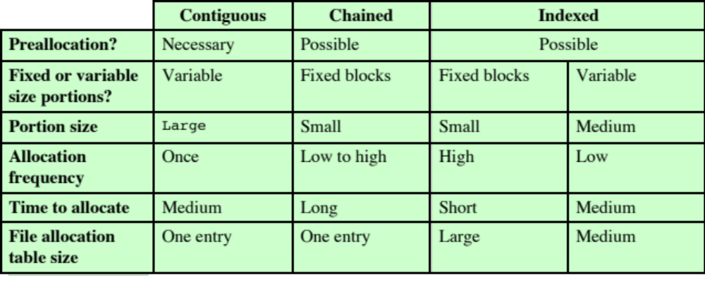
Table 12.2
File Allocation Methods
Notes:
Table 12.2 File Allocation Methods
Having looked at the issues of preallocation versus
dynamic allocation and portion size, we are in a position to consider specific file
allocation methods. Three methods are in common use: contiguous, chained, and
indexed. Table 12.2 summarizes some of the characteristics of each method.

Slide 42
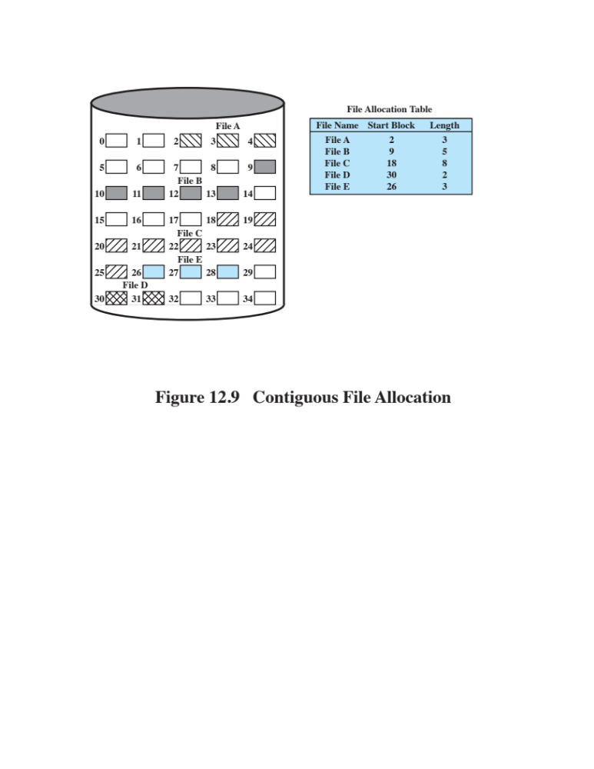
Notes:
With contiguous allocation , a single contiguous set of blocks is allocated to a
file at the time of file creation ( Figure 12.9 ). Thus, this is a preallocation strategy,
using variable-size portions. The file allocation table needs just a single entry for
each file, showing the starting block and the length of the file. Contiguous allocation
is the best from the point of view of the individual sequential file. Multiple blocks
can be read in at a time to improve I/O performance for sequential processing. It is
also easy to retrieve a single block. For example, if a file starts at block b , and the
i th block of the file is wanted, its location on secondary storage is simply b + i – 1.
Contiguous allocation presents some problems. External fragmentation will occur,
making it difficult to find contiguous blocks of space of sufficient length.

Slide 43
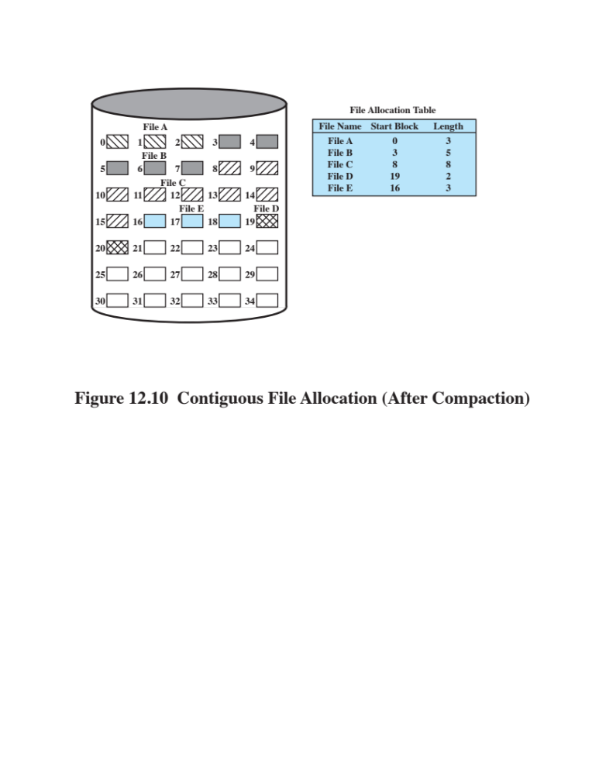
Notes:
From time to time, it will be necessary to perform a compaction algorithm to free up additional
space on the disk ( Figure 12.10 ). Also, with preallocation, it is necessary to declare
the size of the file at the time of creation, with the problems mentioned earlier.

Slide 44
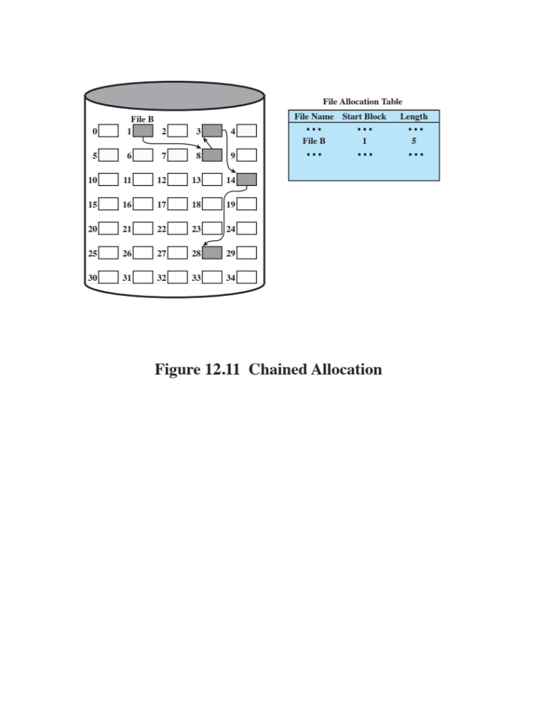
Notes:
At the opposite extreme from contiguous allocation is chained allocation
( Figure 12.11 ). Typically, allocation is on an individual block basis. Each block contains
a pointer to the next block in the chain. Again, the file allocation table needs
just a single entry for each file, showing the starting block and the length of the
file. Although preallocation is possible, it is more common simply to allocate blocks
as needed. The selection of blocks is now a simple matter: Any free block can be
added to a chain. There is no external fragmentation to worry about because only
one block at a time is needed. This type of physical organization is best suited to
sequential files that are to be processed sequentially. To select an individual block
of a file requires tracing through the chain to the desired block.

Slide 45
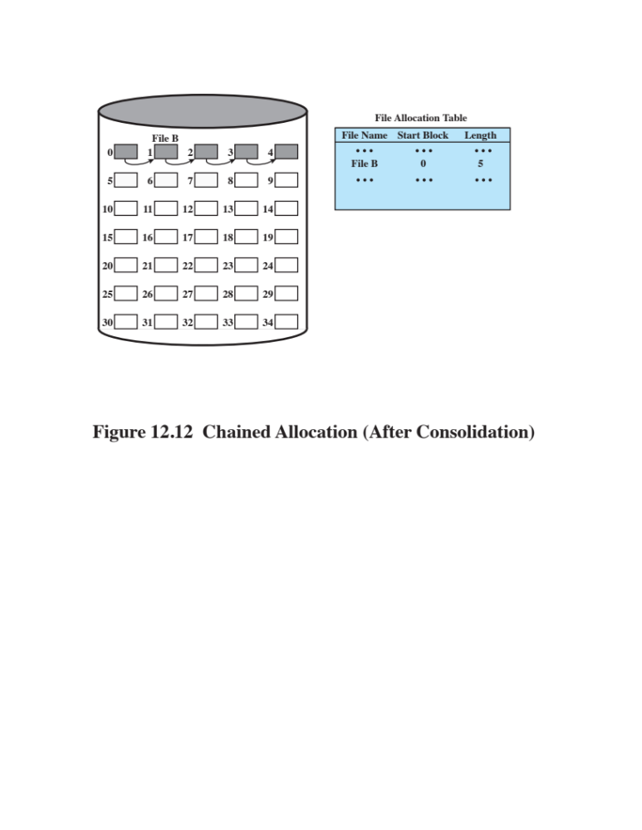
Notes:
One consequence of chaining, as described so far, is that there is no accommodation
of the principle of locality. Thus, if it is necessary to bring in several blocks of
a file at a time, as in sequential processing, then a series of accesses to different parts
of the disk are required. This is perhaps a more significant effect on a single-user
system but may also be of concern on a shared system. To overcome this problem,
some systems periodically consolidate files ( Figure 12.12 ).

Slide 46
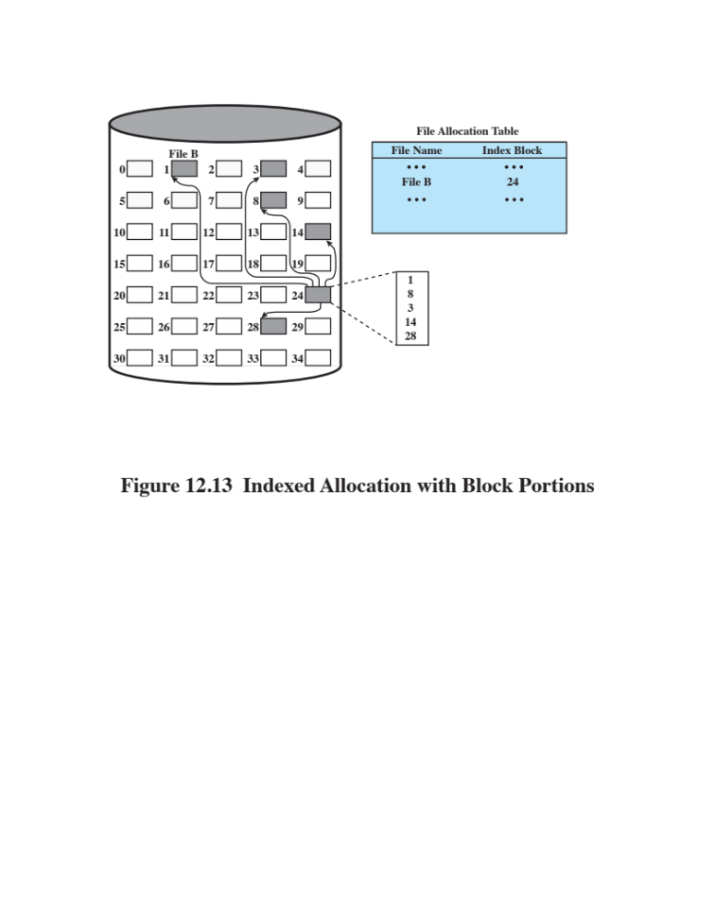
Notes:
Indexed allocation addresses many of the problems of contiguous and chained
allocation. In this case, the file allocation table contains a separate one-level index for
each file; the index has one entry for each portion allocated to the file. Typically, the
file indexes are not physically stored as part of the file allocation table. Rather, the
file index for a file is kept in a separate block, and the entry for the file in the file allocation
table points to that block. Allocation may be on the basis of either fixed-size
blocks ( Figure 12.13 ) or variable-size portions ( Figure 12.14 ). Allocation by blocks
eliminates external fragmentation, whereas allocation by variable-size portions
improves locality. In either case, file consolidation may be done from time to time.
File consolidation reduces the size of the index in the case of variable-size portions,
but not in the case of block allocation. Indexed allocation supports both sequential
and direct access to the file and thus is the most popular form of file allocation.

Slide 47
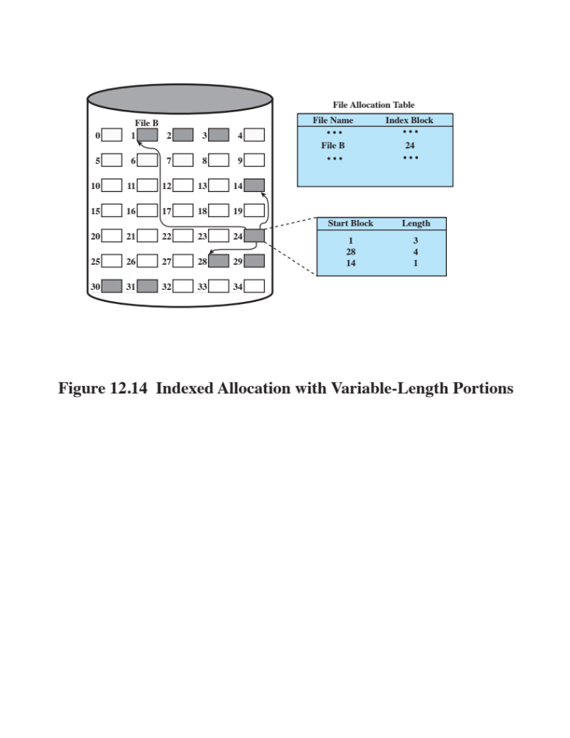
Notes:
Figure 12.14 Indexed allocation with Variable-Length Portions

Slide 48
Free Space Management
Just as allocated space must be managed, so must the unallocated space
To perform file allocation, it is necessary to know which blocks are available
A disk allocation table is needed in addition to a file allocation table
Notes:
Just as the space that is allocated to files must be managed, so the space that is not
currently allocated to any file must be managed. To perform any of the file allocation
techniques described previously, it is necessary to know what blocks on the disk
are available. Thus we need a disk allocation table in addition to a file allocation
table. We discuss here a number of techniques that have been implemented.

Slide 49
Bit Tables
This method uses a vector containing one bit for each block on the disk
Each entry of a 0 corresponds to a free block, and each 1 corresponds to a block in use
Advantages:
Works well with any file allocation method
It is as small as possible
Notes:
This method uses a vector containing one bit for each block on the
disk. Each entry of a 0 corresponds to a free block, and each 1 corresponds to a
block in use. For example, for the disk layout of Figure 12.9 , a vector of length 35 is
needed and would have the following value:
00111000011111000011111111111011000
A bit table has the advantage that it is relatively easy to find one or a contiguous
group of free blocks. Thus, a bit table works well with any of the file
allocation methods outlined. Another advantage is that it is as small as possible.
However, it can still be sizable. The amount of memory (in bytes) required for a
block bitmap is
disk size in bytes
8 x file system block size
Thus, for a 16-Gbyte disk with 512-byte blocks, the bit table occupies about
4 Mbytes. Can we spare 4 Mbytes of main memory for the bit table? If so, then the
bit table can be searched without the need for disk access. But even with today’s
memory sizes, 4 Mbytes is a hefty chunk of main memory to devote to a single function.
The alternative is to put the bit table on disk. But a 4-Mbyte bit table would
require about 8,000 disk blocks. We can’t afford to search that amount of disk space
every time a block is needed, so a bit table resident in memory is indicated.
Even when the bit table is in main memory, an exhaustive search of the table
can slow file system performance to an unacceptable degree. This is especially true
when the disk is nearly full and there are few free blocks remaining. Accordingly,
most file systems that use bit tables maintain auxiliary data structures that summarize
the contents of subranges of the bit table. For example, the table could be
divided logically into a number of equal-size subranges. A summary table could
include, for each subrange, the number of free blocks and the maximum-sized contiguous
number of free blocks. When the file system needs a number of contiguous
blocks, it can scan the summary table to find an appropriate subrange and then
search that subrange.

Slide 50
Chained Free Portions
The free portions may be chained together by using a pointer and length value in each free portion
Negligible space overhead because there is no need for a disk allocation table
Suited to all file allocation methods
Disadvantages:
Leads to fragmentation
Every time you allocate a block you need to read the block first to recover the pointer to the new first free block before writing data to that block
Notes:
The free portions may be chained together by using
a pointer and length value in each free portion. This method has negligible space
overhead because there is no need for a disk allocation table, merely for a pointer to
the beginning of the chain and the length of the first portion. This method is suited
to all of the file allocation methods. If allocation is a block at a time, simply choose
the free block at the head of the chain and adjust the first pointer or length value.
If allocation is by variable-length portion, a first-fit algorithm may be used: The
headers from the portions are fetched one at a time to determine the next suitable
free portion in the chain. Again, pointer and length values are adjusted.
This method has its own problems. After some use, the disk will become quite
fragmented and many portions will be a single block long. Also note that every
time you allocate a block, you need to read the block first to recover the pointer to
the new first free block before writing data to that block. If many individual blocks
need to be allocated at one time for a file operation, this greatly slows file creation.
Similarly, deleting highly fragmented files is very time consuming.

Slide 51
Indexing
Treats free space as a file and uses an index table as it would for file allocation
For efficiency, the index should be on the basis of variable-size portions rather than blocks
This approach provides efficient support for all of the file allocation methods
Notes:
The indexing approach treats free space as a file and uses an index table
as described under file allocation. For efficiency, the index should be on the basis
of variable-size portions rather than blocks. Thus, there is one entry in the table for
every free portion on the disk. This approach provides efficient support for all of
the file allocation methods.

Slide 52
Free Block List
Each block is assigned a number sequentially
The list of the numbers of all free blocks is maintained in a reserved portion of the disk
Depending on the size of the disk, either 24 or 32 bits will be needed to store a single block number
The size of the free block list is 24 or 32 times the size of the corresponding bit table and must be stored on disk
There are two effective techniques for storing a small part of the free block list in main memory:
The list can be treated as a push-down stack with the first few thousand elements of the stack kept in main memory
The list can be treated as a FIFO queue, with a few thousand entries from both the head and the tail of the queue in main memory
Notes:
In this method, each block is assigned a number sequentially
and the list of the numbers of all free blocks is maintained in a reserved portion of
the disk. Depending on the size of the disk, either 24 or 32 bits will be needed to
store a single block number, so the size of the free block list is 24 or 32 times the size
of the corresponding bit table and thus must be stored on disk rather than in main
memory. However, this is a satisfactory method.
Consider the following points:
1. The space on disk devoted to the free block list is less than 1% of the total disk
space. If a 32-bit block number is used, then the space penalty is 4 bytes for
every 512-byte block.
2. Although the free block list is too large to store in main memory, there are
two effective techniques for storing a small part of the list in main memory.
a. The list can be treated as a push-down stack (Appendix P) with the first
few thousand elements of the stack kept in main memory. When a new
block is allocated, it is popped from the top of the stack, which is in main
memory. Similarly, when a block is deallocated, it is pushed onto the stack.
There only has to be a transfer between disk and main memory when the
in-memory portion of the stack becomes either full or empty. Thus, this
technique gives almost zero-time access most of the time.
b. The list can be treated as a FIFO queue, with a few thousand entries from
both the head and the tail of the queue in main memory. A block is allocated
by taking the first entry from the head of the queue and deallocated
by adding it to the end of the tail of the queue. There only has to be a transfer
between disk and main memory when either the in-memory portion of
the head of the queue becomes empty or the in-memory portion of the tail
of the queue becomes full.
In either of the strategies listed in the preceding point (stack or FIFO queue),
a background thread can slowly sort the in-memory list or lists to facilitate contiguous
allocation.

Slide 53
Volumes
A collection of addressable sectors in secondary memory that an OS or application can use for data storage
The sectors in a volume need not be consecutive on a physical storage device
    They need only appear that way to the OS or application
A volume may be the result of assembling and merging smaller volumes
Notes:
The term volume is used somewhat differently by different operating systems and
file management systems, but in essence a volume is a logical disk. [CARR05]
defines a volume as follows:
Volume: A collection of addressable sectors in secondary memory that an OS or
application can use for data storage. The sectors in a volume need not be consecutive
on a physical storage device; instead, they need only appear that way to
the OS or application. A volume may be the result of assembling and merging
smaller volumes.
In the simplest case, a single disk equals one volume. Frequently, a disk is
divided into partitions, with each partition functioning as a separate volume. It is
also common to treat multiple disks as a single volume or partitions on multiple
disks as a single volume.

Slide 54
UNIX File Management
In the UNIX file system, six types of files are distinguished:
Regular, or ordinary
Contains arbitrary data in zero or more data blocks
Directory
Contains a list of file names plus pointers to associated inodes (index nodes)
Special
Contains no data but provides a mechanism to map physical devices to file names
Named pipes
Links
An alternative file name for an existing file
Symbolic links
A data file that contains the name of the file to which it is linked
An interprocess communications facility
Notes:
Regular, or ordinary: Contains arbitrary data in zero or more data blocks.
Regular files contain information entered in them by a user, an application program, or a system utility program.
The file system does not impose any internal structure to a regular file but treats it as a stream of bytes.
Directory: Contains a list of file names plus pointers to associated inodes (index nodes)
Directories are hierarchically organized
Directory files are actually ordinary files with special write protection privileges so that only the file system can write into them, while read access is available to user programs.
Special: Contains no data, but provides a mechanism to map physical devices to file names.
The file names are used to access peripheral devices, such as terminals and printers.
Each I/O device is associated with a special file.
Named pipes: A pipe is an interprocess communications facility.
A pipe file buffers data received in its input so that a process that reads from the pipe’s output receives the data on a first-in-first-out basis.
Links: A link is an alternative file name for an existing file.
Symbolic links: This is a data file that contains the name of the file it is linked to.

Slide 55
Inodes
All types of UNIX files are administered by the OS by means of inodes
An inode (index node) is a control structure that contains the key information needed by the operating system for a particular file
Several file names may be associated with a single inode
    An active inode is associated with exactly one file
    Each file is controlled by exactly one inode
Notes:
Modern UNIX operating systems support multiple file systems but map all of these
into a uniform underlying system for supporting file systems and allocating disk
space to files. All types of UNIX files are administered by the OS by means of
inodes. An inode (index node) is a control structure that contains the key information
needed by the operating system for a particular file. Several file names may be
associated with a single inode, but an active inode is associated with exactly one file,
and each file is controlled by exactly one inode.

Slide 56
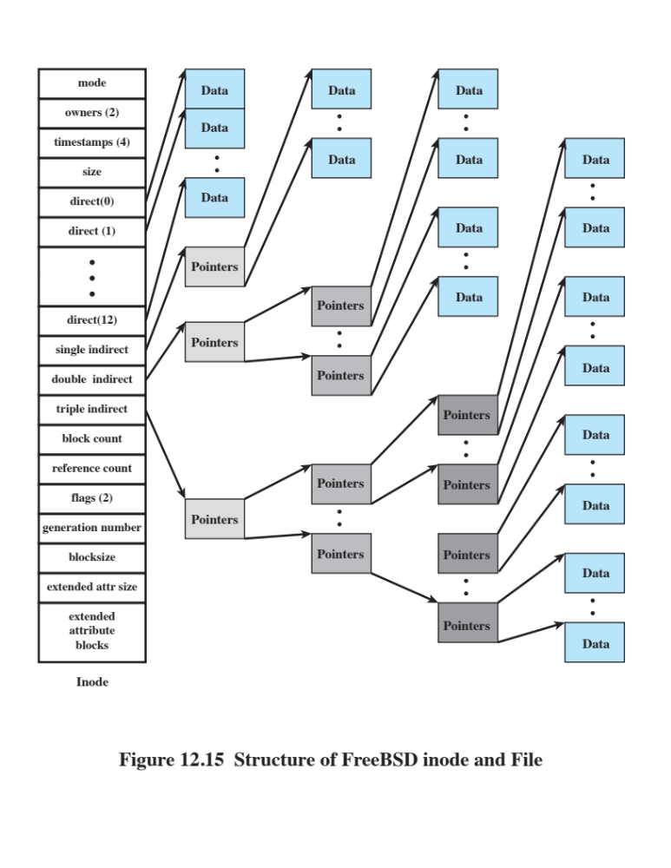
Notes:
The attributes of the file as well as its permissions and other control information
are stored in the inode. The exact inode structure varies from one UNIX
implementation to another. The FreeBSD inode structure, shown in Figure 12.15 ,
includes the following data elements:
• The type and access mode of the file
• The file’s owner and group-access identifiers
• The time that the file was created, when it was most recently read and written, and when its inode was most recently updated by the system
• The size of the file in bytes
• A sequence of block pointers, explained in the next subsection
• The number of physical blocks used by the file, including blocks used to hold indirect pointers and attributes
• The number of directory entries that reference the file
• The kernel and user-settable flags that describe the characteristics of the file
• The generation number of the file (a randomly selected number assigned to the inode each time that the latter is allocated to a new file; the generation number is used to detect references to deleted files)
• The blocksize of the data blocks referenced by the inode (typically the same as, but sometimes larger than, the file system blocksize)
The size of the extended attribute information
• Zero or more extended attribute entries
The blocksize value is typically the same as, but sometimes larger than, the file
system blocksize. On traditional UNIX systems, a fixed blocksize of 512 bytes was
used. FreeBSD has a minimum blocksize of 4,096 bytes (4 Kbytes); the blocksize
can be any power of 2 greater than or equal to 4,096. For typical file systems, the
blocksize is 8 Kbytes or 16 Kbytes. The default FreeBSD blocksize is 16 Kbytes.
Extended attribute entries are variable-length entries used to store auxiliary
data that are separate from the contents of the file. The first two extended attributes
defined for FreeBSD deal with security. The first of these support access control
lists; this is described in Chapter 15 . The second defined extended attribute supports
the use of security labels, which are part of what is known as a mandatory
access control scheme, also defined in Chapter 15 .
On the disk, there is an inode table, or inode list, that contains the inodes of
all the files in the file system. When a file is opened, its inode is brought into main
memory and stored in a memory-resident inode table.

Slide 57
File Allocation
File allocation is done on a block basis
Allocation is dynamic, as needed, rather than using preallocation
An indexed method is used to keep track of each file, with part of the index stored in the inode for the file
In all UNIX implementations the inode includes a number of direct pointers and three indirect pointers (single, double, triple)
Notes:
File allocation is done on a block basis. Allocation is dynamic, as needed, rather
than using preallocation. Hence, the blocks of a file on disk are not necessarily contiguous.
An indexed method is used to keep track of each file, with part of the index
stored in the inode for the file. In all UNIX implementations, the inode includes a
number of direct pointers and three indirect pointers (single, double, triple).
The FreeBSD inode includes 120 bytes of address information that is organized
as fifteen 64-bit addresses, or pointers. The first 12 addresses point to the first
12 data blocks of the file. If the file requires more than 12 data blocks, one or more
levels of indirection is used as follows:
• The thirteenth address in the inode points to a block on disk that contains the
next portion of the index. This is referred to as the single indirect block. This
block contains the pointers to succeeding blocks in the file.
• If the file contains more blocks, the fourteenth address in the inode points to
a double indirect block. This block contains a list of addresses of additional
single indirect blocks. Each of single indirect blocks, in turn, contains pointers
to file blocks.
• If the file contains still more blocks, the fifteenth address in the inode points
to a triple indirect block that is a third level of indexing. This block points to
additional double indirect blocks.
All of this is illustrated in Figure 12.15 .

Slide 58

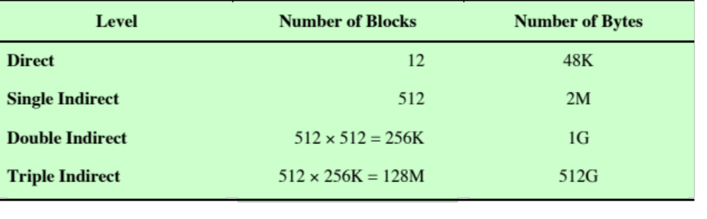
Table 12.3
Capacity of a FreeBSD File with 4-Kbyte Block Size
Notes:
The total number of data blocks
in a file depends on the capacity of the fixed-size blocks in the system. In
FreeBSD, the minimum block size is 4 Kbyte, and each block can hold a total of
512 block addresses. Thus, the maximum size of a file with this block size is over
500 GB ( Table 12.3 ).
This scheme has several advantages:
1. The inode is of fixed size and relatively small and hence may be kept in main
memory for long periods.
2. Smaller files may be accessed with little or no indirection, reducing processing
and disk access time.
3. The theoretical maximum size of a file is large enough to satisfy virtually all
applications.

Slide 59
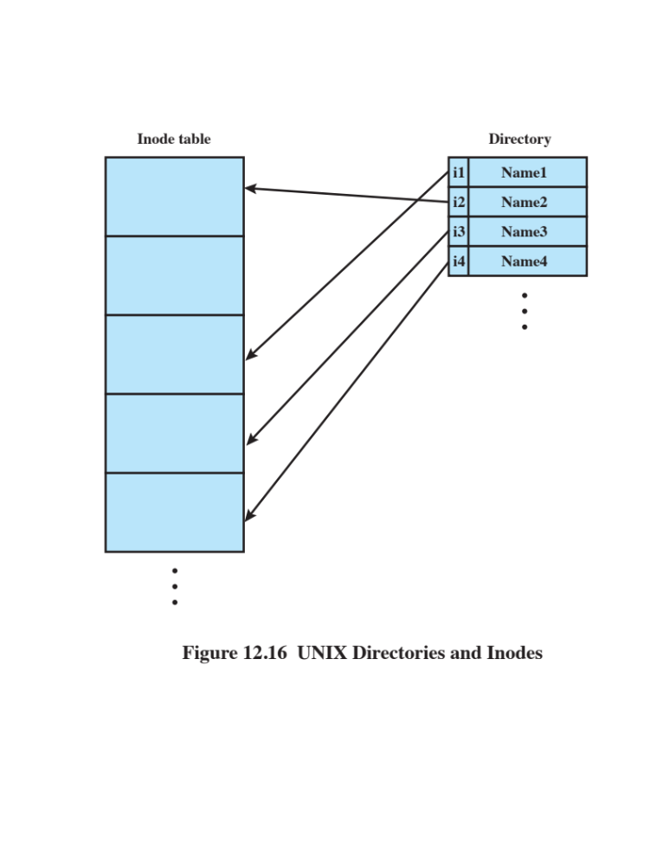
Notes:
Directories are structured in a hierarchical tree. Each directory can contain files
and/or other directories. A directory that is inside another directory is referred to
as a subdirectory. As was mentioned, a directory is simply a file that contains a
list of file names plus pointers to associated inodes. Figure 12.16 shows the overall
structure. Each directory entry (dentry) contains a name for the associated file or
subdirectory plus an integer called the i-number (index number). When the file or
directory is accessed, its i-number is used as an index into the inode table.

Slide 60
Volume Structure
Boot block
Contains code required to boot the operating system
Superblock
Contains attributes and information about the file system
Inode table
Collection of inodes for each file
Data blocks
Storage space available for data files and subdirectories
A UNIX file system resides on a single logical disk or disk partition and is laid out with the following elements:
Notes:
A UNIX file system resides on a single logical disk or disk partition and is laid out
with the following elements:
• Boot block: Contains code required to boot the operating system
• Superblock: Contains attributes and information about the file system, such as
partition size, and inode table size
• Inode table: The collection of inodes for each file
• Data blocks: Storage space available for data files and subdirectories

Slide 61
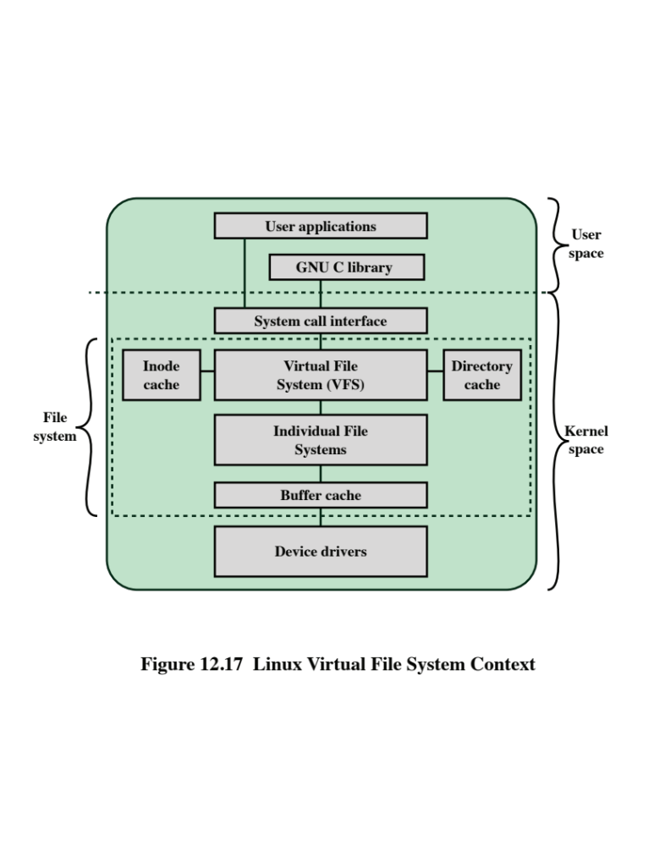
Notes:
Linux includes a versatile and powerful file-handling facility, designed to support a
wide variety of file management systems and file structures. The approach taken in
Linux is to make use of a virtual file system (VFS) , which presents a single, uniform
file system interface to user processes. The VFS defines a common file model that is
capable of representing any conceivable file system’s general feature and behavior.
The VFS assumes that files are objects in a computer’s mass storage memory that
share basic properties regardless of the target file system or the underlying processor
hardware. Files have symbolic names that allow them to be uniquely identified
within a specific directory within the file system. A file has an owner, protection
against unauthorized access or modification, and a variety of other properties. A
file may be created, read from, written to, or deleted. For any specific file system, a
mapping module is needed to transform the characteristics of the real file system to
the characteristics expected by the virtual file system.
Figure 12.17 indicates the key ingredients of the Linux file system strategy. A
user process issues a file system call (e.g., read) using the VFS file scheme. The VFS
converts this into an internal (to the kernel) file system call that is passed to a mapping
function for a specific file system [e.g., IBM’s Journaling File System (JFS)]. In
most cases, the mapping function is simply a mapping of file system functional calls
from one scheme to another. In some cases, the mapping function is more complex.
For example, some file systems use a file allocation table (FAT), which stores the
position of each file in the directory tree. In these file systems, directories are not
files. For such file systems, the mapping function must be able to construct dynamically,
and when needed, the files corresponding to the directories. In any case, the
original user file system call is translated into a call that is native to the target file
system. The target file system software is then invoked to perform the requested
function on a file or directory under its control and secondary storage. The results
of the operation are then communicated back to the user in a similar fashion.

Slide 62
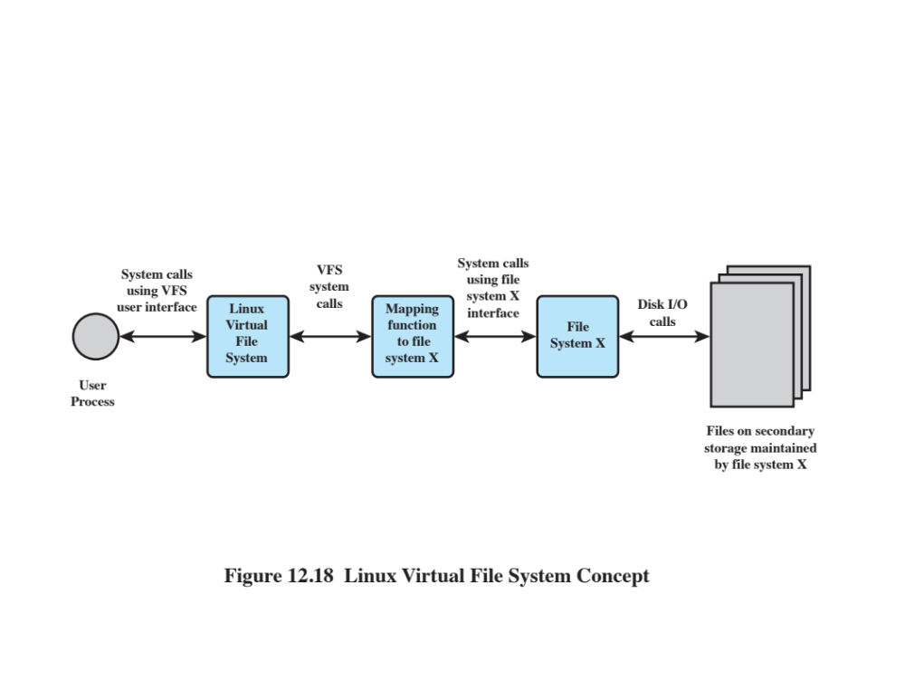
Notes:
Figure 12.18 indicates the role that VFS plays within the Linux kernel. When
a process initiates a file-oriented system call (e.g., read), the kernel calls a function
in the VFS. This function handles the file-system-independent manipulations and
initiates a call to a function in the target file system code. This call passes through
a mapping function that converts the call from the VFS into a call to the target file
system. The VFS is independent of any file system, so the implementation of a mapping
function must be part of the implementation of a file system on Linux. The
target file system converts the file system request into device-oriented instructions
that are passed to a device driver by means of page cache functions.
VFS is an object-oriented scheme. Because it is written in C, rather than a
language that supports object programming (such as C++ or Java), VFS objects are
implemented simply as C data structures. Each object contains both data and pointers
to file-system-implemented functions that operate on data.

Slide 63
Primary Object Types in VFS
Superblock Object
Represents a specific mounted file system
Dentry Object
Represents a specific directory entry
Inode Object
Represents a specific file
File Object
Represents an open file associated with a process
Notes:
The four primary
object types in VFS are as follows:
• Superblock object: Represents a specific mounted file system
• Inode object: Represents a specific file
• Dentry object: Represents a specific directory entry
• File object: Represents an open file associated with a process
This scheme is based on the concepts used in UNIX file systems, as described in
Section 12.7 . The key concepts of UNIX file system to remember are the following. A
file system consists of a hierarchal organization of directories. A directory is the same
as what is known as a folder on many non-UNIX platforms and may contain files and/
or other directories. Because a directory may contain other directories, a tree structure
is formed. A path through the tree structure from the root consists of a sequence
of directory entries, ending in either a directory entry (dentry) or a file name. In
UNIX, a directory is implemented as a file that lists the files and directories contained
within it. Thus, file operations can be performed on either files or directories.

Slide 64
The Superblock Object
Stores information describing a specific file system
Typically, the superblock corresponds to the file system superblock or file system control block, which is stored in a special sector on disk
The superblock object consists of a number of data items
    Examples include:
      The device this file system is mounted on
      The basic block size of the file system
      Dirty flag, to indicate that the superblock has been changed but not written back to disk
      File system type
      Flags, such as a read-only flag
      Pointer to the root of the file system directory
      List of open files
      Semaphore for controlling access to the file system
      List of superblock operations
Notes:
The superblock object stores information describing a specific file system. Typically,
the superblock corresponds to the file system superblock or file system control block,
which is stored in a special sector on disk.
The superblock object consists of a number of data items. Examples include
the following:
• The device this file system is mounted on
• The basic block size of the file system
• Dirty flag, to indicate that the superblock has been changed but not written
back to disk
• File system type
• Flags, such as a read-only flag
• Pointer to the root of the file system directory
• List of open files
• Semaphore for controlling access to the file system
• List of superblock operations

Slide 65
The Inode Object
An inode is associated with each file
The inode object holds all the information about a named file except its name and the actual data contents of the file
Items contained in an inode object include owner, group, permissions, access times for a file, size of data it holds, and number of links
The inode object also includes an inode operations object that describes the file system’s implemented functions that the VFS can invoke on an inode
Notes:
An inode is associated with each file. The inode object holds all the information
about a named file except its name and the actual data contents of the file. Items
contained in an inode object include owner, group, permissions, access times for a
file, size of data it holds, and number of links.
The inode object also includes an inode operations object that describes the file
system’s implemented functions that the VFS can invoke on an inode. The methods
defined for the inode object include the following:
• create: Creates a new inode for a regular file associated with a dentry object
in some directory
• lookup: Searches a directory for an inode corresponding to a file name
• mkdir: Creates a new inode for a directory associated with a dentry object in
some directory

Slide 66
The Dentry Object
A dentry (directory entry) is a specific component in a path
The component may be either a directory name or a file name
Dentry objects facilitate quick lookups to files and directories, and are used in a dentry cache for that purpose
The dentry object includes a pointer to the inode and superblock
It also includes a pointer to the parent dentry and pointers to any subordinate dentrys
Notes:
A dentry (directory entry) is a specific component in a path. The component may be
either a directory name or a file name. Dentry objects facilitate quick lookups to files
and directories, and are used in a dentry cache for that purpose. The dentry object
includes a pointer to the inode and superblock. It also includes a pointer to the parent
dentry and pointers to any subordinate dentrys.

Slide 67
The File Object
The file object is used to represent a file opened by a process
The object is created in response to the open() system call, and destroyed in response to the close () system call
The file object also includes an inode operations object that describes the file system’s implemented functions that the VFS can invoke on a file object
The methods defined for the file object include read, write, open, release, and lock
The file object consists of a number of items, including:
      Dentry object associated with the file
      File system containing the file
      File objects usage counter
      User’s user ID
      User’s group ID
      File pointer, which is the current position in the file from which the next operation will take place
Notes:
The file object is used to represent a file opened by a process. The object is
created in response to the open() system call, and destroyed in response to the
close() system call. The file object consists of a number of items, including the
following:
• Dentry object associated with the file
• File system containing the file
• File objects usage counter
• User’s user ID
• User’s group ID
• File pointer, which is the current position in the file from which the next operation
will take place
The file object also includes an inode operations object that describes the file
system’s implemented functions that the VFS can invoke on a file object. The methods
defined for the file object include read, write, open, release, and lock.

Slide 68
Caches
The VFS employs three caches to improve performance:
    Inode cache
        Because every file and directory is represented by a VFS inode, a directory listing command or a file access command causes a number of inodes to be accessed
        The inode cache stores recently visited inodes to make access quicker
    Directory cache
        The directory cache stores the mapping between the full directory names and their inode numbers
        This speeds up the process of listing a directory
    Buffer cache
        The buffer cache is independent of the file systems and is integrated into the mechanisms that the Linux kernel uses to allocate and read and write data buffers
        As the real file systems read data from the underlying physical disks, this results in requests to the block device drivers to read physical blocks from the device that they control
        If the same data is needed often, it will be retrieved from the buffer cache rather than read from the disk
Notes:
The VFS employs three caches to improve performance:
1. Inode cache: Because every file and directory is represented by a VFS inode, a
directory listing command or a file access command causes a number of inodes
to be accessed. The inode cache stores recently visited inodes to make access
quicker.
2. Directory cache: The directory cache stores the mapping between the full directory
names and their inode numbers. This speeds up the process of listing a
directory.
3. Buffer cache: The buffer cache is independent of the file systems and is integrated
into the mechanisms that the Linux kernel uses to allocate and read
and write data buffers. As the real file systems read data from the underlying
physical disks, this results in requests to the block device drivers to
read physical blocks from the device that they control. So, if the same data
is needed often, it will be retrieved from the buffer cache rather than read
from the disk.

Slide 69
Windows File System
The developers of Windows NT designed a new file system, the New Technology File System (NTFS) which is intended to meet high-end requirements for workstations and servers
Key features of NTFS:
  Recoverability
  Security
  Large disks and large files
  Multiple data streams
  Journaling
  Compression and encryption
  Hard and symbolic links
Notes:
The developers of Windows NT designed a new file system, the New Technology
File System (NTFS), which is intended to meet high-end requirements for workstations
and servers. Examples of high-end applications include the following:
• Client/server applications such as file servers, compute servers, and database
servers
• Resource-intensive engineering and scientific applications
• Network applications for large corporate systems
NTFS is a flexible and powerful file system built, as we shall see, on an elegantly simple
file system model. The most noteworthy features of NTFS include the following:
• Recoverability: High on the list of requirements for the new Windows file
system was the ability to recover from system crashes and disk failures. In the
event of such failures, NTFS is able to reconstruct disk volumes and return
them to a consistent state. It does this by using a transaction-processing model
for changes to the file system; each significant change is treated as an atomic
action that is either entirely performed or not performed at all. Each transaction
that was in process at the time of a failure is subsequently backed out or
brought to completion. In addition, NTFS uses redundant storage for critical
file system data, so that failure of a disk sector does not cause the loss of data
describing the structure and status of the file system.
• Security: NTFS uses the Windows object model to enforce security. An open
file is implemented as a file object with a security descriptor that defines its
security attributes. The security descriptor is persisted as an attribute of each
file on disk.
• Large disks and large files: NTFS supports very large disks and very large files
more efficiently than other file systems, such as FAT.
• Multiple data streams: The actual contents of a file are treated as a stream of
bytes. In NTFS, it is possible to define multiple data streams for a single file.
An example of the utility of this feature is that it allows Windows to be used
by remote Macintosh systems to store and retrieve files. On Macintosh, each
file has two components: the file data and a resource fork that contains information
about the file. NTFS treats these two components as two data streams
within a single file.
• Journaling: NTFS keeps a log of all changes made to files on the volumes.
Programs, such as desktop search, can read the journal to identify what files
have changed.
• Compression and encryption: Entire directories and individual files can be
transparently compressed and/or encrypted.
• Hard and symbolic l inks: In order to support POSIX, Windows has always supported
“hard links,” which allow a single file to be accessible by multiple path
names on the same volume. Starting with Windows Vista, “symbolic links”
are supported which allow a file or directory to be accessible by multiple path
names, even if the names are on different volumes. Windows also supports
“mount points” which allow volumes to appear at junction points on other
volumes, rather than be named by driver letters, such as “D:”.

Slide 70
NTFS Volume and File Structure
NTFS makes use of the following disk storage concepts:
Sector
The smallest physical storage unit on the disk
The data size in bytes is a power of 2 and is almost always 512 bytes
Cluster
One or more contiguous sectors
The cluster size in sectors is a power of 2
Volume
A logical partition on a disk, consisting of one or more clusters and used by a file system to allocate space
Can be all or a portion of a single disk or it can extend across multiple disks
The maximum volume size for NTFS is 2⁶⁴ clusters
Notes:
NTFS makes use of the following disk storage concepts:
• Sector: The smallest physical storage unit on the disk. The data size in bytes is
a power of 2 and is almost always 512 bytes.
• Cluster: One or more contiguous (next to each other on the disk) sectors. The
cluster size in sectors is a power of 2.
• Volume: A logical partition on a disk, consisting of one or more clusters and
used by a file system to allocate space. At any time, a volume consists of file
system information, a collection of files, and any additional unallocated space
remaining on the volume that can be allocated to files. A volume can be all or
a portion of a single disk or it can extend across multiple disks. If hardware or
software RAID 5 is employed, a volume consists of stripes spanning multiple
disks. The maximum volume size for NTFS is 2⁶⁴ clusters.
The cluster is the fundamental unit of allocation in NTFS, which does not
recognize sectors. For example, suppose each sector is 512 bytes and the system is
configured with two sectors per cluster (one cluster 1K bytes). If a user creates
a file of 1,600 bytes, two clusters are allocated to the file. Later, if the user updates
the file to 3,200 bytes, another two clusters are allocated. The clusters allocated to a
file need not be contiguous; it is permissible to fragment a file on the disk. Currently,
the maximum file size supported by NTFS is 2³² clusters, which is equivalent to a
maximum of 2⁴⁸ bytes. A cluster can have at most 2¹⁶ bytes.
The use of clusters for allocation makes NTFS independent of physical sector
size. This enables NTFS to support easily nonstandard disks that do not have a
512-byte sector size and to support efficiently very large disks and very large files
by using a larger cluster size. The efficiency comes from the fact that the file system
must keep track of each cluster allocated to each file; with larger clusters, there are
fewer items to manage.

Slide 71
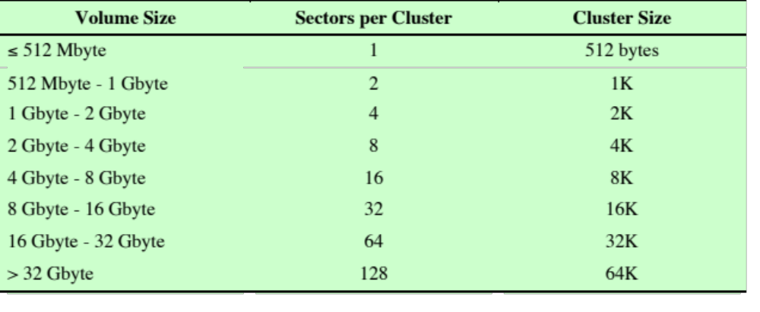
Table 12.4
Windows NTFS Partition and Cluster Sizes
Notes:
Table 12.4 shows the default cluster sizes for NTFS. The defaults depend on
the size of the volume. The cluster size that is used for a particular volume is established
by NTFS when the user requests that a volume be formatted.

Slide 72
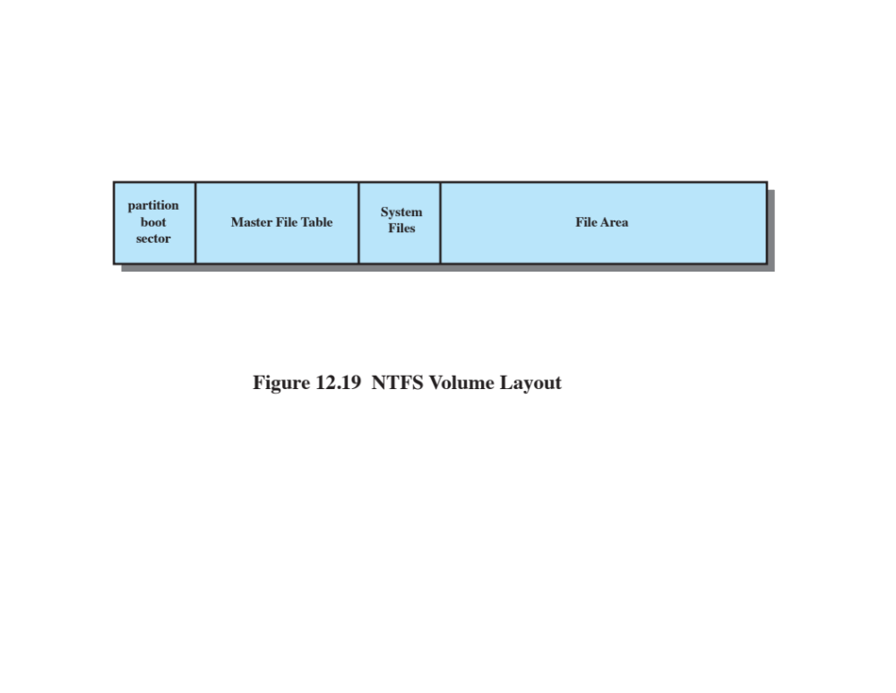
Notes:
NTFS uses a remarkably simple but powerful approach
to organizing information on a disk volume. Every element on a volume is a file,
and every file consists of a collection of attributes. Even the data contents of a file is
treated as an attribute. With this simple structure, a few general-purpose functions
suffice to organize and manage a file system.
Figure 12.19 shows the layout of an NTFS volume, which consists of four
regions. The first few sectors on any volume are occupied by the partition boot
sector (although it is called a sector, it can be up to 16 sectors long), which contains
information about the volume layout and the file system structures as well as boot
startup information and code. This is followed by the master file table (MFT) , which
contains information about all of the files and folders (directories) on this NTFS
volume. In essence, the MFT is a list of all files and their attributes on this NTFS
volume, organized as a set of rows in a table structure.
Following the MFT is a region containing system files . Among the files in this
region are the following:
• MFT2: A mirror of the first few rows of the MFT, used to guarantee access to
the volume in the case of a single-sector failure in the sectors storing the MFT.
• Log file: A list of transaction steps used for NTFS recoverability.
• Cluster bit map: A representation of the space on the volume, showing which
clusters are in use.
• Attribute definition table: Defines the attribute types supported on this
volume and indicates whether they can be indexed and whether they can be
recovered during a system recovery operation.

Slide 73
Master File Table (MFT)
The heart of the Windows file system is the MFT
The MFT is organized as a table of 1,024-byte rows, called records
Each row describes a file on this volume, including the MFT itself, which is treated as a file
Each record in the MFT consists of a set of attributes that serve to define the file (or folder) characteristics and the file contents
Notes:
The heart of the Windows file system is the MFT. The MFT
is organized as a table of 1,024-byte rows, called records. Each row describes a file
on this volume, including the MFT itself, which is treated as a file. If the contents of
a file are small enough, then the entire file is located in a row of the MFT. Otherwise,
the row for that file contains partial information and the remainder of the file spills
over into other available clusters on the volume, with pointers to those clusters in
the MFT row of that file.
Each record in the MFT consists of a set of attributes that serve to define the
file (or folder) characteristics and the file contents.

Slide 74
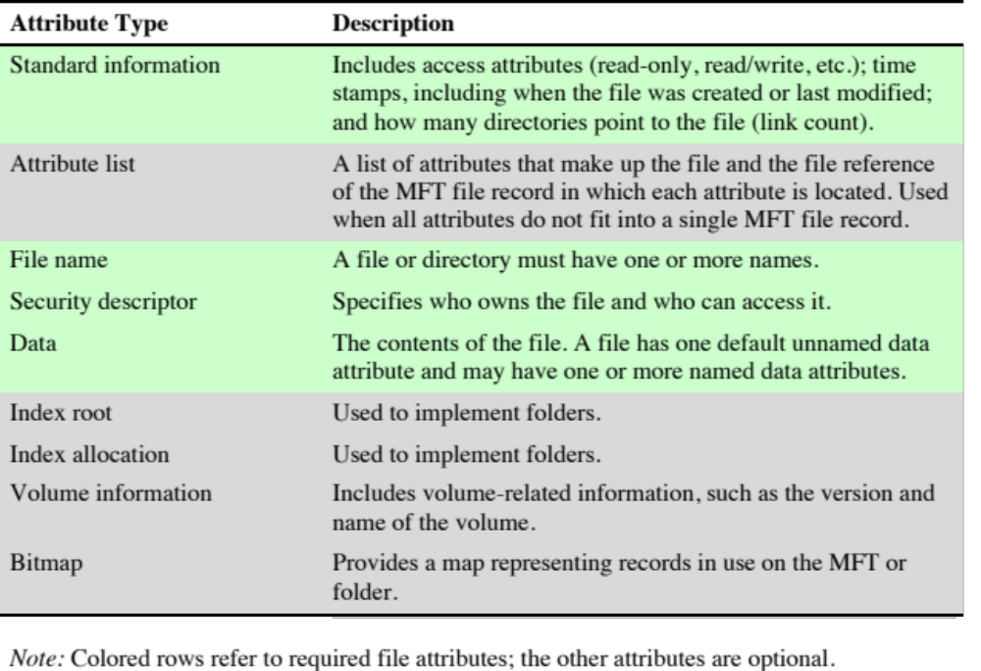
Table 12.5
Windows NTFS File and Directory Attribute Types
Notes:
Table 12.5 lists the attributes
that may be found in a row, with the required attributes indicated by shading.

Slide 75
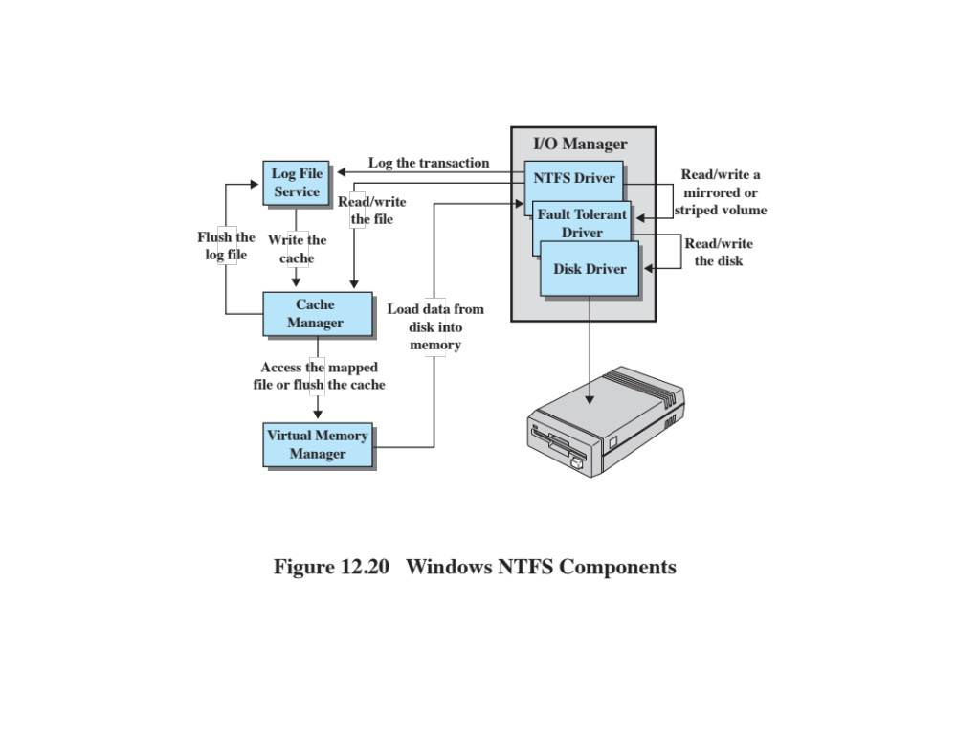
Notes:
NTFS makes it possible to recover the file system to a consistent state following a
system crash or disk failure. The key elements that support recoverability are as
follows ( Figure 12.20 ):
• I/O manager: Includes the NTFS driver, which handles the basic open, close,
read, and write functions of NTFS. In addition, the software RAID module
FTDISK can be configured for use.
• Log file service: Maintains a log of file system metadata changes on disk. The
log file is used to recover an NTFS-formatted volume in the case of a system
failure (i.e., without having to run the file system check utility).
• Cache manager: Responsible for caching file reads and writes to enhance
performance. The cache manager optimizes disk I/O.
• Virtual memory manager: The NTFS accesses cached files by mapping file references
to virtual memory references and reading and writing virtual memory.
It is important to note that the recovery procedures used by NTFS are designed
to recover file system metadata, not file contents. Thus, the user should never lose a
volume or the directory/file structure of an application because of a crash. However,
user data are not guaranteed by the file system. Providing full recoverability, including
user data, would make for a much more elaborate and resource-consuming
recovery facility.
The essence of the NTFS recovery capability is logging. Each operation that
alters a file system is treated as a transaction. Each suboperation of a transaction
that alters important file system data structures is recorded in a log file before being
recorded on the disk volume. Using the log, a partially completed transaction at the
time of a crash can later be redone or undone when the system recovers.
In general terms, these are the steps taken to ensure recoverability, as
described in [RUSS11]:
1. NTFS first calls the log file system to record in the log file (in the cache) any
transactions that will modify the volume structure.
2. NTFS modifies the volume (in the cache).
3. The cache manager calls the log file system to prompt it to flush the log file to
disk.
4. Once the log file updates are safely on disk, the cache manager flushes the
volume changes to disk.

Slide 76
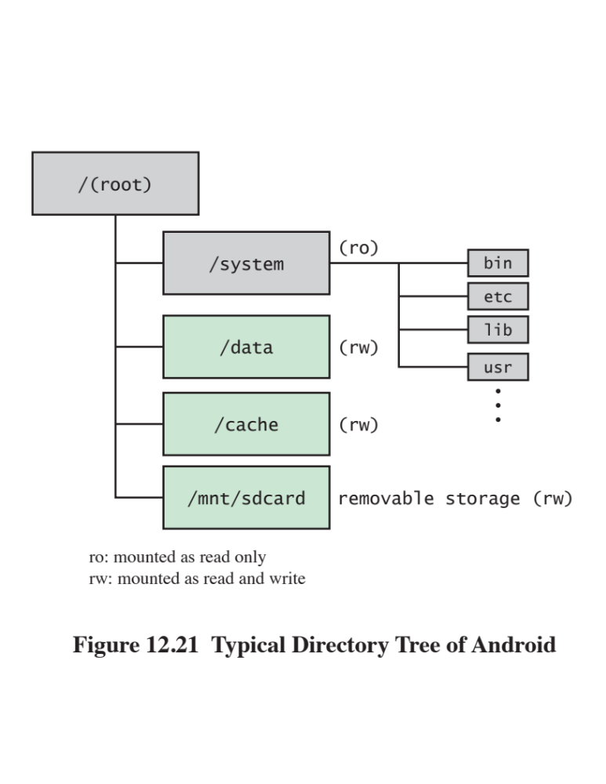
Notes:
Android makes use of the file management capabilities built into Linux. The
Android file system directory is similar to what is seen on a typical Linux installation,
with some Android-specific features.
Figure 12.21 shows the top levels of a typical Android file system directory.
The system directory contains the core parts of the operating system, including
system binaries, system libraries, and configuration files. It also includes a basic set
of Android applications, such as Alarmclock, Calculator, and Camera. The system
image is locked, with only read-only access granted to file system users. The remaining
directories shown in Figure 12.21 are read-write.
The data directory provides the principal location used by applications to store
files. When a new application is installed in the system, the following actions, among
others, are taken with respect to the data directory:
• The .apk (Android package) is placed into /data/app.
• Application-centric libraries are installed into /data/data/<application name>.
This is an application-specific sandbox area, accessible by the application but
not accessible to other applications.
• Application-relevant files databases are set up.
The cache directory is used for temporary storage by applications. This is
the partition where Android stores frequently accessed data and app components.
Wiping the cache doesn’t affect your personal data but simply gets rid of the existing
data there, which gets automatically rebuilt as you continue using the device.
The mnt/sdcard directory is not a partition on the internal memory of the
device but rather the SD card, which is a nonvolatile memory card that can be
incorporated with the Android devices. The SD card is a removable memory card
that the user can remove and plug into his or her computer. In terms of usage, this
is user storage space for the user to read/write data of all sorts, such as data, audio
and video files. On devices with both an internal and external SD card, the /sdcard
partition is always used to refer to the internal SD card. For the external SD card, if
present, an alternative partition is used, which differs from device to device.

Slide 77
SQLite
Most widely deployed SQL database engine in the world
Based on the Structured Query Language (SQL)
Designed to provide a streamlined SQL-based database management system suitable for embedded systems and other limited memory systems
The full SQLite library can be implemented in under 400 KB
In contrast to other database management systems, SQLite is not a separate process that is accessed from the client application
    The SQLite library is linked in, and thus becomes an integral part of the application program
Notes:
SQLite, which is based on SQL, is worth special mention. The Structured Query
Language (SQL) provides as standardized means for definition of and access to a
relational database by either a local or remote user or application. Structured Query
Language (SQL), originally developed by IBM in the mid-1970s, is a standardized
language that can be used to define schema, manipulate, and query data in a relational
database. There are several versions of the ANSI/ISO standard and a variety
of different implementations, but all follow the same basic syntax and semantics.
SQLite is the most widely deployed SQL database engine in the world. It is
designed to provide a streamlined SQL-based database management system suitable
for embedded systems and other limited-memory systems. The full SQLite library can
be implemented in under 400 kilobytes (KB). Unnecessary features can be disabled
at compile-time to further reduce the size of the library to under 190 KB if desired.
In contrast to other database management systems, SQLite is not a separate
process that is accessed from the client application. Instead, the SQLite library is
linked in and thus becomes an integral part of the application program.

Slide 78
Summary
File structure
File management systems
File organization and access
  The pile
  The sequential file
  The indexed sequential file
  The indexed file
  The direct or hashed file
B-Trees
File directories
  Contents
  Structure
  Naming
File sharing
  Access rights
  Simultaneous access
Record blocking
Android file management
  File system
  SQLite
    Secondary storage management
      File allocation
      Free space management
      Volumes
      Reliability
    UNIX file management
      Inodes
      File allocation
      Directories
      Volume structure
    Linux virtual file system
      Superblock object
      Inode object
      Dentry object
      File object
      Caches
    Windows file system
      Key features of NTFS
      NTFS volume and file structure
      Recoverability
Notes:
Summary of Chapter 12.

