Slide 1
CSE111 Introduction to Computer Applications
Lecture 11
Introduction to MS Excel 2010-Part 3
Prepared by Asst. Prof. Dr. Mohamed KURDI
Revised and presented by Asst. Prof. Dr. Samsun M. BAŞARICI

Slide 2

Summary of the Last week
Formulas and Functions
Entering a Formula
Editing a Formula
Changing the Operators Precedence
Copying/Pasting a Formula
Paste Options
Paste
Values
Formulas
Formatting
Pase Special
Inserting a Function
Count Functions (Count, Countif, Countifs)
Sum Functions (Sum, Sumif, Sumifs)
Logical Functions (If, And, Or)
Statistical Functions (Average, Averageif, Median, Mode, Standard Deviation, Min, Max, Large, and Small).

Slide 3
Learning Objectives
Understand the difference between relative, absolute and mixed references.
Understand and apply data sorting.
Understand and apply data filtering.
Understand and apply conditional formatting.
Understand and apply charts creation and modification.

Slide 4
Outlines
Cell References
Relative references
Absolute reference
Mixed reference.
Data Analysis
Data Sorting
Data Filtering
Conditional Formatting
Charts

Slide 5
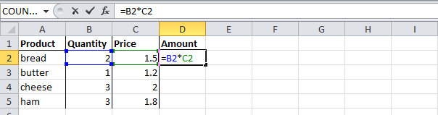
Cell References - Relative Reference
By default, Excel uses relative reference. See the formula in cell D2 below. Cell D2 references (points to) cell B2 and cell C2. Both references are relative.
Select cell D2, click on the lower right corner of cell D2 and drag it down to cell D5.

Slide 6
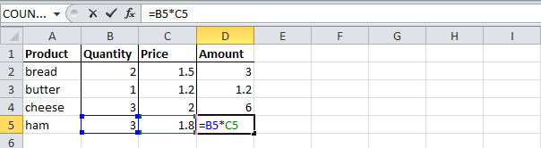
Cell References - Relative Reference
By default, Excel uses relative reference. See the formula in cell D2 below. Cell D2 references (points to) cell B2 and cell C2. Both references are relative.
Select cell D2, click on the lower right corner of cell D2 and drag it down to cell D5.

Slide 7
Cell References - Relative Reference
By default, Excel uses relative reference. See the formula in cell D2 below. Cell D2 references (points to) cell B2 and cell C2. Both references are relative.
Select cell D2, click on the lower right corner of cell D2 and drag it down to cell D5.
Cell D3 references are cell B3 and cell C3.
Cell D4 references are cell B4 and cell C4.
Cell D5 references are cell B5 and cell C5.
In other words: each cell references are its two neighbors on the left.

Slide 8
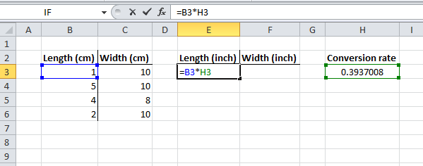
Cell References - Absolute Reference
See the formula in cell E3 below. Now drag to the other cells.

Slide 9
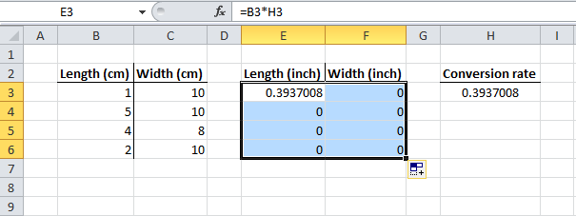
Cell References - Absolute Reference
See the formula in cell E3 below. Now drag to the other cells.
You have got worng results, why?

Slide 10
Cell References - Absolute Reference
See the formula in cell E3 below. Now drag to the other cells.
You have got wrong results, why?
Because the reference to cell H3 should be fixed.

Slide 11
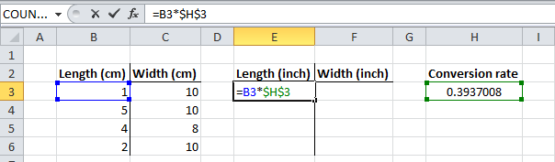
Cell References - Absolute Reference
Solution:
Create an absolute reference to cell H3, by placing a $ symbol in front of the column letter and row number of cell H3 ($H$3) in the formula of cell E3.

Slide 12
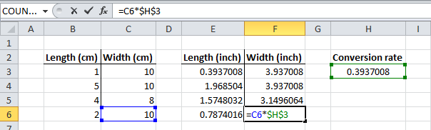
Cell References - Absolute Reference
Solution:
Create an absolute reference to cell H3, by placing a $ symbol in front of the column letter and row number of cell H3 ($H$3) in the formula of cell E3.
Now you can quickly drag this formula to the other cells.
The reference to the cell H3 is fixed (when we drag the formula down and across). As a result, the correct lengths and widths in inches are calculated.

Slide 13
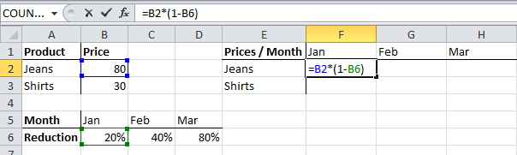
Cell References - Mixed Reference
Sometimes we need a combination of relative and absolute references (mixed reference).
See the formula in cell F2 below.
We want to copy this formula to the other cells quickly. Drag cell F2 across one cell, and look at the formula in cell G2.

Slide 14
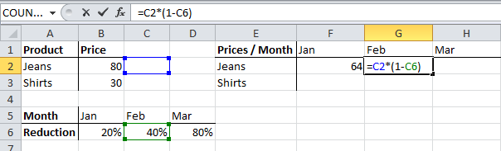
Cell References - Mixed Reference
Sometimes we need a combination of relative and absolute references (mixed reference).
See the formula in cell F2 below.
We want to copy this formula to the other cells quickly. Drag cell F2 across one cell, and look at the formula in cell G2.
You got an incorrect result. Why?

Slide 15
Cell References - Mixed Reference
Sometimes we need a combination of relative and absolute references (mixed reference).
See the formula in cell F2 below.
We want to copy this formula to the other cells quickly. Drag cell F2 across one cell, and look at the formula in cell G2.
You got an incorrect result. Why?
Because the reference to the price should be a fixed reference to column B.

Slide 16
Cell References - Mixed Reference
Sometimes we need a combination of relative and absolute references (mixed reference).
See the formula in cell F2 below.
We want to copy this formula to the other cells quickly. Drag cell F2 across one cell, and look at the formula in cell G2.
You got an incorrect result. Why?
Because the reference to the price should be a fixed reference to column B.
Solution: place a $ symbol in front of the column letter of cell B2 ($B2) in the formula of cell F2.
In a similar way, when we drag the cell F2 down, the reference to the reduction should be a fixed reference to row 6.
Solution: place a $ symbol in front of the row number of cell B6 (B$6) in the formula of cell F2.

Slide 17
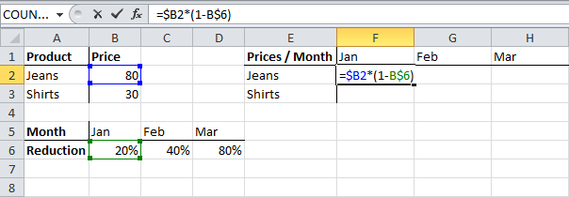
Cell References - Mixed Reference
Result:
Notes:
Note: we don't place a $ symbol in front of the row number of B2 (this way we allow the reference to change from B2 (Jeans) to B3 (Shirts) when we drag the formula down). In a similar way, we don't place a $ symbol in front of the column letter of B6 (this way we allow the reference to change from B6 (Jan) to C6 (Feb) and D6 (Mar) when we drag the formula across).

Slide 18
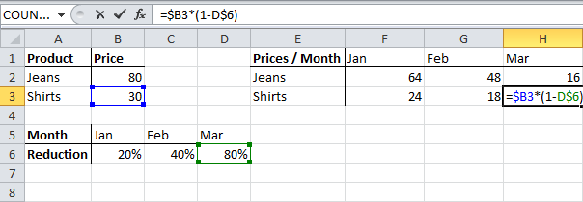
Cell References - Mixed Reference
Result:
Now we can quickly drag this formula to the other cells.
The references to column B and row 6 are fixed.
Notes:
Note: we don't place a $ symbol in front of the row number of B2 (this way we allow the reference to change from B2 (Jeans) to B3 (Shirts) when we drag the formula down). In a similar way, we don't place a $ symbol in front of the column letter of B6 (this way we allow the reference to change from B6 (Jan) to C6 (Feb) and D6 (Mar) when we drag the formula across).

Slide 19
Data Analysis - Sorting Data
You can sort your Excel data on one column or multiple columns.
You can sort in ascending or descending order.

Slide 20
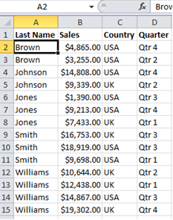
Data Analysis - Sorting Data
You can sort your Excel data on one column or multiple columns.
You can sort in ascending or descending order.
One Column Sorting:
1. Click any cell in the column you want to sort.

Slide 21
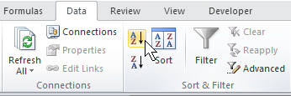
Data Analysis - Sorting Data
You can sort your Excel data on one column or multiple columns.
You can sort in ascending or descending order.
One Column Sorting:
1. Click any cell in the column you want to sort.
2. To sort in ascending order, on the Data tab, click AZ.

Slide 22

Data Analysis - Sorting Data
You can sort your Excel data on one column or multiple columns.
You can sort in ascending or descending order.
One Column Sorting:
1. Click any cell in the column you want to sort.
Result
2. To sort in ascending order, on the Data tab, click AZ.

Slide 23
Data Analysis - Sorting Data
You can sort your Excel data on one column or multiple columns.
You can sort in ascending or descending order.
One Column Sorting:
1. Click any cell in the column you want to sort.
Result
2. To sort in ascending order, on the Data tab, click AZ.
Be careful, don't select the entire column or the cells that are inside it.

Slide 24
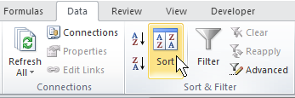
Data Analysis - Sorting Data
Multiple Column Sorting:
On the Data tab, click Sort.

Slide 25
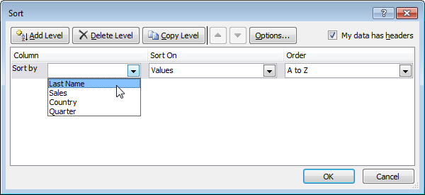
Data Analysis - Sorting Data
Multiple Column Sorting:
On the Data tab, click Sort.
2. Select Last Name from the 'Sort by' drop-down list.

Slide 26
Data Analysis - Sorting Data
Multiple Column Sorting:
On the Data tab, click Sort.
2. Select Last Name from the 'Sort by' drop-down list.
3. Click on Add Level.

Slide 27
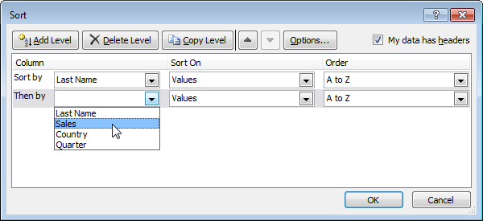
Data Analysis - Sorting Data
Multiple Column Sorting:
On the Data tab, click Sort.
2. Select Last Name from the 'Sort by' drop-down list.
3. Click on Add Level.
4. Select Sales from the 'Then by' drop-down list.

Slide 28
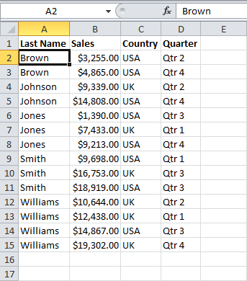
Data Analysis - Sorting Data
Multiple Column Sorting:
On the Data tab, click Sort.
2. Select Last Name from the 'Sort by' drop-down list.
3. Click on Add Level.
4. Select Sales from the 'Then by' drop-down list.
5. Click OK.
Result

Slide 29
Data Analysis - Data Filtering
Filter your Excel data if you only want to display records that meet certain criteria.

Slide 30
Data Analysis - Data Filtering
Filter your Excel data if you only want to display records that meet certain criteria.
Filtering:
1. Click any cell inside a data set.

Slide 31
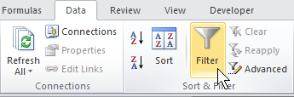
Data Analysis - Data Filtering
Filter your Excel data if you only want to display records that meet certain criteria.
Filtering:
1. Click any cell inside a data set.
2. On the Data tab, click Filter.

Slide 32
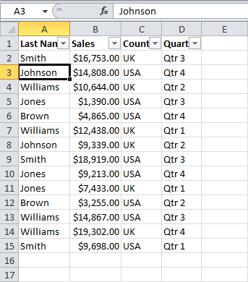
Data Analysis - Data Filtering
Filter your Excel data if you only want to display records that meet certain criteria.
Filtering:
1. Click any cell inside a data set.
2. On the Data tab, click Filter.
Arrows appear in the column headers.

Slide 33
Data Analysis - Data Filtering
Filter your Excel data if you only want to display records that meet certain criteria.
Filtering:
1. Click any cell inside a data set.
2. On the Data tab, click Filter.
Arrows appear in the column headers.
3. Click the arrow next to Country.

Slide 34
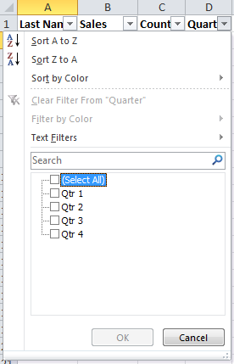
Data Analysis - Data Filtering
4. Click on Select All to clear all the check boxes.

Slide 35
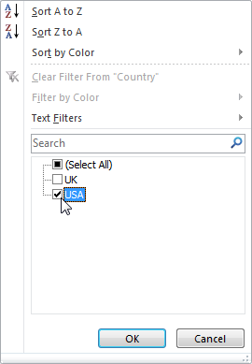
Data Analysis - Data Filtering
4. Click on Select All to clear all the check boxes.
5. Click the check box next to USA.

Slide 36
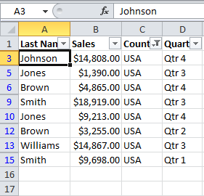
Data Analysis - Data Filtering
4. Click on Select All to clear all the check boxes.
5. Click the check box next to USA.
6. Click OK.

Slide 37
Data Analysis - Conditional Formatting
Conditional formatting in Excel enables you to highlight cells with a certain color, depending on the cell's value.

Slide 38
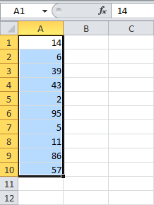
Data Analysis - Conditional Formatting
Conditional formatting in Excel enables you to highlight cells with a certain color, depending on the cell's value.
Highlight Cells:
1. Select the range A1:A10.

Slide 39
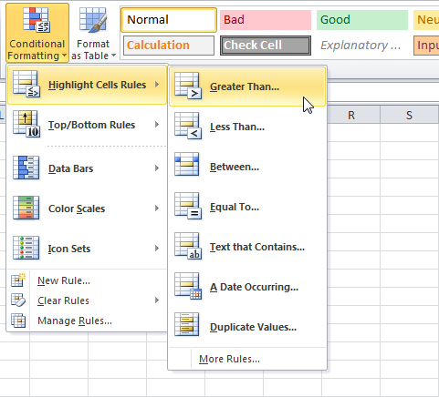
Data Analysis - Conditional Formatting
Conditional formatting in Excel enables you to highlight cells with a certain color, depending on the cell's value.
Highlight Cells:
1. Select the range A1:A10.
2. On the Home tab, click Conditional Formatting, Highlight Cells Rules, Greater Than.

Slide 40
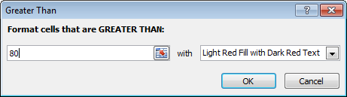
Data Analysis - Conditional Formatting
3. Enter the value 80, select a formatting style, and then click OK.

Slide 41
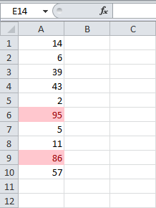
Data Analysis - Conditional Formatting
3. Enter the value 80, select a formatting style, and then click OK.
Result :Excel highlights the cells that are greater than 80

Slide 42
Data Analysis - Charts
A simple chart in Excel can say more than a sheet full of numbers.

Slide 43
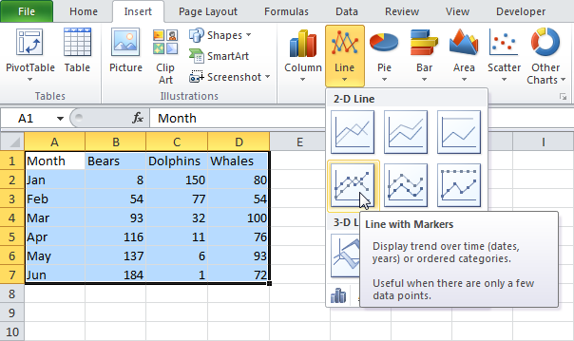
Data Analysis - Charts
A simple chart in Excel can say more than a sheet full of numbers.
Creating a Chart:
1. Select the range A1:D7.

Slide 44
Data Analysis - Charts
A simple chart in Excel can say more than a sheet full of numbers.
Creating a Chart:
1. Select the range A1:D7.
2.On the Insert tab, in the Charts group, choose Line, and select Line with Markers.
Notes:
(h)Wāl ˈdälfin,ˈdôl- be(ə)r

Slide 45
Data Analysis - Charts
A simple chart in Excel can say more than a sheet full of numbers.
Creating a Chart:
1. Select the range A1:D7.
2.On the Insert tab, in the Charts group, choose Line, and select Line with Markers.

Slide 46
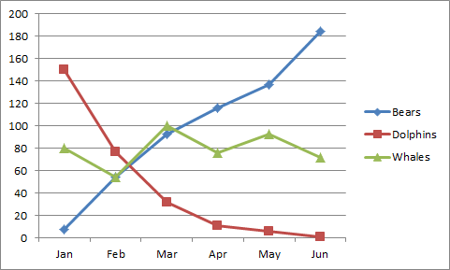
Data Analysis - Charts
A simple chart in Excel can say more than a sheet full of numbers.
Creating a Chart:
1. Select the range A1:D7.
2.On the Insert tab, in the Charts group, choose Line, and select Line with Markers.
Result:

Slide 47
Data Analysis - Charts
Changing the Chart Type:
1. Select the chart (just click on it).

Slide 48
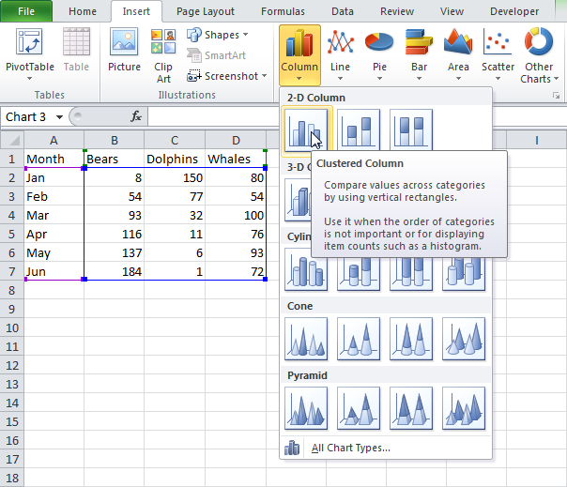
Data Analysis - Charts
Changing the Chart Type:
1. Select the chart (just click on it).
2. On the Insert tab, in the Charts group, choose Column, and select Clustered Column.

Slide 49
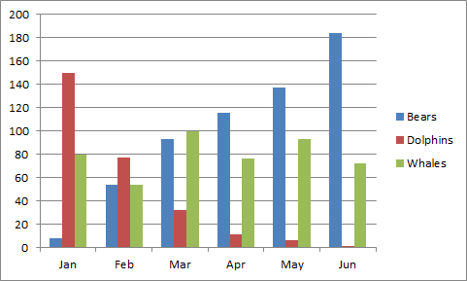
Data Analysis - Charts
Changing the Chart Type:
1. Select the chart (just click on it).
2. On the Insert tab, in the Charts group, choose Column, and select Clustered Column.
Result:

Slide 50
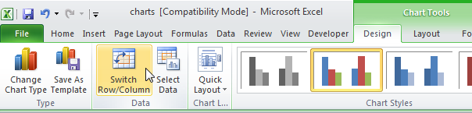
Data Analysis - Charts
Charts
Switching Row/Column:
1. Select the chart,
The Chart Tools contextual tab appears.
2. Click on the Design tab,
then click Switch Row/Column.

Slide 51
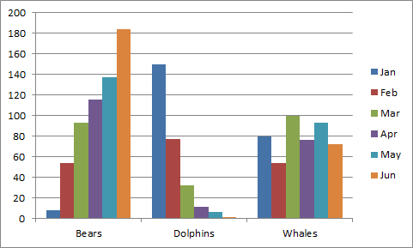
Data Analysis - Charts
Charts
Switching Row/Column:
1. Select the chart,
The Chart Tools contextual tab appears.
2. Click on the Design tab,
then click Switch Row/Column.
Result:

Slide 52
Data Analysis - Charts
Charts
Adding Chart Title:
1. Select the chart,
The Chart Tools contextual tab appears.

Slide 53
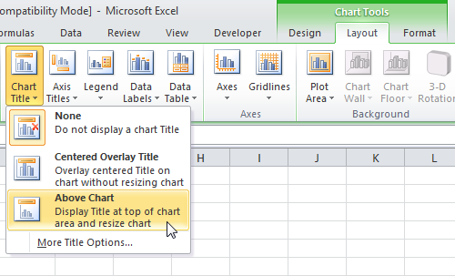
Data Analysis - Charts
Charts
Adding Chart Title:
1. Select the chart,
The Chart Tools contextual tab appears.
2. On the Layout tab, click Chart Title then Above Chart.

Slide 54
Data Analysis - Charts
Charts
Adding Chart Title:
1. Select the chart,
The Chart Tools contextual tab appears.
2. On the Layout tab, click Chart Title then Above Chart.
3. Enter a title. For example, Population.

Slide 55
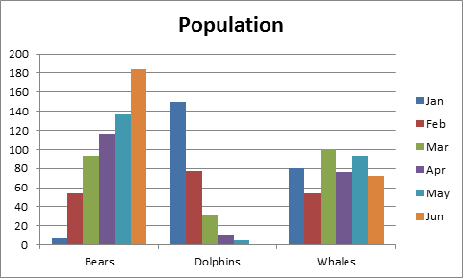
Data Analysis - Charts
Charts
Adding Chart Title:
1. Select the chart,
The Chart Tools contextual tab appears.
2. On the Layout tab, click Chart Title then Above Chart.
3. Enter a title. For example, Population.
Result:

Slide 56
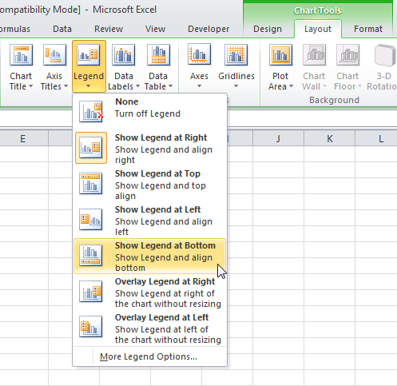
Data Analysis - Charts
Charts
Changing the Legend Position:
1. Select the chart. The Chart Tools contextual tab appears.
2. On the Layout tab, click Legend then Show Legend at Bottom.

Slide 57
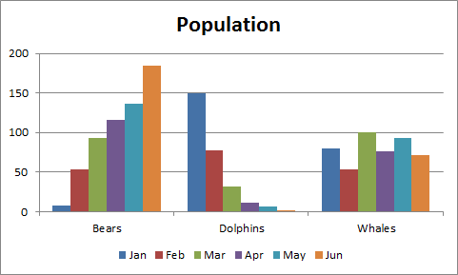
Data Analysis - Charts
Charts
Changing the Legend Position:
1. Select the chart. The Chart Tools contextual tab appears.
2. On the Layout tab, click Legend then Show Legend at Bottom.
Result:

Slide 58
Data Analysis - Charts
Charts
Data Labels:
Use them to get the reader’s attention on a single data series or data point.

Slide 59
Data Analysis - Charts
Charts
Data Labels:
Use them to get the reader’s attention on a single data series or data point.
Steps for adding data labels:
1. Select the chart. The Chart Tools contextual tab appears.

Slide 60
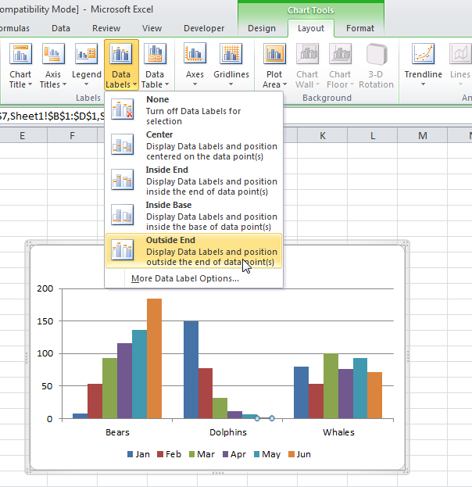
Data Analysis - Charts
Charts
Data Labels:
Use them to get the reader’s attention on a single data series or data point.
Steps for adding data labels:
1. Select the chart. The Chart Tools contextual tab appears.
2. Click an orange bar to select the Jun data series. Click again on an orange bar to select a single data point.

Slide 61
Data Analysis - Charts
Charts
Data Labels:
Use them to get the reader’s attention on a single data series or data point.
Steps for adding data labels:
1. Select the chart. The Chart Tools contextual tab appears.
2. Click an orange bar to select the Jun data series. Click again on an orange bar to select a single data point.
3. On the Layout tab, click Data Labels, then select Outside End.

Slide 62

Data Analysis - Charts
Charts
Data Labels:
Use them to get the reader’s attention on a single data series or data point.
Steps for adding data labels:
1. Select the chart. The Chart Tools contextual tab appears.
2. Click an orange bar to select the Jun data series. Click again on an orange bar to select a single data point.
3. On the Layout tab, click Data Labels, then select Outside End.
Result:

Slide 63
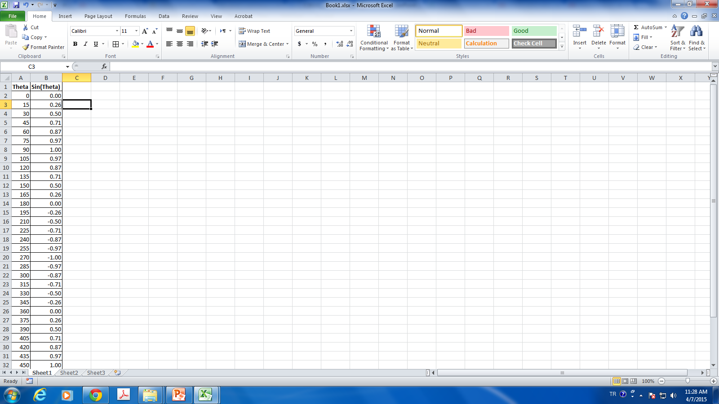
Data Analysis – Charts – Extra Example
In the follwing table,column A contains angles values, that start from 0 in cell A2 and end at 540 in cell A 38. column B contains the following formula =SIN(A*PI()/180) that converts the angles from degrees to radians, then calculates the sines of the angles.
Plot the relation between Theta and Sin(Theta).
http://peltiertech.com/Excel/ChartsHowTo/PlotEquation.html

Slide 64
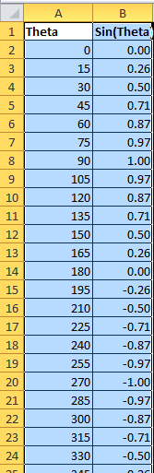
Data Analysis – Charts – Extra Example
Select the range A2:B38

Slide 65
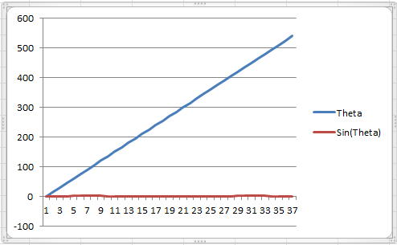
Data Analysis – Charts – Extra Example
Select the range A2:B38
Insert a Line chart

Slide 66
Data Analysis – Charts – Extra Example
Select the range A2:B38
Insert a Line chart
Are we done?

Slide 67
Data Analysis – Charts – Extra Example
Select the range A2:B38
Insert a Line chart
Are we done? Of course not

Slide 68
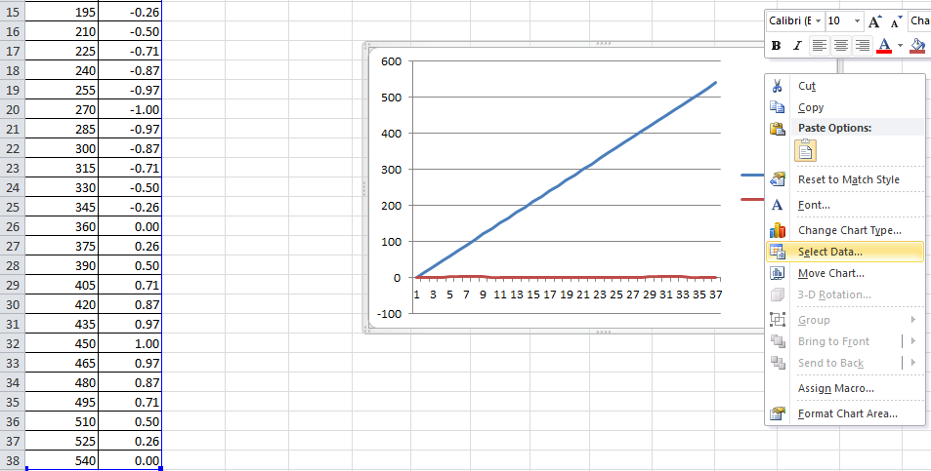
Data Analysis – Charts – Extra Example

Slide 69
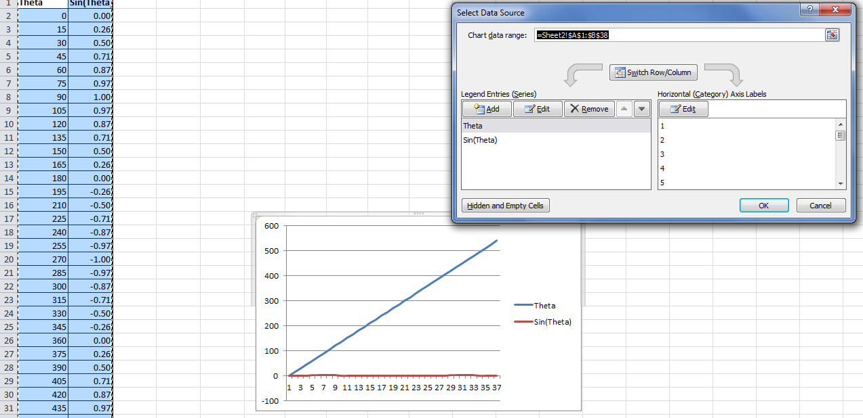
Data Analysis – Charts – Extra Example

Slide 70
Data Analysis – Charts – Extra Example

Slide 71
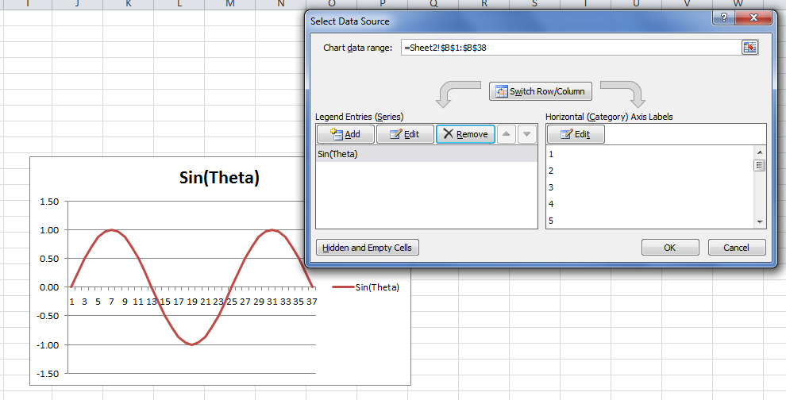
Data Analysis – Charts – Extra Example

Slide 72
Data Analysis – Charts – Extra Example

Slide 73
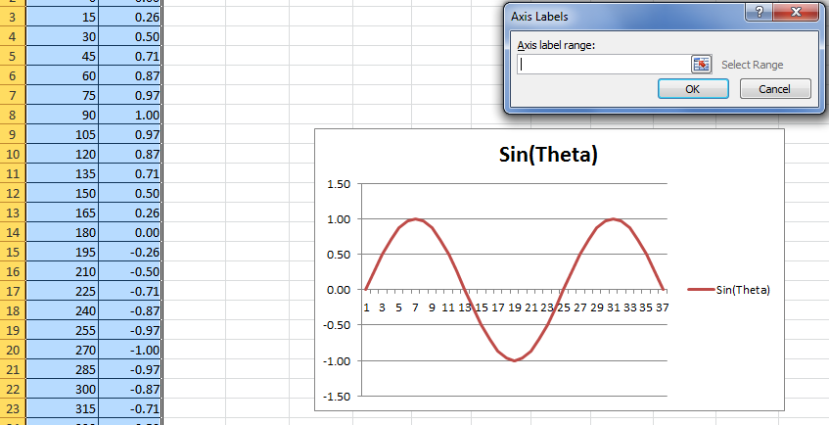
Data Analysis – Charts – Extra Example

Slide 74
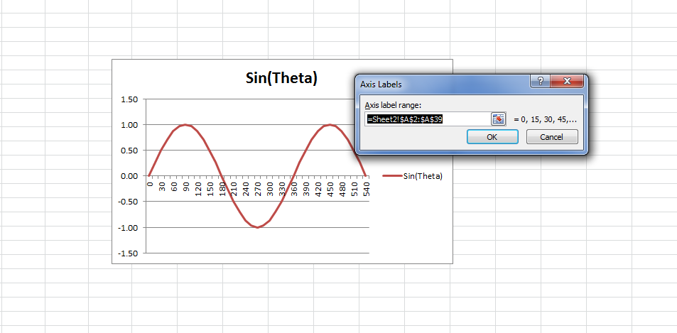
Data Analysis – Charts – Extra Example

Slide 75
Data Analysis – Charts – Extra Example

Slide 76
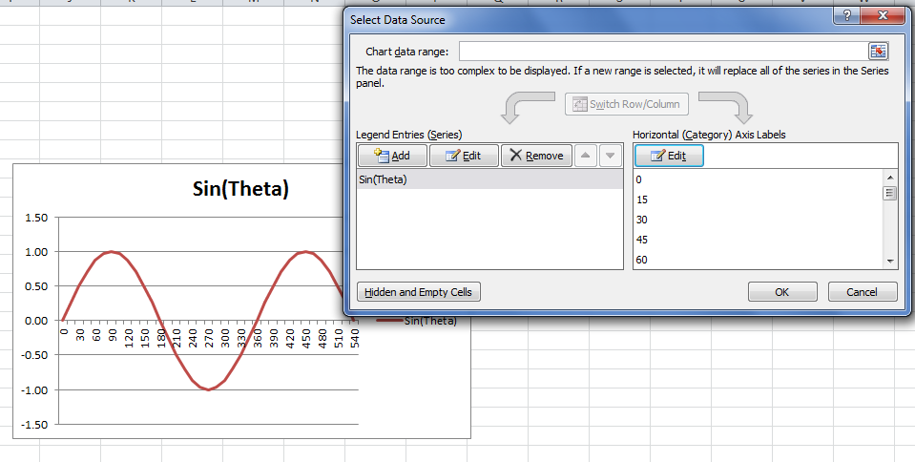
Data Analysis – Charts – Extra Example

Slide 77
Data Analysis – Charts – Extra Example

Slide 78
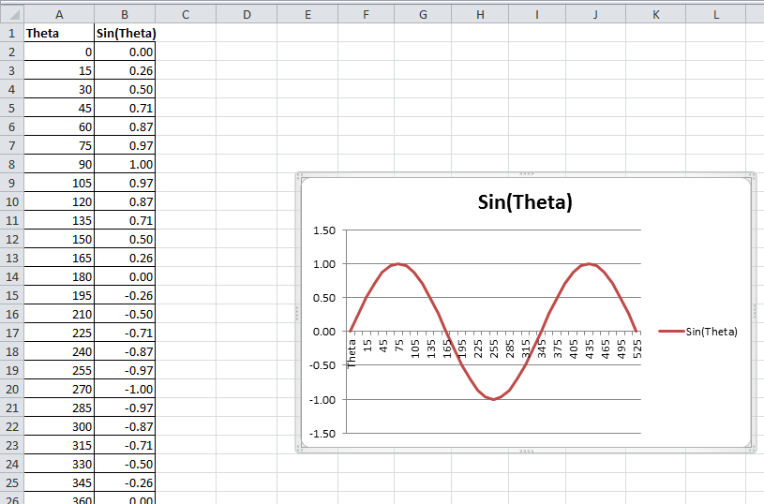
Data Analysis – Charts – Extra Example

Slide 79
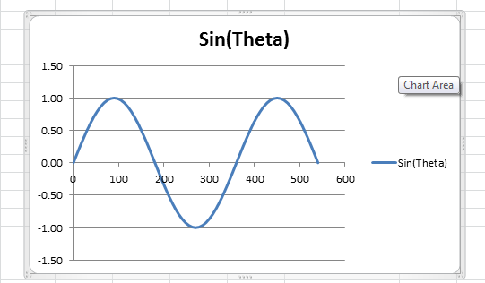
Data Analysis – Charts – Extra Example
Or you could simply follow the following method:
Select the range A2:B38
Insert a Scatter chart

Slide 80
Data Analysis – Charts – Extra Example
You can plot another graph easily on the same chart:

Slide 81
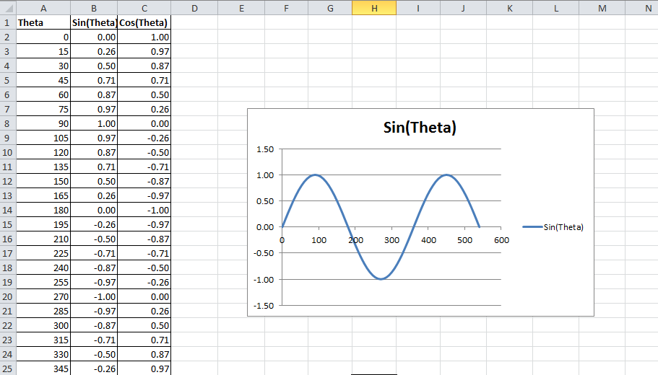
Data Analysis – Charts – Extra Example
You can plot another graph easily on the same chart:
First, Add the new data, for example, cosines of the same angles.

Slide 82
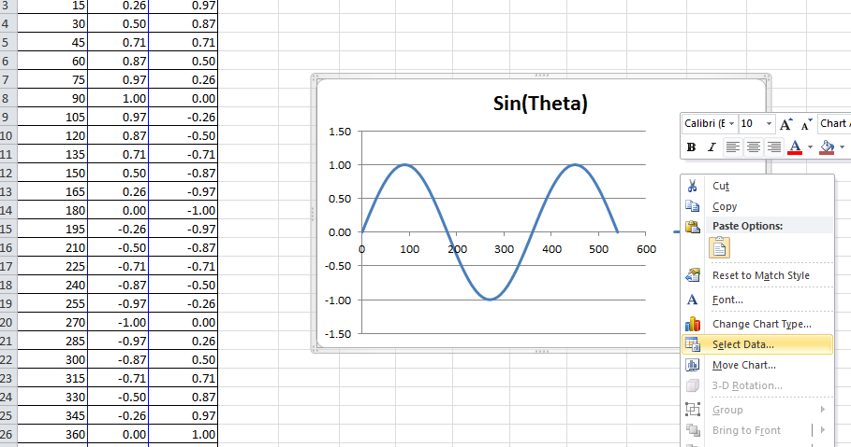
Data Analysis – Charts – Extra Example

Slide 83
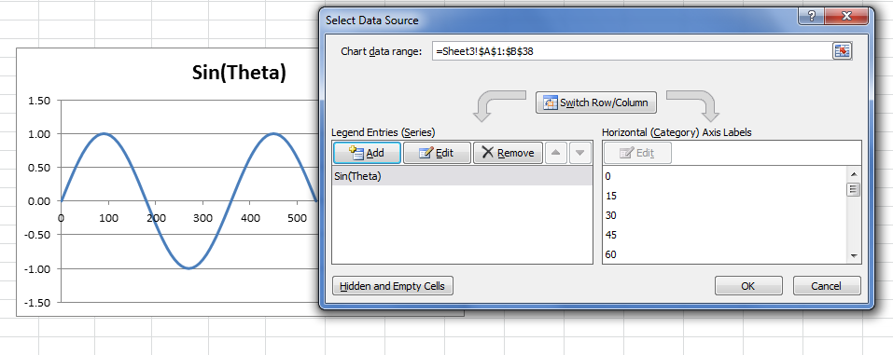
Data Analysis – Charts – Extra Example

Slide 84

Data Analysis – Charts – Extra Example

Slide 85

Data Analysis – Charts – Extra Example

Slide 86

Data Analysis – Charts – Extra Example

Slide 87


Data Analysis – Charts – Extra Example
Or after adding the new data set Cos(Theta), you can simply follow the following method:
Select the data.
Insert a Scatter chart

Slide 88
References
http://www.excel-easy.com

