Slide 1

CSE111 Introduction to Computer Applications
Lecture 9
Introduction to MS Excel 2010-Part 1
Prepared by Asst. Prof. Dr. Mohamed KURDI
Revised and presented by Asst. Prof. Dr. Samsun M. BAŞARICI

Slide 2

Summary of The Last week
Distiguish between the different PowerPoint views.
Understand and apply how to add slide transitions.
Understand and apply how to add animation schemes.
Understand and apply how to add a header/footer, date, or slide number
Understand and apply how to modify the master slide.
Understand and apply how to print slides, handouts, and notes.

Slide 3
Learning Objectives
Understand and apply the following skills:
Explore and identify MS Excel user interface elements.
Moving around worksheets.
Selecting cells, rows, and columns.
Editing & formatting worksheets.
Inserting & deleting rows and columns.
Deleting rows & columns.
Changing row heights & column widths.
Hiding and unhiding rows and columns.
Selecting worksheets.
Navigating between worksheets.
Renaming worksheets.
Inserting & deleting worksheets.
Moving & copying worksheets.
Switching between MS Excel views.
Freezing & unfreezing panes.
Using templates.

Slide 4
Outlines
Introduction
MS PowerPoint 2010 Interface
Moving Around Worksheets
Selecting Cells, Rows, and Columns
Editing & Formatting Worksheets
Formatting Numbers
Inserting Rows and Columns
Deleting Rows and Columns
Changing Row Heights
Changing Column Widths
Hiding and Unhiding Rows and Columns
Selecting Worksheets
Navigating Between Worksheets
Renaming Worksheets
Inserting Worksheets
Deleting Worksheets
Moving Worksheets
Copying Worksheets
MS Excel Views
The Normal View
Page Layout View
Page Break Preview View
Custom Views
Full Screen View
Freezing Panes
Using Templates

Slide 5
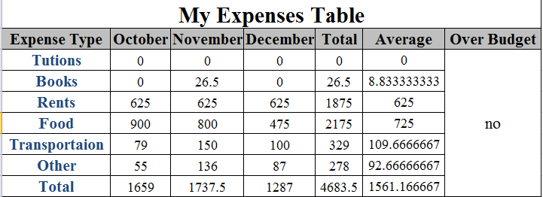
Introduction
A spreadsheet: is a table of values arranged in rows and columns; the intersection of a Row & Column is called a Cell.
  Each cell can have a predefined relationship to the other cells.
  If you change the value of one cell, the values in the other cells may also be changed according to their relationships with that cell.

Slide 6

Introduction
Excel is the MS-Office Application program used for creating spreadsheets.
You can use Excel to enter all sorts of data and perform financial, mathematical, or statistical calculations.
Excel operates like other MS Office programs and has many of the same functions and shortcuts as MS Word & MS PowerPoint.
Excel can do most (not all) of the common (i.e. useful & popular) tasks done in MATLAB or similar software.
MATLAB is more powerful, but it’s also SPECIALIZED and EXPENSIVE.
Excel is more widespread, quick, and easy.

Slide 7
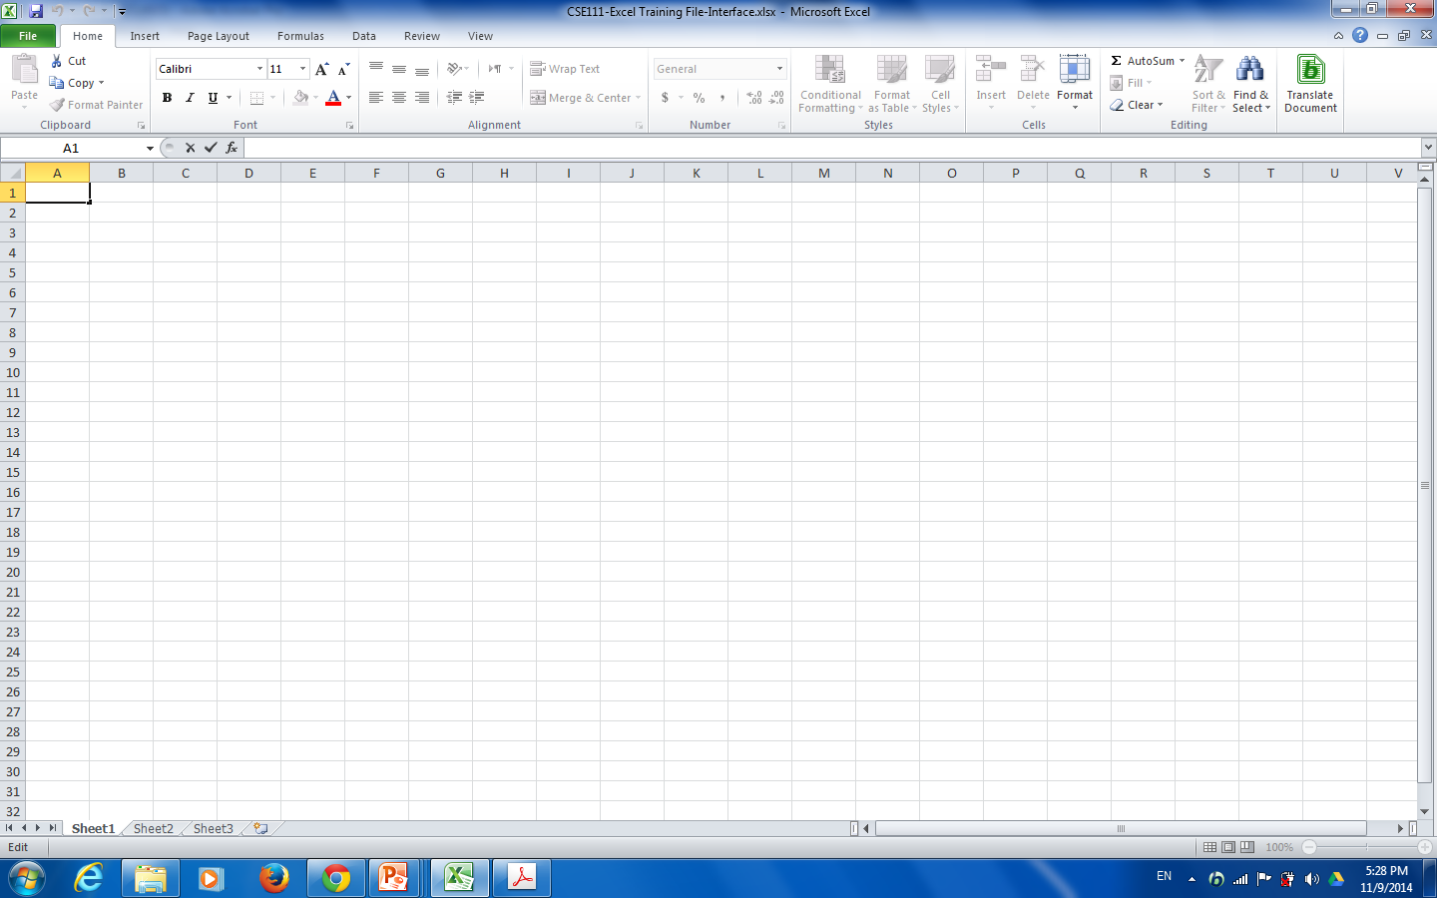
MS Excel 2010 Interface
An Excel file or a workbook: is composed of a number of worksheets (could be more than 200)

Slide 8
MS Excel 2010 Interface
Sheet tabs: each tab represents a different worksheet in the workbook.
An Excel file or a workbook: is composed of a number of worksheets (could be more than 200)

Slide 9
MS Excel 2010 Interface
Active Worksheet
Sheet tabs: each tab represents a different worksheet in the workbook.
An Excel file or a workbook: is composed of a number of worksheets (could be more than 200)

Slide 10
MS Excel 2010 Interface
Row headers
Active Worksheet
Sheet tabs: each tab represents a different worksheet in the workbook.
An Excel file or a workbook: is composed of a number of worksheets (could be more than 200)

Slide 11
MS Excel 2010 Interface
Column headers
Row headers
Active Worksheet
Sheet tabs: each tab represents a different worksheet in the workbook.
An Excel file or a workbook: is composed of a number of worksheets (could be more than 200)

Slide 12
MS Excel 2010 Interface
Column headers
The Active Cell: is the selected cell, and has a thicker black border around it.
Row headers
Active Worksheet
Sheet tabs: each tab represents a different worksheet in the workbook.
An Excel file or a workbook: is composed of a number of worksheets (could be more than 200)

Slide 13
MS Excel 2010 Interface
The Name Box: displays the active cell address or the name of the selected cell, range, or object.
Column headers
The Active Cell: is the selected cell, and has a thicker black border around it.
Row headers
Active Worksheet
Sheet tabs: each tab represents a different worksheet in the workbook.
An Excel file or a workbook: is composed of a number of worksheets (could be more than 200)

Slide 14
MS Excel 2010 Interface
The Name Box: displays the active cell address or the name of the selected cell, range, or object.
Formula Bar: displays the data or formula stored in the active cell.
Column headers
The Active Cell: is the selected cell, and has a thicker black border around it.
Row headers
Row headers
Active Worksheet
Sheet tabs: each tab represents a different worksheet in the workbook.
An Excel file or a workbook: is composed of a number of worksheets (could be more than 200)

Slide 15
Moving Around Worksheets
There are various ways to navigate through a worksheet:
Use the mouse and the scroll bars to scroll through the worksheet in any direction.
Use the navigational keys on the keyboard:
Down arrow or Enter: for moving the active cell one cell down.
Up arrow or Shift+ Enter: for moving the active cell one cell up.
Right arrow or Tab: for moving the active cell one cell to the right.
Left arrow or Shift+Tab: for moving the active cell one cell to the left.
Page Down for moving the active cell down one page.
Page Up: for moving the active cell up one page.
Alt+Page Down: for moving the active cell right one page.
Alt+Page Up: for moving the active cell left one page.
Ctrl+Home: for moving the active cell to cell A1.
Ctrl+End: for moving the active cell to the last used cell in the worksheet.
You can also navigate to a specific cell in the worksheet by entering its address in the Name box, and then pressing Enter.

Slide 16
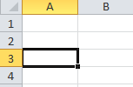
Selecting Cells, Rows, and Columns
To select a single cell, just click on it.

Slide 17

Selecting Cells, Rows, and Columns
To select a single cell, just click on it.
To select a range of cells, click the first cell that you want to include in the range, hold down the Shift key, and then click the last cell in the range. Or, drag from the first cell in the range to the last cell.
NOTES:
When a range is selected, every cell in the range is highlighted, except for the active cell.
You can deselect a range by pressing any arrow key or by clicking any cell in the worksheet.

Slide 18
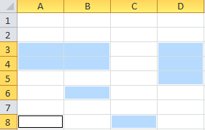
Selecting Cells, Rows, and Columns
To select a single cell, just click on it.
To select a range of cells, click the first cell that you want to include in the range, hold down the Shift key, and then click the last cell in the range. Or, drag from the first cell in the range to the last cell.
NOTES:
When a range is selected, every cell in the range is highlighted, except for the active cell.
You can deselect a range by pressing any arrow key or by clicking any cell in the worksheet.
To select nonadjacent cells or ranges, select the first cell or range, hold down the Ctrl key, and then select the other cells or ranges.

Slide 19
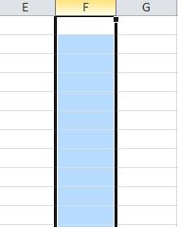

Selecting Cells, Rows, and Columns
To select a single row or column, click the header of the row or column that you want to select.
To select multiple adjacent rows or columns, click the header of the first row or column that you want to select, hold down the Shift key, and then click the header of the last row or column. Or, drag across the headers of the rows or columns that you want to select.
To select multiple nonadjacent rows or columns, hold down the Ctrl key, and then click the headers of the rows or columns that you want to select.
To select all cells in a worksheet, click the Select All button in the upper-left corner of the worksheet. Or, press Ctrl+A.

Slide 20
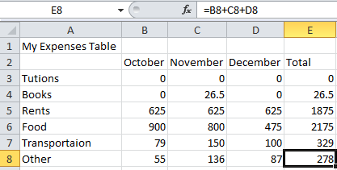
Editing & Formatting Worksheets
The simplest way to add data to a worksheet is to select a cell and enter data.
A cell can contain a maximum of 32,767 characters and can hold any of three basic types of data: text, numbers, or formulas.

Slide 21
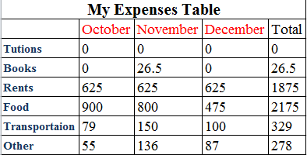
Editing & Formatting Worksheets
MS Excel shares a lot of features with MS Word and PowerPoint.
Moving and copying cells, and copying cell formats can be done using the Copy, Cut, Paste, Format Painter buttons in the Clipboard group, on the Home tab.
Formating cells and cells contents can be done using the Mini Toolbar or the Paragraph group, on the Home tab.
Aligning, indenting, wrapping, rotating, and merging can be done using the Aligmnet group, on the Home tab.
Style changing can be done, using the Styles group, on the Home tab.

Slide 22

Formatting Numbers
To format numbers, select the cell that you want to format, on the Home tab, in the Number group, do one of the following:
Click the Accounting Number Format button to display the number with a dollar sign.
NOTE: You can select a different currency symbol by clicking the Accounting Number Format arrow and selecting the desired symbol from the menu.

Slide 23
Formatting Numbers
To format numbers, select the cell that you want to format, on the Home tab, in the Number group, do one of the following :
Click the Accounting Number Format button to display the number with a dollar sign.
NOTE: You can select a different currency symbol by clicking the Accounting Number Format arrow and selecting the desired symbol from the menu.
Click the Percent Style button to convert the number to a percentage and display it with a percent sign.

Slide 24
Formatting Numbers
To format numbers, select the cell that you want to format, on the Home tab, in the Number group, do one of the following :
Click the Accounting Number Format button to display the number with a dollar sign.
NOTE: You can select a different currency symbol by clicking the Accounting Number Format arrow and selecting the desired symbol from the menu.
Click the Percent Style button to convert the number to a percentage and display it with a percent sign.
Click the Comma Style button to display the number with comma separators and two decimal places.

Slide 25
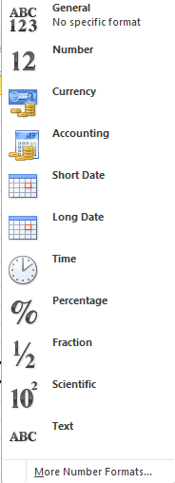
Formatting Numbers
To format numbers, select the cell that you want to format, on the Home tab, in the Number group, do one of the following :
Click the Accounting Number Format button to display the number with a dollar sign.
NOTE: You can select a different currency symbol by clicking the Accounting Number Format arrow and selecting the desired symbol from the menu.
Click the Percent Style button to convert the number to a percentage and display it with a percent sign.
Click the Comma Style button to display the number with comma separators and two decimal places.
NOTE: You can access additional number formats from the Number Format menu

Slide 26
Formatting Numbers
To format numbers, select the cell that you want to format, on the Home tab, in the Number group, do one of the following :
Click the Accounting Number Format button to display the number with a dollar sign.
NOTE: You can select a different currency symbol by clicking the Accounting Number Format arrow and selecting the desired symbol from the menu.
Click the Percent Style button to convert the number to a percentage and display it with a percent sign.
Click the Comma Style button to display the number with comma separators and two decimal places.
NOTE: You can access additional number formats from the Number Format menu
To change the number of decimal places, select the cell that you want to format, and then on the Home tab, in the Number group, do one of the following:
Click the Increase Decimal button to increase the number of decimal places.
Click the Decrease Decimal button to decrease the number of decimal places.

Slide 27
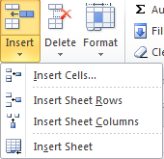
Inserting Rows and Columns
To insert a row:
Select the row above which you want to insert a new row.
On the Home tab, in the Cells group, click the Insert arrow, and then click Insert Sheet Rows.
NOTE: You can also insert a row by right-clicking the header of the row above which you want to insert the new row, and then clicking Insert on the shortcut menu.

Slide 28
Inserting Rows and Columns
To insert a row:
Select the row above which you want to insert a new row.
On the Home tab, in the Cells group, click the Insert arrow, and then click Insert Sheet Rows.
NOTE: You can also insert a row by right-clicking the header of the row above which you want to insert the new row, and then clicking Insert on the shortcut menu.
To insert a column:
Select the column to the left of which you want to insert a new column.
On the Home tab, in the Cells group, click the Insert arrow, and then click Insert Sheet columns.
NOTE: You can also insert a column by right-clicking the header of the column to the left of which you want to insert the new column, and then clicking Insert on the shortcut menu.

Slide 29
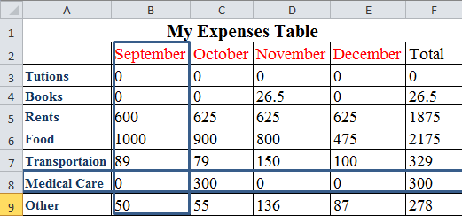
Inserting Rows and Columns
To insert a row:
Select the row above which you want to insert a new row.
On the Home tab, in the Cells group, click the Insert arrow, and then click Insert Sheet Rows.
NOTE: You can also insert a row by right-clicking the header of the row above which you want to insert the new row, and then clicking Insert on the shortcut menu.
To insert a column:
Select the column to the left of which you want to insert a new column.
On the Home tab, in the Cells group, click the Insert arrow, and then click Insert Sheet columns.
NOTE: You can also insert a column by right-clicking the header of the column to the left of which you want to insert the new column, and then clicking Insert on the shortcut menu.

Slide 30
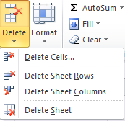
Deleting Rows and Columns
To delete a row:
Select the row that you want to delete
On the Home tab, in the Cells group, click the Delete arrow, and then click delete Sheet Rows.
NOTE: You can also delete a row by right-clicking the row header, and then clicking Delete on the shortcut menu.

Slide 31
Deleting Rows and Columns
To delete a row:
Select the row that you want to delete
On the Home tab, in the Cells group, click the Delete arrow, and then click delete Sheet Rows.
NOTE: You can also delete a row by right-clicking the row header, and then clicking Delete on the shortcut menu.
To delete a column:
Select the column that you want to delete
On the Home tab, in the Cells group, click the Delete arrow, and then click Delete Sheet columns.
NOTE: You can also delete a column by right-clicking the column header, and then clicking
Delete on the shortcut menu.

Slide 32
Deleting Rows and Columns
To delete a row:
Select the row that you want to delete
On the Home tab, in the Cells group, click the Delete arrow, and then click delete Sheet Rows.
NOTE: You can also delete a row by right-clicking the row header, and then clicking Delete on the shortcut menu.
To delete a column:
Select the column that you want to delete
On the Home tab, in the Cells group, click the Delete arrow, and then click Delete Sheet columns.
NOTE: You can also delete a column by right-clicking the column header, and then clicking
Delete on the shortcut menu.

Slide 33
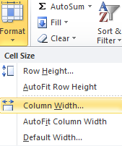
Changing Column Widths
To change a column width:
1. Select the column that you want to resize.
2. On the Home tab, in the Cells group, click the Format button, and then click Column Width.

Slide 34
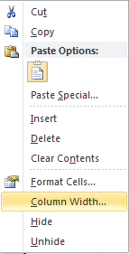
Changing Column Widths
To change a column width:
1. Select the column that you want to resize.
2. On the Home tab, in the Cells group, click the Format button, and then click Column Width. Or, right-click the column header, and then click Column Width on the shortcut menu.

Slide 35
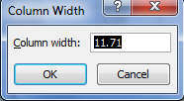
Changing Column Widths
To change a column width:
1. Select the column that you want to resize.
2. On the Home tab, in the Cells group, click the Format button, and then click Column Width. Or, right-click the column header, and then click Column Width on the shortcut menu.
3. In the Column Width dialog box, type a value in the Column width box, and then click the OK button.

Slide 36
Changing Column Widths
To change a column width:
1. Select the column that you want to resize.
2. On the Home tab, in the Cells group, click the Format button, and then click Column Width. Or, right-click the column header, and then click Column Width on the shortcut menu.
3. In the Column Width dialog box, type a value in the Column width box, and then click the OK button.
NOTE:
You can also resize a column by dragging the right edge of the column header right to increase or left to decrease the column width.
Double-clicking the right edge of the column header changes the column width to automatically fits its contents.

Slide 37
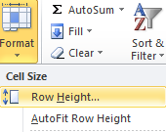
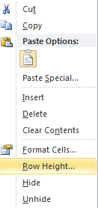
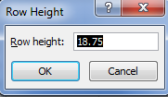
Changing Row Heights
To change a row height:
1. Select the row that you want to resize.
2. On the Home tab, in the Cells group, click the Format button, and then click Row Height. Or, right-click the row header, and then click Row Height on the shortcut menu.
3. In the Row Height dialog box, type a value in the Row height box, and then click the OK button.
NOTE:
You can also resize a row by dragging the bottom edge of the row header down to increase or up to decrease the row height.
Double-clicking the bottom edge of the row header changes the row height to automatically fits its contents.

Slide 38
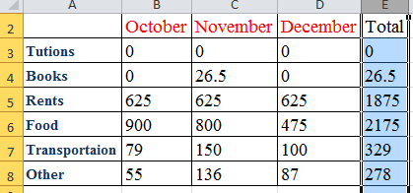
Hiding Rows and Columns
To hide a row or column:
1. Select the row or column that you want to hide.

Slide 39
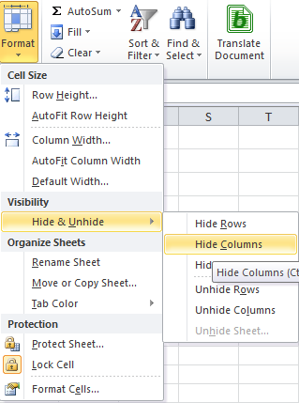
Hiding Rows and Columns
To hide a row or column:
1. Select the row or column that you want to hide.
2. On the Home tab, in the Cells group, click the Format button, point to Hide & Unhide, and then click Hide Rows or Hide Columns.

Slide 40
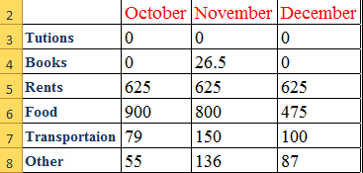
Hiding Rows and Columns
To hide a row or column:
1. Select the row or column that you want to hide.
2. On the Home tab, in the Cells group, click the Format button, point to Hide & Unhide, and then click Hide Rows or Hide Columns.

Slide 41
Hiding Rows and Columns
To hide a row or column:
1. Select the row or column that you want to hide.
2. On the Home tab, in the Cells group, click the Format button, point to Hide & Unhide, and then click Hide Rows or Hide Columns.
NOTE: You can also hide a row or column by right-clicking the row or column header, and then clicking Hide on the shortcut menu.

Slide 42
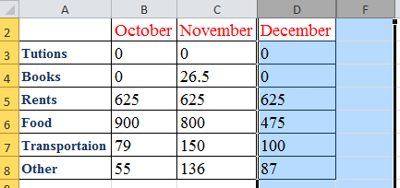
Unhiding Rows and Columns
To hide a row or column:
1. Select the rows above and below the hidden row, or select the columns to the left and right of the hidden column.

Slide 43
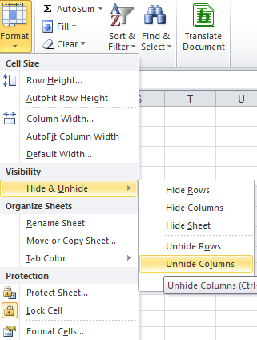
Unhiding Rows and Columns
To hide a row or column:
1. Select the rows above and below the hidden row, or select the columns to the left and right of the hidden column.
2. On the Home tab, in the Cells group, click the Format button, point to Hide & Unhide, and then click Unhide Rows or Unhide Columns.

Slide 44
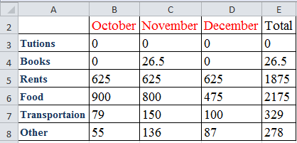
Unhiding Rows and Columns
To hide a row or column:
1. Select the rows above and below the hidden row, or select the columns to the left and right of the hidden column.
2. On the Home tab, in the Cells group, click the Format button, point to Hide & Unhide, and then click Unhide Rows or Unhide Columns.

Slide 45
Unhiding Rows and Columns
To hide a row or column:
1. Select the rows above and below the hidden row, or select the columns to the left and right of the hidden column.
2. On the Home tab, in the Cells group, click the Format button, point to Hide & Unhide, and then click Unhide Rows or Unhide Columns.
NOTE: You can also unhide a row or column by selecting the rows or columns that surround the hidden row or column, right-clicking the selection, and then clicking Unhide on the shortcut menu.

Slide 46
Selecting Worksheets
To select a worksheet, click the tab of the worksheet that you want to select.

Slide 47
Selecting Worksheets
To select a worksheet, click the tab of the worksheet that you want to select.
To select multiple adjacent worksheets, click the tab of the first worksheet that you want to select, hold down the Shift key, and then click the tab of the last worksheet that you want to select.

Slide 48
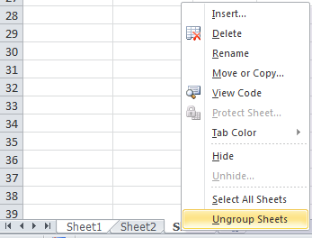
Selecting Worksheets
To select a worksheet, click the tab of the worksheet that you want to select.
To select multiple adjacent worksheets, click the tab of the first worksheet that you want to select, hold down the Shift key, and then click the tab of the last worksheet that you want to select.
NOTE: to cancel the selection of multiple worksheets, click the tab of any unselected worksheet, or right-click the tab of any selected worksheet, and then click Ungroup Sheets on the shortcut menu.

Slide 49
Selecting Worksheets
To select a worksheet, click the tab of the worksheet that you want to select.
To select multiple adjacent worksheets, click the tab of the first worksheet that you want to select, hold down the Shift key, and then click the tab of the last worksheet that you want to select.
NOTE: to cancel the selection of multiple worksheets, click the tab of any unselected worksheet, or right-click the tab of any selected worksheet, and then click Ungroup Sheets on the shortcut menu.
To select multiple nonadjacent worksheets, click the tab of the first worksheet that you want to select, hold down the Ctrl key, and then click the tabs of additional worksheets that you want to select.

Slide 50
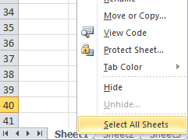
Selecting Worksheets
To select a worksheet, click the tab of the worksheet that you want to select.
To select multiple adjacent worksheets, click the tab of the first worksheet that you want to select, hold down the Shift key, and then click the tab of the last worksheet that you want to select.
NOTE: to cancel the selection of multiple worksheets, click the tab of any unselected worksheet, or right-click the tab of any selected worksheet, and then click Ungroup Sheets on the shortcut menu.
To select multiple nonadjacent worksheets, click the tab of the first worksheet that you want to select, hold down the Ctrl key, and then click the tabs of additional worksheets that you want to select.
To select all worksheets in a workbook, right-click a worksheet tab, and then click Select All Sheets on the shortcut menu.

Slide 51
Navigating Between Worksheets
If a workbook contains many worksheets, all the worksheet tabs may not be visible.
Notes:
If a workbook contains many worksheets, all the worksheet tabs may not be visible. You can use
the tab scrolling buttons located at the bottom of the workbook window to display hidden tabs

Slide 52
Navigating Between Worksheets
If a workbook contains many worksheets, all the worksheet tabs may not be visible.
You can use the tab scrolling buttons located at the bottom of the workbook window to display hidden tabs.
Notes:
If a workbook contains many worksheets, all the worksheet tabs may not be visible. You can use
the tab scrolling buttons located at the bottom of the workbook window to display hidden tabs

Slide 53
Navigating Between Worksheets
If a workbook contains many worksheets, all the worksheet tabs may not be visible.
You can use the tab scrolling buttons located at the bottom of the workbook window to display hidden tabs.
First Tab: displays the first worksheet tab in the workbook.
Notes:
If a workbook contains many worksheets, all the worksheet tabs may not be visible. You can use
the tab scrolling buttons located at the bottom of the workbook window to display hidden tabs

Slide 54
Navigating Between Worksheets
If a workbook contains many worksheets, all the worksheet tabs may not be visible.
You can use the tab scrolling buttons located at the bottom of the workbook window to display hidden tabs.
First Tab: displays the first worksheet tab in the workbook.
Previous Tab: Displays the previous worksheet tab to the left.
Notes:
If a workbook contains many worksheets, all the worksheet tabs may not be visible. You can use
the tab scrolling buttons located at the bottom of the workbook window to display hidden tabs

Slide 55
Navigating Between Worksheets
If a workbook contains many worksheets, all the worksheet tabs may not be visible.
You can use the tab scrolling buttons located at the bottom of the workbook window to display hidden tabs.
Next Tab: displays the next worksheet tab to the right.
First Tab: displays the first worksheet tab in the workbook.
Previous Tab: Displays the previous worksheet tab to the left.
Notes:
If a workbook contains many worksheets, all the worksheet tabs may not be visible. You can use
the tab scrolling buttons located at the bottom of the workbook window to display hidden tabs

Slide 56
Navigating Between Worksheets
If a workbook contains many worksheets, all the worksheet tabs may not be visible.
You can use the tab scrolling buttons located at the bottom of the workbook window to display hidden tabs.
Next Tab: displays the next worksheet tab to the right.
First Tab: displays the first worksheet tab in the workbook.
Previous Tab: Displays the previous worksheet tab to the left.
Last Tab: Displays the last worksheet tab in the workbook.
Notes:
If a workbook contains many worksheets, all the worksheet tabs may not be visible. You can use
the tab scrolling buttons located at the bottom of the workbook window to display hidden tabs

Slide 57

Navigating Between Worksheets
If a workbook contains many worksheets, all the worksheet tabs may not be visible.
You can use the tab scrolling buttons located at the bottom of the workbook window to display hidden tabs.
Next Tab: displays the next worksheet tab to the right.
First Tab: displays the first worksheet tab in the workbook.
Previous Tab: Displays the previous worksheet tab to the left.
Last Tab: Displays the last worksheet tab in the workbook.
NOTE: When you right-click any of the tab scrolling buttons, Excel displays a list of all the worksheets in the workbook. You can quickly activate a sheet by selecting it from the list.
Notes:
If a workbook contains many worksheets, all the worksheet tabs may not be visible. You can use
the tab scrolling buttons located at the bottom of the workbook window to display hidden tabs

Slide 58
Renaming Worksheets
To rename a worksheet:
Double-click the tab of the worksheet that you want to rename. Or, right-click the worksheet tab, and then click Rename on the shortcut menu
Notes:
If a workbook contains many worksheets, all the worksheet tabs may not be visible. You can use
the tab scrolling buttons located at the bottom of the workbook window to display hidden tabs

Slide 59
Renaming Worksheets
To rename a worksheet:
Double-click the tab of the worksheet that you want to rename. Or, right-click the worksheet tab, and then click Rename on the shortcut menu. The worksheet name is selected on the tab.
Notes:
If a workbook contains many worksheets, all the worksheet tabs may not be visible. You can use
the tab scrolling buttons located at the bottom of the workbook window to display hidden tabs

Slide 60
Renaming Worksheets
To rename a worksheet:
Double-click the tab of the worksheet that you want to rename. Or, right-click the worksheet tab, and then click Rename on the shortcut menu. The worksheet name is selected on the tab.
Type a new name, and then press the Enter key, the worksheet tab size adjusts to fit the name.
Notes:
If a workbook contains many worksheets, all the worksheet tabs may not be visible. You can use
the tab scrolling buttons located at the bottom of the workbook window to display hidden tabs

Slide 61
Renaming Worksheets
To rename a worksheet:
Double-click the tab of the worksheet that you want to rename. Or, right-click the worksheet tab, and then click Rename on the shortcut menu. The worksheet name is selected on the tab.
Type a new name, and then press the Enter key, the worksheet tab size adjusts to fit the name.
NOTE: Worksheet names can have up to 31 characters and can include letters, numbers, symbols, and spaces. Each worksheet name in a workbook must be unique.
Notes:
If a workbook contains many worksheets, all the worksheet tabs may not be visible. You can use
the tab scrolling buttons located at the bottom of the workbook window to display hidden tabs

Slide 62
Inserting Worksheets
To insert a worksheet:
Click the tab of the worksheet to the left of which you want to insert a new worksheet.
Notes:
If a workbook contains many worksheets, all the worksheet tabs may not be visible. You can use
the tab scrolling buttons located at the bottom of the workbook window to display hidden tabs

Slide 63
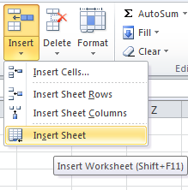
Inserting Worksheets
To insert a worksheet:
Click the tab of the worksheet to the left of which you want to insert a new worksheet.
On the Home tab, in the Cells group, click the Insert arrow, and then click Insert Sheet.
Notes:
If a workbook contains many worksheets, all the worksheet tabs may not be visible. You can use
the tab scrolling buttons located at the bottom of the workbook window to display hidden tabs

Slide 64
Inserting Worksheets
To insert a worksheet:
Click the tab of the worksheet to the left of which you want to insert a new worksheet.
On the Home tab, in the Cells group, click the Insert arrow, and then click Insert Sheet.
NOTE: You can also insert a worksheet by clicking the Insert Worksheet button located on the right side of the last worksheet tab, this inserts a new worksheet after the last
worksheet in the workbook.
Notes:
If a workbook contains many worksheets, all the worksheet tabs may not be visible. You can use
the tab scrolling buttons located at the bottom of the workbook window to display hidden tabs

Slide 65
Deleting Worksheets
To delete a worksheet:
Click the tab of the worksheet that you want to delete.
Notes:
If a workbook contains many worksheets, all the worksheet tabs may not be visible. You can use
the tab scrolling buttons located at the bottom of the workbook window to display hidden tabs

Slide 66
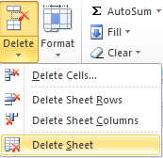
Deleting Worksheets
To delete a worksheet:
Click the tab of the worksheet that you want to delete.
On the Home tab, in the Cells group, click the Delete arrow, and then click Delete Sheet
Notes:
If a workbook contains many worksheets, all the worksheet tabs may not be visible. You can use
the tab scrolling buttons located at the bottom of the workbook window to display hidden tabs

Slide 67
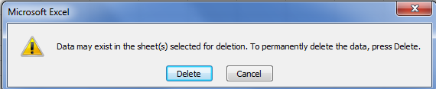
Deleting Worksheets
To delete a worksheet:
Click the tab of the worksheet that you want to delete.
On the Home tab, in the Cells group, click the Delete arrow, and then click Delete Sheet
If the worksheet contains data, a dialog box opens asking you to confirm. Click the Delete button .
Notes:
If a workbook contains many worksheets, all the worksheet tabs may not be visible. You can use
the tab scrolling buttons located at the bottom of the workbook window to display hidden tabs

Slide 68
Deleting Worksheets
To delete a worksheet:
Click the tab of the worksheet that you want to delete.
On the Home tab, in the Cells group, click the Delete arrow, and then click Delete Sheet
If the worksheet contains data, a dialog box opens asking you to confirm. Click the Delete button .
NOTE: You can also delete a worksheet by right-clicking on it, then clicking on Delete from the shortcut menu.
Notes:
If a workbook contains many worksheets, all the worksheet tabs may not be visible. You can use
the tab scrolling buttons located at the bottom of the workbook window to display hidden tabs

Slide 69
Moving Worksheets
You can move a worksheet to another location in the same workbook, or even to another location in another workbook.
Notes:
If a workbook contains many worksheets, all the worksheet tabs may not be visible. You can use
the tab scrolling buttons located at the bottom of the workbook window to display hidden tabs

Slide 70
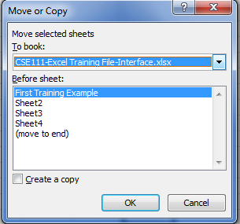
Moving Worksheets
You can move a worksheet to another location in the same workbook, or even to another location in another workbook.
To move a worksheet:
Right-click the tab of the worksheet that you want to move, and then click Move or
Copy on the shortcut menu. The Move or Copy dialog box opens
Notes:
If a workbook contains many worksheets, all the worksheet tabs may not be visible. You can use
the tab scrolling buttons located at the bottom of the workbook window to display hidden tabs

Slide 71
Moving Worksheets
You can move a worksheet to another location in the same workbook, or even to another location in another workbook.
To move a worksheet:
Right-click the tab of the worksheet that you want to move, and then click Move or
Copy on the shortcut menu. The Move or Copy dialog box opens
In the To Book list menu select the name of the destination workbook.
In the Before sheet box, click the name of the worksheet to the left of which you want the selected worksheet to be moved.
Click the OK button.
Notes:
If a workbook contains many worksheets, all the worksheet tabs may not be visible. You can use
the tab scrolling buttons located at the bottom of the workbook window to display hidden tabs

Slide 72
Moving Worksheets
You can move a worksheet to another location in the same workbook, or even to another location in another workbook.
To move a worksheet:
Right-click the tab of the worksheet that you want to move, and then click Move or
Copy on the shortcut menu. The Move or Copy dialog box opens
In the To Book list menu select the name of the destination workbook.
In the Before sheet box, click the name of the worksheet to the left of which you want the selected worksheet to be moved.
Click the OK button.
NOTE: You can also move a worksheet by dragging its tab to the desired location. As you drag, the mouse pointer changes to a small sheet and a small black arrow indicates where the worksheet will be moved when you release the mouse button.
Notes:
If a workbook contains many worksheets, all the worksheet tabs may not be visible. You can use
the tab scrolling buttons located at the bottom of the workbook window to display hidden tabs

Slide 73
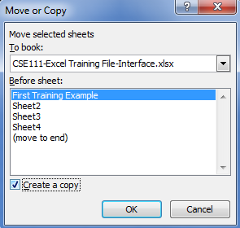
Copying Worksheets
You can copy a worksheet to another location in a workbook, or even to another location in another workbook.
To copy a worksheet:
Right-click the tab of the worksheet that you want to move, and then click Move or
Copy on the shortcut menu. The Move or Copy dialog box opens
In the To Book list menu select the name of the destination workbook.
In the Before sheet box, click the name of the worksheet to the left of which you want the selected worksheet to be moved.
Select the Create a copy check box.
Click the OK button.
NOTE: You can also copy a worksheet by holding down the Ctrl key and dragging its tab to the desired location. As you drag, the mouse pointer changes to a small sheet with a plus sign on it and a small black arrow indicates where the worksheet will be copied when you release the mouse button
Notes:
If a workbook contains many worksheets, all the worksheet tabs may not be visible. You can use
the tab scrolling buttons located at the bottom of the workbook window to display hidden tabs

Slide 74
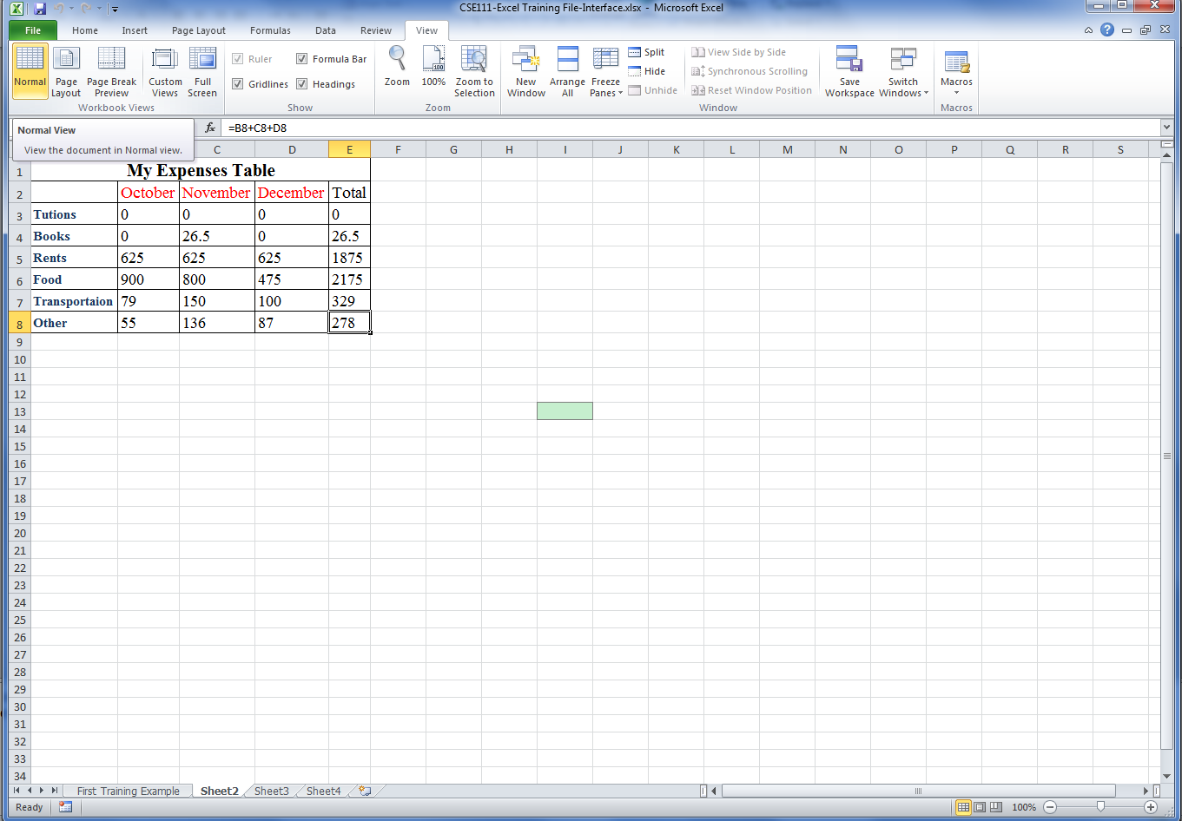
MS Excel Views -The Normal View
This is the default view. If you switch to another view and return to it, Excel displays page breaks.
Notes:
If a workbook contains many worksheets, all the worksheet tabs may not be visible. You can use
the tab scrolling buttons located at the bottom of the workbook window to display hidden tabs

Slide 75
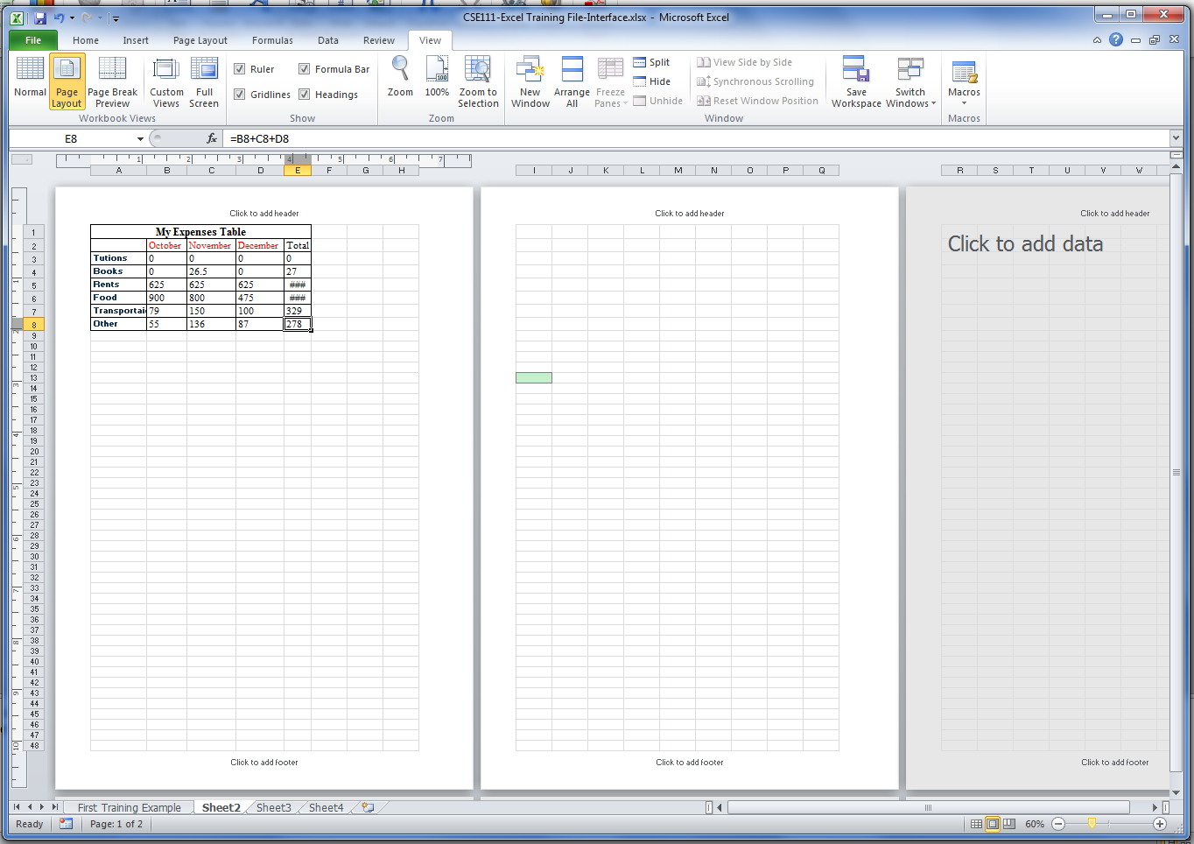
MS Excel Views - Page Layout View
Displays the worksheet as it will appear when printed. Use this view to see where pages begin and end, and to add headers and footers.
Notes:
If a workbook contains many worksheets, all the worksheet tabs may not be visible. You can use
the tab scrolling buttons located at the bottom of the workbook window to display hidden tabs

Slide 76
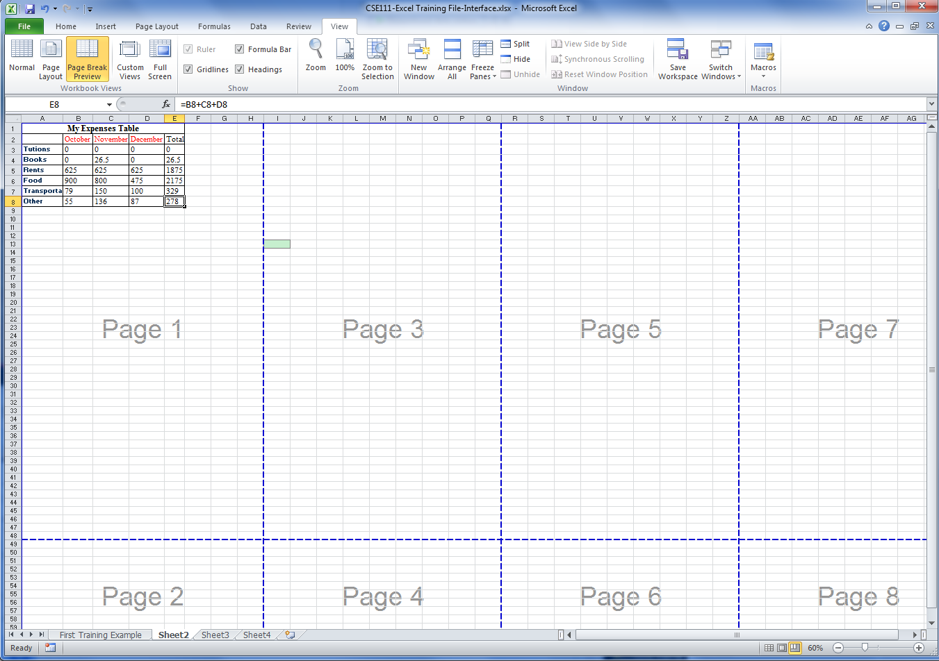
MS Excel Views - Page Break Preview View
Displays a preview of where pages will break when the worksheet is printed. Use this view to easily adjust page breaks.
Notes:
If a workbook contains many worksheets, all the worksheet tabs may not be visible. You can use
the tab scrolling buttons located at the bottom of the workbook window to display hidden tabs

Slide 77
MS Excel Views - Custom Views
Allows you to save a set of display and print settings as a custom view, and then apply it.

Slide 78
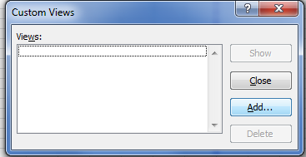
MS Excel Views - Custom Views
Allows you to save a set of display and print settings as a custom view, and then apply it.
To add a new custom view:
On the View tab, in the Workbook Views group, click on Custom Views.
The Custom Views dialog box appears, click on the buttom Add.

Slide 79
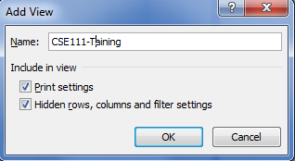
MS Excel Views - Custom Views
Allows you to save a set of display and print settings as a custom view, and then apply it.
To add a new custom view:
On the View tab, in the Workbook Views group, click on Custom Views.
The Custom Views dialog box appears, click on the buttom Add.
The Add View dialog box appears, type a name for the custom view, and then click OK

Slide 80
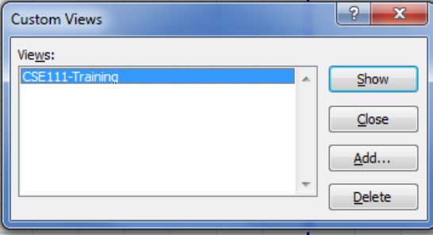
MS Excel Views - Custom Views
Allows you to save a set of display and print settings as a custom view, and then apply it.
To add a new custom view:
On the View tab, in the Workbook Views group, click on Custom Views.
The Custom Views dialog box appears, click on the buttom Add.
The Add View dialog box appears, type a name for the custom view, and then click OK
To apply an existing custom view, custom view:
On the View tab, in the Workbook Views group, click on Custom Views.
The Custom Views dialog box appears, select the view that you would to apply, then click on the buttom Show.

Slide 81
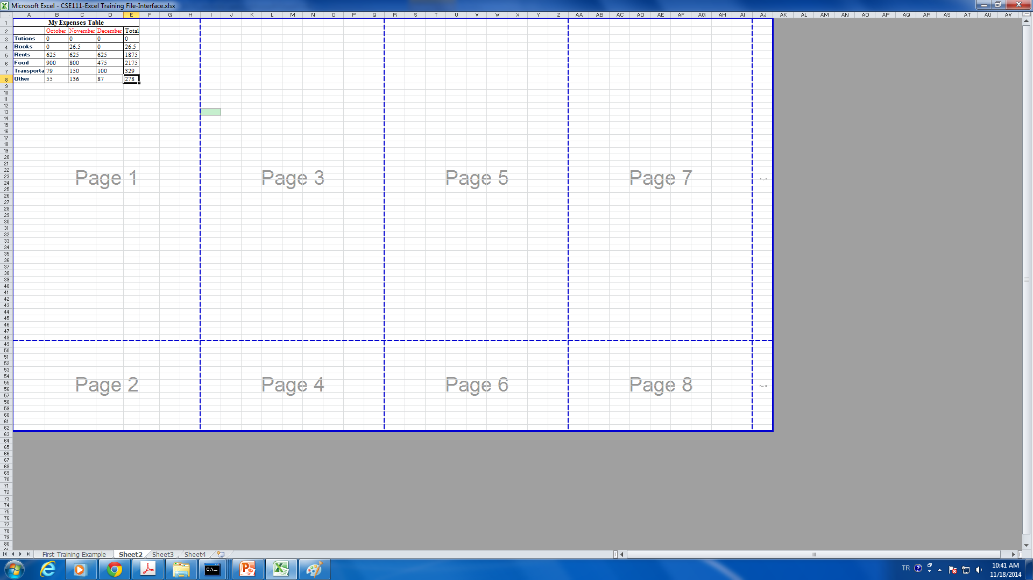
MS Excel Views – Full Screen View
Displays the worksheet in full screen mode which hides the Ribbon, Formula bar, and Status bar. You can exit the Full Screen view by pressing the Esc key.

Slide 82
Freezing and Unfreezing Panes
Freezing panes is a useful technique for keeping an area of a worksheet visible while you scroll to another area of the worksheet.
Notes:
You can choose to freeze just the top row, just the left column, or multiple rows and columns of a worksheet. Excel displays thin black lines to indicate frozen rows and/or columns.
NOTE: You can freeze only rows at the top and columns on the left side of the worksheet; you cannot freeze rows and columns in the middle of the worksheet

Slide 83
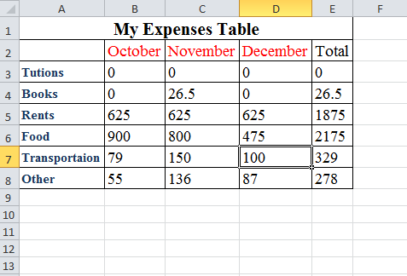
Freezing and Unfreezing Panes
Freezing panes is a useful technique for keeping an area of a worksheet visible while you scroll to another area of the worksheet.
To freeze panes:
Select the cell below the row and to the right of the column that you want to freeze.
Notes:
You can choose to freeze just the top row, just the left column, or multiple rows and columns of a worksheet. Excel displays thin black lines to indicate frozen rows and/or columns.
NOTE: You can freeze only rows at the top and columns on the left side of the worksheet; you cannot freeze rows and columns in the middle of the worksheet

Slide 84
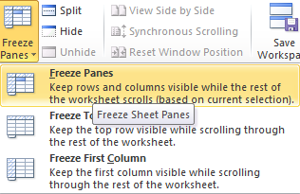
Freezing and Unfreezing Panes
Freezing panes is a useful technique for keeping an area of a worksheet visible while you scroll to another area of the worksheet.
To freeze panes:
Select the cell below the row and to the right of the column that you want to freeze.
On the View tab, in the Window group, click the Freeze Panes button, and then click Freeze Panes.
Notes:
You can choose to freeze just the top row, just the left column, or multiple rows and columns of a worksheet. Excel displays thin black lines to indicate frozen rows and/or columns.
NOTE: You can freeze only rows at the top and columns on the left side of the worksheet; you cannot freeze rows and columns in the middle of the worksheet

Slide 85
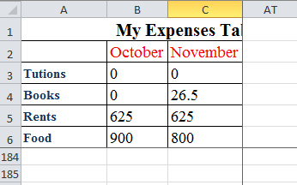
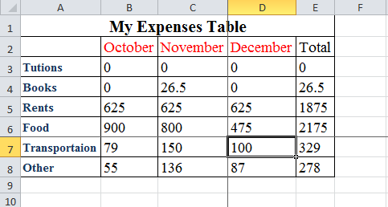
Freezing and Unfreezing Panes
Freezing panes is a useful technique for keeping an area of a worksheet visible while you scroll to another area of the worksheet.
To freeze panes:
Select the cell below the row and to the right of the column that you want to freeze.
On the View tab, in the Window group, click the Freeze Panes button, and then click Freeze Panes.
Scroll
Notes:
You can choose to freeze just the top row, just the left column, or multiple rows and columns of a worksheet. Excel displays thin black lines to indicate frozen rows and/or columns.
NOTE: You can freeze only rows at the top and columns on the left side of the worksheet; you cannot freeze rows and columns in the middle of the worksheet

Slide 86
Freezing and Unfreezing Panes
Freezing panes is a useful technique for keeping an area of a worksheet visible while you scroll to another area of the worksheet.
To freeze panes:
Select the cell below the row and to the right of the column that you want to freeze.
On the View tab, in the Window group, click the Freeze Panes button, and then click Freeze Panes.
Scroll
NOTE: If any rows or columns in a worksheet are frozen, the Freeze Panes option changes to Unfreeze Panes. You can unfreeze panes by clicking the Freeze Panes button, and then clicking Unfreeze Panes.
Notes:
You can choose to freeze just the top row, just the left column, or multiple rows and columns of a worksheet. Excel displays thin black lines to indicate frozen rows and/or columns.
NOTE: You can freeze only rows at the top and columns on the left side of the worksheet; you cannot freeze rows and columns in the middle of the worksheet

Slide 87
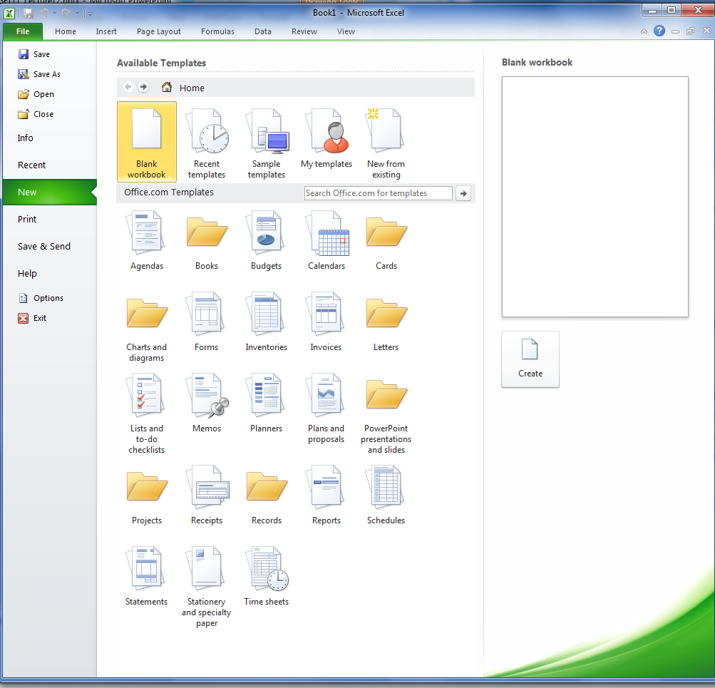
Using Templates
Excel 2010 includes a variety of built-in templates that you can use to create workbooks such as budgets, invoices, and calendars.
To use a template:
Click the File tab, and then click New. The New page of the Backstage view displays thumbnails of the available templates and template categories.
Do one of the following:
To use a built-in template, in the Available Templates section, click Sample templates, select the desired template, and then click the Create button.
To use an online template, in the Office.com Templates section, select a template category, select the desired template, and then click the Download button.
NOTE: You can also search Office.com for templates by using the Search box in the
Office.com Templates section.
Notes:
Templates include predefined layouts and styles, as well as labels, graphics, formulas, or other content that you can modify to meet your needs.

Slide 88
References
California State University, Los Angelos, Information Technology Services, Microsoft Excel 2010 Part 1: Introduction to Excel.
http://www.calstatela.edu/sites/default/files/groups/Information%20Technology%20Services/training/pdf/excel2010p1.pdf
California State University, Los Angelos, Information Technology Services, Microsoft Excel 2010 Part 2: Intermediate.
http://www.calstatela.edu/sites/default/files/groups/Information%20Technology%20Services/training/pdf/excel2010p2.pdf

